Slide 1
Prediction of protein interaction hot spots using rough set-based multiple criteria linear programming
Ruoying Chen(陳若英), Zhiwang Zhang(張志旺), Di Wu(吳荻),
Peng Zhang(張鵬), Xinyang Zhang(張欣陽), Yong Wang(王永),
Yong Shi(施勇)
Journal of Theoretical Biology, Vol. 269, pp. 174–180, 2011
Presenter: Dong-Jian Lin
Date: March 8, 2011

Slide 2
Abstract
Protein–protein interactions are fundamentally important in
many biological processes and it is in pressing need to
understand the principles of protein–protein interactions.
Mutagenesis(突變) studies have found that only a small
fraction of surface residues, known as hot spots, are
responsible for the physical binding in protein complexes.
However, revealing hot spots by mutagenesis experiments
are usually time consuming and expensive. In order to
complement the experimental efforts, we propose a
new computational approach in this paper to predict hot
spots.

Slide 3
Our method, Rough Set-based Multiple Criteria Linear
Programming (RS-MCLP), integrates rough sets theory
and multiple criteria linear programming to choose
dominant features and computationally predict hot spots.
Our approach is benchmarked by a dataset of 904 alanine
(丙氨酸)-mutated residues and the results show that our
RS-MCLP method performs better than other methods, e.g.,
MCLP, Decision Tree, Bayes Net, and the existing
HotSprint database. In addition, we reveal several
biological insights based on our analysis. We ﬁnd that four
features (the change of accessible surface area,

Slide 4
percentage of the change of accessible surface area, size
of a residue, and atomic contacts) are critical in predicting
hot spots. Furthermore, we ﬁnd that three residues (Tyr-羥
丁氨酸 ,Trp-色氨酸 , and Phe-苯丙氨酸 ) are abundant in
hot spots through analyzing the distribution of amino acids.

Slide 5
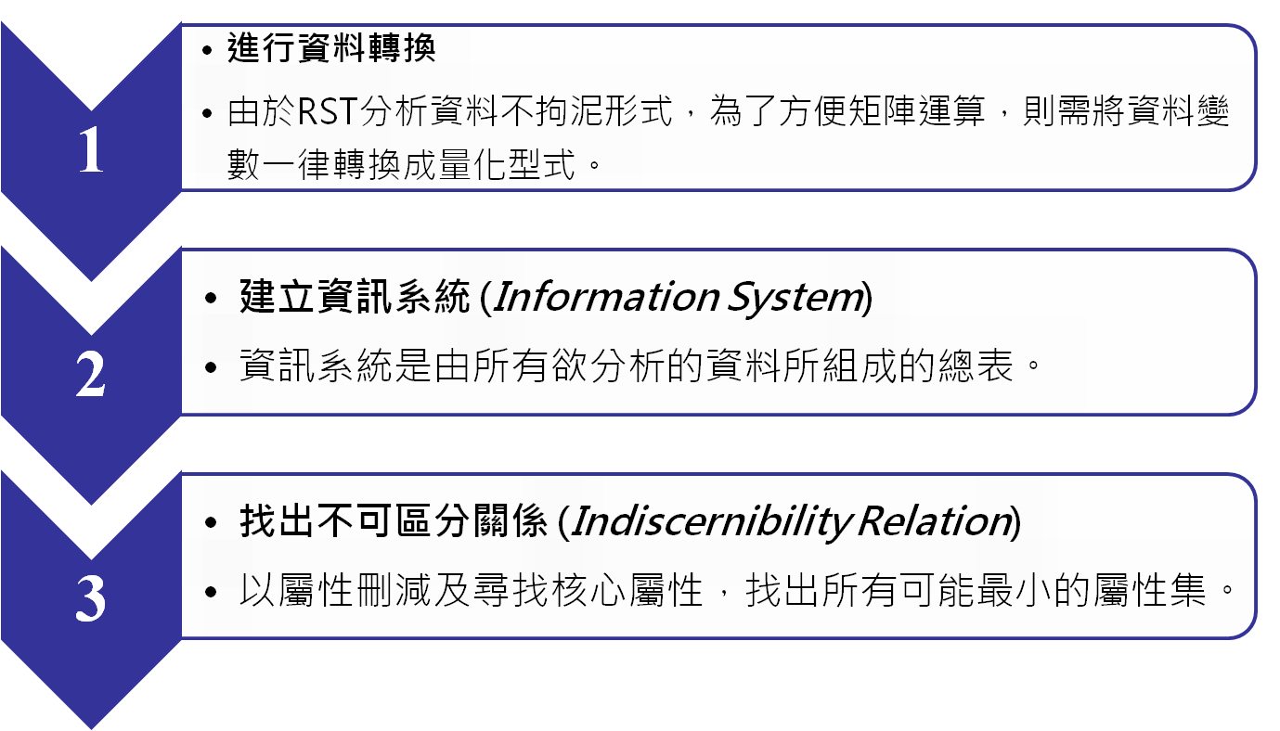
RST concept (1/2)

Slide 6
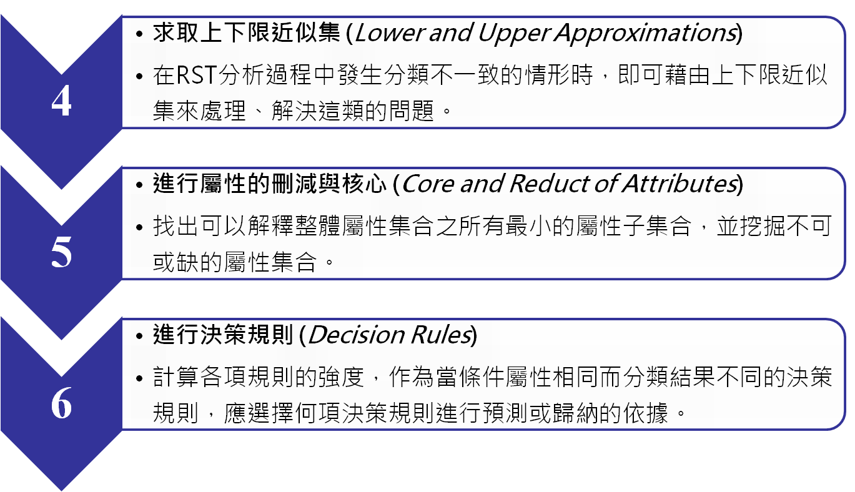
RST concept(2/2)

Slide 7
Information system (IS)
IS = (U, A)
  U = {x₁, x₂,…, x_{m}} (instances)
  A ={a₁, a₂,…,a_{n}} (attributes)
  Va: range of attribute a
U | a₁ | a₂ | a₃
x₁ | 2 | 1 | 3
x₂ | 3 | 2 | 1
x₃ | 2 | 1 | 3
x₄ | 2 | 2 | 3
x₅ | 1 | 1 | 4
x₆ | 1 | 1 | 2
x₇ | 3 | 2 | 1
x₈ | 1 | 1 | 4
x₉ | 2 | 1 | 3
x₁₀ | 3 | 2 | 1
Example:
U = {x₁, x₂,…, x₁₀}
A ={a₁, a₂, a₃}
V₁= {1, 2, 3}
V₂={1, 2}
V₃={1, 2, 3, 4}

Slide 8
Decision table
Any supervised classification problem can be considered as the decision table analysis
U | a₁ | a₂ | a₃ | d
x₁ | 2 | 1 | 3 | 1
x₂ | 3 | 2 | 1 | 2
x₃ | 2 | 1 | 3 | 1
x₄ | 2 | 2 | 3 | 2
x₅ | 1 | 1 | 4 | 3
x₆ | 1 | 1 | 2 | 3
x₇ | 3 | 2 | 1 | 2
x₈ | 1 | 1 | 4 | 3
x₉ | 2 | 1 | 3 | 1
x₁₀ | 3 | 2 | 1 | 2

Slide 9
Discernibility matrix:
須使用何種attributes來區分不同的sets
 | 1 | 2 | 3 | 4 | 5 | 6 | 7 | 8 | 9 | 10
1 | -
2 | a₁,a₂,a₃ | -
3 | - | a₁,a₂,a₃ | -
4 | a₂ | - | a₂ | -
5 | a₁,a₃ | a₁,a₂,a₃ | a₁,a₃ | a₁,a₂,a₃ | -
6 | a₁,a₃ | a₁,a₂,a₃ | a₁,a₃ | a₁,a₂,a₃ | - | -
7 | a₁,a₂,a₃ | - | a₁,a₂,a₃ | - | a₁,a₂,a₃ | a₁,a₂,a₃ | -
8 | a₁,a₃ | a₁,a₂,a₃ | a₁,a₃ | a₁,a₂,a₃ | - | - | a₁,a₂,a₃ | -
9 | - | a₁,a₂,a₃ | - | a₂ | a₁,a₃ | a₁,a₃ | a₁,a₂,a₃ | a₁,a₃ | -
10 | a₁,a₂,a₃ | - | a₁,a₂,a₃ | - | a₁,a₂,a₃ | a₁,a₂,a₃ | - | a₁,a₂,a₃ | a₁,a₂,a₃ | -

Slide 10
f_{A}(D)=(a₁+a₂+a₃)a₂(a₁+a₃) (a₁+a₃) (a₁+a₂+a₃) (a₁+a₃) (a₁+a₂+a₃) (a₁+a₂+a₃) (a₁+a₂+a₃) (a₁+a₂+a₃)a₂(a₁+a₃) (a₁+a₃) (a₁+a₂+a₃) (a₁+a₃) (a₁+a₂+a₃) (a₁+a₂+a₃) (a₁+a₂+a₃) (a₁+a₂+a₃) a₂(a₁+a₃) (a₁+a₂+a₃) (a₁+a₃) (a₁+a₂+a₃) (a₁+a₂+a₃) (a₁+a₃) (a₁+a₂+a₃) (a₁+a₂+a₃) (a₁+a₂+a₃) (a₁+a₃) (a₁+a₂+a₃) (a₁+a₂+a₃) = a₂(a₁+a₃) = a₁a₂ + a₂a₃
D-reducts = {a₁, a₂} and {a₂, a₃}
D-core = {a₂}
U | a₁ | a₂ | d
x₁ | 2 | 1 | 1
x₂ | 3 | 2 | 2
x₃ | 2 | 1 | 1
x₄ | 2 | 2 | 2
x₅ | 1 | 1 | 3
x₆ | 1 | 1 | 3
x₇ | 3 | 2 | 2
x₈ | 1 | 1 | 3
x₉ | 2 | 1 | 1
x₁₀ | 3 | 2 | 2
U | a₂ | a₃ | d
x₁ | 1 | 3 | 1
x₂ | 2 | 1 | 2
x₃ | 1 | 3 | 1
x₄ | 2 | 3 | 2
x₅ | 1 | 4 | 3
x₆ | 1 | 2 | 3
x₇ | 2 | 1 | 2
x₈ | 1 | 4 | 3
x₉ | 1 | 3 | 1
x₁₀ | 2 | 1 | 2

Slide 11
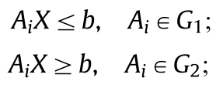
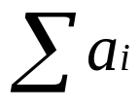
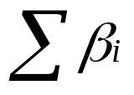
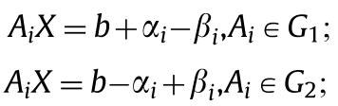
MCLP method for classification
sample: A_{i} = (a_{i1}, a_{i2}, ...,a_{in} )
α_{i} be the overlapping degree for case A_{i} , and β_{i} be the distance of case A_{i} from its adjusted boundary.
Minimize and maximize
Subject to

Slide 12
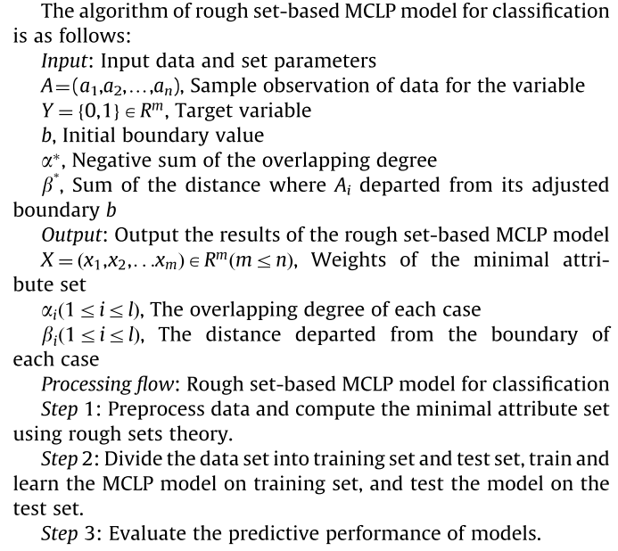

Slide 13
Dataset
28 protein complex structures from the Protein Data Bank (X-ray crystal structures have higher resolution (≦3 Å) and sequence identity is less than 35%. )
A dataset of 904 alanine-mutated residues derived from 28 protein–protein complexes is obtained from the Alanine Scanning Energetics Database (ASEdb), the Binding Interface Database (BID), and previous publications.
There are 107 hot spots (ΔΔG≧2.0 kcal mol⁻¹ when mutated to alanine) and 797 non-hot spots (ΔΔG ＜ 2.0 kcal mol⁻¹ ).

Slide 14
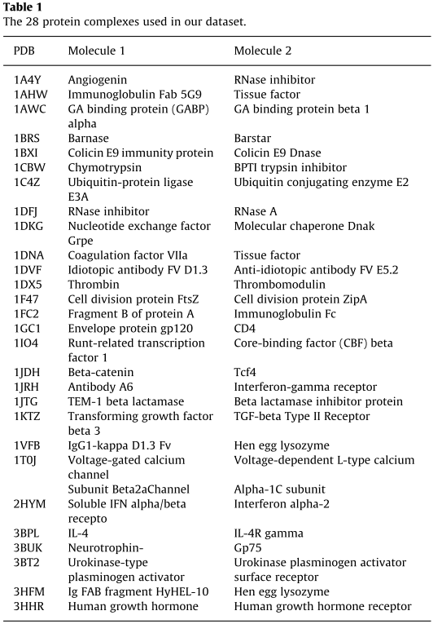

Slide 15
Residue features
The change of accessible surface area (ASA)
Percentage of the change of ASA
Percentage of ASA for polar atoms in a residue
Percentage of ASA for non-polar atoms in a residue
Size of a residue
Chemical nature (polar, non-polar, and charged)
Secondary structure (helix, sheet, and random coil)
Hydrogen bonds
Salt bridges
Atomic contacts

Slide 16

Solvent accessible surface area
The ASA of each residue is calculated using the program
NACCESS with a probe ball radius of 1.4 Å.
The ΔASA is the ASA change of a residue of the protein from
monomer state to complex formation.

Slide 17
Chemical nature and relative size of a residue
Polar residues contain Asn, Cys, Gln, Gly, Ser, Thr, and Tyr.
Non-polar residues contain Ala, Ile, Leu, Met, Phe, Pro, Trp, and Val.
Charged residues contain Arg, Asp, Glu, His, and Lys
The number of side-chain heavy atoms (C, S, N, and O) denotes the relative size of a residue

Slide 18
Other features
If the distance between donor atoms and acceptor atoms from different subunits is less than 3.5 Å , two atoms are considered to form a hydrogen bond.
If the distance is under 4.5 Å, the pair is ﬂagged as a salt bridge.
The atoms are ﬂagged as interacting atoms when the distance between any two atoms, one from each side, is less than the sum of their correspond-ing van der Waals radii plus 0.5 Å

Slide 19
Results
These 9 selected features are ΔASA, ΔASA%, percentage of ASA for polar atoms in a residue, percentage of ASA for non-polar atoms in a residue, size of a residue, non-polar (chemical nature), helix (secondary structure), sheet (secondary structure), and atomic contacts, respectively.
50 hot spots and 50 non-hot spots are selected as training set and the remaining 804 residues are regarded as test set.

Slide 20
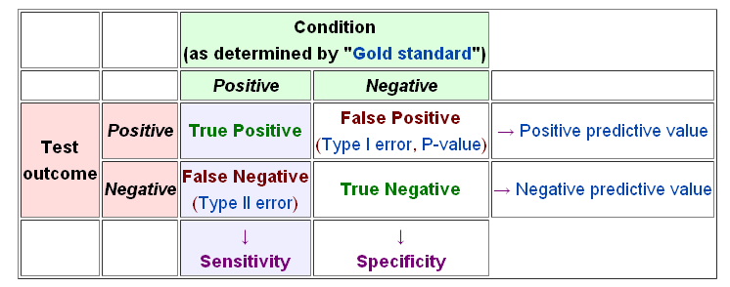
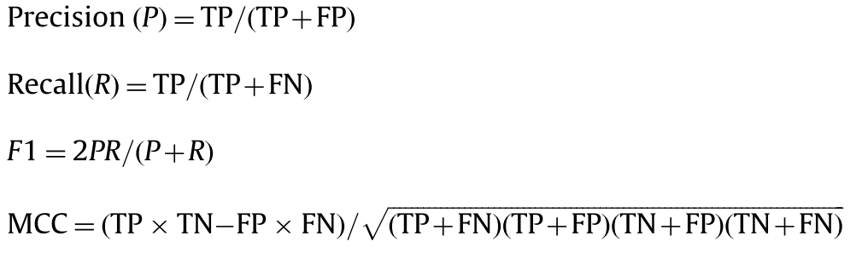

Slide 21
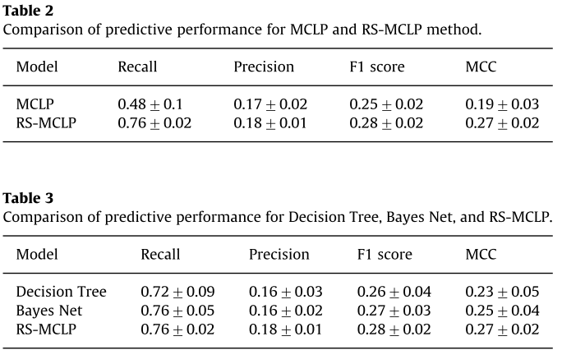

Slide 22
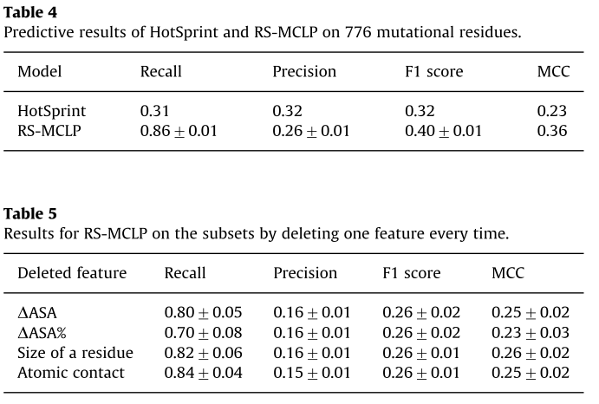

Slide 23
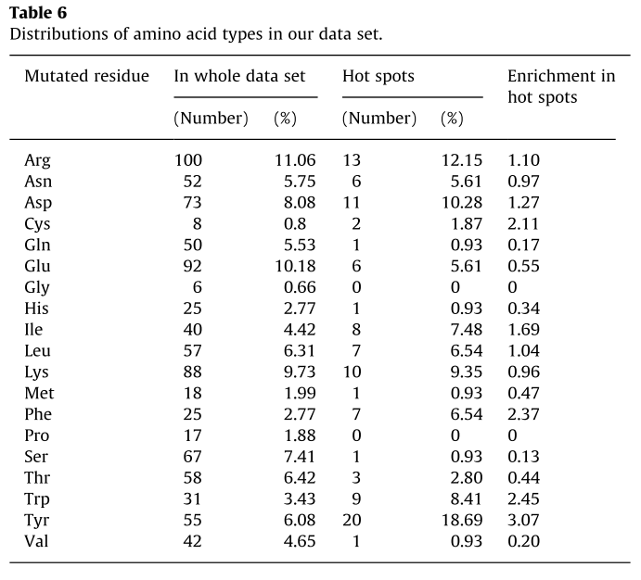
Result(1/3)

Slide 24
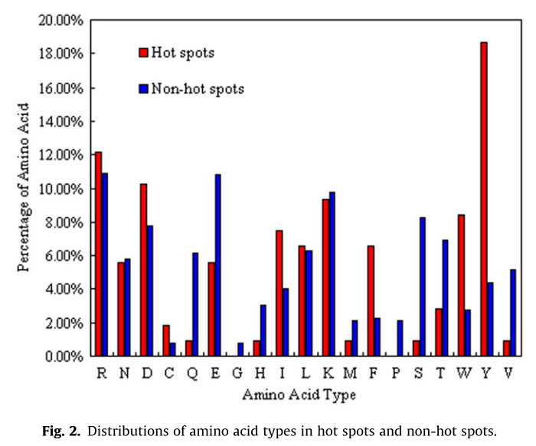

Slide 25
Thanks for your listening!

