Slide 1
Computing Longest Previous non-overlapping Factors
Maxime Crochemore, German Tischler
Information Processing Letters, Vol. 111, pp. 291-295, 2011
Presenter: Hsin-Fang Wu
Date: Mar. 8, 2011

Slide 2
Abstract
The Longest Previous non-overlapping Factor table (LPnF) stores for each position of a string the maximal length of factors occurring both there and in the preceding part of the string. The notion is a slight variant of the LPF table described before and used for text compression. The LPnF table is an essential element for the design of efficient algorithms on strings as it is related to a certain type of Ziv–Lempel factorisation used for this purpose. We show how to compute the LPnF table in linear time from the suffix array of the string when it is drawn from an integer alphabet. The algorithm is a non-immediate extension of the LPF computation and it does not require any other sophisticated data structure than the suffix array of the input string.

Slide 3
Lempel-Ziv (1/2)
以LZ77為例。
原始編碼為： 1001011011010101011
假設現在有空字典，首先由第一個bit開始，索引1對應1，加入字典中；索引2對應到0，因為字典內沒有0，加入字典；第三個bit為0已經出現在字典中，因此往後一個01，沒有出現在字典中，因此索引3為01，加入字典。以此類推。
最終得到1，0，10，11，01，101，010，1011這八個。

Slide 4
Lempel-Ziv (2/2)
1，0，10，11，01，101，010，1011
10為001＋0＝0010
位置 | 內容 | 編碼
001 | 1 | 0001
010 | 0 | 0000
011 | 10 | 0010
100 | 11 | 0011
101 | 01 | 0101
110 | 101 | 0111
111 | 010 | 1010
 | 1011 | 1101
0001 | 0000 | 0010 | 0011 | 0101 | 0111 | 1010 | 1101

Slide 5
The Longest Previous non-overlapping Factor (LPnF)
Let y = y[0 . .n−1] be a word of length n over the finite ordered alphabet A. Let SUF be the array of lexicographically sorted suffixes positions on y, i.e. y[SUF[0] .. n-1] < … < y[SUF[n-1] .. n-1].
lcp(r, q) denote the length of the longest common prefix of the strings y[SUF[r] . .n − 1] and y[SUF[q] . .n − 1] and let the array LCP be given by LCP[r] = lcp(r − 1, r), for r = 1, . . . ,n − 1, and LCP[0] = 0.
The pair of arrays (SUF,LCP) is commonly known as the suffix array of y.
Using the suffix array of y, for r < t, lcp(r, t) can be computed with the formula, lcp(r, t) = min{LCP[r + 1], . . . ,LCP[t]}.

Slide 6
Suffix Array
A[i] | b | b | b | b | a | b | b | b | a | b | b | a | b | b | a | b
suffixes | index
bbbbabbbabbabbab | S(0)
bbbabbbabbabbab | S(1)
bbabbbabbabbab | S(2)
babbbabbabbab | S(3)
abbbabbabbab | S(4)
bbbabbabbab | S(5)
bbabbabbab | S(6)
babbabbab | S(7)
abbabbab | S(8)
bbabbab | S(9)
babbab | S(10)
abbab | S(11)
bbab | S(12)
bab | S(13)
ab | S(14)
b | S(15)
index | Sorted suffix | lcp
14 | ab | 0
11 | abbab | 2
8 | abbabbab | 5
4 | abbbabbabbab | 3
15 | b | 0
13 | bab | 1
10 | babbab | 3
7 | babbabbab | 6
3 | babbbabbabbab | 4
12 | bbab | 1
9 | bbabbab | 4
6 | bbabbabbab | 7
2 | bbabbbabbabbab | 5
5 | bbbabbabbab | 2
1 | bbbabbbabbabbab | 6
0 | bbbbabbbabbabbab | 3

Slide 7
The Longest Previous Factor (LPF)
For each rank r the value LPF[SUF[r]] can be computed by finding the largest rank r< such that r< < r and SUF[r<] < SUF[r], the smallest rank r> such that r> > r and SUF[r>] < SUF[r] and choosing the maximum of lcp(r<, r) and lcp(r>, r). If r< does not exist, we set r< = −1 and lcp(−1, r) = 0. Likewise, if r> does not exist, we set r> =n and lcp(r,n) = 0.
LPF>[r] = lcp(r, next[r]) and LPF<[r] = lcp(prev[r], r) for r = 0, . . . ,n −1. It is clear that the array LPF can be written as
LPF[SUF[r]] = max{LPF<[r],LPF>[r]}.

Slide 8
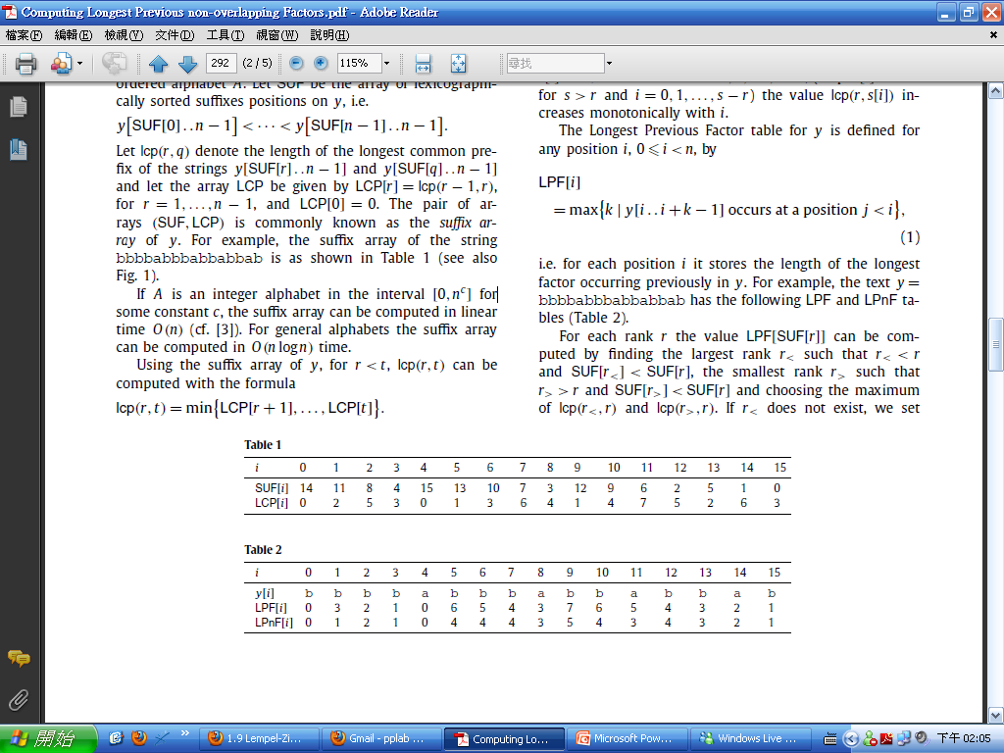
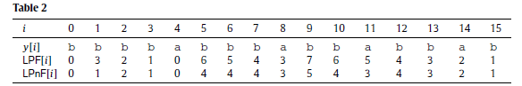
LCP Computation
i | 0 | 1 | 2 | 3 | 4 | 5 | 6 | 7 | 8 | 9 | 10 | 11 | 12 | 13 | 14 | 15
SUF | 14 | 11 | 8 | 4 | 15 | 13 | 10 | 7 | 3 | 12 | 9 | 6 | 2 | 5 | 1 | 0
LPF> | 2 | 5 | 3 | 0 | 1 | 3 | 6 | 4 | 1 | 4 | 7 | 5 | 2 | 6 | 3 | 0
LPF< | 0 | 0 | 0 | 0 | 0 | 0 | 0 | 0 | 0 | 1 | 1 | 1 | 0 | 2 | 0 | 0
LPF | 2 | 5 | 3 | 0 | 1 | 3 | 6 | 4 | 1 | 4 | 7 | 5 | 2 | 6 | 3 | 0

Slide 9
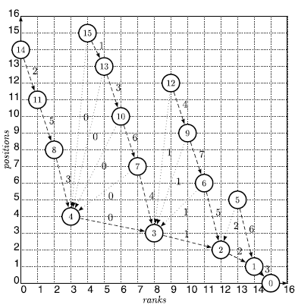
LPF & LPnF Computation

Slide 10
Computing LPnF
If lcp(r, next[r]) is not larger than the difference d(r) = SUF[r] − SUF[next[r]] of the respective positions, then the longest previous factor at position SUF[next[r]] does not overlap the occurrence at position SUF[r]. Therefore we have LPnF[SUF[r]] = LPF[[SUF[r]].
If lcp(r, next[r]) >d(r), then we may have LPnF[r] < LPF[r], as the longest previous factor at position SUF[next[r]] overlaps its occurrence at SUF[r].

Slide 11
Linear time computation of LPnF table
Definition 1. A chain is a sequence of ranks r0, . . . , rk satisfying
1. k > 0
2. 0≤ r0 < · · · <rk <n
3. ri+1 = next[ri ] for i = 0, . . . ,k −1
4. SUF[ri] − SUF[ri+1] < LPF>[ri ] for i = 0, . . . ,k −1

Slide 12
Linear time computation of LPnF table
The graph in Fig. 1 contains the maximal chains of constant period (1, 2), (6, 7), (9, 10, 11), (11, 12), (12, 14, 15) and (13, 14).

Slide 13
Linear time computation of LPnF table
Lemma 1. Let r0, . . . , rk be a maximal chain of constant period p. Then the equality LPF>[ri] = LPF>[r0]+ip = (c0+i)p+o0 holds for i = 0, . . . ,k−1. In particular LPF>[r0] < LPF>[r1] < · · · < LPF>[rk−1].
Proof. Let v be the factor of length LPF>[r0] starting at position SUF[r0]. Then v also occurs at position SUF[r1] and is the longest factor with this property by definition of LPF>. Let u = y[SUF[r1] . .SUF[r0] − 1] be the factor of length p occurring at SUF[r1]. Since the chain has constant period, u also occurs at position SUF[r2]. Therefore uv occurs at both positions SUF[r1] and SUF[r2], is the longest factor with this property, and then LPF>[r1] = |uv| = LPF>[r0]+ p. Iterating the same argument for other values of i leads to the conclusion.

Slide 14
Linear time computation of LPnF table
Lemma 2. Let r0, . . . , rk be a maximal chain of constant period p. If the inequality next[rk] = n holds, SUF[ri] − SUF[next[rk]] ≥ lcp(ri , next[rk]) for each i = 0, . . . ,k −1.

Slide 15
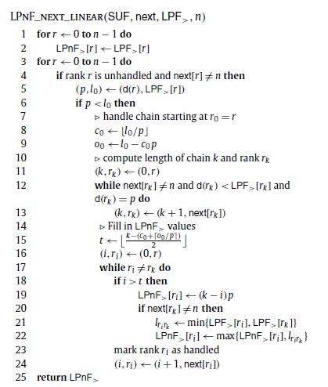

Slide 16
Thank You

Slide 17
The Longest Previous Factor (LPF)
LPF[i] = max({ l | T[i..i+l–1] is a substring of T[0..i+l–2]}, 0)
For i=6, we can find l=7
0 | 1 | 2 | 3 | 4 | 5 | 6 | 7 | 8 | 9 | 10 | 11 | 12
3 | 5 | 1 | 4 | 2 | 3 | 3 | 5 | 1 | 4 | 2 | 3 | 3

Slide 18
Suffix Array
i | 1 | 2 | 3 | 4 | 5 | 6 | 7 | 8 | 9 | 10 | 11 | 12
A[i] | a | b | r | a | c | a | d | a | b | r | a | $
SuffixArray={12,11,8,1,4,6,9,2,5,7,10,3}
a b r a c a d a b r a $ | S(1)
b r a c a d a b r a $ | S(2)
r a c a d a b r a $ | S(3)
a c a d a b r a $ | S(4)
c a d a b r a $ | S(5)
a d a b r a $ | S(6)
d a b r a $ | S(7)
a b r a $ | S(8)
b r a $ | S(9)
r a $ | S(10)
a $ | S(11)
$ | S(12)
index | Sorted suffix | lcp
12 | $ | 0
11 | a $ | 0
8 | a b r a $ | 1
1 | a b r a c a d a b r a $ | 4
4 | a c a d a b r a $ | 1
6 | a d a b r a $ | 1
9 | b r a $ | 0
2 | b r a c a d a b r a $ | 3
5 | c a d a b r a $ | 0
7 | d a b r a $ | 0
10 | r a $ | 0
3 | r a c a d a b r a $ | 2

Slide 19
Longest Common Prefix (LCP)
每個字串都有出現的prefix之中最長的那一個，可能為空。
S1: a a b b c c c
S2: a a b b b c c c
S3: a a b a c c c
=> LCP: a a b

