Slide 1
Statistical Comparisons of Classifiers over Multiple Data Sets
Janez Demšar
Journal of Machine Learning Research, Vol. 7, 2006, pp.1–30

Slide 2
Abstract
While methods for comparing two learning algorithms on a single data set have been scrutinized [詳細檢查] for quite some time already, the issue of statistical tests for comparisons of more algorithms on multiple data sets, which is even more essential to typical machine learning studies, has been all but ignored. This article reviews the current practice and then theoretically and empirically examines several suitable tests. Based on that, we recommend a set of simple, yet safe and robust non-parametric tests for statistical comparisons of classifiers: the Wilcoxon signed ranks test for comparison of two classifiers and the Friedman test with the corresponding post-hoc tests for comparison of more classifiers over multiple data sets. Results of the latter can also be neatly presented with the newly introduced CD (critical difference) diagrams.

Slide 3
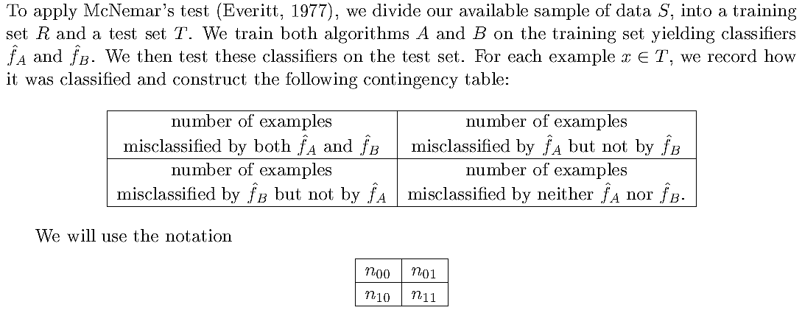
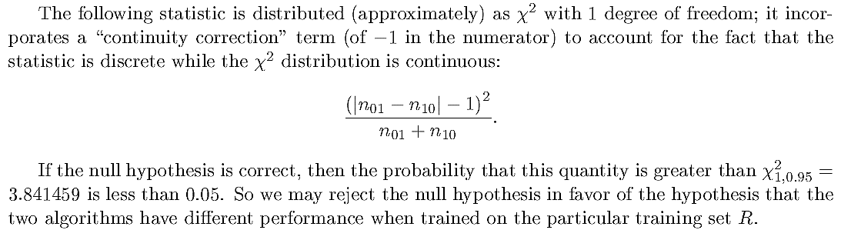
McNemar’s Test
ChristoT. G. Dietterich, “Approximate statistical test for comparing supervised classification learning algorithms"

Slide 4
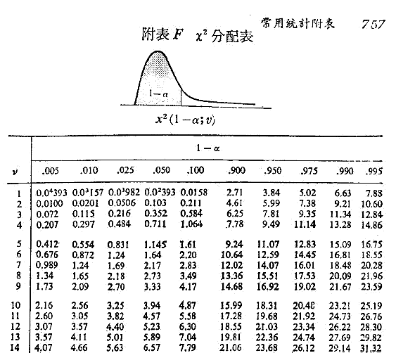
顏月珠, "商用統計學"

Slide 5
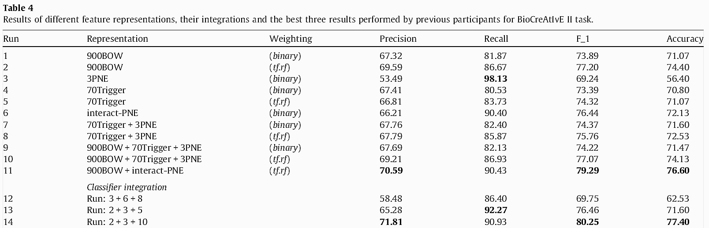

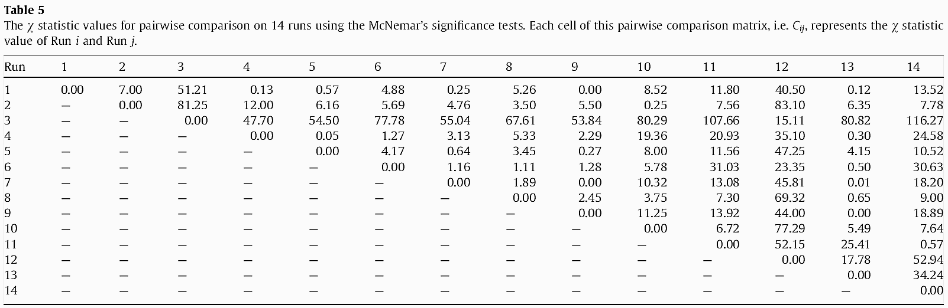
Man Lan, “Feature generation and representations for protein–protein interaction classification"

Slide 6
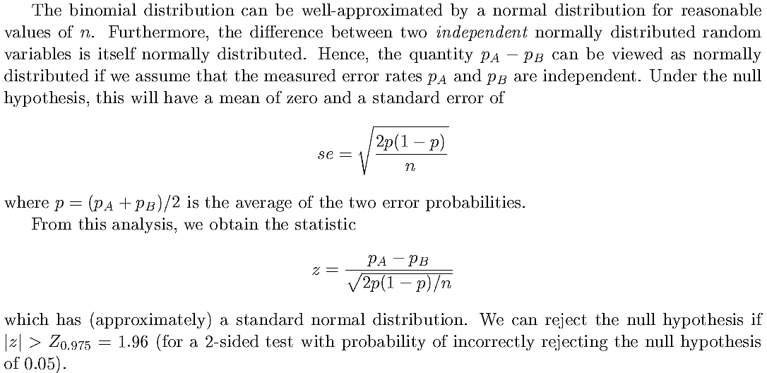
Binomial test
ChristoT. G. Dietterich, “Approximate statistical test for comparing supervised classification learning algorithms"

Slide 7
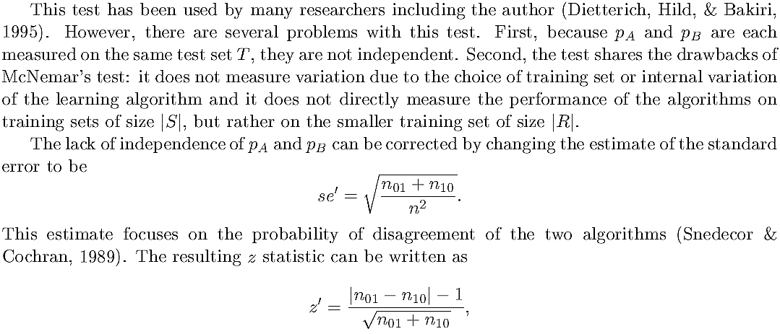
Binomial test
ChristoT. G. Dietterich, “Approximate statistical test for comparing supervised classification learning algorithms"

Slide 8




McNemar vs. Binomial test
The key difference between these two tests lies in whether taking difference of proportions or numbers
Δp=0.2, ΔN=20

Slide 9
相依樣本T檢定的重點
1
首先要觀察成對資料的數量是否足夠，一般須為30以上。
觀察各個變數的分配是否近似常態分配。
查看Ｔ檢定表中之雙尾檢定的〝p-值〞，以判定該兩群之期望值是否相等。若〝p-值〞小於所設定的顯著水準α時，則否定虛無假設H₀，否則不否定虛無假設H₀，亦即在目前無證據否定虛無假設 H₀ 時，就接受 H₀。
觀察此兩期望值之差的〝100*(1－α)%〞之信賴區間。若其差介於此區間中，則不否定其母體的期望值是相同的，此會與第3項的結論一致。
2
3
4
謝佳琳, http://imil.au.edu.tw/~hsichcl/

Slide 10
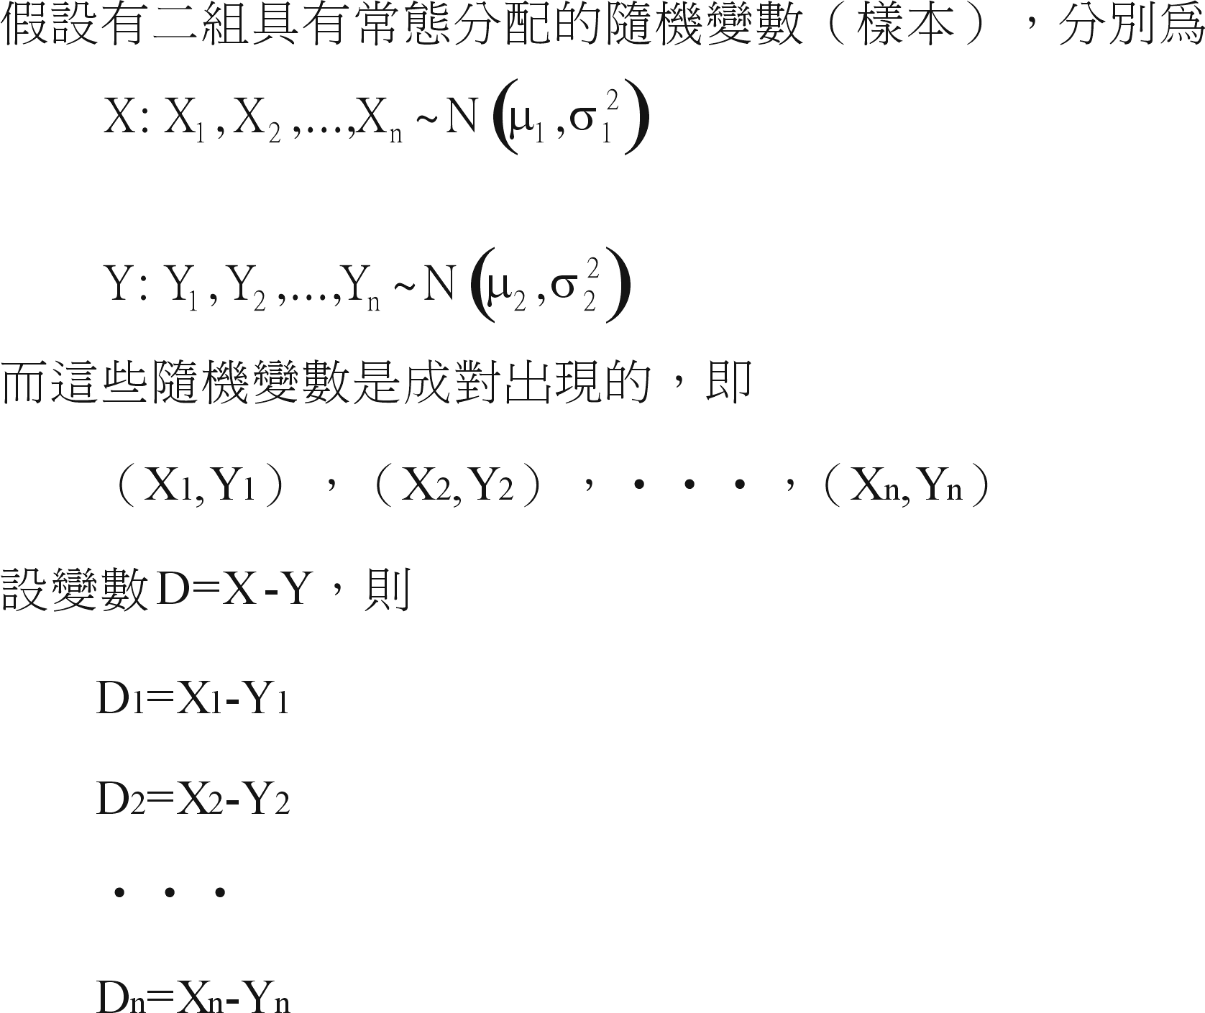
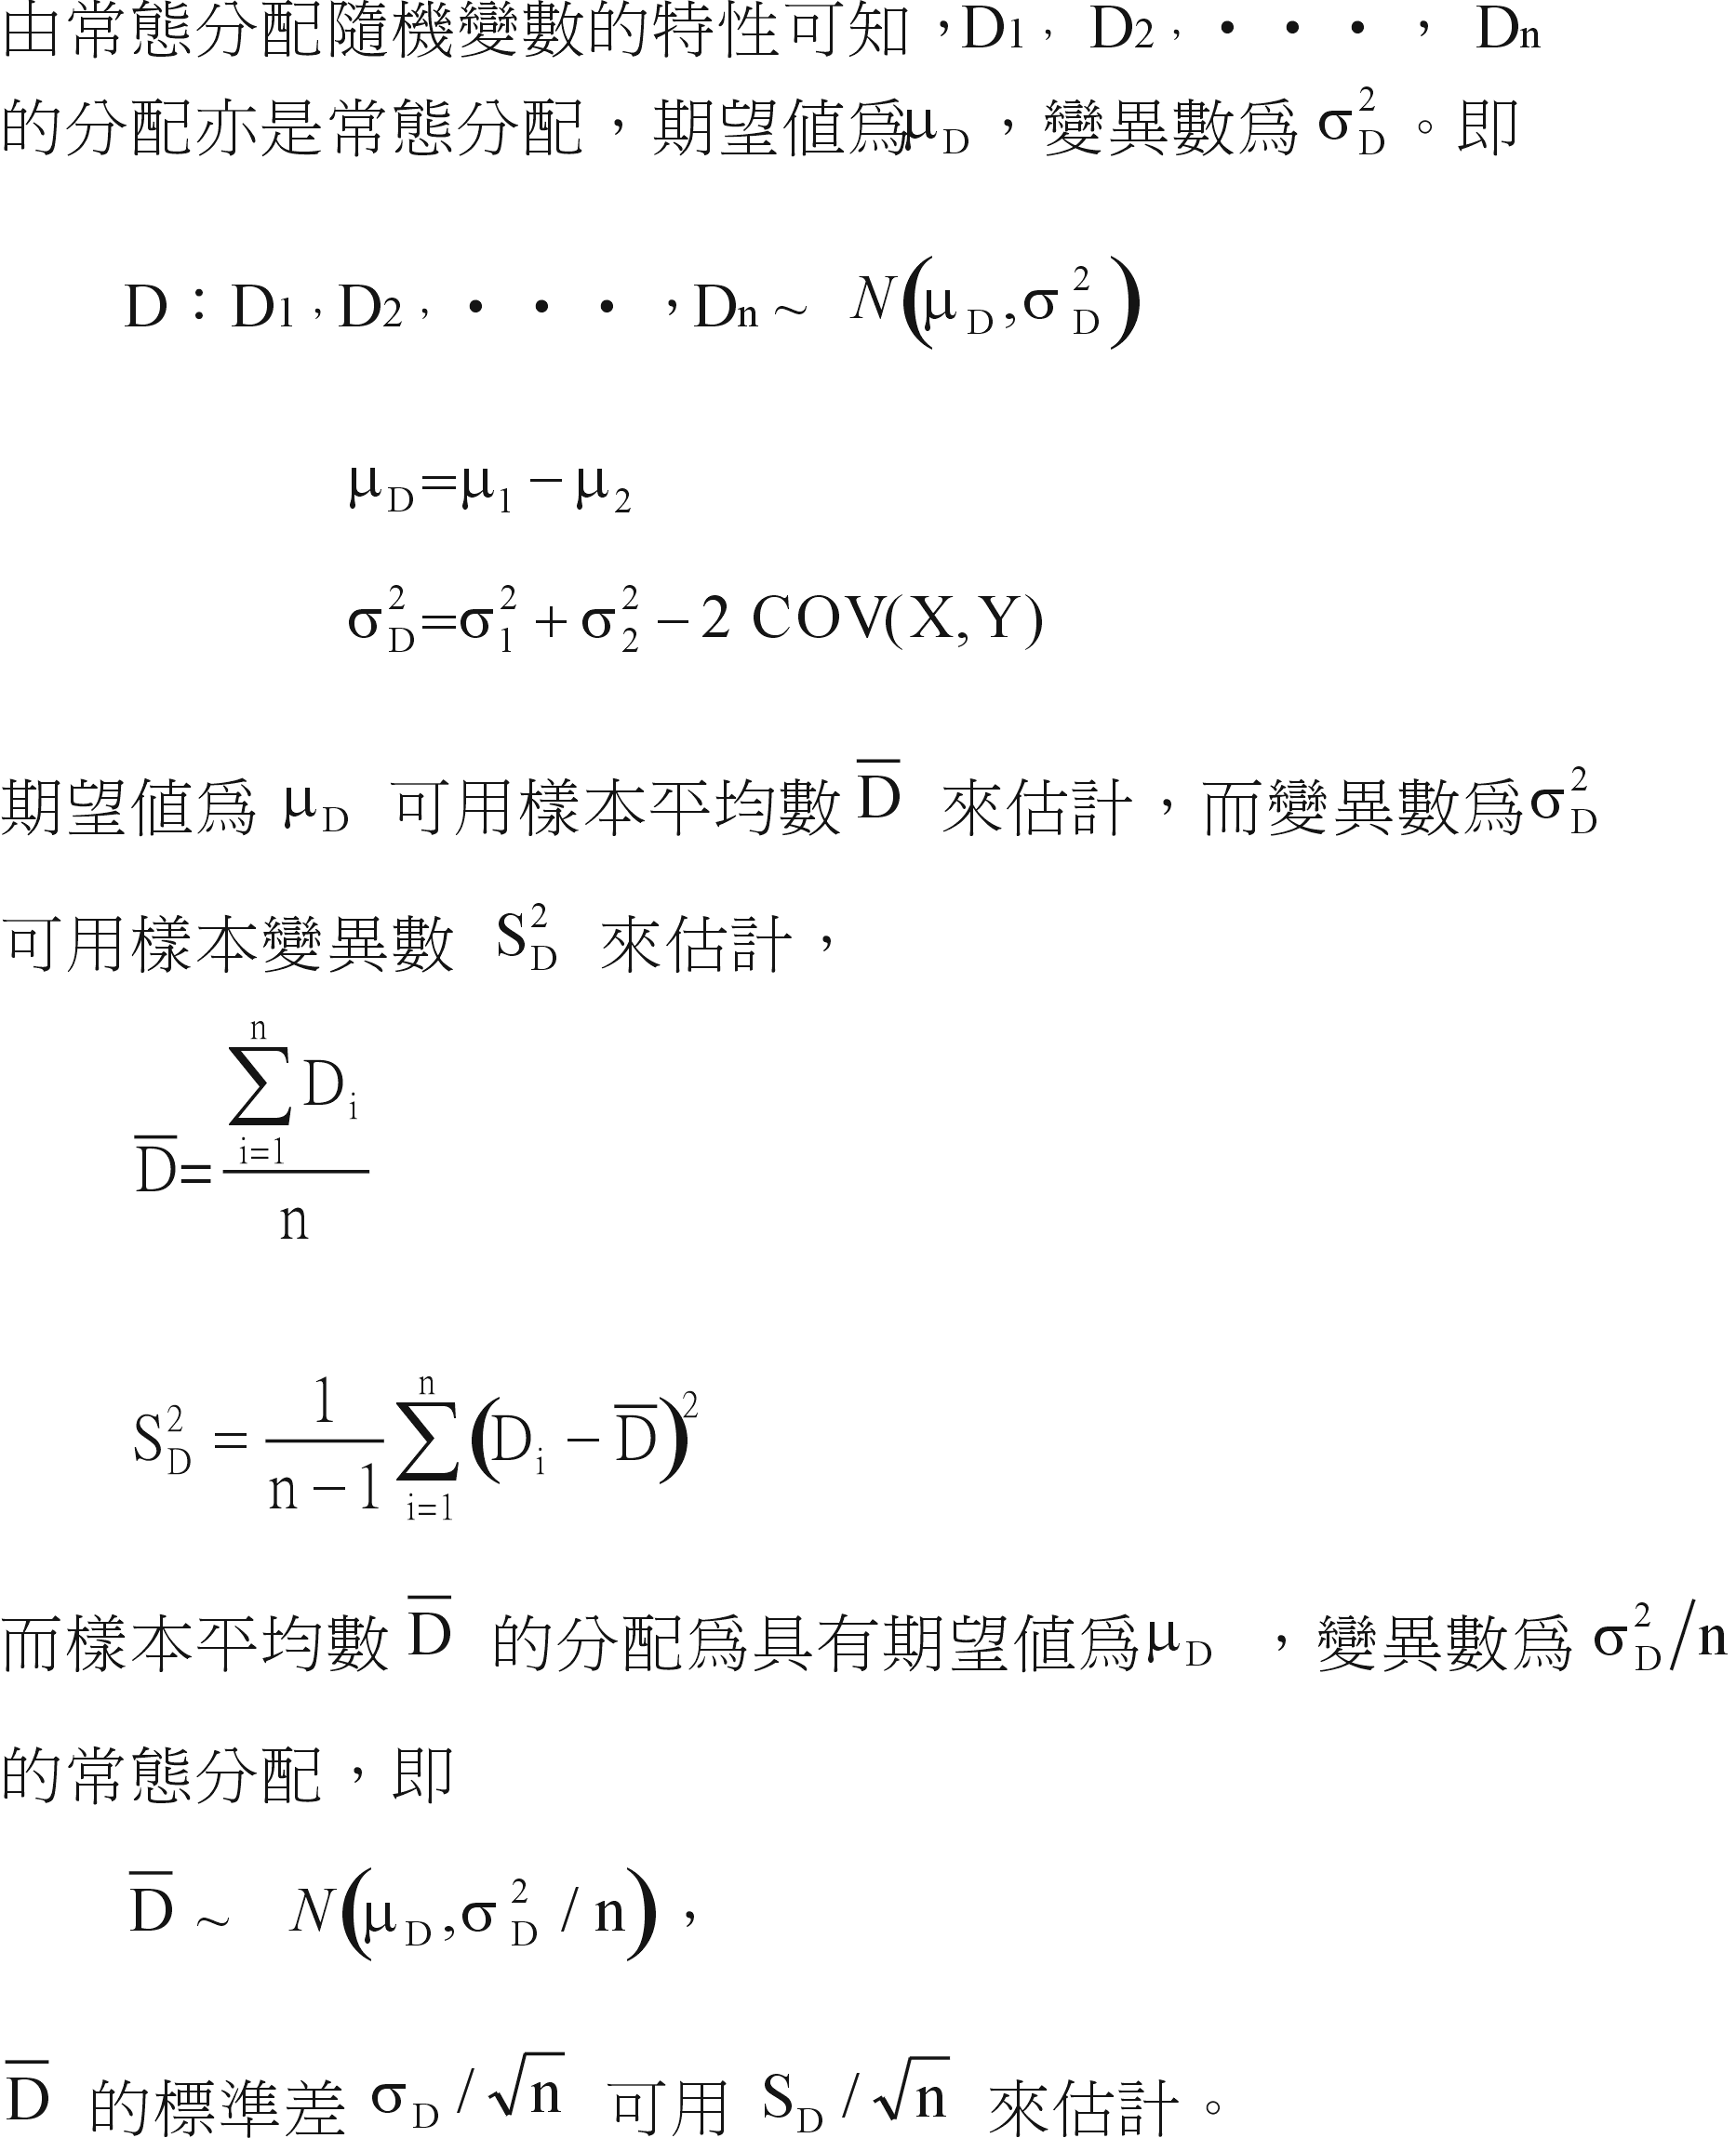
相依樣本的T檢定介紹
相關統計量
謝佳琳, http://imil.au.edu.tw/~hsichcl/

Slide 11
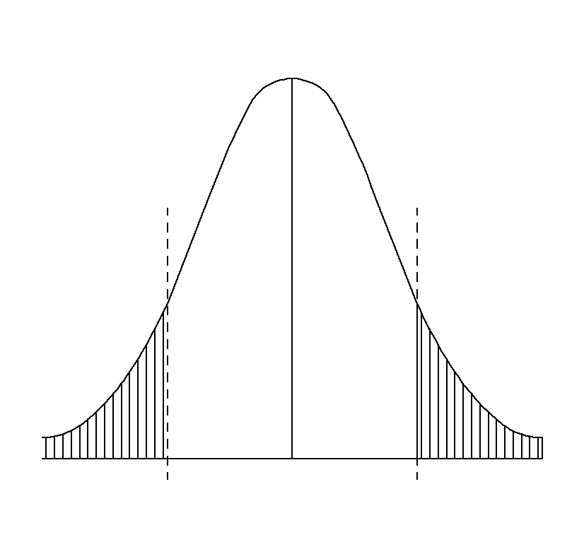
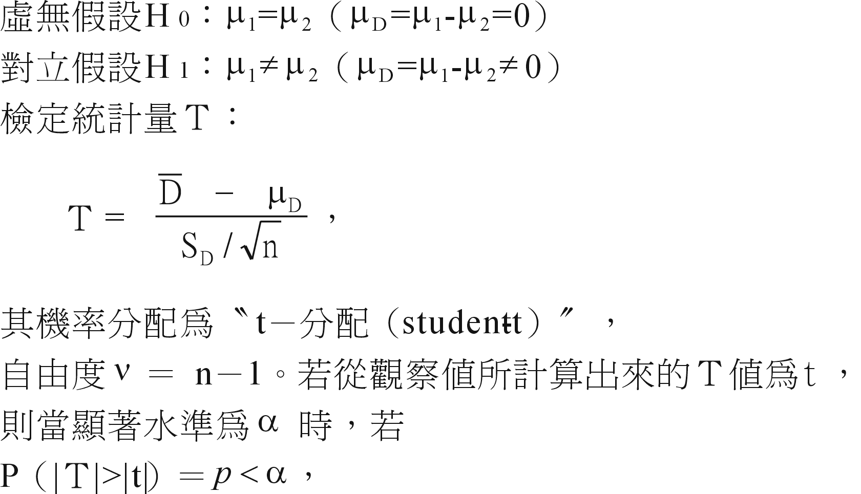

檢定
則否定虛無假設 H₀，亦即接受對立假設 H₁﹔否則不否定虛無假設 H₀，亦即在目前無證據否定虛無假設 H₀ 時，就接受 H₀。
謝佳琳, http://imil.au.edu.tw/~hsichcl/

Slide 12
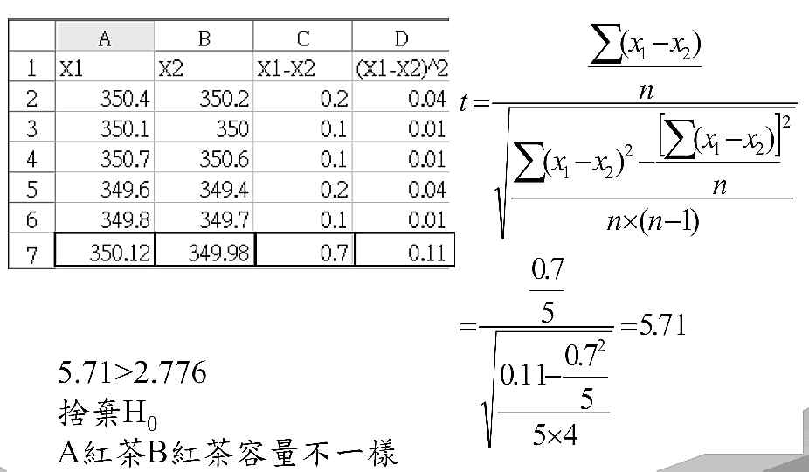
生產線上午包裝紅茶A容量：350.4, 350.1, 350.7, 349.6, 349.8cc
同一生產線下午包裝紅茶B容量：350.2, 350.0, 350.6, 349.4, 349.7cc
檢定紅茶A與紅茶B是否一樣?
  H0：u1=u2
  H1：u1≠u2
  檢定臨界值：t_{0.025,4}=2.776
張弘志 老師 教學資源網站 , http://content.sp.npu.edu.tw/teacher/changhc/SPSS/07TTest.pdf

Slide 13
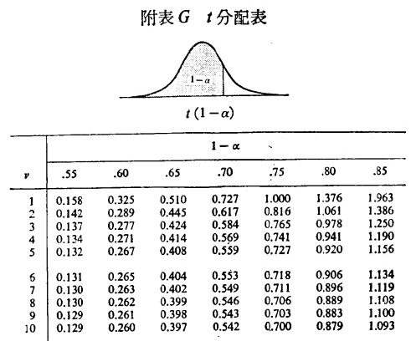
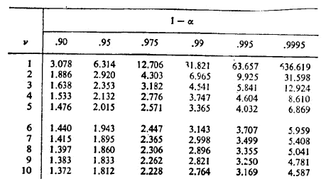
顏月珠, "商用統計學"

Slide 14
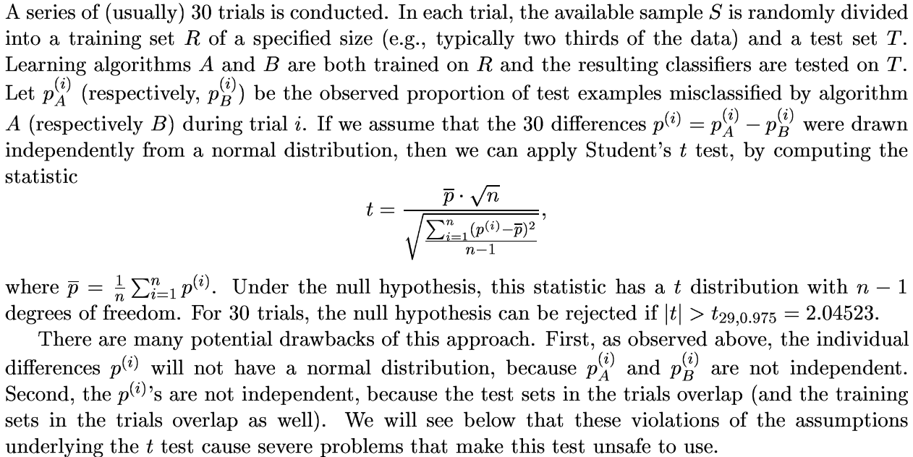
Re-sampled paired t test
ChristoT. G. Dietterich, “Approximate statistical test for comparing supervised classification learning algorithms"

Slide 15
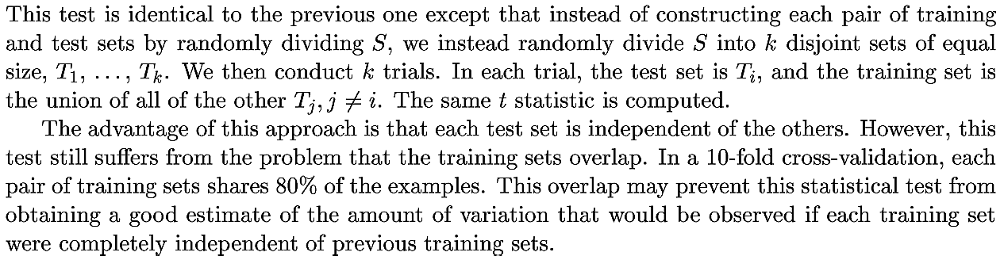
k-fold cross-validated paired t test
ChristoT. G. Dietterich, “Approximate statistical test for comparing supervised classification learning algorithms"

Slide 16
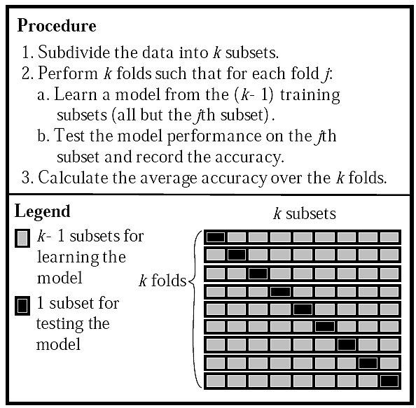
Yoram Reich et al., “Evaluating Machine Learning Models for Engineering Problems"

Slide 17
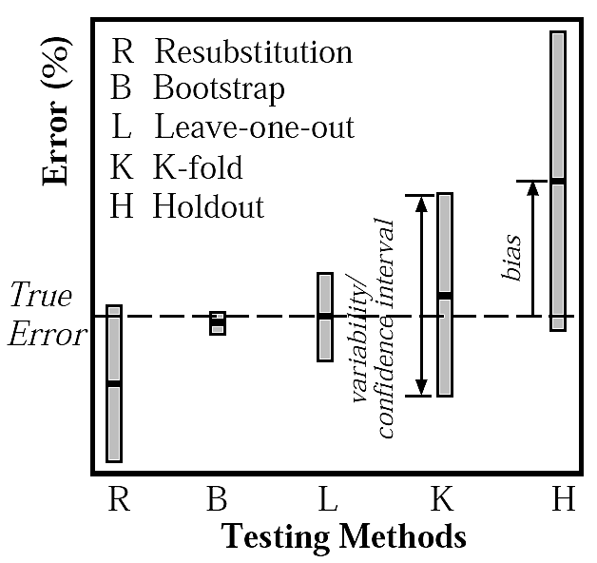
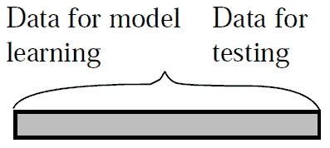
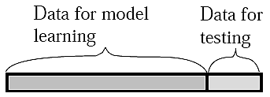
Self-Consistency
Holdout
Yoram Reich et al., “Evaluating Machine Learning Models for Engineering Problems"

Slide 18
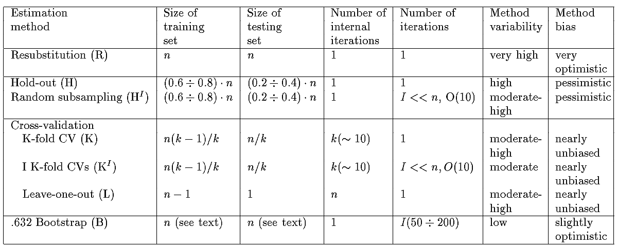
Yoram Reich et al., “Evaluating Machine Learning Models for Engineering Problems"

Slide 19
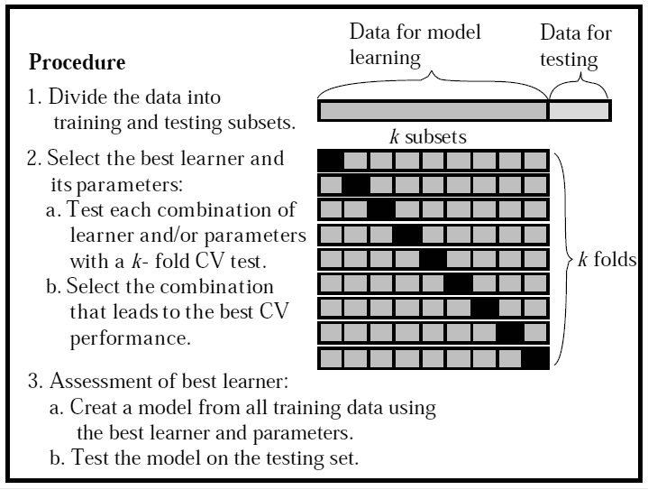
Yoram Reich et al., “Evaluating Machine Learning Models for Engineering Problems"

Slide 20
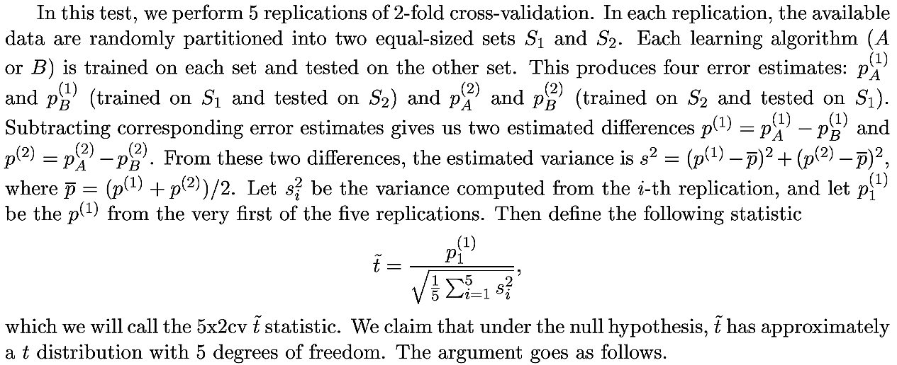
5x2 cv paired t test
ChristoT. G. Dietterich, “Approximate statistical test for comparing supervised classification learning algorithms"

Slide 21
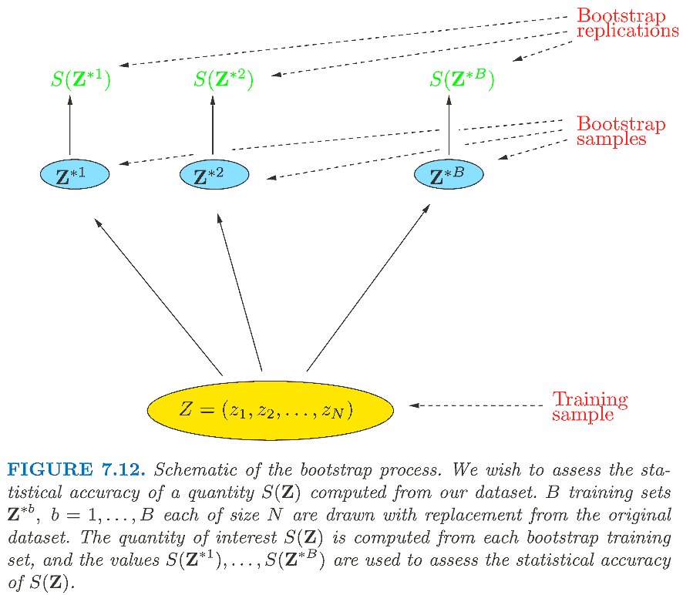
Bootstrap methods
Trevor Hastie et al., “The elements of statistical learning"

Slide 22
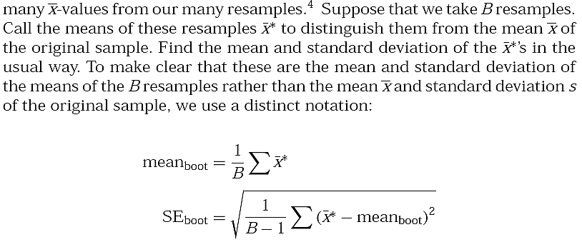
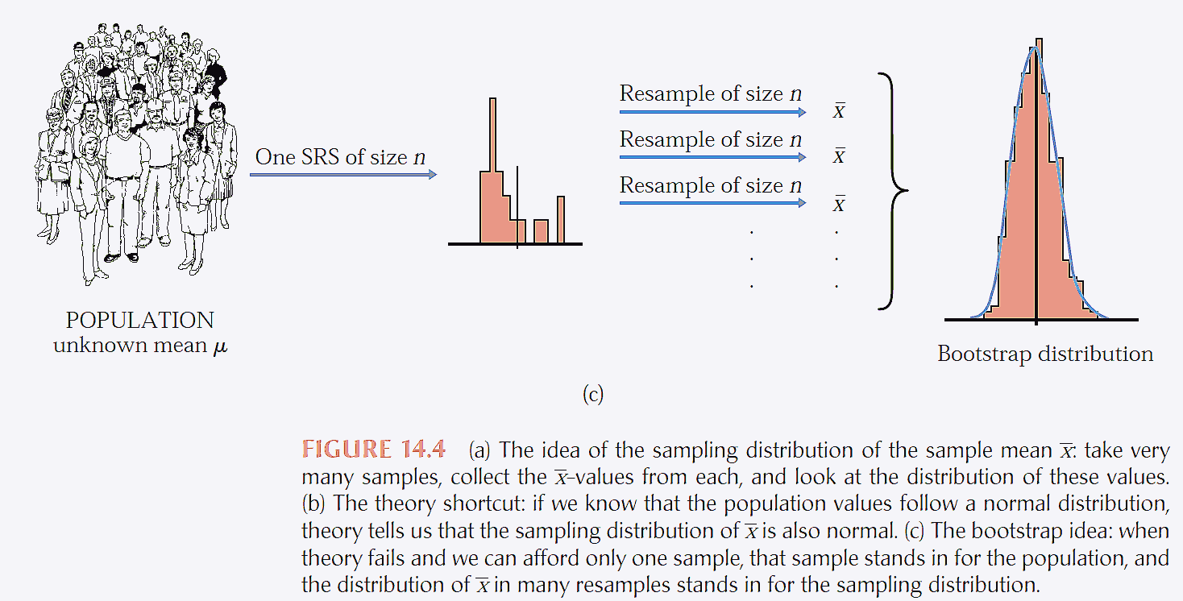
Moore et al., “The practice of business statistics"

Slide 23
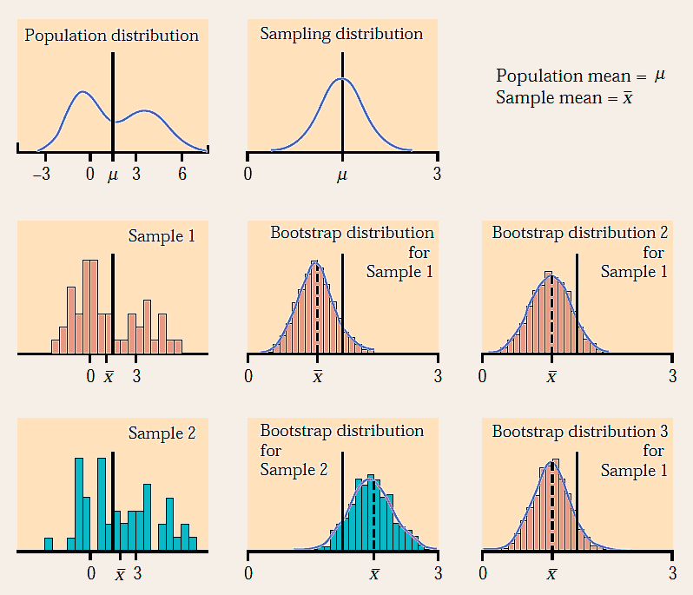
Moore et al., “The practice of business statistics"

Slide 24
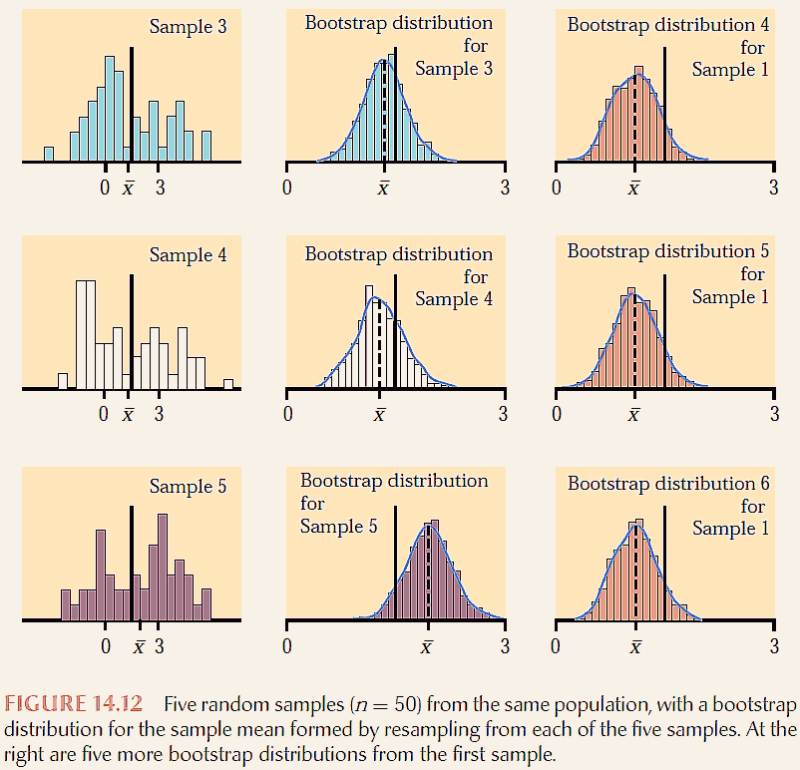
Moore et al., “The practice of business statistics"

Slide 25
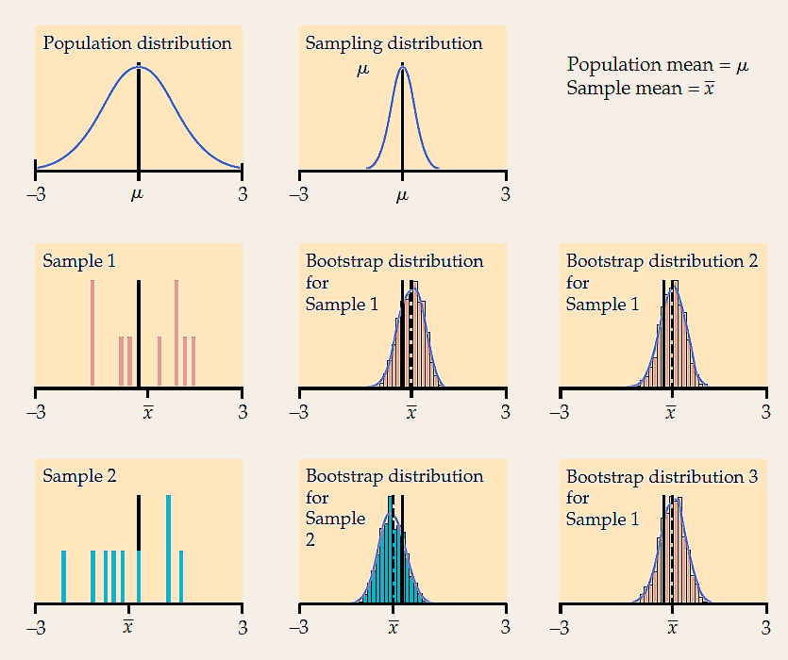
Moore et al., “The practice of business statistics"

Slide 26
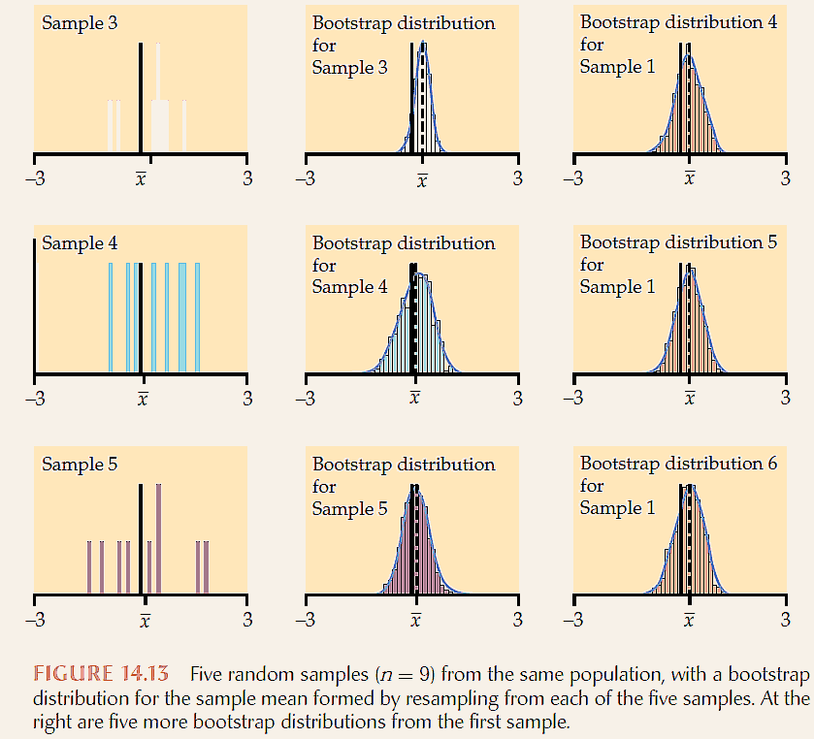
Moore et al., “The practice of business statistics"

Slide 27
Almost all of the variation among bootstrap distributions for a statistic is due to the selection of the original random sample from the population. Re-sampling introduces little additional variation.
Bootstrap distributions based on small samples can be quite variable. Their shape and spread reflect the characteristics of the sample and may not accurately estimate the shape and spread of the sampling distribution. Bootstrap inference from a small sample may therefore be unreliable.
Bootstrap inference based on samples of moderate size is unreliable for statistics like the median and quartiles that are calculated from just a few of the sample observations.
Moore et al., “The practice of business statistics"

Slide 28
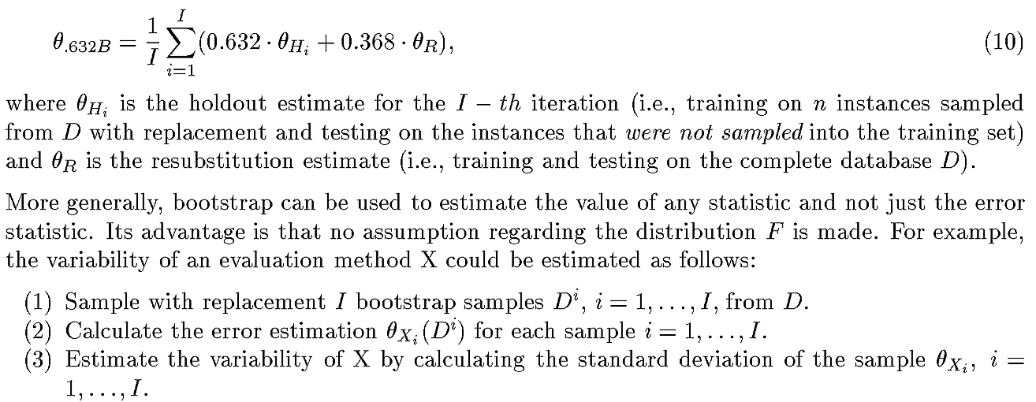
Bootstrap methods
Yoram Reich et al., “Evaluating Machine Learning Models for Engineering Problems"

Slide 29
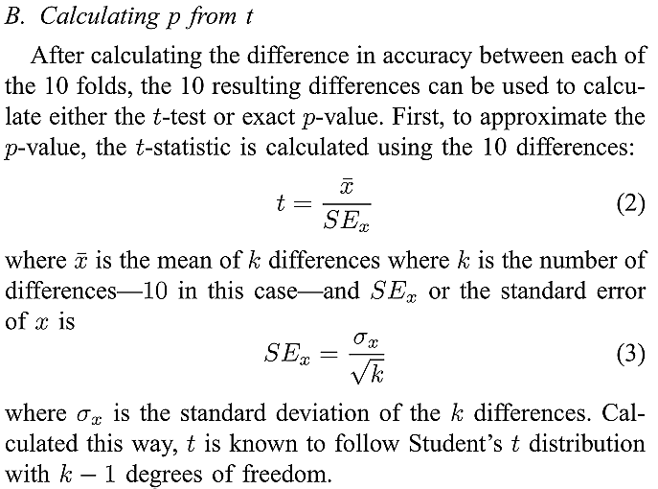
CV paired t test by permutation
Joshua Menke and Tony R. Martinez, “Using Permutations Instead of Student’s t Distribution for p-values in Paired-Difference Algorithm Comparisons"

Slide 30
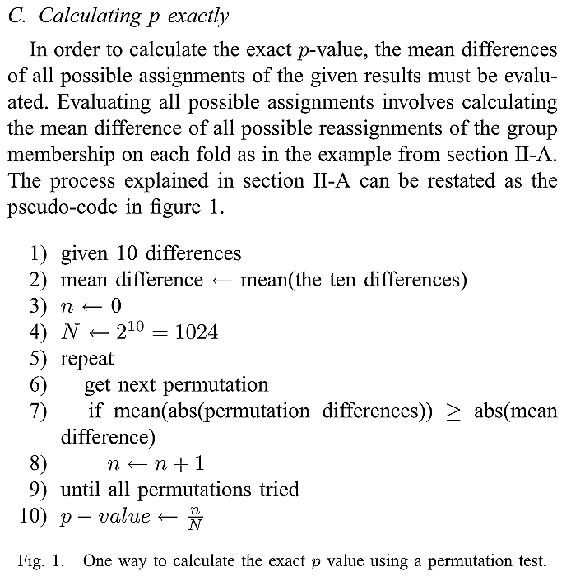
CV paired t test by permutation
Joshua Menke and Tony R. Martinez, “Using Permutations Instead of Student’s t Distribution for p-values in Paired-Difference Algorithm Comparisons"

Slide 31
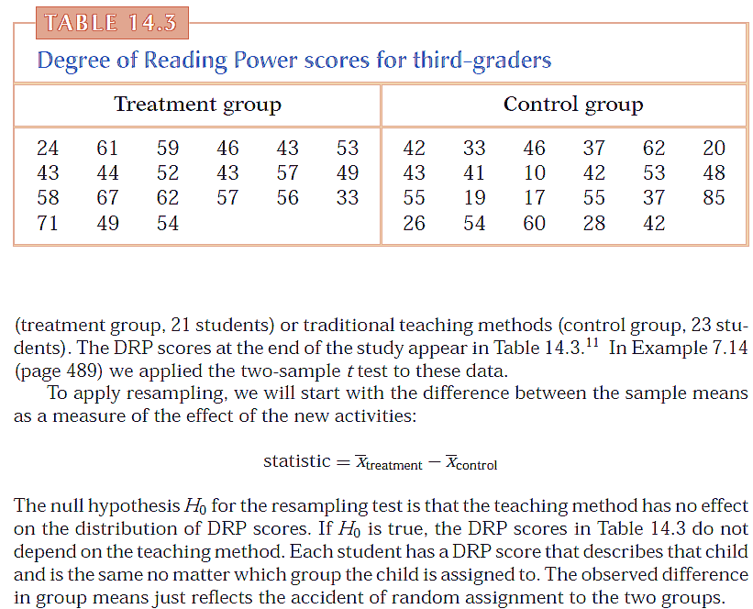
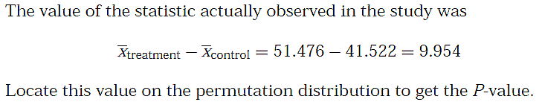
Moore et al., “The practice of business statistics"

Slide 32
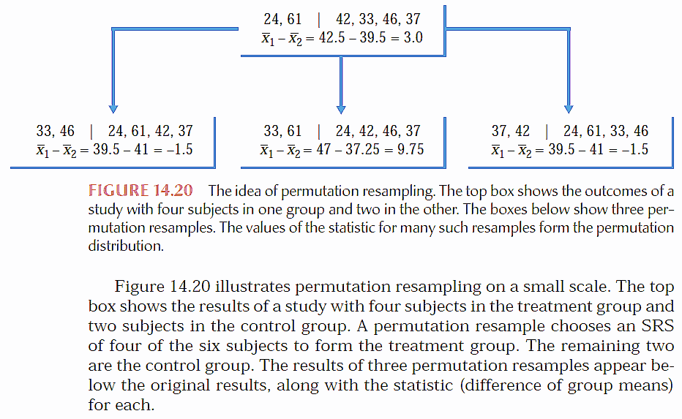
Moore et al., “The practice of business statistics"

Slide 33
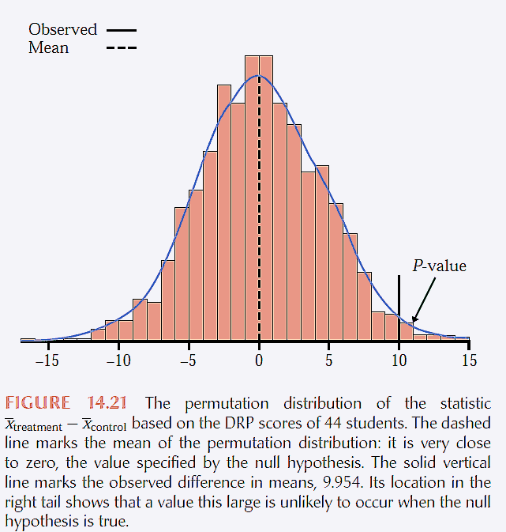

Moore et al., “The practice of business statistics"

Slide 34
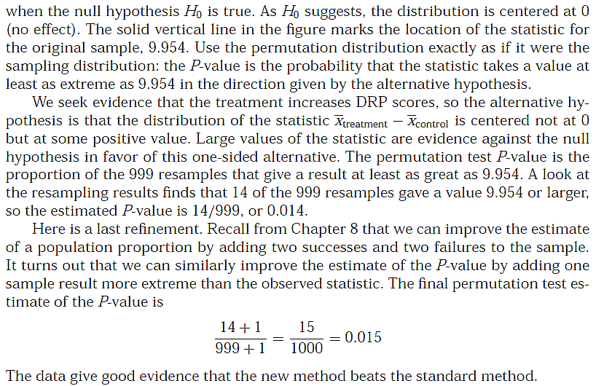
Moore et al., “The practice of business statistics"

Slide 35
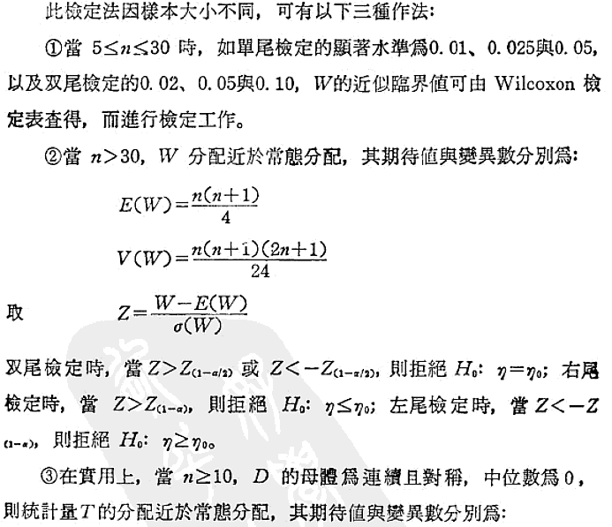
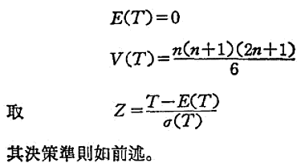
Wilcoxon signed-rank test
顏月珠, "商用統計學"

Slide 36
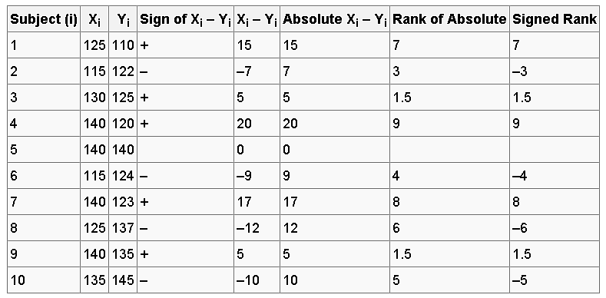
Wilcoxon signed-rank test
The test statistic, W₊, is given by the sum of all of the positive values in the Signed Rank column. The test statistic, W–, is given by the sum of all of the negative values in the Signed Rank column. For this example, W₊ = 27 and W–=18. The minimum of these is 18.
http://en.wikipedia.org/wiki/Wilcoxon_signed-rank_test

Slide 37
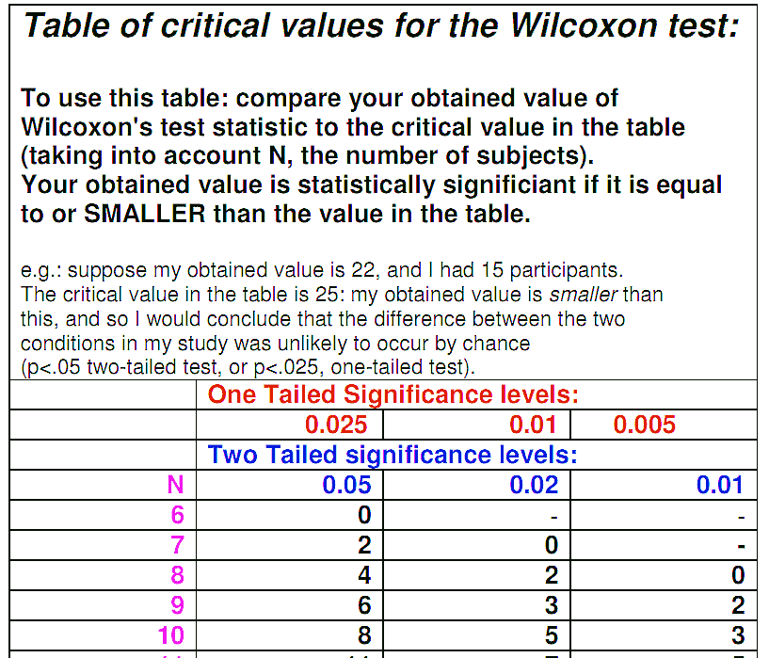
Wilcoxon signed-rank test
In this case the test statistic is W = 18 and the critical value is 8 for a two-tailed p-value of 0.05. The test statistic must be less than this to be significant at this level, so in this case the null hypothesis is not rejected.
http://en.wikipedia.org/wiki/Wilcoxon_signed-rank_test

Slide 38
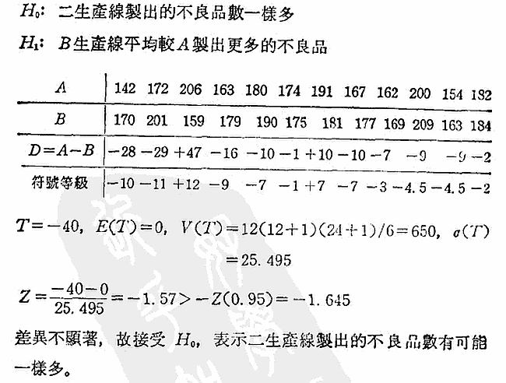
Wilcoxon signed-rank test
顏月珠, "商用統計學"

Slide 39
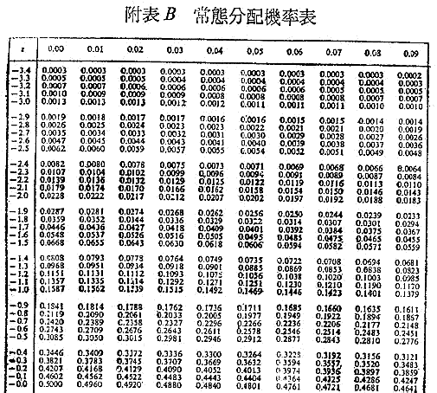
顏月珠, "商用統計學"

Slide 40
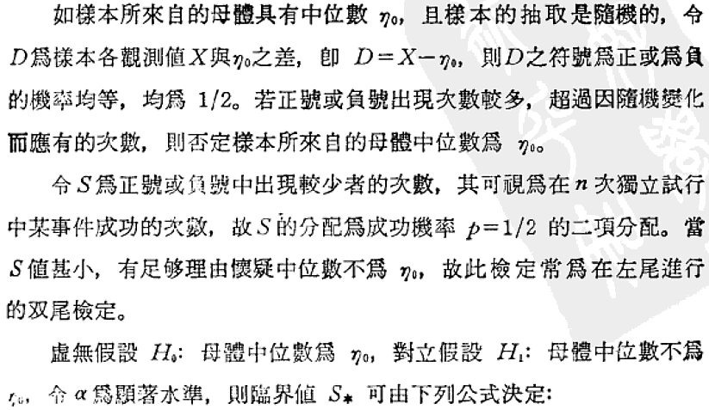
Sign test
顏月珠, "商用統計學"

Slide 41

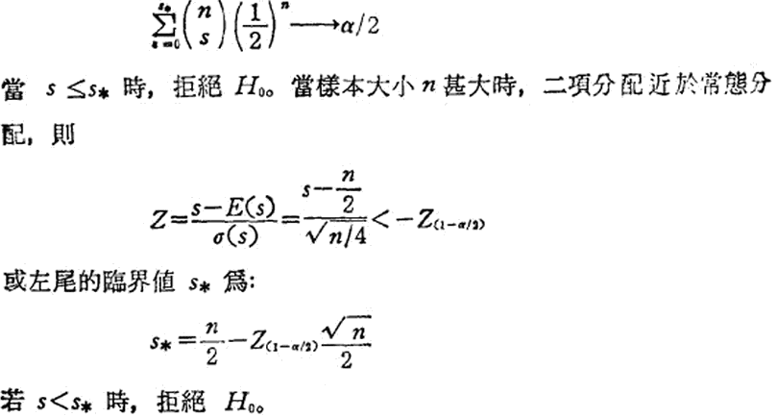
Sign test
顏月珠, "商用統計學"

Slide 42
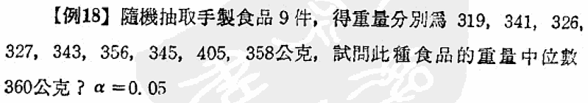
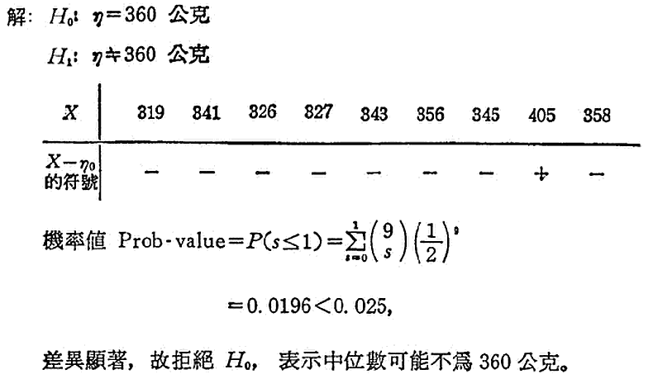
Sign test
顏月珠, "商用統計學"

Slide 43
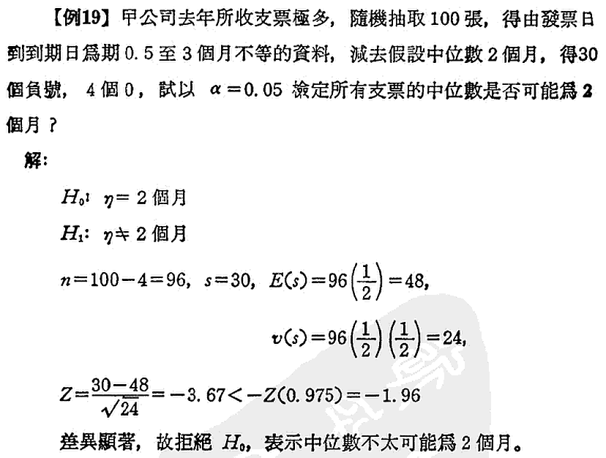
Sign test
顏月珠, "商用統計學"

Slide 44

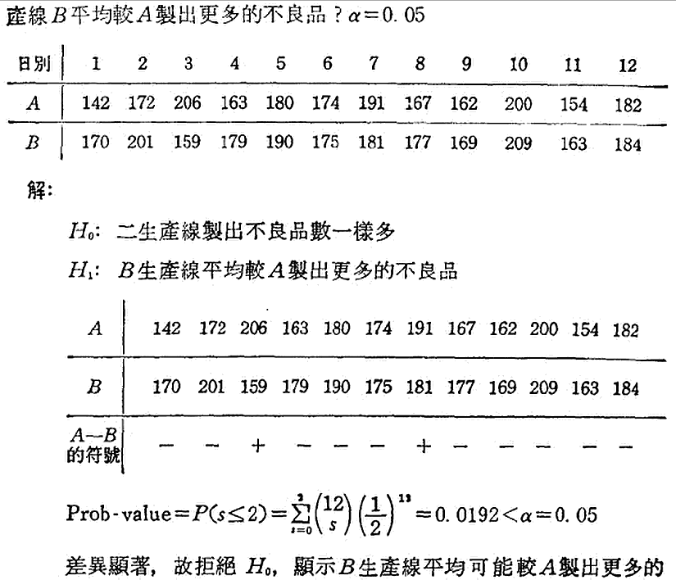
Sign test
顏月珠, "商用統計學"

Slide 45


When comparing all the algorithms against each other, we connect the groups of algorithms that are not significantly different.

Slide 46

ANOVA (analysis of variance)
楊明宗, "應用統計學"

Slide 47


ANOVA (analysis of variance)
楊明宗, "應用統計學"

Slide 48


ANOVA (analysis of variance)
楊明宗, "應用統計學"

Slide 49


ANOVA (analysis of variance)
顏月珠, "商用統計學"

Slide 50


ANOVA (analysis of variance)
% X
0.025 20.569
0.050 22.465
0.075 23.763
0.100 24.797
0.125 25.678
0.150 26.460
0.175 27.174
0.200 27.836
0.225 28.460
0.250 29.054
0.275 29.625
0.300 30.178
0.325 30.717
0.350 31.246
0.375 31.767
0.400 32.282
0.425 32.795
0.450 33.306
0.475 33.819
0.500 34.336
0.525 34.857
0.550 35.386
0.575 35.924
0.600 36.475
0.625 37.040
0.650 37.623
0.675 38.228
0.700 38.859
0.725 39.522
0.750 40.223
0.775 40.971
0.800 41.778
0.825 42.660
0.850 43.640
0.875 44.753
0.900 46.059
0.925 47.663
0.950 49.802
0.975 53.203
顏月珠, "商用統計學"

Slide 51


2.69
2.61
顏月珠, "商用統計學"

Slide 52

Friedman檢定
顏月珠, "商用統計學"

Slide 53


Friedman檢定
顏月珠, "商用統計學"

Slide 54

Friedman檢定

Slide 55




Friedman檢定

Slide 56
Datasets and learning algorithms
40 real-world data sets from the UCI machine learning repository
Learning algorithm
  C4.5
  C4.5 with m
  C4.5 with cf fitted for optimal accuracy
  tree learning algorithm implemented in Orange
  naive Bayesian learner
  kNN (k=10, neighbour weights adjusted with the Gaussian kernel)

Slide 57
Data selection criterion
When comparing two classifiers, samples of 10 data sets were randomly selected so that the probability for the data set i being chosen was proportional to 1/(1+exp(-k*di)), where di is the (positive or negative) difference in the classification accuracies on that data set. (當k越大，越能使兩分類器比出高下的資料被選擇測試的機會越大)
k = 0: the data set selection is random with the uniform distribution
Each kind of experiment is repeated 1000 times.

Slide 58
The power of a statistical test
Being defined as the probability that the test will (correctly) reject the false null-hypothesis. (無法算)
Can only observe the probability of the rejection of the null-hypothesis, which is nevertheless related to the power

Slide 59


The power of a statistical test
Bouckaert’s power, R(e), 0.5~1.0
  the probability that two experiments with the same pair of algorithms will produce the same results (e_{i}=e_{j})
This paper, R(p), 1-2倍p變異

Slide 60


p values as a function of bias (k),平均p越小，檢定能力越強

Slide 61


p values as a function of bias (k)

Slide 62


p values as a function of bias (k)

Slide 63


Slide 64
特性，前三項用於比較兩分類器，後二項用於比較多分類器
t-test
Wilcoxon test
Sign test
----------
ANOVA test
Friedman test
need normal distributions, affected by outliers
Does not need normal distributions
less affected by outliers
less powerful than t-test
Similar to Wilcoxon test but less powerful
--------------------------
need normal distributions, sphericity
Does not need normal distributions

Slide 65


