Slide 1
The wide window string matching algorithm
Longtao He(贺龙涛), Binxing Fang(方滨兴), Jie Sui(隋杰)
Theoretical Computer Science
Vol. 332, pp. 391-404, 2005
Speaker: Kai-Yuan Cheng
Date: Dec. 26, 2011

Slide 2

Abstract
Generally, current string matching algorithms make use of a window whose size is equal to pattern length. In this paper, we present a novel string matching algorithm named WW (for Wide Window) algorithm, which divides the text into overlapping windows of size 2m−1. In the windows, the algorithm attempts m possible occurrence positions in parallel. It firstly searches pattern suffixes from middle to right with a forward suffix automaton, shifts the window directly when it fails, otherwise, scans the corresponding prefixes backward with a reverse prefix automaton. Theoretical analysis shows that WW has optimal time complexity of O(n) in the worst, O(n/m) best and O(n(log _{σ} m)/m) for average case. Experimental comparison of WW with existing algorithms validates our theoretical claims for searching long patterns. It further reveals that WW is also efficient for searching short patterns.

Slide 3
Pattern matching
有限狀態機
在比對前根據樣式建立有限狀態機。記錄符號之間的位置、排列、樣式字首 (prefix) 與字尾 (suffix) 等關係。
KMP algorithm – Knuth, Morris and Pratt, 1977
建立有限狀態機需要大量的儲存空間
符號關係
在比對階段仍為符號比對，當符號比對不符合時，此時必須查詢在比對前根據樣式關係所建立的「位移表」得到下個讀入符號的序列位置以加快比對速度。
BM algorithm – Boyer and Moore
僅記錄樣式中符號之間的關係，不需大量的儲存空間。
在最佳情況下，只需 n / m 次比對，但是最差情況仍需要 n*m 次比對。

Slide 4
Pattern matching
位元同步處理
根據樣式中符號出現的位置以位元值記錄，形成狀態表，比對時查詢狀態表利用位元運算改變狀態。
雖然 Shift-And algorithm 在任何情況都需 n 次比對，但因使用位元運算，所以提升比對速度。
BNDM 利用移動視窗引入符號關係的概念，當比對失敗或視窗內符號比對完畢，則根據符號關係移動到下一個視窗位置。
不利於長樣式比對，受計算機的 word size 所限制。
過濾器概念
Lecroq algorithm 每次讀入一組序列中連續的符號 (q-grams) 計算出赫序值，來判斷此符號組是否為樣式的一部分，若可能為樣式，則將整段序列加以檢查。
BNDMq

Slide 5
Basic Idea
the symbol y_{i} (in text) related to 2m-1 symbol.
Ex:
=> window size = 2m-1
y₁ | y₂ | y₃ | y₄ | y₅ | y₆ | y₇ | y₈ | y₉

Slide 6
Automaton
Suffix automaton (SA)
Reverse prefix automaton (RPA)

Slide 7
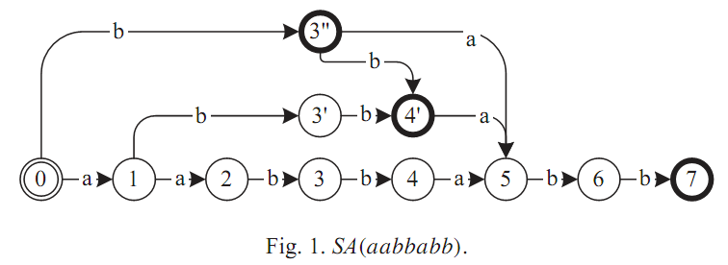
Suffix automaton (SA)
Ex: string aabbabb:
suffix
ε
b
bb
abb
babb
bbabb
abbabb
aabbabb

Slide 8
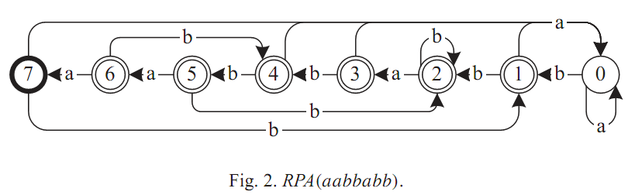
Reverse prefix automaton (RPA)
Ex: string aabbabb:
prefix
reverse prefix
ε
a
aa
aab
aabb
aabba
aabbab
aabbabb
ε
a
aa
baa
bbaa
abbaa
babbaa
bbabbaa

Slide 9
Algorithm
Phase 1. scans the right window y_{km}...y_{(k+1)m−1} from left to right with SA(x) and record the maximal matched suffix.
Phase 2. scans the left window y_{(k−1)m+1}...y_{km−1} from right to left with RPA(x) starting from the state L.

Slide 10
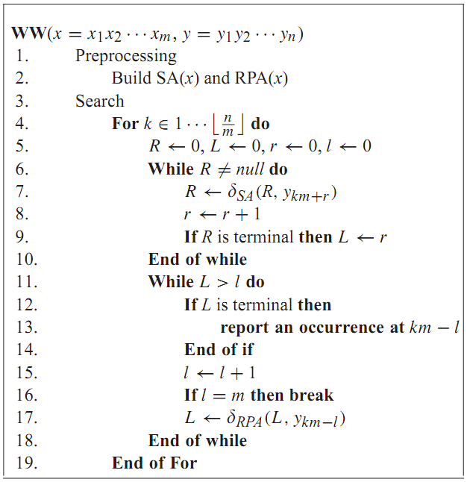
Pseudo-code of WW

Slide 11
Example
Y: ababababababaabbabba X: aabbabb
[ababab a bababa] a bbabba

Slide 12
Example
Y: ababababababaabbabba X: aabbabb
ababab a [bababa a bbabba]

Slide 13
Example
Y: ababababababaabbabba X: aabbabb
ababab a [bababa a bbabba]
Start position: L = 6

Slide 14
Time complexity
Worst case: O(n)
Best case: O(n/m)
Average case: O(n(log _{σ} m)/m)

Slide 15
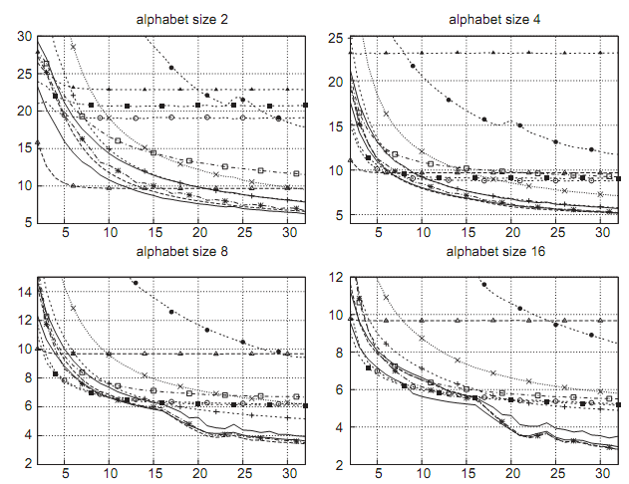
Experimental result

Slide 16
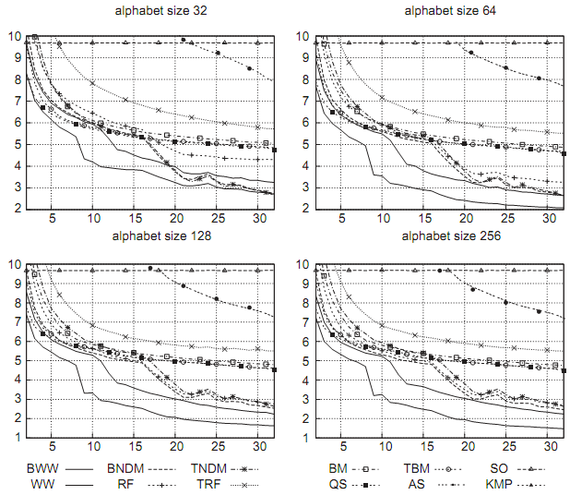
Experimental result

Slide 17
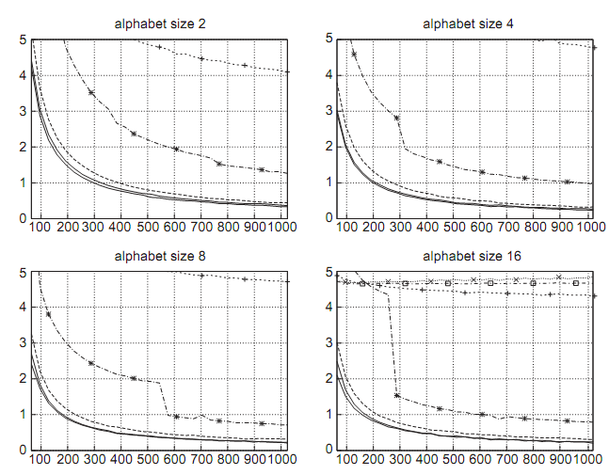
Experimental result

Slide 18
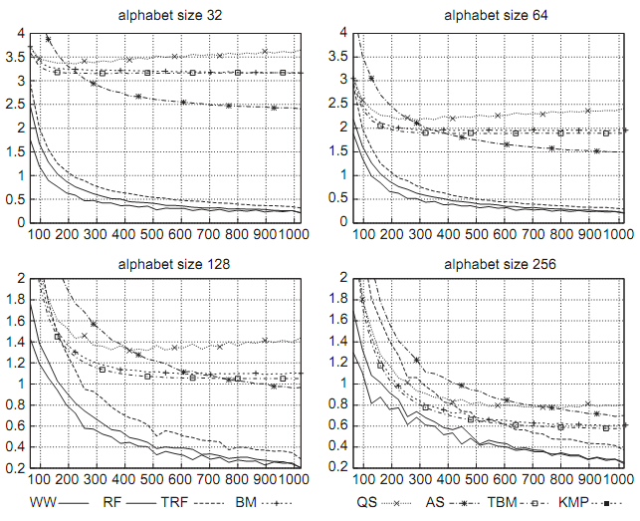
Experimental result

Slide 19
Thank you!!!

