Slide 1
A Fast and Practical Bit-Vector Algorithm for the Longest Common Subsequence Problem
Maxime Crochemore, Costas S. Iliopoulos, Yoan J. Pinzon3, and James F. Reid
Information Processing Letters
Reporter : Cing-Yao Chen Date:2014/1/27

Slide 2
ABSTRACT
This paper presents a new practical bit-vector algorithm for solving the well known Longest Common Subsequence (LCS) problem. Given two strings of length m and n, n ≥ m, we present an algorithm which determines the length p of an LCS in O(nm/w) time and O(m/w) space, where w is the number of bits in a machine word. This algorithm can be thought of as column-wise "parallelization" of the classical dynamic programming approach. Our algorithm is very efficiently in practice, where computing the length of an LCS of two strings can be done in linear time and constant (additional/working) space by assuming that m ≤ w.

Slide 3
BACKGROUND
LCS
J.W.Hunt, T.G.Szymanski. A fast algorithm for computing longest common subsequences. CACM Vol.20 No.5 pp.350-353 1977.
Hunt and Szymanski
Lloyd Allison, Trevor I. Dix
A bit-string longest-common-subsequence algorithm
Information Processing Letters, Volume 23, Issue 5, 24 November 1986, Pages 305–310
Allison and Dix
CIPR
Maxime Crochemore, Costas S. Iliopoulos, Yoan J. Pinzon, James F. Reid
A fast and practical bit-vector algorithm for the Longest Common Subsequence problem
Information Processing Letters, Volume 80, Issue 6, 31 December 2001, Pages 279–285

Slide 4
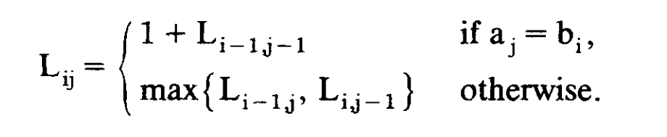
LCS
The rows and columns of L_{ij} contain ascending values for increasing i and j. This prompted Hunt and Szymanski and Hirschberg to 'contour' L and develop fast algorithms for special cases.

Slide 5
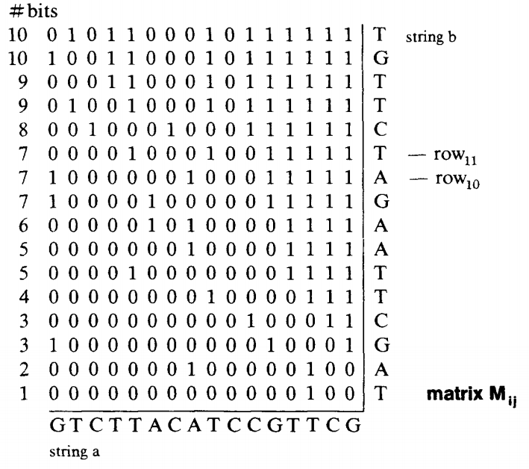
BIT-STRING ALGORITHM
Fig 1

Slide 6
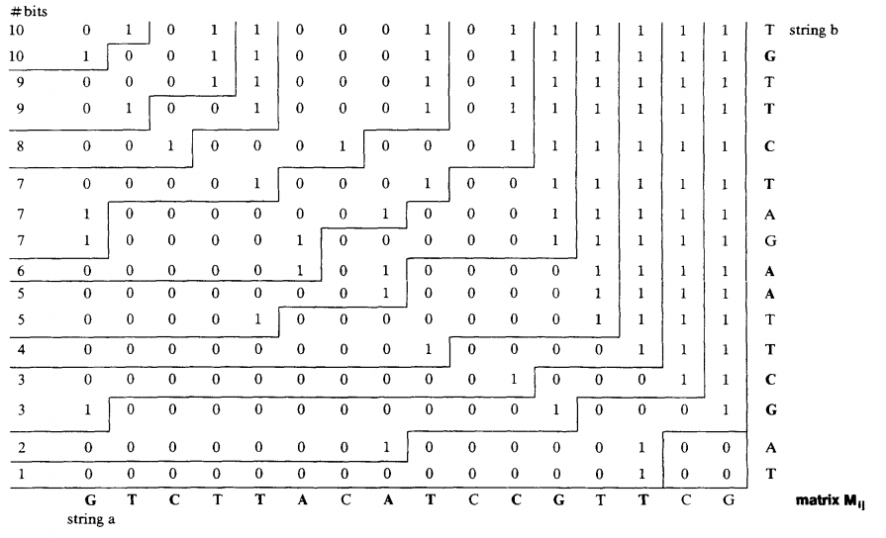
BIT-STRING ALGORITHM
Fig 1
Fig 2

Slide 7
BIT-STRING ALGORITHM

Slide 8
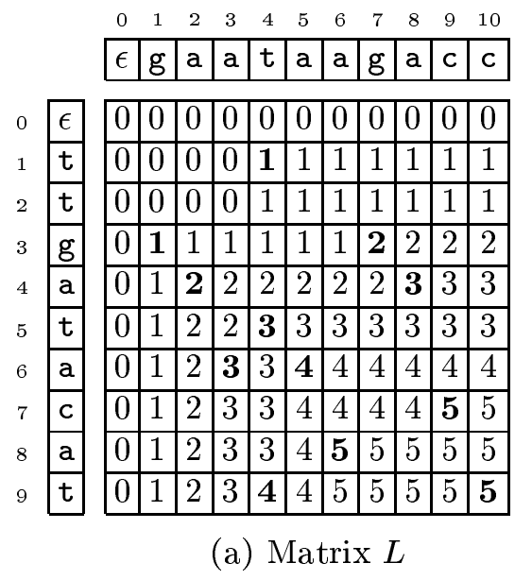
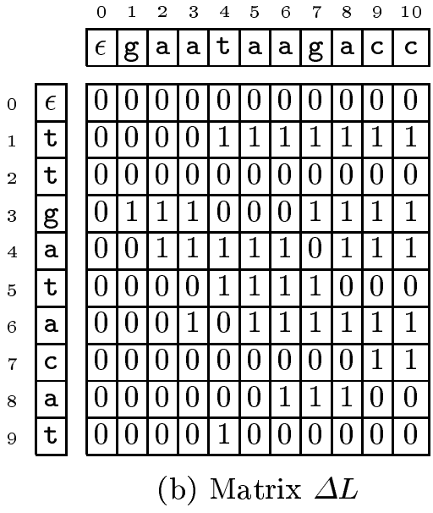
CIPR : ΔL and ΔL’

Slide 9
CIPR : ΔL and ΔL’

Slide 10
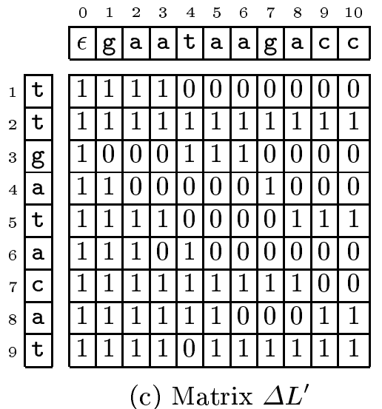
CIPR : ΔL and ΔL’

Slide 11
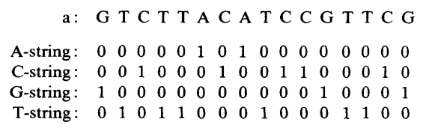
ALPHBET-STRINGS
O(|alphabet| x ceil(|a|/w) + |a|)
Fixed : O(|a|)
Nonfixed: O(|a| X |b|)

Slide 12
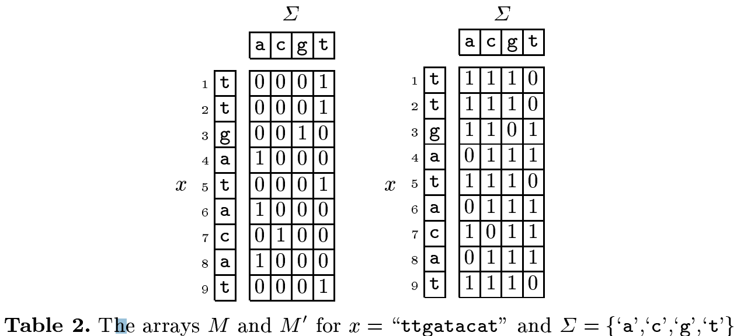
CIPR : M and M’

Slide 13
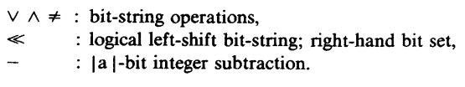
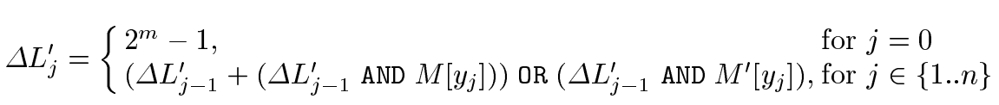
IN SUMMARY

Slide 14
IN SUMMARY

Slide 15
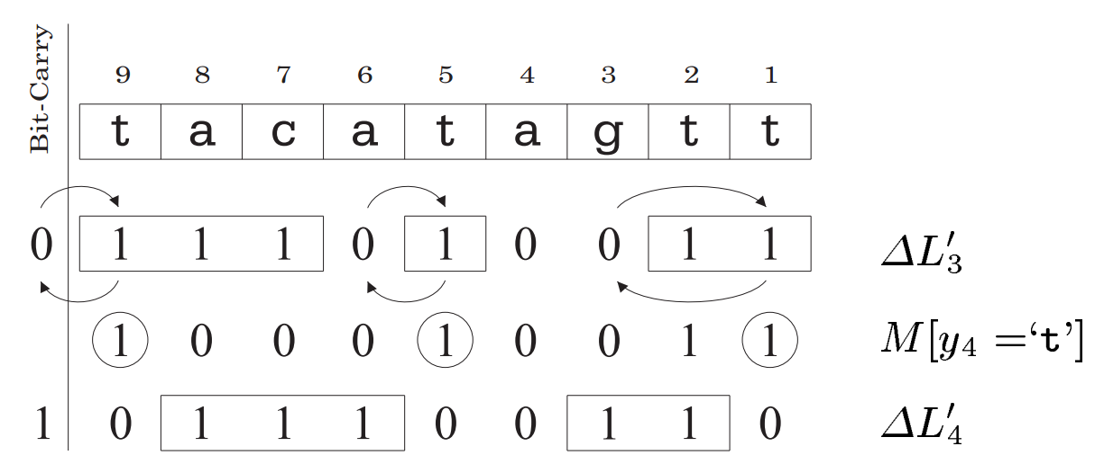
IN SUMMARY

Slide 16
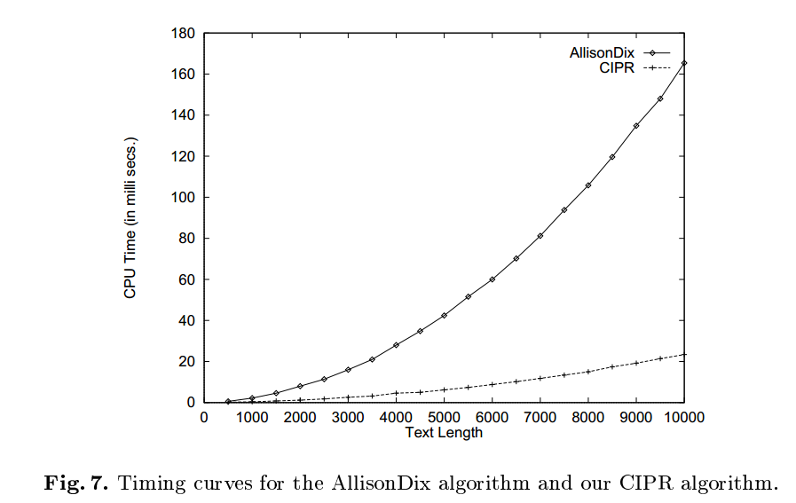
CONCULSION

