Slide 1
Longest Increasing and Decreasing Subsequences
Canadian Journal of Mathematics 13(1961), 179-191
C. Schensted
Date:2013/1/27
許竣傑

Slide 2
Abstract
This paper deals with finite sequences of integers. Typical of the problems we shall treat is the determination of the number of sequences of length n, consisting of the integers 1, 2, . . . , m, which have a longest increasing subsequence of length a. Throughout the first part of the paper we will deal only with sequences in which no numbers are repeated. In the second part we will extend the results to include the possibility of repetition. Our results will be stated in terms of standard Young tableaux.

Slide 3
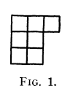
Standard Young Tableaux
2 4 7
3 8
5 9
shape

Slide 4

Standard Young Tableaux
Sequence: 3 5 4 9 8 2 7
$S←6 6→S$
3
5
4
9
8
2
7
3
3 | 5
3 | 4
5
3 | 4 | 9
5
3 | 4 | 8
5 | 9
2 | 4 | 8
3 | 9
5
2 | 4 | 7
3 | 8
5 | 9
2 | 4 | 6
3 | 7
5 | 8
9
2 | 4 | 7
3 | 8
5 | 9
6

Slide 5
Longest Increasing Subsequence
Sequence: 3 5 4 9 8 2 7
LIS = number of columns
LIS: 359, 358, 357, 349, 348, 347
(從basic subsequence各挑一個數字至少會有一個LIS)
9
8
7
3
2
5
4
2 | 4 | 7
3 | 8
5 | 9

Slide 6
Longest Decreasing Subsequence
Sequence: 3 5 4 9 8 2 7
Sequence: 7 2 8 9 4 5 3
LDS = number of rows
2 | 4 | 7
3 | 8
5 | 9
2 | 3 | 5
4 | 8 | 9
7

Slide 7
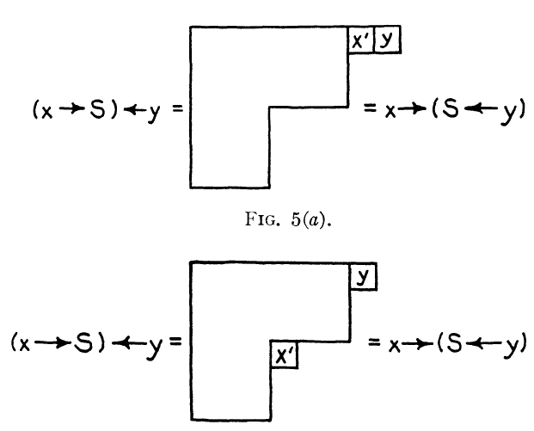





$$\left(x→S\right)←y=x→(S←y)$$
(1)if y is largest number
$x→S$
$$x^{′}$$
$$x^{′}$$
$$x^{′}$$

Slide 8


$$\left(x→S\right)←y=x→(S←y)$$
(2) All integers in x, y and S, the longest number is N, and N is in S.
Order = 0, 1, 2
Assume Order = n is true, prove n+1
S is order n+1
S’ is order n
N is largest number
$$N$$
$$N$$

Slide 9









$$\left(x→S^{′}\right)←y=x→(S^{′}←y)$$
<1> 若x’和y'發生在不同位置
$$S^{′}$$
$${x→S}^{′}$$
$$S^{′}←y$$
$$x^{′}$$
$$x^{′}$$
$$y^{′}$$
$$y^{′}$$
$$\left(x→S^{′}\right)←y=x→(S^{′}←y)$$

Slide 10
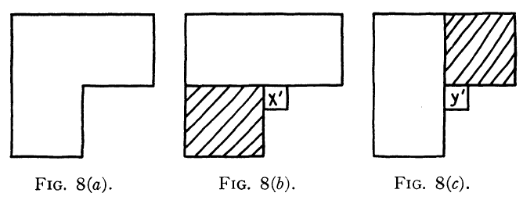
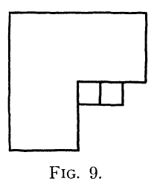
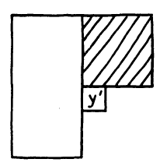
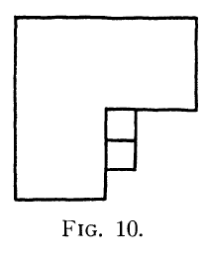






$$\left(x→S^{′}\right)←y=x→(S^{′}←y)$$
<2> 若x’和y‘發生在相同位置
If y’ > x’
If x’ > y’
$$x^{′}$$
$$y^{′}$$
$$\left(x→S^{′}\right)←y=x→(S^{′}←y)$$
(1) y’ 一定取代陰影的部分下來
(2) x’一定比藍色部分還要高，
而y’ > x’，因此y’至少從紅
色部分下來
$$y^{′}$$
$$x^{′}$$
$$\left(x→S^{′}\right)←y=x→(S^{′}←y)$$

Slide 11



$$\left(x→S\right)←y=x→(S←y)$$
(1) x’, y’ 在不同位置
$$x^{′}$$
$$N$$
$$y^{′}$$

Slide 12
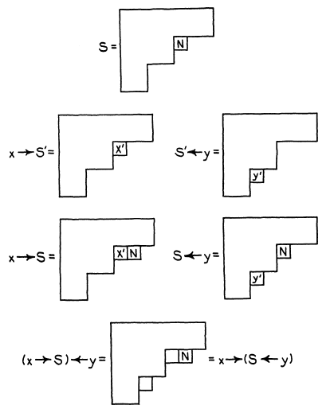
$$\left(x→S\right)←y=x→(S←y)$$
(2)y’在x‘左邊，且x’落在N的位置

Slide 13
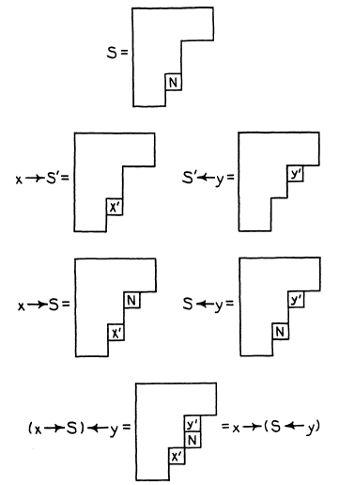




$$\left(x→S\right)←y=x→(S←y)$$
(2)y’在x‘右邊，且x’落在N的位置
#: x’, y’不會發生在同個位置
$$N$$
$$y^{′}$$
$$N$$
$$S^{′}←y$$

Slide 14
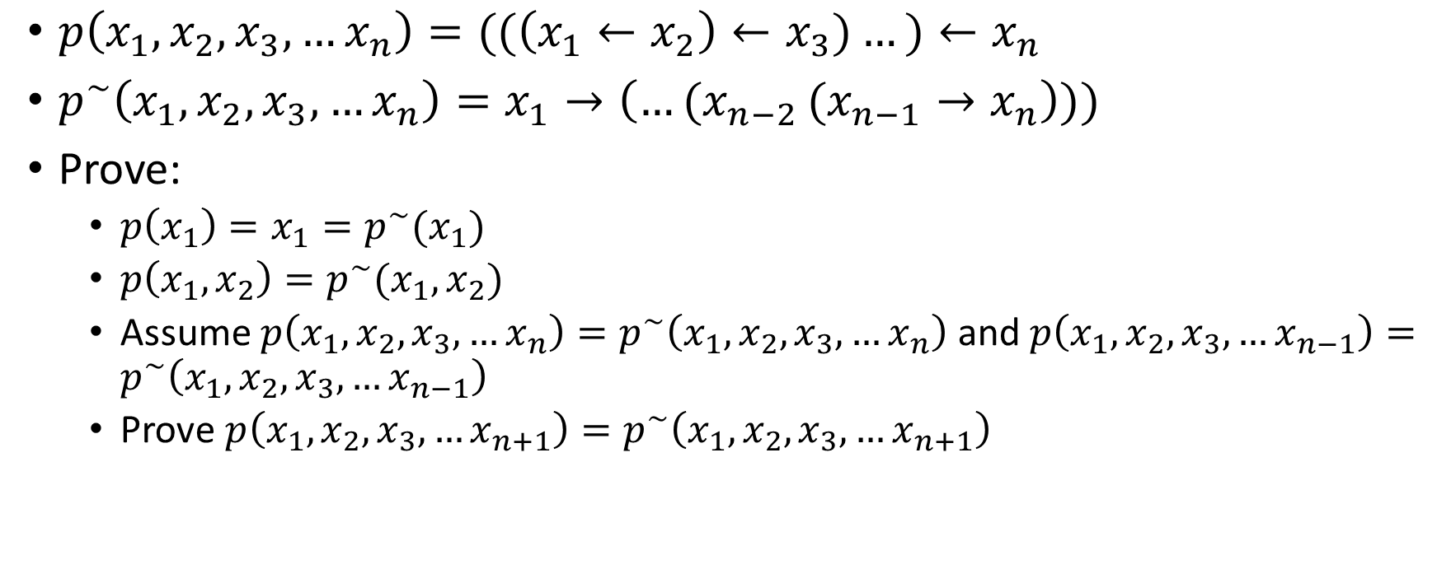
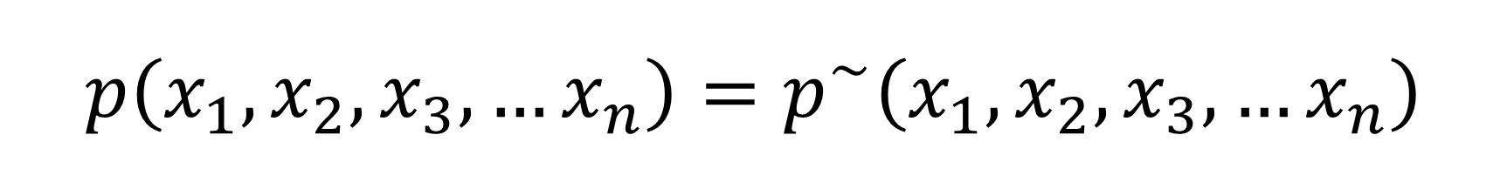
$$p\left(x_{1},x_{2},x_{3},…x_{n}\right)=p^{\sim }\left(x_{1},x_{2},x_{3},…x_{n}\right)$$
$p\left(x_{1},x_{2},x_{3},…x_{n}\right)=((\left(x_{1}←x_{2}\right)←x_{3})…)←x_{n}$
$p^{\sim }\left(x_{1},x_{2},x_{3},…x_{n}\right)=x_{1}→\left({…(x}_{n−2}(x_{n−1}→x_{n}\right)))$
Prove:
$p\left(x_{1}\right)=x_{1}=p^{\sim }(x_{1})$
$p\left(x_{1},x_{2}\right)=p^{\sim }(x_{1},x_{2})$
Assume $p\left(x_{1},x_{2},x_{3},…x_{n}\right)=p^{\sim }\left(x_{1},x_{2},x_{3},…x_{n}\right)$ and $p\left(x_{1},x_{2},x_{3},…x_{n−1}\right)=p^{\sim }\left(x_{1},x_{2},x_{3},…x_{n−1}\right)$
Prove $p\left(x_{1},x_{2},x_{3},…x_{n+1}\right)=p^{\sim }\left(x_{1},x_{2},x_{3},…x_{n+1}\right)$

Slide 15
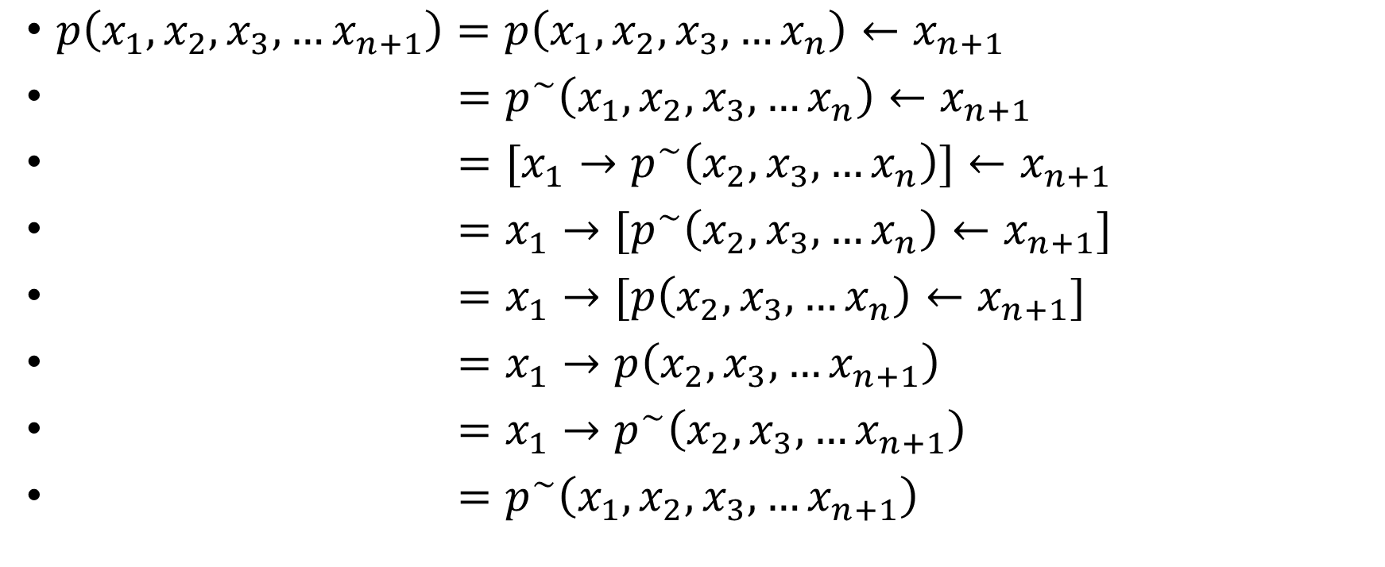
$$p\left(x_{1},x_{2},x_{3},…x_{n}\right)=p^{\sim }\left(x_{1},x_{2},x_{3},…x_{n}\right)$$
$p\left(x_{1},x_{2},x_{3},…x_{n+1}\right)=p\left(x_{1},x_{2},x_{3},…x_{n}\right)←x_{n+1}$
$=p^{\sim }\left(x_{1},x_{2},x_{3},…x_{n}\right)←x_{n+1}$
$=[x_{1}→p^{\sim }\left(x_{2},x_{3},…x_{n}\right)]←x_{n+1}$
$=x_{1}→{[p}^{\sim }\left(x_{2},x_{3},…x_{n}\right)←x_{n+1}]$
$=x_{1}→[p\left(x_{2},x_{3},…x_{n}\right)←x_{n+1}]$
$=x_{1}→p\left(x_{2},x_{3},…x_{n+1}\right)$
$=x_{1}→p^{\sim }\left(x_{2},x_{3},…x_{n+1}\right)$
$=p^{\sim }\left(x_{1},x_{2},x_{3},…x_{n+1}\right)$

Slide 16
Longest Decreasing Subsequence
正的sequence
倒著的sequence

Slide 17
Numbers are repeated
Sequence: 3 3 2 3 4 1
1 by 1
2 by 2
3 3 3 by 3 4 5
4 by 6
Number of columns = longest non decreasing subsequence (3334)
Number of rows = longest decreasing subsequence (321)
1 | 4 | 5 | 6
2
3

