Slide 1
On computing the length of longest increasing subsequences Discrete Mathematics vol. 11 pp. 29–35 (1975)
Michael L. Fredman
Department of Mathematics, Massachusetts Institute of Technology, Cambridge
Presentor：Hsin-Chuan Yuan

Slide 2
Abstract
Let S = x1, x2, … xn be a sequence of n distinct elements from a linearly ordered set. We consider the problem of determining the length of the longest increasing subsequences of S. An algorithm which performs this task is described and is shown to perform nlogn − nloglogn + O(n) comparisons in its worst case. This worst case behavior is shown to be best possible.

Slide 3
The Longest Increasing Subsequence (LIS) Problem
Definition:
Input: One numeric sequence S
Output: The longest increasing subsequence in S
Example: Given S = 35274816, the LIS in S is 3578.
By applying the LCS algorithm, this problem can be solved in O(n²) time.
Robinson-Schensted-Knuth Algorithm can solve the LIS problem in O(nlogn) time.

Slide 4
Robinson-Schensted-Knuth Algorithm for LIS
Input
3
5
2
7
4
8
1
6
1
3
3
2
2
2
2
1
1
L
2
5
5
5
4
4
4
4
3
7
7
7
7
6
4
8
8
8
LIS: 3578
time complexity: O(nlogn)
n numbers are inserted and each insertion takes O(logn) time for binary search.

Slide 5
The Longest Increasing Subsequence (LIS) Problem
Robinson-Schensted-Knuth Algorithm can solve the LIS problem in O(nlogn) time.
Number of comparison: (n-L)log L + O(n)
The worst value for L is roughly n / log n
Upper bound: nlogn – nloglogn + O(n)

Slide 6
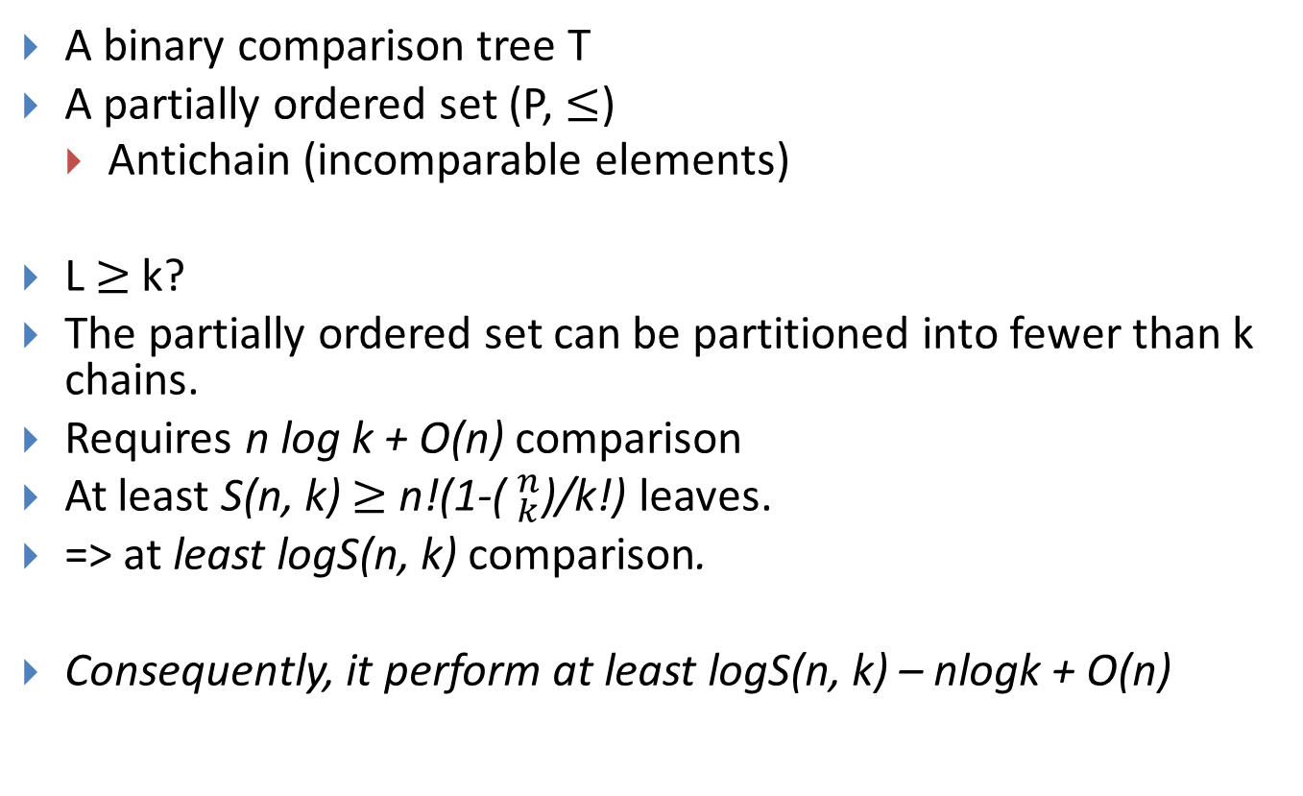
A lower bound
A binary comparison tree T
A partially ordered set (P, $≤$)
Antichain (incomparable elements)
L$≥$k?
The partially ordered set can be partitioned into fewer than k chains.
Requires n log k + O(n) comparison
At least S(n, k) $≥$ n!(1-($_{k}^{n}$)/k!) leaves.
=> at least logS(n, k) comparison.
Consequently, it perform at least logS(n, k) – nlogk + O(n)

Slide 7

A lower bound
Lemma 3.1. A finite partially ordered set (P, $≤$) can be partitioned into m chains, where m us the size of its largest antichain.
Lemma 3.2. Let P be a finite partially ordered set

Slide 8
http://course.cug.edu.cn/21cn/%E7%A6%BB%E6%95%A3%E6%95%B0%E5%AD%A6%EF%BC%88%E5%8C%97%E5%A4%A7%EF%BC%89/part2/chapter07/07_07_01_01.htm
定義7.19 設R為非空集合A上的關係。如果R是自反的、反對稱的和傳遞的，則稱R為A上的偏序關係，記作。設為偏序關係，如果<x，y>∈，則記作xy，讀作“小於或等於”。
注意這裡的“小於或等於”不是指數的大小，而是在偏序關係中的順序性。x“小於或等於”y的含義是：依照這個序，x排在y的前邊或者x就是y。根據不同偏序的定義，對序有著不同的解釋。例如整除關係是偏序關係，36的含義是3整除6。大於或等於關係也是偏序關係，針對這個關係寫54是說大於或等於關係中5排在5的前邊，也就是5比4大。
例如集合A上的恒等關係IA和空關係都是A上的偏序關係。小於或等於關係，整除關係和包含關係也是相應集合上的偏序關係。一般來說，全域關係EA不是A上的偏序關係。
定義7.20 設R為非空集合A上的偏序關係，定義
(1)x，y∈A，xyxy∧x≠y。
(2)x，y∈A，x與y可比xy∨yx。
其中xy讀作x“小於”y。這裡所說的“小於”是指在偏序中x排在y的前邊。
有以上兩個定義可知，在具有偏序關係的集合A中任取兩個元素x和y，可能有下述幾種情況發生：
xy(或yx)，x＝y，x與y不是可比的。
例如A＝{1，2，3}，是A上的整除關係，則有
12，13，
1=1，2=2，3=3，
2和3不可比。

Slide 9
Conclusions

