Slide 1
The significance of protein sequence similarities
Author：J.F.Collins, A.F.W.Coulson and A.Lyall Source：Computer applications in the biosciences : CABIOS Vol.4, no.1. 1988
PP. 67-71
Presenter：Guan-Cheng Guo Date：2014/2/10

Slide 2
Abstract
A general method of assessing the significance of scored best local alignments, particularly suited to protein sequence comparisons, is described. The method establishes the parameters describing the distribution of the best results from any search program, provided that the set is sufficiently large and the majority of the alignments arise from unrelated sequences. The expected frequency of occurrence of any score can then be calculated, together with the number of standard deviations above expectation.

Slide 3
Abstract
These provide sensible measures of significance without additional search operations. However the biological significance of any alignment or set of alignments does not solely depend on the improbability of the alignment, but on all relevant factors known to the biologist.

Slide 4
Introduction
Trying to answer the question: What is the probability that a similarity as strong as that observed in some specific case will occur between unrelated proteins?
Since in any large and non-specialized database, there is a wide variety of protein types, a single family of proteins can only provide a limited number of alignments.

Slide 5
Introduction
If the number of results considerably exceeds the number of alignments possible from a set of related proteins, we can use the distribution of the bulk of the results to assess the significance of the high-scoring alignments, since the majority of the lower scoring alignments must be with proteins we would regard as unrelated.

Slide 6
Introduction
We want to predict the behaviour of the extreme high-scoring end of the distribution, using the observed upper end results, without including results which may have arisen from related proteins.

Slide 7
Algorithm
Suppose we have an alignment, represented by a path through the match matrix, which has reached a score S.
The alignment could be improved if, from any point reached with penalties X, it is possible, by permissible moves to find a continuation which can raise the score by more than X. The greater the loss of score, X, the less likely a net improvement becomes.

Slide 8
Algorithm
The probability of improving an alignment is therefore determined largely by the chance of an improvement starting relatively close to the current end. This chance does not depend on the current value of S. If the probability of improvement is independent of S then the population of alignments scoring more than S will be a constant fraction of the number scoring S.
That is, we have described a process which predicts exponentially declining populations of alignments as the score increases.

Slide 9
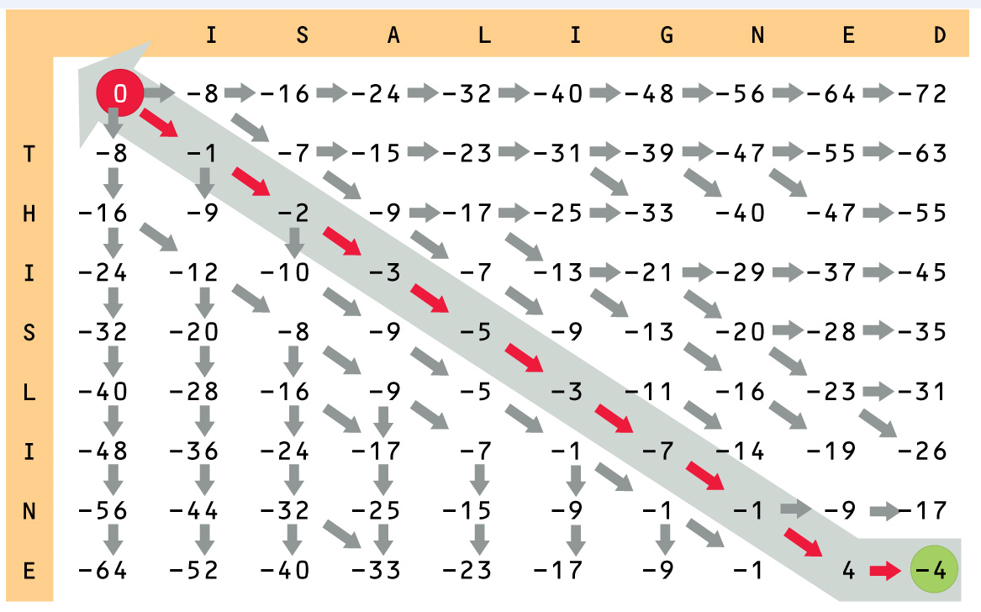
Algorithm
ＴＨＩＳＬＩＮＥ－
ＩＳＡＬＩＧＮＥＤ

Slide 10
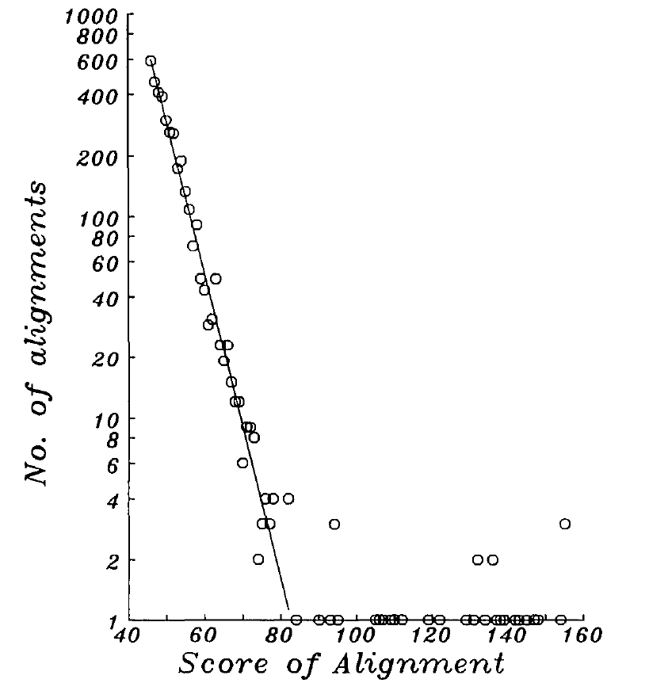
Algorithm
To assess the significance of the high-scoring alignments, we fit the best straight line to the logs of the numbers of observed alignments, against the score.
Only classes containing the lower 97% of the alignments, arising from unrelated proteins, are used.

Slide 11
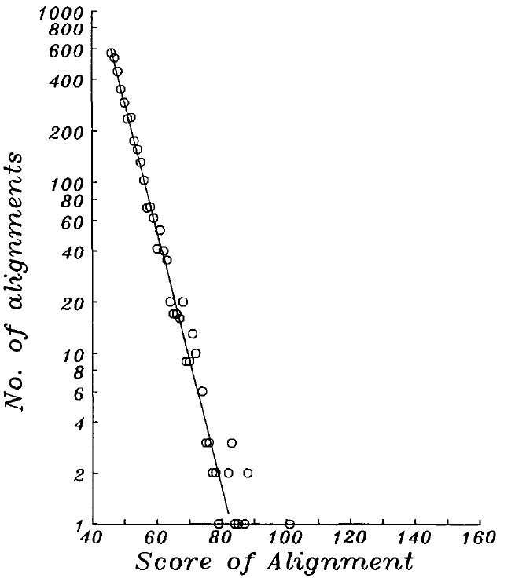
Algorithm
The parameters obtained allow us to predict the expected frequency with which any specific score class should be observed.
A search of the database with a query sequence derived by randomly shuffling a real protein sequence should generate a distribution of results which conforms throughout to the linear model.

Slide 12
Conclusion
The expected frequency is the expectation that an alignment with a specified score occurs by chance in comparisons with a reference set of sequences as large as the database used, containing only unrelated sequences. It has the disadvantage that the expected frequency depends on the size of the database used.

Slide 13
Conclusion
The larger this is, the more comparisons are made with unrelated proteins and the higher will be the scores of alignments reached by a chance similarity.
This problem could be overcome by 'normalizing' the results to a standard-sized database

