Slide 1
On the Complexity of the Extended String-to-String Correction Problem
Robert A. Wagner
Proceedings of seventh annual ACM symposium on Theory of computing, Pages 218-223, 1975
Presenter: Che-Jui Hsu (許哲睿)
Date: 2014/2/8
Notes:
http://dl.acm.org/citation.cfm?id=803771

Slide 2
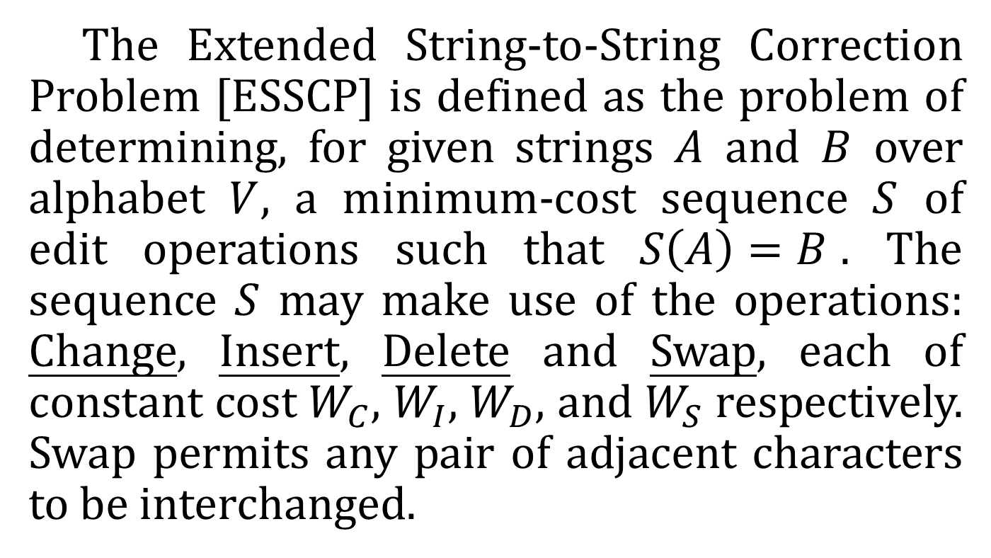
Abstract (1/3)
The Extended String-to-String Correction Problem [ESSCP] is defined as the problem of determining, for given strings $A$ and $B$ over alphabet $V$, a minimum-cost sequence $S$ of edit operations such that $S\left(A\right)=B$. The sequence $S$ may make use of the operations: Change, Insert, Delete and Swap, each of constant cost $W_{C}$, $W_{I}$, $W_{D}$, and $W_{S}$ respectively. Swap permits any pair of adjacent characters to be interchanged.

Slide 3
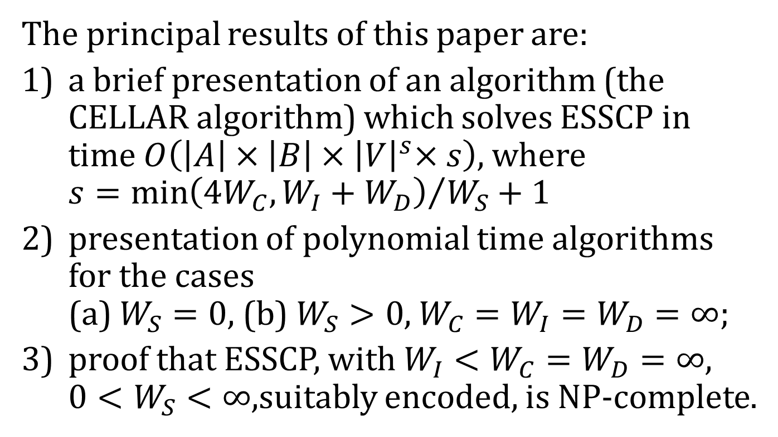
Abstract (2/3)
The principal results of this paper are:
a brief presentation of an algorithm (the CELLAR algorithm) which solves ESSCP in time $O\left(\left|A\right|×\left|B\right|{×\left|V\right|}^{s}×s\right)$, where $s={\min\left(4W_{C}, W_{I}+W_{D}\right)}/{W_{S}}+1$
presentation of polynomial time algorithms for the cases (a) $W_{S}=0$, (b) $W_{S}>0$, $W_{C}=W_{I}=W_{D}=∞$;
proof that ESSCP, with $W_{I}<W_{C}=W_{D}=∞$, $0<W_{S}<∞$,suitably encoded, is NP-complete.

Slide 4
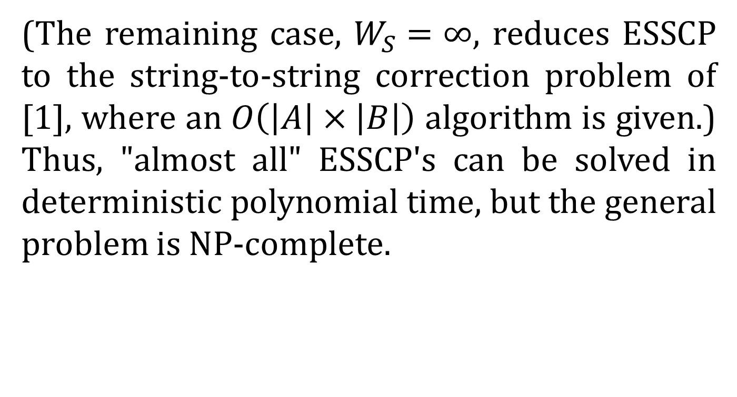
Abstract (3/3)
(The remaining case, $W_{S}=∞$, reduces ESSCP to the string-to-string correction problem of [1], where an $O\left(\left|A\right|×\left|B\right|\right)$ algorithm is given.) Thus, "almost all" ESSCP's can be solved in deterministic polynomial time, but the general problem is NP-complete.

Slide 5
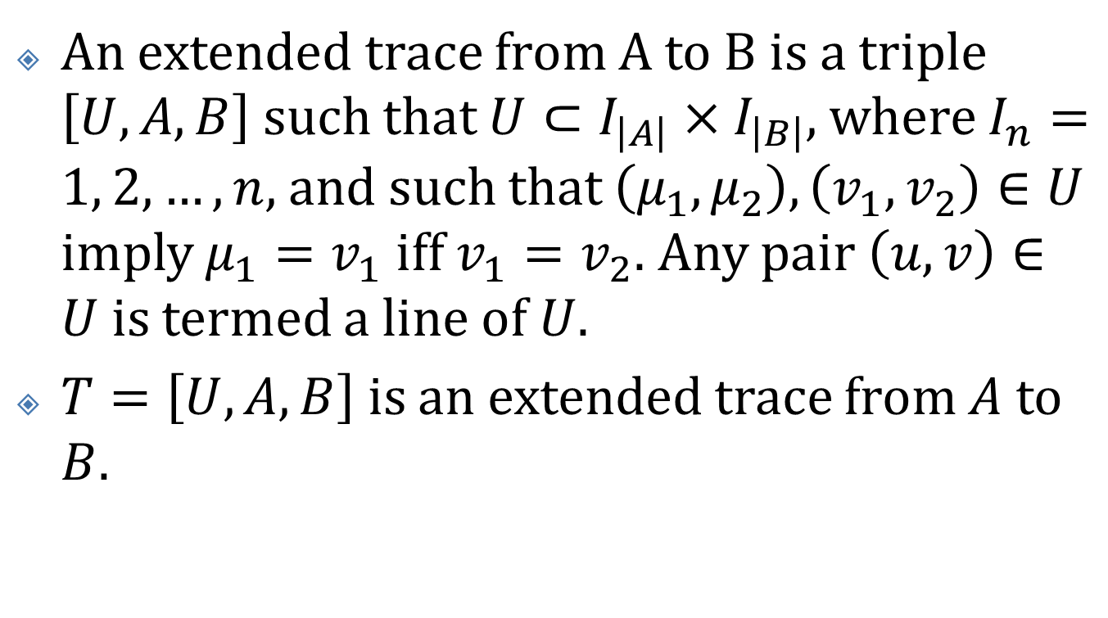
Define
An extended trace from A to B is a triple $\left[U, A, B\right]$ such that $U⊂I_{\left|A\right|}×I_{\left|B\right|}$, where $I_{n}=1, 2, …, n$, and such that $\left(μ_{1},μ_{2}\right), \left(v_{1},v_{2}\right)∈U$ imply $μ_{1}=v_{1}$ iff $v_{1}=v_{2}$. Any pair $\left(u,v\right)∈U$ is termed a line of $U$.
$T=\left[U, A, B\right]$ is an extended trace from $A$ to $B$.

Slide 6

CELLAR
Case: $0<W_{S}<∞$ and ($W_{C}<∞$ or $W_{I}+W_{D}<∞$)
Complexity: $O\left(\left|A\right|×\left|B\right|{×\left|V\right|}^{s}×s\right)$, $s={\min\left(4W_{C}, W_{I}+W_{D}\right)}/{W_{S}}+1$

Slide 7

PERMUTE
Case: $0<W_{S}<∞$ and $W_{I}=W_{D}=W_{C}=∞$
Complexity: $O\left(\left|A\right|+\left|B\right|\right)$
$T$ is an optimal trace from $A$ to $B$ with $W\left(T\right)<∞$

Slide 8
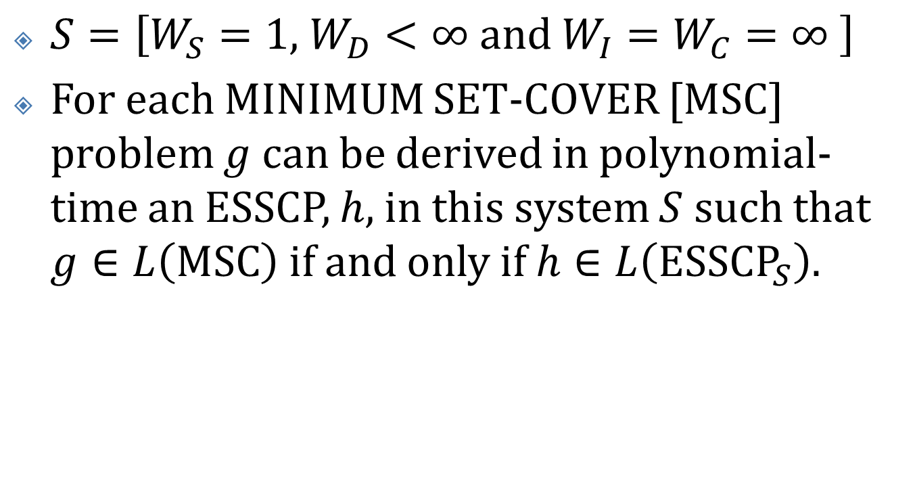
An NP-Complete ESSCP (1/7)
$S=\left[W_{S}=1\text{, }W_{D}<∞ \text{and} W_{I}=W_{C}=∞ \right]$
For each MINIMUM SET-COVER [MSC] problem $g$ can be derived in polynomial-time an ESSCP, $h$, in this system $S$ such that $g∈L\left(\text{MSC}\right)$ if and only if $h∈L\left({\text{ESSCP}}_{S}\right)$.

Slide 9
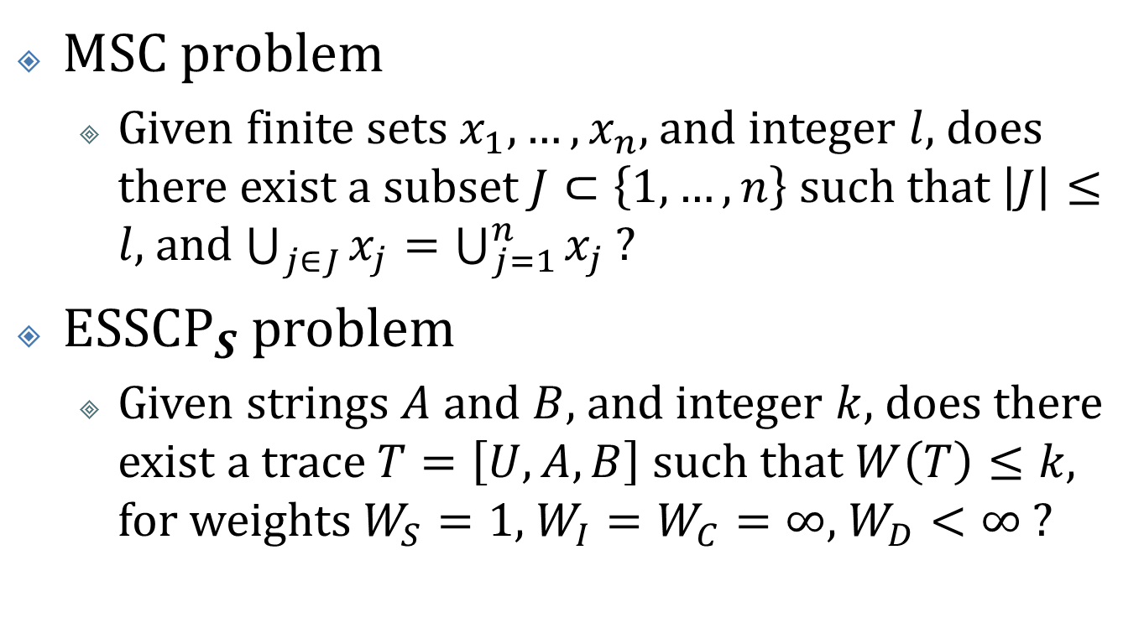
An NP-Complete ESSCP (2/7)
MSC problem
Given finite sets $x_{1}, …, x_{n}$, and integer $l$, does there exist a subset $J⊂\left\{1, …, n\right\}$ such that $\left|J\right|≤l$, and $\bigcup_{j∈J}{x_{j}}=\bigcup_{j=1}^{n}{x_{j}}$ ?
${\text{ESSCP}}_{S}$ problem
Given strings $A$ and $B$, and integer $k$, does there exist a trace $T=\left[U, A, B\right]$ such that $W\left(T\right)≤k$, for weights $W_{S}=1$, $W_{I}=W_{C}=∞$, $W_{D}<∞$ ?

Slide 10
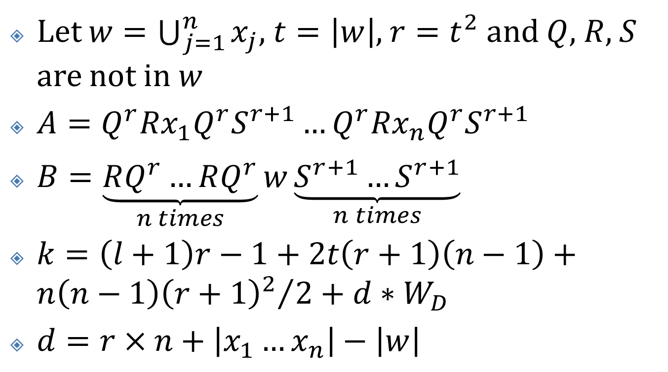
An NP-Complete ESSCP (3/7)
Let $w=\bigcup_{j=1}^{n}{x_{j}}$, $t=\left|w\right|$, $r=t^{2}$ and $Q$, $R$, $S$ are not in $w$
$A=Q^{r}Rx_{1}Q^{r}S^{r+1}…Q^{r}Rx_{n}Q^{r}S^{r+1}$
$B=\underset{n times}{\underbrace{RQ^{r}…RQ^{r}}}w\underset{n times}{\underbrace{S^{r+1}…S^{r+1}}}$
$k=\left(l+1\right)r−1+2t\left(r+1\right)\left(n−1\right)+{n\left(n−1\right){\left(r+1\right)}^{2}}/2+d∗W_{D}$
$d=r×n+\left|x_{1}…x_{n}\right|−\left|w\right|$

Slide 11

An NP-Complete ESSCP (4/7)
closed r-gate: 0 crosses lines
open r-gate: $r$ crosses lines
$w$: crosses $\left(r+1\right)$ lines

Slide 12

An NP-Complete ESSCP (5/7)
$S$ total: $\left({n\left(n−1\right)}/2\right)×\underset{S}{\underbrace{\left(r+1\right)}}×\left(\underset{Q}{\underbrace{r}}+\underset{R}{\underbrace{1}}\right)$
$w$ total: $2t\left(r+1\right)\left(n−1\right)$
Cross $\left(n−1\right)$ other gates
Each gates: $r$ $Q$-lines, 1 $R$-line, $\left(r+1\right)$ $S$-lines

Slide 13
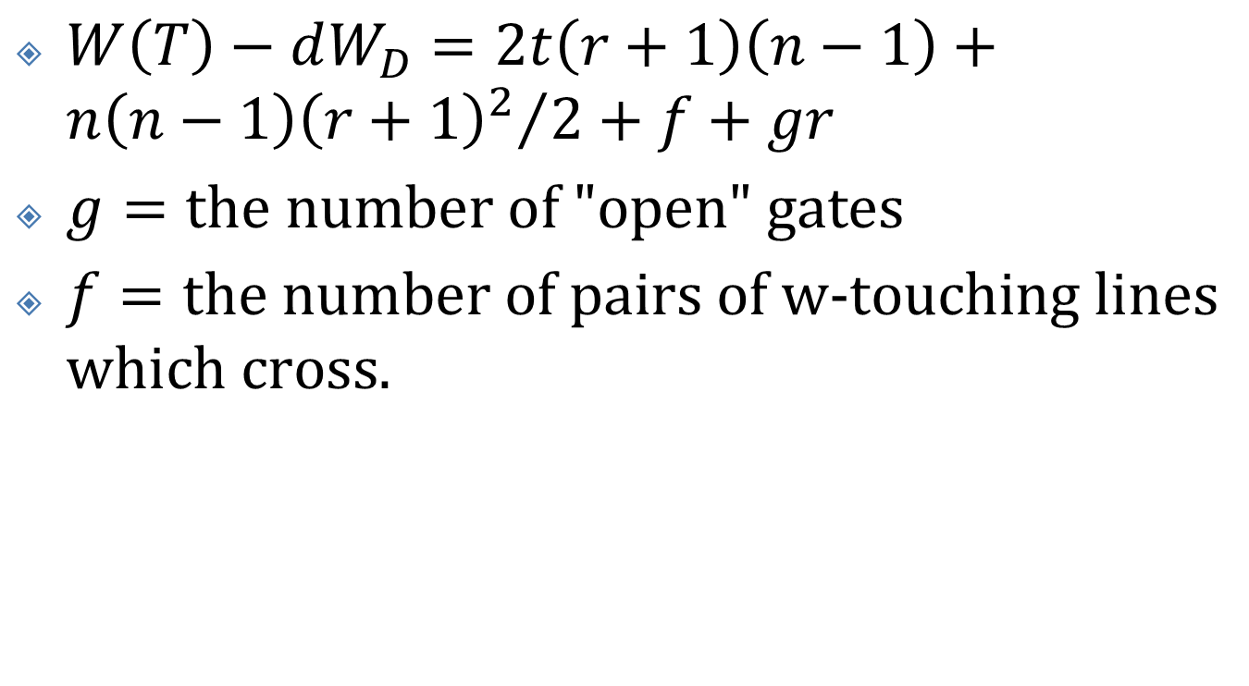
An NP-Complete ESSCP (6/7)
$W\left(T\right)−dW_{D}=2t\left(r+1\right)\left(n−1\right)+{n\left(n−1\right){\left(r+1\right)}^{2}}/2+f+gr$
$g=\text{the} \text{number} \text{of}\text{ "}\text{open}\text{" }\text{gates}$
$f=\text{the} \text{number} \text{of} \text{pairs} \text{of} \text{w}\text{-}\text{touching} \text{lines} \text{which} \text{cross}\text{.}$

Slide 14
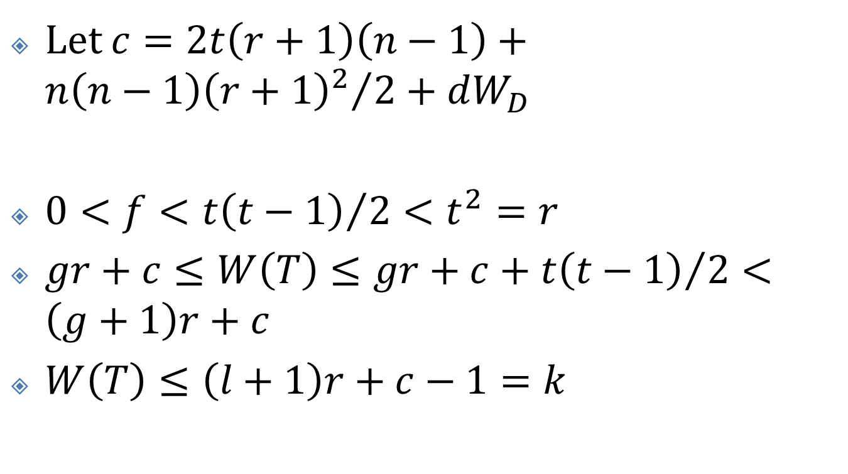
An NP-Complete ESSCP (7/7)
Let $c=2t\left(r+1\right)\left(n−1\right)+{n\left(n−1\right){\left(r+1\right)}^{2}}/2+dW_{D}$
$0<f<{t\left(t−1\right)}/2<t^{2}=r$
$gr+c≤W\left(T\right)≤gr+c+{t\left(t−1\right)}/2<\left(g+1\right)r+c$
$W\left(T\right)≤\left(l+1\right)r+c−1=k$

Slide 15
Generalization (1/2)

Slide 16
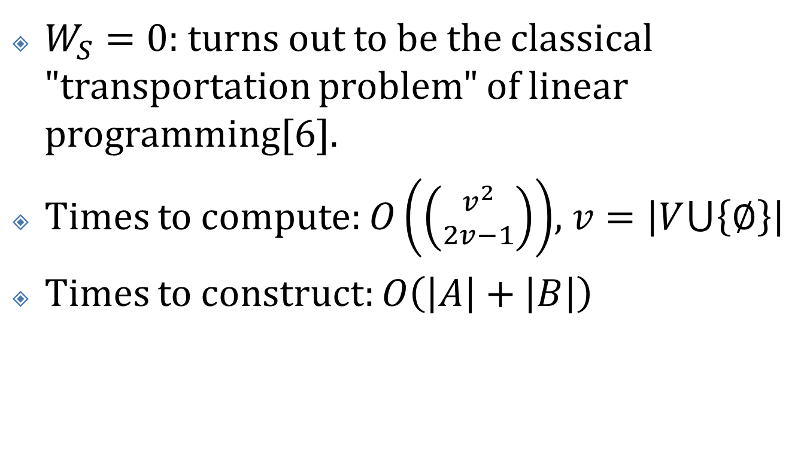
Generalization (2/2)
$W_{S}=0$: turns out to be the classical "transportation problem" of linear programming[6].
Times to compute: $O\left(\left({v^{2} \atop 2v−1}\right)\right)$, $v=\left|V⋃\left\{∅\right\}\right|$
Times to construct: $O\left(\left|A\right|+\left|B\right|\right)$

