Slide 1
A Longest Common Subsequence Algorithm Suitable for Similar Text Strings
Author：Narao Nakatsu, Yahiko Kambayashi and Shuzo Yajima Source：Acta Informatica 18, 1982 PP.171 - 179
Presenter：Guan-Cheng Guo Date：2014/3/4

Slide 2
Abstract
Efficient algorithms for computing the longest common subsequence (LCS for short) are discussed. O(p n) algorithm and O(p(m -p) log n) algorithm [Hirschberg 1977] seem to be best among previously known algorithms, where p is the length of an LCS and m and n are the lengths of given two strings (m < n). There are many applications where the expected length of an LCS is close to m.
In this paper, O(n(m-p)) algorithm is presented. When p is close to m (in other words, two given strings are similar), the algorithm presented here runs much faster than previously known algorithms.

Slide 3
Definition(1/2)
String A = A(1)A(2)…A(m) String B = B(1)B(2)…B(n)
m and n denote the lengths of string a and b.
Assumed m ≤ n.

Slide 4
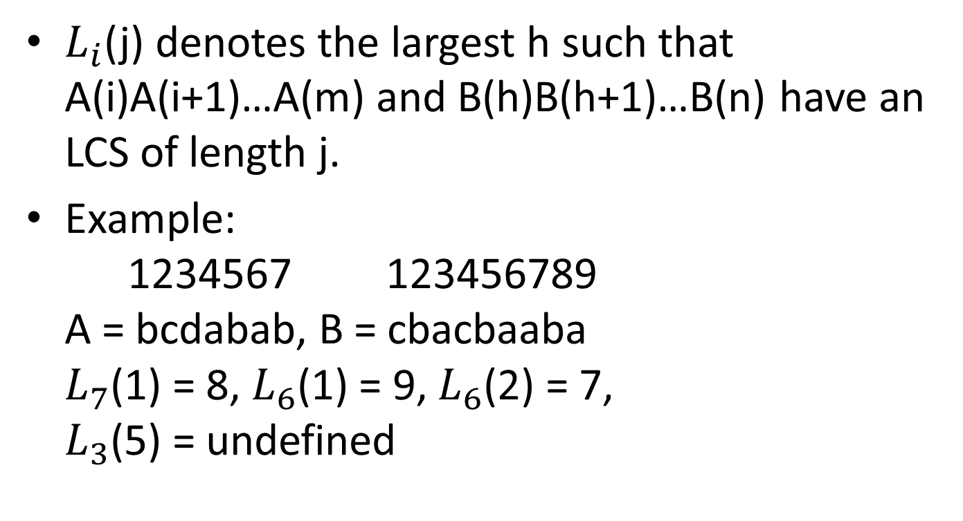
Definition(2/2)
$L_{i}$(j) denotes the largest h such that A(i)A(i+1)…A(m) and B(h)B(h+1)…B(n) have an LCS of length j.
Example: 1234567 123456789 A = bcdabab, B = cbacbaaba $L_{7}$(1) = 8, $L_{6}$(1) = 9, $L_{6}$(2) = 7, $L_{3}$(5) = undefined

Slide 5
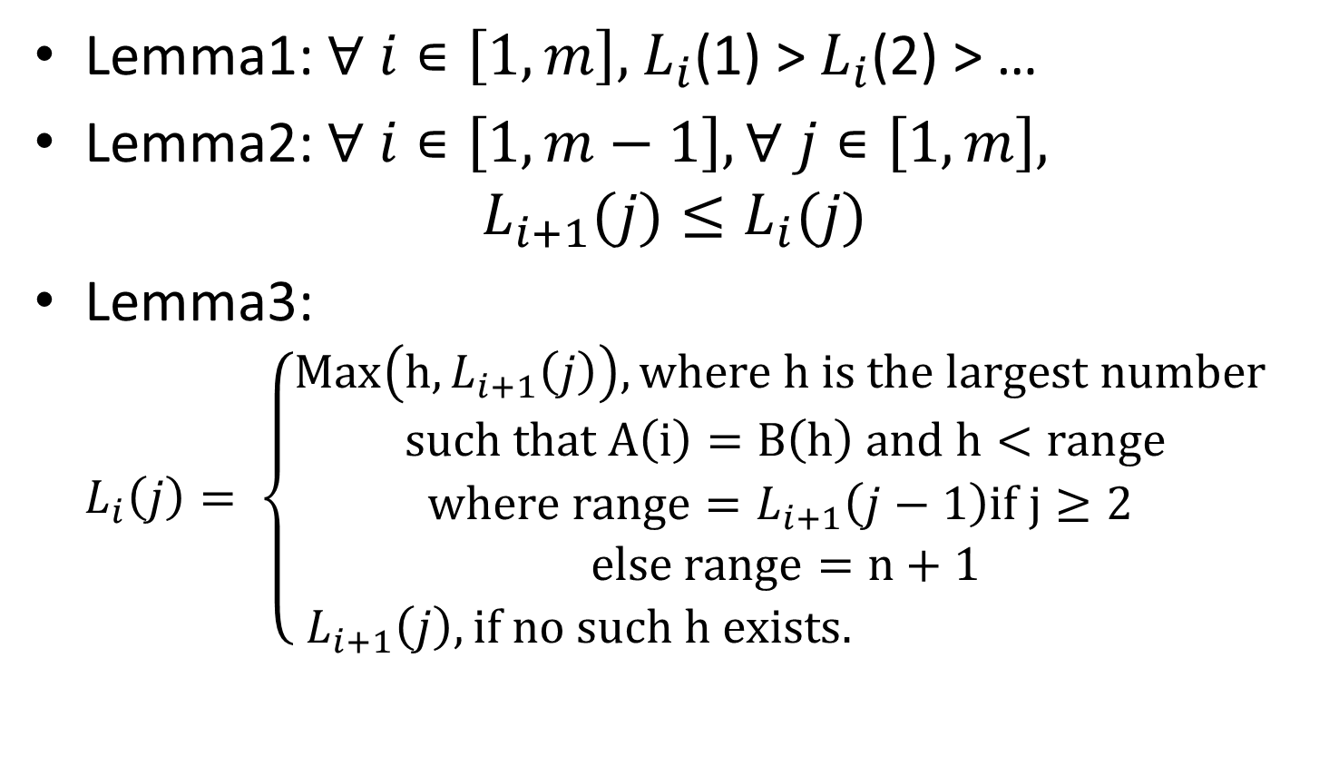
Algorithm
Lemma1: $∀ i∊\left[1,m\right],$ $L_{i}$(1) > $L_{i}$(2) > …
Lemma2: $∀ i∊\left[1,m−1\right],∀ j∊\left[1,m\right],$ $L_{i+1}(j)≤L_{i}(j)$
Lemma3: $L_{i}\left(j\right)= \left\{\begin{aligned}Max\left(h,L_{i+1}\left(j\right)\right), where h is the largest number \\ such that A\left(i\right)=B\left(h\right) and h<range \\ where range=L_{i+1}\left(j−1\right)if j≥2 \\ else range=n+1 \\ L_{i+1}\left(j\right), if no such h exists. \end{aligned} \right.$

Slide 6
Example
1234567 123456789 A = bcdabab, B = cbacbaaba
 | j | 1 | 2 | 3 | 4 | 5 | 6 | 7 | 8 | 9
i |  | c | b | a | c | b | a | a | b | a
1 | b | 0 | 0 | 0 | 0 | 0 | 0 | 0 | 0
2 | c | 0 | 0 | 0 | 0 | 0 | 0 | 0 | 0
3 | d | 0 | 0 | 0 | 0 | 0 | 0 | 0 | 0
4 | a | 0 | 0 | 0 | 0 | 0 | 0 | 0 | 0
5 | b | 0 | 0 | 0 | 0 | 0 | 0 | 0 | 0
6 | a | 0 | 0 | 0 | 0 | 0 | 0 | 0 | 0
7 | b | 0 | 0 | 0 | 0 | 0 | 0 | 0 | 0
8 |  | 0 | 0 | 0 | 0 | 0 | 0 | 0 | 0

Slide 7

Example
1234567 123456789 A = bcdabab, B = cbacbaaba
Begin scan from last position of B compute from $L_{7}(1)$, $L_{6}\left(2\right)…, L_{3}\left(5\right)$ is undifined
 | j | 1 | 2 | 3 | 4 | 5 | 6 | 7 | 8 | 9
i |  | c | b | a | c | b | a | a | b | a
1 | b | 0 | 0 | 0 | 0 | 0 | 0 | 0 | 0
2 | c | 0 | 0 | 0 | 0 | 0 | 0 | 0 | 0
3 | d | 0 | 0 | 0 | 0 | 0 | 0 | 0 | 0
4 | a | 0 | 0 | 0 | 3 | 0 | 0 | 0 | 0
5 | b | 0 | 0 | 5 | 0 | 0 | 0 | 0 | 0
6 | a | 0 | 7 | 0 | 0 | 0 | 0 | 0 | 0
7 | b | 8 | 0 | 0 | 0 | 0 | 0 | 0 | 0
8 |  | 0 | 0 | 0 | 0 | 0 | 0 | 0 | 0

Slide 8

Example
1234567 123456789 A = bcdabab, B = cbacbaaba
Start computation again from $L_{6}\left(1\right),L_{5}\left(2\right)…$
 | j | 1 | 2 | 3 | 4 | 5 | 6 | 7 | 8 | 9
i |  | c | b | a | c | b | a | a | b | a
1 | b | 0 | 0 | 0 | 0 | 0 | 0 | 0 | 0
2 | c | 0 | 0 | 0 | 0 | 1 | 0 | 0 | 0
3 | d | 0 | 0 | 0 | 3 | 0 | 0 | 0 | 0
4 | a | 0 | 0 | 7 | 3 | 0 | 0 | 0 | 0
5 | b | 0 | 8 | 5 | 0 | 0 | 0 | 0 | 0
6 | a | 9 | 7 | 0 | 0 | 0 | 0 | 0 | 0
7 | b | 8 | 0 | 0 | 0 | 0 | 0 | 0 | 0
8 |  | 0 | 0 | 0 | 0 | 0 | 0 | 0 | 0

Slide 9

Example
1234567 123456789 A = bcdabab, B = cbacbaaba
$L_{7}(1)$=8, $L_{6}\left(2\right)$=7, $L_{5}(3)$=5, $L_{4}\left(4\right)$=3$,L_{2}(5)$=1 show the common subsequence:
B(1)B(3)B(5)B(7)B(8)
=A(2)A(4)A(5)A(6)A(7)
=cabab
 | j | 1 | 2 | 3 | 4 | 5 | 6 | 7 | 8 | 9
i |  | c | b | a | c | b | a | a | b | a
1 | b | 0 | 0 | 0 | 0 | 2 | 0 | 0 | 0
2 | c | 0 | 0 | 0 | 4 | 1 | 0 | 0 | 0
3 | d | 0 | 0 | 7 | 3 | 0 | 0 | 0 | 0
4 | a | 0 | 8 | 7 | 3 | 0 | 0 | 0 | 0
5 | b | 9 | 8 | 5 | 0 | 0 | 0 | 0 | 0
6 | a | 9 | 7 | 0 | 0 | 0 | 0 | 0 | 0
7 | b | 8 | 0 | 0 | 0 | 0 | 0 | 0 | 0
8 |  | 0 | 0 | 0 | 0 | 0 | 0 | 0 | 0

Slide 10
Conclusion
This paper are interesting finding one such sequence in example.
When the length of an LCS is expected to be close to m, the algorithm is better than O(pn) algorithm which presented by Hirschberg.

