Slide 1
Predicting protein residue–residue contacts using deep networks and boosting
Jesse Eickholt and Jianlin Cheng
Bioinformatics, Vol. 28, No. 23, 2012, pp. 3066–3072

Slide 2
Abstract
Motivation: Protein residue-residue contacts continue to play a larger and larger role in protein tertiary structure modeling and evaluation. Yet, while the importance of contact information increases, the performance of sequence-based contact predictors has improved slowly. New approaches and methods are needed to spur further development and progress in the field.
Results: Here we present DNCON, a new sequence-based residue-residue contact predictor using deep networks and boosting techniques. Making use of graphical processing units and CUDA parallel computing technology, we are able to train large boosted ensembles of residue–residue contact predictors achieving state-of-the-art performance.

Slide 3
Experimental data & features
DNCON_TRAIN
  PDB 1230 sequences
DNCON_TEST
  PDB 329 sequences
CASP 9(2012 paper)~10(2013 paper)
Features
  Local window features
  Pairwise information features
  Residue type features
  Central segment window feature
  Global features

Slide 4
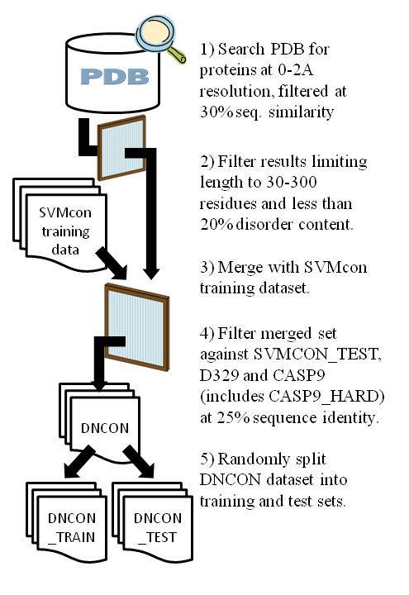
Figure S1. The DNCON datasets were formed by first searching the PDB, filtering the results and then merging the list of identified proteins with the SVMcon training dataset. This merged set of proteins was then filtered by three evaluation datasets (D329, SVMCON_TEST and CASP9) to ensure that the pairwise sequence identity between any sequence in any of the three evaluation sets and the DNCON set was less than 25%. The end result was a training set independent of four evaluation sets.

Slide 5
Contact預測特徵
Aj
Ai
Ai與Aj開Window特徵
  Compostion, 2nd Structure, ACC, PSSM, ...
Ai與Aj間(中央)特徵
  Compostion, 2nd Structure, ACC, PSSM, ...
Ai與Aj相關性特徵
  PSSM / PC-proterties Correlation, pairwise potential
全域特徵(length,composition,i-j,…)

Slide 6
Local window feature
PSSM
2nd structure: helix / sheet / coil
Relative solvent accessibility: exposed / buried
PSSM entropy
by SSPro & ACCPro

Slide 7

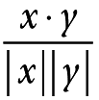
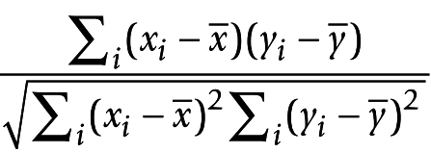
Pairwise information features
PSSM around residue i & j
  Mutual information
  Correlation
  Cosine
Levitt's contact potential
Jernigan's pairwise potential
Braun's pairwise potential

Slide 8

Levitt's contact potential
G A V L I P D E N Q K R S T M C Y W H F
G 0.1 0.7 0.1 0.1 0.0 0.5 0.4 0.6 0.1 0.0 0.4 -0.1 0.4 0.2 -0.1 -0.1 -0.4 -0.7 0.0 -0.3
A 0.7 0.5 -0.3 -0.4 -0.4 0.6 0.3 0.6 0.3 0.0 1.0 0.2 0.5 0.0 -0.5 0.3 -0.7 -0.8 0.0 -0.8
V 0.1 -0.3 -1.1 -1.2 -1.2 0.0 0.4 0.0 0.0 -0.4 0.1 -0.5 0.0 -0.3 -1.0 -0.5 -1.2 -1.6 -0.5 -1.5
L 0.1 -0.4 -1.2 -1.4 -1.4 -0.1 0.0 -0.1 -0.1 -0.6 0.1 -0.6 0.0 -0.3 -1.3 -0.8 -1.4 -1.7 -0.7 -1.6
I 0.0 -0.4 -1.2 -1.4 -1.5 -0.1 0.0 -0.2 -0.1 -0.4 0.0 -0.7 -0.1 -0.6 -1.4 -0.8 -1.4 -1.8 -0.8 -1.7
P 0.5 0.6 0.0 -0.1 -0.1 0.1 0.1 0.1 -0.1 -0.3 0.6 -0.2 0.2 0.0 -0.5 0.0 -1.0 -1.3 -0.4 -0.7
D 0.4 0.3 0.4 0.0 0.0 0.1 0.0 0.0 -0.6 -0.3 -1.0 -1.4 -0.3 -0.3 0.1 0.0 -1.0 -0.6 -1.1 -0.3
E 0.6 0.6 0.0 -0.1 -0.2 0.1 0.0 0.1 -0.6 -0.4 -1.1 -1.5 -0.2 -0.3 -0.3 0.1 -1.0 -0.8 -1.0 -0.5
N 0.1 0.3 0.0 -0.1 -0.1 -0.1 -0.6 -0.6 -0.7 -0.7 -0.3 -0.8 -0.1 -0.4 -0.3 0.0 -0.8 -0.8 -0.8 -0.6
Q 0.0 0.0 -0.4 -0.6 -0.4 -0.3 -0.3 -0.4 -0.7 -0.5 -0.4 -0.9 0.0 -0.5 -0.6 -0.2 -1.1 -1.0 -0.5 -0.8
K 0.4 1.0 0.1 0.1 0.0 0.6 -1.0 -1.1 -0.3 -0.4 0.7 0.1 0.1 0.0 -0.1 0.5 -1.0 -0.8 0.0 -0.4
R -0.1 0.2 -0.5 -0.6 -0.7 -0.2 -1.4 -1.5 -0.8 -0.9 0.1 -0.9 -0.4 -0.6 -0.5 0.0 -1.4 -1.3 -1.0 -0.9
S 0.4 0.5 0.0 0.0 -0.1 0.2 -0.3 -0.2 -0.1 0.0 0.1 -0.4 0.0 -0.2 -0.1 -0.1 -0.6 -0.6 -0.6 -0.4
T 0.2 0.0 -0.3 -0.3 -0.6 0.0 -0.3 -0.3 -0.4 -0.5 0.0 -0.6 -0.2 -0.5 -0.6 -0.3 -0.8 -0.9 -0.7 -0.7
M -0.1 -0.5 -1.0 -1.3 -1.4 -0.5 0.1 -0.3 -0.3 -0.6 -0.1 -0.5 -0.1 -0.6 -1.5 -0.8 -1.5 -2.0 -0.9 -1.9
C -0.1 0.3 -0.5 -0.8 -0.8 0.0 0.0 0.1 0.0 -0.2 0.5 0.0 -0.1 -0.3 -0.8 -2.7 -0.8 -1.3 -0.6 -1.2
Y -0.4 -0.7 -1.2 -1.4 -1.4 -1.0 -1.0 -1.0 -0.8 -1.1 -1.0 -1.4 -0.6 -0.8 -1.5 -0.8 -1.6 -1.8 -1.5 -1.7
W -0.7 -0.8 -1.6 -1.7 -1.8 -1.3 -0.6 -0.8 -0.8 -1.0 -0.8 -1.3 -0.6 -0.9 -2.0 -1.3 -1.8 -2.2 -1.5 -2.0
H 0.0 0.0 -0.5 -0.7 -0.8 -0.4 -1.1 -1.0 -0.8 -0.5 0.0 -1.0 -0.6 -0.7 -0.9 -0.6 -1.5 -1.5 -1.6 -1.2
F -0.3 -0.8 -1.5 -1.6 -1.7 -0.7 -0.3 -0.5 -0.6 -0.8 -0.4 -0.9 -0.4 -0.7 -1.9 -1.2 -1.7 -2.0 -1.2 -2.0
Notes:
Levitt <- function(){
# G A V L I P D E N Q K R S T M C Y W H F
# G 0.1 0.7 0.1 0.1 0.0 0.5 0.4 0.6 0.1 0.0 0.4 -0.1 0.4 0.2 -0.1 -0.1 -0.4 -0.7 0.0 -0.3
# A 0.7 0.5 -0.3 -0.4 -0.4 0.6 0.3 0.6 0.3 0.0 1.0 0.2 0.5 0.0 -0.5 0.3 -0.7 -0.8 0.0 -0.8
# V 0.1 -0.3 -1.1 -1.2 -1.2 0.0 0.4 0.0 0.0 -0.4 0.1 -0.5 0.0 -0.3 -1.0 -0.5 -1.2 -1.6 -0.5 -1.5
# L 0.1 -0.4 -1.2 -1.4 -1.4 -0.1 0.0 -0.1 -0.1 -0.6 0.1 -0.6 0.0 -0.3 -1.3 -0.8 -1.4 -1.7 -0.7 -1.6
# I 0.0 -0.4 -1.2 -1.4 -1.5 -0.1 0.0 -0.2 -0.1 -0.4 0.0 -0.7 -0.1 -0.6 -1.4 -0.8 -1.4 -1.8 -0.8 -1.7
# P 0.5 0.6 0.0 -0.1 -0.1 0.1 0.1 0.1 -0.1 -0.3 0.6 -0.2 0.2 0.0 -0.5 0.0 -1.0 -1.3 -0.4 -0.7
# D 0.4 0.3 0.4 0.0 0.0 0.1 0.0 0.0 -0.6 -0.3 -1.0 -1.4 -0.3 -0.3 0.1 0.0 -1.0 -0.6 -1.1 -0.3
# E 0.6 0.6 0.0 -0.1 -0.2 0.1 0.0 0.1 -0.6 -0.4 -1.1 -1.5 -0.2 -0.3 -0.3 0.1 -1.0 -0.8 -1.0 -0.5
# N 0.1 0.3 0.0 -0.1 -0.1 -0.1 -0.6 -0.6 -0.7 -0.7 -0.3 -0.8 -0.1 -0.4 -0.3 0.0 -0.8 -0.8 -0.8 -0.6
# Q 0.0 0.0 -0.4 -0.6 -0.4 -0.3 -0.3 -0.4 -0.7 -0.5 -0.4 -0.9 0.0 -0.5 -0.6 -0.2 -1.1 -1.0 -0.5 -0.8
# K 0.4 1.0 0.1 0.1 0.0 0.6 -1.0 -1.1 -0.3 -0.4 0.7 0.1 0.1 0.0 -0.1 0.5 -1.0 -0.8 0.0 -0.4
# R -0.1 0.2 -0.5 -0.6 -0.7 -0.2 -1.4 -1.5 -0.8 -0.9 0.1 -0.9 -0.4 -0.6 -0.5 0.0 -1.4 -1.3 -1.0 -0.9
# S 0.4 0.5 0.0 0.0 -0.1 0.2 -0.3 -0.2 -0.1 0.0 0.1 -0.4 0.0 -0.2 -0.1 -0.1 -0.6 -0.6 -0.6 -0.4
# T 0.2 0.0 -0.3 -0.3 -0.6 0.0 -0.3 -0.3 -0.4 -0.5 0.0 -0.6 -0.2 -0.5 -0.6 -0.3 -0.8 -0.9 -0.7 -0.7
# M -0.1 -0.5 -1.0 -1.3 -1.4 -0.5 0.1 -0.3 -0.3 -0.6 -0.1 -0.5 -0.1 -0.6 -1.5 -0.8 -1.5 -2.0 -0.9 -1.9
# C -0.1 0.3 -0.5 -0.8 -0.8 0.0 0.0 0.1 0.0 -0.2 0.5 0.0 -0.1 -0.3 -0.8 -2.7 -0.8 -1.3 -0.6 -1.2
# Y -0.4 -0.7 -1.2 -1.4 -1.4 -1.0 -1.0 -1.0 -0.8 -1.1 -1.0 -1.4 -0.6 -0.8 -1.5 -0.8 -1.6 -1.8 -1.5 -1.7
# W -0.7 -0.8 -1.6 -1.7 -1.8 -1.3 -0.6 -0.8 -0.8 -1.0 -0.8 -1.3 -0.6 -0.9 -2.0 -1.3 -1.8 -2.2 -1.5 -2.0
# H 0.0 0.0 -0.5 -0.7 -0.8 -0.4 -1.1 -1.0 -0.8 -0.5 0.0 -1.0 -0.6 -0.7 -0.9 -0.6 -1.5 -1.5 -1.6 -1.2
# F -0.3 -0.8 -1.5 -1.6 -1.7 -0.7 -0.3 -0.5 -0.6 -0.8 -0.4 -0.9 -0.4 -0.7 -1.9 -1.2 -1.7 -2.0 -1.2 -2.0
#Author: Jianlin Cheng
aa_levitt = "GAVLIPDENQKRSTMCYWHF"
a = c(.1,.7,.1,.1,0,.5,.4,.6,.1,0,.4,-0.1,.4,.2,-0.1,-0.1,-0.4,-0.7,0,-0.3,.5,-0.3,-0.4,-0.4,.6,.3,.6,.3,0,1.0,.2,.5,0,
-0.5,.3,-0.7,-0.8,0,-0.8,-1.1,-1.2,-1.2,0,.4,0,0,-0.4,0.1,-0.5,0,-0.3,-1.0,-0.5,-1.2,-1.6,-0.5,-1.5,-1.4,-1.4,-0.1,
0,-0.1,-0.1,-0.6,0.1,-0.6,0,-0.3,-1.3,-0.8,-1.4,-1.7,-0.7,-1.6,-1.5,-0.1,0,-0.2,-0.1,-0.4,0,-0.7,-0.1,-0.6,-1.4,
-0.8,-1.4,-1.8,-0.8,-1.7,.1,.1,.1,-0.1,-0.3,.6,-0.2,.2,0,-0.5,0,-1.0,-1.3,-0.4,-0.7,0,0,-0.6,-0.3,-1.0,-1.4,-0.3,
-0.3,0.1,0,-1.0,-0.6,-1.1,-0.3,0.1,-0.6,-0.4,-1.1,-1.5,-0.2,-0.3,-0.3,0.1,-1.0,-0.8,-1.0,-0.5,-0.7,-0.7,-0.3,-0.8,
-0.1,-0.4,-0.3,0,-0.8,-0.8,-0.8,-0.6,-0.5,-0.4,-0.9,0,-0.5,-0.6,-0.2,-1.1,-1.0,-0.5,-0.8,.7,.1,.1,0,-0.1,.5,-1.0,
-0.8,0,-0.4,-0.9,-0.4,-0.6,-0.5,0,-1.4,-1.3,-1.0,-0.9,0,-0.2,-0.1,-0.1,-0.6,-0.6,-0.6,-0.4,-0.5,-0.6,-0.3,-0.8,-0.9,
-0.7,-0.7,-1.5,-0.8,-1.5,-2.0,-0.9,-1.9,-2.7,-0.8,-1.3,-0.6,-1.2,-1.6,-1.8,-1.5,-1.7,-2.2,-1.5,-2.0,-1.6,-1.2,-2.0)
m = matrix(0,nchar(aa_levitt),nchar(aa_levitt))
m[lower.tri(m,diag=T)] <- a
m[upper.tri(m)] <- t(m)[upper.tri(m)]
colnames(m) = strsplit(aa_levitt,'')[[1]]
rownames(m) = strsplit(aa_levitt,'')[[1]]
m
}

Slide 9

Jernigan's pairwise potential
Gly Ala Val Leu Ile Pro Asp Glu Asn Gln Lys Arg Ser Thr Met Cys Tyr Trp His Phe
Gly -2.1 -2.2 -3.0 -2.5 -2.7 -1.8 -1.9 -1.3 -2.4 -2.0 -1.9 -2.2 -1.9 -2.4 -2.8 -3.0 -2.8 -3.1 -2.1 -2.6
Ala -2.9 -4.1 -3.7 -3.9 -2.3 -2.6 -1.9 -2.8 -2.7 -1.9 -2.4 -2.4 -3.2 -3.8 -3.1 -3.7 -3.8 -2.6 -3.7
Val -5.1 -4.7 -5.0 -3.2 -2.8 -2.8 -3.5 -3.4 -3.1 -3.5 -3.1 -3.9 -4.7 -4.3 -4.5 -4.8 -3.5 -4.6
Leu -4.3 -4.6 -2.8 -2.7 -2.4 -3.0 -3.1 -2.5 -3.0 -2.6 -3.3 -4.4 -4.0 -4.1 -4.4 -3.1 -4.2
Ile -4.9 -3.0 -2.9 -2.7 -3.2 -3.2 -2.9 -3.3 -3.0 -3.8 -4.7 -4.2 -4.4 -4.7 -3.4 -4.5
Pro -2.2 -2.3 -1.8 -2.7 -2.5 -1.8 -2.4 -2.2 -2.8 -3.4 -2.8 -3.5 -3.7 -2.6 -3.1
Asp -2.6 -2.0 -3.3 -2.7 -3.5 -3.7 -2.8 -3.2 -2.7 -2.9 -3.5 -3.2 -3.3 -2.7
Glu -1.5 -2.8 -2.2 -3.2 -3.2 -2.3 -2.7 -2.7 -2.4 -3.0 -2.8 -2.8 -2.4
Asn -3.6 -3.2 -3.0 -3.2 -2.8 -3.4 -3.3 -3.2 -3.5 -3.5 -3.2 -3.2
Gln -2.6 -2.7 -2.9 -2.3 -3.1 -3.3 -2.9 -3.4 -3.3 -2.5 -3.0
Lys -1.7 -2.0 -2.3 -2.8 -2.9 -2.4 -3.5 -3.3 -2.2 -2.8
Arg -2.9 -2.6 -3.1 -3.1 -2.6 -3.6 -3.5 -2.9 -3.0
Ser -2.4 -2.9 -3.0 -3.0 -3.1 -3.1 -2.7 -2.8
Thr -3.5 -3.8 -3.5 -3.6 -3.7 -3.2 -3.4
Met -4.8 -4.2 -4.4 -4.8 -3.5 -4.6
Cys -6.1 -3.8 -4.3 -3.3 -4.1
Tyr -4.1 -4.3 -3.7 -4.1
Trp -4.7 -3.6 -4.4
His -3.5 -3.3
Phe -4.3
Notes:
JerniganCP <- function(aa1,aa2){
#Author: Jianlin Cheng
#Jernigan contact potential
#Miyazawa & Jernigan
# Gly Ala Val Leu Ile Pro Asp Glu Asn Gln Lys Arg Ser Thr Met Cys Tyr Trp His Phe
#Gly -2.1 -2.2 -3.0 -2.5 -2.7 -1.8 -1.9 -1.3 -2.4 -2.0 -1.9 -2.2 -1.9 -2.4 -2.8 -3.0 -2.8 -3.1 -2.1 -2.6
#Ala -2.9 -4.1 -3.7 -3.9 -2.3 -2.6 -1.9 -2.8 -2.7 -1.9 -2.4 -2.4 -3.2 -3.8 -3.1 -3.7 -3.8 -2.6 -3.7
#Val -5.1 -4.7 -5.0 -3.2 -2.8 -2.8 -3.5 -3.4 -3.1 -3.5 -3.1 -3.9 -4.7 -4.3 -4.5 -4.8 -3.5 -4.6
#Leu -4.3 -4.6 -2.8 -2.7 -2.4 -3.0 -3.1 -2.5 -3.0 -2.6 -3.3 -4.4 -4.0 -4.1 -4.4 -3.1 -4.2
#Ile -4.9 -3.0 -2.9 -2.7 -3.2 -3.2 -2.9 -3.3 -3.0 -3.8 -4.7 -4.2 -4.4 -4.7 -3.4 -4.5
#Pro -2.2 -2.3 -1.8 -2.7 -2.5 -1.8 -2.4 -2.2 -2.8 -3.4 -2.8 -3.5 -3.7 -2.6 -3.1
#Asp -2.6 -2.0 -3.3 -2.7 -3.5 -3.7 -2.8 -3.2 -2.7 -2.9 -3.5 -3.2 -3.3 -2.7
#Glu -1.5 -2.8 -2.2 -3.2 -3.2 -2.3 -2.7 -2.7 -2.4 -3.0 -2.8 -2.8 -2.4
#Asn -3.6 -3.2 -3.0 -3.2 -2.8 -3.4 -3.3 -3.2 -3.5 -3.5 -3.2 -3.2
#Gln -2.6 -2.7 -2.9 -2.3 -3.1 -3.3 -2.9 -3.4 -3.3 -2.5 -3.0
#Lys -1.7 -2.0 -2.3 -2.8 -2.9 -2.4 -3.5 -3.3 -2.2 -2.8
#Arg -2.9 -2.6 -3.1 -3.1 -2.6 -3.6 -3.5 -2.9 -3.0
#Ser -2.4 -2.9 -3.0 -3.0 -3.1 -3.1 -2.7 -2.8
#Thr -3.5 -3.8 -3.5 -3.6 -3.7 -3.2 -3.4
#Met -4.8 -4.2 -4.4 -4.8 -3.5 -4.6
#Cys -6.1 -3.8 -4.3 -3.3 -4.1
#Tyr -4.1 -4.3 -3.7 -4.1
#Trp -4.7 -3.6 -4.4
#His -3.5 -3.3
#Phe -4.3
##################################################################################################################
aa_levitt = "GAVLIPDENQKRSTMCYWHF"
a = list(
c(-2.1,-2.2,-3.0,-2.5,-2.7,-1.8,-1.9,-1.3,-2.4,-2.0,-1.9,-2.2,-1.9,-2.4,-2.8,-3.0,-2.8,-3.1,-2.1,-2.6),
c(-2.9,-4.1,-3.7,-3.9,-2.3,-2.6,-1.9,-2.8,-2.7,-1.9,-2.4,-2.4,-3.2,-3.8,-3.1,-3.7,-3.8,-2.6,-3.7),
c(-5.1,-4.7,-5.0,-3.2,-2.8,-2.8,-3.5,-3.4,-3.1,-3.5,-3.1,-3.9,-4.7,-4.3,-4.5,-4.8,-3.5,-4.6),
c(-4.3,-4.6,-2.8,-2.7,-2.4,-3.0,-3.1,-2.5,-3.0,-2.6,-3.3,-4.4,-4.0,-4.1,-4.4,-3.1,-4.2),
c(-4.9,-3.0,-2.9,-2.7,-3.2,-3.2,-2.9,-3.3,-3.0,-3.8,-4.7,-4.2,-4.4,-4.7,-3.4,-4.5),
c(-2.2,-2.3,-1.8,-2.7,-2.5,-1.8,-2.4,-2.2,-2.8,-3.4,-2.8,-3.5,-3.7,-2.6,-3.1),
c(-2.6,-2.0,-3.3,-2.7,-3.5,-3.7,-2.8,-3.2,-2.7,-2.9,-3.5,-3.2,-3.3,-2.7),
c(-1.5,-2.8,-2.2,-3.2,-3.2,-2.3,-2.7,-2.7,-2.4,-3.0,-2.8,-2.8,-2.4),
c(-3.6,-3.2,-3.0,-3.2,-2.8,-3.4,-3.3,-3.2,-3.5,-3.5,-3.2,-3.2),
c(-2.6,-2.7,-2.9,-2.3,-3.1,-3.3,-2.9,-3.4,-3.3,-2.5,-3.0),
c(-1.7,-2.0,-2.3,-2.8,-2.9,-2.4,-3.5,-3.3,-2.2,-2.8),
c(-2.9,-2.6,-3.1,-3.1,-2.6,-3.6,-3.5,-2.9,-3.0),
c(-2.4,-2.9,-3.0,-3.0,-3.1,-3.1,-2.7,-2.8),
c(-3.5,-3.8,-3.5,-3.6,-3.7,-3.2,-3.4),
c(-4.8,-4.2,-4.4,-4.8,-3.5,-4.6),
c(-6.1,-3.8,-4.3,-3.3,-4.1),
c(-4.1,-4.3,-3.7,-4.1),
c(-4.7,-3.6,-4.4),
c(-3.5,-3.3),
c(-4.3))
aas = strsplit(aa_levitt,'')[[1]]
wh1 = which(aas==aa1)
wh2 = which(aas==aa2)
if(wh1>wh2){tmp=wh2;wh2=wh1;wh1=tmp}
a[[wh1]][wh2-wh1+1]
}

Slide 10

Braun's pairwise potential
G A V L I F Y W M C P S T N Q H K R D E
G -0.29 -0.14 -0.10 -0.04 0.27 -0.09 -0.21 -0.34 0.25 -0.42 0.06 0.04 0.28 0.49 0.54 -0.09 0.56 0.40 -0.26 0.21
A -0.14 -0.18 -0.15 -0.24 -0.25 -0.16 -0.18 -0.01 -0.02 0.08 0.28 0.38 0.06 -0.04 0.35 0.44 0.28 0.59 0.24 0.53
V -0.10 -0.15 -0.48 -0.29 -0.31 -0.31 0.00 0.18 -0.02 0.08 0.76 0.18 0.19 0.48 0.41 0.37 0.53 0.43 0.51 0.37
L -0.04 -0.24 -0.29 -0.43 -0.45 -0.28 -0.10 -0.18 -0.32 0.36 0.30 0.30 0.57 0.25 0.35 0.10 0.37 0.37 0.80 0.51
I 0.27 -0.25 -0.31 -0.45 -0.48 -0.05 -0.34 -0.28 0.21 -0.16 0.99 0.57 0.34 1.45 0.44 0.24 0.00 0.05 0.26 0.53
F -0.09 -0.16 -0.31 -0.28 -0.05 -0.50 -0.27 0.16 -0.36 -0.28 0.65 0.15 0.25 0.12 -0.04 0.25 0.75 0.31 0.33 0.38
Y -0.21 -0.18 0.00 -0.10 -0.34 -0.27 -0.11 -0.30 0.01 0.69 -0.02 -0.03 0.23 -0.14 -0.06 0.33 0.00 0.03 0.61 0.25
W -0.34 -0.01 0.18 -0.18 -0.28 0.16 -0.30 -0.53 -0.73 -0.74 0.70 0.44 0.74 0.46 -0.09 -0.34 0.02 -0.20 0.74 1.37
M 0.25 -0.02 -0.02 -0.32 0.21 -0.36 0.01 -0.73 -0.75 0.27 -0.78 0.00 0.43 -0.52 0.07 1.07 0.44 0.53 0.21 0.44
C -0.42 0.08 0.08 0.36 -0.16 -0.28 0.69 -0.74 0.27 -1.77 0.31 0.12 0.28 0.07 0.39 -0.45 0.68 0.92 0.53 0.17
P 0.06 0.28 0.76 0.30 0.99 0.65 -0.02 0.70 -0.78 0.31 -0.78 0.21 0.04 0.59 0.73 -0.21 0.26 0.34 0.87 0.41
S 0.04 0.38 0.18 0.30 0.57 0.15 -0.03 0.44 0.00 0.12 0.21 -0.68 -0.23 -0.21 0.19 -0.13 -0.05 0.24 -0.03 0.10
T 0.28 0.06 0.19 0.57 0.34 0.25 0.23 0.74 0.43 0.28 0.04 -0.23 -0.58 -0.06 -0.31 -0.22 -0.26 -0.31 0.32 -0.27
N 0.49 -0.04 0.48 0.25 1.45 0.12 -0.14 0.46 -0.52 0.07 0.59 -0.21 -0.06 -0.45 0.20 -0.56 -0.27 0.00 -0.43 0.76
Q 0.54 0.35 0.41 0.35 0.44 -0.04 -0.06 -0.09 0.07 0.39 0.73 0.19 -0.31 0.20 -0.17 0.28 0.05 0.56 -0.03 -0.20
H -0.09 0.44 0.37 0.10 0.24 0.25 0.33 -0.34 1.07 -0.45 -0.21 -0.13 -0.22 -0.56 0.28 -0.15 0.57 -0.11 -0.61 -0.14
K 0.56 0.28 0.53 0.37 0.00 0.75 0.00 0.02 0.44 0.68 0.26 -0.05 -0.26 -0.27 0.05 0.57 0.21 0.58 -0.43 -1.12
R 0.40 0.59 0.43 0.37 0.05 0.31 0.03 -0.20 0.53 0.92 0.34 0.24 -0.31 0.00 0.56 -0.11 0.58 -0.03 -0.79 -0.85
D -0.26 0.24 0.51 0.80 0.26 0.33 0.61 0.74 0.21 0.53 0.87 -0.03 0.32 -0.43 -0.03 -0.61 -0.43 -0.79 0.11 0.86
E 0.21 0.53 0.37 0.51 0.53 0.38 0.25 1.37 0.44 0.17 0.41 0.10 -0.27 0.76 -0.20 -0.14 -1.12 -0.85 0.86 0.58
Notes:
BraunCP <- function(){
#Author: Jianlin Cheng
#Zhu-Braun
#G -0.29
#A -0.14 -0.18
#V -0.10 -0.15 -0.48
#L -0.04 -0.24 -0.29 -0.43
#I 0.27 -0.25 -0.31 -0.45 -0.48
#F -0.09 -0.16 -0.31 -0.28 -0.05 -0.50
#Y -0.21 -0.18 0.00 -0.10 -0.34 -0.27 -0.11
#W -0.34 -0.01 0.18 -0.18 -0.28 0.16 -0.30 -0.53
#M 0.25 -0.02 -0.02 -0.32 0.21 -0.36 0.01 -0.73 -0.75
#C -0.42 0.08 0.08 0.36 -0.16 -0.28 0.69 -0.74 0.27 -1.77
#P 0.06 0.28 0.76 0.30 0.99 0.65 -0.02 0.70 -0.78 0.31 -0.78
#S 0.04 0.38 0.18 0.30 0.57 0.15 -0.03 0.44 0.00 0.12 0.21 -0.68
#T 0.28 0.06 0.19 0.57 0.34 0.25 0.23 0.74 0.43 0.28 0.04 -0.23 -0.58
#N 0.49 -0.04 0.48 0.25 1.45 0.12 -0.14 0.46 -0.52 0.07 0.59 -0.21 -0.06 -0.45
#Q 0.54 0.35 0.41 0.35 0.44 -0.04 -0.06 -0.09 0.07 0.39 0.73 0.19 -0.31 0.20 -0.17
#H -0.09 0.44 0.37 0.10 0.24 0.25 0.33 -0.34 1.07 -0.45 -0.21 -0.13 -0.22 -0.56 0.28 -0.15
#K 0.56 0.28 0.53 0.37 -0.00 0.75 -0.00 0.02 0.44 0.68 0.26 -0.05 -0.26 -0.27 0.05 0.57 0.21
#R 0.40 0.59 0.43 0.37 0.05 0.31 0.03 -0.20 0.53 0.92 0.34 0.24 -0.31 -0.00 0.56 -0.11 0.58 -0.03
#D -0.26 0.24 0.51 0.80 0.26 0.33 0.61 0.74 0.21 0.53 0.87 -0.03 0.32 -0.43 -0.03 -0.61 -0.43 -0.79 0.11
#E 0.21 0.53 0.37 0.51 0.53 0.38 0.25 1.37 0.44 0.17 0.41 0.10 -0.27 0.76 -0.20 -0.14 -1.12 -0.85 0.86 0.58
aa_braun = "GAVLIFYWMCPSTNQHKRDE"; #aa order used in Braun contact potential map
a =
c(
-0.29,
-0.14,-0.18,
-0.10,-0.15,-0.48,
-0.04,-0.24,-0.29,-0.43,
0.27,-0.25,-0.31,-0.45,-0.48,
-0.09,-0.16,-0.31,-0.28,-0.05,-0.50,
-0.21,-0.18,0.00,-0.10,-0.34,-0.27,-0.11,
-0.34,-0.01,0.18,-0.18,-0.28,0.16,-0.30,-0.53,
0.25,-0.02,-0.02,-0.32,0.21,-0.36,0.01,-0.73,-0.75,
-0.42,0.08,0.08,0.36,-0.16,-0.28,0.69,-0.74,0.27,-1.77,
0.06,0.28,0.76,0.30,0.99,0.65,-0.02,0.70,-0.78,0.31,-0.78,
0.04,0.38,0.18,0.30,0.57,0.15,-0.03,0.44,0.00,0.12,0.21,-0.68,
0.28,0.06,0.19,0.57,0.34,0.25,0.23,0.74,0.43,0.28,0.04,-0.23,-0.58,
0.49,-0.04,0.48,0.25,1.45,0.12,-0.14,0.46,-0.52,0.07,0.59,-0.21,-0.06,-0.45,
0.54,0.35,0.41,0.35,0.44,-0.04,-0.06,-0.09,0.07,0.39,0.73,0.19,-0.31,0.20,-0.17,
-0.09,0.44,0.37,0.10,0.24,0.25,0.33,-0.34,1.07,-0.45,-0.21,-0.13,-0.22,-0.56,0.28,-0.15,
0.56,0.28,0.53,0.37,-0.00,0.75,-0.00,0.02,0.44,0.68,0.26,-0.05,-0.26,-0.27,0.05,0.57,0.21,
0.40,0.59,0.43,0.37,0.05,0.31,0.03,-0.20,0.53,0.92,0.34,0.24,-0.31,-0.00,0.56,-0.11,0.58,-0.03,
-0.26,0.24,0.51,0.80,0.26,0.33,0.61,0.74,0.21,0.53,0.87,-0.03,0.32,-0.43,-0.03,-0.61,-0.43,-0.79,0.11,
0.21,0.53,0.37,0.51,0.53,0.38,0.25,1.37,0.44,0.17,0.41,0.10,-0.27,0.76,-0.20,-0.14,-1.12,-0.85,0.86,0.58)
m = matrix(0,nchar(aa_braun),nchar(aa_braun))
m[upper.tri(m,diag=T)] <- a
m = t(m)
m[upper.tri(m)] <- t(m)[upper.tri(m)]
colnames(m) = strsplit(aa_braun,'')[[1]]
rownames(m) = strsplit(aa_braun,'')[[1]]
m
}

Slide 11
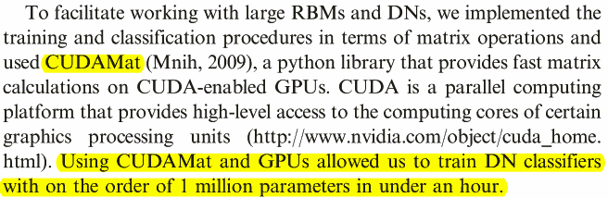
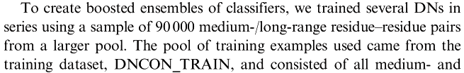
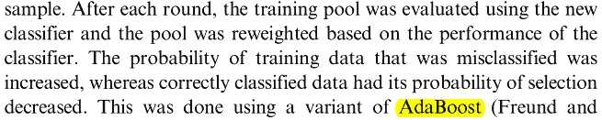
Classifier:
Ensemble of Deep Networks
Notes:
BraunCP <- function(){
#Author: Jianlin Cheng
#Zhu-Braun
#G -0.29
#A -0.14 -0.18
#V -0.10 -0.15 -0.48
#L -0.04 -0.24 -0.29 -0.43
#I 0.27 -0.25 -0.31 -0.45 -0.48
#F -0.09 -0.16 -0.31 -0.28 -0.05 -0.50
#Y -0.21 -0.18 0.00 -0.10 -0.34 -0.27 -0.11
#W -0.34 -0.01 0.18 -0.18 -0.28 0.16 -0.30 -0.53
#M 0.25 -0.02 -0.02 -0.32 0.21 -0.36 0.01 -0.73 -0.75
#C -0.42 0.08 0.08 0.36 -0.16 -0.28 0.69 -0.74 0.27 -1.77
#P 0.06 0.28 0.76 0.30 0.99 0.65 -0.02 0.70 -0.78 0.31 -0.78
#S 0.04 0.38 0.18 0.30 0.57 0.15 -0.03 0.44 0.00 0.12 0.21 -0.68
#T 0.28 0.06 0.19 0.57 0.34 0.25 0.23 0.74 0.43 0.28 0.04 -0.23 -0.58
#N 0.49 -0.04 0.48 0.25 1.45 0.12 -0.14 0.46 -0.52 0.07 0.59 -0.21 -0.06 -0.45
#Q 0.54 0.35 0.41 0.35 0.44 -0.04 -0.06 -0.09 0.07 0.39 0.73 0.19 -0.31 0.20 -0.17
#H -0.09 0.44 0.37 0.10 0.24 0.25 0.33 -0.34 1.07 -0.45 -0.21 -0.13 -0.22 -0.56 0.28 -0.15
#K 0.56 0.28 0.53 0.37 -0.00 0.75 -0.00 0.02 0.44 0.68 0.26 -0.05 -0.26 -0.27 0.05 0.57 0.21
#R 0.40 0.59 0.43 0.37 0.05 0.31 0.03 -0.20 0.53 0.92 0.34 0.24 -0.31 -0.00 0.56 -0.11 0.58 -0.03
#D -0.26 0.24 0.51 0.80 0.26 0.33 0.61 0.74 0.21 0.53 0.87 -0.03 0.32 -0.43 -0.03 -0.61 -0.43 -0.79 0.11
#E 0.21 0.53 0.37 0.51 0.53 0.38 0.25 1.37 0.44 0.17 0.41 0.10 -0.27 0.76 -0.20 -0.14 -1.12 -0.85 0.86 0.58
aa_braun = "GAVLIFYWMCPSTNQHKRDE"; #aa order used in Braun contact potential map
a =
c(
-0.29,
-0.14,-0.18,
-0.10,-0.15,-0.48,
-0.04,-0.24,-0.29,-0.43,
0.27,-0.25,-0.31,-0.45,-0.48,
-0.09,-0.16,-0.31,-0.28,-0.05,-0.50,
-0.21,-0.18,0.00,-0.10,-0.34,-0.27,-0.11,
-0.34,-0.01,0.18,-0.18,-0.28,0.16,-0.30,-0.53,
0.25,-0.02,-0.02,-0.32,0.21,-0.36,0.01,-0.73,-0.75,
-0.42,0.08,0.08,0.36,-0.16,-0.28,0.69,-0.74,0.27,-1.77,
0.06,0.28,0.76,0.30,0.99,0.65,-0.02,0.70,-0.78,0.31,-0.78,
0.04,0.38,0.18,0.30,0.57,0.15,-0.03,0.44,0.00,0.12,0.21,-0.68,
0.28,0.06,0.19,0.57,0.34,0.25,0.23,0.74,0.43,0.28,0.04,-0.23,-0.58,
0.49,-0.04,0.48,0.25,1.45,0.12,-0.14,0.46,-0.52,0.07,0.59,-0.21,-0.06,-0.45,
0.54,0.35,0.41,0.35,0.44,-0.04,-0.06,-0.09,0.07,0.39,0.73,0.19,-0.31,0.20,-0.17,
-0.09,0.44,0.37,0.10,0.24,0.25,0.33,-0.34,1.07,-0.45,-0.21,-0.13,-0.22,-0.56,0.28,-0.15,
0.56,0.28,0.53,0.37,-0.00,0.75,-0.00,0.02,0.44,0.68,0.26,-0.05,-0.26,-0.27,0.05,0.57,0.21,
0.40,0.59,0.43,0.37,0.05,0.31,0.03,-0.20,0.53,0.92,0.34,0.24,-0.31,-0.00,0.56,-0.11,0.58,-0.03,
-0.26,0.24,0.51,0.80,0.26,0.33,0.61,0.74,0.21,0.53,0.87,-0.03,0.32,-0.43,-0.03,-0.61,-0.43,-0.79,0.11,
0.21,0.53,0.37,0.51,0.53,0.38,0.25,1.37,0.44,0.17,0.41,0.10,-0.27,0.76,-0.20,-0.14,-1.12,-0.85,0.86,0.58)
m = matrix(0,nchar(aa_braun),nchar(aa_braun))
m[upper.tri(m,diag=T)] <- a
m = t(m)
m[upper.tri(m)] <- t(m)[upper.tri(m)]
colnames(m) = strsplit(aa_braun,'')[[1]]
rownames(m) = strsplit(aa_braun,'')[[1]]
m
}

Slide 12
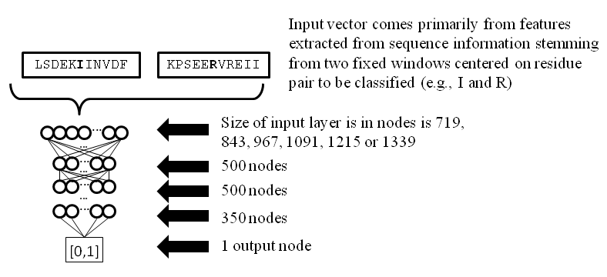
Figure S2. The overall model architecture for a deep network used for medium and long range contact prediction. Note that the exact size of the input layer is dependent on the size of the fix window chosen for the model.

Slide 13
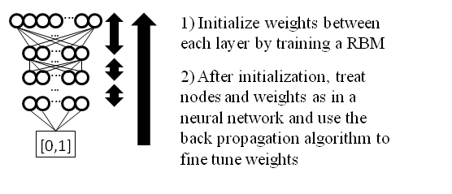
Figure S3. Illustration of the training process for a deep network. Initially, weights are learnt one layer at a time via a restricted Boltzmann machine. After initialization, the nodes in the network are viewed as deterministic and the entire network is fine tuned using the standard back propagation algorithm.

Slide 14
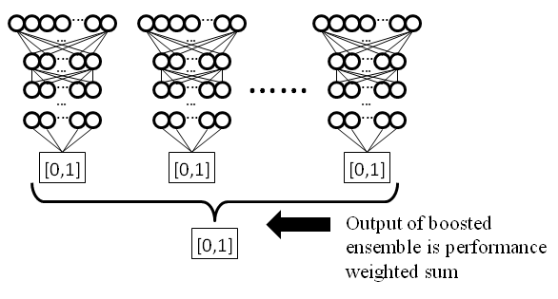
Figure S4. Architecture of a boosted ensemble of deep networks. Each network is trained on a sample from the pool of training data. The final output of the network is a performance weighted sum of the outputs of each individual deep network.

Slide 15
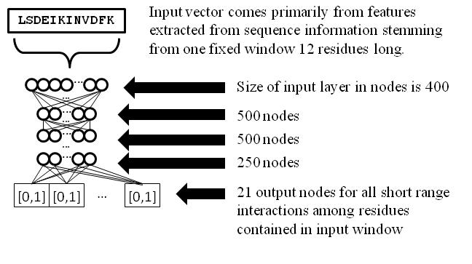
Figure S5. Overall architecture of a deep network used to predict short range contacts.

Slide 16
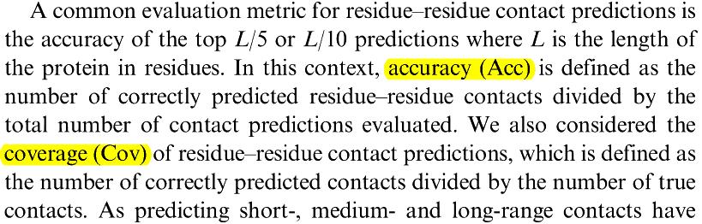
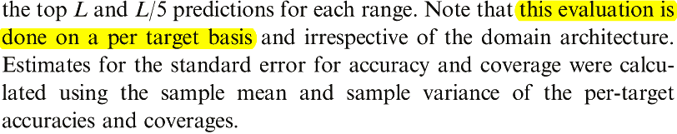
Performance evaluation

Slide 17
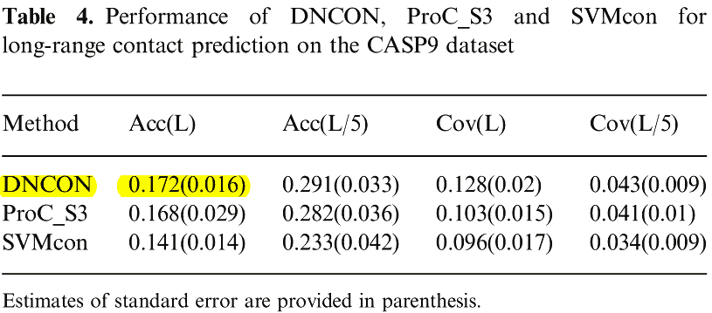
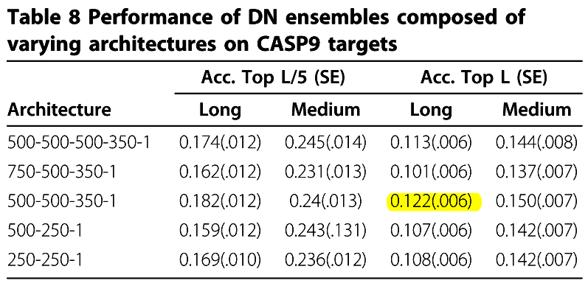
Performance comparison (2012 vs. 2013)
2012 paper
2013 paper

Slide 18
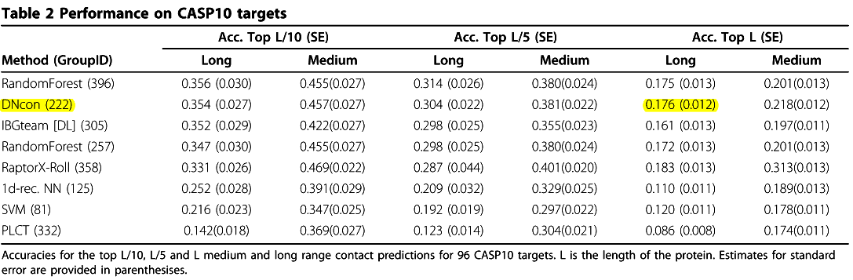
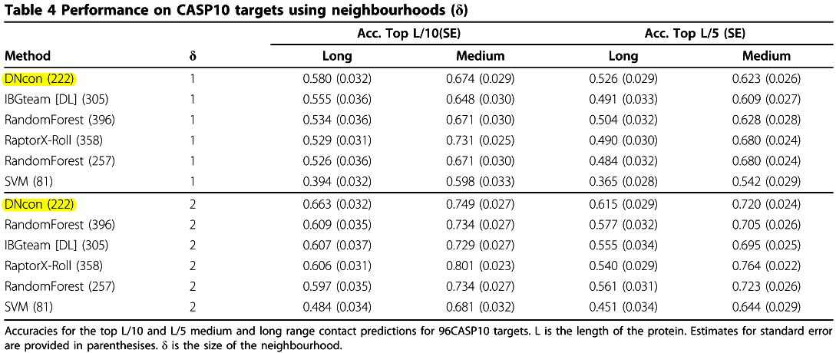
Performance comparison (2013)

Slide 19
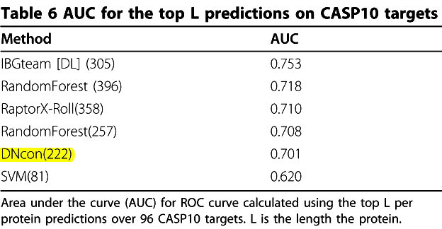
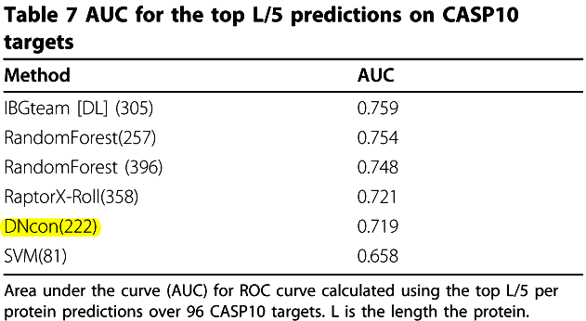
Performance comparison (2013)

Slide 20
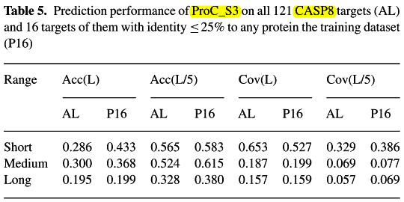
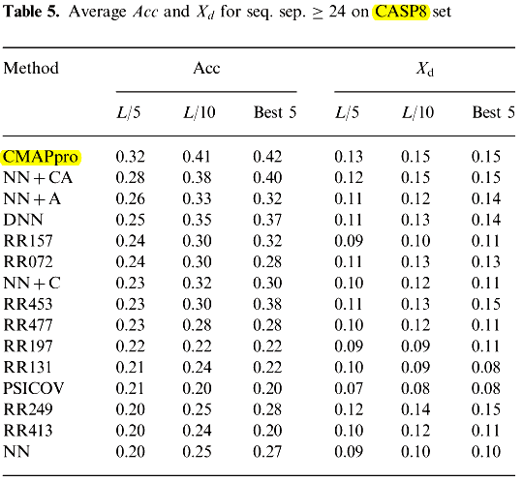
Performance of ProC_S3 & CMAPpro on CASP8
Yunqi Li et al., "Predicting residue–residue contacts using random forest models"
Pietro Di Lena et al., "Deep architectures for protein contact map prediction"

Slide 21
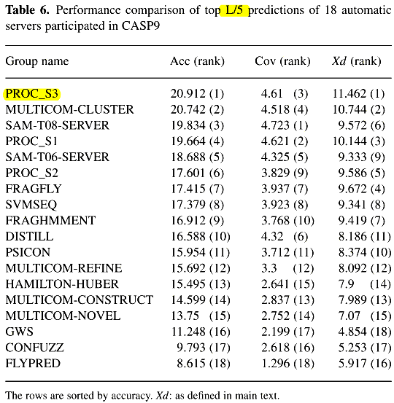
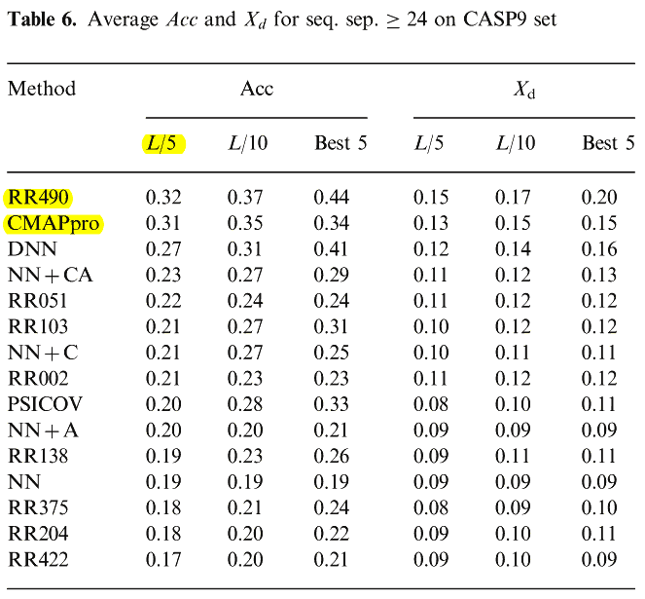
Performance of ProC_S3 & CMAPpro on CASP9
Yunqi Li et al., "Predicting residue–residue contacts using random forest models"
Pietro Di Lena et al., "Deep architectures for protein contact map prediction"

Slide 22
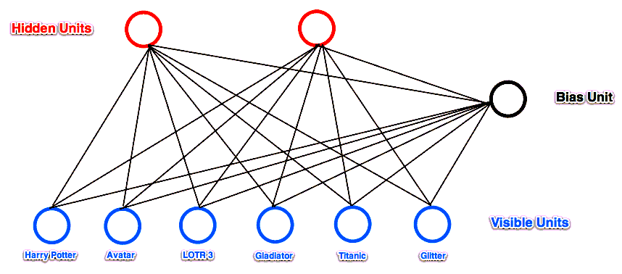
Restricted Boltzmann Machines (RBM)
A Restricted Boltzmann Machine is a stochastic neural network consisting of:
One layer of visible units (users’ movie preferences whose states we know and set);
One layer of hidden units (the latent factors we try to learn);
A bias unit (whose state is always on, and is a way of adjusting for the different inherent popularities of each movie).
http://blog.echen.me/2011/07/18/introduction-to-restricted-boltzmann-machines/

Slide 23

Restricted Boltzmann Machines (RBM)
Training data:
Alice: (Harry Potter = 1, Avatar = 1, LOTR 3 = 1, Gladiator = 0, Titanic = 0, Glitter = 0). Big SF/fantasy fan.
Bob: (Harry Potter = 1, Avatar = 0, LOTR 3 = 1, Gladiator = 0, Titanic = 0, Glitter = 0). SF/fantasy fan, but doesn't like Avatar.
Carol: (Harry Potter = 1, Avatar = 1, LOTR 3 = 1, Gladiator = 0, Titanic = 0, Glitter = 0). Big SF/fantasy fan.
David: (Harry Potter = 0, Avatar = 0, LOTR 3 = 1, Gladiator = 1, Titanic = 1, Glitter = 0). Big Oscar winners fan.
Eric: (Harry Potter = 0, Avatar = 0, LOTR 3 = 1, Gladiator = 1, Titanic = 1, Glitter = 0). Oscar winners fan, except for Titanic.
Fred: (Harry Potter = 0, Avatar = 0, LOTR 3 = 1, Gladiator = 1, Titanic = 1, Glitter = 0). Big Oscar winners fan.
The network learned the following weights:
Bias Unit Hidden 1 Hidden 2
Bias Unit -0.7342946 , 1.62413413, 0.38261796
Harry Potter -8.28013449, 3.46336899, 1.25647695
Avatar -5.63172297, 1.22485789, -0.54704988
LOTR 3 3.18821331, 4.19419496, 4.19278116
Gladiator 7.97049391, -2.81753116, -1.68188448
Titanic 4.37201403, -7.3249733 , -0.68051480
Glitter -3.57746822, -3.10724491, -3.89272309
http://blog.echen.me/2011/07/18/introduction-to-restricted-boltzmann-machines/

Slide 24


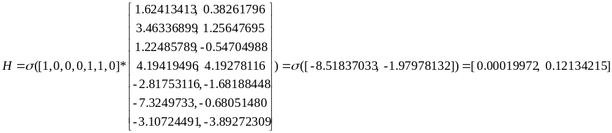
The network learned the following weights:
Bias Unit Hidden 1 Hidden 2
Bias Unit -0.7342946 , 1.62413413, 0.38261796
Harry Potter -8.28013449, 3.46336899, 1.25647695
Avatar -5.63172297, 1.22485789, -0.54704988
LOTR 3 3.18821331, 4.19419496, 4.19278116
Gladiator 7.97049391, -2.81753116, -1.68188448
Titanic 4.37201403, -7.3249733 , -0.68051480
Glitter -3.57746822, -3.10724491, -3.89272309
visible -> hidden
Assuming visible = [0,0,0,1,1,0]
Notes:
from rbm import *
r = RBM(num_visible = 6, num_hidden = 2)
r.weights = np. array([[-0.7342946 , 1.62413413, 0.38261796],
[-8.28013449, 3.46336899, 1.25647695],
[-5.63172297, 1.22485789, -0.54704988],
[ 3.18821331, 4.19419496, 4.19278116],
[ 7.97049391, -2.81753116, -1.68188448],
[ 4.37201403, -7.3249733 , -0.6805148 ],
[-3.57746822, -3.10724491, -3.89272309]])
data=np.array([[1,0,0,0,1,1,0]])
hidden_activations = np.dot(data, r.weights)
hidden_probs = r._logistic(hidden_activations) [:,1:]

Slide 25

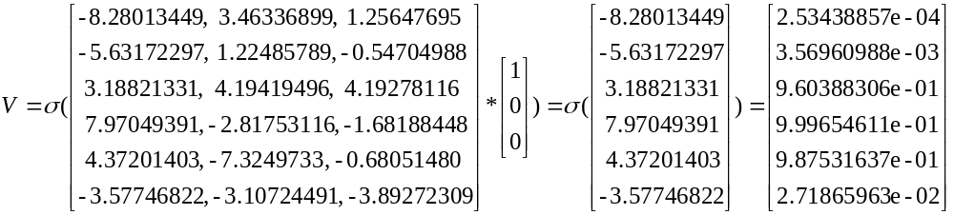
The network learned the following weights:
Bias Unit Hidden 1 Hidden 2
Bias Unit -0.7342946 , 1.62413413, 0.38261796
Harry Potter -8.28013449, 3.46336899, 1.25647695
Avatar -5.63172297, 1.22485789, -0.54704988
LOTR 3 3.18821331, 4.19419496, 4.19278116
Gladiator 7.97049391, -2.81753116, -1.68188448
Titanic 4.37201403, -7.3249733 , -0.68051480
Glitter -3.57746822, -3.10724491, -3.89272309
hidden -> visible
Assuming hidden = [0,0]
Notes:
from rbm import *
r = RBM(num_visible = 6, num_hidden = 2)
r.weights = np. array([[-0.7342946 , 1.62413413, 0.38261796],
[-8.28013449, 3.46336899, 1.25647695],
[-5.63172297, 1.22485789, -0.54704988],
[ 3.18821331, 4.19419496, 4.19278116],
[ 7.97049391, -2.81753116, -1.68188448],
[ 4.37201403, -7.3249733 , -0.6805148 ],
[-3.57746822, -3.10724491, -3.89272309]])
data=np.array([[1,0,0]])
visible_probs = r._logistic(np.dot(r.weights[1:,:],data.T))

Slide 26
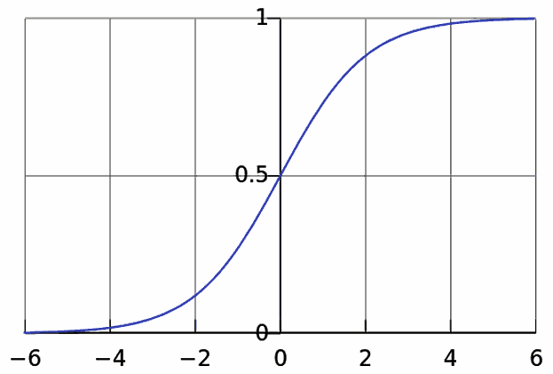
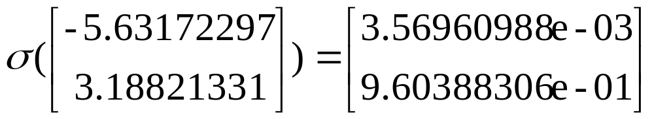
http://en.wikipedia.org/wiki/File:Logistic-curve.svg

Slide 27
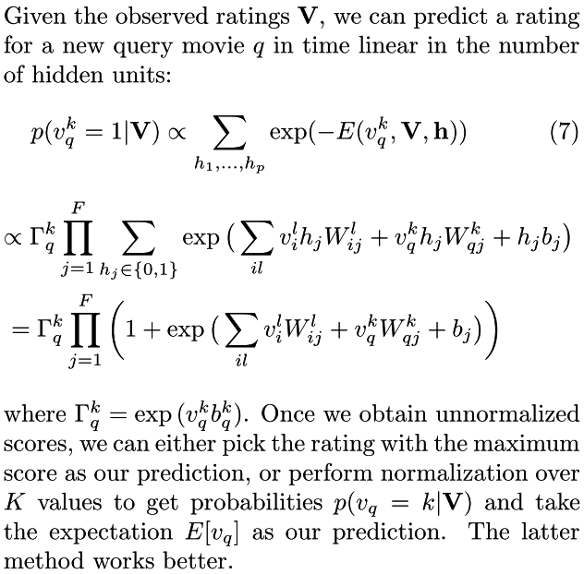
RBM prediction
Ruslan Salakhutdinov et al., "Restricted Boltzmann Machines for Collaborative Filtering"

Slide 28
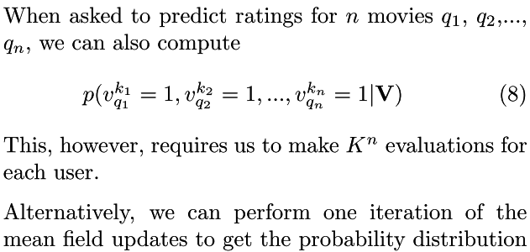
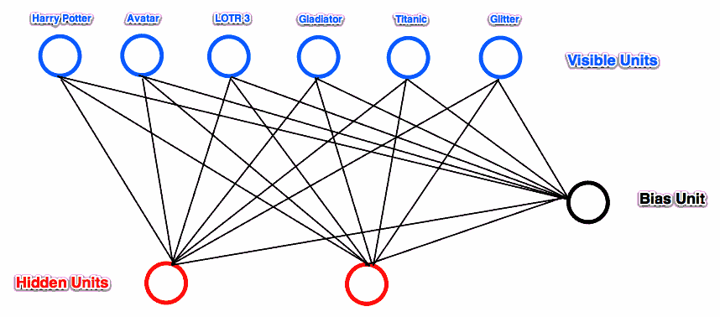
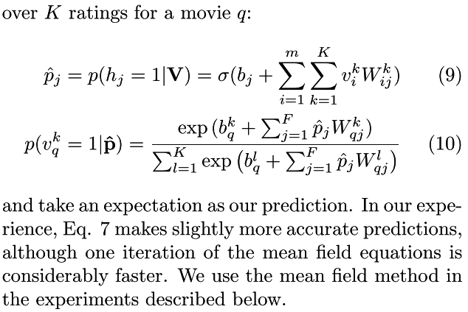
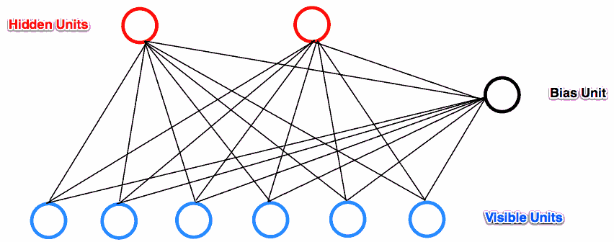
RBM prediction
Ruslan Salakhutdinov et al., "Restricted Boltzmann Machines for Collaborative Filtering"

Slide 29
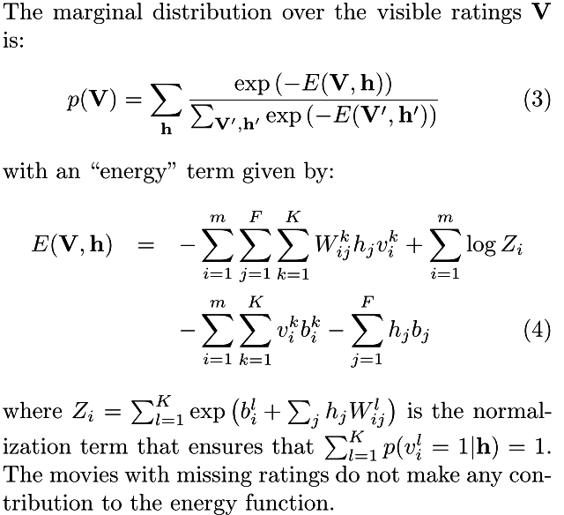
RBM learning
Ruslan Salakhutdinov et al., "Restricted Boltzmann Machines for Collaborative Filtering"

Slide 30
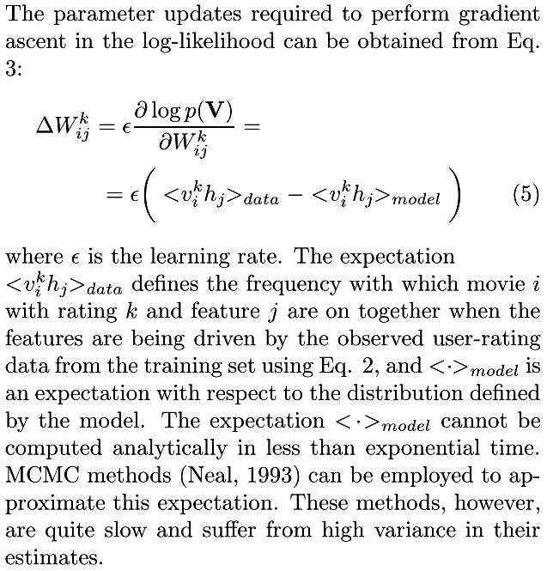
RBM learning
Ruslan Salakhutdinov et al., "Restricted Boltzmann Machines for Collaborative Filtering"

Slide 31
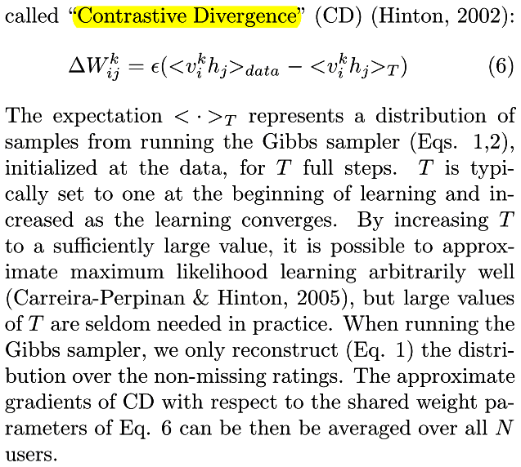
RBM learning
Ruslan Salakhutdinov et al., "Restricted Boltzmann Machines for Collaborative Filtering"

Slide 32
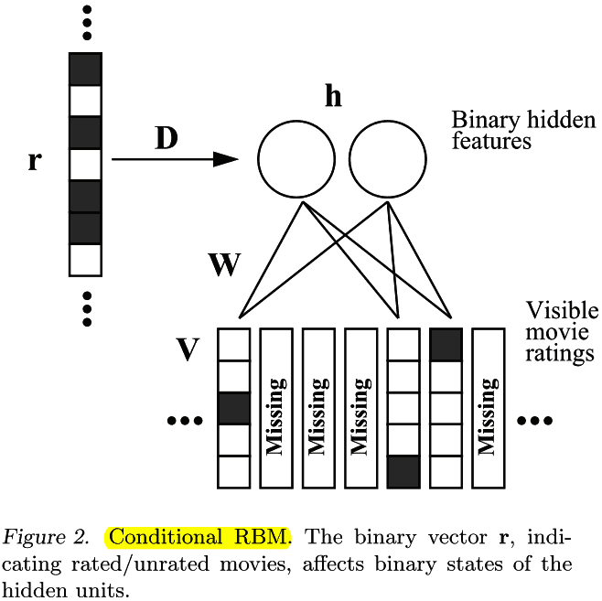
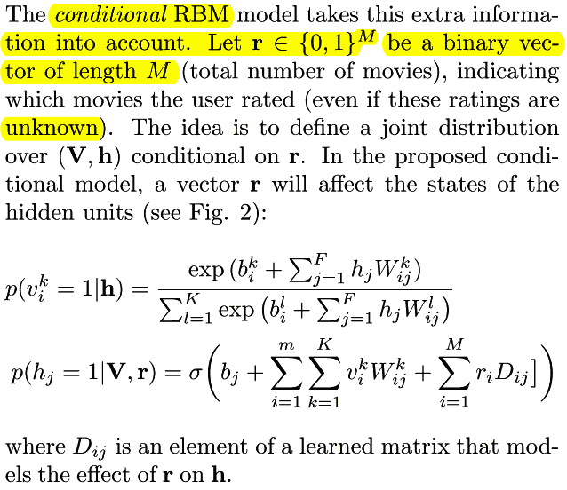
Conditional RBM (CRBM)
Ruslan Salakhutdinov et al., "Restricted Boltzmann Machines for Collaborative Filtering"

Slide 33
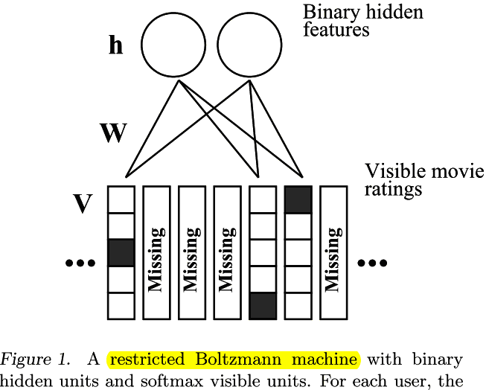

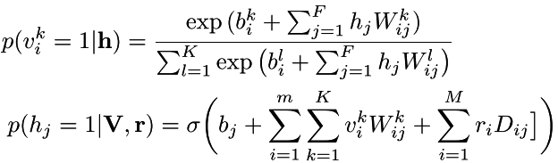

Conditional RBM (CRBM)
Ruslan Salakhutdinov et al., "Restricted Boltzmann Machines for Collaborative Filtering"

Slide 34
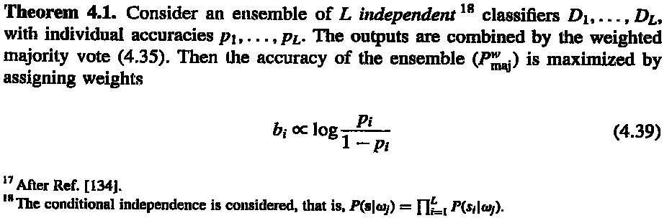
Weighted majority vote αm = log((1-e)/e)
Ludmila I. Kuncheva, "Combining Pattern Classifiers"
Notes:
x <- cbind(rep(seq(0,10,.2),each=51),rep(seq(0,10,.2),51))
cl <- apply(x,1,function(x) if((x[1]-x[2])>=0) "C1" else "C2")
col <- rep("blue",dim(x)[1])
col[which(cl=="C1")] <- "red"
plot(x,type='p',xlab="x1",ylab="x2",col=col,main="Original data")
x<-data.frame(x1=x[,1],x2=x[,2],class=cl)
ad <- adaboost.M1(class~.,x,mfinal=10)
for(i in 1:length(ad$trees)){
pred <- predict(ad$trees[[i]],x,type="class")
col <- rep("blue",dim(x)[1])
col[which(pred=="C1")] <- "red"
str <- sprintf("Classifier %i output, error: %f, weight: %f",
i,sum(pred!=x[,3])/dim(x)[1],ad$weights[i])
print(str)
x11()
plot(x[,1:2],type='p',xlab="x1",ylab="x2",col=col,main=str)
}
pred <- predict(ad,x)$class
col <- rep("blue",dim(x)[1])
col[which(pred=="C1")] <- "red"
str <- sprintf("Classifier 1~%i output, error: %f",
length(ad$trees),sum(pred!=x[,3])/dim(x)[1])
print(str)
x11()
plot(x[,1:2],type='p',xlab="x1",ylab="x2",col=col,main=str)

Slide 35
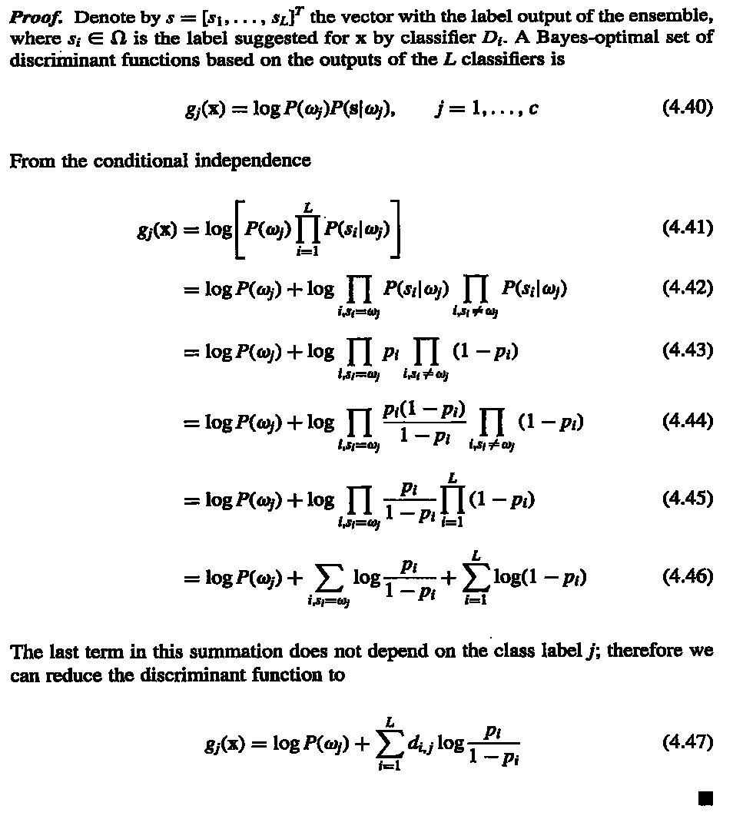
Ludmila I. Kuncheva, "Combining Pattern Classifiers"

Slide 36
Example
125特徵(CSHVPZ)，訓練資料311筆分四類，CSHVPZ各用訓練25隱藏神經元神經網路，驗證正確率分別為：0.84、0.87、0.61、0.58、0.59及0.59。，因此，分類器權重為：1.65、1.93、0.45、0.30、0.34及0.34。
測試資料383筆，正確率分別為：0.68、0.77、0.66、0.63、0.62及0.62。
合併後測試正確率為0.81。
http://ranger.uta.edu/~chqding/protein/

Slide 37
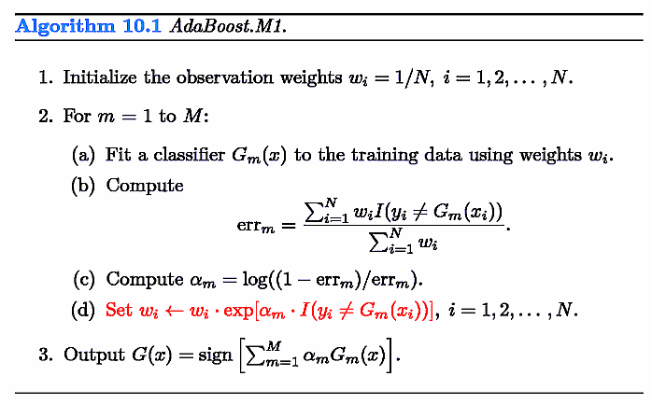
Adaboost
假設某一訓練資料在adaboost訓練時出現狀況(每一輪被選入訓練次數係根據上一輪該資料被分類對或錯的狀況決定)，例如：
第一輪0個，第一輪錯
第二輪2個，第二輪錯
第三輪6個，第三輪錯
第四輪11個，第四輪對
第五輪4個，第五輪錯
第六輪6個，第六輪錯
第七輪10個，第七輪對
第八輪8個，第八輪對
第九輪3個，第九輪錯
Trevor Hastie et al., "The Elements of Statistical Learning"
Notes:
x <- cbind(rep(seq(0,10,.2),each=51),rep(seq(0,10,.2),51))
cl <- apply(x,1,function(x) if((x[1]-x[2])>=0) "C1" else "C2")
col <- rep("blue",dim(x)[1])
col[which(cl=="C1")] <- "red"
plot(x,type='p',xlab="x1",ylab="x2",col=col,main="Original data")
x<-data.frame(x1=x[,1],x2=x[,2],class=cl)
ad <- adaboost.M1(class~.,x,mfinal=10)
for(i in 1:length(ad$trees)){
pred <- predict(ad$trees[[i]],x,type="class")
col <- rep("blue",dim(x)[1])
col[which(pred=="C1")] <- "red"
str <- sprintf("Classifier %i output, error: %f, weight: %f",
i,sum(pred!=x[,3])/dim(x)[1],ad$weights[i])
print(str)
x11()
plot(x[,1:2],type='p',xlab="x1",ylab="x2",col=col,main=str)
}
pred <- predict(ad,x)$class
col <- rep("blue",dim(x)[1])
col[which(pred=="C1")] <- "red"
str <- sprintf("Classifier 1~%i output, error: %f",
length(ad$trees),sum(pred!=x[,3])/dim(x)[1])
print(str)
x11()
plot(x[,1:2],type='p',xlab="x1",ylab="x2",col=col,main=str)

Slide 38
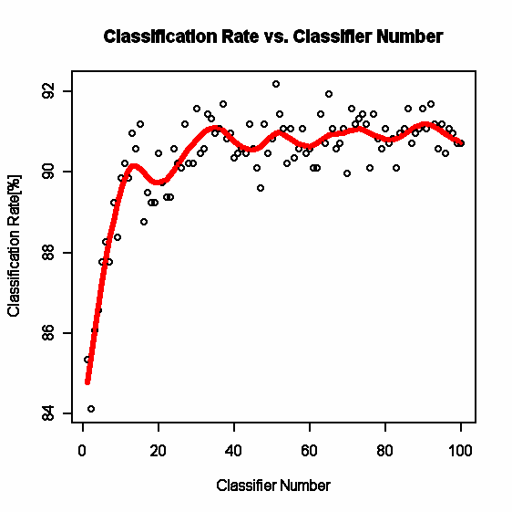
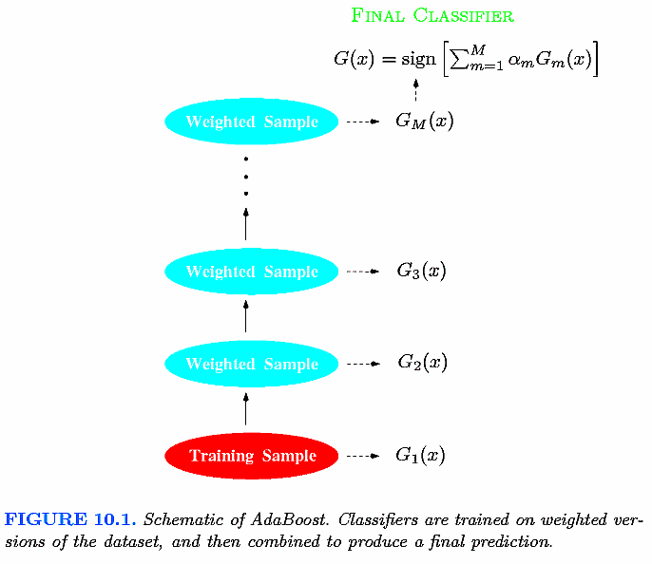
Adaboost
Trevor Hastie et al., "The Elements of Statistical Learning"

