Slide 1
IMPROVING THE WORST-CASE PERFORMANCE OF THE HUNT-SZYMANSKI STRATEGY FOR THE LOGEST COMMON SUBSEQUENCE OF TWO STRINGS
Alberto APOSTOLICO, Department of Computer Science, Purdue University.
Information Processing Letters 23 (1986) 63-69
Reporter : Cing-Yao Chen Date:2014/3/4

Slide 2
ABSTRUCT
Among the algorithms set up to date for finding the longest common subsequence of two strings, the one by Hunt and Szymanski exhibits the best known performance in favorable cases, but can be worse than any straightforward algorithm for a large variety of inputs. The new algorithm presented here pursues a schedule of primitive operations quite close to the one inherent to the Hunt-Szymanski strategy, but with substantially enhanced efficiency. In fact, the new algorithm improves on the former in two important respects. First, its worst case is never worse than linear in the product nm of the lengths of the two input strings. Second, its time bound does not always grow with the cardinality r of the set R of all pairs of matching positions of the input strings. Rather, it depends on the cardinality d of a specific subset of R, whose elements are called here dominant matches, and are elsewhere referred to as minimal candidates. This second improvement also appears of significance, since it seems that whenever r gets too close to mn, this forces d to be linear in m. The new algorithm requires standard preprocessing, and makes use of finger-trees. In a forthcoming paper, it will be shown among other things that the same performance can be achieved with simpler and handier auxiliary data structures.

Slide 3
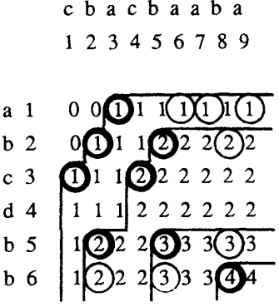
LCS
A = abcdbb
B = cbacbaaba
k:到[i,j]的LCS的長度
Match:圈圈
K-dominant:粗的圈圈
d:K-dominant的數量
l:LCS的長度,k<=l

Slide 4
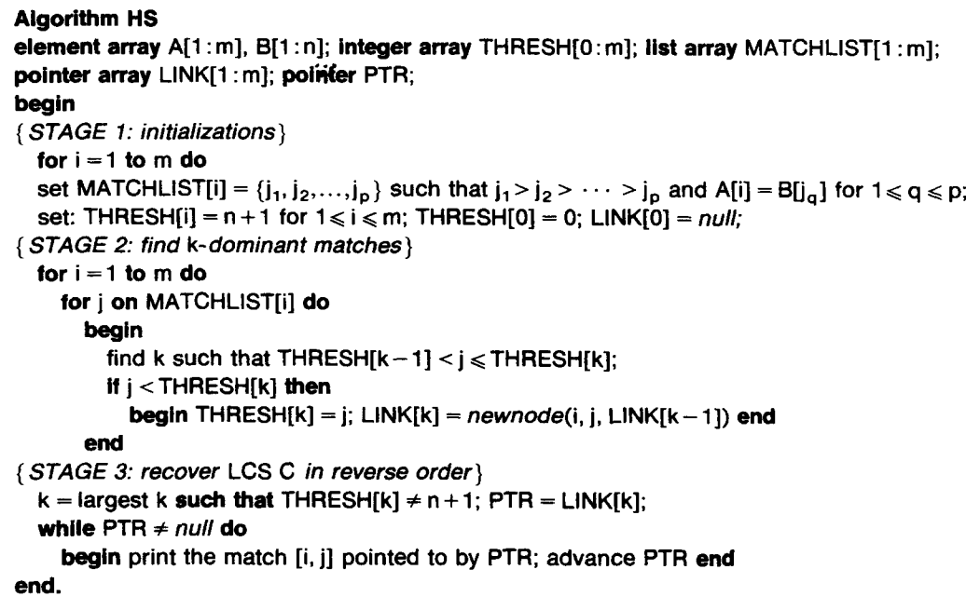
Algorithm HS

Slide 5
Algorithm HS
A
a
b
c
d
b
b
m=6
B
c
b
a
c
b
a
a
b
a
n=9
THRESH
LINK
PTR
MATCHLIST
1
2
3
4
5
6

Slide 6
Algorithm HS
A
a
b
c
d
b
b
m=6
i=1
B
c
b
a
c
b
a
a
b
a
n=9
THRESH
LINK
PTR
MATCHLIST
1
9, 7, 6, 3
2
3
4
5
6

Slide 7
Algorithm HS
A
a
b
c
d
b
b
m=6
i=2
B
c
b
a
c
b
a
a
b
a
n=9
THRESH
LINK
PTR
MATCHLIST
1
9, 7, 6, 3
2
8, 5, 2
3
4
5
6

Slide 8
Algorithm HS
A
a
b
c
d
b
b
m=6
i=6
B
c
b
a
c
b
a
a
b
a
n=9
THRESH
LINK
PTR
MATCHLIST
1
9, 7, 6, 3
2
8, 5, 2
3
4, 1
4
5
8, 5, 2
6
8, 5, 2

Slide 9
Algorithm HS
A
a
b
c
d
b
b
m=6
B
c
b
a
c
b
a
a
b
a
n=9
THRESH
LINK
10
10
10
0
10
10
10
PTR
MATCHLIST
1
9, 7, 6, 3
2
8, 5, 2
3
4, 1
4
5
8, 5, 2
6
8, 5, 2

Slide 10
Algorithm HS
A
a
b
c
d
b
b
m=6
i = 1
j = 9
B
c
b
a
c
b
a
a
b
a
n=9
THRESH
LINK
10
10
10
0
10
10
10
PTR
MATCHLIST
1
9, 7, 6, 3
2
8, 5, 2
3
4, 1
k=1
4
5
8, 5, 2
6
8, 5, 2

Slide 11
Algorithm HS
A
a
b
c
d
b
b
m=6
i = 1
j = 9
B
c
b
a
c
b
a
a
b
a
n=9
THRESH
LINK
10
10
10
0
9
10
10
1,9,null
PTR
MATCHLIST
1
9, 7, 6, 3
2
8, 5, 2
3
4, 1
k=1
4
5
8, 5, 2
6
8, 5, 2

Slide 12
Algorithm HS
A
a
b
c
d
b
b
m=6
i = 1
j = 7
B
c
b
a
c
b
a
a
b
a
n=9
THRESH
LINK
10
10
10
0
9
10
10
1,9,null
PTR
MATCHLIST
1
9, 7, 6, 3
2
8, 5, 2
3
4, 1
k=1
4
5
8, 5, 2
6
8, 5, 2

Slide 13
Algorithm HS
A
a
b
c
d
b
b
m=6
i = 1
j = 7
B
c
b
a
c
b
a
a
b
a
n=9
THRESH
LINK
10
10
10
0
7
10
10
1,7,null
PTR
MATCHLIST
1
9, 7, 6, 3
2
8, 5, 2
3
4, 1
k=1
4
5
8, 5, 2
6
8, 5, 2

Slide 14
Algorithm HS
A
a
b
c
d
b
b
m=6
i = 1
j = 6
B
c
b
a
c
b
a
a
b
a
n=9
THRESH
LINK
10
10
10
0
7
10
10
1,7,null
PTR
MATCHLIST
1
9, 7, 6, 3
2
8, 5, 2
3
4, 1
k=1
4
5
8, 5, 2
6
8, 5, 2

Slide 15
Algorithm HS
A
a
b
c
d
b
b
m=6
i = 1
j = 6
B
c
b
a
c
b
a
a
b
a
n=9
THRESH
LINK
10
10
10
0
6
10
10
1,6,null
PTR
MATCHLIST
1
9, 7, 6, 3
2
8, 5, 2
3
4, 1
k=1
4
5
8, 5, 2
6
8, 5, 2

Slide 16
Algorithm HS
A
a
b
c
d
b
b
m=6
i = 1
j = 3
B
c
b
a
c
b
a
a
b
a
n=9
THRESH
LINK
10
10
10
0
6
10
10
1,6,null
PTR
MATCHLIST
1
9, 7, 6, 3
2
8, 5, 2
3
4, 1
k=1
4
5
8, 5, 2
6
8, 5, 2

Slide 17
Algorithm HS
A
a
b
c
d
b
b
m=6
i = 1
j = 3
B
c
b
a
c
b
a
a
b
a
n=9
THRESH
LINK
10
10
10
0
3
10
10
1,3,null
PTR
MATCHLIST
1
9, 7, 6, 3
2
8, 5, 2
3
4, 1
k=1
4
5
8, 5, 2
6
8, 5, 2

Slide 18
Algorithm HS
A
a
b
c
d
b
b
m=6
i = 2
j = 8
B
c
b
a
c
b
a
a
b
a
n=9
THRESH
LINK
10
10
10
0
3
10
10
1,3,null
PTR
MATCHLIST
1
9, 7, 6, 3
2
8, 5, 2
3
4, 1
k=2
4
5
8, 5, 2
6
8, 5, 2

Slide 19
Algorithm HS
A
a
b
c
d
b
b
m=6
i = 2
j = 8
B
c
b
a
c
b
a
a
b
a
n=9
THRESH
LINK
10
10
0
3
8
10
10
1,3,null
2,8,L1
PTR
MATCHLIST
1
9, 7, 6, 3
2
8, 5, 2
3
4, 1
k=2
4
5
8, 5, 2
6
8, 5, 2

Slide 20
Algorithm HS
A
a
b
c
d
b
b
m=6
i = 2
j = 5
B
c
b
a
c
b
a
a
b
a
n=9
THRESH
LINK
10
10
0
3
8
10
10
1,3,null
2,8,L1
PTR
MATCHLIST
1
9, 7, 6, 3
2
8, 5, 2
3
4, 1
k=2
4
5
8, 5, 2
6
8, 5, 2

Slide 21
Algorithm HS
A
a
b
c
d
b
b
m=6
i = 2
j = 5
B
c
b
a
c
b
a
a
b
a
n=9
THRESH
LINK
10
10
0
3
5
10
10
1,3,null
2,5,L1
PTR
MATCHLIST
1
9, 7, 6, 3
2
8, 5, 2
3
4, 1
k=2
4
5
8, 5, 2
6
8, 5, 2

Slide 22
Algorithm HS
A
a
b
c
d
b
b
m=6
i = 2
j = 2
B
c
b
a
c
b
a
a
b
a
n=9
THRESH
LINK
10
10
0
3
5
10
10
1,3,null
2,5,L1
PTR
MATCHLIST
1
9, 7, 6, 3
2
8, 5, 2
3
4, 1
k=1
4
5
8, 5, 2
6
8, 5, 2

Slide 23
Algorithm HS
A
a
b
c
d
b
b
m=6
i = 2
j = 2
B
c
b
a
c
b
a
a
b
a
n=9
THRESH
LINK
10
10
0
2
5
10
10
2,2,null
2,5,L1
PTR
MATCHLIST
1
9, 7, 6, 3
2
8, 5, 2
3
4, 1
k=1
4
5
8, 5, 2
6
8, 5, 2

Slide 24
Algorithm HS
A
a
b
c
d
b
b
m=6
i = 3
j = 4
B
c
b
a
c
b
a
a
b
a
n=9
THRESH
LINK
10
10
0
2
5
10
10
2,2,null
2,5,L1
PTR
MATCHLIST
1
9, 7, 6, 3
2
8, 5, 2
3
4, 1
k=2
4
5
8, 5, 2
6
8, 5, 2

Slide 25
Algorithm HS
A
a
b
c
d
b
b
m=6
i = 3
j = 4
B
c
b
a
c
b
a
a
b
a
n=9
THRESH
LINK
10
10
0
2
4
10
10
2,2,null
3,4,L1
PTR
MATCHLIST
1
9, 7, 6, 3
2
8, 5, 2
3
4, 1
k=2
4
5
8, 5, 2
6
8, 5, 2

Slide 26
Algorithm HS
A
a
b
c
d
b
b
m=6
i = 3
j = 1
B
c
b
a
c
b
a
a
b
a
n=9
THRESH
LINK
10
10
0
2
4
10
10
2,2,null
3,4,L1
PTR
MATCHLIST
1
9, 7, 6, 3
2
8, 5, 2
3
4, 1
k=1
4
5
8, 5, 2
6
8, 5, 2

Slide 27
Algorithm HS
A
a
b
c
d
b
b
m=6
i = 3
j = 1
B
c
b
a
c
b
a
a
b
a
n=9
THRESH
LINK
10
10
0
1
4
10
10
3,1,null
3,4,L1
PTR
MATCHLIST
1
9, 7, 6, 3
2
8, 5, 2
3
4, 1
k=1
4
5
8, 5, 2
6
8, 5, 2

Slide 28
Algorithm HS
A
a
b
c
d
b
b
m=6
i = 5
j = 8
B
c
b
a
c
b
a
a
b
a
n=9
THRESH
LINK
10
10
0
1
4
10
10
3,1,null
3,4,L1
PTR
MATCHLIST
1
9, 7, 6, 3
2
8, 5, 2
3
4, 1
k=3
4
5
8, 5, 2
6
8, 5, 2

Slide 29
Algorithm HS
A
a
b
c
d
b
b
m=6
i = 5
j = 8
B
c
b
a
c
b
a
a
b
a
n=9
THRESH
LINK
10
10
0
1
4
8
10
3,1,null
5,8,L2
3,4,L1
PTR
MATCHLIST
1
9, 7, 6, 3
2
8, 5, 2
3
4, 1
k=3
4
5
8, 5, 2
6
8, 5, 2

Slide 30
Algorithm HS
A
a
b
c
d
b
b
m=6
i = 5
j = 5
B
c
b
a
c
b
a
a
b
a
n=9
THRESH
LINK
10
10
0
1
4
8
10
3,1,null
5,9,L2
3,4,L1
PTR
MATCHLIST
1
9, 7, 6, 3
2
8, 5, 2
3
4, 1
k=3
4
5
8, 5, 2
6
8, 5, 2

Slide 31
Algorithm HS
A
a
b
c
d
b
b
m=6
i = 5
j = 5
B
c
b
a
c
b
a
a
b
a
n=9
THRESH
LINK
10
10
0
1
4
5
10
3,1,null
5,5,L2
3,4,L1
PTR
MATCHLIST
1
9, 7, 6, 3
2
8, 5, 2
3
4, 1
k=3
4
5
8, 5, 2
6
8, 5, 2

Slide 32
Algorithm HS
A
a
b
c
d
b
b
m=6
i = 5
j = 2
B
c
b
a
c
b
a
a
b
a
n=9
THRESH
LINK
10
10
0
1
4
5
10
3,1,null
5,5,L2
3,4,L1
PTR
MATCHLIST
1
9, 7, 6, 3
2
8, 5, 2
3
4, 1
k=2
4
5
8, 5, 2
6
8, 5, 2

Slide 33
Algorithm HS
A
a
b
c
d
b
b
m=6
i = 5
j = 2
B
c
b
a
c
b
a
a
b
a
n=9
THRESH
LINK
10
10
0
1
2
5
10
3,1,null
5,5,L2
5,2,L1
PTR
MATCHLIST
1
9, 7, 6, 3
2
8, 5, 2
3
4, 1
k=2
4
5
8, 5, 2
6
8, 5, 2

Slide 34
Algorithm HS
A
a
b
c
d
b
b
m=6
i = 6
j = 8
B
c
b
a
c
b
a
a
b
a
n=9
THRESH
LINK
10
10
0
1
2
5
10
3,1,null
5,5,L2
5,2,L1
PTR
MATCHLIST
1
9, 7, 6, 3
2
8, 5, 2
3
4, 1
k=4
4
5
8, 5, 2
6
8, 5, 2

Slide 35
Algorithm HS
A
a
b
c
d
b
b
m=6
i = 6
j = 8
B
c
b
a
c
b
a
a
b
a
n=9
THRESH
LINK
10
0
1
2
5
8
10
3,1,null
5,5,L2
5,2,L1
6,8,L3
PTR
MATCHLIST
1
9, 7, 6, 3
2
8, 5, 2
3
4, 1
k=4
4
5
8, 5, 2
6
8, 5, 2

Slide 36
Algorithm HS
A
a
b
c
d
b
b
m=6
i = 6
j = 5
B
c
b
a
c
b
a
a
b
a
n=9
THRESH
LINK
10
0
1
2
5
8
10
3,1,null
5,5,L2
5,2,L1
6,8,L3
PTR
MATCHLIST
1
9, 7, 6, 3
2
8, 5, 2
3
4, 1
k=3
4
5
8, 5, 2
6
8, 5, 2

Slide 37
Algorithm HS
A
a
b
c
d
b
b
m=6
i = 6
j = 2
B
c
b
a
c
b
a
a
b
a
n=9
THRESH
LINK
10
0
1
2
5
8
10
3,1,null
5,5,L2
5,2,L1
6,8,L3
PTR
MATCHLIST
1
9, 7, 6, 3
2
8, 5, 2
3
4, 1
k=2
4
5
8, 5, 2
6
8, 5, 2

Slide 38
Algorithm HS
A
a
b
c
d
b
b
m=6
i = 6
j = 2
B
c
b
a
c
b
a
a
b
a
n=9
THRESH
LINK
10
0
1
2
5
8
10
3,1,null
5,5,L2
5,2,L1
6,8,L3
PTR
MATCHLIST
1
9, 7, 6, 3
2
8, 5, 2
3
4, 1
4
5
8, 5, 2
k=4
6
8, 5, 2

Slide 39
Algorithm HS
A
a
b
c
d
b
b
m=6
i = 6
j = 2
B
c
b
a
c
b
a
a
b
a
n=9
THRESH
LINK
10
0
1
2
5
8
10
3,1,null
5,5,L2
5,2,L1
6,8,L3
PTR
MATCHLIST
1
9, 7, 6, 3
2
8, 5, 2
3
4, 1
4
5
8, 5, 2
k=4
6
8, 5, 2
b

Slide 40
Algorithm HS
A
a
b
c
d
b
b
m=6
i = 6
j = 2
B
c
b
a
c
b
a
a
b
a
n=9
THRESH
LINK
10
0
1
2
5
8
10
3,1,null
5,5,L2
5,2,L1
6,8,L3
PTR
MATCHLIST
1
9, 7, 6, 3
2
8, 5, 2
3
4, 1
4
5
8, 5, 2
k=4
6
8, 5, 2
b b

Slide 41
Algorithm HS
A
a
b
c
d
b
b
m=6
i = 6
j = 2
B
c
b
a
c
b
a
a
b
a
n=9
THRESH
LINK
10
0
1
2
5
8
10
3,1,null
5,5,L2
5,2,L1
6,8,L3
PTR
MATCHLIST
1
9, 7, 6, 3
2
8, 5, 2
3
4, 1
4
5
8, 5, 2
k=4
6
8, 5, 2
b b c

Slide 42
Algorithm HS
A
a
b
c
d
b
b
m=6
i = 6
j = 2
B
c
b
a
c
b
a
a
b
a
n=9
THRESH
LINK
10
0
1
2
5
8
10
3,1,null
5,5,L2
5,2,L1
6,8,L3
PTR
MATCHLIST
1
9, 7, 6, 3
2
8, 5, 2
3
4, 1
4
5
8, 5, 2
k=4
6
8, 5, 2
b b c b

Slide 43
Worse Case
A = B
O(mn log n)
 | a | a | a | a | a
a | 1 | 1 | 1 | 1 | 1
a | 1 | 2 | 2 | 2 | 2
a | 1 | 2 | 3 | 3 | 3
a | 1 | 2 | 3 | 4 | 4
a | 1 | 2 | 3 | 4 | 5
MATCHLIST
1
5, 4, 3, 2, 1
2
5, 4, 3, 2, 1
3
5, 4, 3, 2, 1
4
5, 4, 3, 2, 1
5
5, 4, 3, 2, 1

Slide 44
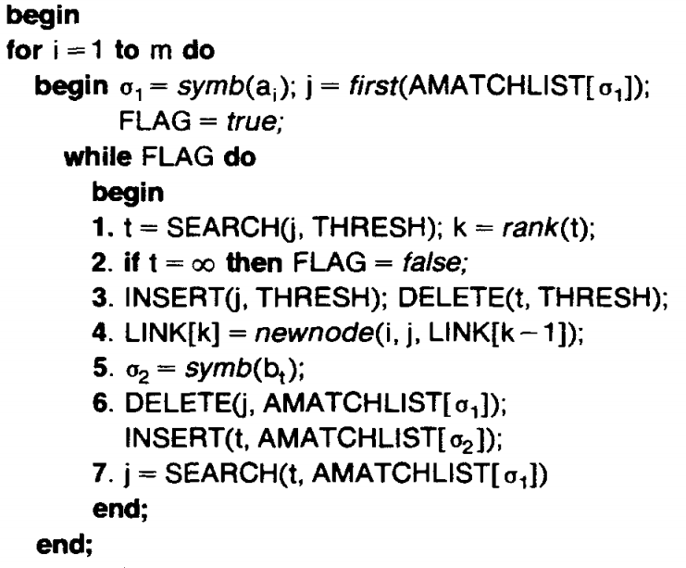
Algorithm HS1

Slide 45
Algorithm HS1
A
a
b
c
d
b
b
m=6
i = 7
j = 3
B
c
b
a
c
b
a
a
b
a
n=9
THRESH
LINK
10
0
1
2
5
8
10
3,1,null
5,5,L2
5,2,L1
6,8,L3
PTR
a 7
a
True
AMATCHLIST
(Active list)
a
3, 6, 7, 9
b
2, 5, 8
c
1, 4
d
b b c b

Slide 46
Algorithm HS1
A
a
b
c
d
b
b
m=6
i = 7
j = 3
B
c
b
a
c
b
a
a
b
a
n=9
THRESH
LINK
10
0
1
2
5
8
10
3,1,null
5,5,L2
5,2,L1
6,8,L3
PTR
a 7
a
True
5
AMATCHLIST
(Active list)
a
3, 6, 7, 9
b
2, 5, 8
c
1, 4
d
b b c b

Slide 47
Algorithm HS1
A
a
b
c
d
b
b
m=6
i = 7
j = 3
B
c
b
a
c
b
a
a
b
a
n=9
THRESH
LINK
10
0
1
2
3
8
10
3,1,null
5,5,L2
5,2,L1
6,8,L3
PTR
a 7
3
a
True
5
AMATCHLIST
(Active list)
a
3, 6, 7, 9
b
2, 5, 8
c
1, 4
d
b b c b

Slide 48
Algorithm HS1
A
a
b
c
d
b
b
m=6
i = 7
j = 3
B
c
b
a
c
b
a
a
b
a
n=9
THRESH
LINK
10
0
1
2
3
8
10
3,1,null
7,3,L2
5,2,L1
6,8,L3
PTR
a 7
3
a
True
5
AMATCHLIST
(Active list)
a
3, 6, 7, 9
b
2, 5, 8
c
1, 4
d
b b c b

Slide 49
Algorithm HS1
A
a
b
c
d
b
b
m=6
i = 7
j = 3
B
c
b
a
c
b
a
a
b
a
n=9
THRESH
LINK
10
0
1
2
3
8
10
3,1,null
7,3,L2
5,2,L1
6,8,L3
PTR
a 7
3
a
True
5
AMATCHLIST
(Active list)
a
3, 6, 7, 9
symb(bt) = b
b
2, 5, 8
c
1, 4
d
b b c b

Slide 50
Algorithm HS1
A
a
b
c
d
b
b
m=6
i = 7
j = 3
B
c
b
a
c
b
a
a
b
a
n=9
THRESH
LINK
10
0
1
2
3
8
10
3,1,null
7,3,L2
5,2,L1
6,8,L3
PTR
a 7
3
a
True
5
AMATCHLIST
(Active list)
a
6, 7, 9
symb(bt) = b
b
2, 5, 8
c
1, 4
d
b b c b

Slide 51
Algorithm HS1
A
a
b
c
d
b
b
m=6
i = 7
j = 6
B
c
b
a
c
b
a
a
b
a
n=9
THRESH
LINK
10
0
1
2
3
8
10
3,1,null
7,3,L2
5,2,L1
6,8,L3
PTR
a 7
3
a
True
5
AMATCHLIST
(Active list)
a
6, 7, 9
symb(bt) = b
b
2, 5, 8
c
1, 4
d
b b c b

Slide 52
Algorithm HS1
A
a
b
c
d
b
b
m=6
i = 7
j = 6
B
c
b
a
c
b
a
a
b
a
n=9
THRESH
LINK
10
0
1
2
3
8
10
3,1,null
7,3,L2
5,2,L1
6,8,L3
PTR
a 7
3
a
True
8
AMATCHLIST
(Active list)
a
6, 7, 9
symb(bt) = b
b
2, 5, 8
c
1, 4
d
b b c b

Slide 53
Algorithm HS1
A
a
b
c
d
b
b
m=6
i = 7
j = 6
B
c
b
a
c
b
a
a
b
a
n=9
THRESH
LINK
10
0
1
2
3
6
10
3,1,null
7,3,L2
5,2,L1
6,8,L3
PTR
a 7
3
3
a
True
8
AMATCHLIST
(Active list)
a
6, 7, 9
symb(bt) = b
b
2, 5, 8
c
1, 4
d
b b c b

Slide 54
Algorithm HS1
A
a
b
c
d
b
b
m=6
i = 7
j = 6
B
c
b
a
c
b
a
a
b
a
n=9
THRESH
LINK
10
0
1
2
3
6
10
3,1,null
7,6,L2
5,2,L1
6,8,L3
PTR
a 7
3
3
a
True
8
AMATCHLIST
(Active list)
a
6, 7, 9
symb(bt) = b
b
2, 5, 8
c
1, 4
d
b b c b

Slide 55
Algorithm HS1
A
a
b
c
d
b
b
m=6
i = 7
j = 6
B
c
b
a
c
b
a
a
b
a
n=9
THRESH
LINK
10
0
1
2
3
6
10
3,1,null
7,6,L2
5,2,L1
6,8,L3
PTR
a 7
3
3
a
True
8
AMATCHLIST
(Active list)
a
6, 7, 9
symb(bt) = b
b
2, 5, 8
c
1, 4
d
b b c b

Slide 56
Algorithm HS1
A
a
b
c
d
b
b
m=6
i = 7
j = 6
B
c
b
a
c
b
a
a
b
a
n=9
THRESH
LINK
10
0
1
2
3
6
10
3,1,null
7,6,L2
5,2,L1
6,8,L3
PTR
a 7
3
3
a
True
8
AMATCHLIST
(Active list)
a
7, 9
symb(bt) = b
b
2, 5, 8
c
1, 4
d
b b c b

Slide 57
Algorithm HS1
A
a
b
c
d
b
b
m=6
i = 7
j = 9
B
c
b
a
c
b
a
a
b
a
n=9
THRESH
LINK
10
0
1
2
3
6
10
3,1,null
7,6,L2
5,2,L1
6,8,L3
PTR
a 7
3
4
a
True
8
AMATCHLIST
(Active list)
a
7, 9
symb(bt) = b
b
2, 5, 8
c
1, 4
d
b b c b

Slide 58
Algorithm HS1
A
a
b
c
d
b
b
m=6
i = 7
j = 9
B
c
b
a
c
b
a
a
b
a
n=9
THRESH
LINK
10
0
1
2
3
6
10
3,1,null
7,6,L2
5,2,L1
6,8,L3
PTR
a 7
3
4
a
True
∞
AMATCHLIST
(Active list)
a
7, 9
symb(bt) = b
b
2, 5, 8
c
1, 4
d
b b c b

Slide 59
Algorithm HS1
A
a
b
c
d
b
b
m=6
i = 7
j = 9
B
c
b
a
c
b
a
a
b
a
n=9
THRESH
LINK
10
0
1
2
3
6
10
3,1,null
7,6,L2
5,2,L1
6,8,L3
PTR
a 7
3
4
a
False
∞
AMATCHLIST
(Active list)
a
7, 9
symb(bt) = b
b
2, 5, 8
c
1, 4
d
b b c b

Slide 60
Algorithm HS1
A
a
b
c
d
b
b
m=6
i = 7
j = 9
B
c
b
a
c
b
a
a
b
a
n=9
THRESH
LINK
0
1
2
3
6
9
10
3,1,null
7,6,L2
5,2,L1
6,8,L3
PTR
a 7
3
3
a
False
∞
AMATCHLIST
(Active list)
a
7, 9
symb(bt) = b
b
2, 5, 8
c
1, 4
d
b b c b

Slide 61
Algorithm HS1
A
a
b
c
d
b
b
m=6
i = 7
j = 9
B
c
b
a
c
b
a
a
b
a
n=9
THRESH
LINK
0
1
2
3
6
9
10
3,1,null
7,6,L2
7,9,L4
5,2,L1
6,8,L3
PTR
a 7
3
3
5
a
False
∞
AMATCHLIST
(Active list)
a
7, 9
symb(bt) = b
b
2, 5, 8
c
1, 4
d
b b c b

Slide 62
Algorithm HS1
A
a
b
c
d
b
b
m=6
i = 7
j = 9
B
c
b
a
c
b
a
a
b
a
n=9
THRESH
LINK
0
1
2
3
6
9
10
3,1,null
7,6,L2
7,9,L4
5,2,L1
6,8,L3
PTR
a 7
3
3
5
a
False
∞
AMATCHLIST
(Active list)
a
7, 9
symb(bt) =Λ
b
2, 5, 8
c
1, 4
d
b b c b

Slide 63
Algorithm HS1
A
a
b
c
d
b
b
m=6
i = 7
j = 9
B
c
b
a
c
b
a
a
b
a
n=9
THRESH
LINK
0
1
2
3
6
9
10
3,1,null
7,6,L2
7,9,L4
5,2,L1
6,8,L3
PTR
a 7
3
3
5
a
False
∞
AMATCHLIST
(Active list)
a
7,
symb(bt) =Λ
b
2, 5, 8
c
1, 4
d
Λ
∞
b b c b

Slide 64
Algorithm HS1
A
a
b
c
d
b
b
m=6
i = 7
j = ∞
B
c
b
a
c
b
a
a
b
a
n=9
THRESH
LINK
0
1
2
3
6
9
10
3,1,null
7,6,L2
7,9,L4
5,2,L1
6,8,L3
PTR
a 7
3
3
5
a
False
∞
AMATCHLIST
(Active list)
a
7,
symb(bt) =Λ
b
2, 5, 8
c
1, 4
d
Λ
∞
b b c b

Slide 65
Worst Case (HS1)
O(m log n + d log(mn/d))
d:
(i) the number of times that FLAG was true equals the
number of dominant matches detected so far,
(ii) j identifies the last dominant match detected, and
(iii) j is the only such match which has not been recorded yet.

Slide 66
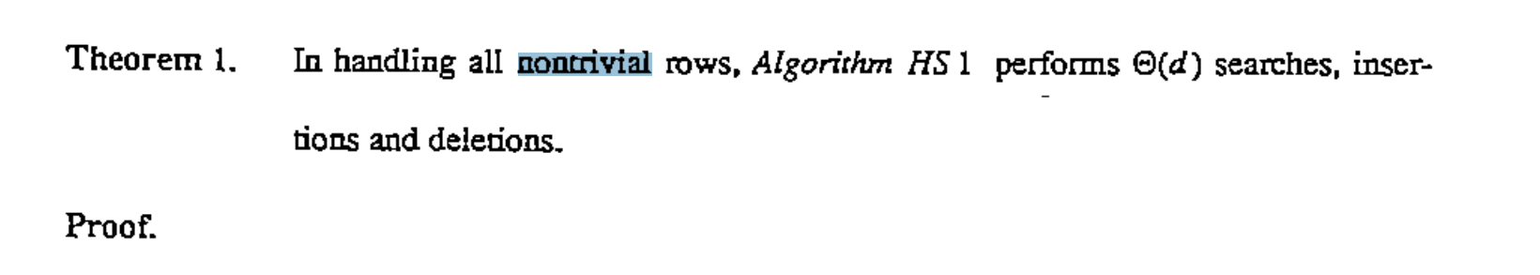
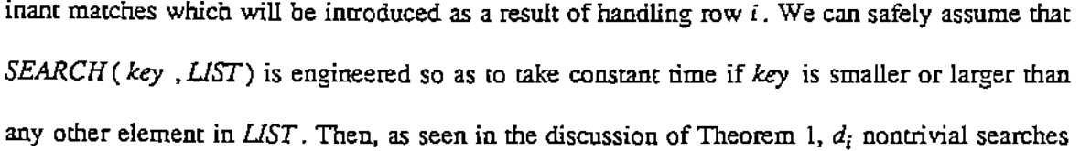
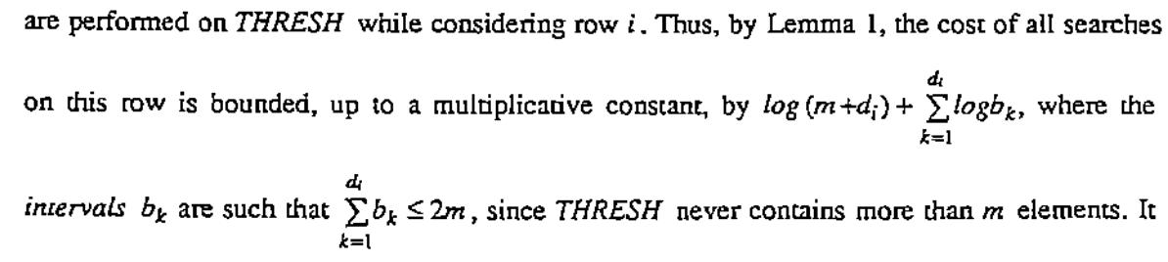
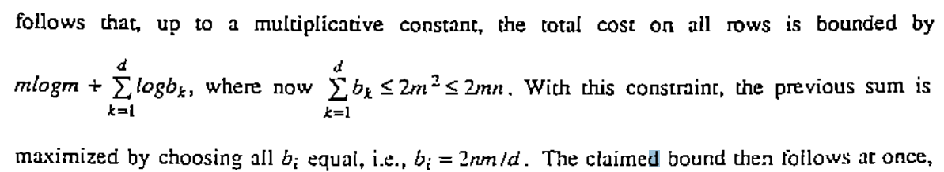
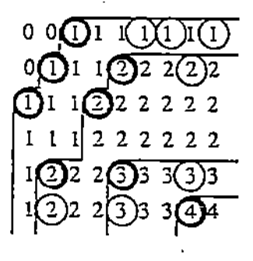
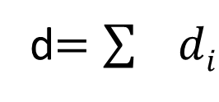
d_{i}
d$=\sum{di}$
~= 粗黑圈圈的個數
O(m log n + d log(mn/d))

