Slide 1
Flexible Dynamic Time Warping for Time Series
Presenter: Che-Jui Hsu(許哲睿)
Date: 2014/3/10

Slide 2
Dynamic Time Warping (1/4)
定義：Dynamic time warping (DTW) is an algorithm for measuring similarity between two sequences which may vary in time or speed.
Notes:
http://en.wikipedia.org/wiki/Dynamic_time_warping

Slide 3
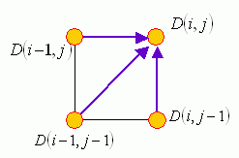

Dynamic Time Warping (2/4)
$D\left(i, j\right)=\text{cost}\left(i, j\right)+$ $\min\left(D\left(i−1, j\right),D\left(i, j−1\right),D\left(i,−1 j−1\right)\right)$
Notes:
Ref: http://mirlab.org/jang/books/dcpr/dpDtw.asp?title=8-4%20Dynamic%20Time%20Warping&language=all

Slide 4

Dynamic Time Warping (3/4)
$Q\left[i\right]=\left\{0.1, 0.3, 0.5, 0.4, 0.2\right\}$
$C\left[j\right]=\left\{0.3, 0.2, 0.4, 0.1, 0.5\right\}$
$cost\left(i, j\right)=\left|Q\left[i\right]−C\left[j\right]\right|$

Slide 5
Dynamic Time Warping (4/4)
0.5 | INF | 0.4+0.6 | 0.2+0.6 | 0+0.6 | 0.1+0.6 | 0.3+0.5
0.1 | INF | 0+0.6 | 0.2+0.4 | 0.4+0.4 | 0.3+0.4 | 0.1+0.4
0.4 | INF | 0.3+0.3 | 0.1+0.3 | 0.1+0.3 | 0+0.4 | 0.2+0.4
0.2 | INF | 0.1+0.2 | 0.1+0.2 | 0.3+0.2 | 0.2+0.4 | 0+0.5
0.3 | INF | 0.2+0 | 0+0.2 | 0.2+0.2 | 0.1+0.4 | 0.1+0.5
 | 0 | INF | INF | INF | INF | INF
 |  | 0.1 | 0.3 | 0.5 | 0.4 | 0.2
0.1 | 0.3 | 0.5 | 0.4 | 0.2
0.3 | 0.2 | 0.4 | 0.1 | 0.5

Slide 6
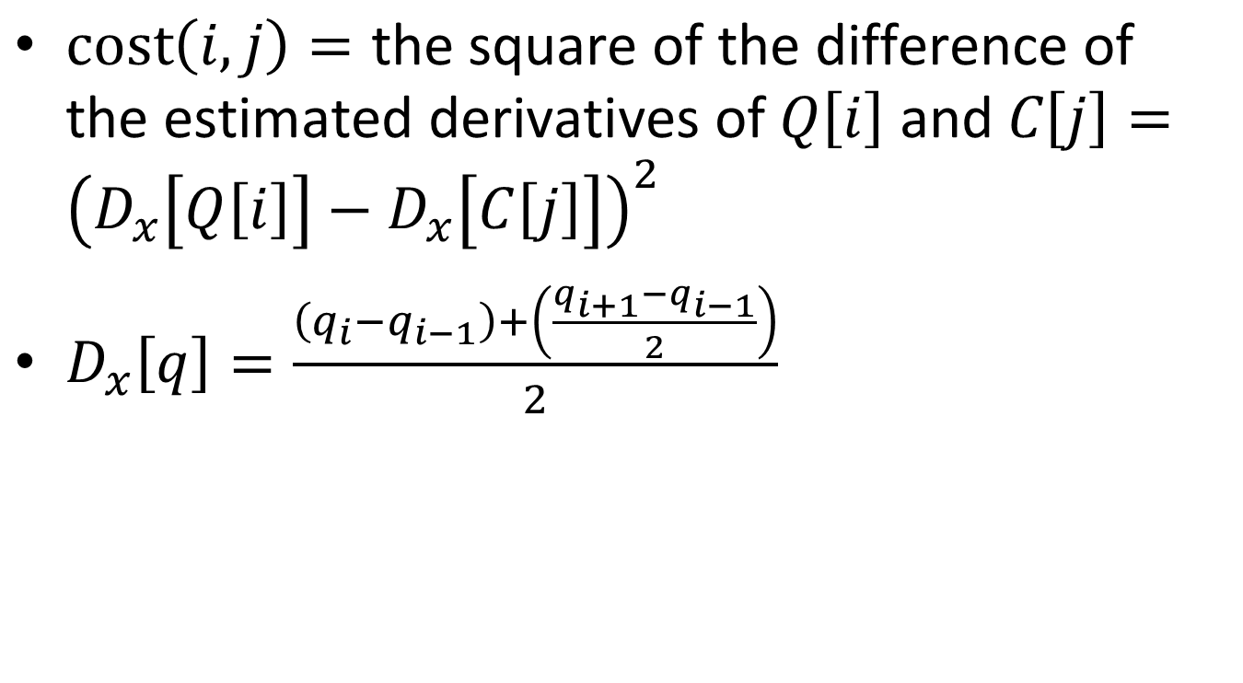
Derivative Dynamic Time Warping (DDTW)
$\text{cost}\left(i, j\right)=\text{the} \text{square} \text{of} \text{the} \text{difference} \text{of} \text{the} \text{estimated} \text{derivatives} \text{of} Q\left[i\right] \text{and} C\left[j\right]={\left(D_{x}\left[Q\left[i\right]\right]−D_{x}\left[C\left[j\right]\right]\right)}^{2}$
$D_{x}\left[q\right]=\frac{\left(q_{i}−q_{i−1}\right)+\left(\frac{q_{i+1}−q_{i−1}}{2}\right)}{2}$
Notes:
http://kanjiteacher.googlecode.com/svn/Non-Code/Papers/HWR/Keogh2001.pdf

Slide 7
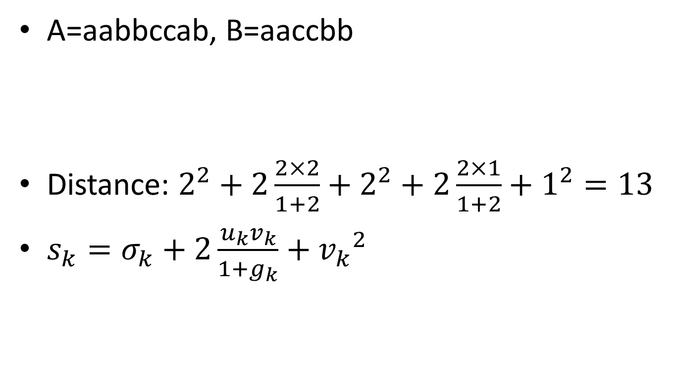
Flexible Longest Common Subsequence (FLCS) (1/2)
A=aabbccab, B=aaccbb
Distance: $2^{2}+2\frac{2×2}{1+2}+2^{2}+2\frac{2×1}{1+2}+1^{2}=13$
$s_{k}=σ_{k}+2\frac{u_{k}v_{k}}{1+g_{k}}+{v_{k}}^{2}$
A | a | a | b | b | c | c | - | a | b
B | a | a | - | - | c | c | b | - | b

Slide 8
Flexible Longest Common Subsequence (FLCS) (2/2)
 |  | a | a | c | c | b | b
 | 0.00 (0.00,∞) 0-0-0 | 0.00 (0.00,∞) 0-1-0 | 0.00 (0.00,∞) 0-2-0 | 0.00 (0.00,∞) 0-3-0 | 0.00 (0.00,∞) 0-4-0 | 0.00 (0.00,∞) 0-5-0 | 0.00 (0.00,∞) 0-6-0
a | 0.00 (0.00,∞) 0-1-0 | 1.00 (1.00,∞) 0-0-1 | 1.00 (1.00,∞) 0-1-1 | 1.00 (1.00,∞) 1-1-0 | 1.00 (1.00,∞) 1-2-0 | 1.00 (1.00,∞) 1-3-0 | 1.00 (1.00,∞) 1-4-0
a | 0.00 (0.00,∞) 0-2-0 | 1.00 (1.00,∞) 0-1-1 | 4.00 (4.00,∞) 0-0-2 | 4.00 (4.00,∞) 2-1-0 | 4.00 (4.00,∞) 2-2-0 | 4.00 (4.00,∞) 2-3-0 | 4.00 (4.00,∞) 2-4-0
b | 0.00 (0.00,∞) 0-3-0 | 1.00 (1.00,∞) 1-1-0 | 4.00 (4.00,∞) 2-1-0 | 4.00 (4.00,∞) 2-2-0 | 4.00 (4.00,∞) 2-3-0 | 6.33 (6.33,∞) 2-2-1 | 6.33 (6.33,0) 1-1-0 (6.00,∞) 2-3-1
b | 0.00 (0.00,∞) 0-4-0 | 1.00 (1.00,∞) 1-2-0 | 4.00 (4.00,∞) 2-2-0 | 4.00 (4.00,∞) 2-3-0 | 4.00 (4.00,∞) 2-4-0 | 6.33 (6.33,0) 1-1-0 (6.00,∞) 2-3-1 | 10.67 (10.67,∞) 2-2-2
c | 0.00 (0.00,∞) 0-5-0 | 1.00 (1.00,∞) 1-3-0 | 4.00 (4.00,∞) 2-3-0 | 6.33 (6.33,∞) 2-2-1 | 6.33 (6.33,0) 1-1-0 (6.00,∞) 2-3-1 | 6.33 (6.33,∞) 1-2-0 | 10.67 (10.67,∞) 2-1-0
c | 0.00 (0.00,∞) 0-6-0 | 1.00 (1.00,∞) 1-4-0 | 4.00 (4.00,∞) 2-4-0 | 6.33 (6.33,0) 1-1-0 (6.00,∞) 2-3-1 | 10.67 (10.67,∞) 2-2-2 | 10.67 (10.67,∞) 2-1-0 | 10.67 (10.67,∞) 2-2-0
a | 0.00 (0.00,∞) 0-7-0 | 1.00 (1.00,∞) 0-6-1 | 4.00 (4.00,0) 2-5-0 (2.40,∞) 1-4-1 | 6.33 (6.33,∞) 1-2-0 | 10.67 (10.67,∞) 2-1-0 | 10.67 (10.67,∞) 2-2-0 | 10.67 (10.67,∞) 2-3-0
b | 0.00 (0.00,∞) 0-8-0 | 1.00 (1.00,∞) 1-1-0 | 4.00 (4.00,∞) 2-6-0 | 6.33 (6.33,∞) 1-3-0 | 10.67 (10.67,∞) 2-2-0 | 13.67 (13.67,∞) 2-1-1 | 13.67 (13.67,0) 1-1-0 (13.00,∞) 2-2-1

Slide 9
Our Method (1/3)
Like FLCS, while calculate the distance, adding the distance of gap.
Problem:
LCS is calculate for similarity but DTW is calculate for distance. (need to change the formula)
The data of time series are all floating numbers and they may be greater than 1 or less than 1.

Slide 10
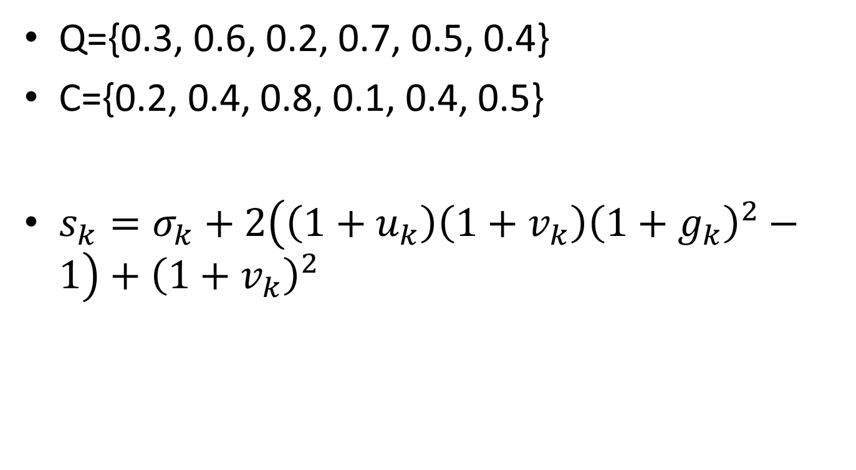
Our Method (2/3)
Q={0.3, 0.6, 0.2, 0.7, 0.5, 0.4}
C={0.2, 0.4, 0.8, 0.1, 0.4, 0.5}
$s_{k}=σ_{k}+2\left(\left(1+u_{k}\right)\left(1+v_{k}\right){\left(1+g_{k}\right)}^{2}−1\right)+{\left(1+v_{k}\right)}^{2}$

Slide 11
Our Method (3/3)
 |  | 0.2 | 0.4 | 0.8 | 0.1 | 0.4 | 0.5
 | Infinity (0.00,∞) 0.00-0.00-0.00 | Infinity (0.88,∞) 0.00-0.20-0.00 | Infinity (3.12,∞) 0.00-0.60-0.00 | Infinity (9.52,∞) 0.00-1.40-0.00 | Infinity (10.50,∞) 0.00-1.50-0.00 | Infinity (14.82,∞) 0.00-1.90-0.00 | Infinity (21.12,∞) 0.00-2.40-0.00
0.3 | Infinity (1.38,∞) 0.00-0.30-0.00 | 0.41 (0.41,∞) 0.00-0.00-0.10 | 1.07 (1.38,∞) 0.00-0.20-0.10 (1.07,∞) 0.10-0.10-0.00 | 4.04 (6.93,∞) 0.00-0.60-0.50 (4.04,∞) 0.10-0.60-0.00 | 5.54 (12.26,∞) 0.00-1.40-0.20 (5.54,∞) 0.10-0.80-0.00 | 6.35 (11.96,∞) 0.00-1.50-0.10 (6.35,∞) 0.10-0.90-0.00 | 8.11 (18.62,∞) 0.00-1.90-0.20 (8.11,∞) 0.10-1.10-0.00
0.6 | Infinity (5.22,∞) 0.00-0.90-0.00 | 2.72 (3.69,∞) 0.00-0.30-0.40 (2.72,∞) 0.10-0.40-0.00 | 1.29 (1.29,∞) 0.00-0.00-0.30 | 2.04 (2.43,∞) 0.00-0.20-0.30 (2.04,∞) 0.10-0.10-0.20 | 5.44 (11.24,∞) 0.00-0.60-1.00 (8.11,∞) 0.10-0.60-0.50 (5.44,∞) 0.20-0.50-0.00 | 6.98 (15.09,∞) 0.00-1.40-0.40 (7.40,∞) 0.10-0.80-0.20 (6.98,∞) 0.20-0.70-0.00 | 7.36 (13.44,∞) 0.00-1.50-0.20 (7.36,∞) 0.10-0.90-0.10
0.2 | Infinity (6.82,∞) 0.00-1.10-0.00 | 2.72 (2.72,∞) 0.10-0.40-0.00 | 3.03 (4.97,∞) 0.00-0.30-0.60 (4.02,∞) 0.10-0.40-0.20 (3.03,∞) 0.30-0.20-0.00 | 4.41 (4.41,∞) 0.00-0.00-0.90 | 2.56 (2.99,∞) 0.00-0.20-0.40 (2.56,∞) 0.10-0.10-0.30 | 4.30 (13.10,∞) 0.00-0.60-1.20 (9.87,∞) 0.10-0.60-0.70 (6.96,∞) 0.20-0.50-0.20 (4.30,∞) 0.30-0.20-0.00 | 6.41 (19.47,∞) 0.00-1.40-0.70 (10.35,∞) 0.10-0.80-0.50 (9.75,∞) 0.20-0.70-0.30 (6.41,∞) 0.30-0.50-0.00
0.7 | Infinity (13.68,∞) 0.00-1.80-0.00 | 6.35 (12.48,∞) 0.00-1.10-0.50 (6.35,∞) 0.10-0.90-0.00 | 4.71 (4.71,∞) 0.10-0.40-0.30 | 3.62 (5.64,∞) 0.00-0.30-0.70 (4.71,∞) 0.10-0.40-0.30 (3.62,∞) 0.30-0.20-0.10 | 7.22 (8.25,∞) 0.00-0.00-1.50 (7.22,∞) 0.30-0.60-0.00 | 4.23 (4.79,∞) 0.00-0.20-0.70 (4.23,∞) 0.10-0.10-0.60 | 5.49 (15.05,∞) 0.00-0.60-1.40 (11.72,∞) 0.10-0.60-0.90 (8.56,∞) 0.20-0.50-0.40 (5.49,∞) 0.30-0.20-0.20
0.5 | Infinity (19.78,∞) 0.00-2.30-0.00 | 9.06 (19.07,∞) 0.00-1.80-0.30 (9.06,∞) 0.10-1.20-0.00 | 5.85 (13.67,∞) 0.00-1.10-0.60 (7.36,∞) 0.10-0.90-0.10 (5.85,∞) 0.30-0.10-0.00 | 5.34 (6.87,∞) 0.10-0.40-0.60 (5.34,∞) 0.10-0.30-0.00 | 6.16 (8.51,∞) 0.00-0.30-1.10 (7.63,∞) 0.10-0.40-0.70 (6.16,∞) 0.30-0.20-0.50 | 6.10 (8.96,∞) 0.00-0.00-1.60 (8.09,∞) 0.30-0.60-0.10 (6.10,∞) 0.60-0.10-0.00 | 4.23 (4.79,∞) 0.00-0.20-0.70 (4.23,∞) 0.10-0.10-0.60
0.4 | Infinity (25.38,∞) 0.00-2.70-0.00 | 11.08 (24.58,∞) 0.00-2.30-0.20 (11.08,∞) 0.10-1.40-0.00 | 5.85 (19.07,∞) 0.00-1.80-0.30 (5.85,∞) 0.30-0.10-0.00 | 7.98 (18.64,∞) 0.00-1.10-1.00 (11.57,∞) 0.10-0.90-0.50 (8.07,∞) 0.30-0.10-0.40 (7.98,∞) 0.10-0.70-0.00 | 7.14 (9.21,∞) 0.10-0.40-0.90 (7.14,∞) 0.10-0.30-0.30 | 6.10 (8.51,∞) 0.00-0.30-1.10 (7.63,∞) 0.10-0.40-0.70 (6.16,∞) 0.30-0.20-0.50 (6.10,∞) 0.60-0.10-0.00 | 6.10 (9.69,∞) 0.00-0.00-1.70 (8.99,∞) 0.30-0.60-0.20 (6.70,∞) 0.60-0.10-0.10 (6.10,∞) 0.60-0.10-0.00

Slide 12
UCR Time Series
http://www.cs.ucr.edu/~eamonn/time_series_data/

Slide 13
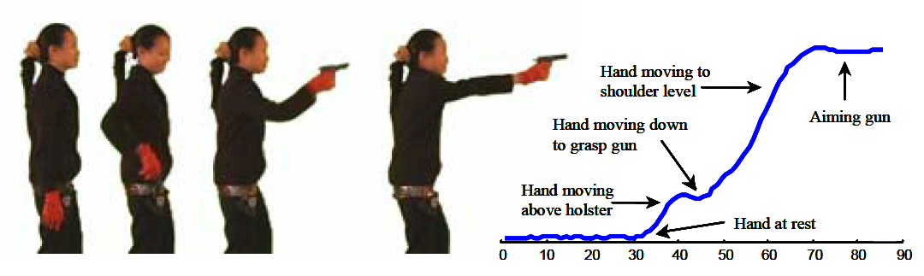
Video Retrieval
Notes:
http://www.cs.ucr.edu/~eamonn/DTW_myths.pdf

Slide 14
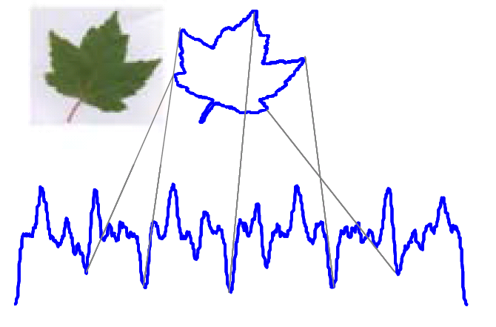
Image Retrieval
Notes:
http://www.cs.ucr.edu/~eamonn/DTW_myths.pdf

Slide 15
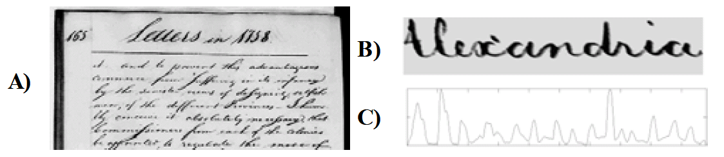
Handwriting Retrieval
Notes:
http://www.cs.ucr.edu/~eamonn/DTW_myths.pdf

Slide 16
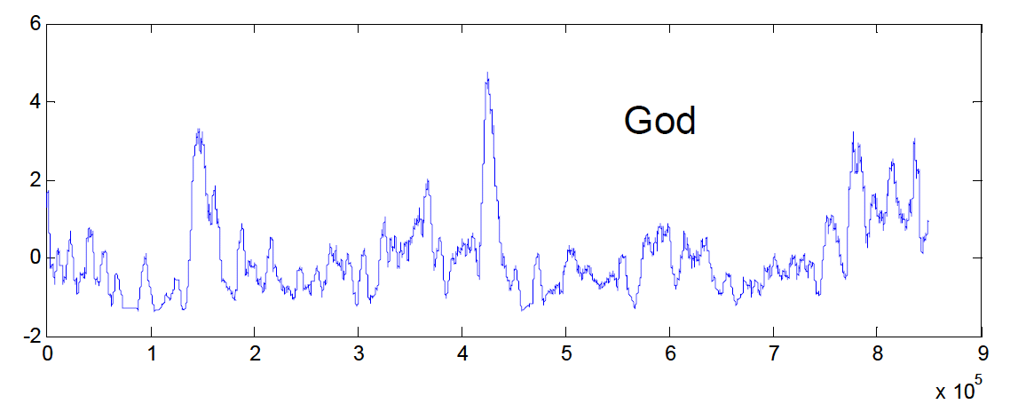
Text Mining
“In the beginning God created the heaven and the earth” => “0001000000”
Notes:
http://www.cs.ucr.edu/~eamonn/DTW_myths.pdf

