Slide 1
The alignment of sets of sequences and the construction of phylogenetic trees: An integrated method
P. Hogeweg, B. Hesper
Joural of Molecular Evolution
1984, Volume 20,Issue 2, pp 175-186
Presenter: Ding-Yao Huang
2014/3/10

Slide 2
Abstract
In this paper we argue that the alignment of sets of sequences and the construction of phyletic trees cannot be treated separately. The concept of ‘good alignment’ is meaningless without reference to a phyletic tree, and the construction of phyletic trees presupposes alignment of the sequences.
We propose an integrated method that generates both an alignment of a set of sequences and a phyletic tree. In this method a putative tree is used to align the sequences and the alignment obtained is used to adjust the tree; this process is iterated. As a demonstration we apply the method to the analysis of the evolution of 5S rRNA sequences in prokaryotes.

Slide 3
The Alignment of Molecular Sequences
Alignment
Insertions
Deletions
Changes
Bias
Bias=X,Y
X 是 insertion/deletion 的penalty(假設1)
Y 是根據空格長度的penalty(假設0.1)
Sequence A
Sequence B
FAJG_SDJ_FZX
F_JABS_JCFZX
FAJG_SDJ_FZX
F_JABS_JCFZX
7-2*1-2*1-4*0.1-2=0.4

Slide 4
Phyletic Tree Construction
Heuristic methods
Matrix method
No need a global alignment
Character-based method
Need a global alignment
 | A | B | C | D
A | - | 0.3 | 0.6 | 0.4
B | 0.3 | - | 0.2 | 0.8
C | 0.6 | 0.2 | - | 0.6
D | 0.4 | 0.8 | 0.6 | -
Species A
Species B
FAJG_SDJ_FZX
F_JABS_JCFZX

Slide 5
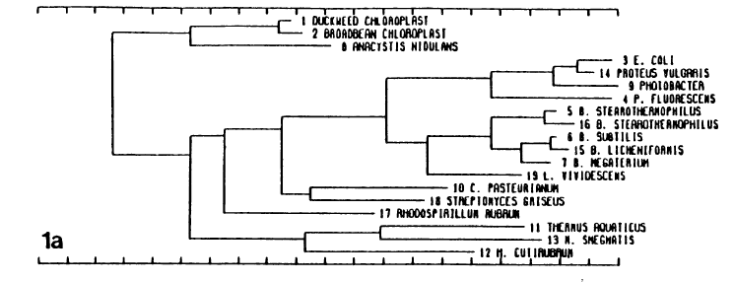
Tree

Slide 6
Method(outline)
1. The concept of ‘good alignment’ refers to ancestry
2. Alignment and tree construction are decided by maximal matching
3. Pairwise alignments are feasible
4. Use matrix method to construct the tree
5. This tree is a binary tree
6. Alignments of the similarity sequence are the most reliable
7. Internode sequence
ATCGCGATA
ATCGCGGTA
ATTGCGATA

Slide 7
Method
Step1: Create N*N similarity matrix
Step2: Construct phyletic tree
Step3: Construct pairwise alignments and internode sequence
Step4: Calculate the number of mutations and draw the tree
Step5: Calculate character weights by the mutational frequency
Step6: Adjust the similarity matrix by character weights
Step7: Repeat from Step2 until convergence or the stopping rule is satisfied

Slide 8
Method
Step1:
Create N*N similarity matrix
Step2: Construct phyletic tree
 | A | B | C | D
A | - | 0.3 | 0.6 | 0.4
B | 0.3 | - | 0.2 | 0.8
C | 0.6 | 0.2 | - | 0.6
D | 0.4 | 0.8 | 0.6 | -

Slide 9
Method
Step3:
Construct pairwise alignments and internode sequence
Step4: Calculate the number of mutations and sign the branch length
ATCGCGATA
|||| | | ||
ATCGCGATA
ATCGCGGTA
ATCGCGGTA
ATTGCGATA
ATCGCGATA
1
1
ATCGCGGTA
ATTGCGATA

Slide 10
Method
Step5: Calculate character weights by the mutational frequency
W_{i}=N_{i}/(M_{i}+1)
Step6: Adjust the similarity matrix by character weights
Step7:
Repeat from Step2 until convergence or the stopping rule is satisfied
W_{i:} the weight at the i-th position
N_{i :} the number of difference amino acid at this position
M_{i} :the number of the mutations at this position
 | A | B | C | D
A | - | 0.3 | 0.6 | 0.4
B | 0.3 | - | 0.2 | 0.8
C | 0.6 | 0.2 | - | 0.6
D | 0.4 | 0.8 | 0.6 | -

Slide 11
Implementation of The Method (Group Averaging)
UPGMA
1
A
2
4
7
3
B
C
3
2
E
 | A | B | C | D | E
A | - | 8 | 6 | 11 | 12
B |  | - | 12 | 17 | 18
C |  |  | - | 11 | 12
D |  |  |  | - | 3
E |  |  |  |  | -
1
D

Slide 12
Implementation of The Method (Group Averaging)
 | A | B | C | D
A | - | 8 | 6 | 11
B |  | - | 12 | 17
C |  |  | - | 11
D |  |  |  | -
 | A-C | B | D
A-C | - | 10 | 11
B |  | - | 17
D |  |  | -
A
C
B
D

Slide 13
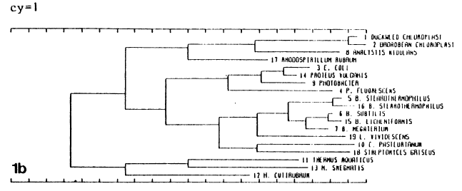
5S-rRNA(group averaging)

Slide 14
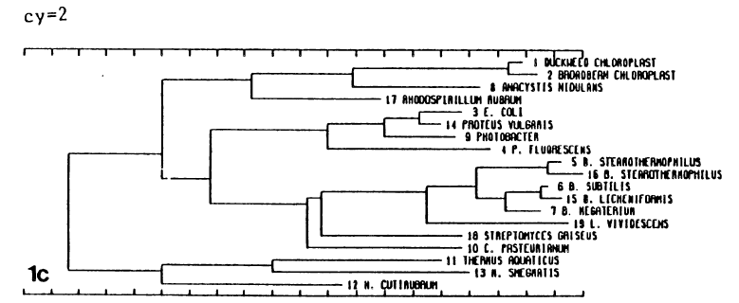
5S-rRNA(group averaging)

Slide 15
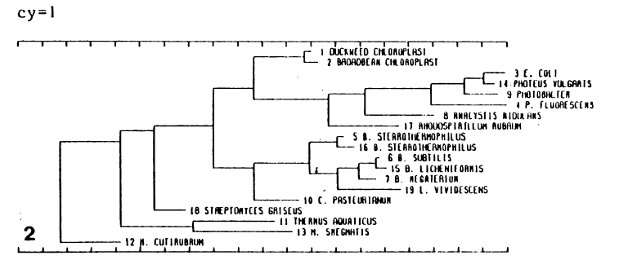
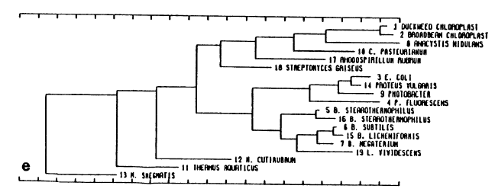
5S-rRNA(Present-Day Ancestor Method)

Slide 16
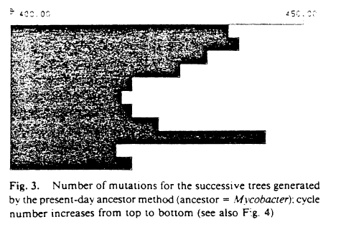
5S-rRNA(Present-Day Ancestor Method)

Slide 17
Conclusions
Propose an integrated method
Alignment
Phyletic tree
Use non-optimal methods optimally
Flexibility
Explicitness

