Slide 1
The Disulfide Connectivity Prediction
Student: Jun-Yi Fang (方鈞毅)
Advisor: Prof. Chang-Biau Yang (楊昌彪)
Date: March 17, 2014

Slide 2
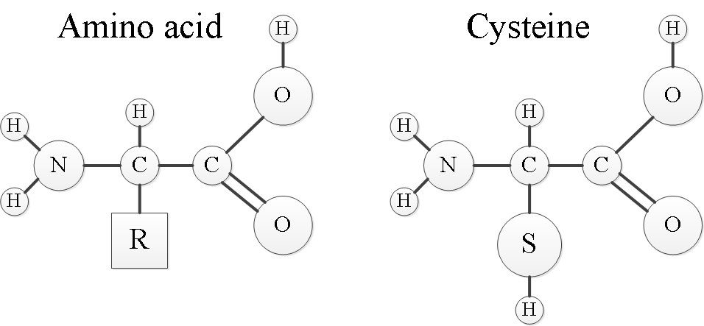
Introduction (1/6)
There are two substructures of an amino acid.
core part ,and side chain
We usually a symbol “R” to represent a side chain, the others are the core part.
Different amino acids with a different compositions of the side chain.
There are twenty more amino acids.

Slide 3
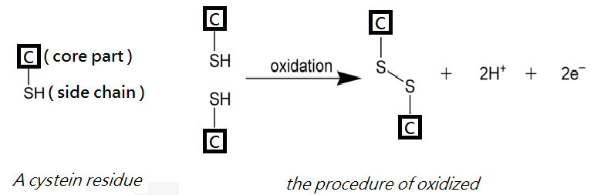
Introduction (2/6)
A disulfide bond is a single covalent bond fromed by two oxidized cystein residues.

Slide 4
Introduction (3/6)
Proteins are lists of Amino Acids
There are many ways to represent a protein. First, the primary structure.
Different English letters represent different kinds of Amino Acids.
eg
id: 2AJW with its primary structure as following
primary structure: GCCSNPVCHLEHSNLCGGAAGG

Slide 5
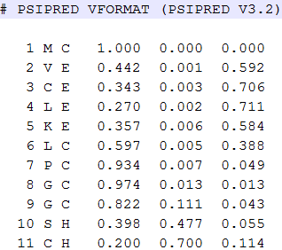
Introduction (4/6)
Second, is secondary structure, which show one of the three states, coil ”C”, helix “H”, and sheet ”S”, for a amino acid.
Here is a example generate by PSI-Blast

Slide 6
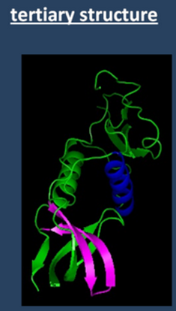
Introduction (5/6)
Third , Tertiary structure
three-dimensional atomic coordinates.
Forth, Quaternary structure

Slide 7
Introduction (6/6)
The definition of the disulfide problem
Input:
A protein primary structure.
the bonding states of all cysteines.
Output:
The disulfide connectivity pattern for the protein.
Example:
Input:
primary structure: GCCSNPVCHLEHSNLCGGAAGG
All cysteines are in oxidized state.
Output:
The bonding pattern: 1- 2 -1 -2

Slide 8
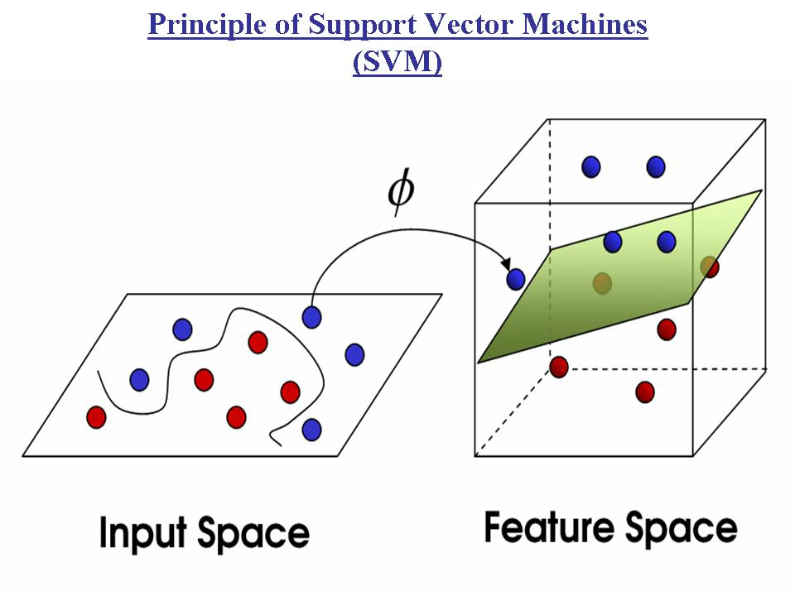
Support Vector Machine (SVM)
SVM is a machine learning , designed for 2-class clasification problems.
It use a kernel function φ to map the datas into a feature space and find a best hyperplane to divide different groups of samples.

Slide 9
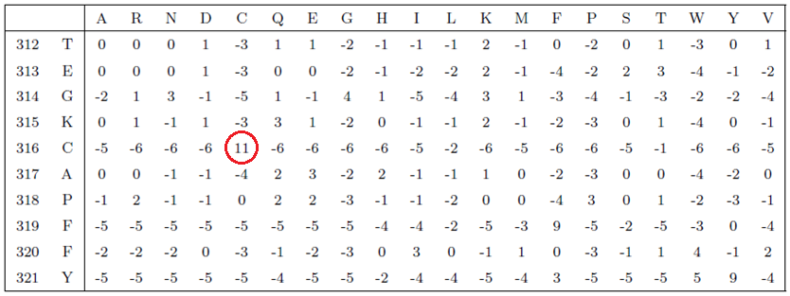
Position-specific Scoring Matrix (PSSM)
PSSM matrix: generated by PSI-BLAST according to the occurrence frequency of the aligned amino acids.
A4_HUMAN

Slide 10
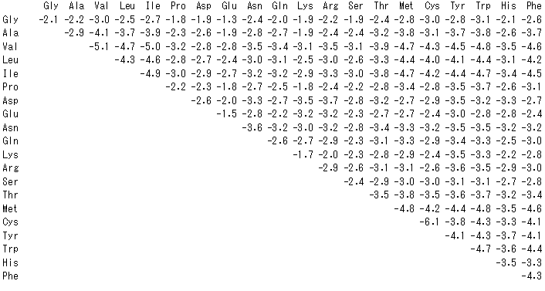
Contact potential
A statistical potential or knowledge-based potential is an energy function derived from an analysis of known protein structures in the Protein Data Bank.

Slide 11
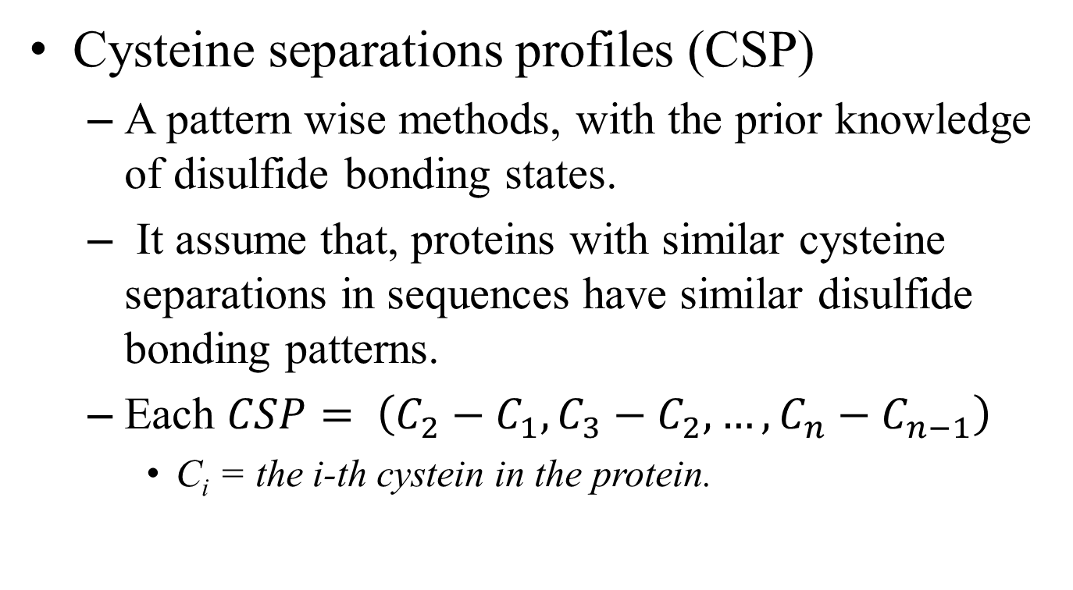
Zhao’s Method by Using Cysteine Separations Profiles
Cysteine separations profiles (CSP)
A pattern wise methods, with the prior knowledge of disulfide bonding states.
It assume that, proteins with similar cysteine separations in sequences have similar disulfide bonding patterns.
Each $CSP= \left(C_{2}−C_{1},C_{3}−C_{2},…,C_{n}−C_{n−1}\right)$
C_{i} = the i-thcystein in the protein.

Slide 12
SVM methods
Predict the connecting of each cysteines in a protein pairwisely.
Features
Position-specific Scoring Matrix (PSSM)
Secondly structure,...,etc
Using svm to predict the probability of each pairs.
Finally, turn each pairs of cysteines into a graph matching problem to forcast the disulfide pattern.
Nodes as cysteines
Edges are probability of each pairs of cysteines.

Slide 13
Chen’s Hybird Method by Using Behavior Knowledge Space(BKS)
Methods:
SVM methods with different paremeters.
Cysteine separations profiles (CSP).
voting protocol
Using Behavior Knowledge Space(BKS) to choose pripor solutions.

Slide 14
Hung’s Method by Using the Structural Information
Take the three dimension position of residue , produced by MODELLER, as one of SVM features.
This methods without the prior knowledge of cysteines bonding state.
Using the Multiple Trajectory Search(MTS) to adjust the parameters of SVM.
Using a modified graph matching methods.

Slide 15
Dataset
SP39(SWISS-PROT release no. 39)
10-fold cross-validation
SP39id30
The sequence identity of proteins between any two subsets is less than 30% for data set SP39.
Number of proteins in bond level:
Dataset | B = 2 | B = 3 | B = 4 | B = 5 | B = 2..5
sp39 | 156 | 146 | 99 | 45 | 446
sp39id30 | 93 | 80 | 43 | 27 | 243

Slide 16
PSSM Alignment (1/2)
A pattern wise methods, with the prior knowledge of disulfide bonding state.
For each protein sequences in the dataset taking the sequence alignment with the PSSM matrix as the score function.
consider the endgap penalty, and without the endgap penalty.

Slide 17
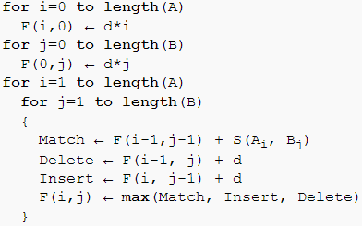
PSSM Alignment (2/2)
Use Needleman–Wunsch algorithm
S(A_{i} , B_{j}) = test protein’s PSSM[symbol][will be replaced by]

Slide 18
Contact potential

Slide 19
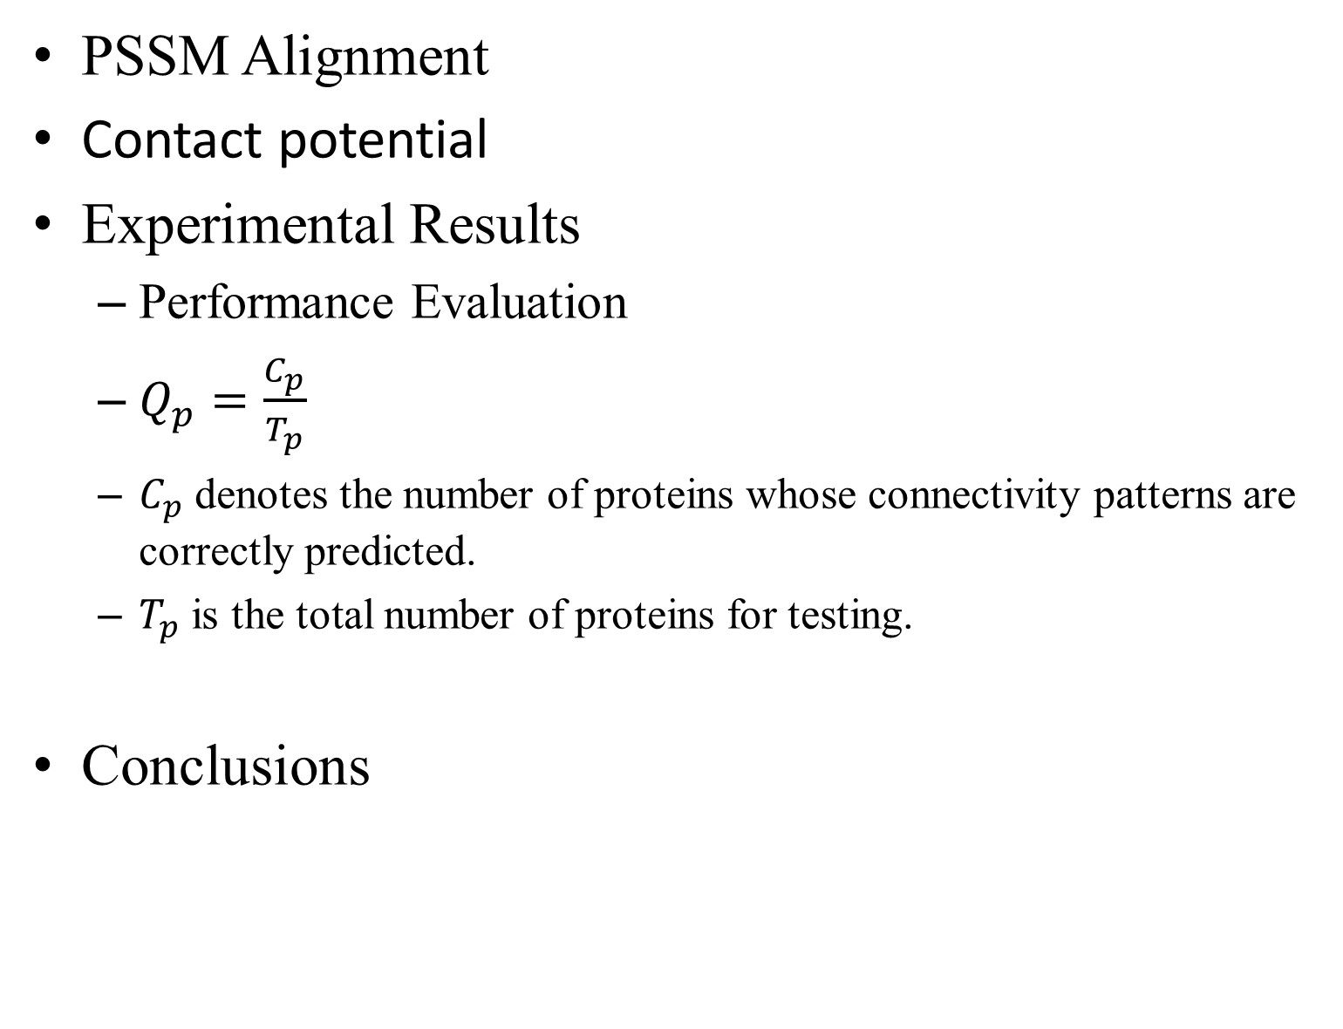
PSSM Alignment
Contact potential
Experimental Results
Performance Evaluation
$Q_{p}=\frac{C_{p}}{T_{p}}$
$C_{p}$ denotes the number of proteins whose connectivity patterns are correctly predicted.
$T_{p}$ is the total number of proteins for testing.
Conclusions

