Slide 1
Sequence alignments in the neighborhood of the optimum with general application to dynamic programming
Source: Proc. NatL. Acad. Sci. USA
Vol. 80, pp. 3123-3124, May 1983
Applied Mathematical Sciences
MICHAEL S. WATERMAN
Departments of Mathematics and Biological Sciences, University of Southern California, Los Angeles, California 90089-1113
Presenter: Chong Xuan Lo
Date:2014/3/17

Slide 2
Abstract
When applying dynamic programming techniques to obtain
optimal sequence alignments, a set of weights must be assigned to
mismatches, insertion/deletions, etc. These weights are not
predetermined, although efforts are being made to deduce biologically
meaningful values from data.
In addition, there are sometimes unknown constraints on the
sequences that cause the “true” alignment to disagree with the optimum
(computer) solution. To assist in overcoming these difficulties, an
algorithm has been developed to produce all alignments within a
specified distance of the optimum

Slide 3
Abstract
The distance can be chosen after the optimum is computed,
and the algorithm can be repeated at will . Earlier algorithms to
solve this problem were very complex and not practical for any
case involving sequences with significant time or storage
requirements. The algorithm presented here overcomes these
difficulties and has application to general, discrete dynamic
programming problems.

Slide 4
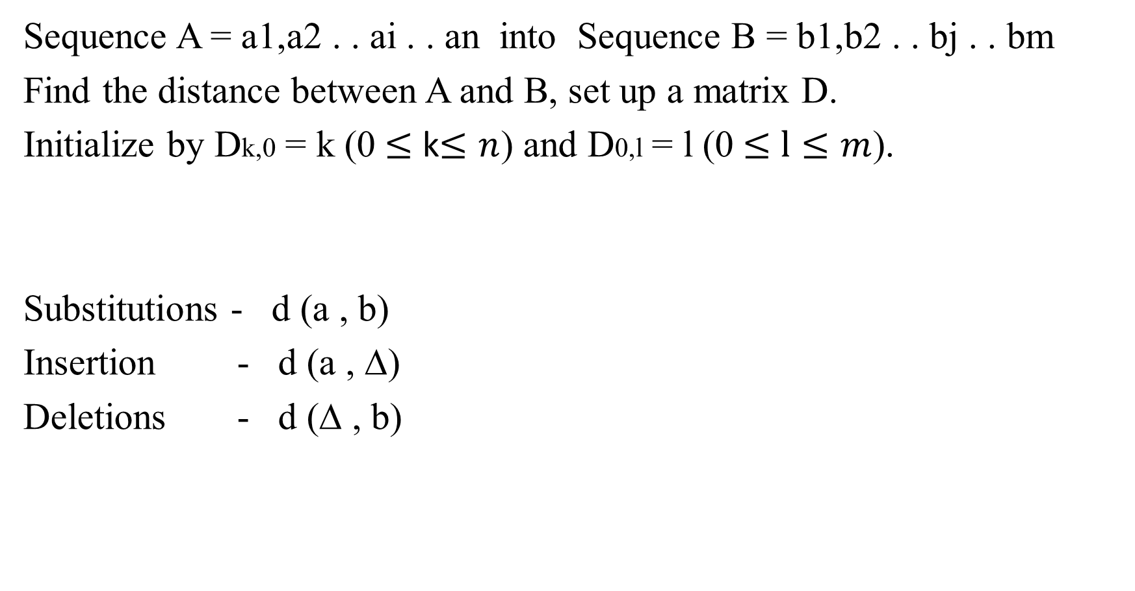
OPTIMAL ALIGNMENTS
Sequence A = a1,a2 . . ai . . an into Sequence B = b1,b2 . . bj . . bm
Find the distance between A and B, set up a matrix D.
Initialize by Dk,0 = k (0 $≤$ k$≤n$) and D0,l = l (0 $≤$ $l≤m$).
Substitutions - d (a , b)
Insertion - d (a , ∆)
Deletions - d (∆ , b)

Slide 5
OPTIMAL ALIGNMENTS D i,j = min {Di-1,j + d(ai, ∆) , Di-1,j-1+ d(ai , bj) , Di,j-1 + d(∆ ,bj)} Di,j matrix resulting from application of recursion to sequences A-U-A-A-A and A-U-G-G-A-A-A. The lines indicate the traceback .
 | ∆ | A | U | G | G | A | A | A
∆ | 0 | 1 | 2 | 3 | 4 | 5 | 6 | 7
A | 1 | 0 | 1 | 2 | 3 | 4 | 5 | 6
U | 2 | 1 | 0 | 1 | 2 | 3 | 4 | 5
A | 3 | 2 | 1 | 1 | 2 | 2 | 3 | 4
A | 4 | 3 | 2 | 2 | 2 | 2 | 2 | 3
A | 5 | 4 | 3 | 3 | 3 | 2 | 2 | 2

Slide 6
OPTIMAL ALIGNMENTS
A = A-U-A-A-A and B = A-U-G-G-A-A-A
The corresponding alignment with D5,7 = 2 is
A-U- G- G -A-A-A
A-U- ∆ - ∆ -A-A-A

Slide 7
NEAR OPTIMAL ALIGNMENTS
The problem is to find all alignments with score within e of
D n,m the best possible score.
The approach here is to exploit the meaning of the entries
Di,j and to modify the traceback procedure in an appropriate
manner.

Slide 8
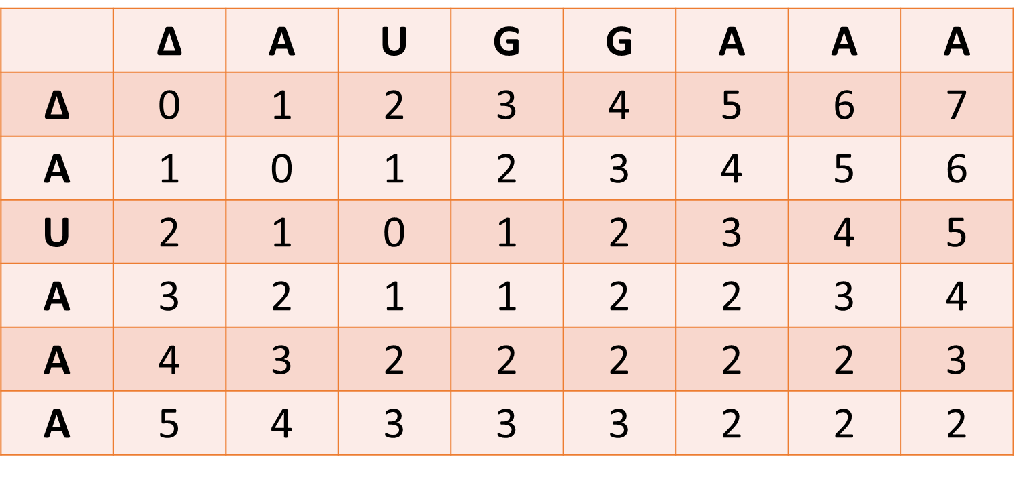
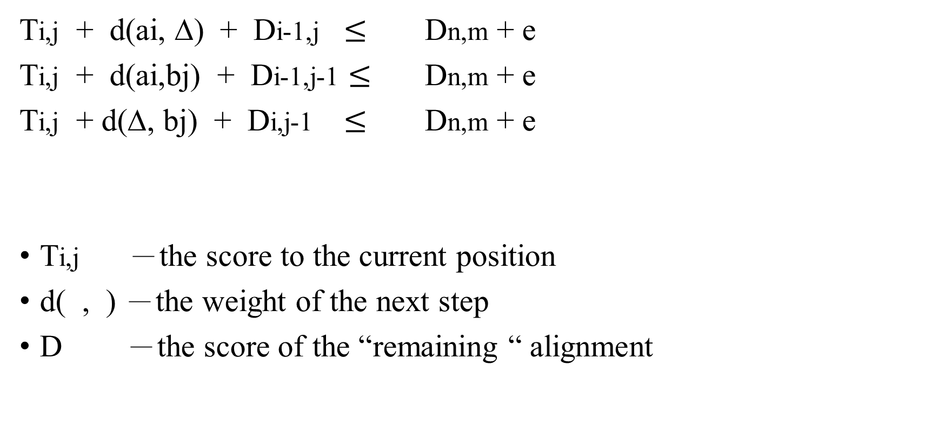
NEAR OPTIMAL ALIGNMENTS
Ti,j + d(ai, ∆) + Di-1,j $≤$ Dn,m + e
Ti,j + d(ai,bj) + Di-1,j-1 $≤$ Dn,m + e
Ti,j + d(∆, bj) + Di,j-1 $≤$ Dn,m + e
Ti,j －the score to the current position
d( , ) －the weight of the next step
D －the score of the “remaining “ alignment

Slide 9
NEAR OPTIMAL ALIGNMENTS
At position (2, 3) (a2 = U and b3 = G), T2,3 = 1, resulting from the
alignment
G-A-A-A
∆-A-A-A.

Slide 10
NEAR OPTIMAL ALIGNMENTS

Slide 11
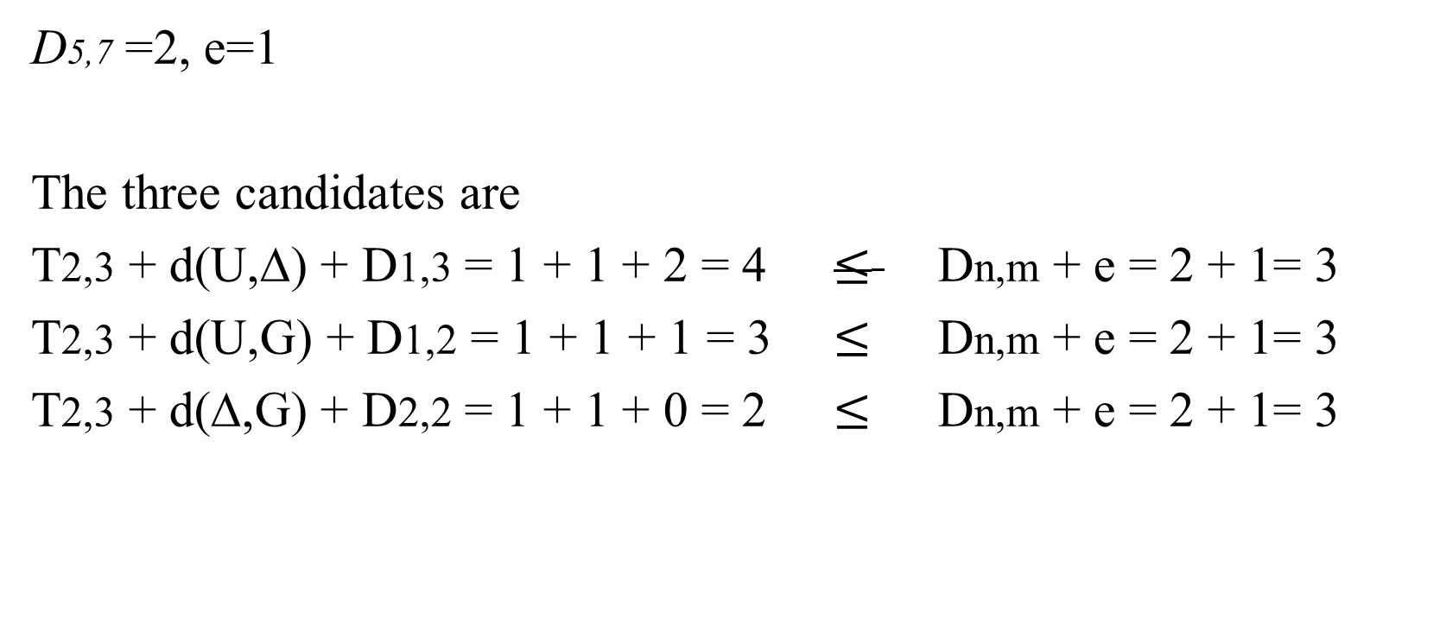
NEAR OPTIMAL ALIGNMENTS
D5,7 =2, e=1
The three candidates are
T2,3 + d(U,∆) + D1,3 = 1 + 1 + 2 = 4 $≤$ Dn,m + e = 2 + 1= 3
T2,3 + d(U,G) + D1,2 = 1 + 1 + 1 = 3 $≤$ Dn,m + e = 2 + 1= 3
T2,3 + d(∆,G) + D2,2 = 1 + 1 + 0 = 2 $≤$ Dn,m + e = 2 + 1= 3

Slide 12
NEAR OPTIMAL ALIGNMENTS
Assume the lower path has been followed already and see
that we can move to position (1,2) with T1,2 = 2, resulting
from T1,2 = 1 + T2,3, the alignment being
G-G-A-A-A
U-∆-A-A-A.
T1,2 = 2

Slide 13
NEAR OPTIMAL ALIGNMENTS
FIG. 2. Nonoptimal alignment with score 3. The alignment is
A-U-G-G-A-A-A
A-∆-U-∆-A-A-A

Slide 14
NEAR OPTIMAL ALIGNMENTS
For D5,7 = 2 and e = 1, there are eight alignments with the
score of 3 and one alignment (the optimum) with the score
of 2.

