Slide 1
The Department Score Forecast and Analysis of the College Entrance Examination
Teacher: Chang-Biau Yang
Student:Jyun-Jie Shiu
Date: 140317

Slide 2
Admission Pipeline
Star Recommend (less than 15%)
Individuals Applying for Admission to a School (less than 45%)
College Entrance Advanced Subjects Test (greater than 40%)
We construct a prediction system in order for students to entrance a suitable University.

Slide 3

Prediction System
College Entrance Advanced Subjects Test
Minimum required test score
$\sum_{i=1}^{|SUB|}{x_{i}w_{i}}$

Slide 4
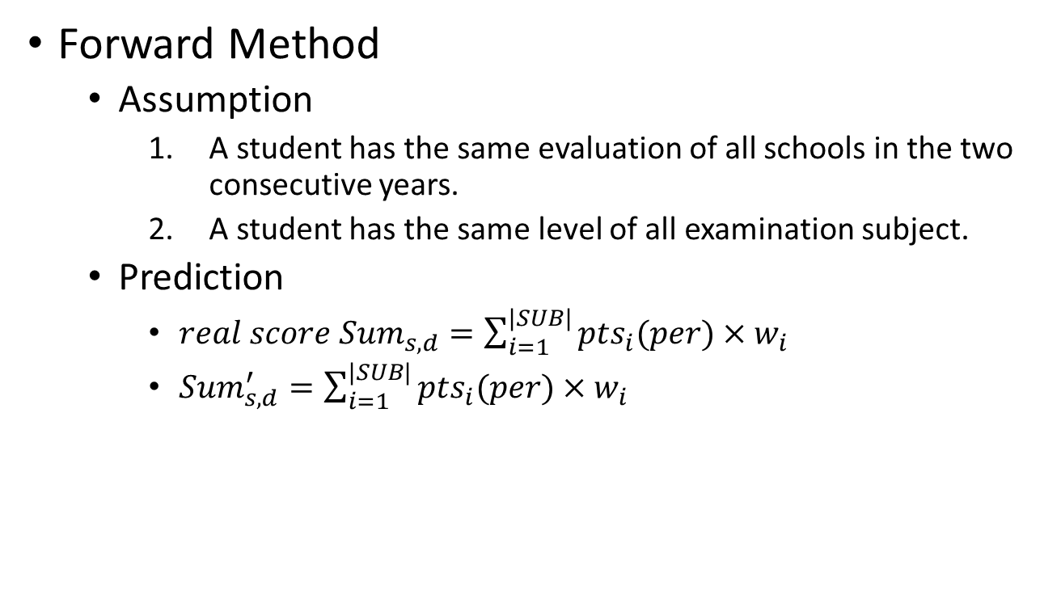
Preliminaries(1/2)
Forward Method
Assumption
A student has the same evaluation of all schools in the two consecutive years.
A student has the same level of all examination subject.
Prediction
$real score {Sum}_{s,d}=\sum_{i=1}^{|SUB|}{{pts}_{i}(per)×w_{i}}$
${Sum}_{s,d}^{′}=\sum_{i=1}^{|SUB|}{{pts}_{i}(per)×w_{i}}$

Slide 5
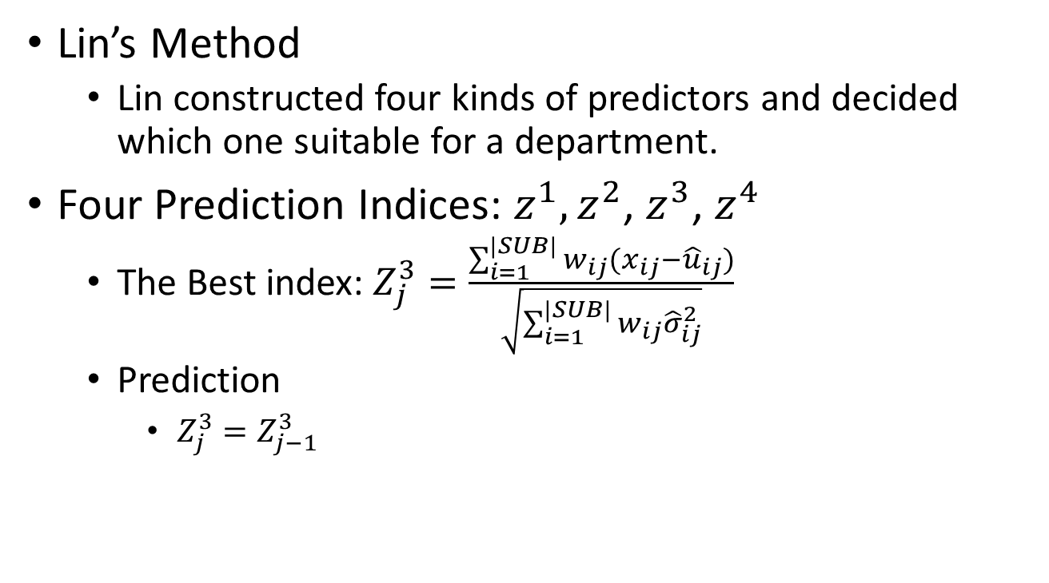
Preliminaries(2/2)
Lin’s Method
Lin constructed four kinds of predictors and decided which one suitable for a department.
Four Prediction Indices: $z^{1},z^{2}$,$z^{3}$,$z^{4}$
The Best index: $Z_{j}^{3}=\frac{\sum_{i=1}^{|SUB|}{w_{ij}(x_{ij}−{\hat{u}}_{ij})}}{\sqrt{\sum_{i=1}^{|SUB|}{w_{ij}{\hat{σ}}_{ij}^{2}}}}$
Prediction
$Z_{j}^{3}=Z_{j−1}^{3}$

Slide 6
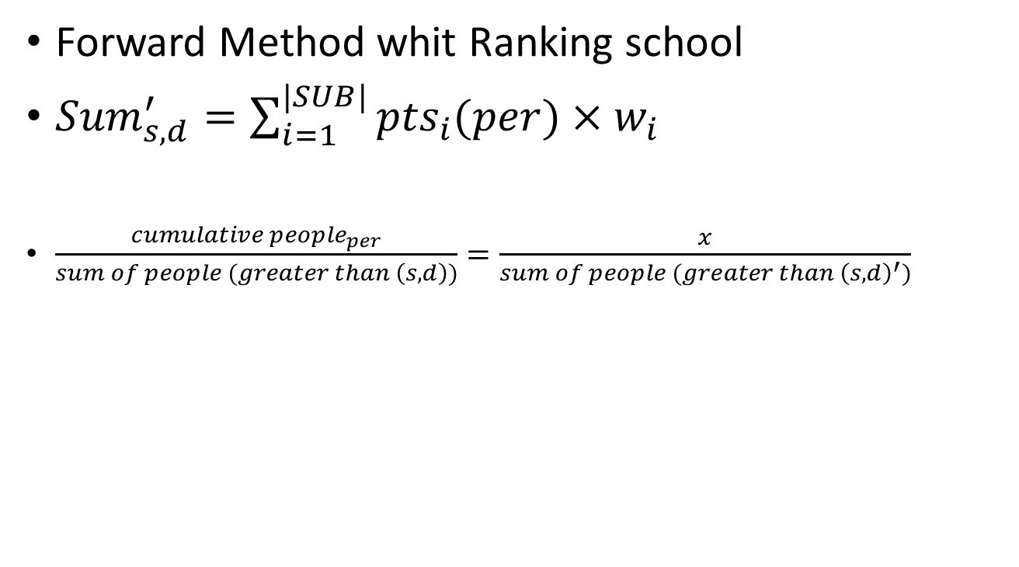
Tried Method(1/2)
Forward Method whit Ranking school
${Sum}_{s,d}^{′}=\sum_{i=1}^{|SUB|}{{pts}_{i}(per)×w_{i}}$
$\frac{cumulative {people}_{per}}{sum of people (greater than \left(s,d\right))}=\frac{x}{sum of people (greater than {\left(s,d\right)}^{′})}$

Slide 7
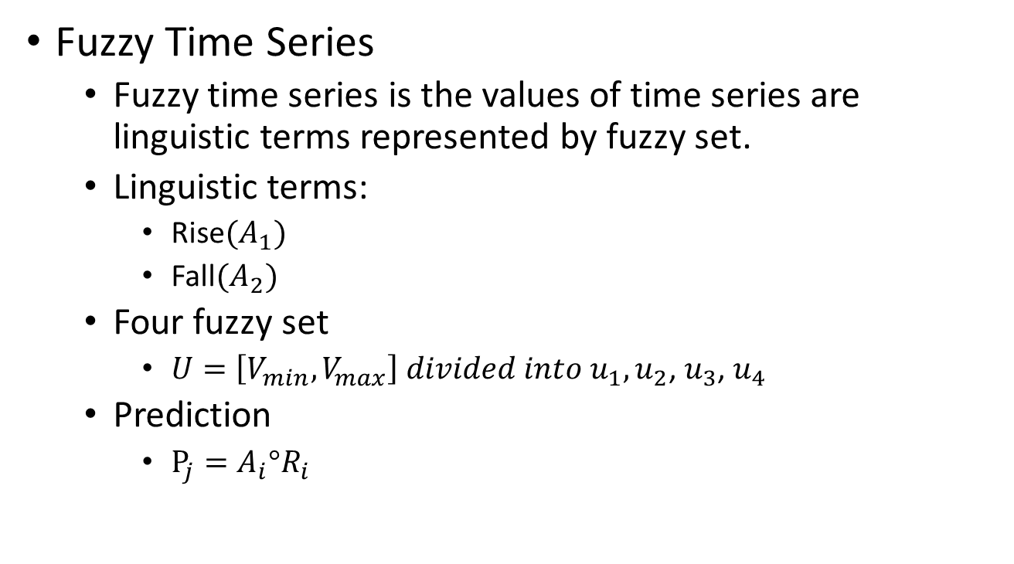
Tried Method(2/2)
Fuzzy Time Series
Fuzzy time series is the values of time series are linguistic terms represented by fuzzy set.
Linguistic terms:
Rise${(A}_{1})$
Fall${(A}_{2})$
Four fuzzy set
$U=\left[V_{min},V_{max}\right] divided into u_{1},u_{2}$,$u_{3}$,$u_{4}$
Prediction
$P_{j}=A_{i}°R_{i}$

Slide 8
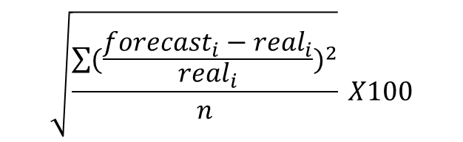
Experimental Results(1/3)
Root-mean-square error
RMSE=
$$\sqrt{\frac{\sum{{(\frac{{forecast}_{i}−{real}_{i}}{{real}_{i}})}^{2}}}{n}} X100$$
 | 2005 | 2006 | 2007 | 2008 | 2009 | 2010 | 2011 | 2012 | 2013
Ranking | 13.45 | 15.93 | 34.26 | 52.15 | 26.13 | 26.41 | 8.12 | 4.00 | 6.67
Lin | 6.59 | 5.89 | 35.91 | 39.57 | 18.66 | 16.98 | 8.60 | 6.10 | 6.67
Fuzzy set |  |  |  | 29.07 | 18.00 | 20.87 | 17.84 | 9.18 | 7.82
Forward | 5.73 | 5.77 | 35.93 | 36.49 | 18.35 | 14.41 | 7.92 | 6.28 | 6.49

Slide 9
Experimental Results(2/3)
H: the prediction scores almost greater than real scores
L: the prediction scores almost less than real scores
 | 2004 | 2005 | 2006 | 2007 | 2008 | 2009 | 2010 | 2011 | 2012 | 2013
Forward |  | H | H | H | H | H | L | L | L | H
Per of H |  | 4.23 72.02% | 4.67 78.62% | 11.38 88.20% | 12 87.74% | 9.99 77.40% | 9.70 32.60% | 1.46 16.86% | 1.00 30.00% | 5.00 85.69%
Per of L |  | -2.58 27.98% | -1.46 21.38% | -1.92 11.81% | -3.92 12.25% | -5.04 22.60% | -5.10 67.40% | -5.29 83.14% | -3.89 70.00% | -1.22 14.31%
Admission rate | 75.60% | 76.32% rise | 80.94% rise | 85.86% rise | 91.02% rise | 94.01% rise | 86.50% fall | 80.29% fall | 77.49% fall | 82.95% rise

Slide 10

Experimental Results(3/3)
${Sum}_{s,d}^{′}=\sum_{i=1}^{|SUB|}{{pts}_{i}(per×Ratio of AR)×w_{i}}$
 | 2004 | 2005 | 2006 | 2007 | 2008 | 2009 | 2010 | 2011 | 2012 | 2013
Admission rate | 75.60% | 76.32% rise | 80.94% rise | 85.86% rise | 91.02% rise | 94.01% rise | 86.50% fall | 80.29% fall | 77.49% fall | 82.95% rise
Ratio of AR |  | 1.0095 | 1.0606 | 1.0607 | 1.0601 | 1.0329 | 0.9202 | 0.9281 | 0.9652 | 1.0705
Rmse | Forward: Ratio of AR: | 5.73 5.40 | 5.77 3.36 | 35.93 27.05 | 36.49 26.04 | 18.35 18.23 | 14.41 29.14 | 7.92 5.80 | 6.28 3.89 | 6.49 3.95

Slide 11
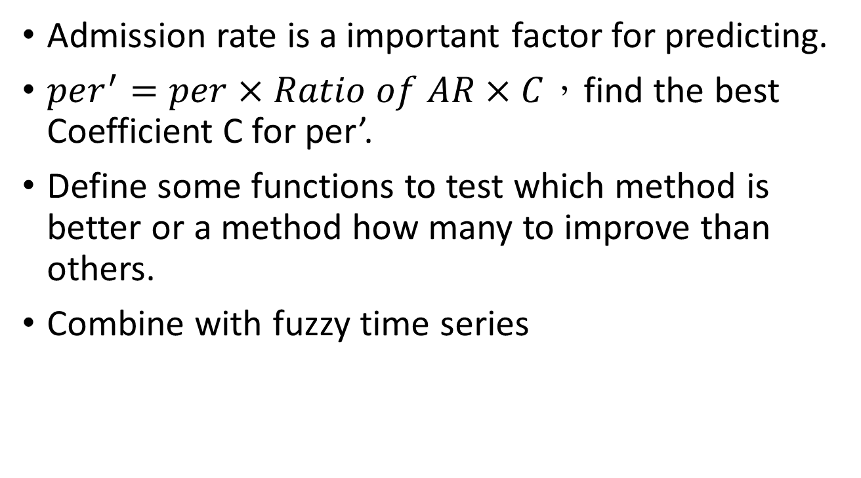
Conclusion and Future Work
Admission rateis a important factor for predicting.
$per^{′}=per×Ratio of AR×C$，find the best Coefficient C for per’.
Define some functions to test which method is better or a method how many to improve than others.
Combine with fuzzy time series

Slide 12
Thank You

