Slide 1
The Generalized Definitions of the Two-Dimensional Largest Common Substructure Problems
Huang-Ting Chan, Hsuan-Tsung Chiu, Chang-Biau Yang, Yung-Hsing Peng
Speaker: Kuan-Lin Lai
Date: Jan. 7, 2020

Slide 2
Abstract
The similarity of two one-dimensional sequences is usually measured by the longest common subsequence (LCS) algorithms. However, these algorithms cannot be directly extended to solve the two or higher dimensional data. Thus, for the two-dimensional data, computing the similarity with an LCS-like approach remains worthy of investigation. In this paper, we utilize a systematic way to give the generalized definition of the two-dimensional largest common substructure (TLCS) problem by referring to the traditional LCS concept. With various matching rules, eight possible versions of TLCS problems may be defined. However, only four of them are shown to be valid. We prove that all of these four TLCS problems are N P-hard and APX -hard. To accomplish the proofs, two of the TLCS problems are reduced from the the 3-satisfiability problem, and the other two are reduced from the 3-dimensional matching problem.

Slide 3
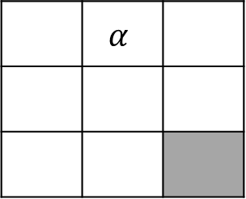
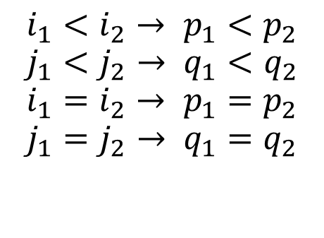
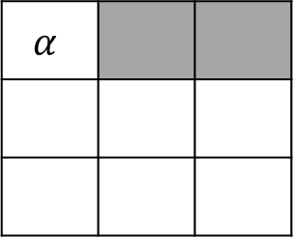
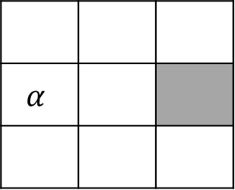
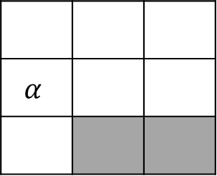
2D-LCS problem by Amir et al.(2008)
Matrix A
Matrix B
Matrix A
Matrix B
 | $$α$$
$$α$$
$$α$$
$$α$$
$$i_{1}<i_{2}→ p_{1}<p_{2}$$
$$j_{1}<j_{2}→ q_{1}<q_{2}$$
$$i_{1}=i_{2}→ p_{1}=p_{2}$$
$$j_{1}=j_{2}→ q_{1}=q_{2}$$
Matrix A
Matrix B
1 | 2 | 7
9 | 3 | 5
6 | 8 | 4
1 | 7 | 8
3 | 2 | 9
6 | 4 | 5
NP-hard !!
A. Amir, T. Hartmana, O. Kapahand, B. Riva Shalom, D. Tsur, Generalized LCS, Theoretical Computer Science, Vol. 409, pp. 438-449, 2008.

Slide 4

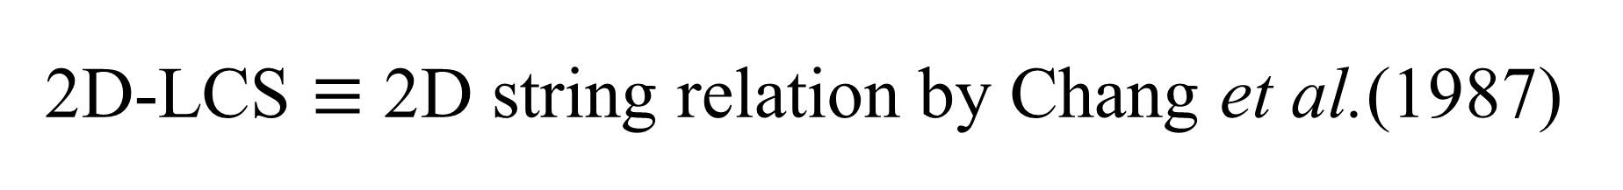
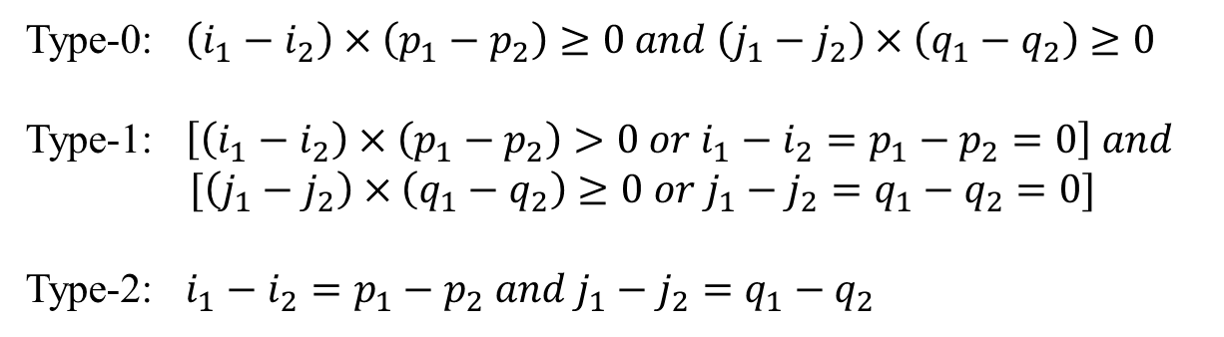
2D-LCS $≡$ 2D string relation by Chang et al.(1987)
$$i_{1}<i_{2}→ p_{1}<p_{2}$$
$$j_{1}<j_{2}→ q_{1}<q_{2}$$
$$i_{1}=i_{2}→ p_{1}=p_{2}$$
$$j_{1}=j_{2}→ q_{1}=q_{2}$$
Type-0: $\left(i_{1}−i_{2}\right)×\left(p_{1}−p_{2}\right)≥0 and \left(j_{1}−j_{2}\right)×\left(q_{1}−q_{2}\right)≥0$
Type-1: $\left[\left(i_{1}−i_{2}\right)×\left(p_{1}−p_{2}\right)>0 or i_{1}−i_{2}=p_{1}−p_{2}=0\right] and$ $[\left(j_{1}−j_{2}\right)×\left(q_{1}−q_{2}\right)≥0 or j_{1}−j_{2}=q_{1}−q_{2}=0]$
Type-2: $i_{1}−i_{2}=p_{1}−p_{2} and j_{1}−j_{2}=q_{1}−q_{2}$
Guan et al.(2000) had proved type-0, type-1 are NP-hard

Slide 5
One dimensional LCS
Matching index set {(1,1), (2,3), (3,2), (3,4), (4,3)}
Two rules
No duplicate matches
No crossing matches
A | T | G | T
A | G | T | G

Slide 6
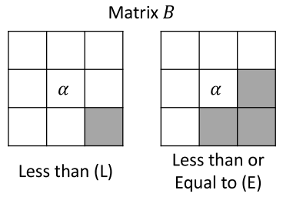
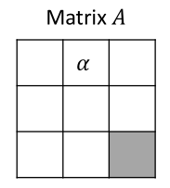
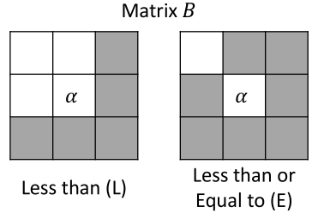
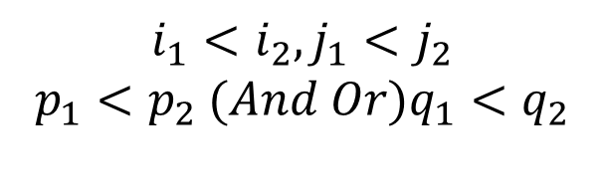
Corner
And(N) operator
Or(O) operator
$$i_{1}<i_{2}, j_{1}<j_{2}$$
$$p_{1}<p_{2} (And Or)q_{1}<q_{2}$$

Slide 7
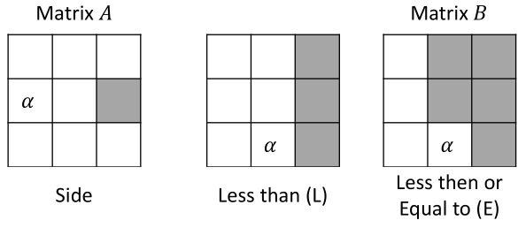
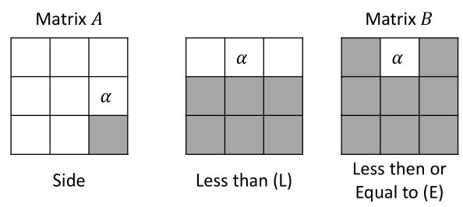
Side

Slide 8
8 versions TLCS problems
P(LNL) = P(Less than, aNd, Less than)
P(LNE) = P(Less than, aNd, less than or Equal to)
P(ENL) = P(less than or Equal to, aNd, Less than)
P(ENE) = P(less than or Equal to, aNd, less than or Equal to)
P(LOL) = P(Less than, Or, Less than)
P(LOE) = P(Less than, Or, less than or Equal to)
P(EOL) = P(less than or Equal to, Or, Less than)
P(EOE) = P(less than or Equal to, Or, less than or Equal to)

Slide 9
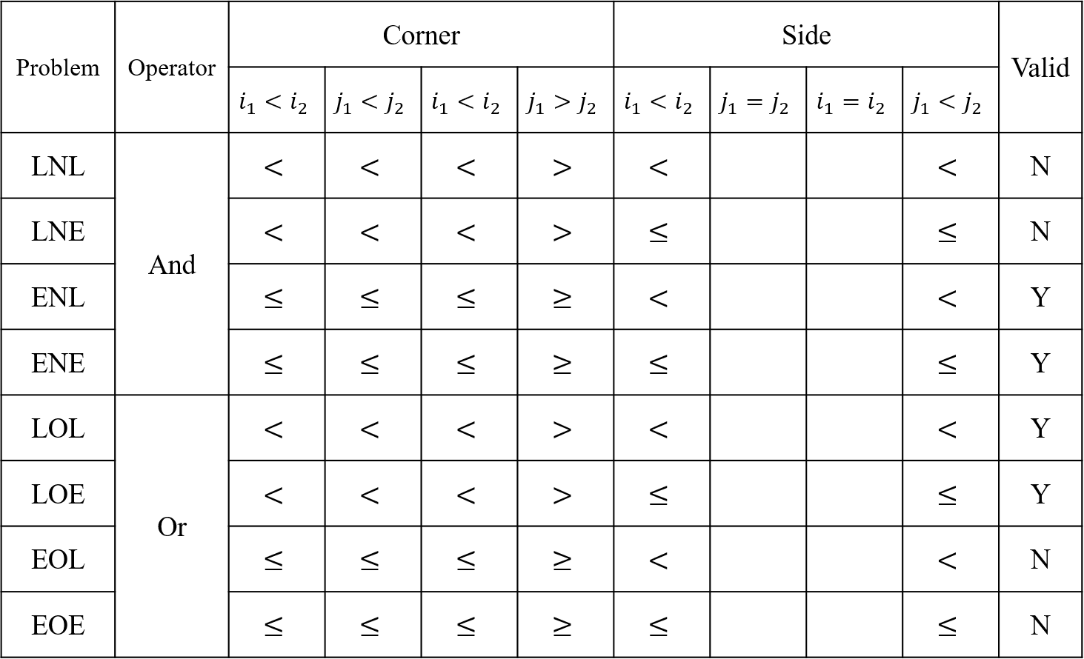

Slide 10
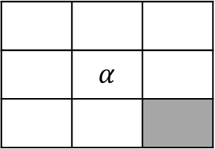
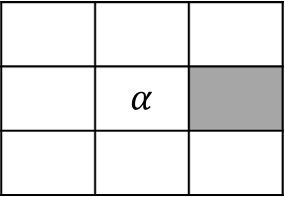

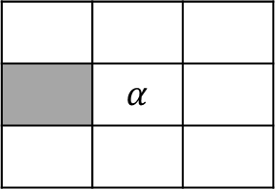
Invalid cases
 | $$α$$
 | $$α$$
P(LNL), P(LNE) invalid
 | $$α$$
 | $$α$$
P(EOL), P(EOE) invalid

Slide 11
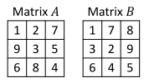

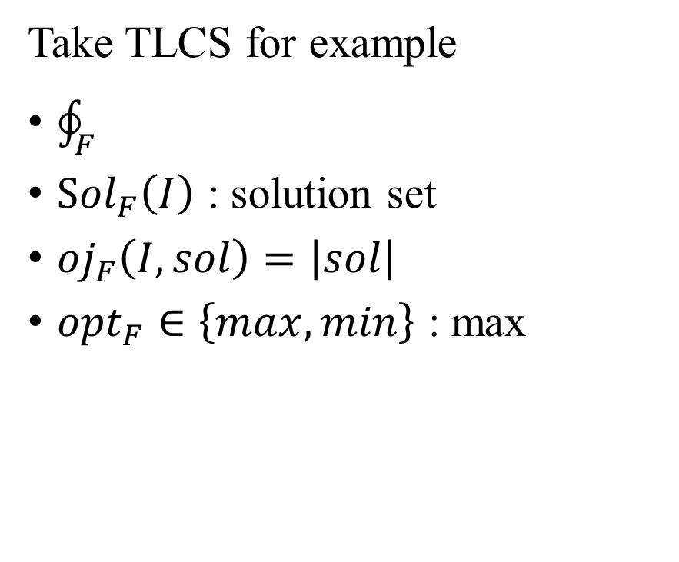
NP optimization (NPO)
Take TLCS for example
$\oint_{F}{}$
${Sol}_{F}\left(I\right)$ : solution set
${oj}_{F}\left(I, sol\right)=\left|sol\right|$
${opt}_{F}∈\left\{max, min\right\}$ : max
: All possible pair of matrices

Slide 12
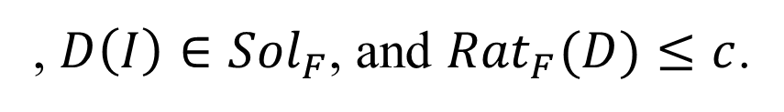

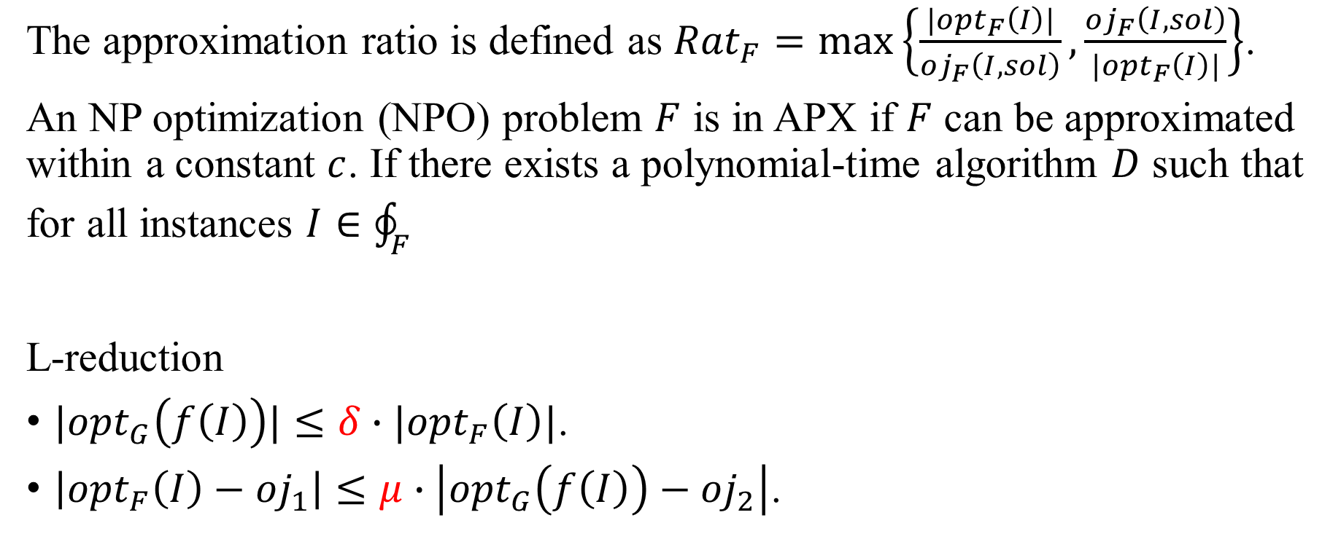



Approximability(APX) problem
The approximation ratio is defined as ${Rat}_{F}=\max\left\{\frac{{|opt}_{F}\left(I\right)|}{{oj}_{F}\left(I, sol\right)}, \frac{{oj}_{F}\left(I, sol\right)}{{|opt}_{F}\left(I\right)|}\right\}$.
An NP optimization (NPO) problem $F$ is in APX if $F$ can be approximated within a constant $c$. If there exists a polynomial-time algorithm $D$ such that for all instances $I∈{\oint_{F}{}}_{}$
L-reduction
$|{opt}_{G}\left(f\left(I\right)\right)|≤δ∙|{opt}_{F}\left(I\right)|$.
$\left|{opt}_{F}\left(I\right)−{oj}_{1}\right|≤μ∙\left|{opt}_{G}\left(f\left(I\right)\right)−{oj}_{2}\right|$.
, $D\left(I\right)∈{Sol}_{F}$, and ${Rat}_{F}(D)≤c$.
L-reduction
Instance of $F$
Instance of $G$
Solution of $F$
Solution of $G$

Slide 14
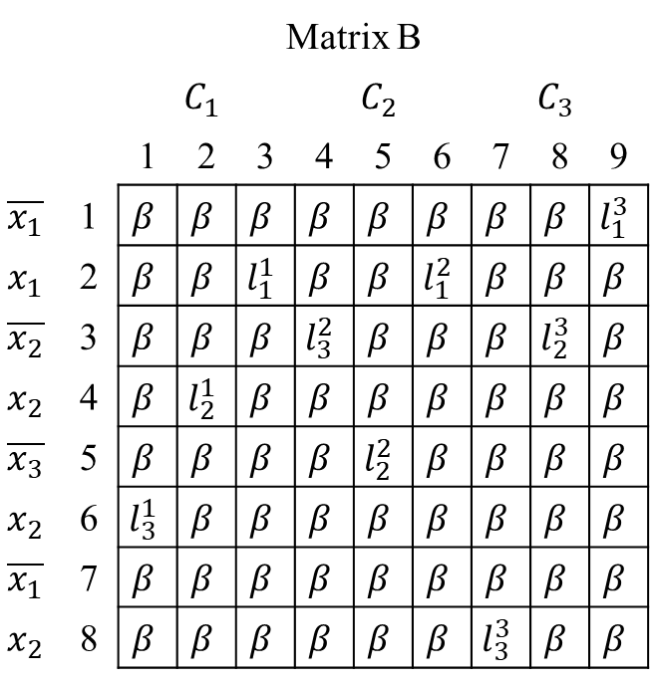
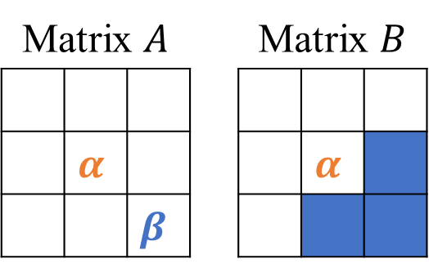
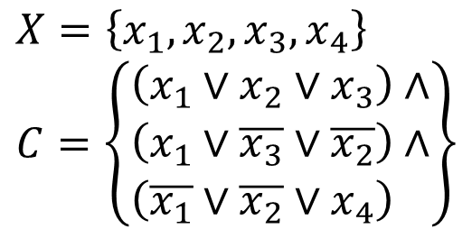
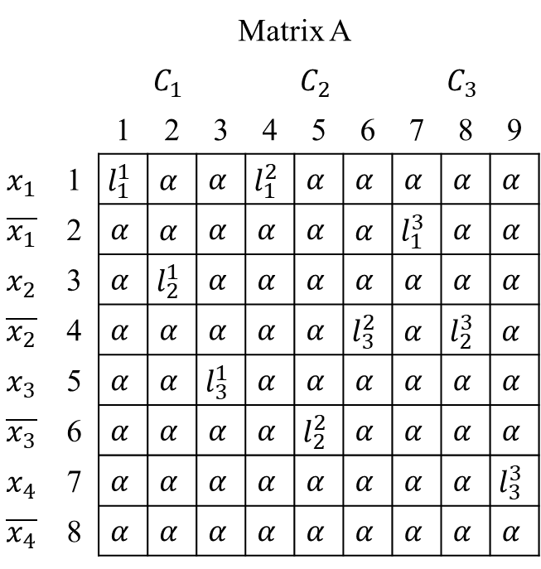
P(ENL) is NP-hardness.
Maximize the clauses to be true.
Proof: MAX 3SAT-3 ∝ P(ENL) [Guan2000]
Matrix $A$ |  |  |  | Matrix $B$
 | $$α$$ |  |  |  | $$α$$
 |  | $$β$$
$X=\left\{x_{1},x_{2},x_{3},x_{4}\right\}$
$$C=\left\{\begin{aligned}\left(x_{1}∨x_{2}∨x_{3}\right)∧ \\ \left(x_{1}∨\overline{x_{3}}∨\overline{x_{2}}\right)∧ \\ \left(\overline{x_{1}}∨\overline{x_{2}}∨x_{4}\right)∧\end{aligned}\right\}$$
 | Matrix A
 |  | $$C_{1}$$ |  |  | $$C_{2}$$ |  |  | $$C_{3}$$
 |  | 1 | 2 | 3 | 4 | 5 | 6 | 7 | 8 | 9
$$x_{1}$$ | 1 | $$l_{1}^{1}$$ | $$α$$ | $$α$$ | $$l_{1}^{2}$$ | $$α$$ | $$α$$ | $$α$$ | $$α$$ | $$α$$
$$\overline{x_{1}}$$ | 2 | $$α$$ | $$α$$ | $$α$$ | $$α$$ | $$α$$ | $$α$$ | $$l_{1}^{3}$$ | $$α$$ | $$α$$
$$x_{2}$$ | 3 | $$α$$ | $$l_{2}^{1}$$ | $$α$$ | $$α$$ | $$α$$ | $$α$$ | $$α$$ | $$α$$ | $$α$$
$$\overline{x_{2}}$$ | 4 | $$α$$ | $$α$$ | $$α$$ | $$α$$ | $$α$$ | $$l_{3}^{2}$$ | $$α$$ | $$l_{2}^{3}$$ | $$α$$
$$x_{3}$$ | 5 | $$α$$ | $$α$$ | $$l_{3}^{1}$$ | $$α$$ | $$α$$ | $$α$$ | $$α$$ | $$α$$ | $$α$$
$$\overline{x_{3}}$$ | 6 | $$α$$ | $$α$$ | $$α$$ | $$α$$ | $$l_{2}^{2}$$ | $$α$$ | $$α$$ | $$α$$ | $$α$$
$$x_{4}$$ | 7 | $$α$$ | $$α$$ | $$α$$ | $$α$$ | $$α$$ | $$α$$ | $$α$$ | $$α$$ | $$l_{3}^{3}$$
$$\overline{x_{4}}$$ | 8 | $$α$$ | $$α$$ | $$α$$ | $$α$$ | $$α$$ | $$α$$ | $$α$$ | $$α$$ | $$α$$
 | Matrix B
 |  | $$C_{1}$$ |  |  | $$C_{2}$$ |  |  | $$C_{3}$$
 |  | 1 | 2 | 3 | 4 | 5 | 6 | 7 | 8 | 9
$$\overline{x_{1}}$$ | 1 | $$β$$ | $$β$$ | $$β$$ | $$β$$ | $$β$$ | $$β$$ | $$β$$ | $$β$$ | $$l_{1}^{3}$$
$$x_{1}$$ | 2 | $$β$$ | $$β$$ | $$l_{1}^{1}$$ | $$β$$ | $$β$$ | $$l_{1}^{2}$$ | $$β$$ | $$β$$ | $$β$$
$$\overline{x_{2}}$$ | 3 | $$β$$ | $$β$$ | $$β$$ | $$l_{3}^{2}$$ | $$β$$ | $$β$$ | $$β$$ | $$l_{2}^{3}$$ | $$β$$
$$x_{2}$$ | 4 | $$β$$ | $$l_{2}^{1}$$ | $$β$$ | $$β$$ | $$β$$ | $$β$$ | $$β$$ | $$β$$ | $$β$$
$$\overline{x_{3}}$$ | 5 | $$β$$ | $$β$$ | $$β$$ | $$β$$ | $$l_{2}^{2}$$ | $$β$$ | $$β$$ | $$β$$ | $$β$$
$$x_{2}$$ | 6 | $$l_{3}^{1}$$ | $$β$$ | $$β$$ | $$β$$ | $$β$$ | $$β$$ | $$β$$ | $$β$$ | $$β$$
$$\overline{x_{1}}$$ | 7 | $$β$$ | $$β$$ | $$β$$ | $$β$$ | $$β$$ | $$β$$ | $$β$$ | $$β$$ | $$β$$
$$x_{2}$$ | 8 | $$β$$ | $$β$$ | $$β$$ | $$β$$ | $$β$$ | $$β$$ | $$l_{3}^{3}$$ | $$β$$ | $$β$$

Slide 15
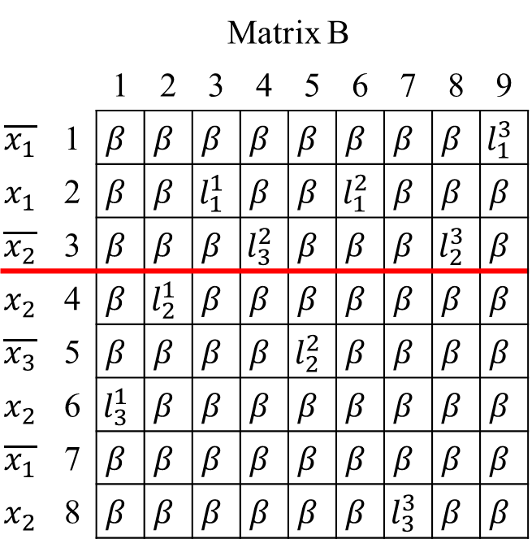
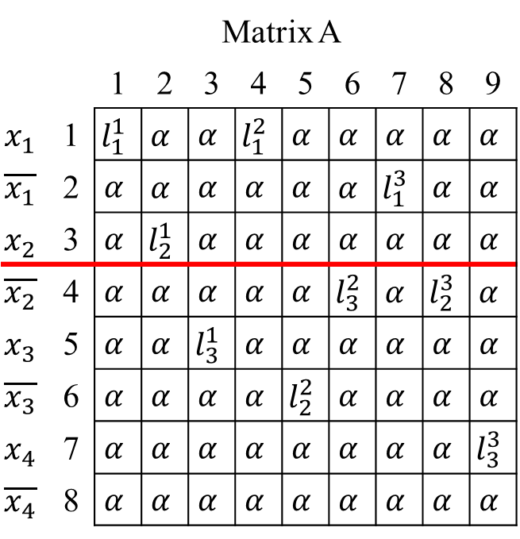
If the variables are complementary,
they cannot be both true.
P(ENL)
Matrix $A$ |  |  |  | Matrix $B$
 | $$α$$ |  |  |  | $$α$$
 |  | $$β$$
$X=\left\{x_{1},x_{2},x_{3},x_{4}\right\}$
$$C=\left\{\begin{aligned}\left(x_{1}∨x_{2}∨x_{3}\right)∧ \\ \left(x_{1}∨\overline{x_{3}}∨\overline{x_{2}}\right)∧ \\ \left(\overline{x_{1}}∨\overline{x_{2}}∨x_{4}\right)∧\end{aligned}\right\}$$
 | Matrix A
 |  | 1 | 2 | 3 | 4 | 5 | 6 | 7 | 8 | 9
$$x_{1}$$ | 1 | $$l_{1}^{1}$$ | $$α$$ | $$α$$ | $$l_{1}^{2}$$ | $$α$$ | $$α$$ | $$α$$ | $$α$$ | $$α$$
$$\overline{x_{1}}$$ | 2 | $$α$$ | $$α$$ | $$α$$ | $$α$$ | $$α$$ | $$α$$ | $$l_{1}^{3}$$ | $$α$$ | $$α$$
$$x_{2}$$ | 3 | $$α$$ | $$l_{2}^{1}$$ | $$α$$ | $$α$$ | $$α$$ | $$α$$ | $$α$$ | $$α$$ | $$α$$
$$\overline{x_{2}}$$ | 4 | $$α$$ | $$α$$ | $$α$$ | $$α$$ | $$α$$ | $$l_{3}^{2}$$ | $$α$$ | $$l_{2}^{3}$$ | $$α$$
$$x_{3}$$ | 5 | $$α$$ | $$α$$ | $$l_{3}^{1}$$ | $$α$$ | $$α$$ | $$α$$ | $$α$$ | $$α$$ | $$α$$
$$\overline{x_{3}}$$ | 6 | $$α$$ | $$α$$ | $$α$$ | $$α$$ | $$l_{2}^{2}$$ | $$α$$ | $$α$$ | $$α$$ | $$α$$
$$x_{4}$$ | 7 | $$α$$ | $$α$$ | $$α$$ | $$α$$ | $$α$$ | $$α$$ | $$α$$ | $$α$$ | $$l_{3}^{3}$$
$$\overline{x_{4}}$$ | 8 | $$α$$ | $$α$$ | $$α$$ | $$α$$ | $$α$$ | $$α$$ | $$α$$ | $$α$$ | $$α$$
 | Matrix B
 |  | 1 | 2 | 3 | 4 | 5 | 6 | 7 | 8 | 9
$$\overline{x_{1}}$$ | 1 | $$β$$ | $$β$$ | $$β$$ | $$β$$ | $$β$$ | $$β$$ | $$β$$ | $$β$$ | $$l_{1}^{3}$$
$$x_{1}$$ | 2 | $$β$$ | $$β$$ | $$l_{1}^{1}$$ | $$β$$ | $$β$$ | $$l_{1}^{2}$$ | $$β$$ | $$β$$ | $$β$$
$$\overline{x_{2}}$$ | 3 | $$β$$ | $$β$$ | $$β$$ | $$l_{3}^{2}$$ | $$β$$ | $$β$$ | $$β$$ | $$l_{2}^{3}$$ | $$β$$
$$x_{2}$$ | 4 | $$β$$ | $$l_{2}^{1}$$ | $$β$$ | $$β$$ | $$β$$ | $$β$$ | $$β$$ | $$β$$ | $$β$$
$$\overline{x_{3}}$$ | 5 | $$β$$ | $$β$$ | $$β$$ | $$β$$ | $$l_{2}^{2}$$ | $$β$$ | $$β$$ | $$β$$ | $$β$$
$$x_{2}$$ | 6 | $$l_{3}^{1}$$ | $$β$$ | $$β$$ | $$β$$ | $$β$$ | $$β$$ | $$β$$ | $$β$$ | $$β$$
$$\overline{x_{1}}$$ | 7 | $$β$$ | $$β$$ | $$β$$ | $$β$$ | $$β$$ | $$β$$ | $$β$$ | $$β$$ | $$β$$
$$x_{2}$$ | 8 | $$β$$ | $$β$$ | $$β$$ | $$β$$ | $$β$$ | $$β$$ | $$l_{3}^{3}$$ | $$β$$ | $$β$$

Slide 16
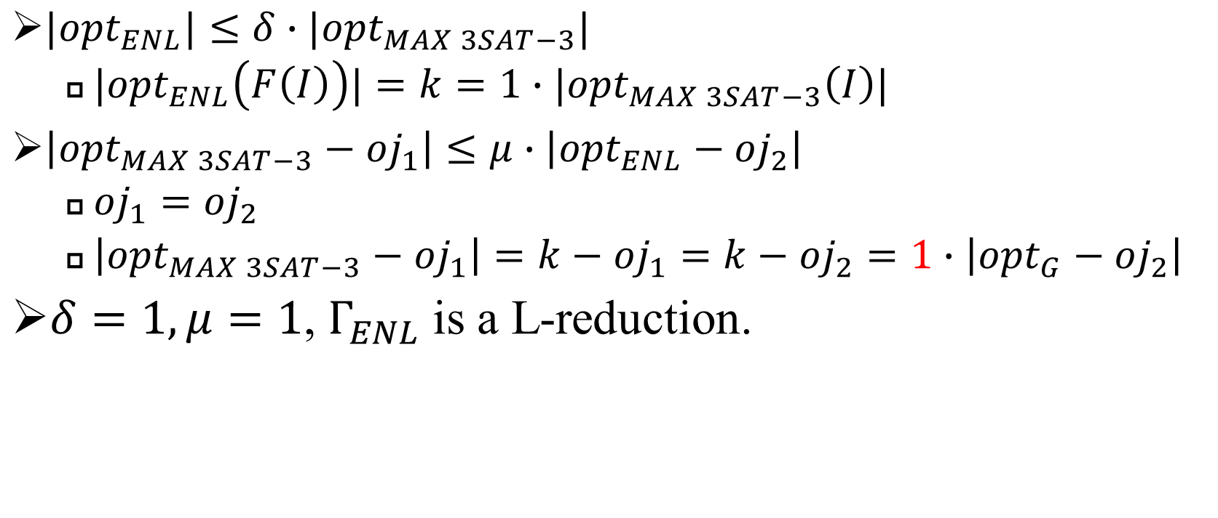





P(ENL) is $APX$-hard.
$|{opt}_{ENL}|≤δ∙{|opt}_{MAX 3SAT−3}|$
${|opt}_{ENL}\left(F\left(I\right)\right)|=k=1∙|{opt}_{MAX 3SAT−3}\left(I\right)|$
$\left|{opt}_{MAX 3SAT−3}−{oj}_{1}\right|≤μ∙\left|{opt}_{ENL}−{oj}_{2}\right|$
${oj}_{1}={oj}_{2}$
$\left|{opt}_{MAX 3SAT−3}−{oj}_{1}\right|=k−{oj}_{1}=k−{oj}_{2}=1∙\left|{opt}_{G}−{oj}_{2}\right|$
$δ=1, μ=1$, $Γ_{ENL}$ is a L-reduction.
Instance of $MAX 3SAT−3$
Instance of $P(ENL)$
$$oj_{1}$$
$$oj_{2}$$

Slide 17


















Maximum 3-dimensional Matching Bounded by 3 (MAX 3DM-3) Problem
Input:
A set $M⊆X×Y×Z$, where $X$, $Y$ and $Z$ are disjoint finite sets. The number of occurrences in $M$ of an element in $X$, $Y$ or $Z$ is bounded by a constant 3.
Output:
The largest number of 3-dimensional matching.
Solution
$$M=\left\{\begin{aligned}\left(x_{1},y_{1},z_{1}\right), \\ \left(x_{1},y_{2},z_{2}\right), \\ \left(x_{2},y_{2},z_{1}\right), \\ \left(x_{3},y_{2},z_{3}\right),\end{aligned}\right\}$$
$$x_{1}$$
$$y_{1}$$
$$z_{1}$$
$$x_{1}$$
$$y_{1}$$
$$z_{1}$$
$$x_{2}$$
$$y_{2}$$
$$z_{2}$$
$$x_{2}$$
$$y_{2}$$
$$z_{2}$$
$$x_{3}$$
$$z_{3}$$
$$x_{3}$$
$$z_{3}$$

Slide 18
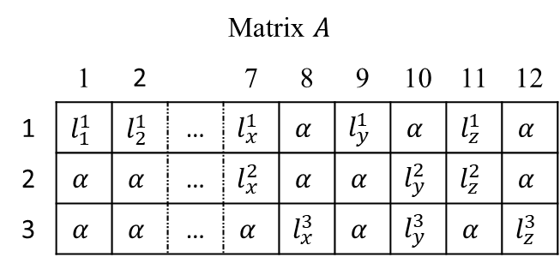


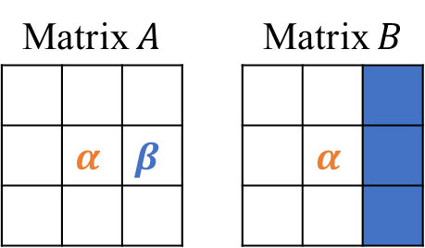
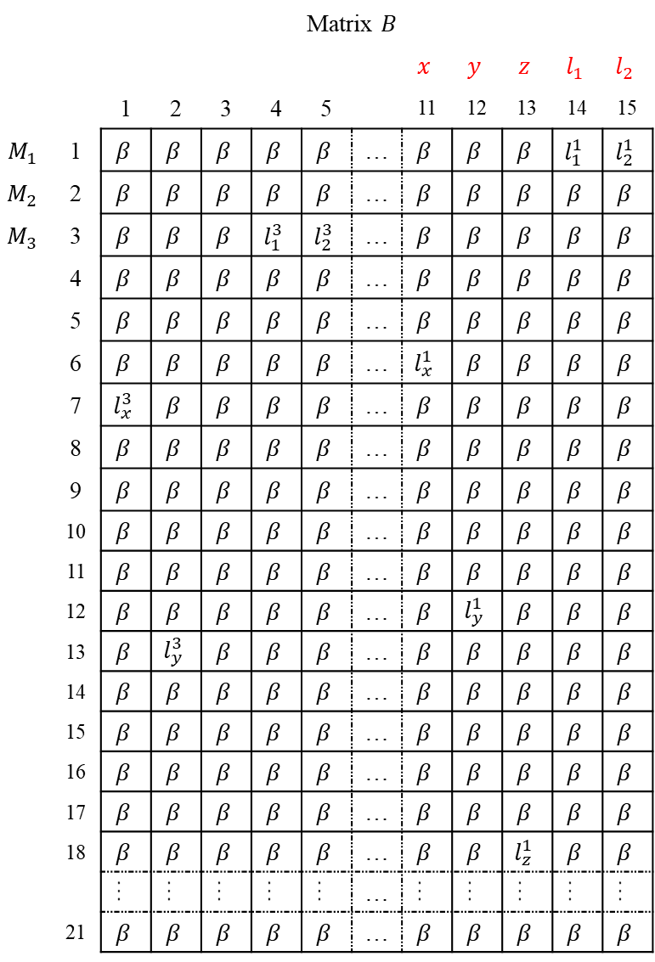

P(LOL) is NP-hard.
3 elements of a matching
should be all in the answer.
 | Matrix $B$
 |  |  |  |  |  |  |  | $$x$$ | $$y$$ | $$z$$ | $$l_{1}$$ | $$l_{2}$$
 |  | 1 | 2 | 3 | 4 | 5 |  | 11 | 12 | 13 | 14 | 15
$$M_{1}$$ | 1 | $$β$$ | $$β$$ | $$β$$ | $$β$$ | $$β$$ | … | $$β$$ | $$β$$ | $$β$$ | $$l_{1}^{1}$$ | $$l_{2}^{1}$$
$$M_{2}$$ | 2 | $$β$$ | $$β$$ | $$β$$ | $$β$$ | $$β$$ | … | $$β$$ | $$β$$ | $$β$$ | $$β$$ | $$β$$
$$M_{3}$$ | 3 | $$β$$ | $$β$$ | $$β$$ | $$l_{1}^{3}$$ | $$l_{2}^{3}$$ | … | $$β$$ | $$β$$ | $$β$$ | $$β$$ | $$β$$
 | 4 | $$β$$ | $$β$$ | $$β$$ | $$β$$ | $$β$$ | … | $$β$$ | $$β$$ | $$β$$ | $$β$$ | $$β$$
 | 5 | $$β$$ | $$β$$ | $$β$$ | $$β$$ | $$β$$ | … | $$β$$ | $$β$$ | $$β$$ | $$β$$ | $$β$$
 | 6 | $$β$$ | $$β$$ | $$β$$ | $$β$$ | $$β$$ | … | $$l_{x}^{1}$$ | $$β$$ | $$β$$ | $$β$$ | $$β$$
 | 7 | $$l_{x}^{3}$$ | $$β$$ | $$β$$ | $$β$$ | $$β$$ | … | $$β$$ | $$β$$ | $$β$$ | $$β$$ | $$β$$
 | 8 | $$β$$ | $$β$$ | $$β$$ | $$β$$ | $$β$$ | … | $$β$$ | $$β$$ | $$β$$ | $$β$$ | $$β$$
 | 9 | $$β$$ | $$β$$ | $$β$$ | $$β$$ | $$β$$ | … | $$β$$ | $$β$$ | $$β$$ | $$β$$ | $$β$$
 | 10 | $$β$$ | $$β$$ | $$β$$ | $$β$$ | $$β$$ | … | $$β$$ | $$β$$ | $$β$$ | $$β$$ | $$β$$
 | 11 | $$β$$ | $$β$$ | $$β$$ | $$β$$ | $$β$$ | … | $$β$$ | $$β$$ | $$β$$ | $$β$$ | $$β$$
 | 12 | $$β$$ | $$β$$ | $$β$$ | $$β$$ | $$β$$ | … | $$β$$ | $$l_{y}^{1}$$ | $$β$$ | $$β$$ | $$β$$
 | 13 | $$β$$ | $$l_{y}^{3}$$ | $$β$$ | $$β$$ | $$β$$ | … | $$β$$ | $$β$$ | $$β$$ | $$β$$ | $$β$$
 | 14 | $$β$$ | $$β$$ | $$β$$ | $$β$$ | $$β$$ | … | $$β$$ | $$β$$ | $$β$$ | $$β$$ | $$β$$
 | 15 | $$β$$ | $$β$$ | $$β$$ | $$β$$ | $$β$$ | … | $$β$$ | $$β$$ | $$β$$ | $$β$$ | $$β$$
 | 16 | $$β$$ | $$β$$ | $$β$$ | $$β$$ | $$β$$ | … | $$β$$ | $$β$$ | $$β$$ | $$β$$ | $$β$$
 | 17 | $$β$$ | $$β$$ | $$β$$ | $$β$$ | $$β$$ | … | $$β$$ | $$β$$ | $$β$$ | $$β$$ | $$β$$
 | 18 | $$β$$ | $$β$$ | $$β$$ | $$β$$ | $$β$$ | … | $$β$$ | $$β$$ | $$l_{z}^{1}$$ | $$β$$ | $$β$$
 |  | … | … | … | … | … | … | … | … | … | … | …
 | 21 | $$β$$ | $$β$$ | $$β$$ | $$β$$ | $$β$$ | … | $$β$$ | $$β$$ | $$β$$ | $$β$$ | $$β$$
Proof: 3DM ∝ P(LOL)
$$\left\{\begin{aligned}\left(x_{1},y_{1},z_{1}\right), \\ \left(x_{1},y_{2},z_{1}\right), \\ \left(x_{2},y_{2},z_{2}\right),\end{aligned}\right\}$$
$$\left\{\begin{aligned}\left(l_{1}^{1}, l_{2}^{1}\right), \\ \left(l_{1}^{2}, l_{2}^{2}\right), \\ \left(l_{1}^{3}, l_{2}^{3}\right),\end{aligned}\right\}$$
Matrix $A$
 | 1 | 2 |  | 7 | 8 | 9 | 10 | 11 | 12
1 | $$l_{1}^{1}$$ | $$l_{2}^{1}$$ | … | $$l_{x}^{1}$$ | $$α$$ | $$l_{y}^{1}$$ | $$α$$ | $$l_{z}^{1}$$ | $$α$$
2 | $$α$$ | $$α$$ | … | $$l_{x}^{2}$$ | $$α$$ | $$α$$ | $$l_{y}^{2}$$ | $$l_{z}^{2}$$ | $$α$$
3 | $$α$$ | $$α$$ | … | $$α$$ | $$l_{x}^{3}$$ | $$α$$ | $$l_{y}^{3}$$ | $$α$$ | $$l_{z}^{3}$$
$$P(LOL)$$
Matrix $A$ |  |  |  | Matrix $B$
 | $$α$$ | $$β$$ |  |  | $$α$$

Slide 19
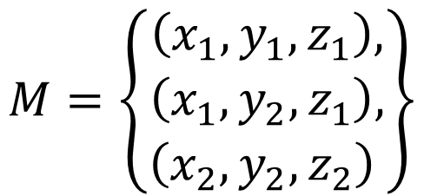
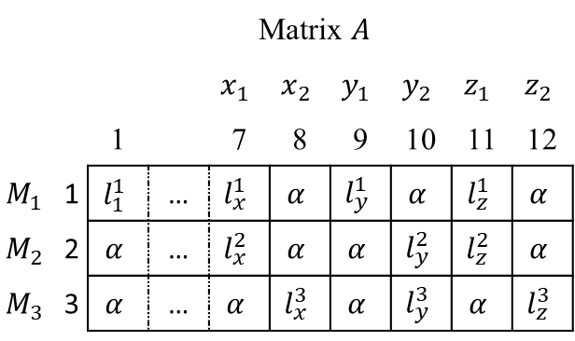
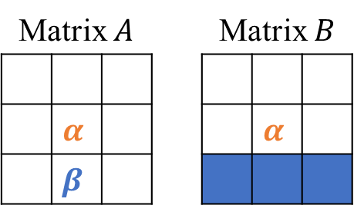
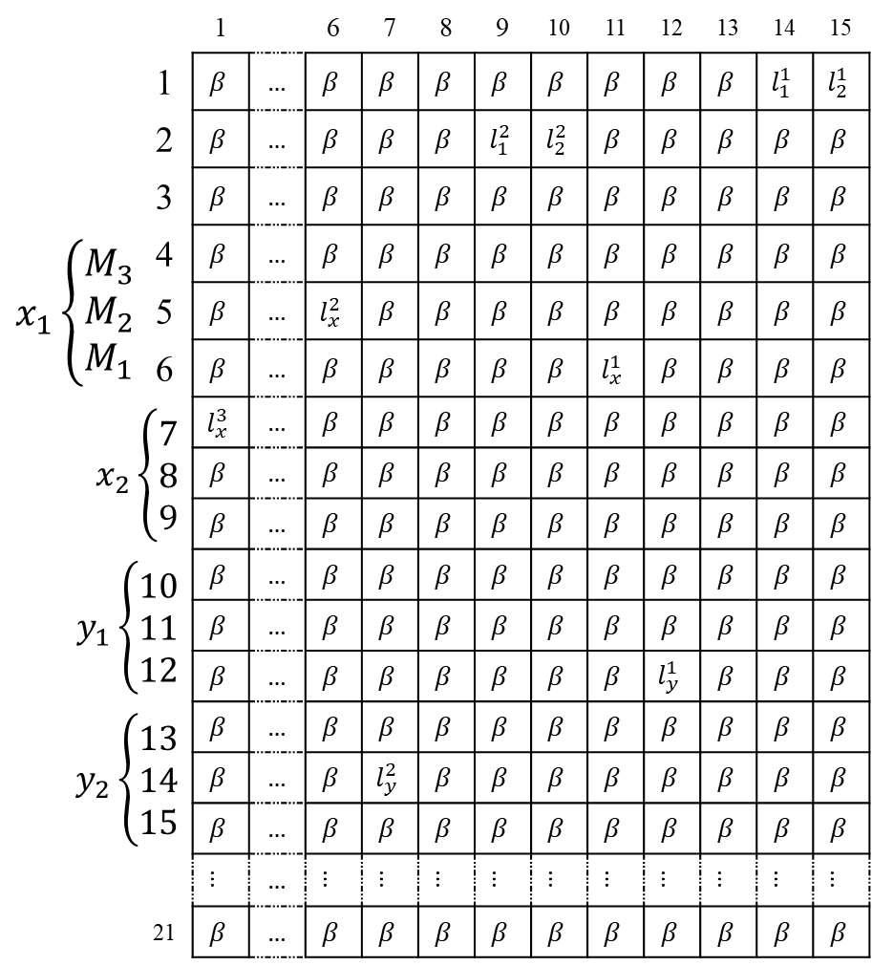
Two same variables cannot be both in the answer.
 |  | 1 |  | 6 | 7 | 8 | 9 | 10 | 11 | 12 | 13 | 14 | 15
 | 1 | $$β$$ | … | $$β$$ | $$β$$ | $$β$$ | $$β$$ | $$β$$ | $$β$$ | $$β$$ | $$β$$ | $$l_{1}^{1}$$ | $$l_{2}^{1}$$
 | 2 | $$β$$ | … | $$β$$ | $$β$$ | $$β$$ | $$l_{1}^{2}$$ | $$l_{2}^{2}$$ | $$β$$ | $$β$$ | $$β$$ | $$β$$ | $$β$$
 | 3 | $$β$$ | … | $$β$$ | $$β$$ | $$β$$ | $$β$$ | $$β$$ | $$β$$ | $$β$$ | $$β$$ | $$β$$ | $$β$$
$$x_{1}\left\{\begin{aligned}M_{3} \\ M_{2} \\ M_{1}\end{aligned}\right.$$ | 4 | $$β$$ | … | $$β$$ | $$β$$ | $$β$$ | $$β$$ | $$β$$ | $$β$$ | $$β$$ | $$β$$ | $$β$$ | $$β$$
 | 5 | $$β$$ | … | $$l_{x}^{2}$$ | $$β$$ | $$β$$ | $$β$$ | $$β$$ | $$β$$ | $$β$$ | $$β$$ | $$β$$ | $$β$$
 | 6 | $$β$$ | … | $$β$$ | $$β$$ | $$β$$ | $$β$$ | $$β$$ | $$l_{x}^{1}$$ | $$β$$ | $$β$$ | $$β$$ | $$β$$
$x_{2}\left\{\begin{aligned}7 \\ 8 \\ 9\end{aligned}\right.$ |  | $$l_{x}^{3}$$ | … | $$β$$ | $$β$$ | $$β$$ | $$β$$ | $$β$$ | $$β$$ | $$β$$ | $$β$$ | $$β$$ | $$β$$
 |  | $$β$$ | … | $$β$$ | $$β$$ | $$β$$ | $$β$$ | $$β$$ | $$β$$ | $$β$$ | $$β$$ | $$β$$ | $$β$$
 |  | $$β$$ | … | $$β$$ | $$β$$ | $$β$$ | $$β$$ | $$β$$ | $$β$$ | $$β$$ | $$β$$ | $$β$$ | $$β$$
$y_{1}\left\{\begin{aligned}10 \\ 11 \\ 12\end{aligned}\right.$ |  | $$β$$ | … | $$β$$ | $$β$$ | $$β$$ | $$β$$ | $$β$$ | $$β$$ | $$β$$ | $$β$$ | $$β$$ | $$β$$
 |  | $$β$$ | … | $$β$$ | $$β$$ | $$β$$ | $$β$$ | $$β$$ | $$β$$ | $$β$$ | $$β$$ | $$β$$ | $$β$$
 |  | $$β$$ | … | $$β$$ | $$β$$ | $$β$$ | $$β$$ | $$β$$ | $$β$$ | $$l_{y}^{1}$$ | $$β$$ | $$β$$ | $$β$$
$y_{2}\left\{\begin{aligned}13 \\ 14 \\ 15\end{aligned}\right.$ |  | $$β$$ | … | $$β$$ | $$β$$ | $$β$$ | $$β$$ | $$β$$ | $$β$$ | $$β$$ | $$β$$ | $$β$$ | $$β$$
 |  | $$β$$ | … | $$β$$ | $$l_{y}^{2}$$ | $$β$$ | $$β$$ | $$β$$ | $$β$$ | $$β$$ | $$β$$ | $$β$$ | $$β$$
 |  | $$β$$ | … | $$β$$ | $$β$$ | $$β$$ | $$β$$ | $$β$$ | $$β$$ | $$β$$ | $$β$$ | $$β$$ | $$β$$
 |  | … | … | … | … | … | … | … | … | … | … | … | …
 | 21 | $$β$$ | … | $$β$$ | $$β$$ | $$β$$ | $$β$$ | $$β$$ | $$β$$ | $$β$$ | $$β$$ | $$β$$ | $$β$$
$$M=\left\{\begin{aligned}\left(x_{1},y_{1},z_{1}\right), \\ \left(x_{1},y_{2},z_{1}\right), \\ \left(x_{2},y_{2},z_{2}\right),\end{aligned}\right\}$$
 | Matrix $A$
 |  |  |  | $$x_{1}$$ | $$x_{2}$$ | $$y_{1}$$ | $$y_{2}$$ | $$z_{1}$$ | $$z_{2}$$
 |  | 1 |  | 7 | 8 | 9 | 10 | 11 | 12
$$M_{1}$$ | 1 | $$l_{1}^{1}$$ | … | $$l_{x}^{1}$$ | $$α$$ | $$l_{y}^{1}$$ | $$α$$ | $$l_{z}^{1}$$ | $$α$$
$$M_{2}$$ | 2 | $$α$$ | … | $$l_{x}^{2}$$ | $$α$$ | $$α$$ | $$l_{y}^{2}$$ | $$l_{z}^{2}$$ | $$α$$
$$M_{3}$$ | 3 | $$α$$ | … | $$α$$ | $$l_{x}^{3}$$ | $$α$$ | $$l_{y}^{3}$$ | $$α$$ | $$l_{z}^{3}$$
$$P(LOL)$$
Matrix $A$ |  |  |  | Matrix $B$
 | $$α$$ |  |  |  | $$α$$
 | $$β$$

Slide 20
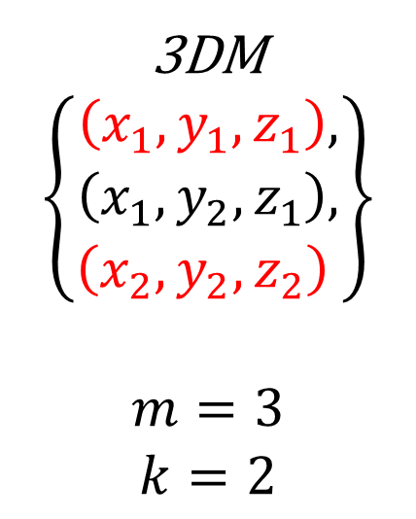
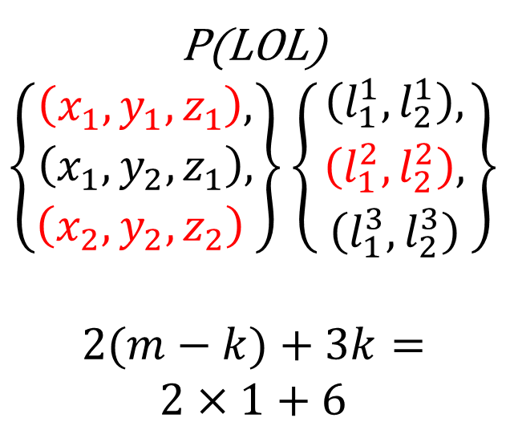
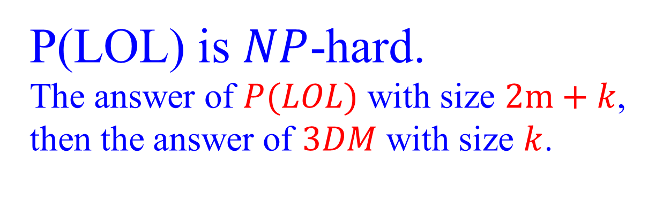
P(LOL) is $NP$-hard.
The answer of $P(LOL)$ with size $2m+k$,
then the answer of $3DM$ with size $k$.
3DM
$$\left\{\begin{aligned}\left(x_{1},y_{1},z_{1}\right), \\ \left(x_{1},y_{2},z_{1}\right), \\ \left(x_{2},y_{2},z_{2}\right),\end{aligned}\right\}$$
$$m=3$$
$$k=2$$
P(LOL)
$$\left\{\begin{aligned}\left(x_{1},y_{1},z_{1}\right), \\ \left(x_{1},y_{2},z_{1}\right), \\ \left(x_{2},y_{2},z_{2}\right),\end{aligned}\right\}\left\{\begin{aligned}\left(l_{1}^{1}, l_{2}^{1}\right), \\ \left(l_{1}^{2}, l_{2}^{2}\right), \\ \left(l_{1}^{3}, l_{2}^{3}\right),\end{aligned}\right\}$$
$$2(m−k)+3k=$$
$$2×1+6$$

Slide 21

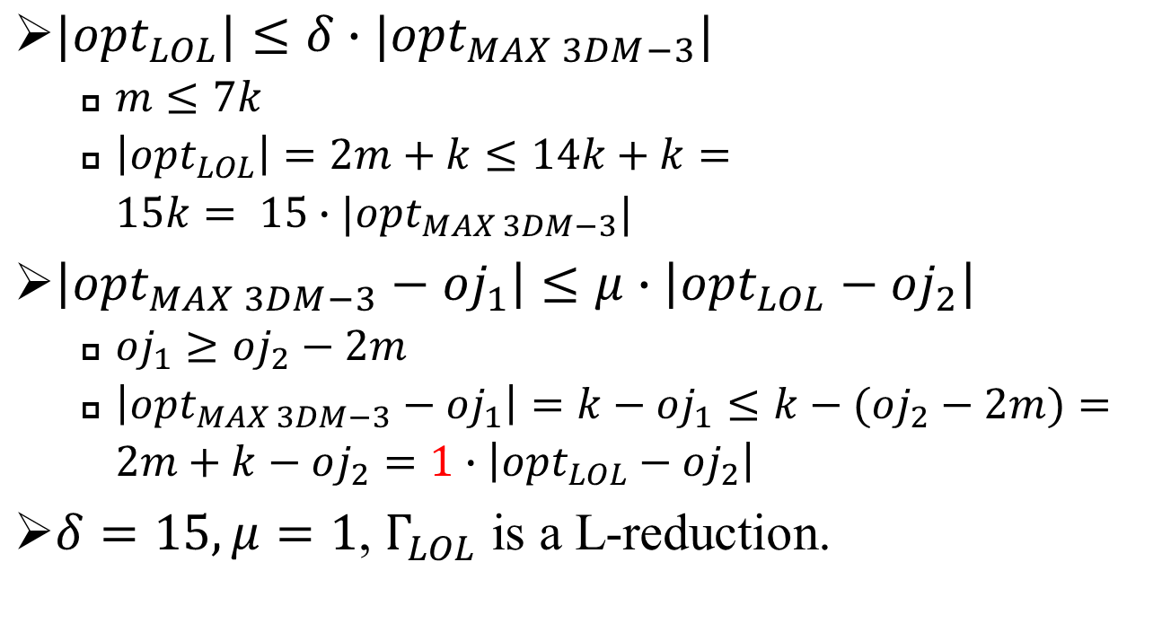
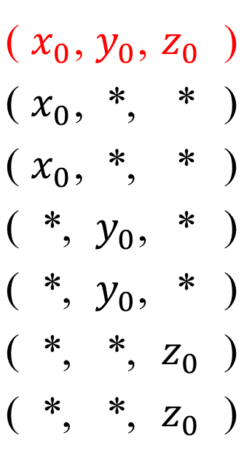
P(LOL) is $APX$-hard.
( | $x_{0}$, | $y_{0}$, | $$z_{0}$$ | )
( | $x_{0}$, | *, | * | )
( | $x_{0}$, | *, | * | )
( | *, | $y_{0}$, | * | )
( | *, | $y_{0}$, | * | )
( | *, | *, | $$z_{0}$$ | )
( | *, | *, | $$z_{0}$$ | )
$|{opt}_{LOL}|≤δ∙|{opt}_{MAX 3DM−3}|$
$m≤7k$
$\left|{opt}_{LOL}\right|=2m+k≤14k+k=$
$15k= 15∙|{opt}_{MAX 3DM−3}|$
$\left|{opt}_{MAX 3DM−3}−{oj}_{1}\right|≤μ∙\left|{opt}_{LOL}−{oj}_{2}\right|$
${oj}_{1}≥{oj}_{2}−2m$
$\left|{opt}_{MAX 3DM−3}−{oj}_{1}\right|=k−{oj}_{1}≤k−({oj}_{2}−2m)=$
$2m+k−oj_{2}=1∙\left|{opt}_{LOL}−{oj}_{2}\right|$
$δ=15, μ=1$, $Γ_{LOL}$ is a L-reduction.

Slide 23
Proofs
Only 4 versions are valid: P(ENL), P(ENE), P(LOL), P(LOE)
Prove P(ENL), P(ENE), P(LOL), P(LOE) are NP-hard and APX-hard

Slide 24
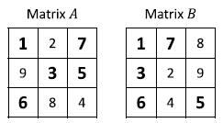
Example of P(ENL)

Slide 25

P(ENL) is an NP problem
$2^{n^{2}}$ cases

Slide 26
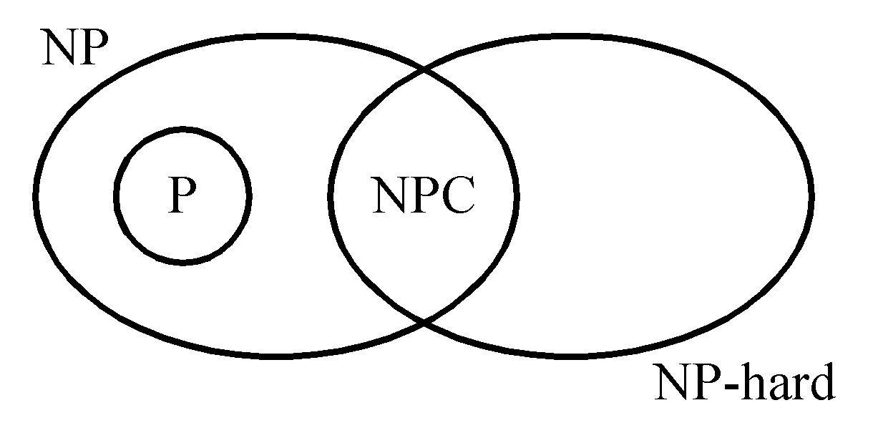
Proof of NPC
To show that A is NP-complete
(I) Prove that A is an NP problem.
(II) Prove that ∃ B ∈ NPC, B ∝ A.
⇒ A ∈ NPC

