Slide 1
Content-based Image Retrieval and Semantic Automatic Image Annotation Based on the Weighted Average of Triangular Histograms Using Support Vector Machine
Zahid Mehmood, Toqeer Mahmood, Muhammad Arshad Javid
Applied Intelligence, January 2018, Volume 48, Issue 1, pp 166–181
Presenter : Tz-Hsu Lee
Date : Jun. 07, 2020.
Notes:
University of Engineering and Technology, Taxila
Islamabad, Pakistan

Slide 2
Abstract(1/2)
In recent years, the rapid growth of multimedia content makes content-based image retrieval (CBIR) a challenging research problem. The content-based attributes of the image are associated with the position of objects and regions within the image. The addition of image content-based attributes to image retrieval enhances its performance. In the last few years, the bag-of-visual-words (BoVW) based image representation model gained attention and significantly improved the efficiency and effectiveness of CBIR. In BoVW-based image representation model, an image is represented as an order-less histogram of visual words by ignoring the spatial attributes. In this paper, we present a novel image representation based on the weighted average of triangular histograms (WATH) of visual words.
Notes:
敲乎李 ate 敖

Slide 3
Abstract(2/2)
The proposed approach adds the image spatial contents to the inverted index of the BoVW model, reduces overfitting problem on larger sizes of the dictionary and semantic gap issues between high-level image semantic and low-level image features. The qualitative and quantitative analysis conducted on three image benchmarks demonstrates the effectiveness of the proposed approach based on WATH.
Notes:
敲乎李 ate 敖

Slide 4

CBIR(content-based image retrieval)
images are represented in the form of feature vectors that consist of low-level visual features that are based on shape, color, and texture.
The real world applications of CBIR
Notes:
Aligning distance matrices for structural alignment

Slide 5
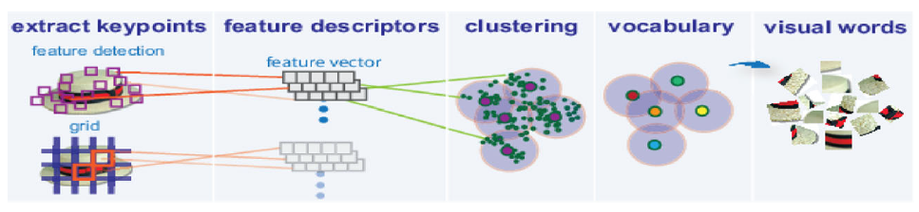
BoVW(bag-of-visual-words)
Feature descriptors are used for the extraction of image features.
Histograms of visual words are the feature vectors of images.
Notes:
Aligning distance matrices for structural alignment

Slide 6
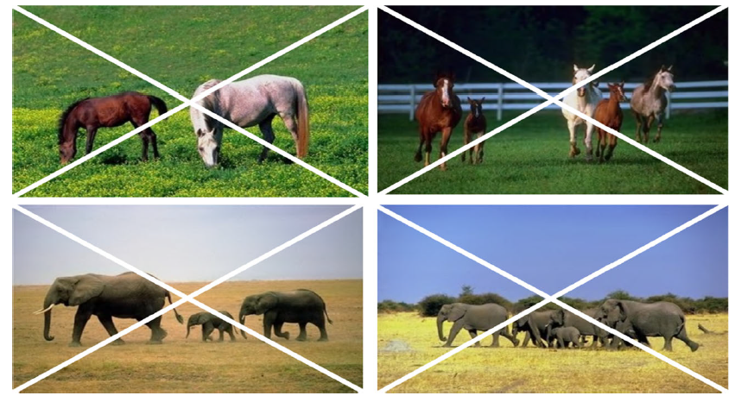
The content-based spatial triangular relationship between the images of the Corel image database.

Slide 7
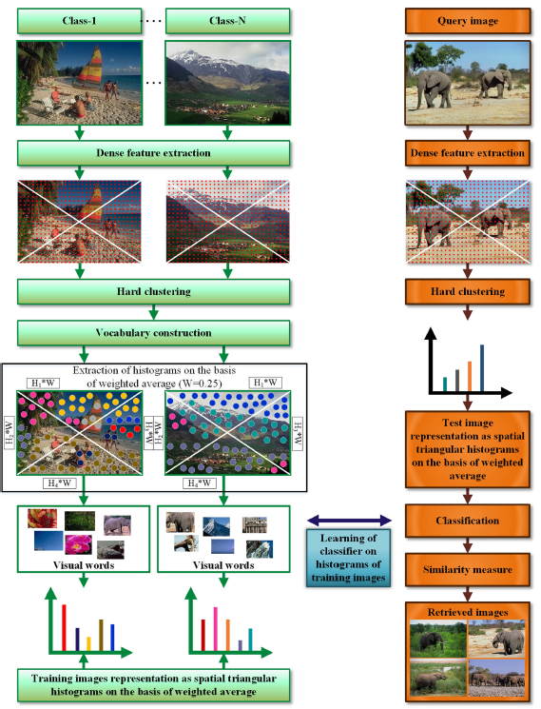

Slide 8
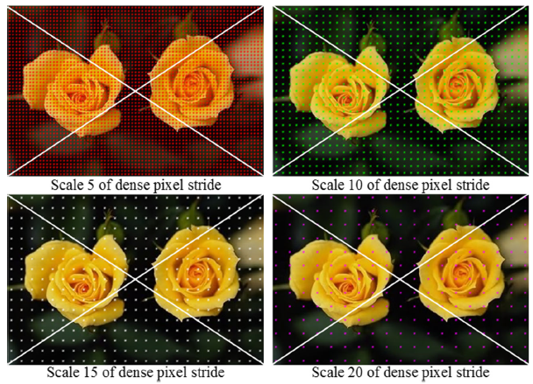
Experimental parameters and results
The value of weight W = 0.25
Dictionary size and percentage of features for the dictionary construction
The scale of dense features
Dense pixel stride or step size
Notes:
Aligning distance matrices for structural alignment

Slide 9


Evaluation measures
Rc is the total number of correctly retrieved images.
Rt is the total number of retrieved images.
Ts is the total number of images in the semantic class s.
Rc is the correctly retrieved images.
Notes:
Aligning distance matrices for structural alignment

Slide 10
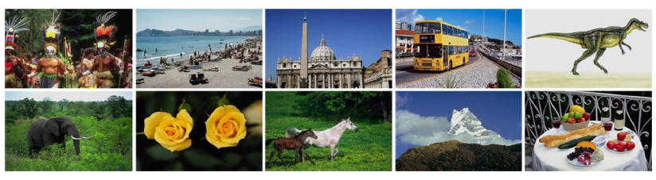
Performance evaluation on the Corel-A image database
Sample images from 10 semantic classes of the Corel-A image database
Notes:
Aligning distance matrices for structural alignment

Slide 11
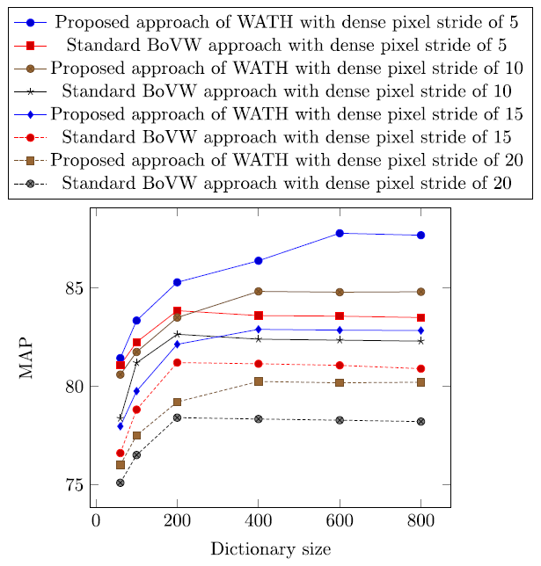
Performance evaluation on the Corel-A image database
Notes:
Aligning distance matrices for structural alignment

Slide 12
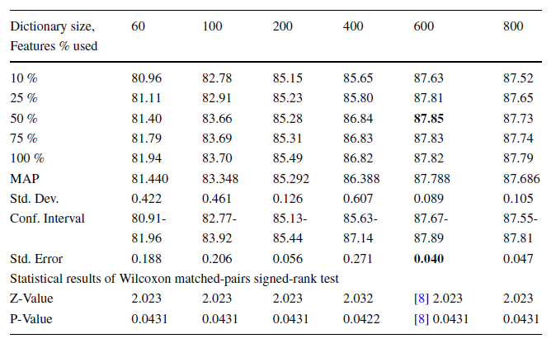
Performance evaluation on the Corel-A image database
Statistical analysis of MAP on the Corel-A image database with a dense pixel stride of 5
Notes:
Aligning distance matrices for structural alignment

Slide 13
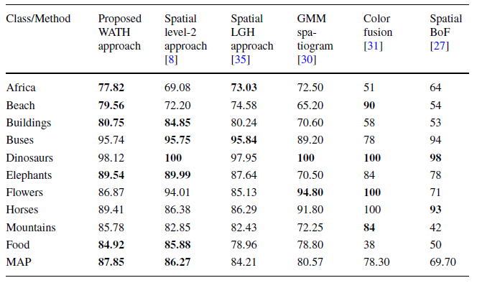
Performance evaluation on the Corel-A image database
Performance measure of MAP for top-20 image retrievals on the Corel-A image database
Notes:
Aligning distance matrices for structural alignment

Slide 14
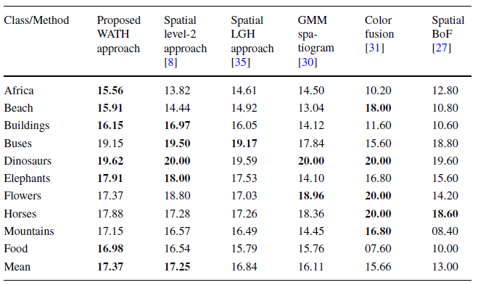
Performance evaluation on the Corel-A image database
Performance measure of recall for top-20 image retrievals on the Corel-A image database
Notes:
Aligning distance matrices for structural alignment

Slide 15
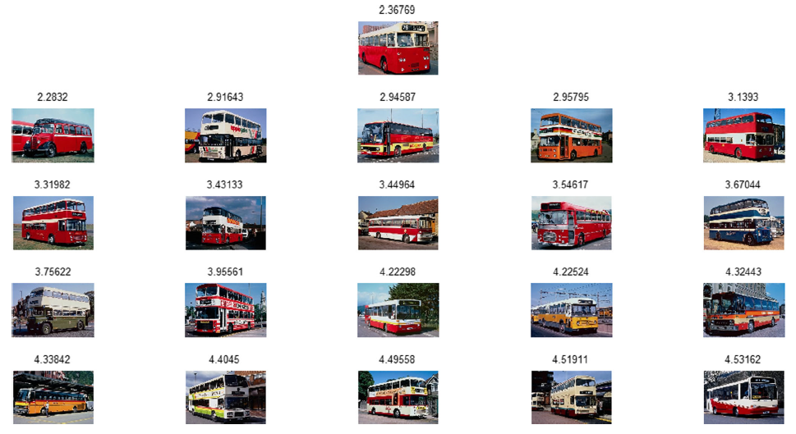
Performance evaluation on the Corel-A image database
Notes:
Aligning distance matrices for structural alignment

Slide 16
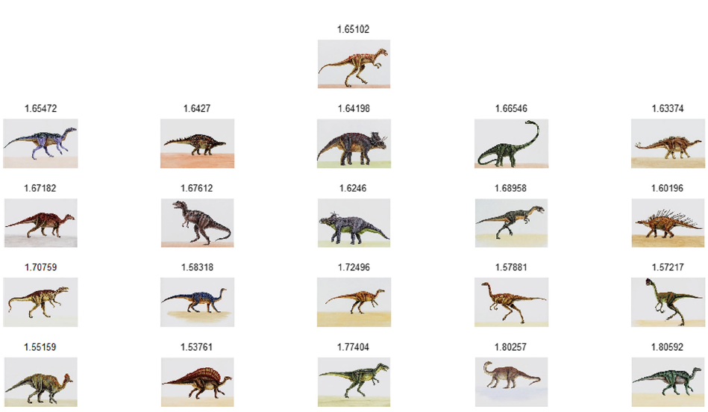
Performance evaluation on the Corel-A image database
Notes:
Aligning distance matrices for structural alignment

Slide 17
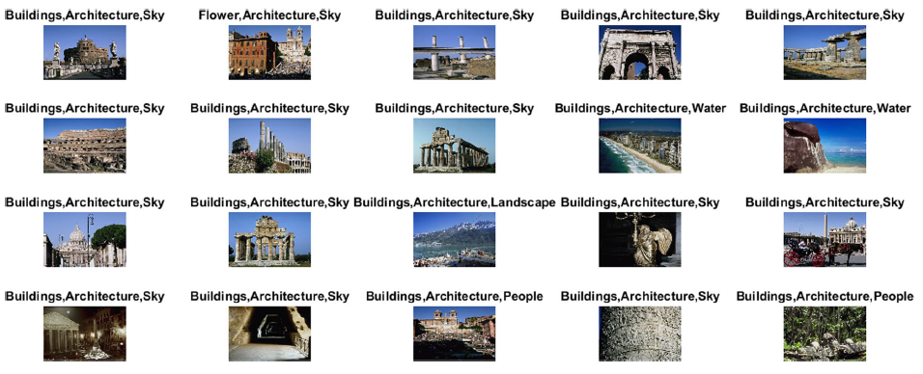
Performance evaluation on the Corel-A image database
Notes:
Aligning distance matrices for structural alignment

Slide 18
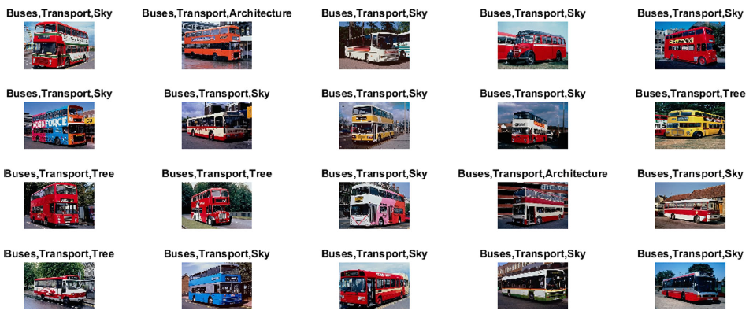
Performance evaluation on the Corel-A image database
Notes:
Aligning distance matrices for structural alignment

Slide 19
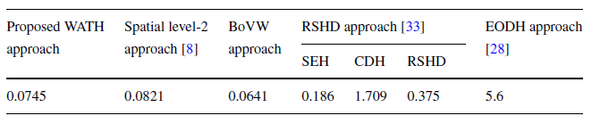
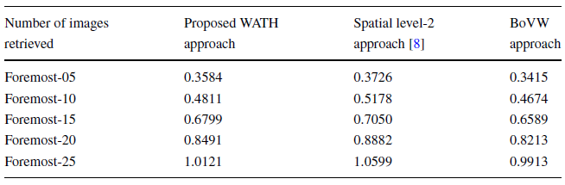
Computational complexity
Intel Pentium (R) Core i7 2.4 GHz microprocessor, 2 GB GPU, and 8 GB RAM using Windows 7 operating system, and implemented in MATLAB 2015a.
Comparison of computational cost (in seconds) required for feature extraction only
Comparison of computational cost (in seconds) of the proposed approach with state-of-the-art CBIR approaches
Notes:
Aligning distance matrices for structural alignment

Slide 20
Conclusion and future directions
The proposed approach based on the WATH outperforms state-of-the-art CBIR approaches.
They will evaluate the performance of proposed approach using deep learning for large-scale image retrieval on ImageCLEF and ImageNET image databases.
Notes:
i, j, k, l are matching positions in A and B
Hence if we define the set of 2D points (i, k)to consist of the set of matching position pairs between A and B and then solve the MDNRS problem,
the solution list L describes a set of rectangles with maximum nesting depth,
and the characters that correspond to the lower-left and upper-right corner matching position pairs define an LCPS between the input strings A and B.

