Slide 1
Antlion optimization algorithm for pairwise structural alignment with bi-objective functions
R. Ranjani Rani and D. Ramyachitra
Neural Computing and Applications, 31(19), 2019, 3139– 3146
Presenter : Feng-Yang Tsai
Date:Jan. 7, 2019.

Slide 2
Abstract(1/2)
This research work concentrates on the pairwise protein structure alignment of numerous protein structures. This is considered to be a problematic job which is an NP-hard problem. This work proposed a bi-objective-based antlion optimization algorithm (BO-ALO) which is aimed to improve the geometrical and evolutionary relationship among the protein structures. The bi-objective functions are the RMSD and TM scores which aim to minimize the RMSD score and maximize the TM score. The BO-ALO method has been compared with various widespread existing methods such as SPalignNS, UniAlign, DALI, MICAN, GANGSTA, DeepAlign, TM-align, CE, ant colony optimization and artiﬁcial bee colony optimization methods.

Slide 3
Abstract(2/2)
The experiments were taken from the benchmark datasets, namely SCOPe and CATH. Also, the predicted alignments were compared with gold standard benchmark databases such as CDD, MALIDUP, MALISAM and HOMSTRAD. The outcomes of the proposed method have better bi-objective function scores and performance measures than other well-known existing approaches. This work also evaluates the proposed method with its biological signiﬁcance of predicting the common gene ontology functions among the aligned protein structures.

Slide 4
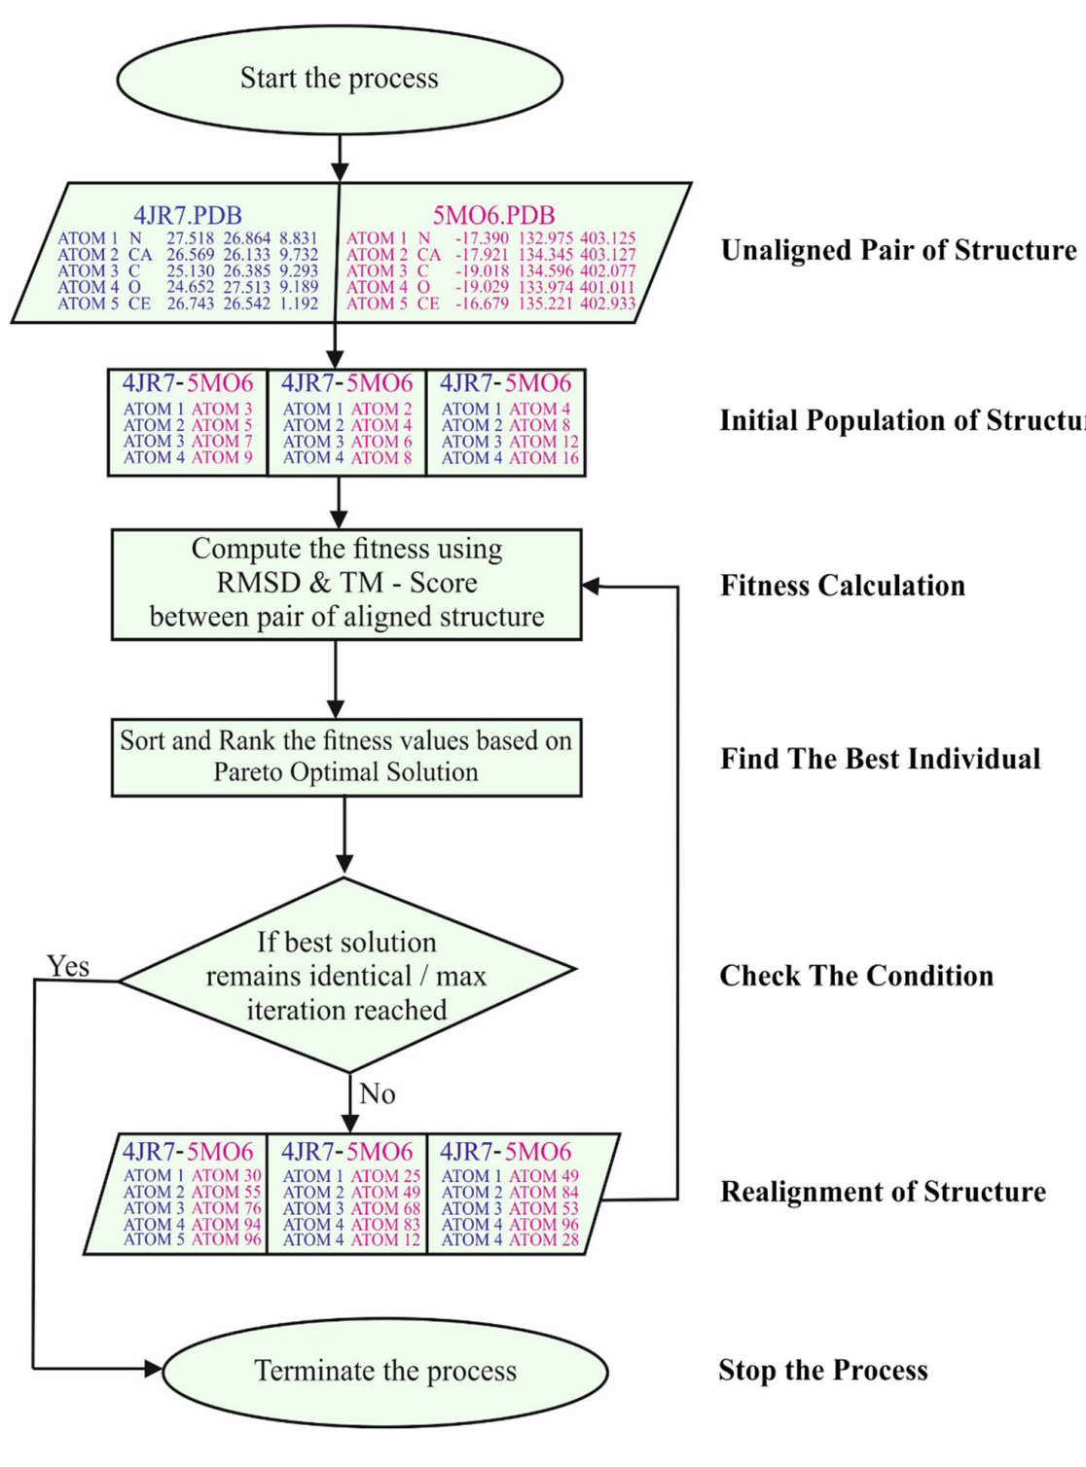
Method:

Slide 5
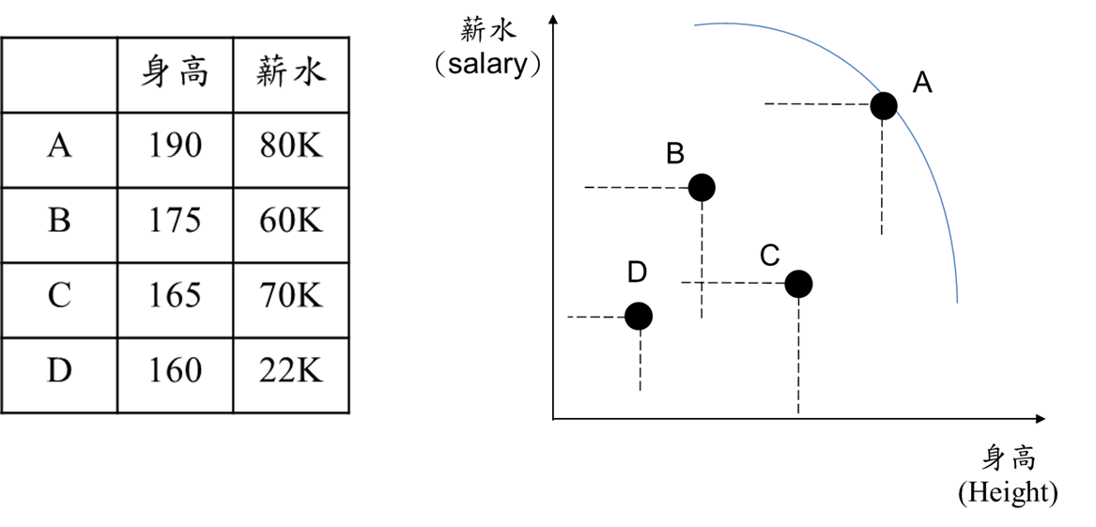
Pareto-optimal solution:
A為non-dominated solution

Slide 6

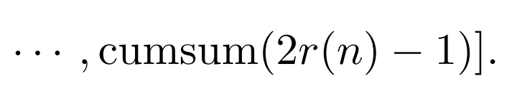
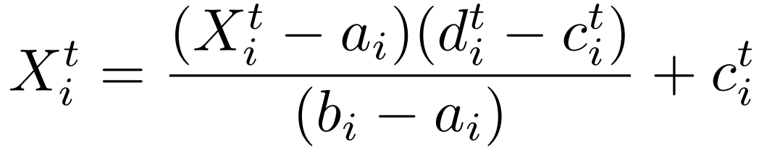
Method:
(a) Arbitrary random walks of ants (alignments):

Slide 7
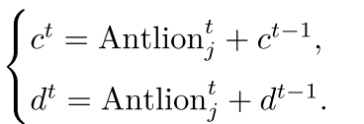
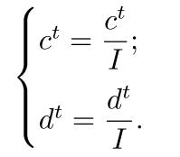
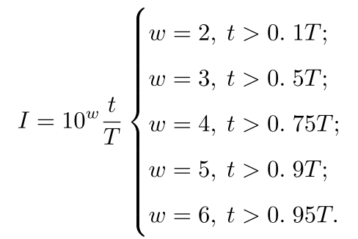
Method:
(b) Trapping in the antlions dump:
(c) Sliding ants (alignments) toward antlions (residues):

Slide 8


Method:
(d) Catching preys and reconstructing the trap:
(e) Elitism:

Slide 9
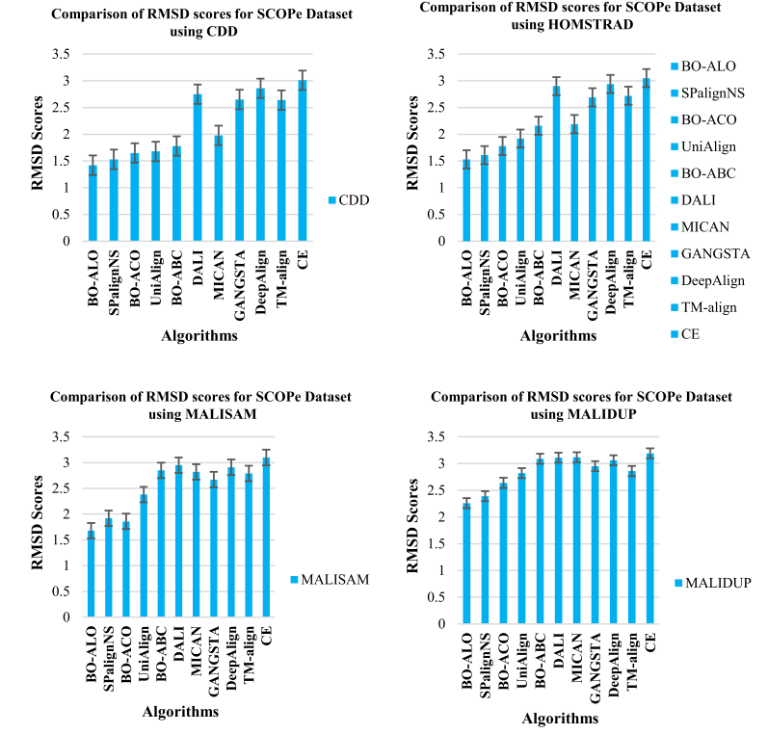


Result:

Slide 10
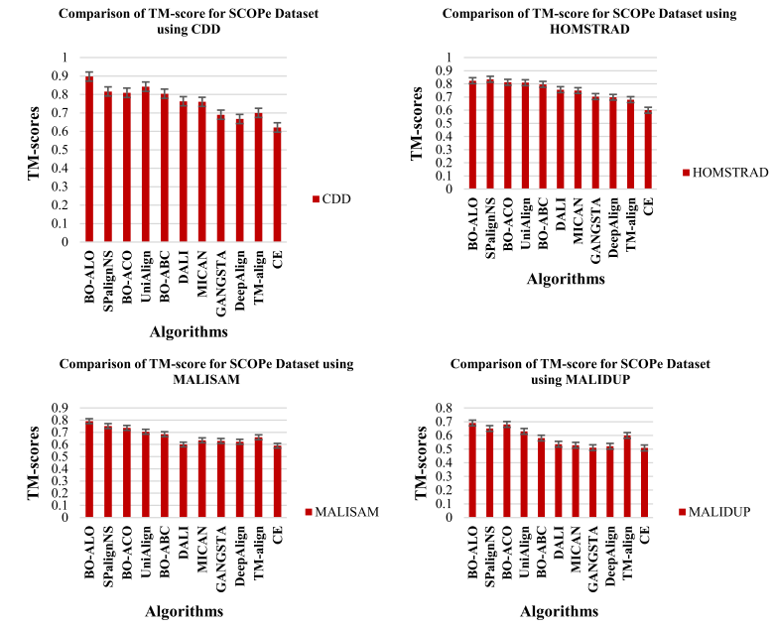
Result:

