Slide 1
A New String Matching Algorithm Based on Logical Indexing
Daniar Heri Kurniawan, Ir. Rinaldi Munir, M.T.
The 5th International Conference on Electrical Engineering and Informatics 2015
August 10-11, 2015, Bali, Indonesia
Presenter：Yu-Cheng Chang
Date：Jan. 14, 2019

Slide 2
Abstract(1/2)
Searching process performance is very important in this modern world that consists of various advanced technology. String matching algorithm is one of the most commonly applied algorithms for searching. String that contains sequences of character is the simplest representation of any complex data in our real life, such as search engine database, finger print minutiae, or DNA sequence. The current most famous string algorithms are Knuth-Morris-Pratt (KMP) algorithm and Boyer-Moore (BM) algorithm. Boyer-Moore algorithm and KMP algorithm are not efficient in some cases. We introduced a new variation of string matching algorithm based on Logical-Indexing (LI), which is more efficient than those algorithms.

Slide 3
Abstract(2/2)
Logical-Indexing algorithm implements a new function or method and defines different jumping rules compared to others. The indexes of texts and patterns are used to reduce the number of comparisons. Index enables us to analyze the condition of comparison without directly comparing each character in the pattern. Theoretically, we have proven that Logical-Indexing algorithm can skip more characters than KMP and BM algorithm by analyzing KMP’s and BM’s weaknesses then giving the better solution that are implemented in LI. Furthermore, experiments conducted on various combinations of pattern matching cases also demonstrate that the average number of LI’s direct comparisons is smaller than KMP’s and BM’s algorithm.

Slide 4
Term
S is a string of size m, P is a string of size n, n < m
Ｓ＝ｂａｃｘｙｂａａｂａｂａｂａｘｂａａｃａａｂａｃｘａｂａ
Ｐ＝ｂａｃｘａｂａ
matched-string = ｂａ
unmatched-string = ｂａｃｘａ
paired-character = ｘｙ
margin-string： longest string between suffix of matched-string and prefix of pattern => front-margin = ｂａ, back-margin = ｂａ
in-pair : (3) can be found in (2)

Slide 5
Shift Rules(1/4)
Matched Jumping：
Ｓ＝ｂａｃｘｙｂａａｂａｂａｂａｘｂａａｃａａｂａｃｘａｂａ
Ｐ＝ ｂａｃｘａｂａ
paired-character =ａｂ is in-pairedｂａｃｘａｂａ
Ｓ＝ｂａｃｘｙｂａａｂａｂａｂａｘｂａａｃａａｂａｃｘａｂａ
Ｐ＝ ｂａｃｘａｂａ

Slide 6
Shift Rules(2/4)
Matched Jumping - Single-Match：
Ｓ＝ｂａｃｘｙｂａａｂａｂａｂａｘｂａａｃａａｂａｃｘａｂａ
Ｐ＝ ｂａｃｘａｂａ
paired-character =ａｂ is single-match ｂａｃｘａｂａ
Ｓ＝ｂａｃｘｙｂａａｂａｂａｂａｘｂａａｃａａｂａｃｘａｂａ
Ｐ＝ ｂａｃｘａｂａ

Slide 7
Shift Rules(3/4)
Margin jumping：
Ｓ＝ｂａｃｘｙｂａａｂａｂａｂａｘｂａａｃａａｂａｃｘａｂａ
Ｐ＝ｂａｃｘａｂａ
Align front-margin with previous position of back-margin
Ｓ＝ｂａｃｘｙｂａａｂａｂａｂａｘｂａａｃａａｂａｃｘａｂａ
Ｐ＝ ｂａｃｘａｂａ

Slide 8
Shift Rules(4/4)
Full Jumping：
Ｓ＝ｂａｃｘｙｂａａｂａｂａｂａｘｂａａｃａａｂａｃｘａｂａ
Ｐ＝ ｂａｃｘａｂａ
The pattern will be moved to the right as long as it’s length
Ｓ＝ｂａｃｘｙｂａａｂａｂａｂａｘｂａａｃａａｂａｃｘａｂａ
Ｐ＝ ｂａｃｘａｂａ

Slide 9
Preprocessing
Ｓ＝ｂａｃｘｙｂａａｂａｂａｂａｘｂａａｃａａｂａｃｘａｂａ
Ｐ＝ｂａｃｘａｂａ
paired-character = ｘｙ
Table 1. Pattern
j | 0 | 1 | 2 | 3 | 4 | 5 | 6
P[j] | b | a | c | x | a | b | a
Table 2. Margin Table
j | 0 | 1 | 2 | 3 | 4 | 5 | 6
marginTable[j] | 2 | 2 | 2 | 2 | 2 | 0 | 0
Table 3. Occurrence Table
j | 0 | 1 | 2 | 3 | 4 | 5 | 6
occurrenceTable[j] | -1 | -1 | -1 | -1 | 1 | 0 | 4
Table 4. Char Table
charTable[0] | -1
…
charTable[‘a’] | 6
…
charTable[‘y’] | -1
…
charTable[225] | -1

Slide 10
Preprocessing
Ｓ＝ｂａｃｘｙｂａａｂａｂａｂａｘｂａａｃａａｂａｃｘａｂａ
Ｐ＝ｂａｃｘａｂａ
paired-character = ｘｙ
Table 1. Pattern
j | 0 | 1 | 2 | 3 | 4 | 5 | 6
P[j] | b | a | c | x | a | b | a
Table 2. Margin Table
j | 0 | 1 | 2 | 3 | 4 | 5 | 6
marginTable[j] | 2 | 2 | 2 | 2 | 2 | 0 | 0
Table 3. Occurrence Table
j | 0 | 1 | 2 | 3 | 4 | 5 | 6
occurrenceTable[j] | -1 | -1 | -1 | -1 | 1 | 0 | 4
Table 4. Char Table
charTable[0] | -1
…
charTable[‘a’] | 6
…
charTable[‘y’] | -1
…
charTable[225] | -1

Slide 11
Match(1/6) – Margin Jumping
Ｃ |  |  |  |  | ３ | ２ | １
Ｓ | ｂ | ａ | ｃ | ｘ | ｙ | ｂ | ａ | ａ | ｂ | ａ | ｂ | ａ | ｂ | ａ | ｘ | ｂ | ａ | ａ | ｃ | ａ | ａ | ｂ | ａ | ｃ | ｘ | ａ | ｂ | ａ
Ｐ | ｂ | ａ | ｃ | ｘ | ａ | ｂ | ａ
 |  |  |  |  |  | ｂ | ａ | ｃ | ｘ | ａ | ｂ | ａ
 |  |  |  |  |  |  |  |  | ｂ | ａ | ｃ | ｘ | ａ | ｂ | ａ
 |  |  |  |  |  |  |  |  |  |  |  |  |  |  |  | ｂ | ａ | ｃ | ｘ | ａ | ｂ | ａ
 |  |  |  |  |  |  |  |  |  |  |  |  |  |  |  |  | ｂ | ａ | ｃ | ｘ | ａ | ｂ | ａ
 |  |  |  |  |  |  |  |  |  |  |  |  |  |  |  |  |  |  |  |  |  | ｂ | ａ | ｃ | ｘ | ａ | ｂ | ａ
margin-string = ｂａ
paired-character = ｘｙ
unmatched-string = ｂａｃｘａ
distance = P.length – marginTable[4] = 7 – 2 = 5
mark the margin-string’s index

Slide 12
Match(2/6) – Single-Match
Ｃ |  |  |  |  |  |  |  |  | ７ | ６ | ５ | ４
Ｓ | ｂ | ａ | ｃ | ｘ | ｙ | ｂ | ａ | ａ | ｂ | ａ | ｂ | ａ | ｂ | ａ | ｘ | ｂ | ａ | ａ | ｃ | ａ | ａ | ｂ | ａ | ｃ | ｘ | ａ | ｂ | ａ
Ｐ | ｂ | ａ | ｃ | ｘ | ａ | ｂ | ａ
 |  |  |  |  |  | ｂ | ａ | ｃ | ｘ | ａ | ｂ | ａ
 |  |  |  |  |  |  |  |  | ｂ | ａ | ｃ | ｘ | ａ | ｂ | ａ
 |  |  |  |  |  |  |  |  |  |  |  |  |  |  |  | ｂ | ａ | ｃ | ｘ | ａ | ｂ | ａ
 |  |  |  |  |  |  |  |  |  |  |  |  |  |  |  |  | ｂ | ａ | ｃ | ｘ | ａ | ｂ | ａ
 |  |  |  |  |  |  |  |  |  |  |  |  |  |  |  |  |  |  |  |  |  | ｂ | ａ | ｃ | ｘ | ａ | ｂ | ａ
margin-string = ｂａ
paired-character = ａｂ
unmatched-string = ｂａｃｘ
shift until first index reach mismatch’s index

Slide 13
Match(3/6) – Full Jumping
Ｃ |  |  |  |  |  |  |  |  |  |  |  |  |  |  | ８
Ｓ | ｂ | ａ | ｃ | ｘ | ｙ | ｂ | ａ | ａ | ｂ | ａ | ｂ | ａ | ｂ | ａ | ｘ | ｂ | ａ | ａ | ｃ | ａ | ａ | ｂ | ａ | ｃ | ｘ | ａ | ｂ | ａ
Ｐ | ｂ | ａ | ｃ | ｘ | ａ | ｂ | ａ
 |  |  |  |  |  | ｂ | ａ | ｃ | ｘ | ａ | ｂ | ａ
 |  |  |  |  |  |  |  |  | ｂ | ａ | ｃ | ｘ | ａ | ｂ | ａ
 |  |  |  |  |  |  |  |  |  |  |  |  |  |  |  | ｂ | ａ | ｃ | ｘ | ａ | ｂ | ａ
 |  |  |  |  |  |  |  |  |  |  |  |  |  |  |  |  | ｂ | ａ | ｃ | ｘ | ａ | ｂ | ａ
 |  |  |  |  |  |  |  |  |  |  |  |  |  |  |  |  |  |  |  |  |  | ｂ | ａ | ｃ | ｘ | ａ | ｂ | ａ
margin-string = null
paired-character = ａｘ
unmatched-string = ｂａｃｘａｂａ
margin-string is null && not in-paired

Slide 14
Match(4/6) – Matched Jumping
Ｃ |  |  |  |  |  |  |  |  |  |  |  |  |  |  |  |  |  |  |  |  |  | ９
Ｓ | ｂ | ａ | ｃ | ｘ | ｙ | ｂ | ａ | ａ | ｂ | ａ | ｂ | ａ | ｂ | ａ | ｘ | ｂ | ａ | ａ | ｃ | ａ | ａ | ｂ | ａ | ｃ | ｘ | ａ | ｂ | ａ
Ｐ | ｂ | ａ | ｃ | ｘ | ａ | ｂ | ａ
 |  |  |  |  |  | ｂ | ａ | ｃ | ｘ | ａ | ｂ | ａ
 |  |  |  |  |  |  |  |  | ｂ | ａ | ｃ | ｘ | ａ | ｂ | ａ
 |  |  |  |  |  |  |  |  |  |  |  |  |  |  |  | ｂ | ａ | ｃ | ｘ | ａ | ｂ | ａ
 |  |  |  |  |  |  |  |  |  |  |  |  |  |  |  |  | ｂ | ａ | ｃ | ｘ | ａ | ｂ | ａ
 |  |  |  |  |  |  |  |  |  |  |  |  |  |  |  |  |  |  |  |  |  | ｂ | ａ | ｃ | ｘ | ａ | ｂ | ａ
margin-string = null
paired-character = ａｂ
unmatched-string = ｂａｃｘａｂａ
in-paired, shift and mark mismatch’s index

Slide 15
Match(5/6) – Margin Jumping
Ｃ |  |  |  |  |  |  |  |  |  |  |  |  |  |  |  |  |  |  |  | 11 |  |  | 10
Ｓ | ｂ | ａ | ｃ | ｘ | ｙ | ｂ | ａ | ａ | ｂ | ａ | ｂ | ａ | ｂ | ａ | ｘ | ｂ | ａ | ａ | ｃ | ａ | ａ | ｂ | ａ | ｃ | ｘ | ａ | ｂ | ａ
Ｐ | ｂ | ａ | ｃ | ｘ | ａ | ｂ | ａ
 |  |  |  |  |  | ｂ | ａ | ｃ | ｘ | ａ | ｂ | ａ
 |  |  |  |  |  |  |  |  | ｂ | ａ | ｃ | ｘ | ａ | ｂ | ａ
 |  |  |  |  |  |  |  |  |  |  |  |  |  |  |  | ｂ | ａ | ｃ | ｘ | ａ | ｂ | ａ
 |  |  |  |  |  |  |  |  |  |  |  |  |  |  |  |  | ｂ | ａ | ｃ | ｘ | ａ | ｂ | ａ
 |  |  |  |  |  |  |  |  |  |  |  |  |  |  |  |  |  |  |  |  |  | ｂ | ａ | ｃ | ｘ | ａ | ｂ | ａ
margin-string = ｂａ
paired-character = ｃａ
unmatched-string = ｂａｃｘ
distance = P.length – marginTable[3] = 7 – 2 = 5
mark the margin-string’s index
marked

Slide 16
Match(6/6)
Ｃ |  |  |  |  |  |  |  |  |  |  |  |  |  |  |  |  |  |  |  |  |  |  |  | 16 | 15 | 14 | 13 | 12
Ｓ | ｂ | ａ | ｃ | ｘ | ｙ | ｂ | ａ | ａ | ｂ | ａ | ｂ | ａ | ｂ | ａ | ｘ | ｂ | ａ | ａ | ｃ | ａ | ａ | ｂ | ａ | ｃ | ｘ | ａ | ｂ | ａ
Ｐ | ｂ | ａ | ｃ | ｘ | ａ | ｂ | ａ
 |  |  |  |  |  | ｂ | ａ | ｃ | ｘ | ａ | ｂ | ａ
 |  |  |  |  |  |  |  |  | ｂ | ａ | ｃ | ｘ | ａ | ｂ | ａ
 |  |  |  |  |  |  |  |  |  |  |  |  |  |  |  | ｂ | ａ | ｃ | ｘ | ａ | ｂ | ａ
 |  |  |  |  |  |  |  |  |  |  |  |  |  |  |  |  | ｂ | ａ | ｃ | ｘ | ａ | ｂ | ａ
 |  |  |  |  |  |  |  |  |  |  |  |  |  |  |  |  |  |  |  |  |  | ｂ | ａ | ｃ | ｘ | ａ | ｂ | ａ
In this algorithm, shift 5 times and compare 16 times
In Boyer-Moore algorithm, shift 6 times and compare 21 times
marked

Slide 17
Compare
LI | Ｓ | ｂ | ａ | ｃ | ｘ | ｙ | ｂ | ａ | ａ | ｂ | ａ | ｂ | ａ | ｂ | ａ | ｘ | ｂ | ａ | ａ | ｃ | ａ | ａ | ｂ | ａ | ｃ | ｘ | ａ | ｂ | ａ
 | Ｐ | ｂ | ａ | ｃ | ｘ | ａ | ｂ | ａ
 |  |  |  |  |  |  | ｂ | ａ | ｃ | ｘ | ａ | ｂ | ａ
 |  |  |  |  |  |  |  |  |  | ｂ | ａ | ｃ | ｘ | ａ | ｂ | ａ
 |  |  |  |  |  |  |  |  |  |  |  |  |  |  |  |  | ｂ | ａ | ｃ | ｘ | ａ | ｂ | ａ
 |  |  |  |  |  |  |  |  |  |  |  |  |  |  |  |  |  | ｂ | ａ | ｃ | ｘ | ａ | ｂ | ａ
 |  |  |  |  |  |  |  |  |  |  |  |  |  |  |  |  |  |  |  |  |  |  | ｂ | ａ | ｃ | ｘ | ａ | ｂ | ａ
BM | Ｓ | ｂ | ａ | ｃ | ｘ | ｙ | ｂ | ａ | ａ | ｂ | ａ | ｂ | ａ | ｂ | ａ | ｘ | ｂ | ａ | ａ | ｃ | ａ | ａ | ｂ | ａ | ｃ | ｘ | ａ | ｂ | ａ
 | Ｐ | ｂ | ａ | ｃ | ｘ | ａ | ｂ | ａ
 |  |  |  |  |  |  | ｂ | ａ | ｃ | ｘ | ａ | ｂ | ａ
 |  |  |  |  |  |  |  |  |  | ｂ | ａ | ｃ | ｘ | ａ | ｂ | ａ
 |  |  |  |  |  |  |  |  |  |  |  |  |  |  |  |  | ｂ | ａ | ｃ | ｘ | ａ | ｂ | ａ
 |  |  |  |  |  |  |  |  |  |  |  |  |  |  |  |  |  | ｂ | ａ | ｃ | ｘ | ａ | ｂ | ａ
 |  |  |  |  |  |  |  |  |  |  |  |  |  |  |  |  |  |  |  | ｂ | ａ | ｃ | ｘ | ａ | ｂ | ａ
 |  |  |  |  |  |  |  |  |  |  |  |  |  |  |  |  |  |  |  |  |  |  | ｂ | ａ | ｃ | ｘ | ａ | ｂ | ａ

Slide 18
Compare
LI | Ｓ | ｂ | ａ | ｃ | ｘ | ｙ | ｂ | ａ | ａ | ｂ | ａ | ｂ | ａ | ｂ | ａ | ｘ | ｂ | ａ | ａ | ｃ | ａ | ａ | ｂ | ａ | ｃ | ｘ | ａ | ｂ | ａ
 | Ｐ | ｂ | ａ | ｃ | ｘ | ａ | ｂ | ａ
 |  |  |  |  |  |  | ｂ | ａ | ｃ | ｘ | ａ | ｂ | ａ
 |  |  |  |  |  |  |  |  |  | ｂ | ａ | ｃ | ｘ | ａ | ｂ | ａ
 |  |  |  |  |  |  |  |  |  |  |  |  |  |  |  |  | ｂ | ａ | ｃ | ｘ | ａ | ｂ | ａ
 |  |  |  |  |  |  |  |  |  |  |  |  |  |  |  |  |  | ｂ | ａ | ｃ | ｘ | ａ | ｂ | ａ
 |  |  |  |  |  |  |  |  |  |  |  |  |  |  |  |  |  |  |  |  |  |  | ｂ | ａ | ｃ | ｘ | ａ | ｂ | ａ
BM | Ｓ | ｂ | ａ | ｃ | ｘ | ｙ | ｂ | ａ | ａ | ｂ | ａ | ｂ | ａ | ｂ | ａ | ｘ | ｂ | ａ | ａ | ｃ | ａ | ａ | ｂ | ａ | ｃ | ｘ | ａ | ｂ | ａ
 | Ｐ | ｂ | ａ | ｃ | ｘ | ａ | ｂ | ａ
 |  |  |  |  |  |  | ｂ | ａ | ｃ | ｘ | ａ | ｂ | ａ
 |  |  |  |  |  |  |  |  |  | ｂ | ａ | ｃ | ｘ | ａ | ｂ | ａ
 |  |  |  |  |  |  |  |  |  |  |  |  |  |  |  |  | ｂ | ａ | ｃ | ｘ | ａ | ｂ | ａ
 |  |  |  |  |  |  |  |  |  |  |  |  |  |  |  |  |  | ｂ | ａ | ｃ | ｘ | ａ | ｂ | ａ
 |  |  |  |  |  |  |  |  |  |  |  |  |  |  |  |  |  |  |  | ｂ | ａ | ｃ | ｘ | ａ | ｂ | ａ
 |  |  |  |  |  |  |  |  |  |  |  |  |  |  |  |  |  |  |  |  |  |  | ｂ | ａ | ｃ | ｘ | ａ | ｂ | ａ

Slide 19
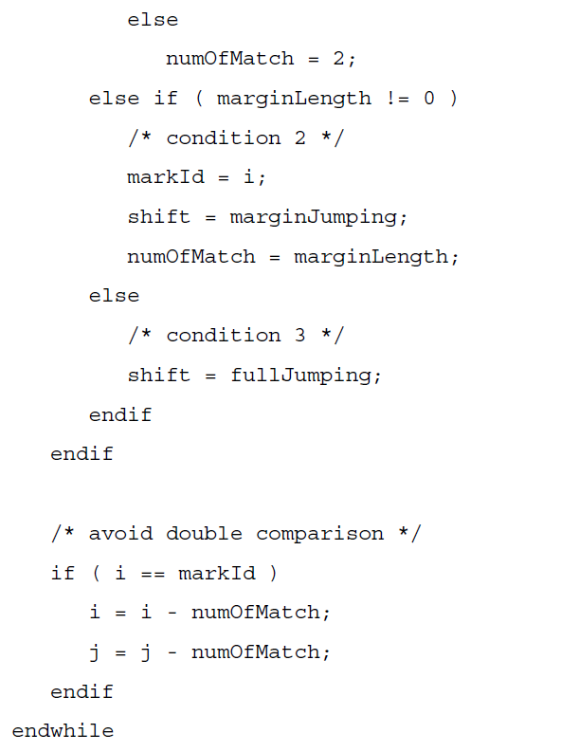
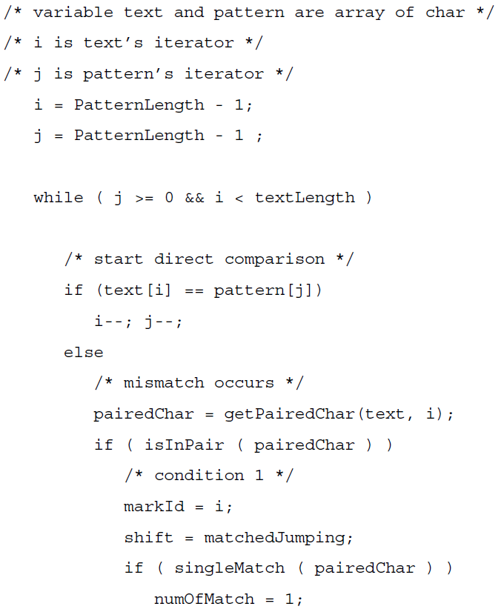
Pseudo Code

Slide 20
Time Complexity
S is a string of size m, P is a string of size n, n < m
Best : O(m)
Ｓ＝ｂａｃｘａｂａ
Ｐ＝ｂａｃｘａｂａ

Slide 21
Time Complexity
S is a string of size m, P is a string of size n, n < m
Worst : O( (m-n+1)(n-1) )
Ｓ＝ａａａａａａａａａａａａａ , m = 13
Ｐ＝ａｘａａａａａａａａａａ , n = 12
Ｃ＝ １０９８７６５４３２１
Ｓ＝ａａａａａａａａａａａａａ , m = 13
Ｐ＝ ａｘａａａａａａａａａａ , n = 12
Ｃ＝ ２１０９８７６５４３２
共 m-n+1 個 phase(s)，每次需比較 n-1 次

Slide 22
Result

