Slide 1
A Multi-View Fusion Neural Network for Answer Selection
Feb. 2-7 2018, the 32nd AAAI Conference on Artificial Intelligence
Lei Sha, Xiaodong Zhang, Feng Qian, Baobao Chang, Zhifang Sui
Present: Chia-Lin, Chen
Date: Jan. 14th , 2020
Notes:
Feb.2-7, 2018 美國路易斯安那州希爾頓酒店

Slide 2
Abstract(1/2)
Community question answering aims at choosing the most appropriate answer for a given question, which is important in many NLP applications. Previous neural network-based methods consider several different aspects of information through calculating attentions. These different kinds of attentions are always simply summed up and can be seen as a “single view”, causing severe information loss.

Slide 3
Abstract(2/2)
To overcome this problem, we propose a Multi-View Fusion Neural Net- work, where each attention component generates a “view” of the QA pair and a fusion RNN integrates the generated views to form a more holistic representation. In this fusion RNN method, a filter gate collects important information of input and directly adds it to the output, which borrows the idea of residual networks. Experimental results on the WikiQA and SemEval-2016 CQA datasets demonstrate that our proposed model outperforms the state-of-the-art methods.

Slide 4
Background(1/2)
In NLP, QA is a topic.
Previous QA work -- related with attention.
->Too single view
So in this paper, propose a Multi-View Fusion Neural Network(MVFNN).

Slide 5
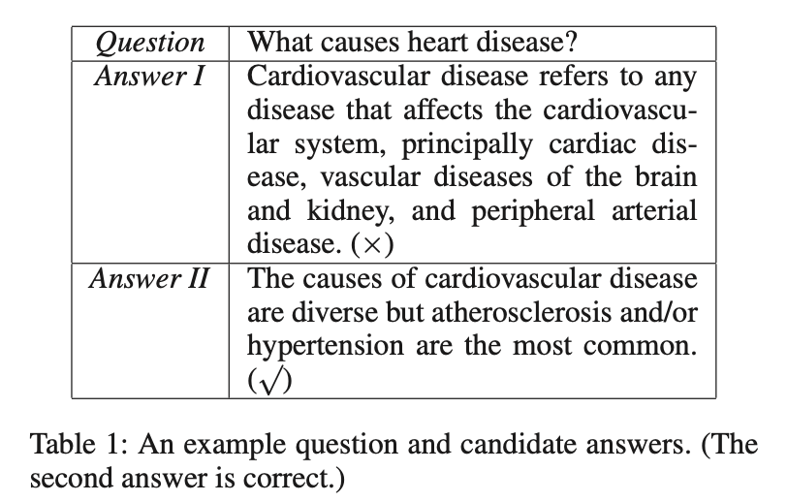
Background(2/2)

Slide 6
Past works on QA (traditional)
Syntactic parse tree
translation feature frequency/density

Slide 7
Past works on QA (neural network)
BiLSTM
CNN
RNN
CNN/RNN with attention
Multi-View Fusion Neural Network(MVFNN) (2018)

Slide 8
Attention for four views
inquiry type
inquiry main verb
inquiry semantic
co-attention

Slide 9
Attention for four views (first three)
inquiry type
inquiry main verb
inquiry semantic
co-attention

Slide 10
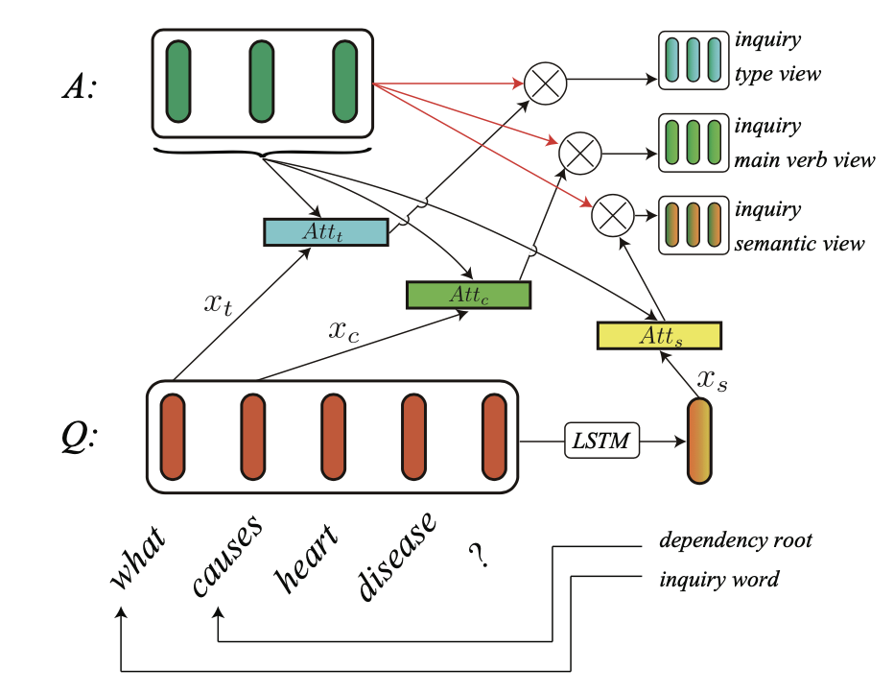


Attention for four views (first three)
Notes:
LSTM-RNN for inquiry semantic view

Slide 11
Attention for four views (co-attention)
inquiry type
inquiry main verb
inquiry semantic
co-attention

Slide 12
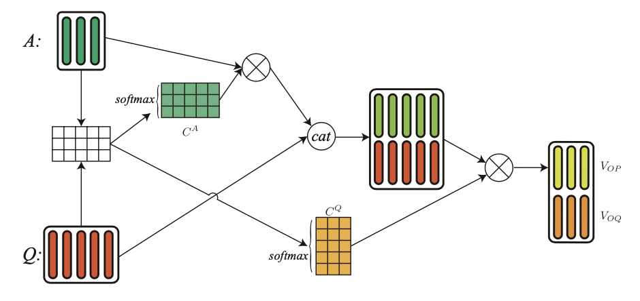
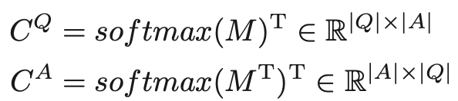

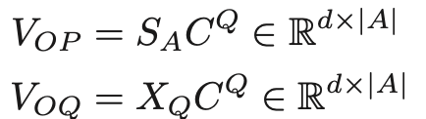
Attention for four views (co-attention)

Slide 13
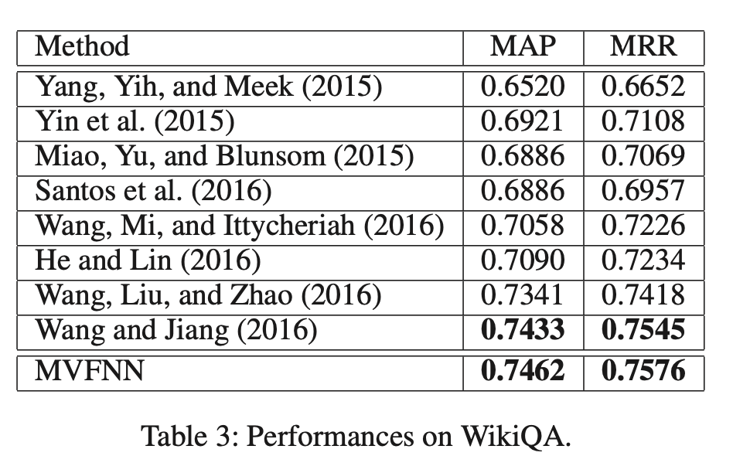
Experiment (1/4)

Slide 14
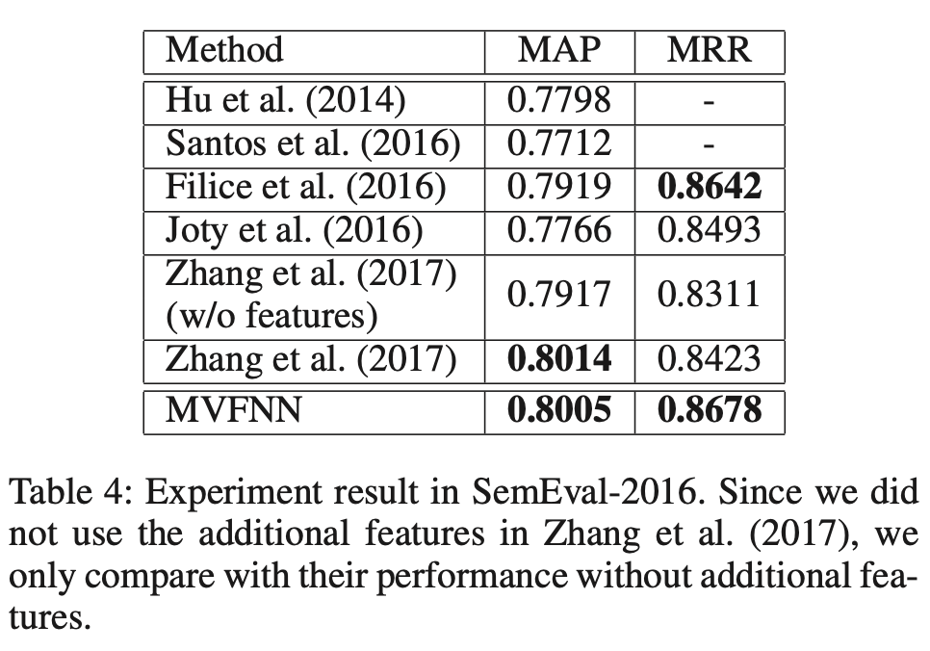
Experiment (2/4)

Slide 15
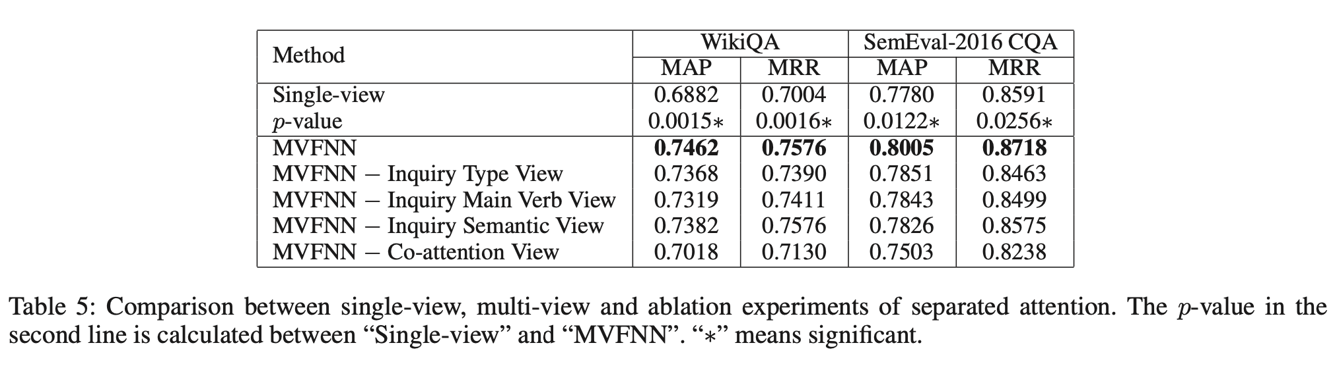
Experiment (3/4)

Slide 16
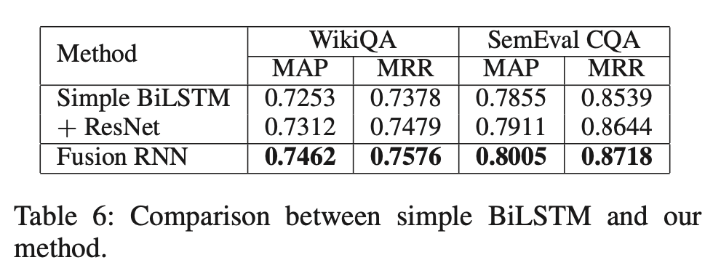
Experiment (4/4)

Slide 17
Conclusion
Multi-View Fusion Neural Network
inquiry type
inquiry main verb
inquiry semantic
co-attention
Dataset: WikiQA, SemEval-2016 CQA
Future work: unlabeled data

Slide 18
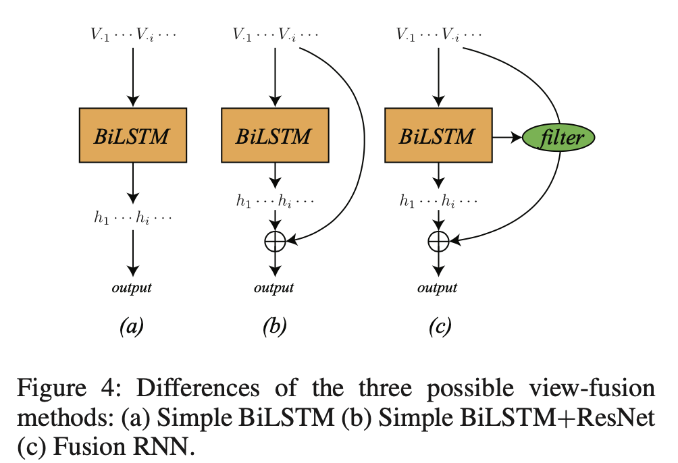
Bonus: BiLSTM / BiLSTM+ResNet / Fusion RNN

Slide 19
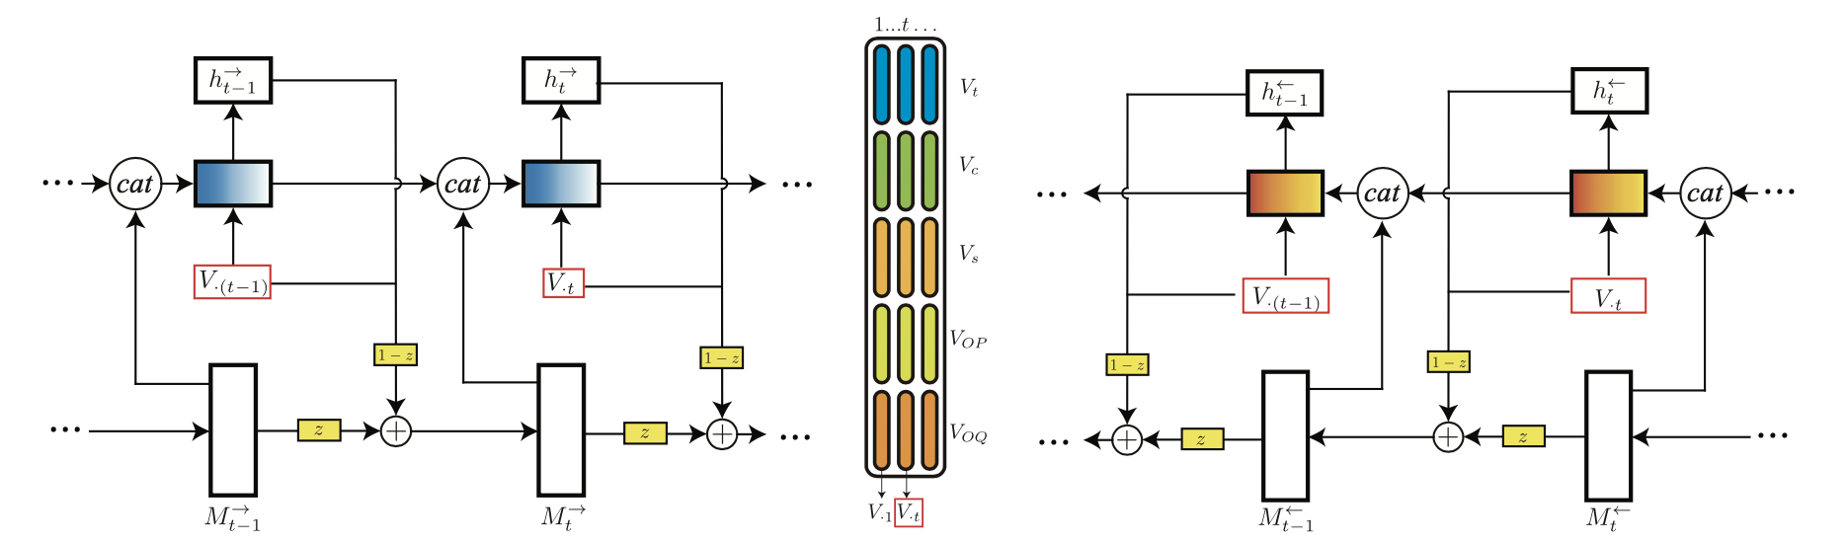
Bonus: Bidirectional fusion RNN

Slide 20
Thank you!

