Slide 1
Longest Property-Preserved Common Factor
Lorraine A.K Ayad1, Giulia Bernardini2, Roberto Grossi3, Costas S. Iliopoulos4, Nadia Pisanti5, Solon P. Pissis6, and Giovanna Rosone7
25th International Symposium, String Processing and Information Retrieval 2018, Lima, Peru
Presenter: Shao-Xuan Lee
Date: : Jan. 21, 2020
Notes:
https://www.google.com.tw/maps/place/%E7%A7%98%E9%AD%AF%E5%88%A9%E9%A6%AC/@-12.0266034,-77.1278665,11z/data=!3m1!4b1!4m5!3m4!1s0x9105c5f619ee3ec7:0x14206cb9cc452e4a!8m2!3d-12.0463731!4d-77.042754?hl=zh-TW

Slide 2
Abstract
In this paper we introduce a new family of string processing problems. We are given two or more strings and we are asked to compute a factor common to all strings that preserves a speciﬁc property and has maximal length. Here we consider three fundamental string properties: square-free factors, periodic factors, and palindromic factors under three diﬀerent settings, one per property. In the ﬁrst setting, we are given a string x and we are asked to construct a data structure over x answering the following type of on-line queries: given string y, ﬁnd a longest square-free factor common to x and y. In the second setting, we are given k strings and an integer 1 < k’≤ k and we are asked to ﬁnd a longest periodic factor common to at least k’ strings. In the third setting, we are given two strings and we are asked to ﬁnd a longest palindromic factor common to the two strings. We present linear-time solutions for all settings.

Slide 3
Square-Free-Preserved Matching Statistics
A string uu, is called a square.
A square-free string is a string that does not contain a square as a factor.
EX :
A = a b a b (square)
B = a b a a (square)
C = a b a (square-free)

Slide 4
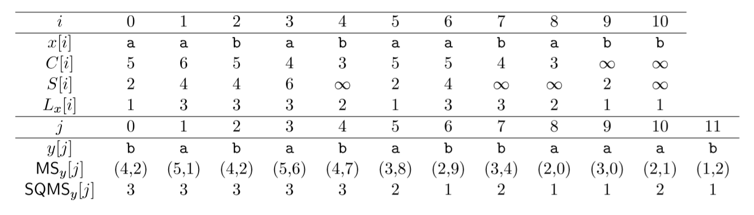
Let x = aababaababb and y = babababbaaab.
The length of a longest common square-free factor is 3, and the factors are bab and aba.

Slide 5
Let x = aababaababb and y = babababbaaab.
The length of a longest common square-free factor is 3, and the factors are bab and aba.

Slide 6
Let x = aababaababb and y = babababbaaab.
The length of a longest common square-free factor is 3, and the factors are bab and aba.

Slide 7
Let x = aababaababb and y = babababbaaab.
The length of a longest common square-free factor is 3, and the factors are bab and aba.

Slide 8
Let x = aababaababb and y = babababbaaab.
The length of a longest common square-free factor is 3, and the factors are bab and aba.

Slide 9
Let x = aababaababb and y = babababbaaab.
The length of a longest common square-free factor is 3, and the factors are bab and aba.

Slide 10
Let x = aababaababb and y = babababbaaab.
The length of a longest common square-free factor is 3, and the factors are bab and aba.

Slide 11
Let x = aababaababb and y = babababbaaab.
The length of a longest common square-free factor is 3, and the factors are bab and aba.

Slide 12
Longest Periodic-Preserved Common Factor
A= a b a b b a b b a
The runs of A :
A[0,3] = a b a b
A[1,8] = b a b b a b b a
A[3,4] = b b
A[6,7] = b b

Slide 13
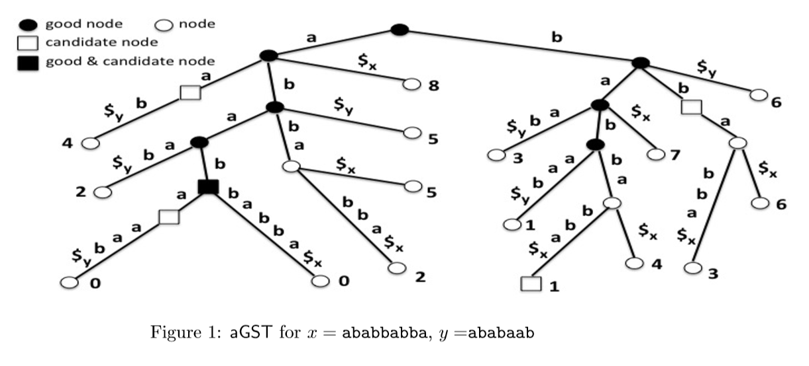

Slide 14
Longest Palindromic-Preserved Common Factor
A = a b a b a a
Palindromic factor of A :
A[0,0] = a
A[1,2] = b a
A[2,4] = a b a
A[3,4] = a b
A[4,4] = a
A[5,5] = a

Slide 15
Example
x = a b a b a a
x[0..0] = a
x[1..2] = b a
x[2..4] = a b a
x[3..4] = b a
x[4..4] = a
x[5..5] = a
y = b a b a b b
y[0..0] = b
y[1..2] = a b
y[2..4] = b a b
y[3..4] = a b
y[4..4] = b
y[5..5] = b
aba and bab are the longest palindromic-preserved common factors of odd length.

