Slide 1
MiRGOFS: a GO-based functional similarity measurement for miRNAs, with applications to the prediction of miRNA subcellular localization and miRNA–disease association
Yang Yang, Xiao-feng Fu, Wen-hao Qu, Yi-qun Xiao, Hong-Bin Shen
Bioinformatics, Volume 34, Issue 20, Pages 3547–3556, 2018
Speaker: Jheng-Yan Lyu
Date: Jan. 21, 2020

Slide 2
Abstract (1/2)
Motivation Benefiting from high-throughput experimental technologies, whole-genome analysis of microRNAs (miRNAs) has been more and more common to uncover important regulatory roles of miRNAs and identify miRNA biomarkers for disease diagnosis. As a complementary information to the high-throughput experimental data, domain knowledge like the Gene Ontology and KEGG pathway is usually used to guide gene function analysis. However, functional annotation for miRNAs is scarce in the public databases. Till now, only a few methods have been proposed for measuring the functional similarity between miRNAs based on public annotation data, and these methods cover a very limited number of miRNAs, which are not applicable to large-scale miRNA analysis. Results In this paper, we propose a new method to measure the functional similarity for miRNAs, called miRGOFS, which has two notable features: (i) it adopts a new GO semantic similarity metric which considers both common ancestors and descendants of GO terms; (i) it computes similarity between GO sets in an asymmetric manner, and weights each GO term by its statistical significance.

Slide 3
Abstract (2/2)
The miRGOFS-based predictor achieves an F1 of 61.2% on a benchmark dataset of miRNA localization, and AUC values of 87.7% and 81.1% on two benchmark sets of miRNA–disease association, respectively. Compared with the existing functional similarity measurements of miRNAs, miRGOFS has the advantages of higher accuracy and larger coverage of human miRNAs (over 1000 miRNAs).

Slide 4

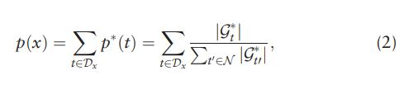
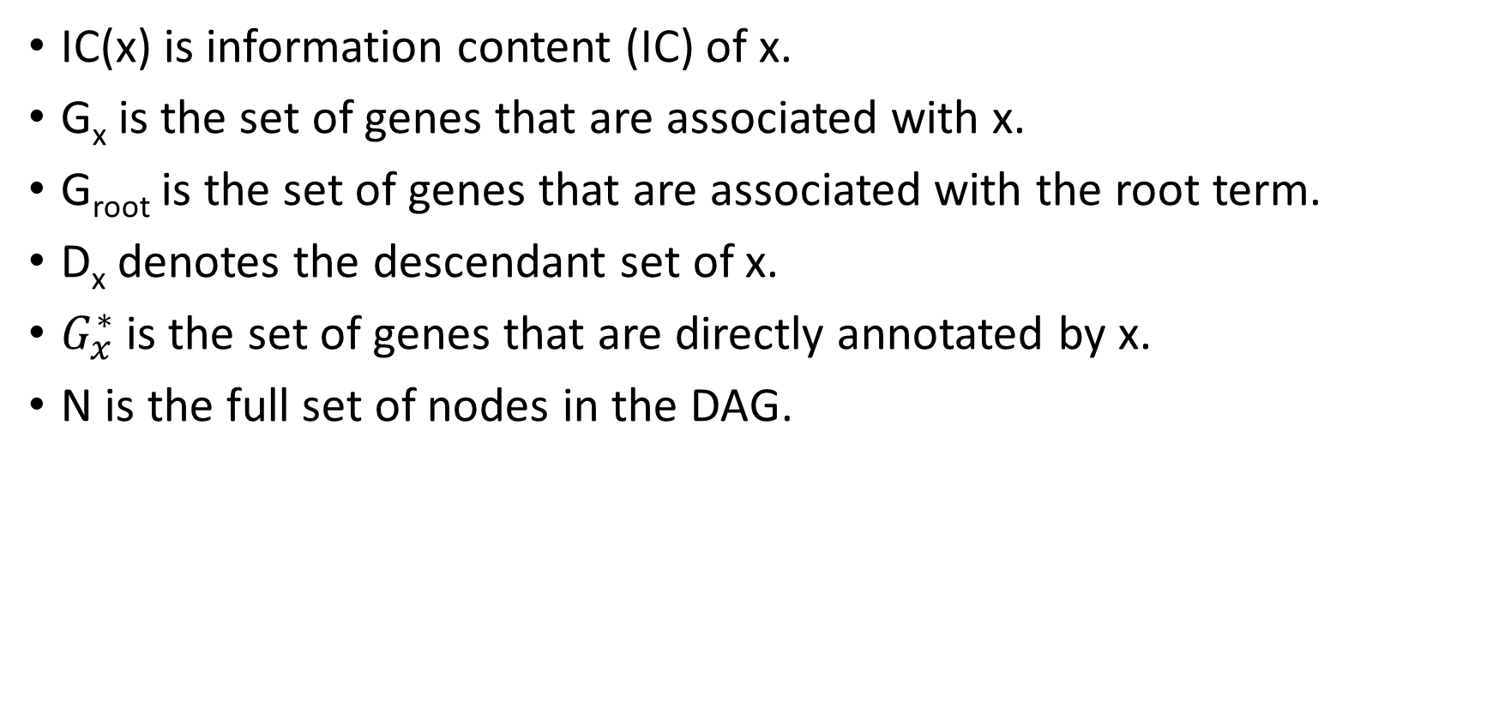
Semantic similarity between GO terms
IC(x) is information content (IC) of x.
G_{x} is the set of genes that are associated with x.
G_{root} is the set of genes that are associated with the root term.
D_{x} denotes the descendant set of x.
$G_{x}^{∗}$is the set of genes that are directly annotated by x.
N is the full set of nodes in the DAG.

Slide 5


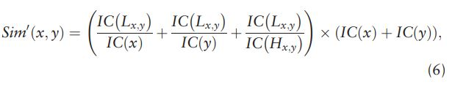

GO term similarity
L represents lowest common ancestors (LCAs)
H represents highest common descendants (HCDs)

Slide 6
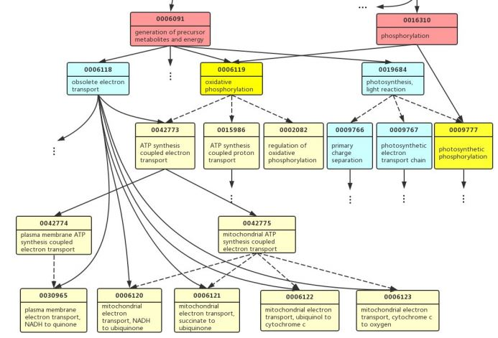
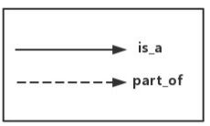
Notes:
A partial GO DAG. For the GO pair, GO:0006091 and GO:0016310, the dark yellow nodes (GO:0006119 and GO:000977) are their highest common descendants (HCDs). The yellow nodes (including light and dark yellow) belong to the intersection set of their descendants. All the yellow nodes and light blue nodes belong to the union set of their descendants.

Slide 7


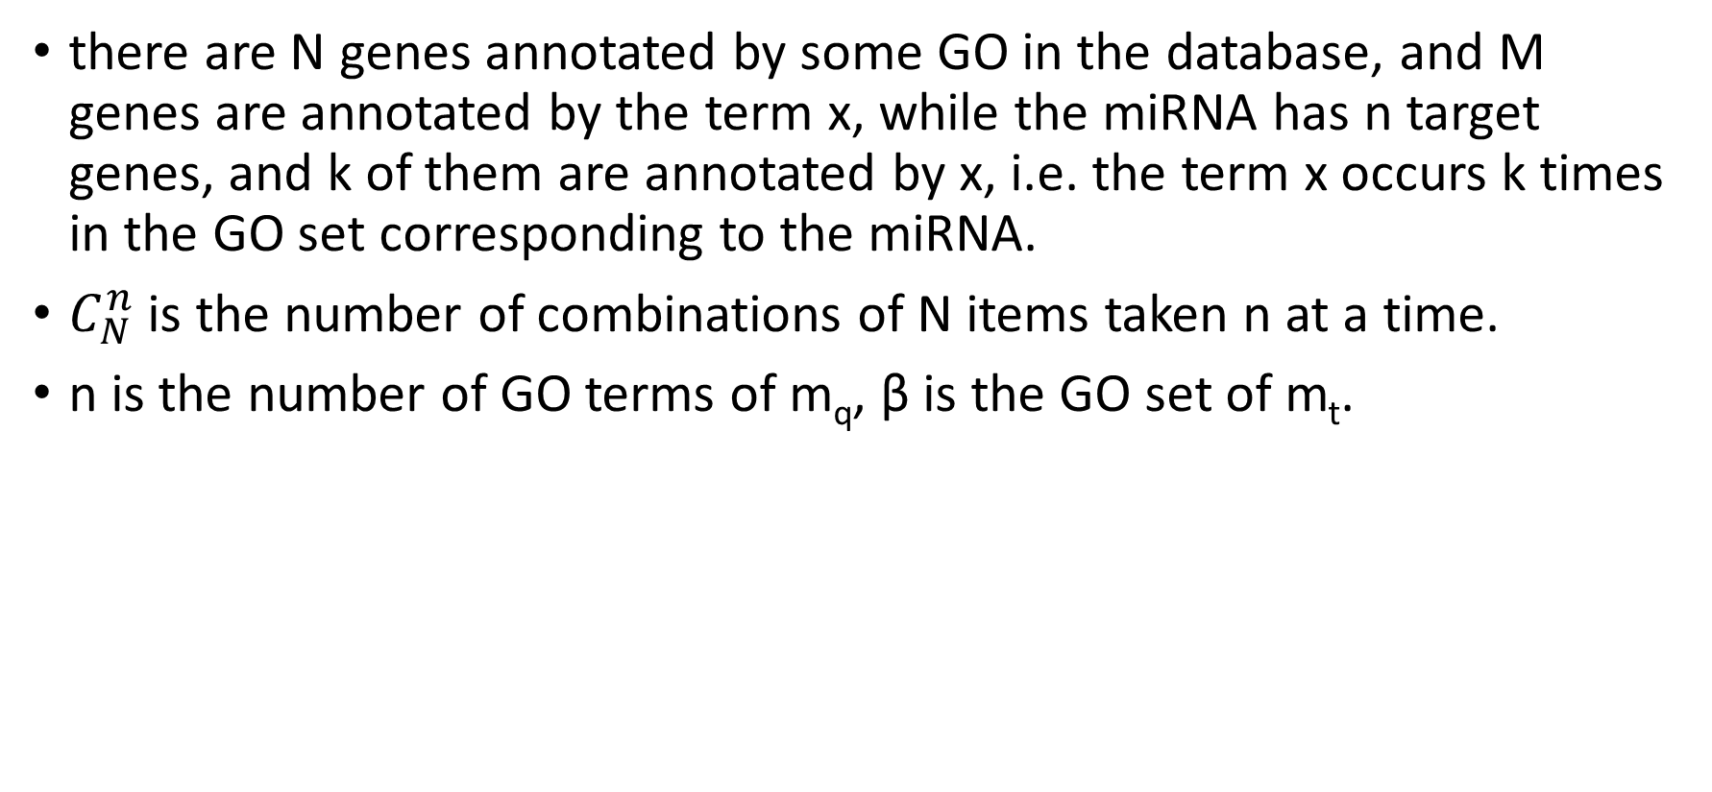
Similarity between miRNAs
there are N genes annotated by some GO in the database, and M genes are annotated by the term x, while the miRNA has n target genes, and k of them are annotated by x, i.e. the term x occurs k times in the GO set corresponding to the miRNA.
$C_{N}^{n}$ is the number of combinations of N items taken n at a time.
n is the number of GO terms of m_{q}, β is the GO set of m_{t}.

Slide 8
Benchmark datasets of miRNA–disease association
Data1 contains all the records in HMDD database (released on September 2009), includes 1388 associations, 267 miRNAs and 137 diseases.
Data2 was initially collected from HMDD and miR2Disease, includes 242 miRNA–disease associations, 99 miRNAs and 51 diseases.

Slide 9
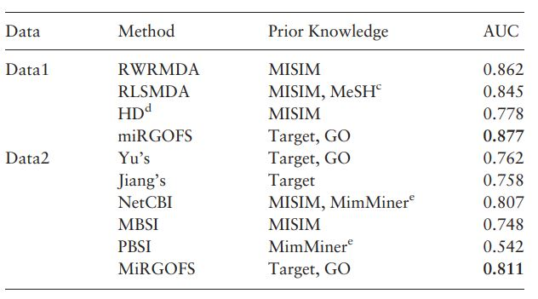
Results
Comparison of disease-related miRNA prediction methods

Slide 10
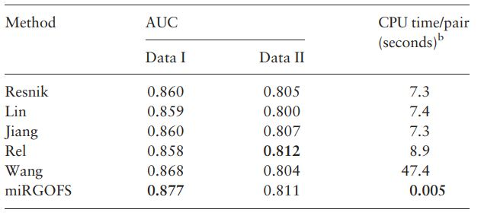
Results
Comparison of different types of miRNA functional similarity

