Slide 1
LCS Algorithm with Vector-markers
Levon Aslanyan
Institute for Informatics and Automation Problems
of the National Academy of Science of Armenia
Presenter: Yuan-Hsiu Tsai
Date: Jan. 21, 2020
Notes:
亞美尼亞--https://zh.wikipedia.org/wiki/%E4%BA%9E%E7%BE%8E%E5%B0%BC%E4%BA%9E
亞美尼亞大屠殺--https://zh.wikipedia.org/wiki/%E4%BA%9A%E7%BE%8E%E5%B0%BC%E4%BA%9A%E7%A7%8D%E6%97%8F%E5%A4%A7%E5%B1%A0%E6%9D%80
亞美尼亞國家科學院--https://zh.wikipedia.org/zh-tw/%E4%BA%9E%E7%BE%8E%E5%B0%BC%E4%BA%9E%E5%9C%8B%E5%AE%B6%E7%A7%91%E5%AD%B8%E9%99%A2

Slide 2
Abstract(1/2)
The Multiple Longest Common Subsequence (MLCS) problem is aimed at constructing a maximum length subsequence, common to a given set of sequences, defined on some finite alphabet of symbols. The paper considers the particular case of two input sequences (LCS), which is simply extendable to the general MLCS problem. We consider the problem in an online manner, where symbols arrive one-by-one and the next acquired symbol is appending any one of the two input sequences.

Slide 3
Abstract(2/2)
The sought-for LCS algorithm acts by recursive handling of parts of sequences arrived so far, constructing and updating specific supportive structures of markers representing the interrelations of the longest common subsequences of the two input sequences. In paper we discuss a perfect online parallelization framework of the algorithm for the “simple” memory model, so that the parallel complexity becomes O(mn / t) for t parallel threads. The general outcome of paper is the use of vector markers instead of matrix markers or graphs, which helps in minimization of the memory, used by the algorithm.

Slide 4
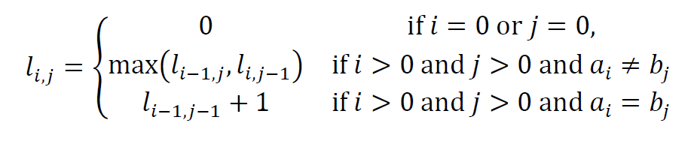
Introduction - LCS
General function – dynamic programming
S = a a t t c c
T = a t t a g g
LCS= a t t
T\S |  | a | a | t | t | c | c
 | 0 | 0 | 0 | 0 | 0 | 0 | 0
a | 0 | 1 | 1 | 1 | 1 | 1 | 1
t | 0 | 1 | 1 | 2 | 2 | 2 | 2
t | 0 | 1 | 1 | 2 | 3 | 3 | 3
a | 0 | 1 | 2 | 2 | 3 | 3 | 3
g | 0 | 1 | 2 | 2 | 3 | 3 | 3
g | 0 | 1 | 2 | 2 | 3 | 3 | 3

Slide 5
Introduction - dominant
T\S |  | a | a | t | t | c | c
 | 0 | 0 | 0 | 0 | 0 | 0 | 0
a | 0 | 1 | 1 | 1 | 1 | 1 | 1
t | 0 | 1 | 1 | 2 | 2 | 2 | 2
t | 0 | 1 | 1 | 2 | 3 | 3 | 3
a | 0 | 1 | 2 | 2 | 3 | 3 | 3
g | 0 | 1 | 2 | 2 | 3 | 3 | 3
g | 0 | 1 | 2 | 2 | 3 | 3 | 3

Slide 6
Introduction - dominant

Slide 7
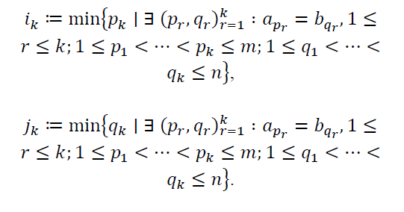
Introduction - variation
Notes:
Ik : 以A字串為主，先找出長度為k的 common sequence 且其range最少，但不考慮B所用range

Slide 8
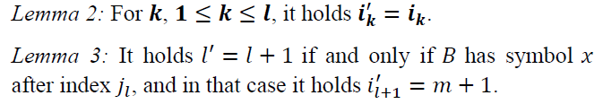
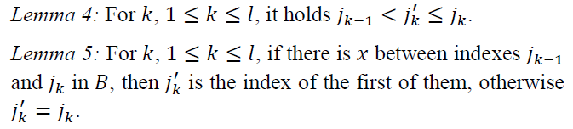
Lemma

Slide 9
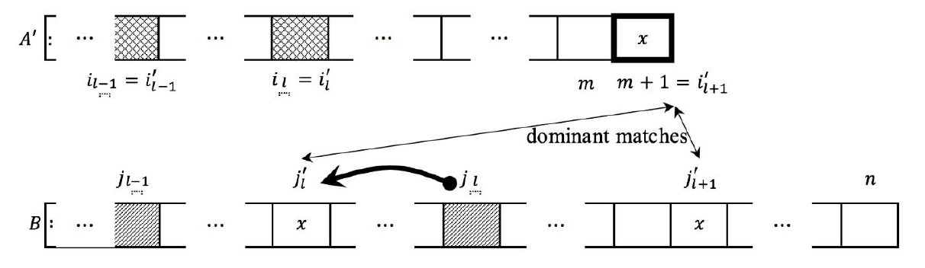

Slide 10
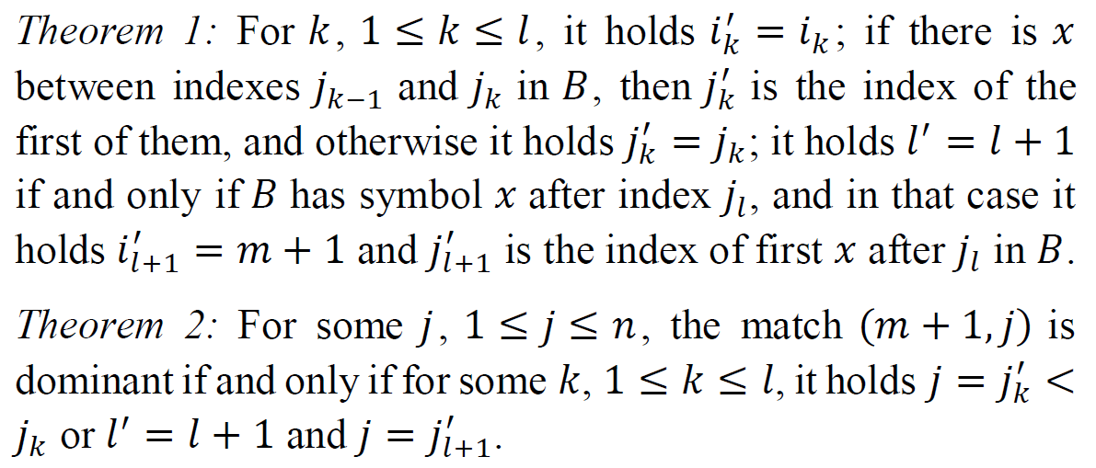
Theorem
Notes:
Theorem1 and 2 : 如果x 的字元在 j(k-1) ~ jk之間(即jk`)出現，則 jk替換成jk`，否則jk`=jk
如果 x字元在 j(L)之後出現，則 L` = L+1

Slide 11
Example

Slide 12
Example

Slide 13
Example

Slide 14
Example

Slide 15
Conclusion
1. it can be designed to online parallel version.
2. many parallel algorithm is depend critically on the lengths of input sequences and the number of processors.

