Slide 1
The substring inclusion constraint longest common subsequence problem can be solved in quadratic time
Muhammad Rashed Alam, M. Sohel Rahman
Journal of Discrete Algorithms 17 (2012) 67–73
Presenter: EN-AN SONG
Date: February 18, 2020

Slide 2
Abstract
In this paper, we study some variants of the Constrained Longest Common Subsequence(CLCS) problem, namely, the substring inclusion CLCS (Substring-IC-CLCS) problem and a generalized version thereof. In the Substring-IC-CLCS problem, we are to find a longest common subsequence (LCS) of two given strings containing a third constraint string(given) as a substring. Previous solution to this problem runs in cubic time, i.e, O(nmk) time, where n,m and k are the length of the 3 input strings. In this paper, we present simple O(nm) time algorithms to solve the Substring-IC-CLCS problem. We also study the Generalized Substring-IC-LCS problem where we are given two strings of length n and m respectively and an ordered list of p strings and the goal is to find an LCS containing each of them as a substring in the order they appear in the list. We present an O(nmp) algorithm for this generalized version of the problem.

Slide 3
Introduction(Substring-IC-LCS Problem)
Given two strings X=x1,x2,...,xm and Y=y1,y2,...,yn and a third constraint string S=s1,s2,...,sk. we are to find a longest common subsequence C=c1,c2,...,cr such that S is a substring of C.
X = cdabcde
Y = dabccae
S = abc
C = dabce

Slide 4
Introduction(Generalized Substring-IC-LCS Problem)
Generalized version of this problem, where we are given two strings X, Y(as before) and an ordered list of constraint strings S={S1,S2,...,Sp}
X = cdabcde
Y = dabccae
S1 = abc
S2 = ce
C = dabce

Slide 5
Introduction
Suppose that S occurs in X. Then, we say SX[i′]=i if and only if S occurs in Xi...i’.
There exists no i1,i<i1<i′ such that S occurs in Xi1...i′ and no i2,i<i2<i′ such that S occurs in Xi...i2.
If there is no occurrence of string S ending at Position i′, SX[i′]=0.
X = dabeabc
S = abc
S occurs in the range X2…7 and X5…7.However we have SX[7]=5

Slide 6
Introduction
X = caxbcde
Y = dabccae
S = abc
i | 1 | 2 | 3 | 4 | 5 | 6 | 7
Sx[i] | 0 | 0 | 0 | 0 | 2 | 0 | 0
j | 1 | 2 | 3 | 4 | 5 | 6 | 7
SY[j] | 0 | 0 | 0 | 2 | 0 | 0 | 0

Slide 7
A Simple algorithm for Substring-IC-LCS
Compute LCS(X1...i−1 , Y1...j−1). Let the length of the computed LCS is l1
Compute LCS(Xi′+1...m , Yj′+1...n). Let the length of the computed LCS is l2
Return LCS(X1...i−1 , Y1...j−1 ).S.LCS(Xi′+1...m , Yj′+1...n )as a Substring-IC-LCS and l1+|S|+l2 as the length.
S = abc
X =
Y =
c | d | a | b | c | d | e
d | a | b | c | c | a | e

Slide 8
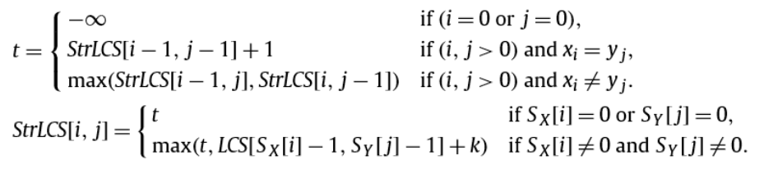
Substring-IC-LCS(Dynamic programming)

Slide 9
Substring-IC-LCS(Dynamic programming)
t = StrLCS[6,6] + 1 = 5
S = abc
X = cdabcde
Y = dabcace
SX[5] = 3 t = -∞
SY[4] = 2 LCS[SX[5]-1, SY[4]-1]+3 = 4
StrLCS |  | d | a | b | c | a | c | e
 | -∞ | -∞ | -∞ | -∞ | -∞ | -∞ | -∞ | -∞
c | -∞ | -∞ | -∞ | -∞ | -∞ | -∞ | -∞ | -∞
d | -∞ | -∞ | -∞ | -∞ | -∞ | -∞ | -∞ | -∞
a | -∞ | -∞ | -∞ | -∞ | -∞ | -∞ | -∞ | -∞
b | -∞ | -∞ | -∞ | -∞ | -∞ | -∞ | -∞ | -∞
c | -∞ | -∞ | -∞ | -∞ | 4 | 4 | 4 | 4
d | -∞ | -∞ | -∞ | -∞ | 4 | 4 | 4 | 4
e | -∞ | -∞ | -∞ | -∞ | 4 | 4 | 4 | 5
StrLCS |  | d | a | b | c | a | c | e
 | -∞ | -∞ | -∞ | -∞ | -∞ | -∞ | -∞ | -∞
c | -∞ | -∞
d | -∞
a | -∞
b | -∞
c | -∞
d | -∞
e | -∞
StrLCS |  | d | a | b | c | a | c | e
 | -∞ | -∞ | -∞ | -∞ | -∞ | -∞ | -∞ | -∞
c | -∞ | -∞ | -∞ | -∞ | -∞ | -∞ | -∞ | -∞
d | -∞ | -∞ | -∞ | -∞ | -∞ | -∞ | -∞ | -∞
a | -∞ | -∞ | -∞ | -∞ | -∞ | -∞ | -∞ | -∞
b | -∞ | -∞ | -∞ | -∞ | -∞ | -∞ | -∞ | -∞
c | -∞ | -∞ | -∞ | -∞ | 4
d | -∞ | -∞ | -∞ | -∞
e | -∞ | -∞ | -∞ | -∞
StrLCS |  | d | a | b | c | a | c | e
 | -∞ | -∞ | -∞ | -∞ | -∞ | -∞ | -∞ | -∞
c | -∞
d | -∞
a | -∞
b | -∞
c | -∞
d | -∞
e | -∞
StrLCS |  | d | a | b | c | a | c | e
 | -∞ | -∞ | -∞ | -∞ | -∞ | -∞ | -∞ | -∞
c | -∞ | -∞ | -∞ | -∞ | -∞ | -∞ | -∞ | -∞
d | -∞ | -∞
a | -∞
b | -∞
c | -∞
d | -∞
e | -∞

Slide 10
Generalized Substring-IC-LCS Problem
Two cases :
Case1 : No overlap
Case2 : Overlap
No overlap
X = cdabcde
Y = dabccae
S1 = ab
S2 = ce
C = dabce

Slide 11
Generalized Substring-IC-LCS Problem
Overlap
X = cdabcde
Y = dabccae
S1 = abc
S2 = ce
C = dabce

Slide 12
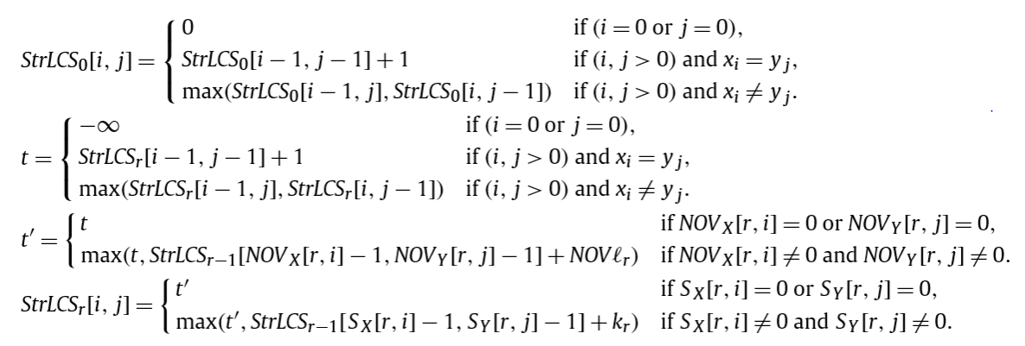
Generalized Substring-IC-LCS Problem
Overlap
No overlap

Slide 13
Generalized Substring-IC-LCS Problem
S1 = abc
StrLCS1 |  | d | a | b | c | a | c | e
 | -∞ | -∞ | -∞ | -∞ | -∞ | -∞ | -∞ | -∞
c | -∞ | -∞ | -∞ | -∞ | -∞ | -∞ | -∞ | -∞
d | -∞ | -∞ | -∞ | -∞ | -∞ | -∞ | -∞ | -∞
a | -∞ | -∞ | -∞ | -∞ | -∞ | -∞ | -∞ | -∞
b | -∞ | -∞ | -∞ | -∞ | -∞ | -∞ | -∞ | -∞
c | -∞ | -∞ | -∞ | -∞ | 4 | 4 | 4 | 4
d | -∞ | -∞ | -∞ | -∞ | 4 | 4 | 4 | 4
e | -∞ | -∞ | -∞ | -∞ | 4 | 4 | 4 | 5

Slide 14
Generalized Substring-IC-LCS Problem
S2 = ce
StrLCS2 |  | d | a | b | c | a | c | e
 | -∞ | -∞ | -∞ | -∞ | -∞ | -∞ | -∞ | -∞
c | -∞ | -∞ | -∞ | -∞ | -∞ | -∞ | -∞ | -∞
d | -∞ | -∞ | -∞ | -∞ | -∞ | -∞ | -∞ | -∞
a | -∞ | -∞ | -∞ | -∞ | -∞ | -∞ | -∞ | -∞
b | -∞ | -∞ | -∞ | -∞ | -∞ | -∞ | -∞ | -∞
c | -∞ | -∞ | -∞ | -∞ | -∞ | -∞ | -∞ | -∞
d | -∞ | -∞ | -∞ | -∞ | -∞ | -∞ | -∞ | -∞
e | -∞ | -∞ | -∞ | -∞ | -∞ | -∞ | -∞

Slide 15
Generalized Substring-IC-LCS Problem
S1 = abc, S2 = ce
Calculate StrLCS2[7,7]
Consider no overlap
X =
Y =
c | d | a | b | c | d | e
d | a | b | c | c | a | e
StrLCS1[4,4] = -∞
2

Slide 16
Generalized Substring-IC-LCS Problem
S1 = abc, S2 = ce
Calculate StrLCS2[7,7]
Consider overlap
X =
Y =
c | d | a | b | c | d | e
d | a | b | c | c | a | e
StrLCS1[5,4] = 4
2-1=1

Slide 17
Generalized Substring-IC-LCS Problem
S2 = ce
StrLCS2 |  | d | a | b | c | a | c | e
 | -∞ | -∞ | -∞ | -∞ | -∞ | -∞ | -∞ | -∞
c | -∞ | -∞ | -∞ | -∞ | -∞ | -∞ | -∞ | -∞
d | -∞ | -∞ | -∞ | -∞ | -∞ | -∞ | -∞ | -∞
a | -∞ | -∞ | -∞ | -∞ | -∞ | -∞ | -∞ | -∞
b | -∞ | -∞ | -∞ | -∞ | -∞ | -∞ | -∞ | -∞
c | -∞ | -∞ | -∞ | -∞ | -∞ | -∞ | -∞ | -∞
d | -∞ | -∞ | -∞ | -∞ | -∞ | -∞ | -∞ | -∞
e | -∞ | -∞ | -∞ | -∞ | -∞ | -∞ | -∞ | 5

Slide 18
Conclusion
Time complexity
Substring-IC-LCS : O(n²)
SX : O(n²)
SY : O(n²)
StrLCS : O(n²)
Generalized Substring-IC-LCS Problem : O(n²p)
p constraint patterns

