Slide 1
Selecting the Right Similarity-Scoring Matrix
William R. Pearson
Current Protocols in Bioinformatics. 2013;43:3.5.1–3.5.9
Presenter : Feng-Yang Tsai
Date:Feb. 18, 2020.

Slide 2
Abstract(1/2)
Protein sequence similarity searching programs like BLASTP, SSEARCH, and FASTA use scoring matrices that are designed to identify distant evolutionary relationships (BLOSUM62 for BLAST, BLOSUM50 for SSEARCH and FASTA). Different similarity scoring matrices are most effective at different evolutionary distances. “Deep” scoring matrices like BLOSUM62 and BLOSUM50 target alignments with 20 – 30% identity, while “shallow” scoring matrices (e.g. VTML10 – VTML80), target alignments that share 90 – 50% identity, reflecting much less evolutionary change. While “deep” matrices provide very sensitive similarity searches, they also require longer sequence alignments and can sometimes produce alignment overextension into non-homologous regions.

Slide 3
Abstract(2/2)
Shallower scoring matrices are more effective when searching for short protein domains, or when the goal is to limit the scope of the search to sequences that are likely to be orthologous between recently diverged organisms. Likewise, in DNA searches, the match and mismatch parameters set evolutionary look-back times and domain boundaries. In this unit, we will discuss the theoretical foundations that drive practical choices of protein and DNA similarity scoring matrices and gap penalties. Deep scoring matrices (BLOSUM62 and BLOSUM50) should be used for sensitive searches with full-length protein sequences, but short domains or restricted evolutionary look-back require shallower scoring matrices.

Slide 4
Scoring matrices as odds ratios :
BLOSUM-90
PAM-10
BLOSUM-62
PAM-50
BLOSUM-20
PAM-250
closely related sequences
distant related sequences
PAM2 matrix models alignments with 2% differences and has the entropy of 3.97 bits and PAM250 modeling alignments with 80% differences has the entropy of only 0.354 bits. Let's say that the minimum required amount of information is 50 bits to distinguish an alignment from chance, then the closely related minimum sequence alignment length is 50/3.97 = about 13 residues, whereas the more distantly related sequences require 50/0.354 = about 142 residues to be significant.

Slide 5
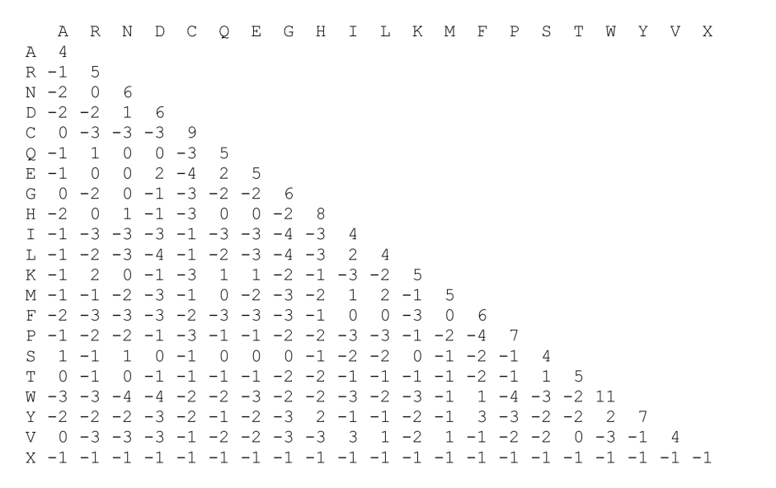
Scoring matrices as odds ratios :
BLOSUM45 for score of 15 for the same W-W match.
BLOSUM45 for Isoleucine-Tryptophan (I-W) is -2
For Leucine-Leucine (L-L) matches, BLOSUM45 gives the score +5.
Notes:
Tryptophan:色胺酸
Leucine:亮氨酸
Isoleucine:異白胺酸

Slide 6
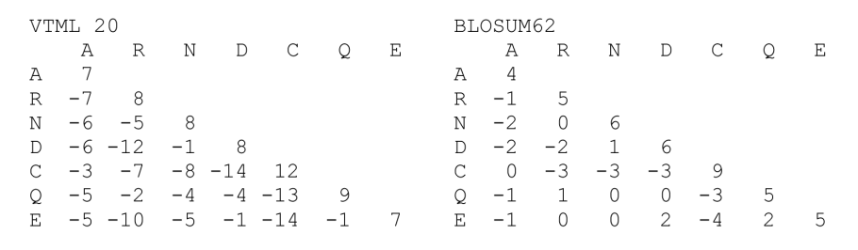
Scoring matrices as odds ratios :
Notes:
通常，比對100％相同的序列，不匹配的代價會很高，
因為我們不希望有任何不匹配的情況，而相距遙遠的相關序列的比對則，不匹配的分數會更低，而匹配的得分會更高。
Tryptophan:色胺酸
Leucine:亮氨酸
Isoleucine:異白胺酸

Slide 7
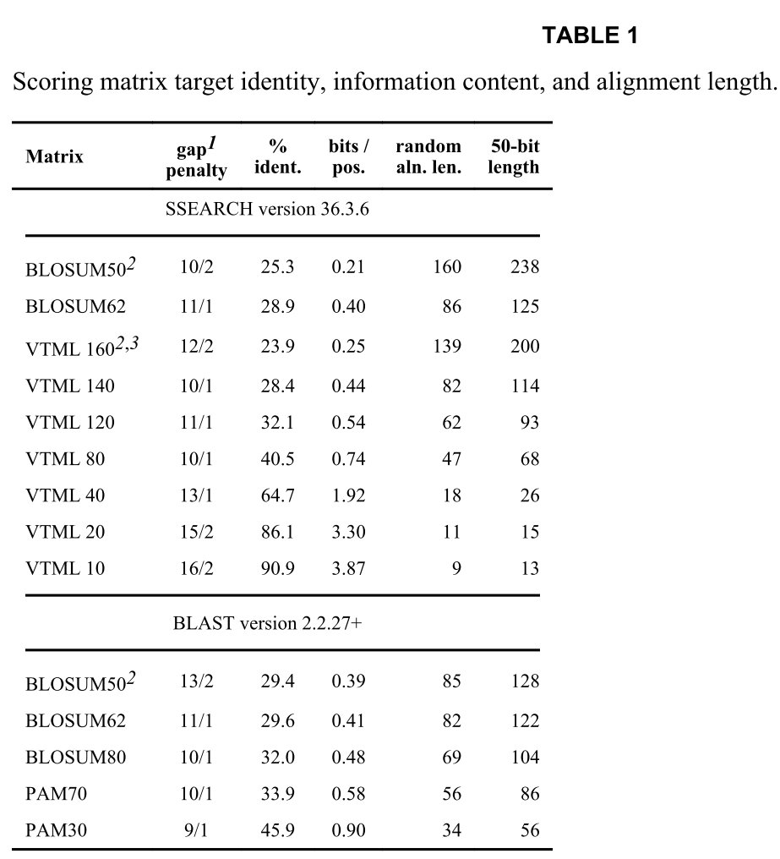
Matrix information content, target identity, and alignment length:
For instance, PAM30 with the gap open penalty of nine and the extension penalty of one yields 0.90 bits per position, and without gaps, PAM30 produces 2.6 bits per position almost a triple of information. With BLOSUM62 the information content increases from 0.40 to 0.74 without gaps and the minimum alignment length generating a statistically significant score, requiring 50 bits, reduce from 125 to 68 residues (Table 1).

Slide 8
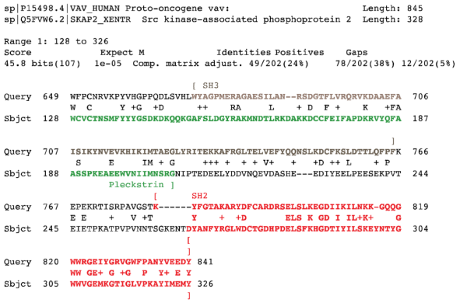
Alignment overextension:
Notes:
Homologous over-extension often occurs from short repeated domains
同源過度延伸通常發生在短的重複域中。 例如，圖3A顯示了VAV_HUMAN（P 15498）與SKAP2_XENTR（Q5FVW6）的BLASTP比對，
SKAP2_XENTR（Q5FVW6）是一種蛋白質，其包含與58個氨基酸同源的SH3結構域。
但是，比對長度為198個殘基。
比對中的另外140個殘基包括SKAP2_XENTR中的100個殘基Pleckstrin結構域，該結構域不是同源的（VAV_HUMAN在與SKAP2_XENTR中的Pleckstrin結構域對準的區域中包含SH3結構域）。
58個殘基同源的SH3結構域貢獻了位得分的85％，另外的140個殘基貢獻了不到得分的15％。 使用稍微更嚴格（更淺）的BLOSUM80矩陣不會更改擴展的對齊方式。

