Slide 1
Short Text Classification Improved by Learning Multi-Granularity Topics
Proceedings of the Twenty-Second International Joint Conference on Artificial Intelligence
Mengen Chen, Xiaoming Jin, Dou Shen
Present: Chia-Lin, Chen
Date: April. 7th , 2020
Notes:
該IJCAI-11會議在July 19, 2011 – July 22, 2011
西班牙Barcelona巴賽隆納
作者皆為中國人

Slide 2
Abstract(1/2)
Understanding the rapidly growing short text is very important.
Short text is different from traditional documents in its shortness
and sparsity, which hinders the application of conventional machine
learning and text mining algorithms. Two major approaches have been
exploited to enrich the representation of short text. One is to fetch
contextual information of a short text to directly add more text;
the other is to derive latent topics from existing large corpus,
which are used as features to enrich the representation of short text.
The latter approach is elegant and efficient in most cases.

Slide 3
Abstract(2/2)
The major trend along this direction is to derive latent topics of
certain granularity through well-known topic models such as latent
Dirichlet allocation (LDA). However, topics of certain granularity
are usually not sufficient to set up effective feature spaces.
In this paper, we move forward along this direction by proposing
an method to leverage topics at multiple granularity, which can
model the short text more precisely. Taking short text classification
as an example, we compared our proposed method with the state-of-the-art baseline over one open data set. Our method reduced the classification error by 20.25 % and 16.68 % respectively on two classifiers.

Slide 4
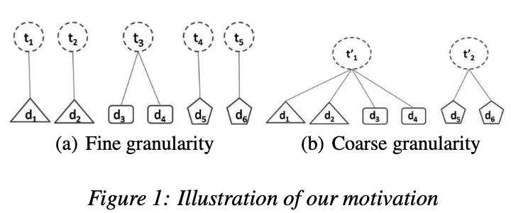
Multi-Granularity Framework(1/2)
Notes:
assume there are 6 short texts,
belonging to 3 categories

Slide 5
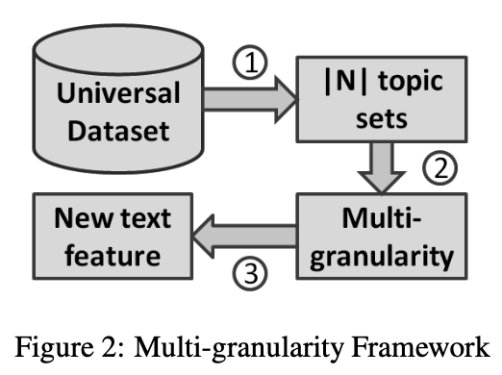
Multi-Granularity Framework(2/2)

Slide 6
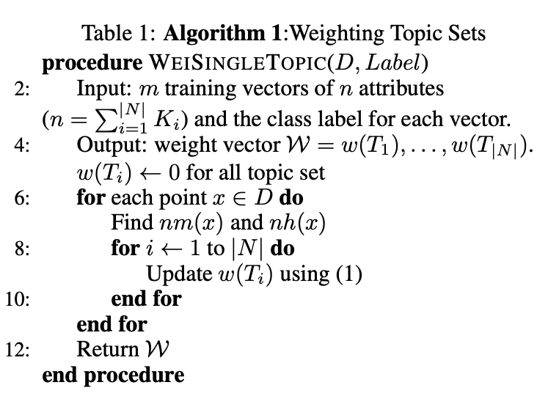
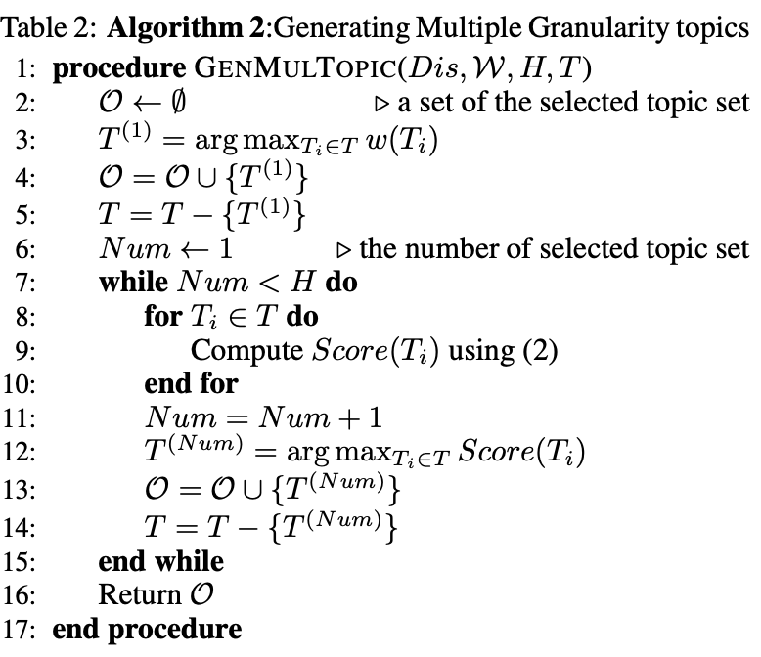


Slide 7
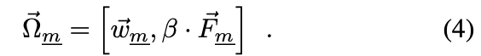

Slide 8
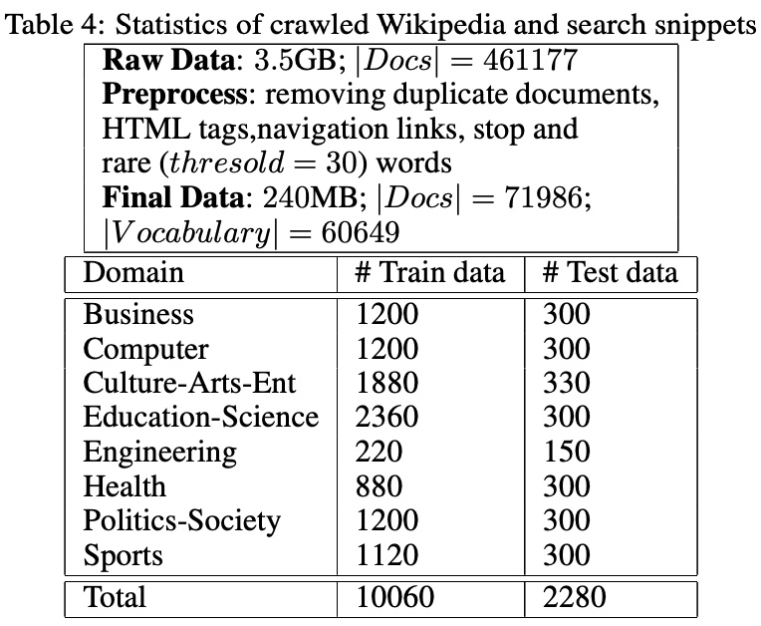
Experiment(1/3)

Slide 9
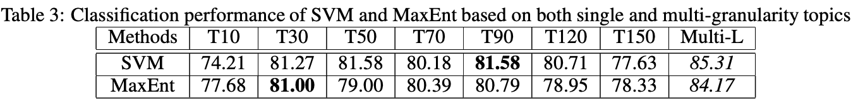
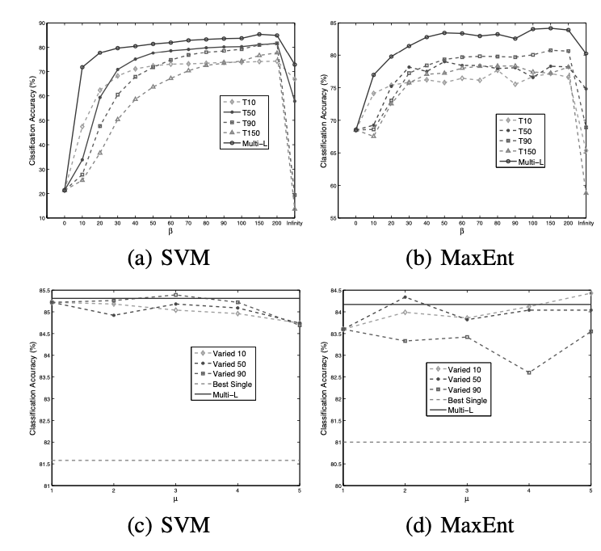
Experiment(2/3)

Slide 10
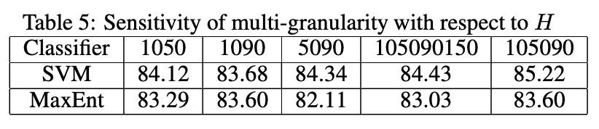
Experiment(3/3)

Slide 11
Thank you!

