Slide 1
Predicting MicroRNA-Disease Associations Using Network Topological Similarity Based on DeepWalk
Guanghui Li, Jiawei Luo, Qiu Xiao, Cheng Liang, Pingjian Ding, Buwen Cao
IEEE Access, Volume 5, 2017
Speaker: Jheng-Yan Lyu
Date: Apr. 7, 2020

Slide 2
Abstract (1/2)
Recently, increasing experimental studies have shown that microRNAs (miRNAs) involved in multiple physiological processes are connected with several complex human diseases. Identifying human disease-related miRNAs will be useful in uncovering novel prognostic markers for cancer. Currently, several computational approaches have been developed for miRNA-disease association prediction based on the integration of additional biological information of diseases and miRNAs, such as disease semantic similarity and miRNA functional similarity. However, these methods do not work well when this information is unavailable. In this paper, we present a similarity-based miRNA-disease prediction method that enhances the existing association discovery methods through a topology-based similarity measure. DeepWalk, a deep learning method, is utilized in this paper to calculate similarities within a miRNA-disease association network.

Slide 3
Abstract (2/2)
It shows superior predictive performance for 22 complex diseases, with area under the ROC curve scores ranging from 0.805 to 0.937 by using five-fold cross-validation. In addition, case studies on breast cancer, lung cancer, and prostatic cancer further justify the use of our method to discover latent miRNA-disease pairs.

Slide 4
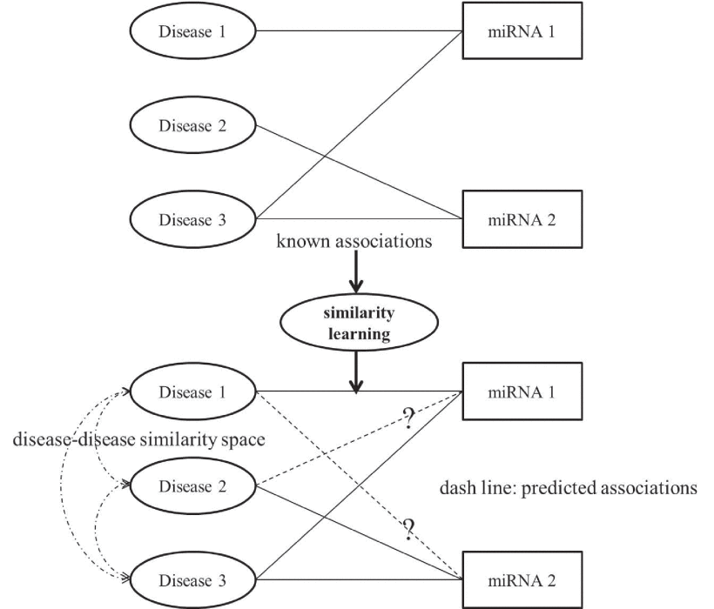
Workflow

Slide 5
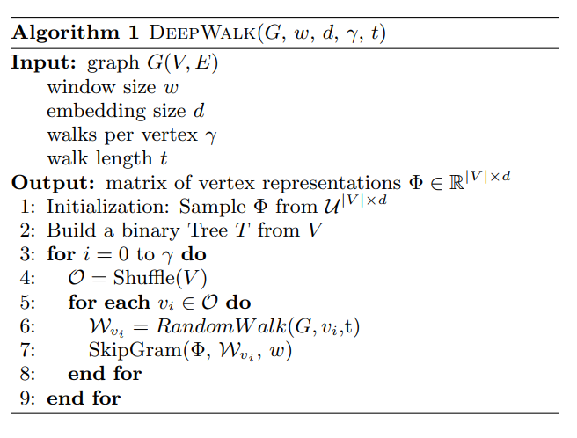
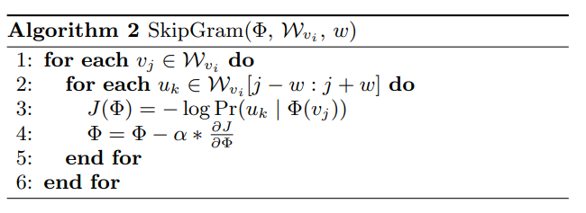
Similarity Learning

Slide 6
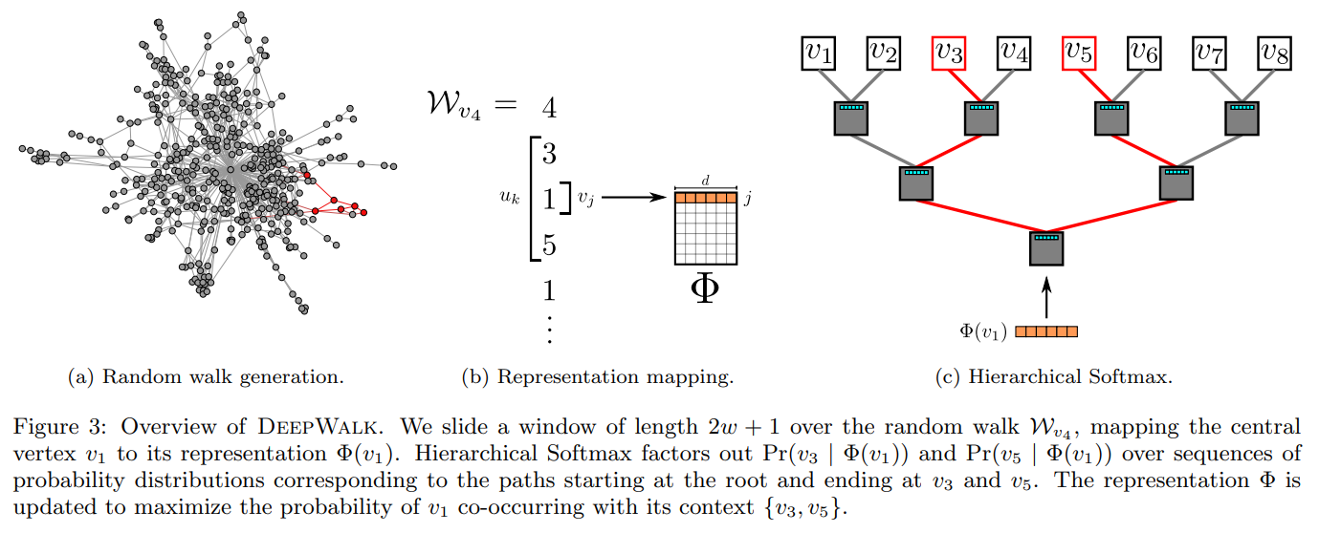
Similarity Learning
2123

Slide 7
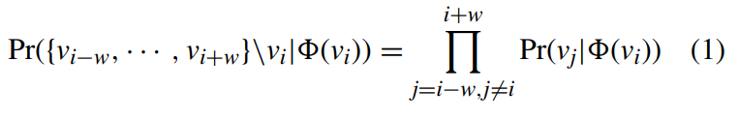
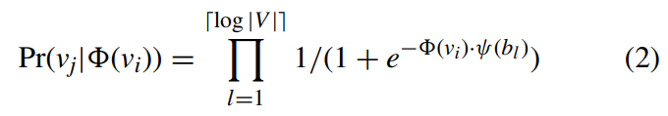
Similarity Learning

Slide 8
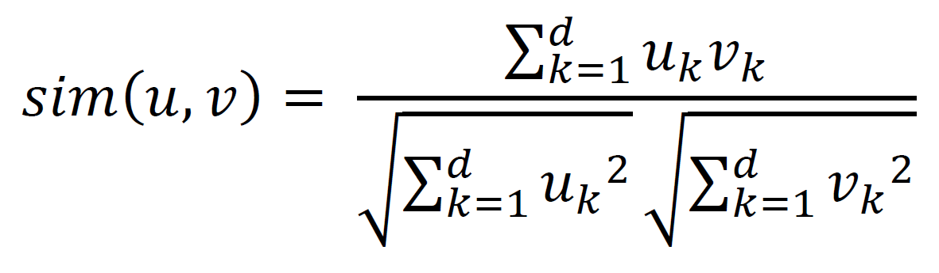
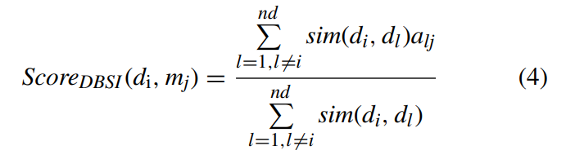
Similarity Learning
Disease-Based Similarity Inference

Slide 9
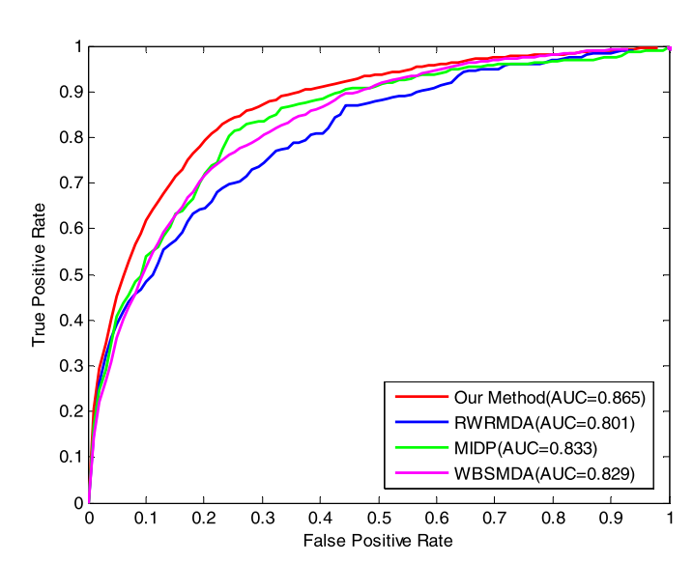
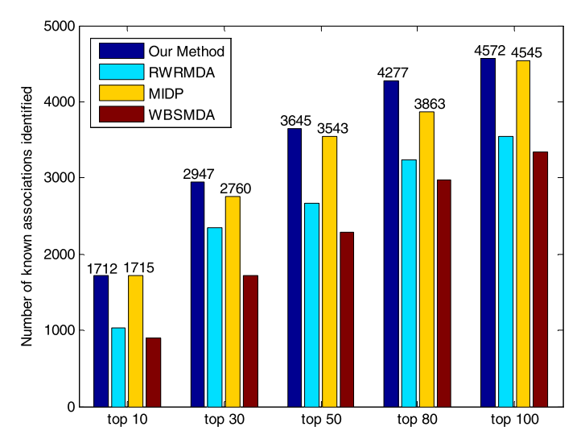
Results

Slide 10
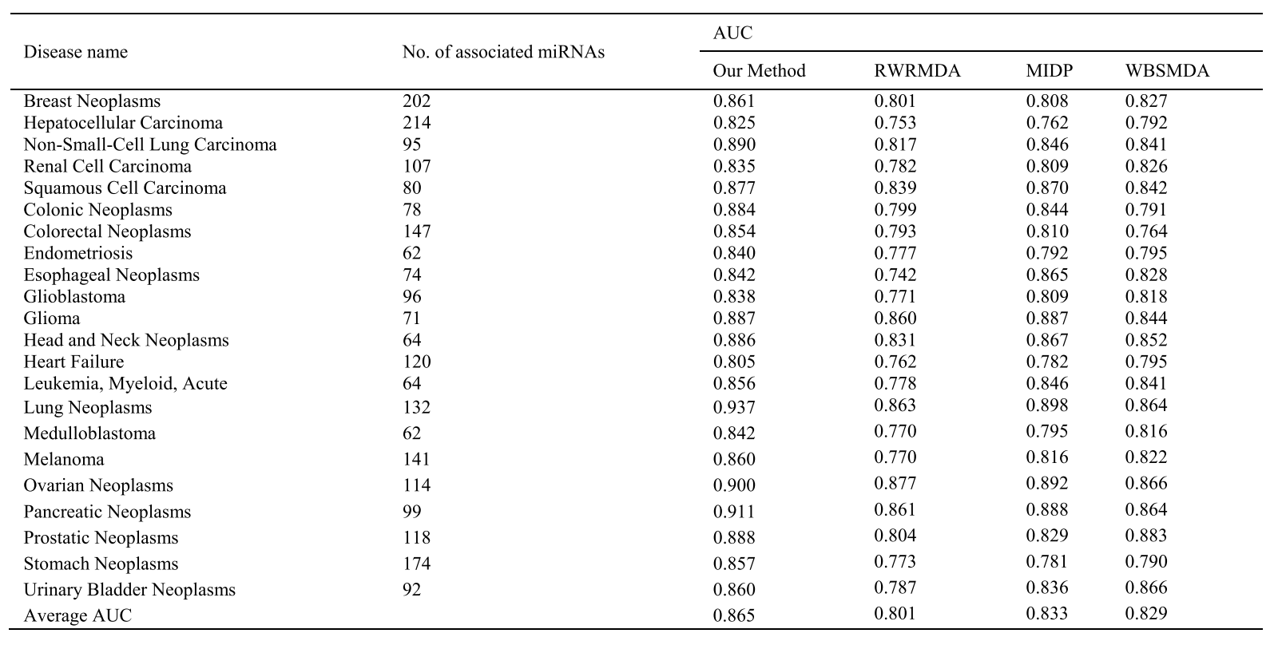
Results

