Slide 1
Selecting the Right Similarity-Scoring Matrix
William R. Pearson
Current Protocols in Bioinformatics 3.5.1-3.5.9, October 2013
Presenter: Yuan-Hsiu Tsai
Date: Apri. 7, 2020

Slide 2
Abstract(1/2)
Protein sequence similarity searching programs like BLASTP, SSEARCH, and FASTA use scoring matrices that are designed to identify distant evolutionary relationships (BLOSUM62 for BLAST, BLOSUM50 for SSEARCH and FASTA). Different similarity scoring matrices are most effective at different evolutionary distances. “Deep” scoring matrices like BLOSUM62 andBLOSUM50 target alignments with 20% to 30% identity, while “shallow” scoring matrices (e.g.,VTML10 to VTML80) target alignments that share 90% to 50% identity, reflecting much less evolutionary change. While “deep” matrices provide very sensitive similarity searches, they also require longer sequence alignments and can sometimes produce alignment overextension into nonhomologous regions.

Slide 3
Abstract(2/2)
Shallower scoring matrices are more effective when searching for short protein domains, or when the goal is to limit the scope of the search to sequences that are likely to be orthologous between recently diverged organisms. Likewise, in DNA searches, the match and mismatch parameters set evolutionary look-back times and domain boundaries. In this unit, we will discuss the theoretical foundations that drive practical choices of protein and DNA similarity scoring matrices and gap penalties. Deep scoring matrices (BLOSUM62 and BLOSUM50)should be used for sensitive searches with full-length protein sequences, but short domains or restricted evolutionary look-back require shallower scoring matrices.

Slide 4
Introduction
Scoring Matrix They are used to determine the relative score made by matching two characters in a sequence alignment. If some amino acids replace frequently, then the score of this match would lower.

Slide 5
Introduction
Scoring Matrix There are two main type： 1. deep scoring matrix 2. shallow scoring matrix

Slide 6
Introduction
Deep scoring matrix： 1. used in longer sequence alignment 2. high sensitivity for homologous and overextension into nonhomologous sometimes 3. scoring matrix are always conservative.

Slide 7
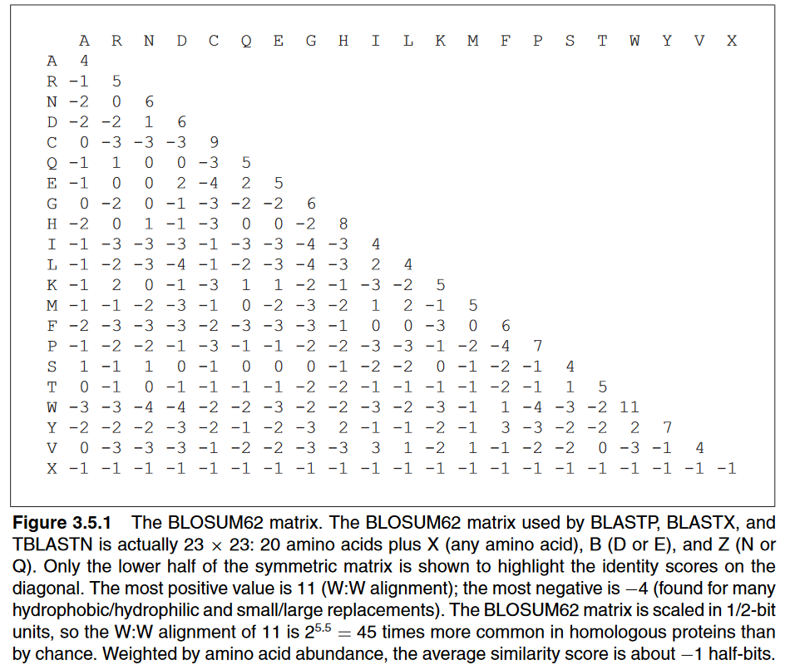

Slide 8
Introduction
Shallow scoring matrix： 1. used in short sequence alignment 2. used to search orthologous 3. same residue match have very high positive score and different residue match usually have high negative score

Slide 9
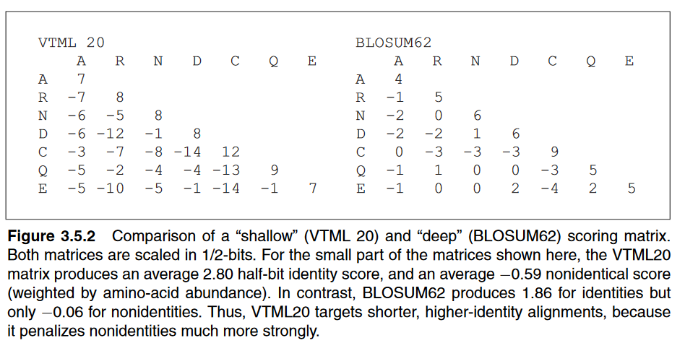

Slide 10
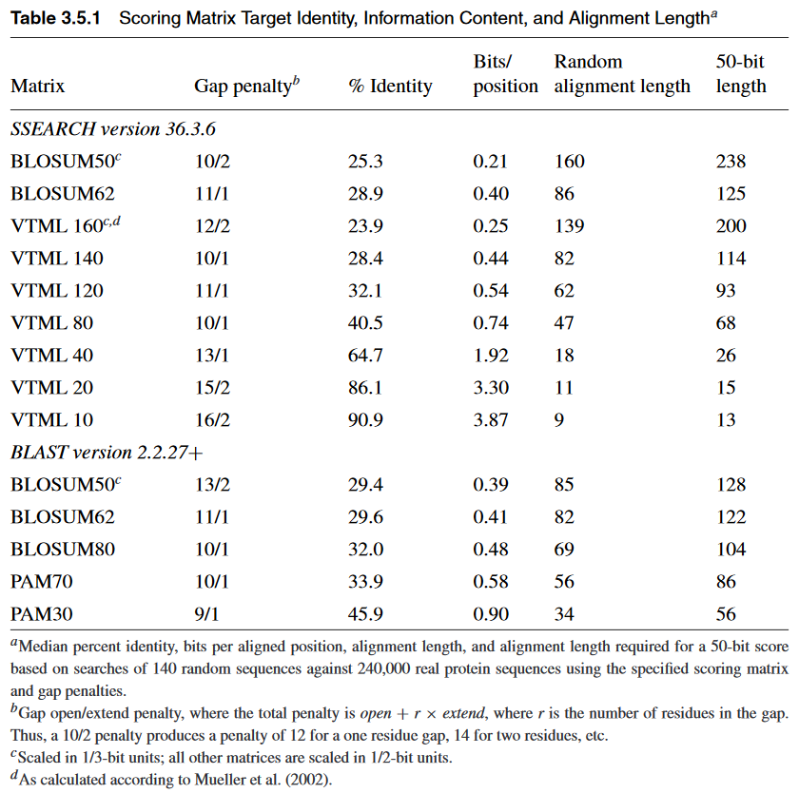

Slide 11
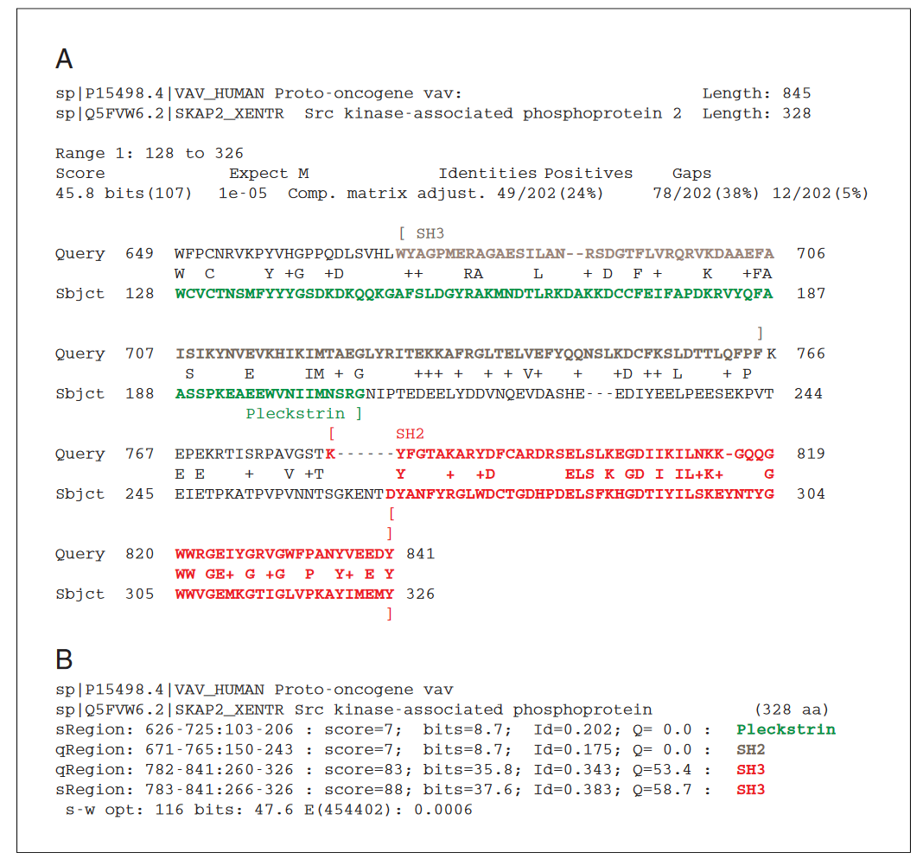

Slide 12
Improvement
Gap penalty 1. It always be negative score 2. Continue gap will get more penalty Ex: -15-4(x-1) x:continue gap number
It can decrease the match number very much

Slide 13
Improvement
Gap penalty In short sequence alignment, if gap penalty is too low, it will cause the low efficiency.

Slide 14
Scoring matrix for DNA
In BLASTN, it use +2 / -3 In FASTA, it use +5 / -4
It is mush less sensitive than protein sequence comparison.

Slide 15
Summary
If we use the wrong scoring matrix, it can`t produce significant match to a nonhomologous protein, but the wrong matrix can loss some short homologous region and produce overextension in nonhomologous region.

