Slide 1
Networks and Algorithms in
Bio-informatics
D. Frank Hsu
Fordham University
hsu@cis.fordham.edu
*Joint work with
Stuart Brown; NYU Medical School
Hong Fang Liu; Columbia School of Medicine
and
Students at Fordham, Columbia, and NYU

Slide 2
Outlines
(1) Networks in Bioinformatics
(2) Micro-array Technology
(3) Data Analysis and Data Mining
(4) Rank Correlation and Data Fusion
(5) Remarks and Further Research

Slide 3
(1) Networks in Bioinformatics
Real Networks
Gene regulatory networks, Metabolic networks, Protein-interaction networks.
Virtual Networks
Network of interacting organisms, Relationship networks.
Abstract Networks
Cayley networks, etc.

Slide 4
(1) Networks in Bioinformatics, (A)&(B)
DNA RNA Protein
Biosphere - Network of interacting organisms
Organism - Network of interacting cells
Cell - Network of interacting Molecules
Molecule - Genome, transcriptome, Proteome

Slide 5
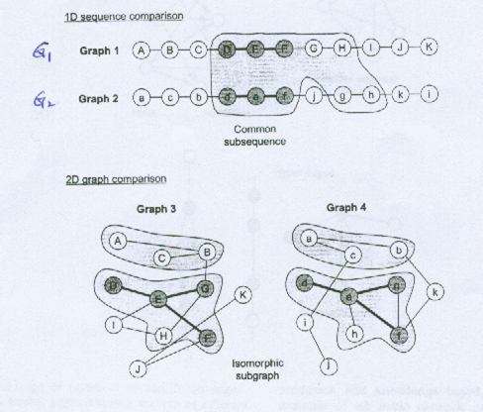

Slide 6
The DBRF Method for Inferring a Gene Network
S. Onami, K. Kyoda, M. Morohashi, H. Kitano
In “Foundations of Systems Biology,” 2002
Presented by Wesley Chuang

Slide 7
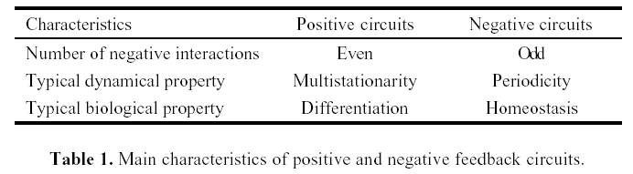
Positive vs. Negative Circuit

Slide 8
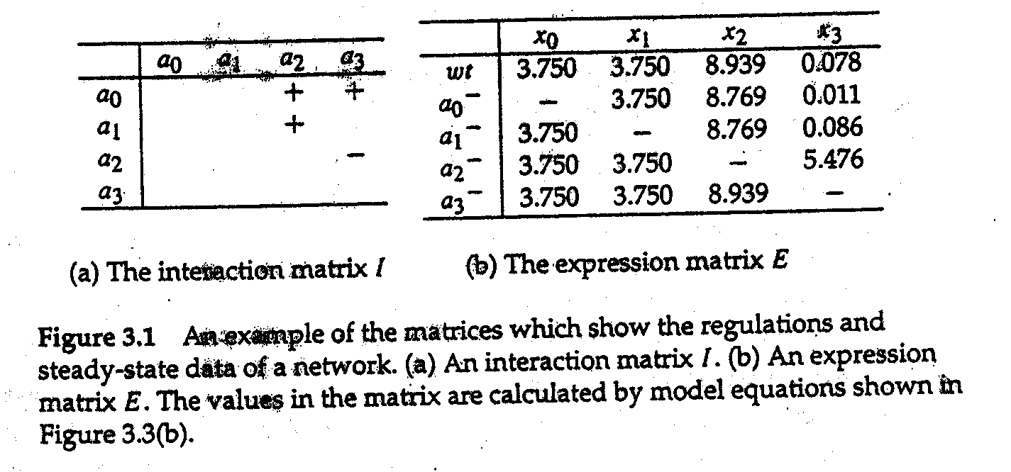
Difference Based Regulation Finding Method (DBRF)

Slide 9
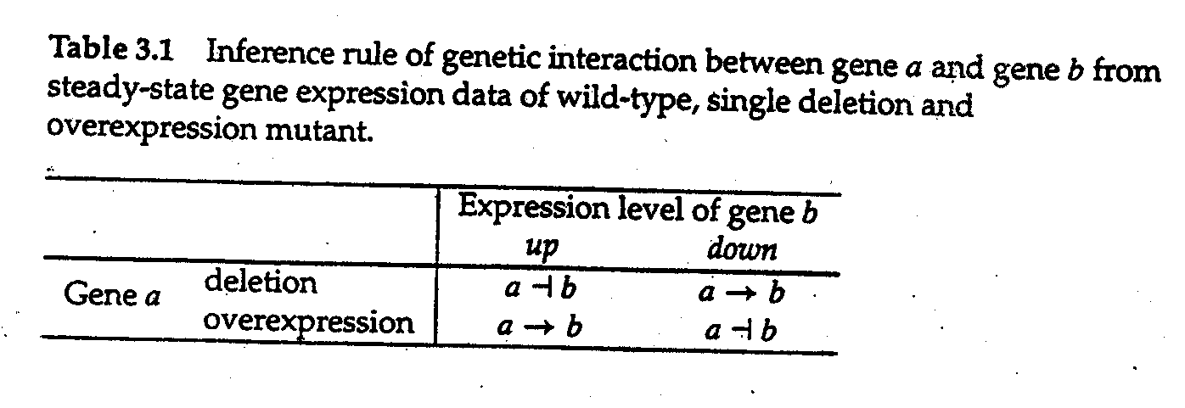
Inference Rule of Genetic Interaction
Gene a activates (represses) gene b if the expression of b goes down (up) when a is deleted.

Slide 10
Parsimonious Network
The route consists of the largest number of genes is the parsimonious route; others are redundant.
The regulatory effect only depends on the parity of the number negative regulations involved in the route.

Slide 11
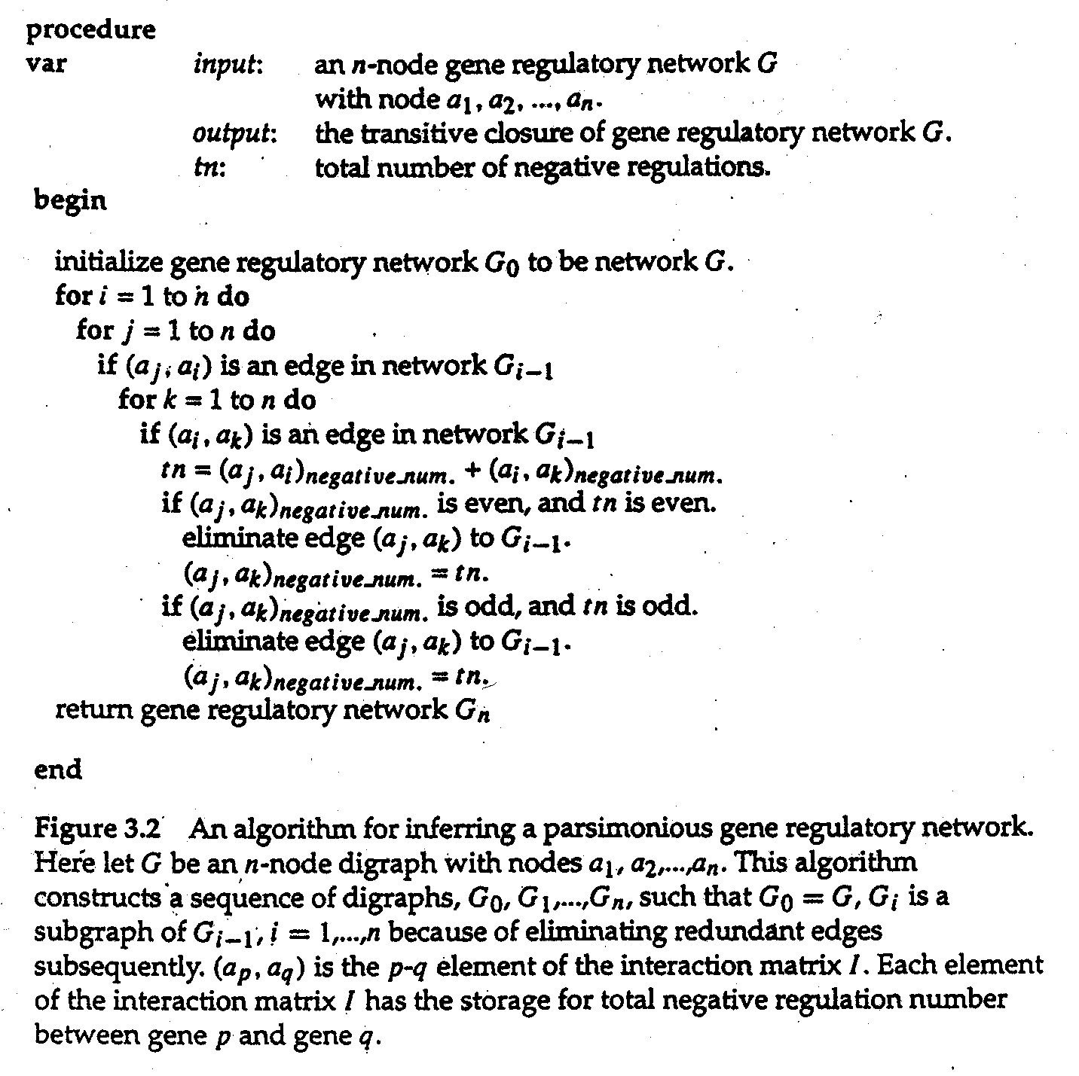
Algorithm for Parsimonious Network

Slide 12
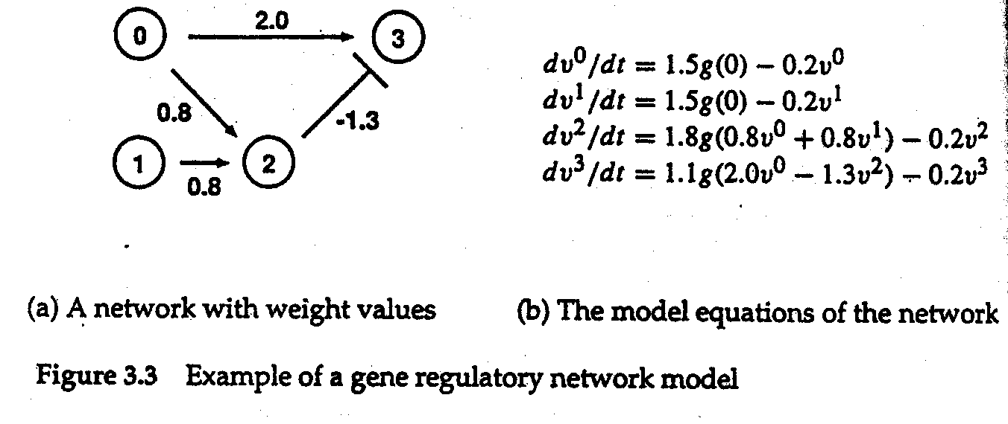
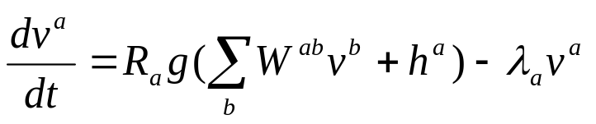
A Gene Regulatory Network Model
node: gene
edge: regulation
vª: expression level of gene a
R_{a}: max rate of synthesis
g(u): a sigmoidal function
W: connection weight
hª: effect of general transcription factor
λ_{a}: degradation (proteolysis) rate
Parameters were randomly determined.

Slide 13
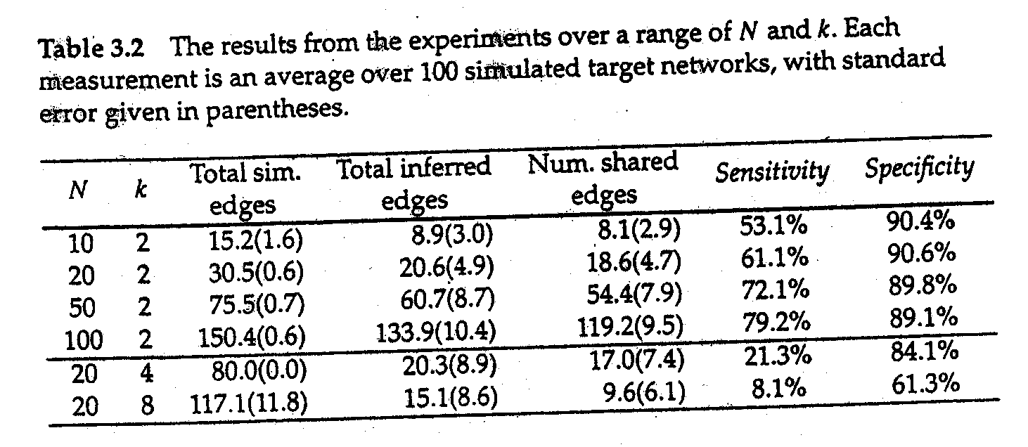
Experiment Results
Sensitivity: the percentage of edges in the target network that are also present in the inferred network.
Specificity: the percentage of edges in the inferred network that are also present in the target network
N: gene number
K: max indegree

Slide 14
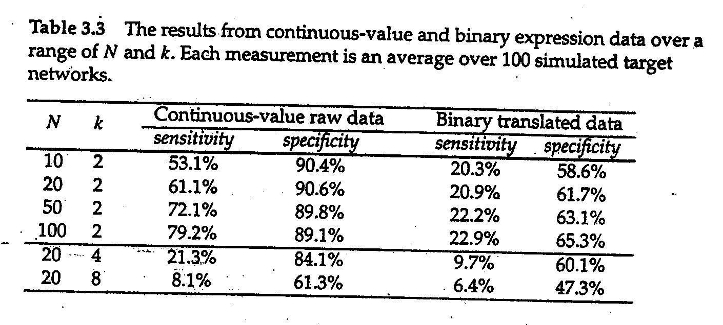
Continuous vs. Binary Data

Slide 15
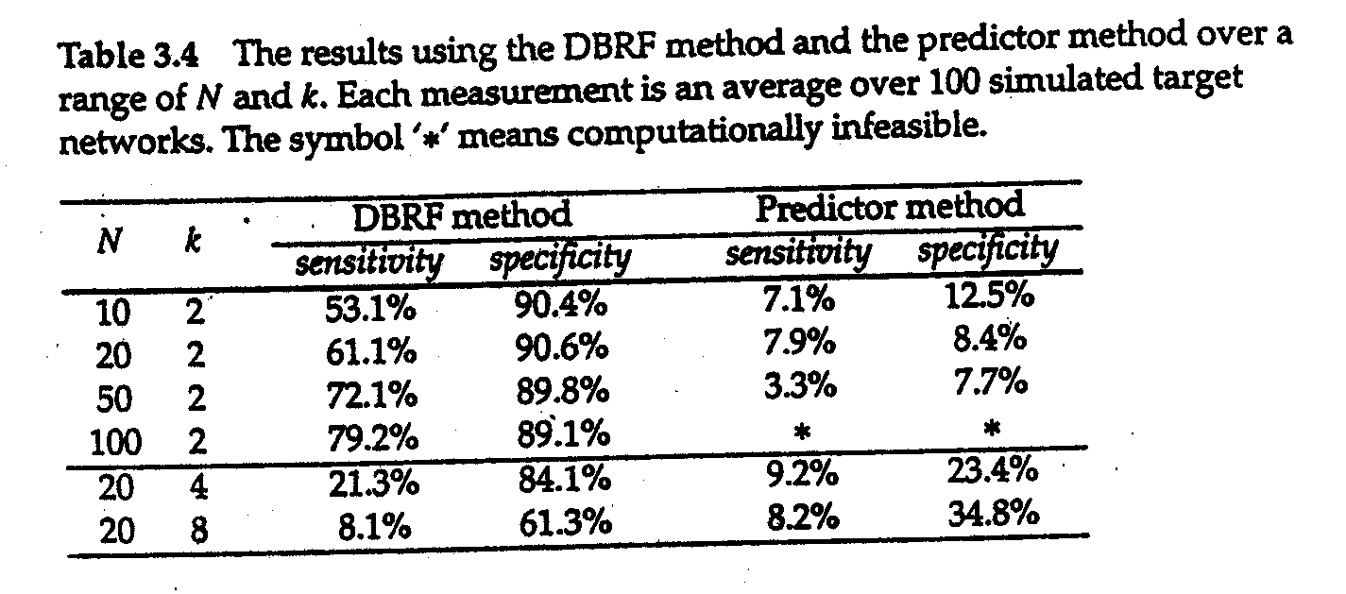
DBRF vs. Predictor Method

Slide 16
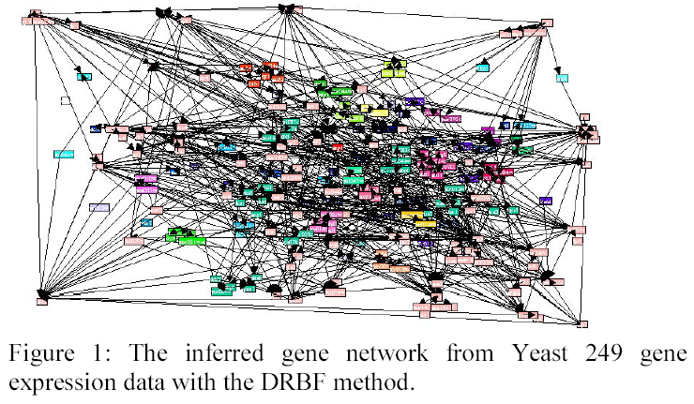
Inferred (Yeast) Gene Network

Slide 17
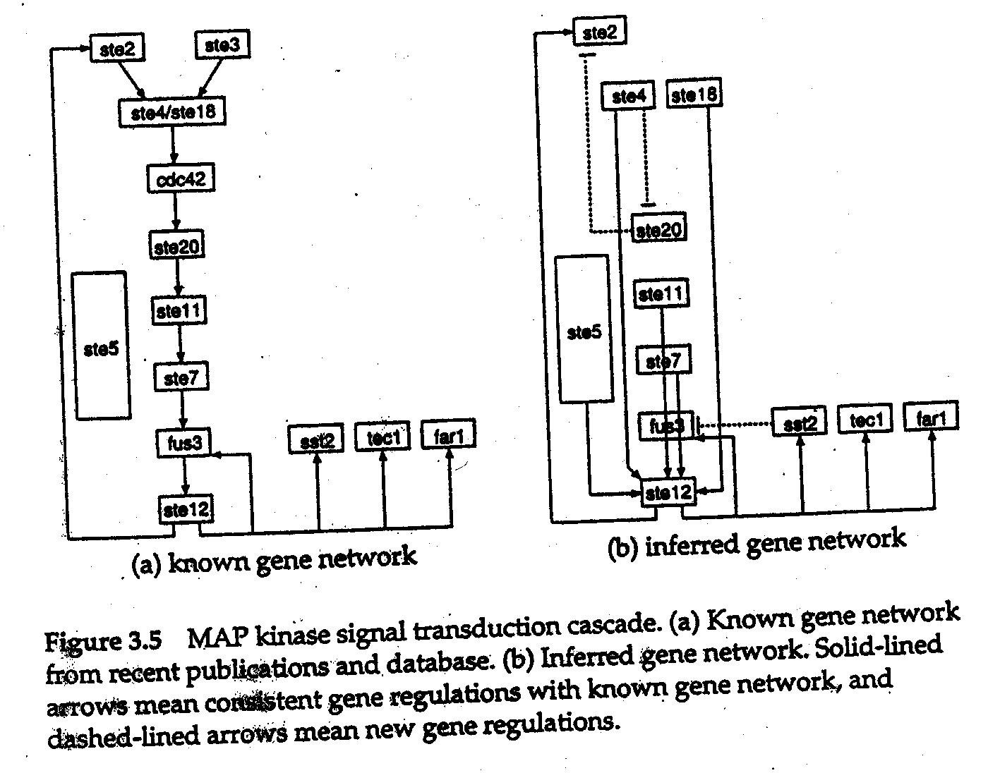
Known vs. Inferred Gene Network

Slide 18
Conclusion
Applicable to continuous values of expressions.
Scalable for large-scale gene expression data.
DBRF is a powerful tool for genome-wide gene network analysis.

Slide 19
(3) Data Analysis and Data Mining
cDNA microarray & high-clesity oligonucleotide chips
Gene expression levels,
Classification of tumors, disease and disorder (already known or yet to be discovered)
Drug design and discovery, treatment of cancer, etc.

Slide 20
(3) Data Analysis and Data Mining
 | c₁ | t₁ | c₂ | t₂ | c₃ | t₃ | … | c_{n} | t_{n}
g₁
g₂
g₃
:
g_{p}

Slide 21
(3) Data Analysis and Data Mining
Tumor classification - three methods
(a) identification of new/unknown tumor classes using gene expression profiles. (Cluster analysis/unsupervised learning)
(b) classification of malignancies into known classes. (discriminant analysis/supervised learning)
(c) the identification of “marker” genes that characterize the different tumor classes (variable selection).

Slide 22
(3) Data Analysis and Data Mining
Cancer classification and identification
HC – hierarchical clustering methods,
SOM – self-organizing map,
SVM – support vector machines.

Slide 23
(3) Data Analysis and Data Mining
Prediction methods (Discrimination methods)
FLDA – Fisher’s linear discrimination analysis
ML – Maximum likelihood discriminat rule,
NN – nearest neighbor,
Classification trees,
Aggregating classifiers.

Slide 24
Rank Correlation and Data Fusion
Problem 1:
For what A and B,
P(C)(or P(D))>max{P(A),P(B)}?
Problem 2:
For what A and B,
P(C)>P(D)?

Slide 25
x | 1 | 2 | 3 | 4 | 5 | 6 | 7 | 8 | 9 | 10
r_{A}(x) | 2 | 8 | 5 | 6 | 3 | 1 | 4 | 7 | 10 | 9
s_{A}(x) | 10 | 7 | 6.4 | 6.2 | 4.2 | 4 | 3 | 2 | 1 | 0
(a) Ranked list A
x | 1 | 2 | 3 | 4 | 5 | 6 | 7 | 8 | 9 | 10
r_{B}(x) | 5 | 9 | 6 | 2 | 8 | 7 | 1 | 3 | 10 | 4
s_{B}(x) | 10 | 9 | 8 | 7 | 6 | 5 | 4 | 3 | 2 | 1
(b) Ranked list B

Slide 26
x | 1 | 2 | 3 | 4 | 5 | 6 | 7 | 8 | 9 | 10
f_{AB}(x) | 6.5 | 2.5 | 4 | 8.5 | 2 | 3.5 | 7 | 6.5 | 6 | 9
s_{f}(x) | 2 | 2.5 | 3.5 | 4 | 6 | 6.5 | 6.5 | 7 | 8.5 | 9
r_{C}(x) | 5 | 2 | 6 | 3 | 9 | 1 | 8 | 7 | 4 | 10
(c) Combination of A and B by rank
x | 1 | 2 | 3 | 4 | 5 | 6 | 7 | 8 | 9 | 10
g_{AB}(x) | 4.0 | 8.5 | 3.6 | 2.0 | 8.2 | 7.1 | 3.5 | 5 | 4.5 | 1.5
s_{g}(x) | 8.5 | 8.2 | 7.1 | 5.0 | 4.5 | 4.0 | 3.6 | 3.5 | 2.0 | 1.5
r_{D}(x) | 2 | 5 | 6 | 8 | 9 | 1 | 3 | 7 | 4 | 0
(d) Combinations of A and B by score

Slide 27
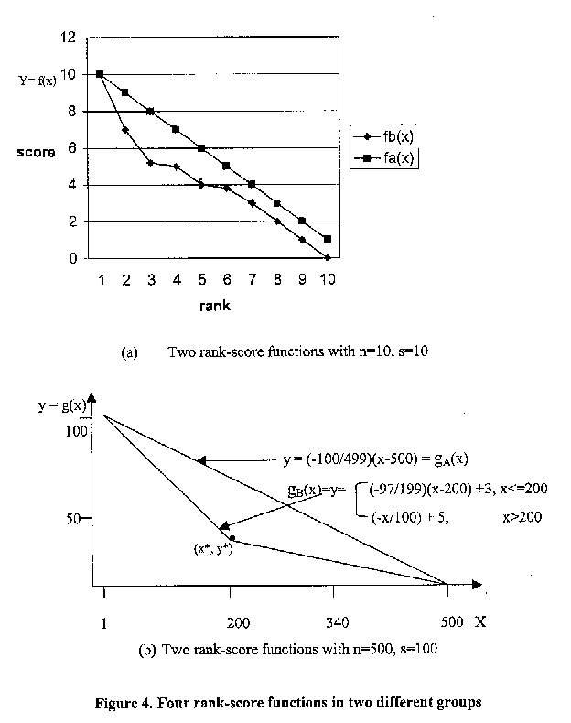

Slide 28
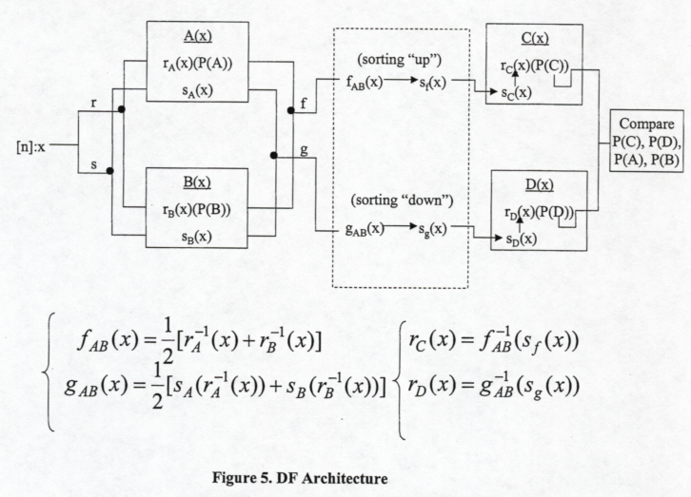

Slide 29
Theorem 3:
Let A, B, C and D be defined as before. Let s_{A}=L and s_{B}=L₁∪L₂ (L₁ and L₂ meet at
(x*, y*) be defined as above). Let r_{A}=e_{A} be the identity permutation. If r_{B}=t。e_{A}, where t= the transposition (i,j), (i<j), and q<x*, then P_{@q}(C) ≥P_{@q}(D).

Slide 30
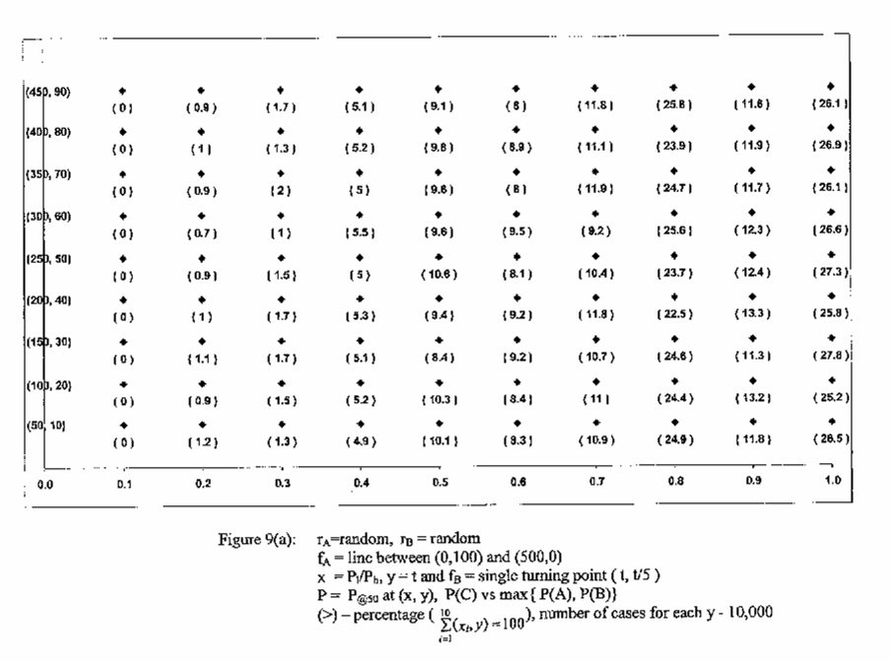

Slide 31
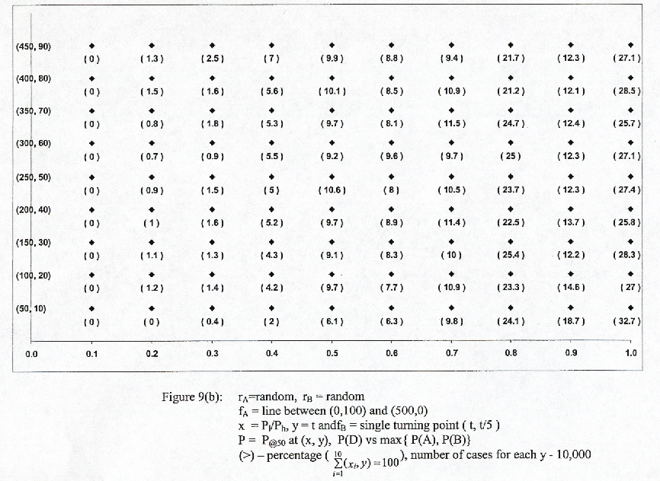

Slide 32
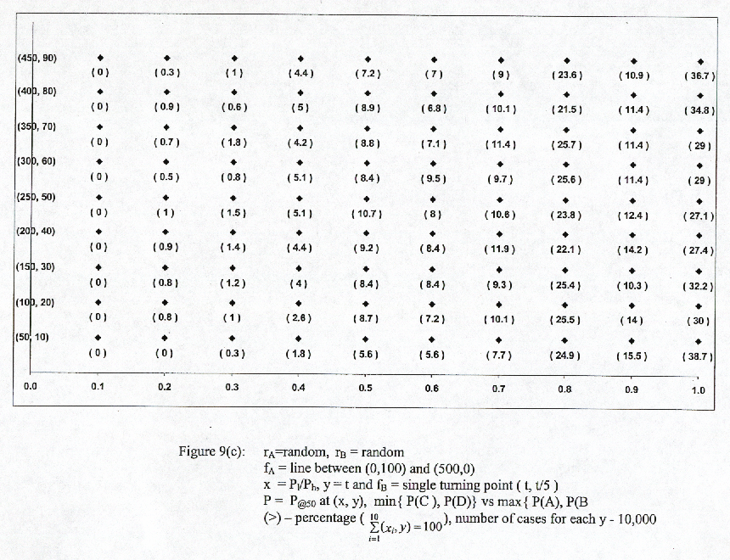

Slide 33
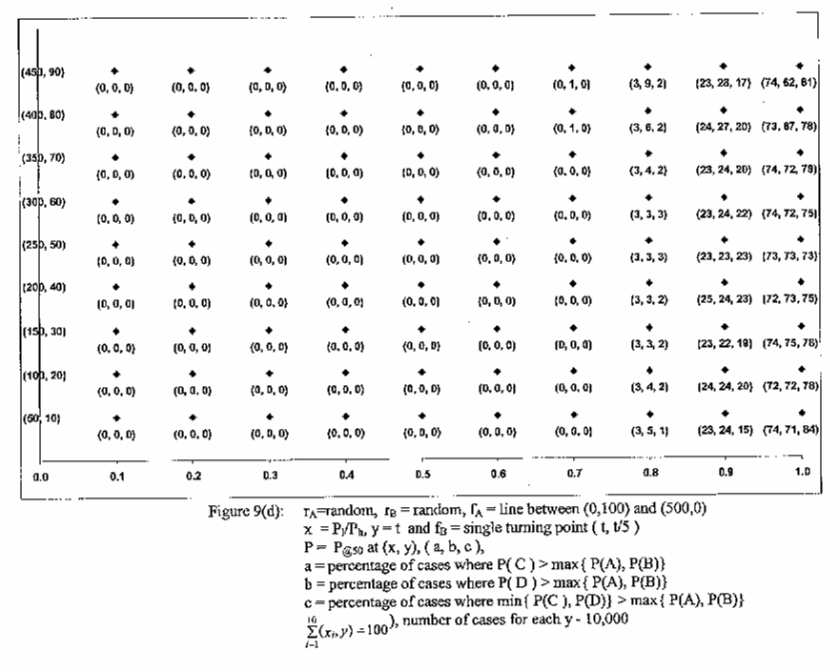

Slide 34
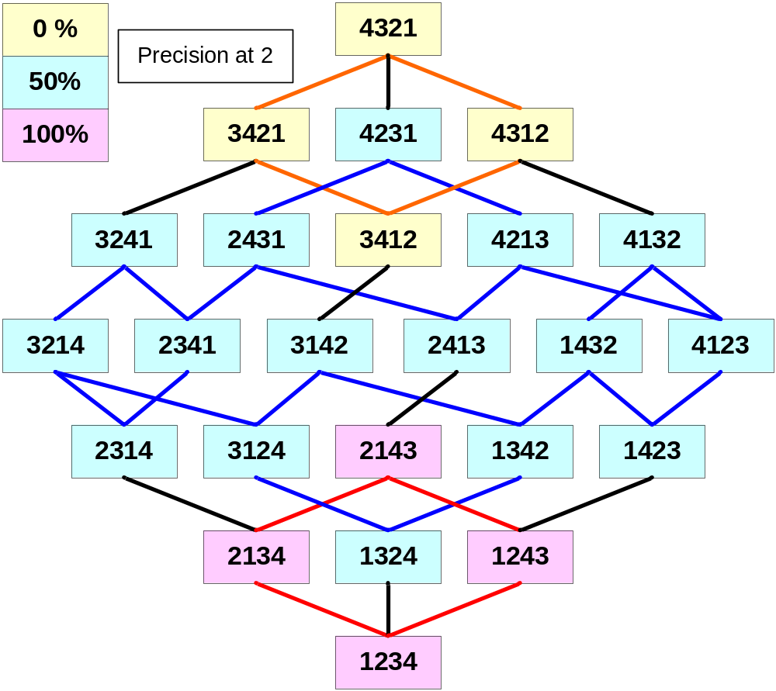
(S₄,S) where
S={(1,2),(2,3),(3,4)}

Slide 35
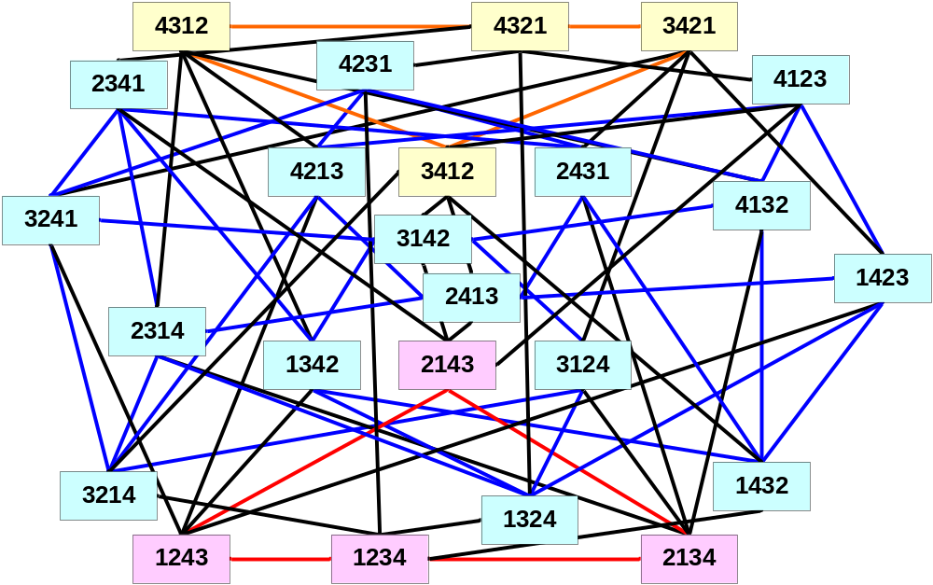
(S₄,T) where T={(i,j)|i≠j}

Slide 36
References
Lenwood S. Heath; Networks in Bioinformatics, I-SPAN’02, May 2002, IEEE Press, (2002), 141-150
Minoru Kanehisa; Prediction of higher order functional networks from genomie data, Bharnacogonomics (2)(4), (2001), 373-385.
D. F. Hsu, J. Shapiro and I. Taksa; Methods of data fusion in information retrieval; rank vs. score combination, DIMACS Technical Report 2002-58, (2002)
M. Grammatikakis, D. F. Hsu, and M. Kratzel; Parallel system interconnection and communications, CRC Press(2001).
S. Dudoit, J. Fridlyand and T. Speed; Comparison of discrimination methods for the classification of tumors using gene expressions data, UC Berkeley, Technical Report #576, (2000).

