Slide 1
Predicting rRNA-, RNA-, and DNA-binding Proteins from Primary Structure with Support Vector Machines
Xiaojing Yu, Jianping Cao, Yudong Cai, Tieliu Shi, Yixue Li
Bioinformatics Center, Shanghai Institutes for Biological Sciences, Chinese Academy of Sciences, Graduate School of the Chinese Academy of Sciences,
Department of Biomedical Engineering, School of Life Science & Technology, University of Electonic Science and Technology of China,
Department of Biomolecular Sciences, UMIST, Manchester M60 1QD, UK
Journal of Theoretical Biology 240(2006) 175-184
Presenter: Yen, Hsin-Wei

Slide 2
Abstract (1/3)
In the post-genome era, the prediction of protein function is one of the most demanding tasks in the study of bioinformatics. Machine learning methods, such as the support vector machines (SVMs), greatly help to improve the classification of protein function. In this work, we integrated SVMs, protein sequence amino acid composition, and associated physicochemical properties into the study of nucleic-acid-binding proteins prediction. We developed the binary classifications for rRNA-, RNA-, DNA-binding proteins that play an important role in the control of many cell processes.

Slide 3
Abstract (2/3)
Each SVM predicts whether a protein belongs to rRNA-, RNA-, or DNA-binding protein class. Self-consistency and jackknife tests were performed on the protein data sets in which the sequences identity was <25%. Test results show that the accuracies of rRNA-, RNA-, DNA-binding SVMs predictions are ~84%, ~78%, ~72%, respectively. The predictions were also performed on the ambiguous and negative data set.

Slide 4
Abstract (3/3)
The results demonstrate that the predicted scores of proteins in the ambiguous data set by RNA- and DNA-binding SVM models were distributed around zero, while most proteins in the negative data set were predicted as negative scores by all three SVMs. The score distributions agree well with the prior knowledge of those proteins and show the effectiveness of sequence associated physicochemical properties in the protein function prediction.

Slide 5
Data Sets
Search the Swiss-Prot database
Positive set: use “rRNA-binding”, “RNA-binding”, and “DNA-binding” as keywords, retrieved 3341, 4819, and 10476 proteins
Contrast set: proposed by Cai and Lin, 34938 proteins
Negative set: remove the proteins in the contrast set from the Swiss-Prot database, 118993 proteins
Ambiguous set: remove the three positive sets from contrast set, 18663 proteins

Slide 6
Data Sets
Remove sequences with length > 6000aa or < 50aa
Ambiguous set: 18663 -> 18061
Negative set: 118933 -> 113852
Use CD-HIT and PISCES, with a threshold of 25%
Positive set: 3341 -> 88, 4819 -> 337, 10476 -> 1153
Negative set: 113852 -> 17799

Slide 7
Build Our Data Sets
First select all the proteins in each positive set
Randomly select the same number of proteins from the negative set
i.e. the rRNA-binding training set of 176 proteins, the DNA-binding training set of 754 proteins, and the DNA-binding training set of 2306 proteins.

Slide 8
Feature Vector
Hydrophobicity
Secondary structure
Solvent accessibility
Van Der Waals volume
Polarity
Polarizability

Slide 9
Three Descriptors
Composition (C): the percent of amino acids of certain properties
Transition (T): the frequency of which amino acids of a certain property is followed by amino acids of a different property
Distribution (D): measures the percent of sequence length within which the first, 25%, 50%, 75%, and 100% of the amino acids of a certain property

Slide 10
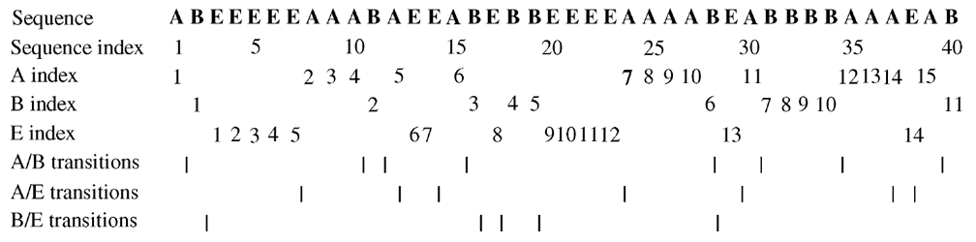
Example
C = ( 15/40, 11/40, 14/40)
T = (8/39, 7/39, 5/39)
D = (1/40, 10/40, 25/40, 35/40, 39/40,…)

Slide 11
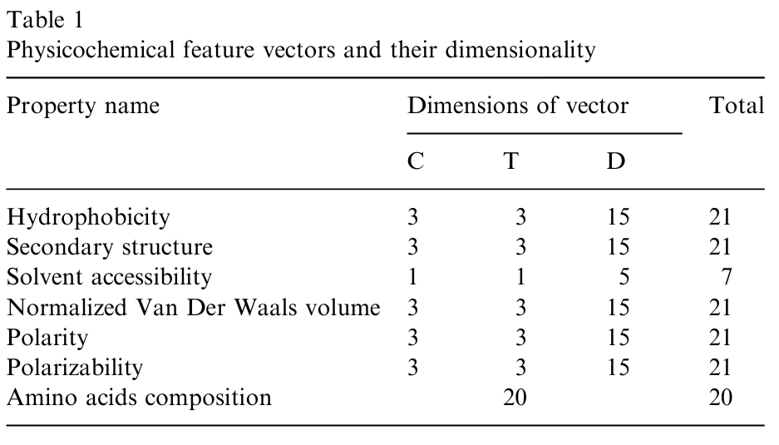
132-dimensional Feature Vector

Slide 12
Accuracy Measure
Sensitivity = TP / (TP + FN)
Specificity = TN / (TN + FP)
Accuracy = (TP + TN) / ( TP + TN + FP + FN)

Slide 13
Tests
Self-consistency test: SVM is trained and test with the same data set.
Jackknife test: every data in the training data set is taken out one by one for prediction, and the remaining data is used to train the model

Slide 14
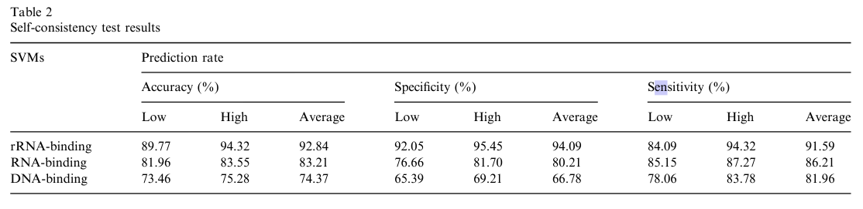
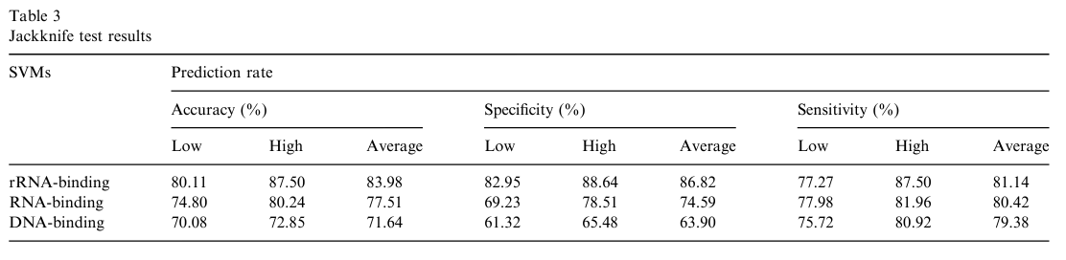
Results

Slide 15
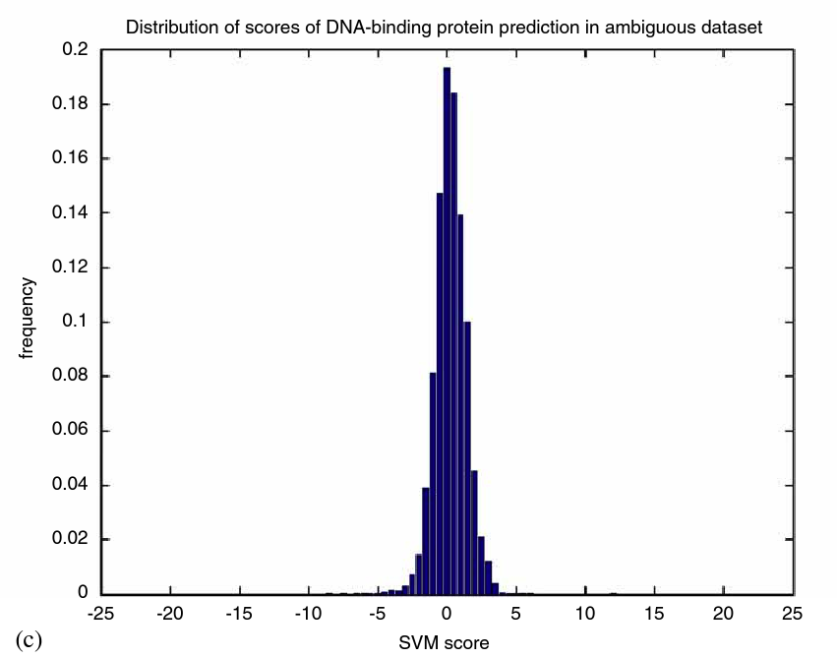
Prediction Score of Ambiguous Set

Slide 16
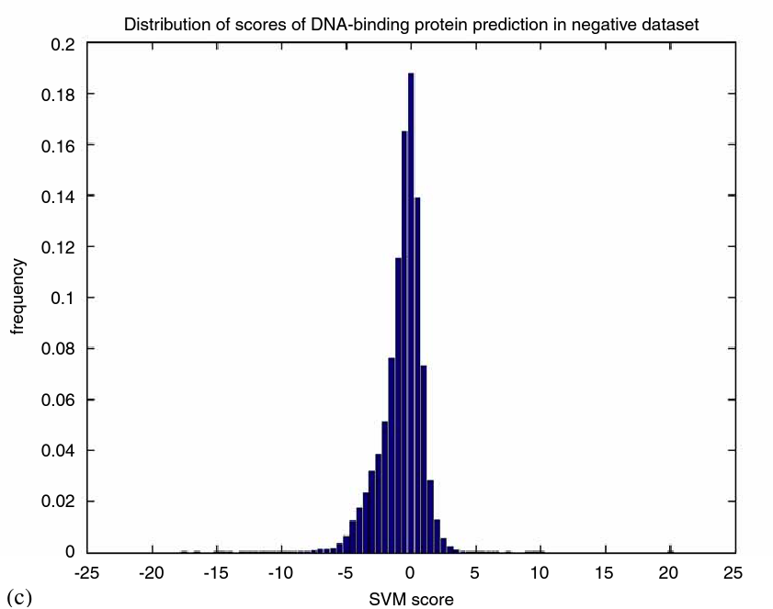
Prediction Score of Negative Set

Slide 17
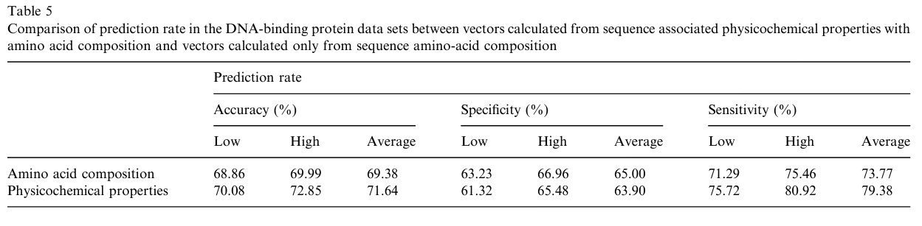
Other Vectors

