Slide 1
Algorithms for Pattern Matching and Discovery in RNA Secondary Structure
Giancarlo Mauri, Giulio Pavesi
Theoretical Computer Science, Vol. 335, pp. 29-51, 2005
Presenter: Chiou-Ting Tseng
Date: Apr. 23, 2008

Slide 2
Abstract (1/2)
Text-indexing structures provide significant advantages in the solution of many problems related to string analysis and comparison, and are nowadays widely used in the analysis of biological sequences. In this paper, we present some applications of affix trees to problems of exact and approximate pattern matching and discovery in RNA sequences. By allowing bidirectional search for symmetric patterns in the sequences, affix trees permit to discover and locate in the sequences patterns describing not only sequence regions,

Slide 3
Abstract (2/2)
but also containing information about the secondary structure that a given region could form, with improvements in terms of theoretical and practical efficiency over the existing methods. The search can be either exact or approximate, where the approximation can be defined simultaneously both for the sequence and the structure of patterns. The approach presented in this paper could provide significant help in the analysis of RNA sequences, where the functional motifs often involve not only sequence, but also the structural constraints.

Slide 4
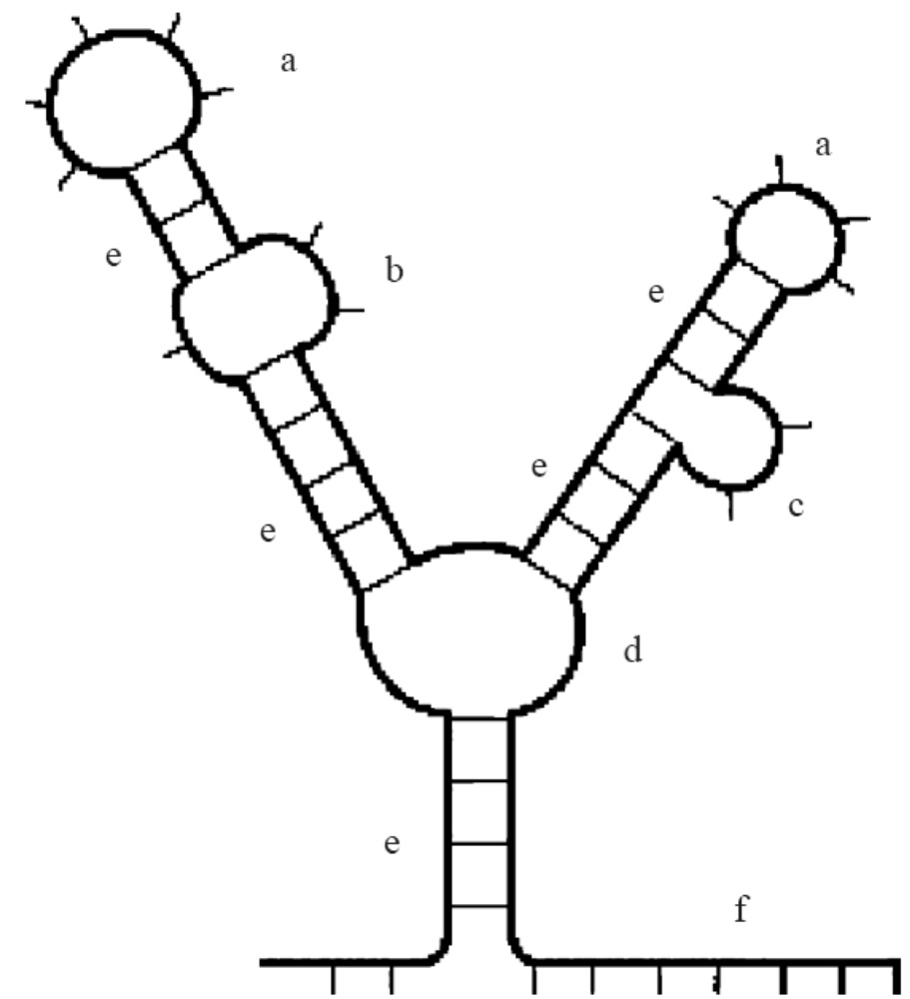
RNA Secondary Structure
a: hairpin loop
b: internal loop
c: bulge
d: multi-loop
e: stack
f: external element

Slide 5
Motif
A substring appearing in all strings.
Several experiments and observations have shown that local distinct structural elements in non-coding RNA molecules are strictly correlated with their function.

Slide 6
RNA Motifs
Very often, conserved motifs present similarity at the sequence level only in the unpaired elements (internal or hairpin loops), that are free to interact with other nucleotides and/or proteins.
Paired elements (i.e., along stacks) are instead much less conserved at sequence level, since what is required from them is only to bind to each other.

Slide 7
RNA Motifs
It is therefore important, when developing algorithms for pattern matching and discovery in RNA sequences to consider not only sequence similarity, but also associate with the regions compared the (potential) secondary structure that they might form.

Slide 8
Suffix Tree
A
C
S=ATATC
TATC
ATC
TC
C
T
T
A
C
A
C
T
C
T
C

Slide 9
Prefix Tree
S=CTATA
TATA
ATA
TA
A
C
T
A
T
A
A
T
A
T
A
T
A

Slide 10
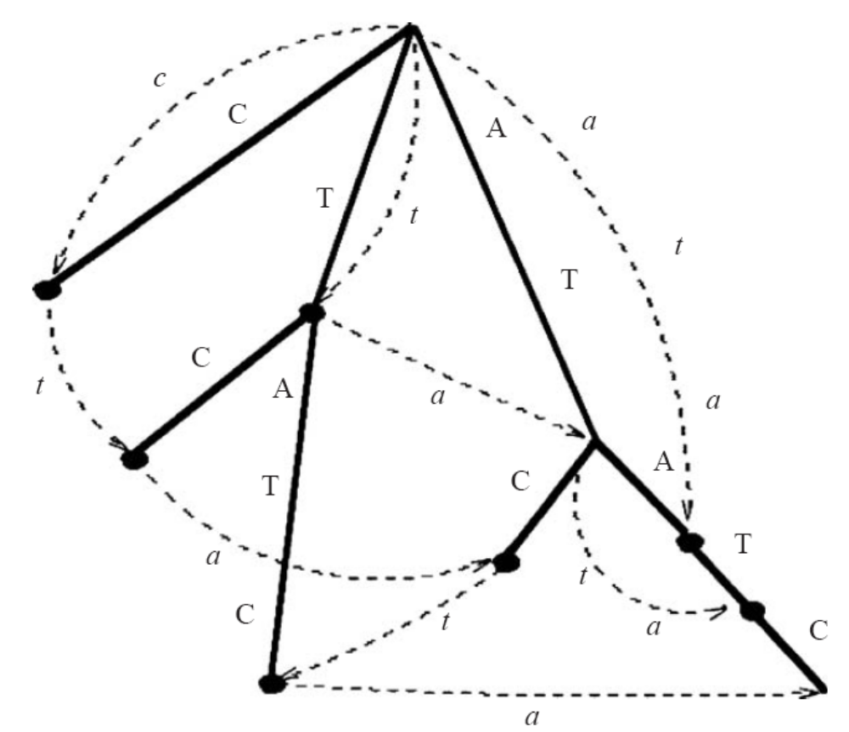
Affix Tree
S=ATATC
TATC
ATC
TC
C
S^{R}=CTATA
TATA
ATA
TA
A
A
C
T
C
A
T
T
T
T
A
A
A
A
C
C
T
A
T
T
A
T
C
A
C

Slide 11
Affix Tree
An affix tree for a non-empty string S = s₁ . . . s_{n} is a directed acyclic graph A(S) = (V ,E) such that:
(1) one distinct node, with no incoming edges, is marked as root;
(2) E = E_{s} ∪ E_{p}, and E_{s} ∩ E_{p} = ∅. That is, the edges of A(S) are divided in two disjoint subsets, that we will call suffix and prefix edges;
(3) suffix edges are labeled with non-empty substrings of S;
(4) prefix edges are labeled with non-empty substrings of S^{R};
(5) two edges of the same type leavingthe same node cannot have labels startingwith the same character;

Slide 12
Affix Tree
(6) on each path starting from the root and following suffix edges only, the concatenation of the edge labels spells out a substring of S;
(7) on each path starting from the root and following prefix edges only, the concatenation of the edge labels spells out a substring of S^{R};
(8) every substring of S is spelled out by a unique path starting from the root and following suffix edges only, while every substring of S^{R} is spelled by a unique path following prefix edges only.
(9) for each node p the tree, where α is the concatenation of the labels of suffix edges from the root to p, the path from the root to p following prefix edges spells out α^{R}.

Slide 13
Pattern Matching with Affix Trees
Given the affix tree for a string S, we can match a pattern P = p₁p₂ . . . p_{m} with the sequence starting from any character of P. For example, let p_{i} be the middle character: we will have to match the characters p_{i+1} . . . p_{m} on suffix edges as usual (forward match), and those preceding p_{i} on prefix edges (backward match).

Slide 14
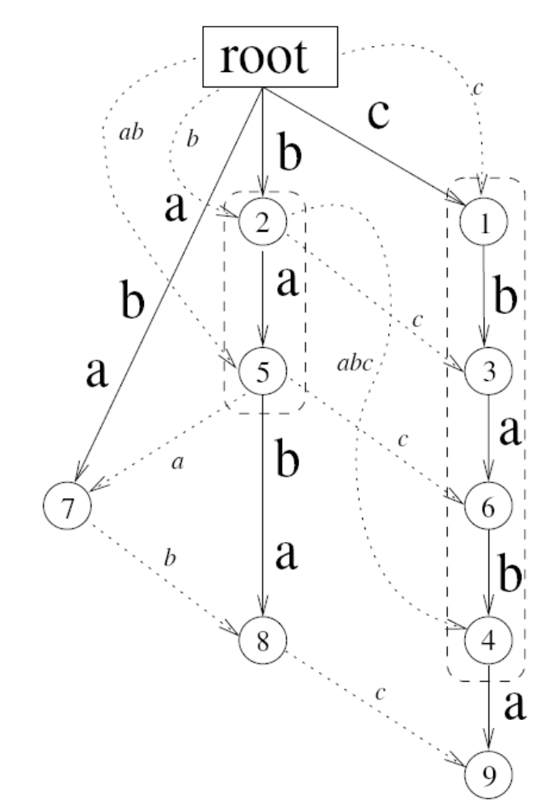
Affix Tree
S = cbaba
T₁ = bab
T₂ = baba

Slide 15
Matching Hairpins
To match the hairpin ecea
Find all substring of length 4
Travel the prefix edge and suffix edge to match the three base pairs
Travel the suffix edge 2 characters to match the buldge
Travel the prefix edge and suffix edge to match the four base pairs

Slide 16
Complexity
Naïve approach: O(mn) time
Construct affix tree: O(n) time
If string depth l was reached by adding b base pairs and u unpaired nucleotides, the number of paths is thus bounded by p = min{6^{b}4^{u}, n}.
Each expansion takes constant time on each path, and, if P appears in S, the algorithm performs at most O(pm) expansions.
Outperforms when n>>m or query many sequences to a given sequence.

Slide 17
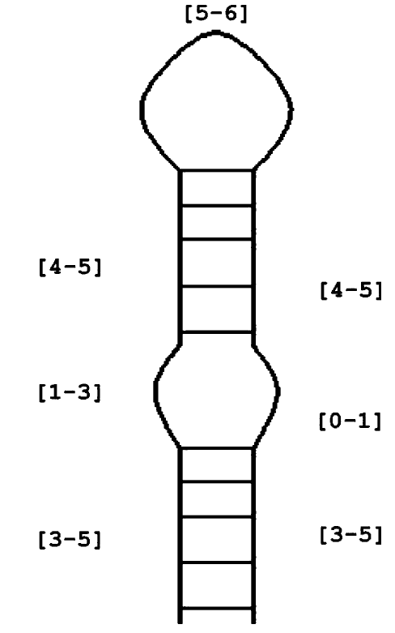
Matching Approximate Descriptors
([3-5].[1-3]([4-5].[5-6])[4-5].[0-1])[3-5]
To do this approximate matching
Find all substring of length [5-6]
Extend them by [4-5] residues on both side
Add [1-3] nucleotides on the left hand side
Add [0-1] nucleotides on the right hand side
Extend them by [3-5] residues on both side

Slide 18
Iron Responsive Element
The iron responsive element (IRE) is a hairpin structure conserved in the 5’UTR or in the 3’UTR of various mRNAs coding for proteins involved in cellular iron metabolism, that works as a sensor of the iron level of the cell.
(((((.(((((......))))))))))
NNNNNCNNNNNCAGWGHNNNNNNNNNN
(((((...(((((......))))).)))))
NNNNNNNCNNNNNCAGWGHNNNNNNNNNNN
([3-5] .[1-3] ([5-5] .[6-6] )[5-5] .[0-1] )[3-5]
We can match while keeping the sequence motif information.

Slide 19
Hairpin Discovery
Input: A set of RNA sequences S, a maximum value for the loop size of the motifs (≤ 20), a maximum number u of unpaired nucleotides that can form internal loops and bulges along the stem (10), and a quorum q representing the minimum number of sequences a motif has to appear in.

Slide 20
Algorithm
Initialization (strings S, int max_loop_size, quorum q):
Build and annotate with bit strings the affix tree for the strings of S.
For each loop size l, with 3 ≤l ≤ l_{max_loop_size}:
  Locate in the affix tree all the nodes corresponding to substrings of length l, and try to add a base pair to each one; let P be the set of the surviving paths;
  Call Expand(P);

Slide 21
Algorithm
Procedure Expand(paths P):
For each path in P try to add a base pair; let P’ be the set of paths obtained.
If at least q bits are set in the bit string of P’, call Expand(P’), otherwise Report(P).
If less than u unpaired nucleotides have been added, for each path in P add a single letter by following suffix edges; let P’ be the set of paths reached.
Call Expand(P’).
If less than u unpaired nucleotides have been added, and the current structure does not end with unpaired nucleotides, add a single letter to each path of P by following prefix edges; let P’ be the set of paths reached.
Call Expand(P’).
Return.

Slide 22
Sequence Similarity
First, we use the algorithm to locate structural motifs, without taking into account sequence information.
Then, in case more than a single occurrence per sequence is reported by the algorithm, we post-process the output by looking for similarity in the unpaired nucleotides, in order to find out which candidate regions are more likely to correspond to a conserved structural motif.

Slide 23
Result - IRE
20 sequences, length 100 – 600
We ran the algorithm looking for motifs appearing in all the sequences with the same loop size, and an internal loop on each side of the stem.
Time < 5 sec, previous work 10-12h
No false positive.
We re-ran the algorithm searching for motifs with different structures, allowing the loop size to vary from three to twenty nucleotides, and allowing up to ten unpaired nucleotides, regardless of their position in the sequences.
< 1 min, only find IRE

Slide 25
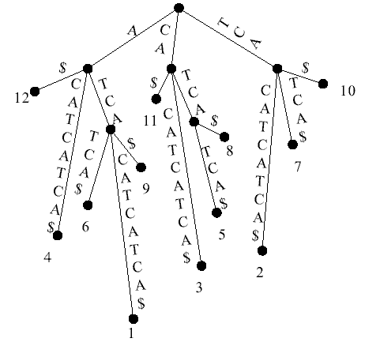
Suffix Trees
A suffix Tree for S=“ATCACATCATCA”

Slide 26
Variations
We can also allow some differences in the occurrences of a motif, that is
Motifs with apical loops of different size in their occurrences (providing a range value Δl to the algorithm for the initialization step: the algorithm will start each iteration with loop sizes ranging from l to l + Δl);
Motifs presenting in their occurrences internal loops of different size (or bulges) located at the same positions along the stem;
Motifs presenting in their occurrences internal loops of different size (or bulges), located at different positions along the stem;
Motifs differing in their occurrences in any combination of the previous points;
Any stem–loop structure that appears in the sequences is considered as an instance of the same motif.

