Slide 1
A subquadratic algorithm for minimum palindromic factorization
Gabriele Fici, Travis Gagie, Juha Kärkkäinen, Dominik Kempa Journal of Discrete Algorithms
Volume 28, September 2014, Pages 41-48
Speaker: Kuan-Lin Lai
Date: Feb. 25, 2020

Slide 2
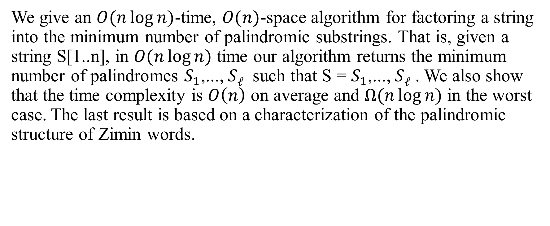
Abstract
We give an $O(n\log{n})$-time, $O(n)$-space algorithm for factoring a string into the minimum number of palindromic substrings. That is, given a string S[1..n], in $O(n\log{n})$ time our algorithm returns the minimum number of palindromes $S_{1}$,..., $Sℓ$ such that S = $S_{1}$,..., $Sℓ$ . We also show that the time complexity is $O\left(n\right)$ on average and $Ω(n\log{n})$ in the worst case. The last result is based on a characterization of the palindromic structure of Zimin words.

Slide 3
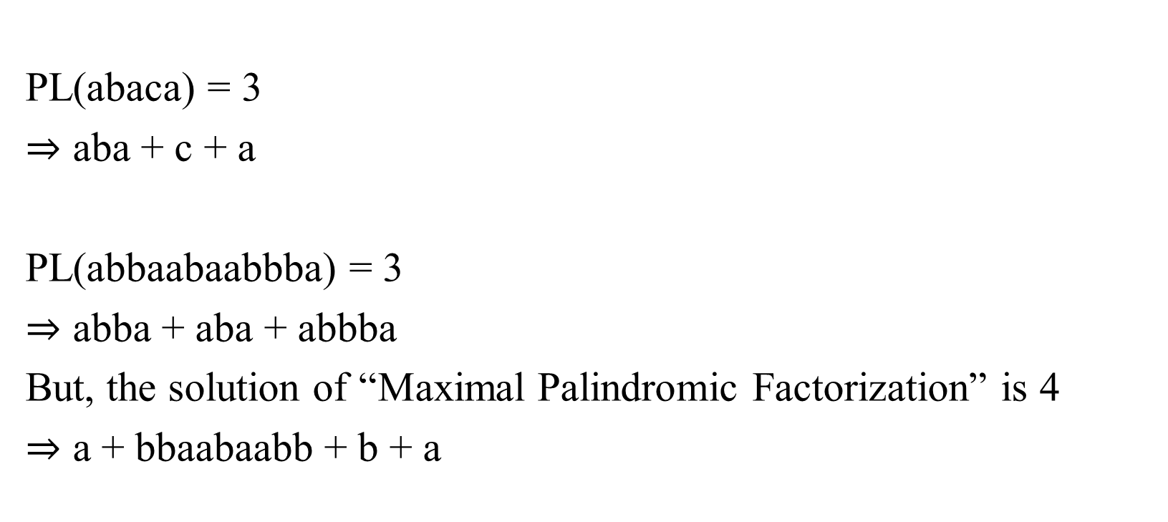
Minimum v.s. Maximal Palindromic Factorization
PL(abaca) = 3
$⇒$ aba + c + a
PL(abbaabaabbba) = 3
$⇒$ abba + aba + abbba
But, the solution of “Maximal Palindromic Factorization” is 4
$⇒$ a + bbaabaabb + b + a
Ali Alatabbi, Costas S. Iliopoulos and M. Sohel Rahman, “Maximal Palindromic Factorization”, Proceedings of Prague Stringology Conference, Prague, Czech, September 2-4, pp. 70-77, 2013

Slide 4


Simple Quadratic Algorithm
$$PL(S[1..j])=\min_{ⅈ}\left\{PL\left(S\left[1..i−1\right]\right)+1:i≤j, S\left[i..j\right]is a palindrome\right\}$$
c | a | a | a | b | a | a | a | b | a | a | a | b | a | a | a
$$G_{j−1}$$
2
6
10
14
15
16
c | a | a | a | b | a | a | a | b | a | a | a | b | a | a | a | b
$$G_{j}$$
5
9
13
17

Slide 5
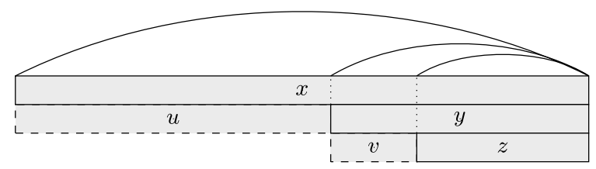
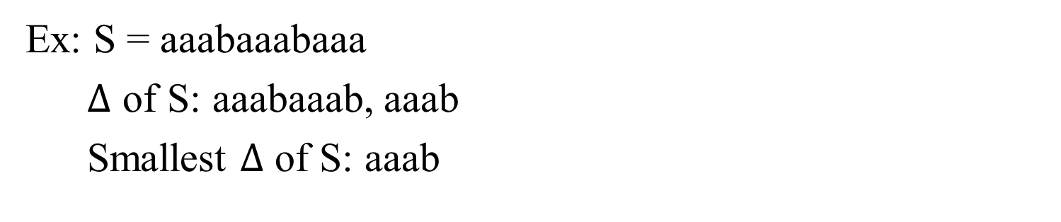

Period($∆$)
Ex: S = aaabaaabaaa
$∆$ of S: aaabaaab, aaab
Smallest $∆$ of S: aaab

Slide 6
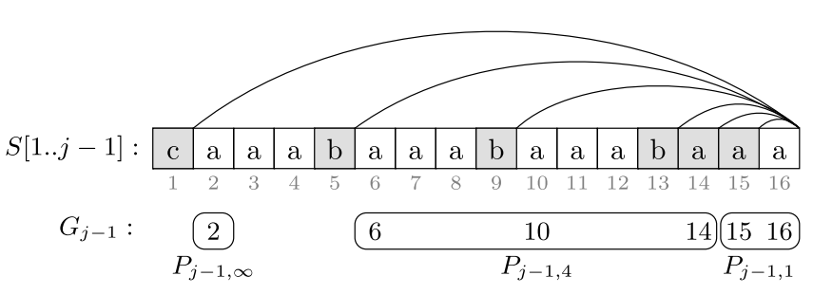
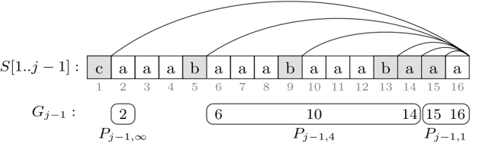
Group Suffix Palindrome
c | a | a | a | b | a | a | a | b | a | a | a | b | a | a | a
2
6
10
14
15
16

Slide 7
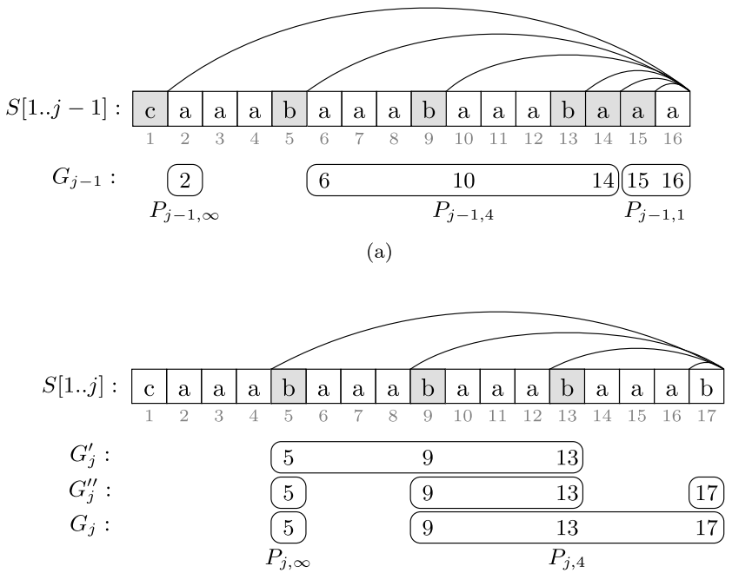

Slide 8
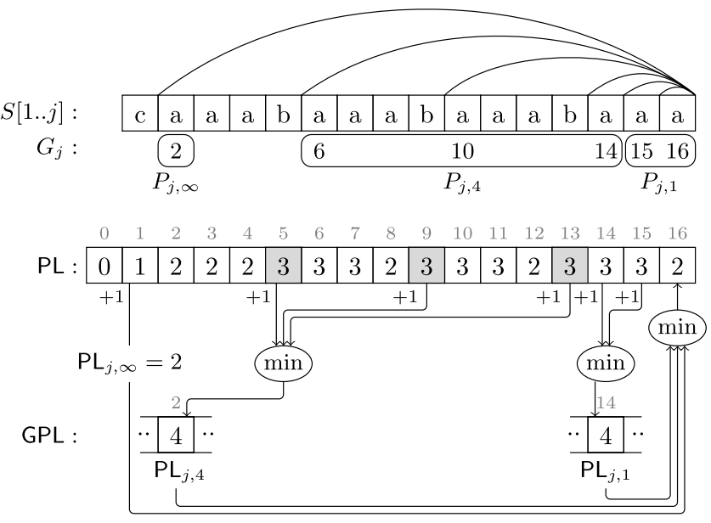
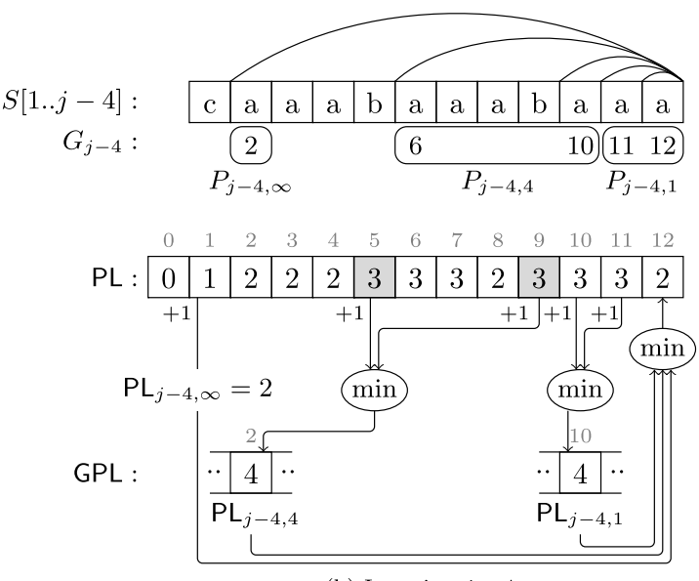
Faster Factorization

Slide 9

Complexity
Time Complexity
Average: $O(n)$
Worst Case : $O(n\log{n} )$
Space Complexity
$O(n)$

