Slide 1
A Revised Algorithm to Find Longest Common Subsequence
Deena Nath, Jitendra Kurmi, Deveki Nandan Shukla
International Journal for Research in Applied Science & Engineering Technology (IJRASET)
ISSN: 2321-9653; IC Value: 45.98; SJ Impact Factor: 6.887
Volume 6 Issue IV
Presenter : Tz-Hsu Lee
Date : Feb. 25, 2020.
Notes:
雄死ㄍㄟ nen na ga 黑給 虎摟

Slide 2
Abstract
The aim of this paper is to make a revised algorithm in order to fetch the longest common subsequence from the given two strings ‘X’ and ‘Y’ for DNA matching in molecular biology etc. The revised algorithm prominence on the running time optimization and reduces the space and time complexity. The analysis of comparison between revised and current dynamic LCS has also performed. Moreover, the anticipated significance of this algorithm is to apply this algorithm in multiple sequences.
Notes:
敲乎李 ate 敖

Slide 3

Example(1/5)
X = BCDACBA
Y = ABDBCA
LCS(X,Y) = BDCA
Matrix C [m x n] (m = 7, n = 6)
Notes:
Aligning distance matrices for structural alignment

Slide 4
Example(2/5)
X = BCDACBA
Y = ABDBCA
C[0][0] = 0 C[0][0] = 0
C[0][1] = 1 C[1][0] = 0
C[0][2] = 0 C[2][0] = 1
C[0][3] = 1 C[3][0] = 0
C[0][4] = 0 C[4][0] = 0
C[0][5] = 0 C[5][0] = 1
Notes:
Aligning distance matrices for structural alignment

Slide 5
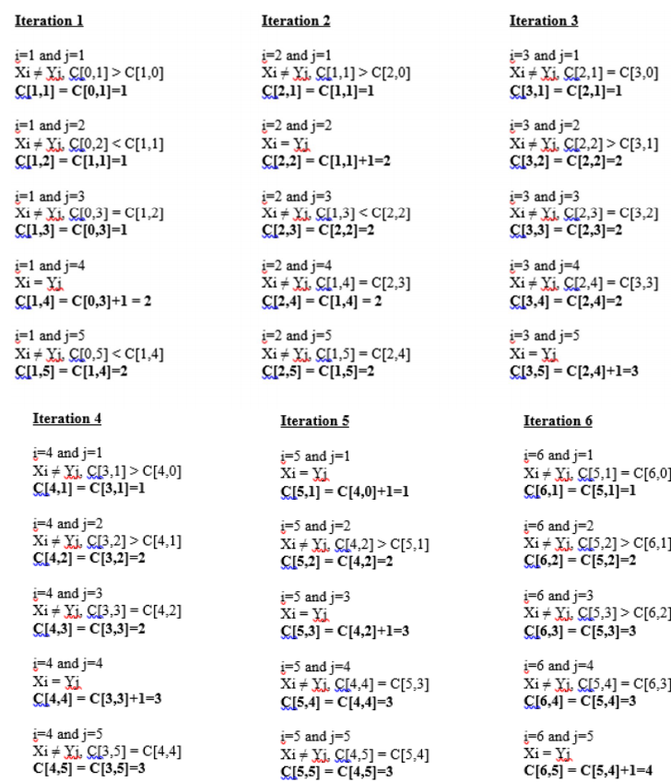
Example(3/5)
Notes:
Aligning distance matrices for structural alignment

Slide 6
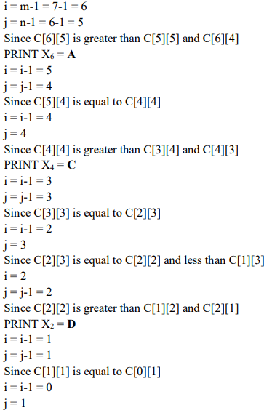

Example(4/5)
Notes:
Aligning distance matrices for structural alignment

Slide 7
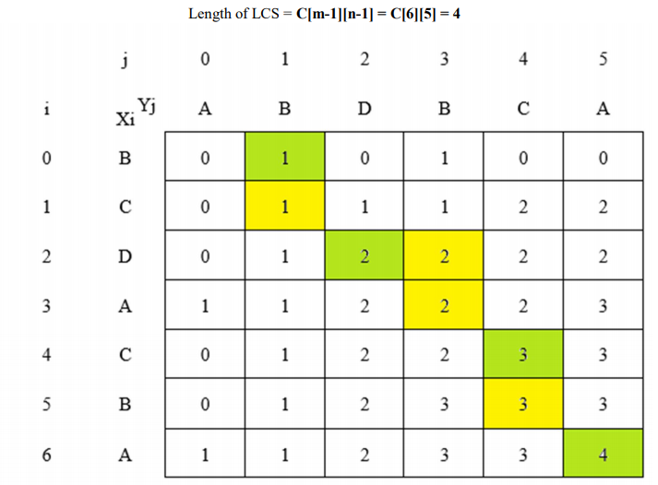
Example(5/5)
Notes:
Aligning distance matrices for structural alignment

Slide 8
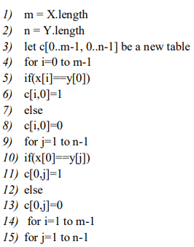
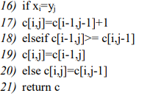
Algorithm
Notes:
Aligning distance matrices for structural alignment

Slide 9
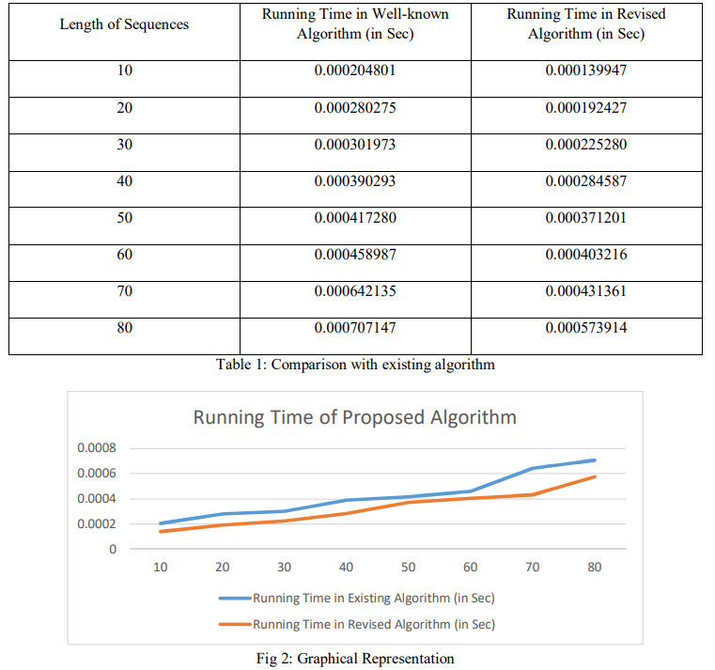
Result and Analysis
Notes:
Aligning distance matrices for structural alignment

