Slide 1
Computing Longest Common Square Subsequences
Takafumi Inoue, Shunsuke Inenaga, Heikki Hyyrö, Hideo Bannai, Masayuki Takeda
Proceedings of 29th Annual Symposium on Combinatorial Pattern Matching, CPM 2018, Qingdao, China
Presenter: Shao-Xuan Lee
Date: Mar. 3, 2020

Slide 2
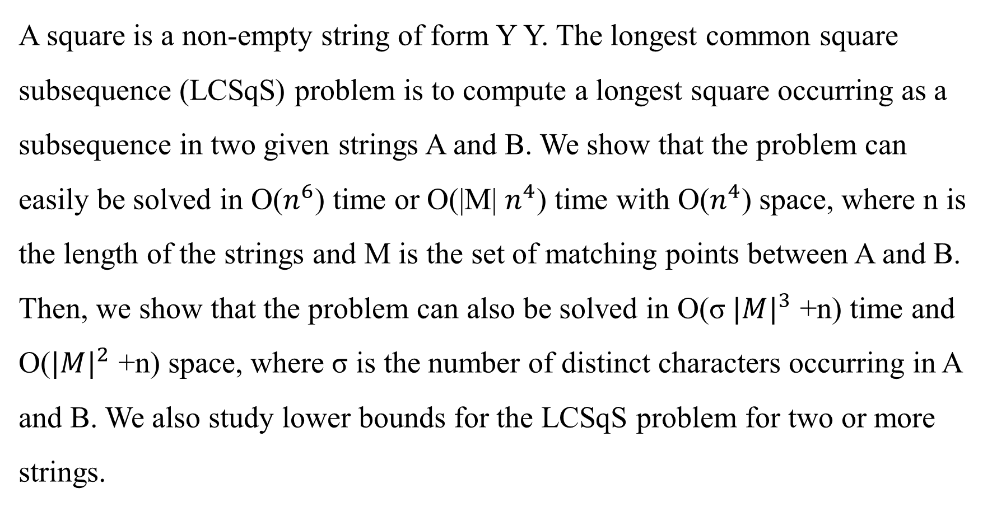
Abstract
A square is a non-empty string of form Y Y. The longest common square subsequence (LCSqS) problem is to compute a longest square occurring as a subsequence in two given strings A and B. We show that the problem can easily be solved in O($n^{6}$) time or O(|M| $n^{4}$) time with O($n^{4}$) space, where n is the length of the strings and M is the set of matching points between A and B. Then, we show that the problem can also be solved in O(σ ${|M|}^{3}$ +n) time and O(${|M|}^{2}$ +n) space, where σ is the number of distinct characters occurring in A and B. We also study lower bounds for the LCSqS problem for two or more strings.

Slide 3
Longest common square subsequence (LCSqS)
A = c a a a b c a b a b
B = a b a b b a a c b c
LCSqS(A,B) = a a b a a b

Slide 4
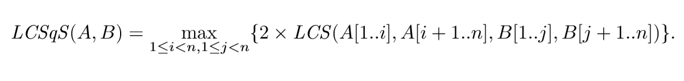
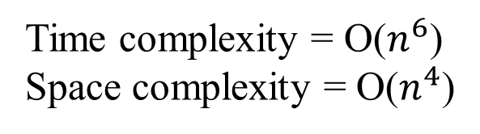
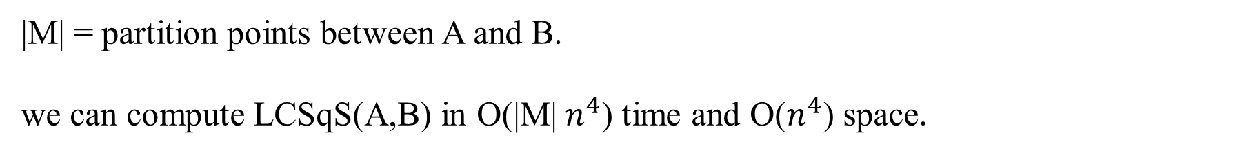
Simple Algorithm
Time complexity = O($n^{6}$)
Space complexity = O($n^{4}$)
|M| = partition points between A and B.
we can compute LCSqS(A,B) in O(|M| $n^{4}$) time and O($n^{4}$) space.

Slide 5
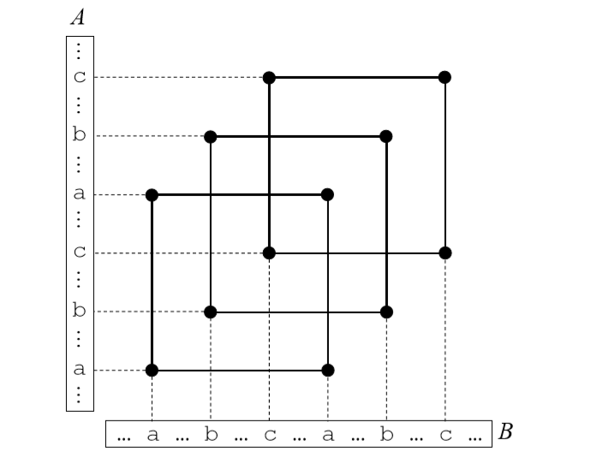
Diagonally overlapping matching rectangles (DOMRs)
Time complexity = O(σ ${|M|}^{4}$ +n) , σ is the number of distinct characters occurring in A and B
Space complexity = O(${|M|}^{2}$ +n)

Slide 6
Diagonally overlapping matching rectangles (DOMRs)
r3
r2
r1
Time complexity = O(σ ${|M|}^{4}$ +n) , σ is the number of distinct characters occurring in A and B
Space complexity = O(${|M|}^{2}$ +n)

Slide 7
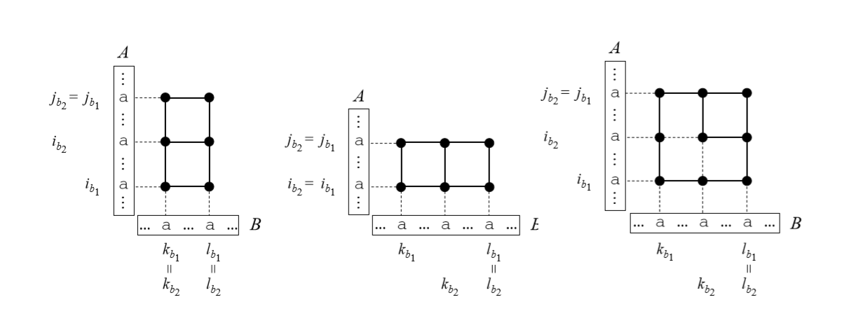
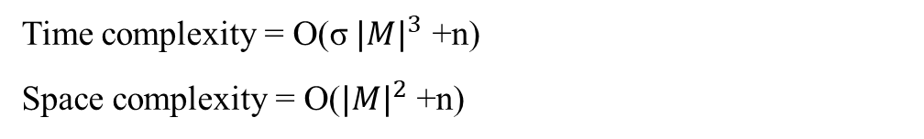
Improved algorithm
Time complexity = O(σ ${|M|}^{3}$ +n)
Space complexity = O(${|M|}^{2}$ +n)

Slide 8
Improved algorithm
Time complexity = O(σ ${|M|}^{3}$ +n)
Space complexity = O(${|M|}^{2}$ +n)

