Slide 1
Prediction of microRNAs Associated with Human Diseases Based on Weighted k Most Similar Neighbors
Ping Xuan, Ke Han, Maozu Guo, Yahong Guo, Jinbao Li, Jian Ding, Yong Liu, Qiguo Dai, Jin Li, Zhixia Teng, Yufei Huang
PLOS ONE, Volume 8, 2013
Speaker: Jheng-Yan Lyu
Date: Mar. 3, 2020

Slide 2
Abstract (1/2)
Background: The identification of human disease-related microRNAs (disease miRNAs) is important for further investigating their involvement in the pathogenesis of diseases. More experimentally validated miRNA-disease associations have been accumulated recently. On the basis of these associations, it is essential to predict disease miRNAs for various human diseases. It is useful in providing reliable disease miRNA candidates for subsequent experimental studies. Methodology/Principal Findings: It is known that miRNAs with similar functions are often associated with similar diseases and vice versa. Therefore, the functional similarity of two miRNAs has been successfully estimated by measuring the semantic similarity of their associated diseases. To effectively predict disease miRNAs, we calculated the functional similarity by incorporating the information content of disease terms and phenotype similarity between diseases. Furthermore, the members of miRNA family or cluster are assigned higher weight since they are more probably associated with similar diseases. A new prediction method, HDMP, based on weighted k most similar neighbors is presented for predicting disease miRNAs. Experiments validated that HDMP achieved significantly higher prediction performance than existing methods.

Slide 3
Abstract (2/2)
In addition, the case studies examining prostatic neoplasms, breast neoplasms, and lung neoplasms, showed that HDMP can uncover potential disease miRNA candidates. Conclusions: The superior performance of HDMP can be attributed to the accurate measurement of miRNA functional similarity, the weight assignment based on miRNA family or cluster, and the effective prediction based on weighted k most similar neighbors.

Slide 4
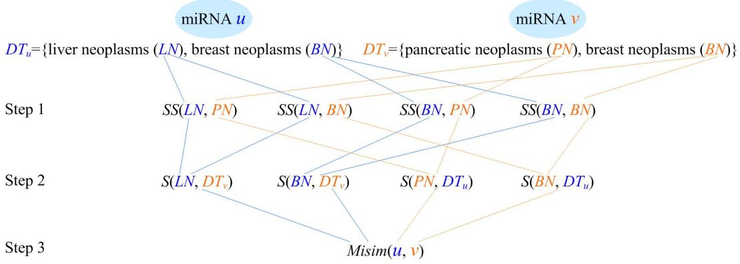
MiRNA functional similarity measurement

Slide 5
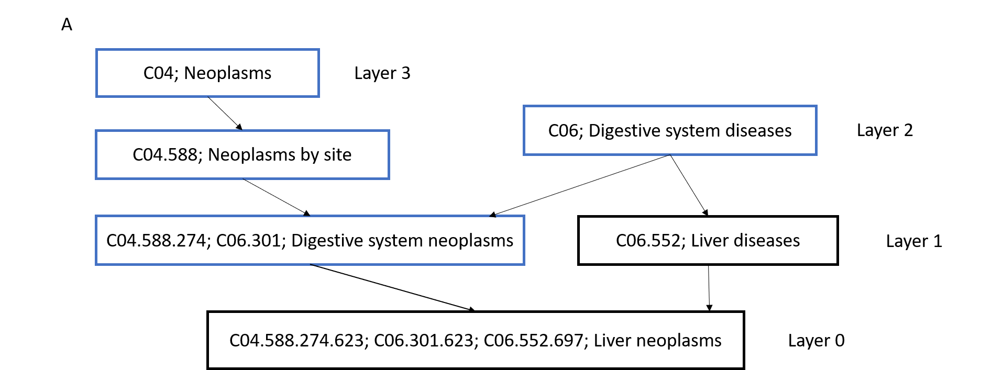
MiRNA functional similarity measurement
IC(t) = -log[p(t)]
the semantic value of ‘liver neoplasms’, DV(LN), is updated as 10.160 (10.160 is the value of IC(liver neoplasms)) + 6.838 (IC(digestive system neoplasms)) + 4.453 (IC(neoplasms by site)) + 2.785 (IC(neoplasms)) + 6.116 (IC(liver diseases)) + 3.961 (IC(digestive system diseases)) = 34.313.

Slide 6
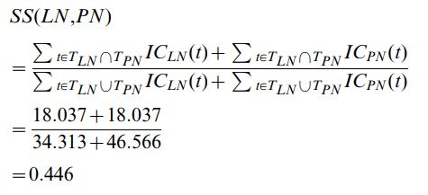
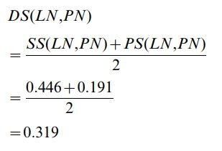
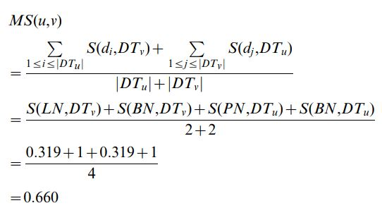
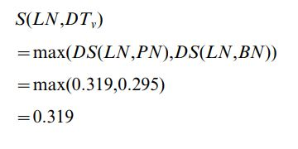
MiRNA functional similarity measurement
dadad

Slide 7
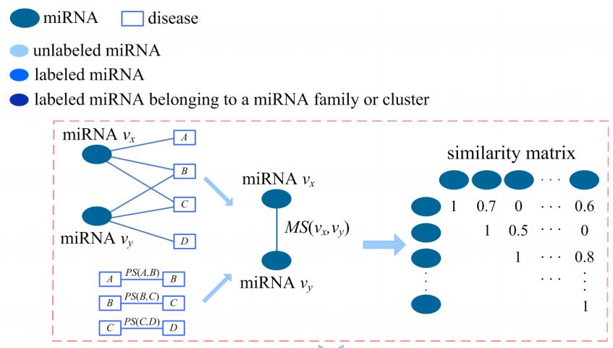
MiRNA functional similarity measurement
dadad

Slide 8
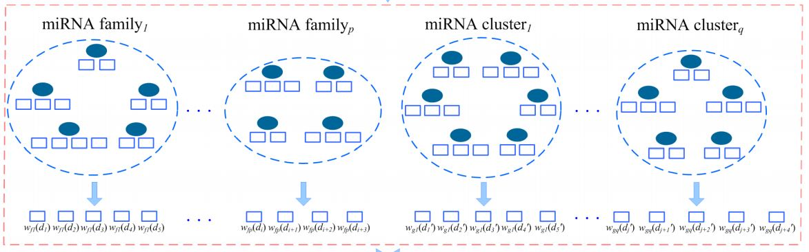
Assignment of weight based on miRNA families or clusters

Slide 9




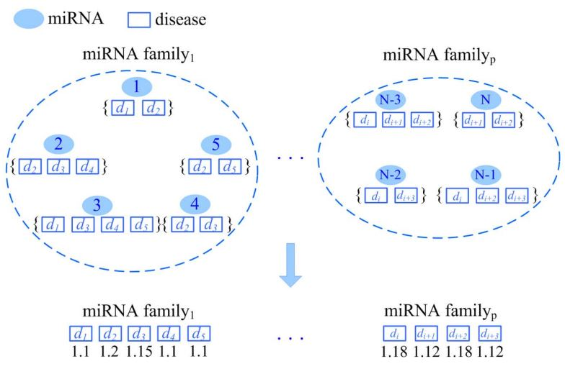
Assignment of weight based on miRNA families or clusters

Slide 10
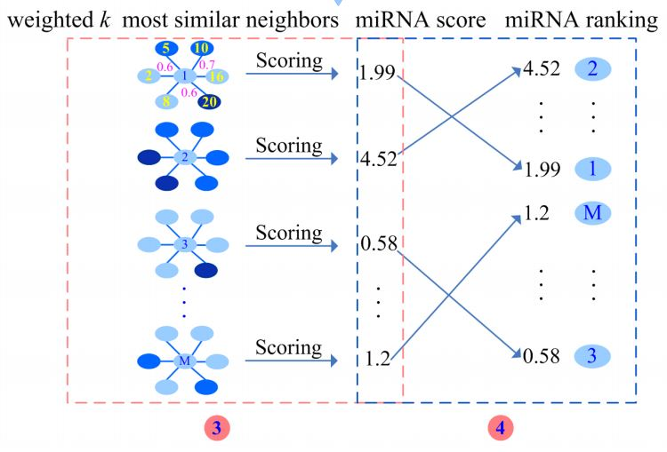
Assignment of weight based on miRNA families or clusters

Slide 11
Assignment of weight based on miRNA families or clusters
MiRNA u and its neighbor v are not in the same miRNA family or cluster. Also, v is associated with d. For instance, as shown in the 3th part of Figure 1, miRNA 1 is an unlabeled miRNA. Since its neighbor 5 is associated with d, 1 is possibly associated with d. The greater functional similarity between 1 and 5, MS(1, 5), means that 1 is more likely to associate with d. Thus, with respect to 1, the subscore of 5 is assigned to MS(1, 5) = 0.6.
MiRNA u and its neighbor v belong to the same miRNA family or cluster. Also, v is associated with d. In Figure 1, since the neighbor 20 is associated with d, 1 is possibly associated with d. Furthermore, as both 1 and 20 are in the ith family, they are more likely to associate with d. Therefore, to assign the subscore of 20, we consider the functional similarity between 1 and 20. At the same time, the weight of these two miRNAs in this family is considered. The subscore of 20 is MS(1, 20)×wfi(d) = 0.6×1.15 = 0.69. In addition, if two miRNAs not only belong to a family but also belong to a cluster, both the weight based on this family and that based on this cluster are multiplied by their functional similarity as the subscore.
The neighbor v has no evidence to validate that it is associated with d. For instance, miRNA 2 is a neighbor of 1 and 2 is not associated with d. As far as 2 is concerned, it is very little possibility that 1 is associated with d. At this time, the subscore of 2 is assigned to 0.

Slide 12
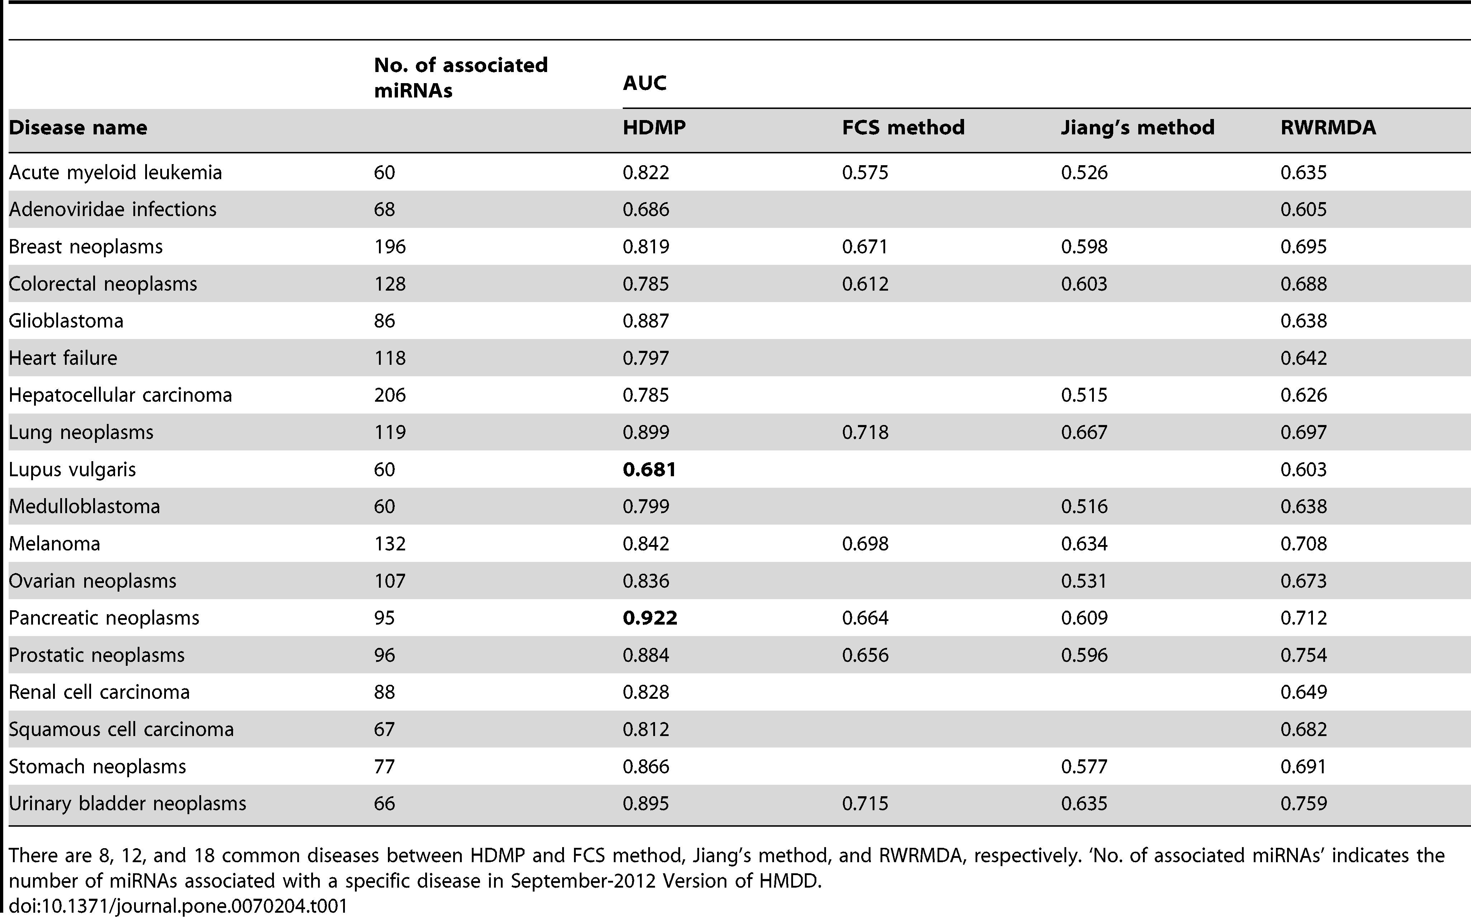
Results

