Slide 1
An OpenMP-based tool for finding longest common subsequence in bioinformatics
Rayhan Shikder, Parimala Thulasiraman,
Pourang Irani and Pingzhao Hu
BMC Research Notes 12, Article number: 220
Published: 11 April 2019
Presenter: Yuan-Hsiu Tsai
Date: Mar. 2, 2020
Notes:
BMC Research Notes
https://en.wikipedia.org/wiki/BioMed_Central
作者是 加拿大人

Slide 2
Abstract(1/3)
Objective:
Finding the longest common subsequence (LCS) among sequences is NP-hard. This is an important problem in bioinformatics for DNA sequence alignment and pattern discovery. In this research, we propose new CPU-based parallel implementations that can provide significant advantages in terms of execution times, monetary cost, and pervasiveness in finding LCS of DNA sequences in an environment where Graphics Processing Units are not available. For general purpose use, we also make the OpenMP-based tool publicly available to end users.

Slide 3
Abstract(2/3)
Result:
In this study, we develop three novel parallel versions of the LCS algorithm on:
distributed memory machine using message passing interface (MPI).
shared memory machine using OpenMP.
hybrid platform that utilizes both distributed and shared memory using MPI-OpenMP.
Notes:
2.MPI(Message Passing Interface)
https://zh.wikipedia.org/wiki/%E8%A8%8A%E6%81%AF%E5%82%B3%E9%81%9E%E4%BB%8B%E9%9D%A2
3.open multi-processing (OpenMP))
https://zh.wikipedia.org/wiki/OpenMP

Slide 4
Abstract(3/3)
The experimental results with both simulated and real DNA sequence data show that the shared memory OpenMP implementation provides at least two-times absolute speedup than the best sequential version of the algorithm and a relative speedup of almost 7. We provide a detailed comparison of the execution times among the implementations on different platforms with different versions of the algorithm. We also show that removing branch conditions negatively affects the performance of the CPU-based parallel algorithm on OpenMP platform.

Slide 5
Introduction
Longest Common Subsequence
S = ATTCGA
T = ATCTGA
=> LCS of (S,T)= ATTGA

Slide 6
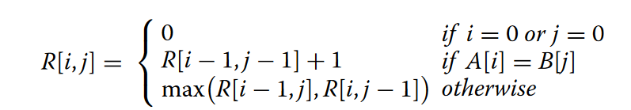
Introduction
S = ATTCGA
T = ATCTGA => length of LCS = 5
T \ S |  | A | T | T | C | G | A
 | 0 | 0 | 0 | 0 | 0 | 0 | 0
A | 0 | 1 | 1 | 1 | 1 | 1 | 1
T | 0 | 1 | 2 | 2 | 2 | 2 | 2
C | 0 | 1 | 2 | 2 | 3 | 3 | 3
T | 0 | 1 | 2 | 3 | 3 | 3 | 3
G | 0 | 1 | 2 | 3 | 3 | 4 | 4
A | 0 | 1 | 2 | 3 | 3 | 4 | 5

Slide 7
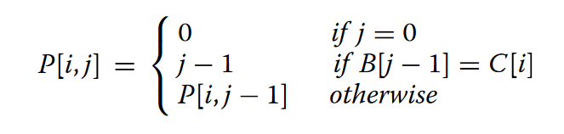
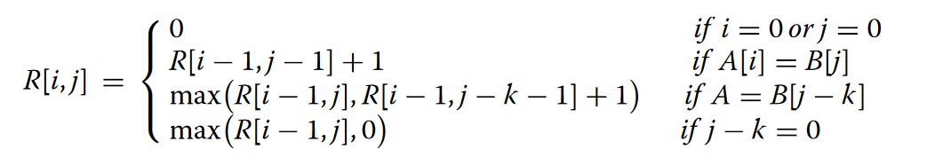
Algorithm—version 1

Slide 8
Algorithm—version 1
T=ATCTGA
 |  | A | T | C | T | G | A
 | 0 | 1 | 2 | 3 | 4 | 5 | 6
A | 0 | 0 | 1 | 1 | 1 | 1 | 1
T | 0 | 0 | 0 | 1 | 1 | 4 | 4
C | 0 | 0 | 0 | 0 | 3 | 3 | 3
G | 0 | 0 | 0 | 0 | 0 | 0 | 5

Slide 9
Algorithm—version 1
P |  | A | T | C | T | G | A
 | 0 | 1 | 2 | 3 | 4 | 5 | 6
A | 0 | 0 | 1 | 1 | 1 | 1 | 1
T | 0 | 0 | 0 | 1 | 1 | 4 | 4
C | 0 | 0 | 0 | 0 | 3 | 3 | 3
G | 0 | 0 | 0 | 0 | 0 | 0 | 5
T \ S |  | A | T | T | C | G | A
 | 0 | 0 | 0
A | 0 | 1 | 1
T | 0 | 1 | 2
C | 0 | 1 | ?(2)
T | 0 | 1
G | 0 | 1
A | 0 | 1

Slide 10
Algorithm—version 1
P |  | A | T | C | T | G | A
 | 0 | 1 | 2 | 3 | 4 | 5 | 6
A | 0 | 0 | 1 | 1 | 1 | 1 | 1
T | 0 | 0 | 0 | 1 | 1 | 4 | 4
C | 0 | 0 | 0 | 0 | 3 | 3 | 3
G | 0 | 0 | 0 | 0 | 0 | 0 | 5
T \ S |  | A | T | T | C | G | A
 | 0 | 0 | 0
A | 0 | 1 | 1
T | 0 | 1 | 2
C | 0 | 1 | ?(2)
T | 0 | 1 | 2
G | 0 | 1 | 2
A | 0 | 1 | 2

Slide 11
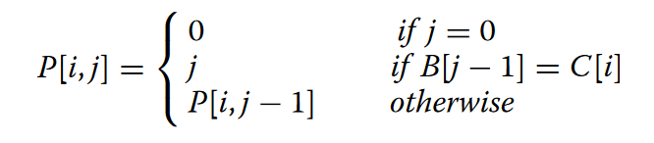
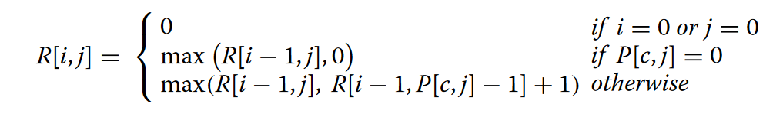
Algorithm---Version2

Slide 12
Algorithm—version 2
T=ATCTGA
P |  | A | T | C | T | G | A
 | 0 | 1 | 2 | 3 | 4 | 5 | 6
A | 0 | 1 | 1 | 1 | 1 | 1 | 6
T | 0 | 0 | 2 | 2 | 4 | 4 | 4
C | 0 | 0 | 0 | 3 | 3 | 3 | 3
G | 0 | 0 | 0 | 0 | 0 | 5 | 5

Slide 13
Algorithm---Version2
P |  | A | T | C | T | G | A
 | 0 | 1 | 2 | 3 | 4 | 5 | 6
A | 0 | 1 | 1 | 1 | 1 | 1 | 6
T | 0 | 0 | 2 | 2 | 4 | 4 | 4
C | 0 | 0 | 0 | 3 | 3 | 3 | 3
G | 0 | 0 | 0 | 0 | 0 | 5 | 5
T \ S |  | A | T | T | C | G | A
 | 0 | 0 | 0
A | 0 | 1 | 1
T | 0 | 1 | ?(2)
C | 0 | 1 | 2
T | 0 | 1 | 2
G | 0 | 1 | 2
A | 0 | 1 | 2

Slide 14
Algorithm---Version2
P |  | A | T | C | T | G | A
 | 0 | 1 | 2 | 3 | 4 | 5 | 6
A | 0 | 1 | 1 | 1 | 1 | 1 | 6
T | 0 | 0 | 2 | 2 | 4 | 4 | 4
C | 0 | 0 | 0 | 3 | 3 | 3 | 3
G | 0 | 0 | 0 | 0 | 0 | 5 | 5
T \ S |  | A | T | T | C | G | A
 | 0 | 0 | 0 | 0 | 0 | 0 | 0
A | 0 | 1 | 1 | 1 | 1 | 1 | 1
T | 0 | 1 | ?(2) | 2 | 2 | 2 | 2
C | 0 | 1 | 2 | 2 | 3 | 3 | 3
T | 0 | 1 | 2 | 3 | 3 | 3 | 3
G | 0 | 1 | 2 | 3 | 3 | 4 | 4
A | 0 | 1 | 2 | 3 | 3 | 4 | 5

Slide 15
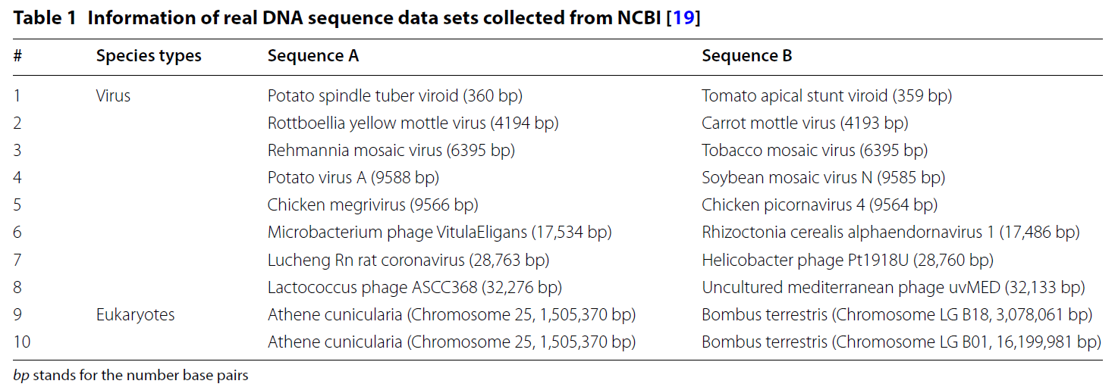
Experiments

Slide 16
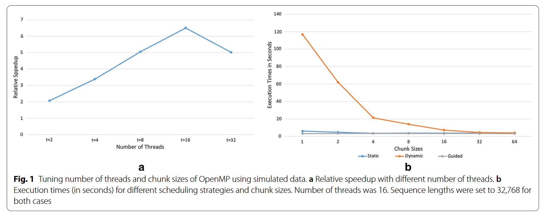
Experiments
Notes:
openMP程式平行化 參數解說
https://kheresy.wordpress.com/2006/09/15/%E7%B0%A1%E6%98%93%E7%9A%84%E7%A8%8B%E5%BC%8F%E5%B9%B3%E8%A1%8C%E5%8C%96%EF%BC%8Dopenmp%EF%BC%88%E5%9B%9B%EF%BC%89%E7%AF%84%E4%BE%8B-for/
static:指定chunk_size 來切成數個chunk ，將chunk指定給thread執行，若未指定chunk_size則平均分配給thread
dynamic:指定chunk_size 來切數個chunk，如果未指定chunk_size則預設為1，即切成總執行個數， thread執行完畢會自動去尋找未執行的chunk
guided:指定chunk_size，但 會以遞減的方式減至chunk_size，即 一開始分配很大，後來逐次減少，以逐步減輕thread執行的數量，若未指定chunk_size則預設為1

Slide 17
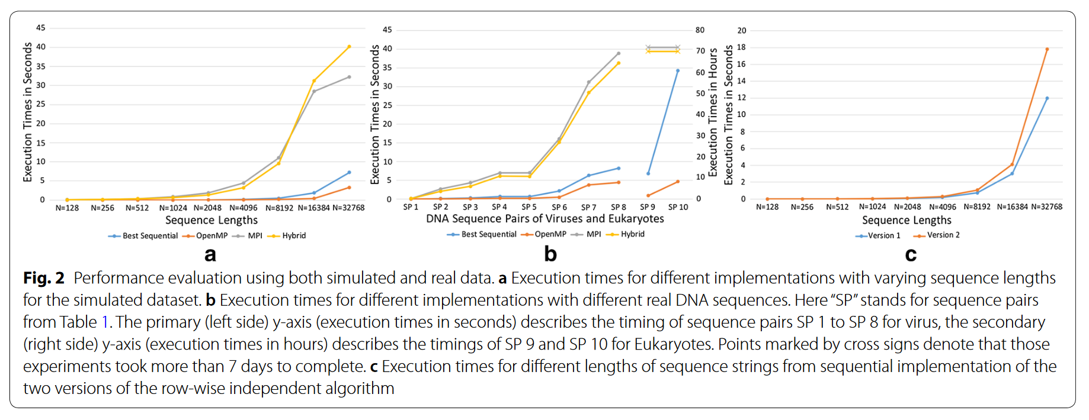
Experiments
Notes:
a.長度不同
b.真實的DNA序列---SP9跟10都是真核生物的鹼基對，MPI跟hybrid都超過1周
c.版本1跟2的差別---CPU在版本1較好，GPU在版本2較好
MPI效能差的原因，可能是在 communication 跟 synchronization 的開銷太大

