Slide 1
Pairwise Sequence Alignment Algorithms – A Survey
Waqar Haque, Alex Aravind, Bharath Reddy
ISTA '09: Information Science, Technology and Applications Kuwait, Kuwait, March, 2009, Pages 96–103
Presenter: Yuan-Hsiu Tsai
Date: Oct. 27, 2020
Notes:
ISTA: Information Science, Technology and Applications -- https://dl.acm.org/conference/ista
Kuwait Kuwait 科威特 的 科威特城

Slide 2
Abstract(1/2)
Pairwise sequence alignment is a fundamental compute-intensive problem in bioinformatics that has helped researchers analyse biological sequences. The analysis has helped biologists detect pathogens, develop drugs, and identify common genes. The biological sequence database has been growing rapidly due to new sequences being discovered. This has brought many new challenges including sequence database searching and aligning long sequences.

Slide 3
Abstract(2/2)
To solve these problems, many sequence alignment algorithms have been developed. These algorithms employ various techniques to efficiently find optimal or nearly-optimal alignments. In this paper, we present the popular past and recent work on both local and global pairwise sequence alignment algorithms. In addition to identifying the techniques used, the advantages and limitations of the algorithms are also presented.

Slide 4
Introduction
DNA = {A,T,C,G}
RNA = {A,U,C,G}
Protein = {A,R,N,D,C,Q,E,G,H,I,L,K,M,F,P,S,T,W,Y,V,B,Z,X}

Slide 5
Introduction – DP formula
where Score is score matrix, g is gap penalty.

Slide 6
Introduction - Algorithm
Divide in two type
Optimal alignment algorithm
Needleman-Wunsch algorithm
Smith-Waterman algorithm
Heuristic alignment algorithm
FASTA
BLAST / BLAT / BLASTZ
PatternHunter
MASAA
MUMmer
GLASS
AVID
LAGAN

Slide 7
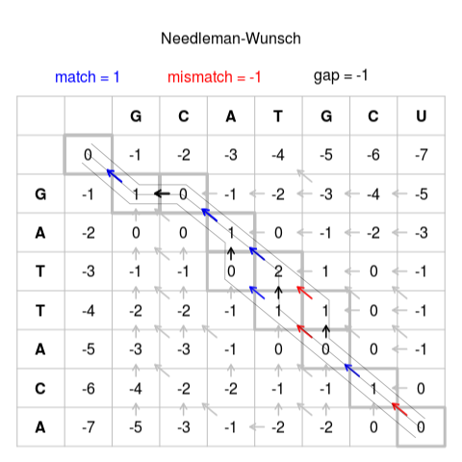
Introduction – Optimal algorithm

Slide 8
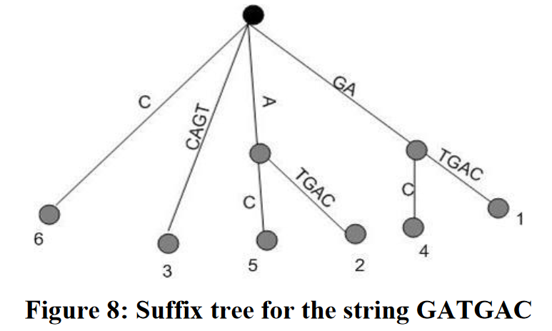
Introduction – Heuristic algorithm
Usually use tool
Look-up table 1234567 S1= ATATCGG => A:1,3; T:2,4; C:5; G:6,7
Suffix tree

Slide 9
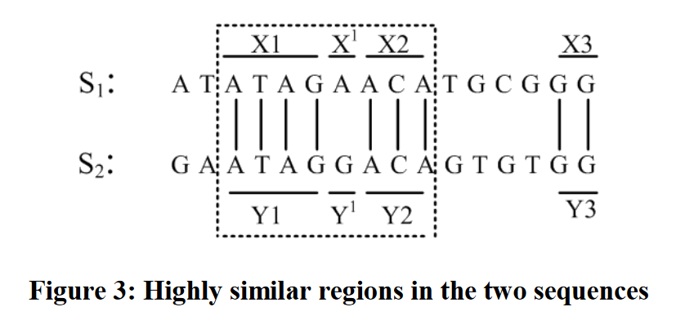
Introduction – Heuristic algorithm
There are three basic steps
Index ex: look-up table
Identify seeds ex:
Final compute / alignment ex: compute remain sequence score

Slide 10
Local alignment
FASTA
BLAST / BLAT / BLASTZ
PatternHunter
MASAA

Slide 11
FASTA
Index by look-up table
Identify perfect match seeds of length “k”
Use “diagonal” method to find all seeds.
Save best 10 seeds.
Find “init1” (best score without gap) and cut seed since it lower than threshold
Combine seeds and find “initn”(best combine without gap)
Compute score(use SW)with region which extend “initn” of k length

Slide 12
FASTA - disadvantage
If sequences have homology , just find first region
If the length of seed is less than “k”, it could be missed.

Slide 13
BLAST
Index by look-up table
Identify perfect match seeds of length “k” (protein : 3, genome : 11 )
Use threshold “t” to filter seeds (neighbourhood)
Extend all seeds both direction without gap until score less than “t”. Then, the remain seeds call “high scoring pair(HSP)”
Compute score(use SW) with all “HSP”

Slide 14
BLAST - disadvantage
If the length of seed is less than “k”, it could be missed.
It finds too many seeds, thus it reduces speed and does not allow gap in sequence

Slide 15
BLAT (like FASTA + BLAST)
Index by look-up table
Identify perfect match seeds of length “k”
Find seeds which are not overlapping
If multiple seeds are in distance “d”, they can be extended to form a single seed
The remaining seeds are called “HSP”
Compute score(use SW) with all “HSP”

Slide 16
BLAT - disadvantage
If the length of seed is less than “k”, it could be missed.

Slide 17
BLASTZ (faster than BLAST)
Index by look-up table
Remove all repeats
Identify match seeds of length “k” at most one transition
Extend all seeds both direction without gap until score less than “X”.
If multiple seed are in distance “d”, they extend to form a single seed
The remain seed call “HSP”
Compute score(use SW) with all “HSP”

Slide 18
BLASTZ - disadvantage
If the length of seed is less than “k”, it could be missed.
It finds too many seeds, thus spend most time to calculating HSP.

Slide 19
PatternHunter (like BLAST & BLAT)
Structure to increase speed
Priority queue, variation of red-black tree, hash table
Indexing by look-up table
Identity match seeds of length “k” at most one transition and save in “hit table”
Extend all seeds both direction without gap until score less than threshold “t”. (HSP)
Sort HSP by red-black tree
Connect “HSP” to find best score

Slide 20
PatternHunter - disadvantage
Because it can increase sensitivity, but speed is not better than BLAST

Slide 21
MASAA
Create suffix tree
Find long common substrings to get perfect match seeds
Since substrings are all non-overlapping
Between two earlier long substring, find smaller seeds.
Extend two substring if within a distance “d”

Slide 22
MASAA - advantage
When sequence is divergent, it outperform than BLASTZ.

Slide 23
Global alignment
MUMmer
GLASS
AVID
LAGAN

Slide 24
MUMmer
Use suffix tree , LIS and SW alignment
Five stages
(1,2)Identify “SNP”(both sequence with only one difference)
(3)Identity large segments which appear only in one genome
(4,5)Identity repeats (repeats more than another)
Create Suffix tree to get at least half of length of the longest maximal unique match(MUM)
Sort match by LIS
Use SW alignment between MUMs to get short MUMs
Use NW alignment connect MUMs

Slide 25
MUMmer - disadvantage
If MUMs are few, algorithm perform poorly.
If MUM are spread wide apart, the inter MUM would have to be aligned with SW, thus increasing the computation time.

Slide 26
GLASS
Find all common k-mers in both sequence
conver each matching k-mers to a unique character (jpg)
Compute all k-mers score by SDP to select combination.
(it will remove all overlapping and crossing seeds)
Between k-mers matchs, use smaller k-mers to get short match
Extend all match by SDP
Use SDP to align remain unalign region.

Slide 27
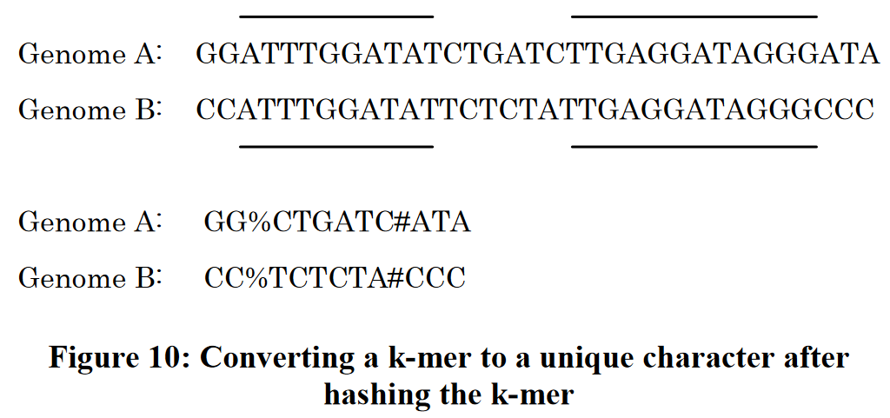

Slide 28
GLASS - disadvantage
It slower than MUMmer, but it sensitive than MUMmer

Slide 29
AVID
Find all maximal repeat substrings
Sort the matchs to non-criss-crossing and non-overlaping
Compute the score (SW) of matchs with small extend while score above a threshold “t” to extend the matchs length
Use NW to align remain region

Slide 30
AVID - disadvantage
It is not sensitive when aligning distantly related sequences.

Slide 31
LAGAN
Using multiple short inexact to instead of the longer exact words to find seeds
Combination seeds if they distance “d”
Use sparse dynamic programming to construct best alignment
Use NW algorithm to get final alignment

Slide 32
LAGAN - disadvantage
It spends most of time in chaining local alignments.
Not faster than MUMmer and BLASTZ
When detecting trans-position , its sensitive is not good because it not consider overlapping seeds.

