Slide 1
Pairwise Sequence Alignment Method Using Flower Pollination Algorithm
Kaur Yadvir, and Neelofar Sohi
4th International Conference on Signal Processing, Computing and Control (ISPCC). IEEE, 2017, pp. 408-413.
Presenter : Tz-Hsu Lee
Date : Oct. 27, 2020.
Notes:
journal

Slide 2
Abstract(1/2)
Biomolecular sequence alignment is an important research area in bioinformatics. Based on Flower Pollination Algorithm (FPA), we have proposed a new sequence alignment algorithm, named Pairwise Sequence Alignment with Flower Pollination Algorithm (PSAFPA). PSAFPA helps in finding the optimal or near-optimal solution to sequence alignment problem. PSAFPA first finds the current best solution with the help of FPA and then divides this solution into various segments of nonmatching regions to find the better results. These segments are rearranged using FPA and finally the best identity value of each segment is added into the current best solution to get the final alignment identity value. Such segmentation helped to get better results.
Notes:
the least number of tuning parameters, low computational complexity, fast convergence, and high local optima avoidance

Slide 3
Abstract(2/2)
We have also done comparison of PSAFPA with the well-known methods using various DNA sequence pairs, which resulted in to better performance of PSAFPA for a majority of sequence pairs.
Notes:
the least number of tuning parameters, low computational complexity, fast convergence, and high local optima avoidance

Slide 4
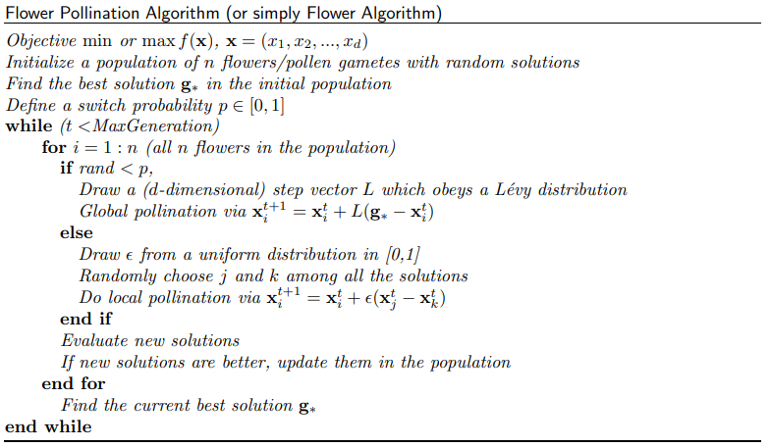

Flower Pollination Algorithm (FPA)(1/2)

Slide 5
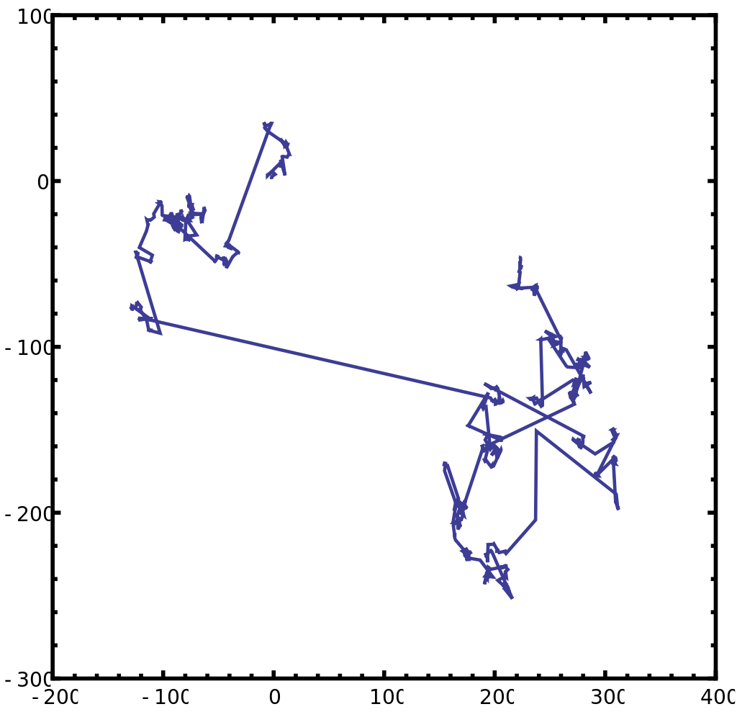
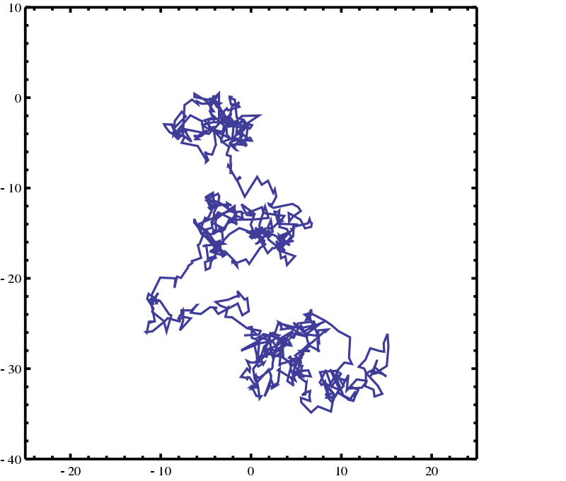
Flower Pollination Algorithm (FPA)(2/2)
Lévy flight in two dimensions
step size is distributed according to a Lévy
Brownian motion in two dimensions
step size is distributed according to a normal distribution

Slide 6
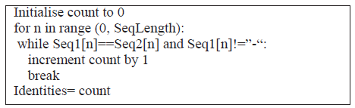
Pairwise Sequence Alignment with Flower Pollination Algorithm(PSAFPA)(1/5)
Input two sequences :
ex :
S1 : ACCAAGAAGTCAA
S2 : TACTACTGTGCCTGTGACCT
Initialize population size and objective function :
objective function :

Slide 7
Pairwise Sequence Alignment with Flower Pollination Algorithm(PSAFPA)(2/5)
3. Generate initial population randomly :
Pair 1 :
S1 : -A-C-CA-AGAAGT-CAA--
S2 : TACTACTGTGCCTGTGACCT
Pair 2 :
S1 : -A-C----CA-AGAAGTCAA
S2 : TACTACTGTGCCTGTGACCT
Pair 3 :
S1 : -A-CC--A-AG-AAG-TCAA
S2 : TACTACTGTGCCTGTGACCT
4. Find the current best solution by objective function :
obj(P1) = 4, obj(P2) = 3, obj(P3) = 2
Pair 1 is the best.

Slide 8
Pairwise Sequence Alignment with Flower Pollination Algorithm(PSAFPA)(3/5)
5. Apply FPA on both the sequences of the best solution and generate new one :
Pair 1 :
S1 : -A-C-CA-AGAAGT-CAA---
S2 : TA-CTACTGTGCCTGTGACCT
Pair 2 :
S1 : -A-C-CA-A-GAAGT-CAA--
S2 : TACTACTGTGCCTGT-GACCT
Pair 3 :
S1 : -A--C-CA-AGAAGT-CAA--
S2 : TACT-ACTGTGCCTGTGACCT
6. Find the new current best solution by objective function :
Pair 1 is the best.
7. Take the new current best solution and decompose it into segments of non- matching regions :

Slide 9
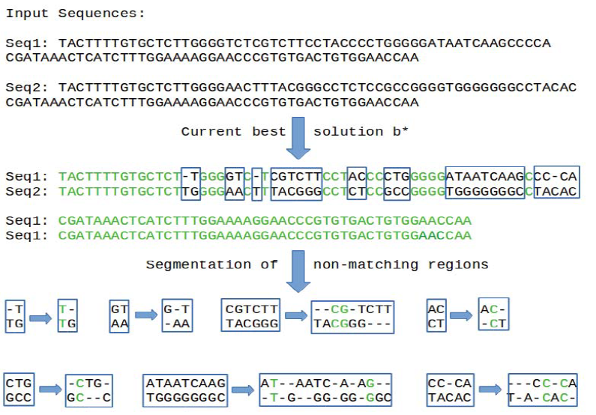
Pairwise Sequence Alignment with Flower Pollination Algorithm(PSAFPA)(4/5)

Slide 10
Pairwise Sequence Alignment with Flower Pollination Algorithm(PSAFPA)(5/5)
Summation of the best solution of each segment to the current best solution, and get the final best solution.
Loop step 5 ~ step 8.

Slide 11
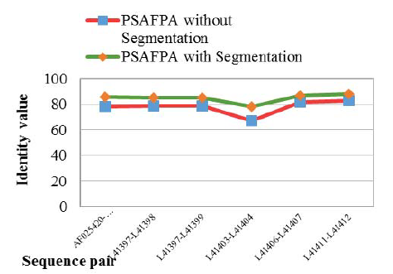
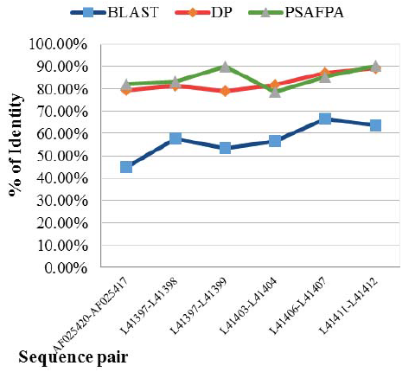
Results (1/2)
Notes:
population to 50 The maximumnumbers of iterations are also e1000 for IMO.qual to 10,000 1000 for IMO.

Slide 12
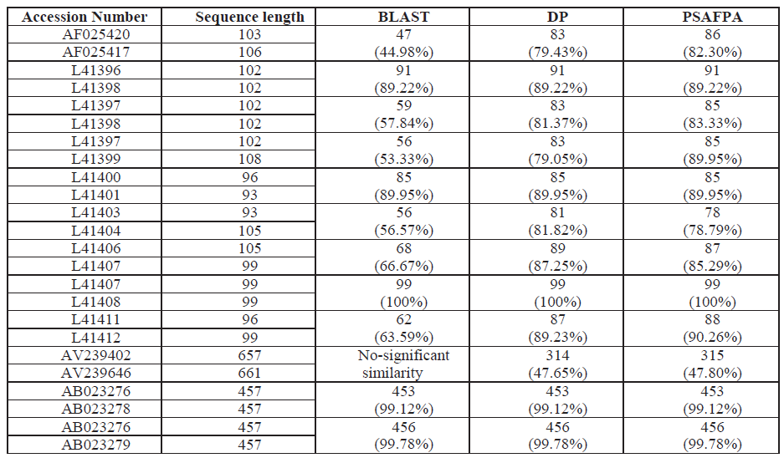
Results (2/2)
Notes:
population to 50 The maximum numbers of iterations are also equal to 10,000 1000 for IMO.

