Slide 1
A linear-time algorithm for the longest path problem in rectangular grid graphs
Fatemeh Keshavarz-Kohjerdi, Alireza Bagheri , Asgharian-Sardroud
Discrete Applied Mathematics 160
(2012) 210-217
Presenter: En-An Song
Date: Oct 27, 2020

Slide 2
Abstract
The longest path problem is a well-known NP-hard problem and so far it has been solved polynomially only for a few classes of graphs . In this paper , we give a linear-time algorithm for finding a longest path between any two given vertices in a rectangular grid graph .

Slide 3
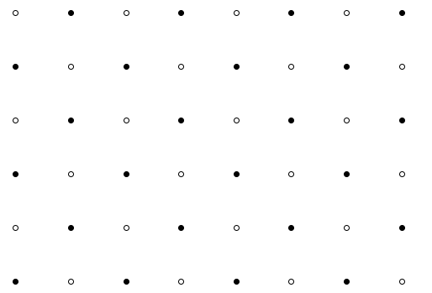
R(m,n,s,t)
m ≥ n
t_{x} ≥ s_{x}
s
t
R(8,6,s,t)

Slide 4
The longest path problem in grid graph
s
t
R(8,6,s,t)
Find the longest path from vertex s to vertex t

Slide 5
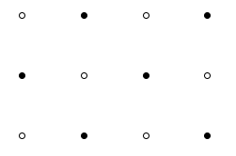
Hamiltonian path
Go from the specified starting point to the specified end point, passing all other nodes on the way and passing only once .
s
t

Slide 6
Color-Compatibility
考量vertex的數量以及s跟t的顏色，檢驗是否可能全部都走完。
Case 1 : vertex的數量是偶數, s跟t是不同顏色
s → t : WBWBWBWB….B (|W|=|B| ，可能全部走完，路徑最大值=m*n)
Case 2 : vertex的數量是偶數, s跟t是相同顏色
s → t : WBWBWBWB….W (|W|=|B|+1， 不可能全部走完，路徑最大值=m*n-1)
Case 3 : vertex的數量是奇數, s是白色,t是黑色
s → t : WBWBWBWB….B (|W|=|B| ，不可能全部走完，路徑最大值=m*n-1)
Case 4 : vertex的數量是奇數, s跟t都是白色
s → t : WBWBWBWB….W (|W|=|B|+1，可能全部走完，路徑最大值=m*n)
Case 5 : vertex的數量是奇數, s跟t都是黑色
s → t : BWBWBWB….B (|B|=|W|+1，不可能全部走完，路徑最大值=m*n-2)

Slide 7




Color-Compatibility but not Hamiltonian path
Case1 : R(m,n) is a 1-rectangle and either s or t is not a corner vertex.
Case2 : R(m, n) is a 2-rectangle and s_{x} = t_{x}
Case3 : R(m,n) is a 3-rectangle grid graph. And
1. m is even
2. s is black , t is white
3. s_{y} =2 and s_{x} < t_{x} or s_{y} ≠ 2 and s_{x}< t_{x}-1

Slide 8
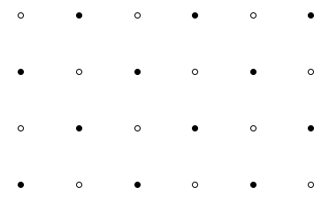
Strip (Simplify the problem)
R(m,n) has a Hamiltonian cycle if and only if it is even-sized and m,n>1
t
t
s
s
R(6,4,s,t)
Hamiltonian cycle
R(4,4,s,t)

Slide 9
Strip (Simplify the problem)
t
t
s
s
Hamiltonian cycle
R(4,4,s,t)
Hamiltonian cycle
R(4,4,s,t)

Slide 10
Split (Simplify the problem)
s₁
t
s₁
t
s
Color-Compatibility
R(6,4,s,t)
R(4,4,s1,t) + 8

Slide 11
Simplify the problem
s
t
Hamiltonian cycle

Slide 12
Simplify the problem
Hamiltonian cycle
s
t
Hamiltonian cycle

Slide 13
Simplify the problem
Hamiltonian cycle
s
s₁
t
Hamiltonian cycle

Slide 14
Simplify the problem
Hamiltonian cycle
s
s₁
t
s₂
Hamiltonian cycle

Slide 15
Simplify the problem
Hamiltonian cycle
s
s₁
t
s₂
Hamiltonian cycle

Slide 16
Simplify the problem
Hamiltonian cycle
Hamiltonian cycle
s
s
s₁
s₁
t
t
s₂
Hamiltonian cycle
s₂
Hamiltonian cycle

Slide 17
Simplify the problem
Hamiltonian cycle
Hamiltonian cycle
s
s
s₁
s₁
t
t
s₂
Hamiltonian cycle
s₂
Hamiltonian cycle

Slide 18
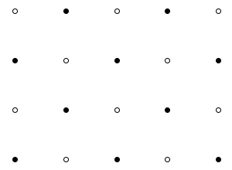
Exception of stripping
(m,n)∈{(5,4),(4,4)} , s and t are different color . (Color-Compatibility)
s
s
t
t
Wrong answer

Slide 19
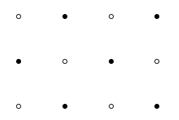
Exception of stripping
s
s
t
t
Color-Compatibility but not Hamiltonian path (Case 3)

Slide 20
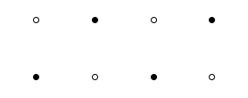
Exception of stripping
t
s
t
s
Color-Compatibility but not Hamiltonian path (Case 2)

Slide 21
Conclusion
We presented a linear-time algorithm for finding a longest path in a rectangular grid graph between any two given vertices. Since the longest path problem is NP-hard in general grid graphs , it remains open whether the problem is polynomially solvable in solid grid graphs.

