Slide 1
A High Performance, Low Complexity Algorithm for Compile-Time Task Scheduling in Heterogeneous Systems
Tarek Hagras and Jan Janecek
18th International Parallel and Distributed Processing Symposium, 2004. Santa Fe, NM, USA, 2004, pp. 107-115
Presenter : Chih-Kai Wu
Date: Dec.1, 2020.

Slide 2
Abstract(1/2)
The heterogeneous computing environment is an interesting computing platform due to the fact that a single parallel architecture may not be adequate for exploiting all of a program’s available parallelism. In some cases, heterogeneous systems have been shown to produce higher performance for lower cost than a single large machine. Task scheduling
is the key issue when aiming at high performance in this kind of environment.

Slide 3
Abstract(2/2)
A large number of scheduling heuristics have been presented in the literature, most of them target only homogeneous computing systems. In this paper we present a simple scheduling algorithm based on list-scheduling and task-duplication on a bounded number of heterogeneous machines called Heterogeneous Critical Parents with Fast Duplicator (HCPFD). The analysis and experiments have shown that HCPFD outperforms on average all other higher complexity algorithms.

Slide 4
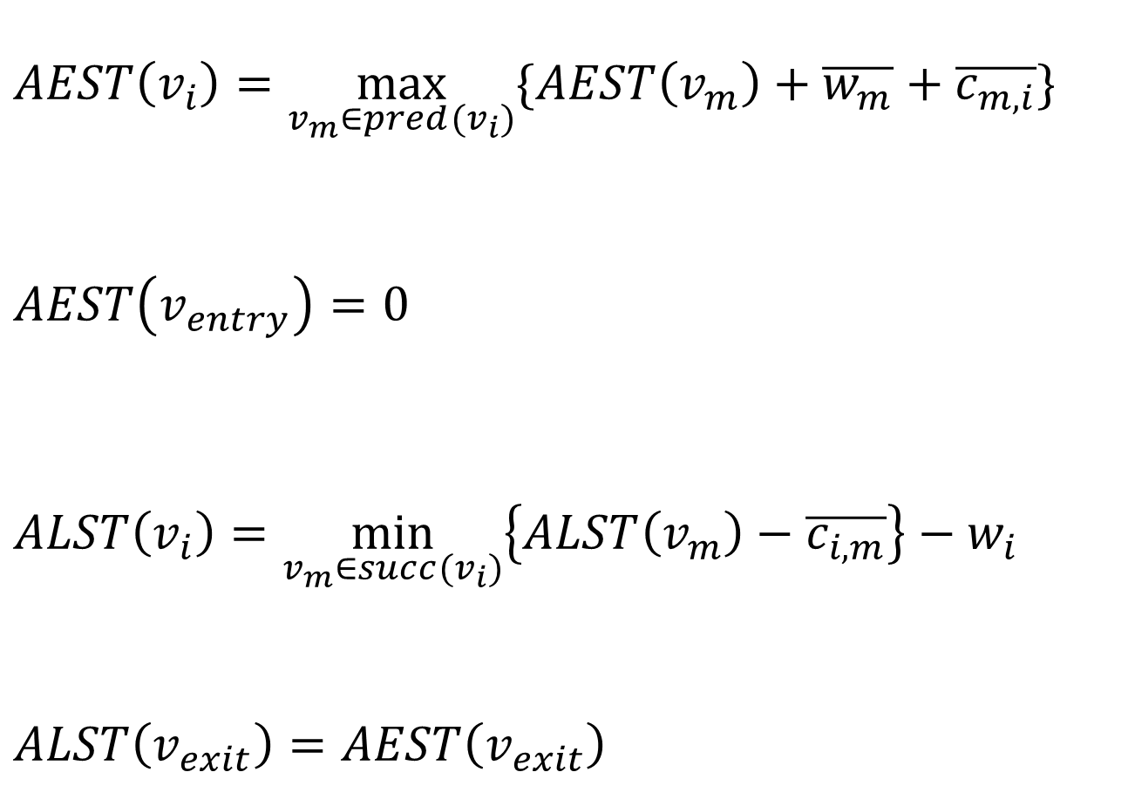
$$AEST\left(v_{i}\right)=\max_{v_{m}∈pred(v_{i})}{\{AEST\left(v_{m}\right)+\overline{w_{m}}+\overline{c_{m,i}}\}}$$
$$AEST\left(v_{entry}\right)=0$$
$$ALST\left(v_{i}\right)=\min_{v_{m}∈succ(v_{i})}\left\{ALST\left(v_{m}\right)−\overline{c_{i,m}}\right\}−w_{i}$$
$$ALST\left(v_{exit}\right)=AEST\left(v_{exit}\right)$$

Slide 5
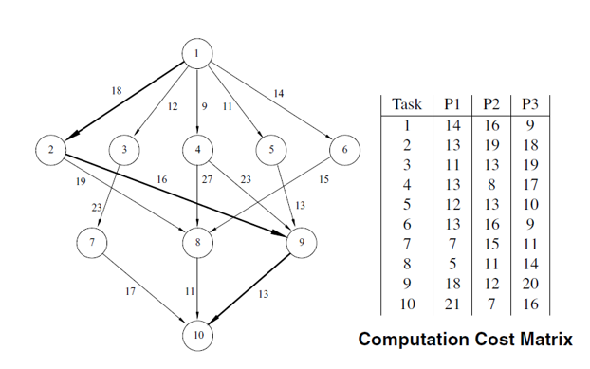
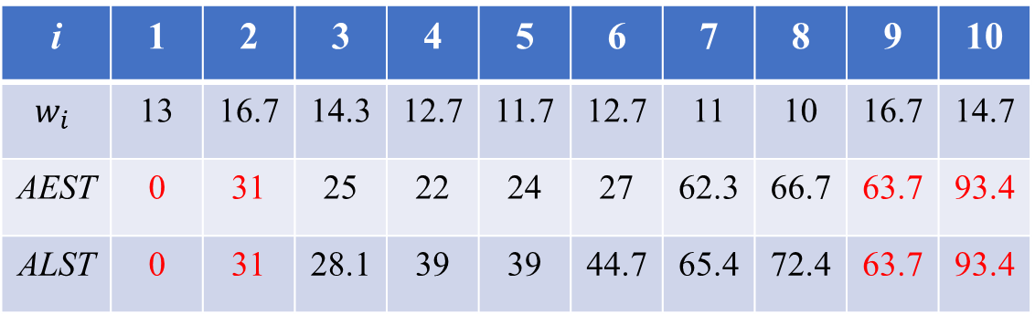
i | 1 | 2 | 3 | 4 | 5 | 6 | 7 | 8 | 9 | 10
$$w_{i}$$ | 13 | 16.7 | 14.3 | 12.7 | 11.7 | 12.7 | 11 | 10 | 16.7 | 14.7
AEST | 0 | 31 | 25 | 22 | 24 | 27 | 62.3 | 66.7 | 63.7 | 93.4
ALST | 0 | 31 | 28.1 | 39 | 39 | 44.7 | 65.4 | 72.4 | 63.7 | 93.4

Slide 6
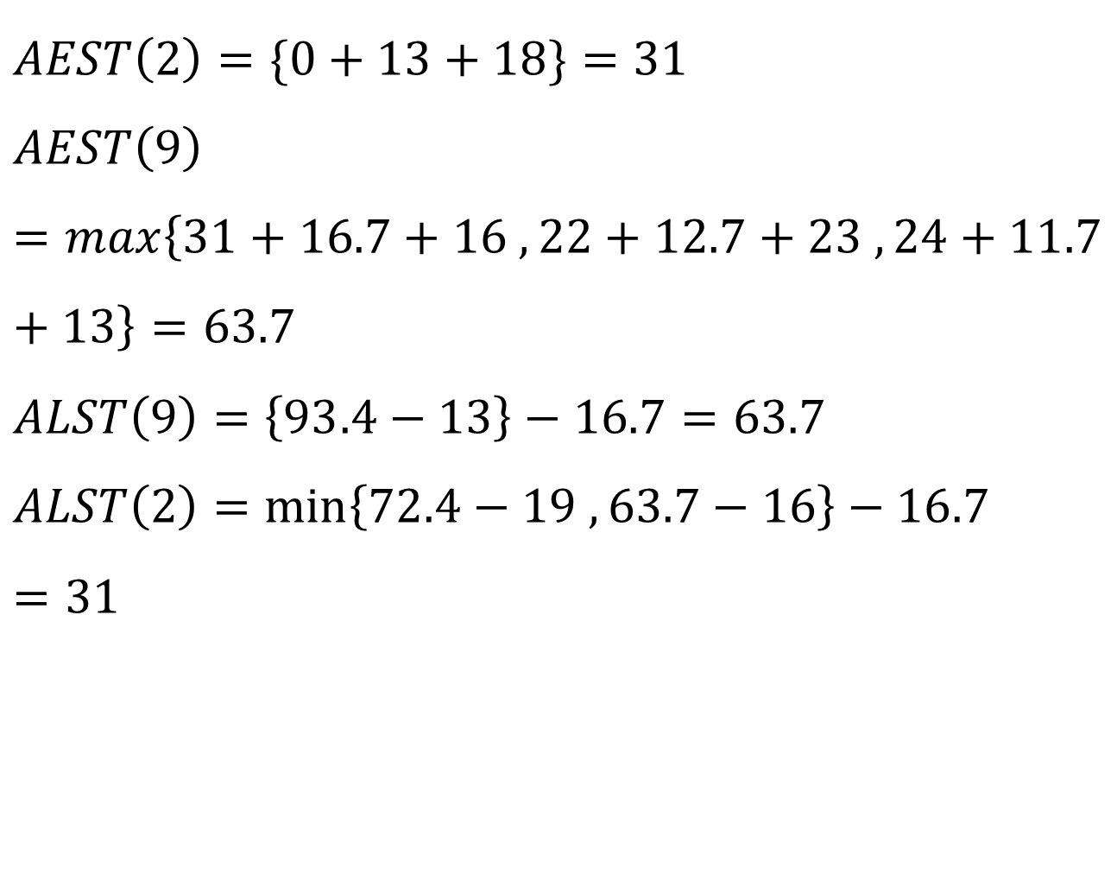
$$AEST\left(2\right)=\{0+13+18\}=31$$
$$AEST\left(9\right)=max\left\{31+16.7+16 , 22+12.7+23 , 24+11.7+13\right\}=63.7$$
$$ALST\left(9\right)=\left\{93.4−13\right\}−16.7=63.7$$
$$ALST\left(2\right)=min\left\{72.4−19 , 63.7−16\right\}−16.7=31$$

Slide 7
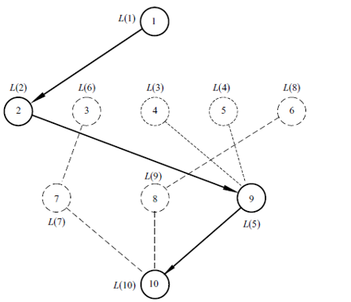
i | 1 | 2 | 3 | 4 | 5 | 6 | 7 | 8 | 9 | 10
$$w_{i}$$ | 13 | 16.7 | 14.3 | 12.7 | 11.7 | 12.7 | 11 | 10 | 16.7 | 14.7
AEST | 0 | 31 | 25 | 22 | 24 | 27 | 62.3 | 66.7 | 63.7 | 93.4
ALST | 0 | 31 | 28.1 | 39 | 39 | 44.7 | 65.4 | 72.4 | 63.7 | 93.4

Slide 8
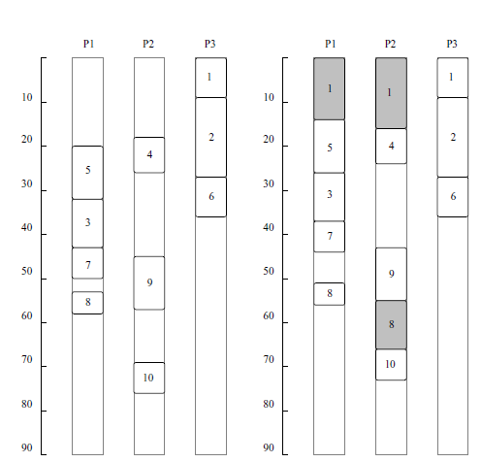
若沒有多做一次8的情況 :
56+11+7=74
本篇提出的方法 :
55+11+7=73

Slide 9
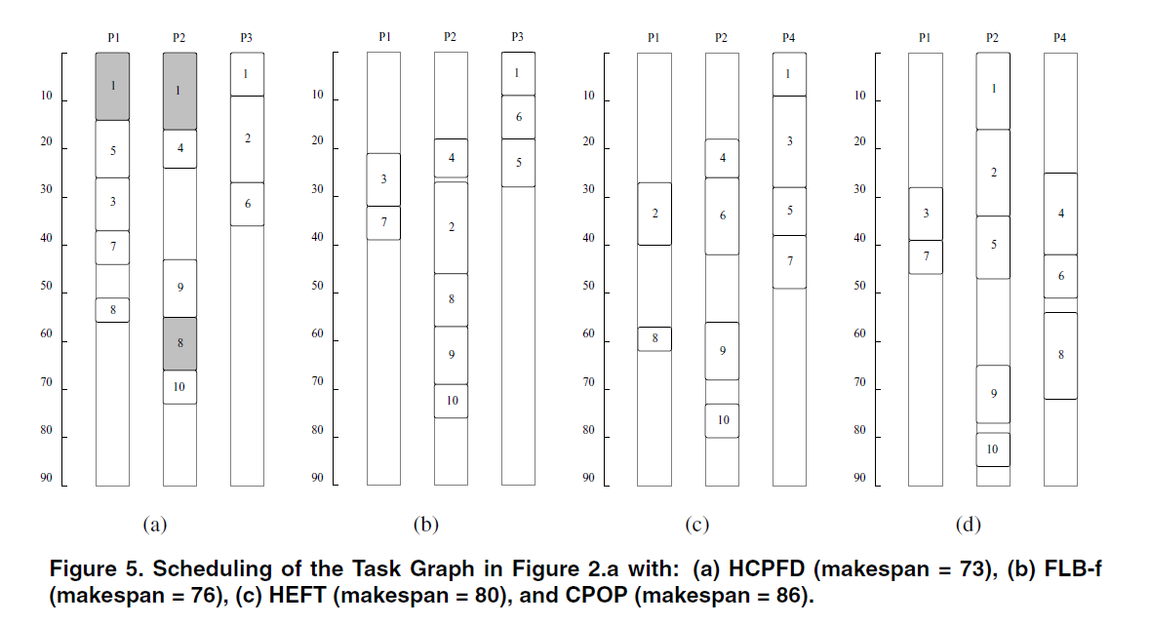
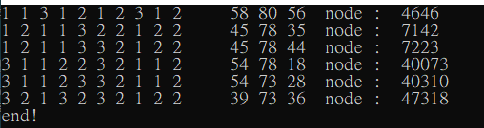

Slide 10
