Slide 1
An Efficient Algorithm for LCS Problem between Two Arbitrary Sequences
Yubo Li
Mathematical Problems in Engineering, 2018.
Presenter: Shao-Xuan Lee
Date: Dec. 16, 2020

Slide 2
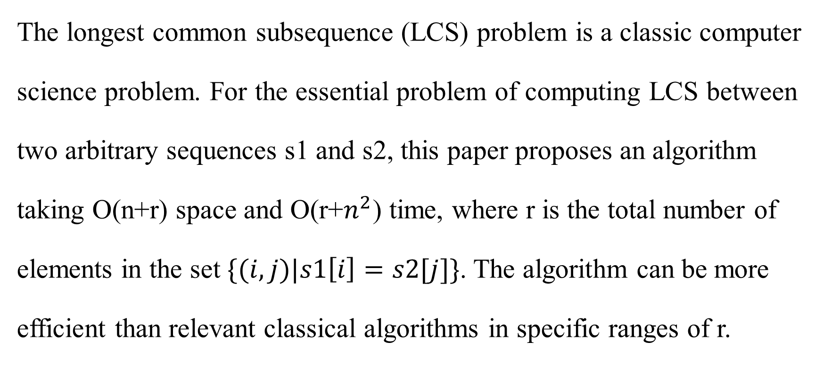
Abstract
The longest common subsequence (LCS) problem is a classic computer
science problem. For the essential problem of computing LCS between
two arbitrary sequences s1 and s2, this paper proposes an algorithm
taking O(n+r) space and O(r+$n^{2}$) time, where r is the total number of
elements in the set $\{(i,j)|s1\left[i\right]=s2[j]\}$. The algorithm can be more
efficient than relevant classical algorithms in specific ranges of r.

Slide 3
Longest Common Subsequence
A = x n f a f a
B = y f a n f a
LCS(A,B) = f a f a

Slide 4
A
B
0 | 1 | 2 | 3 | 4 | 5
x | n | f | a | f | a
0 | 1 | 2 | 3 | 4 | 5
y | f | a | n | f | a
n | f |  | a |  | f |  | a
0 | 1 | 2 | 3 | 4 | 5 | 6 | 7 | 8
(1, 3) | (2, 4) | (2, 1) | (3, 5) | (3, 2) | (4, 4) | (4, 1) | (5, 5) | (5, 2)
L

Slide 5
s2′
L[0] = (1, 3)
s2′
n | f |  | a |  | f |  | a
0 | 1 | 2 | 3 | 4 | 5 | 6 | 7 | 8
(1, 3) | (2, 4) | (2, 1) | (3, 5) | (3, 2) | (4, 4) | (4, 1) | (5, 5) | (5, 2)
L
 | y | f | a | n | f | a
0 | 1 | 2 | 3 | 4 | 5 | 6
(0, -) | (0, -) | (0, -) | (0, -) | (0, -) | (0, -) | (0, -)
 | y | f | a | n | f | a
0 | 1 | 2 | 3 | 4 | 5 | 6
(0, -) | (0, -) | (0, -) | (0, -) | (1, 0) | (1, 0) | (1, 0)
0 | 1 | 2 | 3 | 4 | 5 | 6 | 7 | 8
-
pre
1
0
end

Slide 6
n | f |  | a |  | f |  | a
0 | 1 | 2 | 3 | 4 | 5 | 6 | 7 | 8
(1, 3) | (2, 4) | (2, 1) | (3, 5) | (3, 2) | (4, 4) | (4, 1) | (5, 5) | (5, 2)
L
 | y | f | a | n | f | a
0 | 1 | 2 | 3 | 4 | 5 | 6
(0, -) | (0, -) | (0, -) | (0, -) | (1, 0) | (1, 0) | (1, 0)
L[0] = (1, 3)
 | y | f | a | n | f | a
0 | 1 | 2 | 3 | 4 | 5 | 6
(0, -) | (0, -) | (0, -) | (0, -) | (1, 0) | (2, 1) | (2, 1)
L[1] = (2, 4)
0 | 1 | 2 | 3 | 4 | 5 | 6 | 7 | 8
- | 0
pre
1 | 2
0 | 1
end

Slide 7
n | f |  | a |  | f |  | a
0 | 1 | 2 | 3 | 4 | 5 | 6 | 7 | 8
(1, 3) | (2, 4) | (2, 1) | (3, 5) | (3, 2) | (4, 4) | (4, 1) | (5, 5) | (5, 2)
L
L[1] = (2, 4)
L[2] = (2, 1)
 | y | f | a | n | f | a
0 | 1 | 2 | 3 | 4 | 5 | 6
(0, -) | (0, -) | (0, -) | (0, -) | (1, 0) | (2, 1) | (2, 1)
 | y | f | a | n | f | a
0 | 1 | 2 | 3 | 4 | 5 | 6
(0, -) | (0, -) | (1, 2) | (1, 2) | (1, 0) | (2, 1) | (2, 1)
pre
0 | 1 | 2 | 3 | 4 | 5 | 6 | 7 | 8
- | 0 | -
end
1 | 2
0, 2 | 1

Slide 8
n | f |  | a |  | f |  | a
0 | 1 | 2 | 3 | 4 | 5 | 6 | 7 | 8
(1, 3) | (2, 4) | (2, 1) | (3, 5) | (3, 2) | (4, 4) | (4, 1) | (5, 5) | (5, 2)
L
L[2] = (2, 1)
L[3] = (3, 5)
 | y | f | a | n | f | a
0 | 1 | 2 | 3 | 4 | 5 | 6
(0, -) | (0, -) | (1, 2) | (1, 2) | (1, 0) | (2, 1) | (2, 1)
 | y | f | a | n | f | a
0 | 1 | 2 | 3 | 4 | 5 | 6
(0, -) | (0, -) | (1, 2) | (1, 2) | (1, 0) | (2, 1) | (3, 3)
pre
 | 1 | 2 | 3 | 4 | 5 | 6 | 7 | 8
- | 0 | - | 1
1 | 2 | 3
0, 2 | 1 | 3
end

Slide 9
n | f |  | a |  | f |  | a
0 | 1 | 2 | 3 | 4 | 5 | 6 | 7 | 8
(1, 3) | (2, 4) | (2, 1) | (3, 5) | (3, 2) | (4, 4) | (4, 1) | (5, 5) | (5, 2)
L
L[3] = (3, 5)
L[4] = (3, 2)
 | y | f | a | n | f | a
0 | 1 | 2 | 3 | 4 | 5 | 6
(0, -) | (0, -) | (1, 2) | (1, 2) | (1, 0) | (2, 1) | (3, 3)
 | y | f | a | n | f | a
0 | 1 | 2 | 3 | 4 | 5 | 6
(0, -) | (0, -) | (1, 2) | (2, 4) | (2, 4) | (2, 1) | (3, 3)
pre
 | 1 | 2 | 3 | 4 | 5 | 6 | 7 | 8
- | 0 | - | 1 | 2
1 | 2 | 3
0, 2 | 1, 4 | 3
end

Slide 10
n | f |  | a |  | f |  | a
0 | 1 | 2 | 3 | 4 | 5 | 6 | 7 | 8
(1, 3) | (2, 4) | (2, 1) | (3, 5) | (3, 2) | (4, 4) | (4, 1) | (5, 5) | (5, 2)
L
L[4] = (3, 2)
L[5] = (4, 4)
 | y | f | a | n | f | a
0 | 1 | 2 | 3 | 4 | 5 | 6
(0, -) | (0, -) | (1, 2) | (2, 4) | (2, 4) | (2, 1) | (3, 3)
 | y | f | a | n | f | a
0 | 1 | 2 | 3 | 4 | 5 | 6
(0, -) | (0, -) | (1, 2) | (2, 4) | (2, 4) | (3, 5) | (3, 3)
pre
0 | 1 | 2 | 3 | 4 | 5 | 6 | 7 | 8
- | 0 | - | 1 | 2 | 4
1 | 2 | 3
0, 2 | 1, 4 | 3, 5
end

Slide 11
n | f |  | a |  | f |  | a
0 | 1 | 2 | 3 | 4 | 5 | 6 | 7 | 8
(1, 3) | (2, 4) | (2, 1) | (3, 5) | (3, 2) | (4, 4) | (4, 1) | (5, 5) | (5, 2)
L
L[5] = (4, 4)
L[6] = (4, 1)
 | y | f | a | n | f | a
0 | 1 | 2 | 3 | 4 | 5 | 6
(0, -) | (0, -) | (1, 2) | (2, 4) | (2, 4) | (3, 5) | (3, 3)
 | y | f | a | n | f | a
0 | 1 | 2 | 3 | 4 | 5 | 6
(0, -) | (0, -) | (1, 6) | (2, 4) | (2, 4) | (3, 5) | (3, 3)
pre
0 | 1 | 2 | 3 | 4 | 5 | 6 | 7 | 8
- | 0 | - | 1 | 2 | 4 | -
1 | 2 | 3
0, 2, 6 | 1, 4 | 3, 5
end

Slide 12
n | f |  | a |  | f |  | a
0 | 1 | 2 | 3 | 4 | 5 | 6 | 7 | 8
(1, 3) | (2, 4) | (2, 1) | (3, 5) | (3, 2) | (4, 4) | (4, 1) | (5, 5) | (5, 2)
L
L[6] = (4, 1)
L[7] = (5, 5)
 | y | f | a | n | f | a
0 | 1 | 2 | 3 | 4 | 5 | 6
(0, -) | (0, -) | (1, 6) | (2, 4) | (2, 4) | (3, 5) | (3, 3)
 | y | f | a | n | f | a
0 | 1 | 2 | 3 | 4 | 5 | 6
(0, -) | (0, -) | (1, 6) | (2, 4) | (2, 4) | (3, 5) | (4, 7)
pre
0 | 1 | 2 | 3 | 4 | 5 | 6 | 7 | 8
- | 0 | - | 1 | 2 | 4 | - | 5
1 | 2 | 3 | 4
0, 2, 6 | 1, 4 | 3, 5 | 7
end

Slide 13
n | f |  | a |  | f |  | a
0 | 1 | 2 | 3 | 4 | 5 | 6 | 7 | 8
(1, 3) | (2, 4) | (2, 1) | (3, 5) | (3, 2) | (4, 4) | (4, 1) | (5, 5) | (5, 2)
L
L[7] = (5, 5)
L[8] = (5, 2)
 | y | f | a | n | f | a
0 | 1 | 2 | 3 | 4 | 5 | 6
(0, -) | (0, -) | (1, 6) | (2, 4) | (2, 4) | (3, 5) | (4, 7)
 | y | f | a | n | f | a
0 | 1 | 2 | 3 | 4 | 5 | 6
(0, -) | (0, -) | (1, 6) | (2, 8) | (2, 4) | (3, 5) | (4, 7)
pre
0 | 1 | 2 | 3 | 4 | 5 | 6 | 7 | 8
- | 0 | - | 1 | 2 | 4 | - | 5 | 6
1 | 2 | 3 | 4
0, 2, 6 | 1, 4, 8 | 3, 5 | 7
end

Slide 14
n | f |  | a |  | f |  | a
0 | 1 | 2 | 3 | 4 | 5 | 6 | 7 | 8
(1, 3) | (2, 4) | (2, 1) | (3, 5) | (3, 2) | (4, 4) | (4, 1) | (5, 5) | (5, 2)
L
L[7] = (5, 5) and pre[7] = 5
L[5] = (4, 4) and pre[5] = 4
L[4] = (3, 2) and pre[4] = 2
L[2] = (2, 1) and pre[2] = -
LCS(A, B) = A[2][3][4][5] = B[1][2][4][5] = f a f a
0 | 1 | 2 | 3 | 4 | 5 | 6 | 7 | 8
- | 0 | - | 1 | 2 | 4 | - | 5 | 6
pre
1 | 2 | 3 | 4
0, 2, 6 | 1, 4, 8 | 3, 5 | 7
end
A = x n f a f a
B = y f a n f a

Slide 15
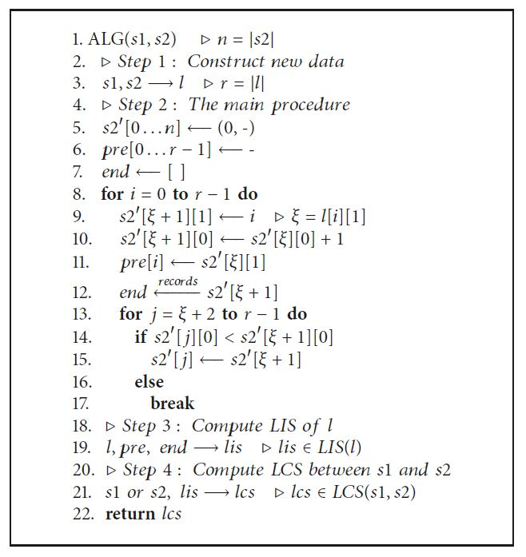
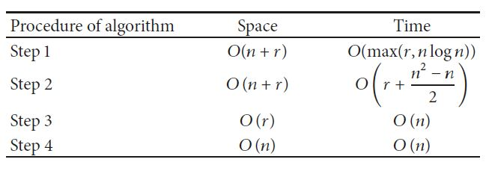
Complexity

