Slide 1
MREclat: an Algorithm for Parallel Mining Frequent Itemsets
Zhigang Zhang, Genlin Ji, Mengmeng
2013 International Conference on Advanced Cloud and Big Data ,Nanjing, China
Presenter : Yu-Ju, Liao
Date: Dec. 16, 2020

Slide 2
Abstract
Algorithm Eclat is a classical algorithm for mining frequent itemsets, which is based on vertical layout databases. It is greatly different from those algorithms based on horizontal layout databases, such as algorithm Apriori and FP-Growth. In order to improve the efficiency of mining frequent itemsets from massive datasets, parallel algorithm MREclat based on Map/Reduce framework is presented. The algorithm also overcomes the problem of memory and computational capability insufficient when mining frequent itemsets from massive datasets. In this paper, the idea of MREclat is introduced and the performance of the algorithm is studied. The experimental results show that algorithm MREclat has high scalability and good speedup.

Slide 3
Frequent itemsets
ID | Item
T1 | ABCD
T2 | BCD
T3 | AB
T4 | CD
Item | ID
A | T1,T3
B | T1,T2,T3
C | T1,T2,T4
D | T1,T2,T3

Slide 4
Bottom-up
Item | ID
A,B | T1,T3
A,C | T1
A,D | T1,T3
B,C | T1,T2
B,D | T1,T2
C,D | T1,T2
Item | ID
A | T1,T3
B | T1,T2,T3
C | T1,T2,T4
D | T1,T2,T3
Min _ sup = 0.5
Min _ sup = 0.5
Item | ID
A,B,D | T1,T3
B,C,D | T1,T2
4*0.5=2

Slide 5
Initial Step
<{A,B},T1> , <{A,C},T1> , <{A,D},T1>, <{B,C},T1> , <{B,D},T1> , <{C,D},T1>,
<{B,C},T2> , <{B,D},T2> , <{C,D},T2>,
<{A,B},T3> , <{A,C},T3> , <{B,C},T3>,
<{C,D},T4>
ID | Item
T1 | ABCD
T2 | BCD
T3 | ABC
T4 | CD

Slide 6
Initial Step
<{A,B},T1> , <{A,C},T1> , <{A,D},T1>, <{B,C},T1> , <{B,D},T1> , <{C,D},T1>,
<{B,C},T2> , <{B,D},T2> , <{C,D},T2>,
<{A,B},T3> , <{A,C},T3> , <{B,C},T3>,
<{C,D},T4>
ID | Item
T1 | ABCD
T2 | BCD
T3 | ABC
T4 | CD

Slide 7
Initial Step
<{A,B},T1> , <{A,C},T1> , <{A,D},T1>, <{B,C},T1> , <{B,D},T1> , <{C,D},T1>,
<{B,C},T2> , <{B,D},T2> , <{C,D},T2>,
<{A,B},T3> , <{A,C},T3> , <{B,C},T3>,
<{C,D},T4>
ID | Item
T1 | ABCD
T2 | BCD
T3 | ABC
T4 | CD

Slide 8
Initial Step
<{A,B},T1> , <{A,C},T2> , <{A,D},T1>, <{B,C},T1>, <{B,D},T1>, <{C,D},T1>,
<{B,C},T2>, <{B,D},T2>, <{C,D},T2>,
<{A,B},T3>, <{A,C},T3> , <{B,C},T3>, <{C,D},T4>
<{A,B},{T1,T3}>
<{A,C},{T1,T3}>
<{A,D},T1>
<{B,C},{T1,T2,T3}>
<{B,D},{T1,T2}>
<{C,D},{T1,T2,T4}>,
<{A,B},{T1,T3}>
<{A,C},{T1,T3}>
<{B,C},{T1,T2,T3}>
<{B,D},{T1,T2}>
<{C,D},{T1,T2,T4}>,
Min _ sup = 0.5

Slide 9
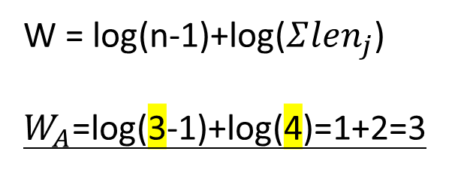
Balanced Group
W = log(n-1)+log($Σ{len}_{j}$)
$W_{A}$=log(3-1)+log(4)=1+2=3
<{A,B},{T1,T3}>
<{A,C},{T1,T3}>
<{B,C},{T1,T2,T3}>
<{B,D},{T1,T2}>
<{C,D},{T1,T2,T4}>
group
1 | A
2 | B
w
 | W
A | 3
B | 3.32
C | 1.58
D | x
3
3.52

Slide 10
Balanced Group
W = log(n-1)+log($Σ{len}_{j}$)
$W_{A}$=log(3-1)+log(4)=1+2=3
<{A,B},{T1,T3}>
<{A,C},{T1,T3}>
<{B,C},{T1,T2,T3}>
<{B,D},{T1,T2}>
<{C,D},{T1,T2,T4}>
group
1 | A,C
2 | B
w
 | W
A | 3
B | 3.32
C | 1.58
D | x
3 +1.58
3.52

Slide 11
The Redistribution and Parallel Ecalt Step
<{A,B},{T1,T3}>
<{A,C},{T1,T3}>
<{B,C},{T1,T2,T3}>
<{B,D},{T1,T2}>
<{C,D},{T1,T2,T4}>
<{A,B},{T1,T3}>
<{A,C},{T1,T3}>
<{C,D},{T1,T2,T4}>
group
1 | A,C
2 | B
<{B,C},{T1,T2,T3}>
<{B,D},{T1,T2}>

Slide 12
The Redistribution and Parallel Ecalt Step
<{A,B},{T1,T3}>
<{A,C},{T1,T3}>
<{C,D},{T1,T2,T4}>
<{A,B},{T1,T3}>
<{A,C},{T1,T3}>
<{A,B,C},{T1,T3}>
<{C,D},{T1,T2,T4}>
Node 1
<{A,B},{T1,T3}>
<{A,C},{T1,T3}>
<{A,B,C},{T1,T3}>
<{C,D},{T1,T2,T4}>
<{B,C},{T1,T2,T3}>
<{B,D},{T1,T2}>
<{B,C,D},{T1,T2}>
<{B,C},{T1,T2,T3}>
<{B,D},{T1,T2}>
<{B,C},{T1,T2,T3}>
<{B,D},{T1,T2}>
<{B,C,D},{T1,T2}>
Node 2

Slide 13
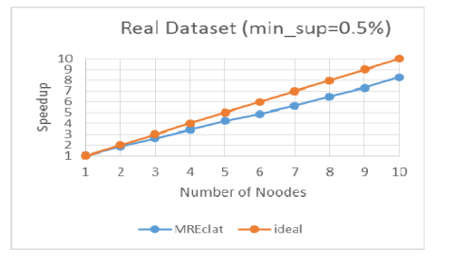
Performance Evaluation

