Slide 1
New Algorithms for the LCS Problem *
W. J. Hsu and M. W. Du
JOURNAL OF COMPUTER AND SYSTEM SCIENCES 29, 133-152 (1984)
Presenter : De-Sheng Jhan
2014/03/24

Slide 2
Abstract
The LCS problem is to determine a longest common subsequence (LCS) of two symbol sequences. Two algorithms which improve two existing results, respectively, are resented. Let m, n be the lengths of the two input strings, with m ≦ n, p being the length of the LCS, and s being the number of distinct symbols appearing in the two strings. It is shown that the first algorithm presented requires at most O(n log s) reprocessing time and O(pm log(n/m) + pm) processing time to solve the problem. This bound is better than that of previous algorithms especially when n is much greater than m. The algorithm also exhibits desirable properties under conditions of sparse matches. The second scheme achieves essentially the same bound O(pm log(n/p) + pm) by employing efficient merging methods in the computations. It also outperforms existing algorithms designed for sparsely-matched situations. Together, the two algorithms provide interesting contrasts of different approaches to one problem; they also offer improved alternatives for actual implementation.

Slide 3
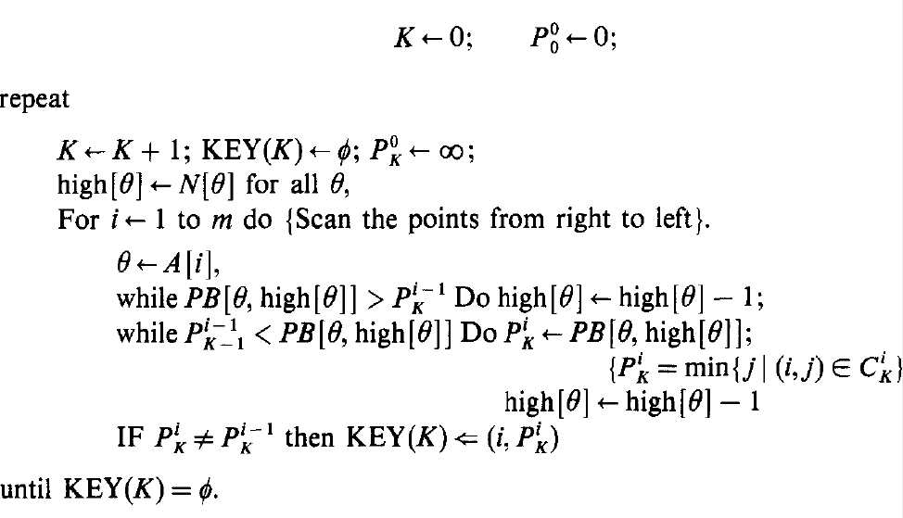
Approach 1(1/13)
D. S. HIRSCHBERG, Algorithms for the longest common subsequence problem
O(p(m + n))

Slide 4
Approach 1(2/13)
A = “abcdbb” , B = “cbacbaaba”
 |  |  | c | B | a | c | b | a | a | b | a
 |  | 0 | 1 | 2 | 3 | 4 | 5 | 6 | 7 | 8 | 9
 | 0 | 0 | 0 | 0 | 0 | 0 | 0 | 0 | 0 | 0 | 0
a | 1 | 0 | 0 | 0 | 1 | 1 | 1 | 1 | 1 | 1 | 1
b | 2 | 0 | 0 | 1 | 1 | 1 | 2 | 2 | 2 | 2 | 2
c | 3 | 0 | 1 | 1 | 1 | 2 | 2 | 2 | 2 | 2 | 2
d | 4 | 0 | 1 | 1 | 1 | 2 | 2 | 2 | 2 | 2 | 2
b | 5 | 0 | 1 | 2 | 2 | 2 | 3 | 3 | 3 | 3 | 3
b | 6 | 0 | 1 | 2 | 2 | 2 | 3 | 3 | 3 | 4 | 4
 | c | b | a | c | b | a | a | b | a
a |  |  | 1 |  |  | 1 | 1 |  | 1
b |  | 1 |  |  | 2 |  |  | 2
c | 1 |  |  | 2
d
b |  | 2 |  |  | 3 |  |  | 3
b |  | 2 |  |  | 3 |  |  | 4

Slide 5
Approach 1(3/13)
rank(i, j)
 |  |  | c | B | a | c | b | a | a | b | a
 |  | 0 | 1 | 2 | 3 | 4 | 5 | 6 | 7 | 8 | 9
 | 0 | 0 | 0 | 0 | 0 | 0 | 0 | 0 | 0 | 0 | 0
a | 1 | 0 | 0 | 0 | 1 | 1 | 1 | 1 | 1 | 1 | 1
b | 2 | 0 | 0 | 1 | 1 | 1 | 2 | 2 | 2 | 2 | 2
c | 3 | 0 | 1 | 1 | 1 | 2 | 2 | 2 | 2 | 2 | 2
d | 4 | 0 | 1 | 1 | 1 | 2 | 2 | 2 | 2 | 2 | 2
b | 5 | 0 | 1 | 2 | 2 | 2 | 3 | 3 | 3 | 3 | 3
b | 6 | 0 | 1 | 2 | 2 | 2 | 3 | 3 | 3 | 4 | 4
rank(3,4) = 2
rank(6,8) = 4

Slide 6
Approach 1(4/13)
successor (繼承者): a point P(i, j) to be a successor of another point P’(i’, j’) iff i’ < i and j’ < j , which simply means rank(i, j) ≧ rank(i’, j’)
 |  |  | c | b | a | c | b | a | a | b | a
 |  | 0 | 1 | 2 | 3 | 4 | 5 | 6 | 7 | 8 | 9
 | 0 | 0 | 0 | 0 | 0 | 0 | 0 | 0 | 0 | 0 | 0
a | 1 | 0 | 0 | 0 | 1 | 1 | 1 | 1 | 1 | 1 | 1
b | 2 | 0 | 0 | 1 | 1 | 1 | 2 | 2 | 2 | 2 | 2
c | 3 | 0 | 1 | 1 | 1 | 2 | 2 | 2 | 2 | 2 | 2
d | 4 | 0 | 1 | 1 | 1 | 2 | 2 | 2 | 2 | 2 | 2
b | 5 | 0 | 1 | 2 | 2 | 2 | 3 | 3 | 3 | 3 | 3
b | 6 | 0 | 1 | 2 | 2 | 2 | 3 | 3 | 3 | 4 | 4

Slide 7
Approach 1(5/13)
A = “abcdbb” , B = “cbacbaaba”
if A[i] == b[j] => *
 | c | b | a | c | b | a | a | b | a
a |  |  | * |  |  | * | * |  | *
b |  | * |  |  | * |  |  | *
c | * |  |  | *
d
b |  | * |  |  | * |  |  | *
b |  | * |  |  | * |  |  | *

Slide 8
Approach 1(6/13)
find rank = 1
 | c | b | a | c | b | a | a | b | a
a |  |  | * |  |  | * | * |  | 1
b |  | * |  |  | * |  |  | *
c | * |  |  | *
d
b |  | * |  |  | * |  |  | *
b |  | * |  |  | * |  |  | *
 | c | b | a | c | b | a | a | b | a
a |  |  | * |  |  | * | 1 |  | 1
b |  | * |  |  | * |  |  | *
c | * |  |  | *
d
b |  | * |  |  | * |  |  | *
b |  | * |  |  | * |  |  | *

Slide 9
Approach 1(7/13)
find rank = 1
 | c | b | a | c | b | a | a | b | a
a |  |  | * |  |  | * | 1 |  | 1
b |  | * |  |  | * |  |  | *
c | * |  |  | *
d
b |  | * |  |  | * |  |  | *
b |  | * |  |  | * |  |  | *
 | c | b | a | c | b | a | a | b | a
a |  |  | 1 |  |  | 1 | 1 |  | 1
b |  | * |  |  | * |  |  | *
c | * |  |  | *
d
b |  | * |  |  | * |  |  | *
b |  | * |  |  | * |  |  | *

Slide 10
Approach 1(8/13)
“Minimal candidates” is sufficient in determining a single LCS
 | c | b | a | c | b | a | a | b | a
a |  |  | 1 |  |  | 1 | 1 |  | 1
b |  | * |  |  | * |  |  | *
c | * |  |  | *
d
b |  | * |  |  | * |  |  | *
b |  | * |  |  | * |  |  | *
A point(i,j) is a minimal K-candidate iff
< j < and j =
point(1,3)
< 3 < and 3 =
0 < 3 < ∞ and 3 = 3
=>point(1,3) is minimal 1-candidate

Slide 11
Approach 1(9/13)
find rank = 1
 | c | b | a | c | b | a | a | b | a
a |  |  | 1 |  |  | 1 | 1 |  | 1
b |  | * |  |  | * |  |  | *
c | * |  |  | *
d
b |  | * |  |  | * |  |  | *
b |  | * |  |  | * |  |  | *
 | c | b | a | c | b | a | a | b | a
a |  |  | 1 |  |  | 1 | 1 |  | 1
b |  | 1 |  |  | * |  |  | *
c | * |  |  | *
d
b |  | * |  |  | * |  |  | *
b |  | * |  |  | * |  |  | *

Slide 12
Approach 1(10/13)
find rank = 1
 | c | b | a | c | b | a | a | b | a
a |  |  | 1 |  |  | 1 | 1 |  | 1
b |  | 1 |  |  | * |  |  | *
c | 1 |  |  | *
d
b |  | * |  |  | * |  |  | *
b |  | * |  |  | * |  |  | *

Slide 13
Approach 1(11/13)
find rank = 2
 | c | b | a | c | b | a | a | b | a
a |  |  | 1 |  |  | 1 | 1 |  | 1
b |  | 1 |  |  | * |  |  | 2
c | 1 |  |  | *
d
b |  | * |  |  | * |  |  | *
b |  | * |  |  | * |  |  | *
 | c | b | a | c | b | a | a | b | a
a |  |  | 1 |  |  | 1 | 1 |  | 1
b |  | 1 |  |  | 2 |  |  | 2
c | 1 |  |  | *
d
b |  | * |  |  | * |  |  | *
b |  | * |  |  | * |  |  | *

Slide 14
Approach 1(12/13)
find rank = 2
 | c | b | a | c | b | a | a | b | a
a |  |  | 1 |  |  | 1 | 1 |  | 1
b |  | 1 |  |  | 2 |  |  | 2
c | 1 |  |  | 2
d
b |  | * |  |  | * |  |  | *
b |  | * |  |  | * |  |  | *
 | c | b | a | c | b | a | a | b | a
a |  |  | 1 |  |  | 1 | 1 |  | 1
b |  | 1 |  |  | 2 |  |  | 2
c | 1 |  |  | 2
d
b |  | 2 |  |  | * |  |  | *
b |  | 2 |  |  | * |  |  | *
……

Slide 15
Approach 1(13/13)
find rank = 3 find rank = 4
 | c | b | a | c | b | a | a | b | a
a |  |  | 1 |  |  | 1 | 1 |  | 1
b |  | 1 |  |  | 2 |  |  | 2
c | 1 |  |  | 2
d
b |  | 2 |  |  | 3 |  |  | 3
b |  | 2 |  |  | 3 |  |  | *
 | c | b | a | c | b | a | a | b | a
a |  |  | 1 |  |  | 1 | 1 |  | 1
b |  | 1 |  |  | 2 |  |  | 2
c | 1 |  |  | 2
d
b |  | 2 |  |  | 3 |  |  | 3
b |  | 2 |  |  | 3 |  |  | 4

Slide 16
Improvement Approach 1(1/5)
O(pm * max(1 , log(n/m)))
 |  |  | c | B | a | c | b | a | a | b | a
 |  | 0 | 1 | 2 | 3 | 4 | 5 | 6 | 7 | 8 | 9
 | 0 | 0 | 0 | 0 | 0 | 0 | 0 | 0 | 0 | 0 | 0
a | 1 | 0 | 0 | 0 | 1 | 1 | 1 | 1 | 1 | 1 | 1
b | 2 | 0 | 0 | 1 | 1 | 1 | 2 | 2 | 2 | 2 | 2
c | 3 | 0 | 1 | 1 | 1 | 2 | 2 | 2 | 2 | 2 | 2
d | 4 | 0 | 1 | 1 | 1 | 2 | 2 | 2 | 2 | 2 | 2
b | 5 | 0 | 1 | 2 | 2 | 2 | 3 | 3 | 3 | 3 | 3
b | 6 | 0 | 1 | 2 | 2 | 2 | 3 | 3 | 3 | 4 | 4
 |  |  | c | B | a | c | b | a | a | b | a
 |  | 0 | 1 | 2 | 3 | 4 | 5 | 6 | 7 | 8 | 9
 | 0 | 0 | 0 | 0 | 0 | 0 | 0 | 0 | 0 | 0 | 0
a | 1 | 0 | 0 | 0 | 1 | 1 | 1 | 1 | 1 | 1 | 1
b | 2 | 0 | 0 | 1 | 1 | 1 | 2 | 2 | 2 | 2 | 2
c | 3 | 0 | 1 | 1 | 1 | 2 | 2 | 2 | 2 | 2 | 2
d | 4 | 0 | 1 | 1 | 1 | 2 | 2 | 2 | 2 | 2 | 2
b | 5 | 0 | 1 | 2 | 2 | 2 | 3 | 3 | 3 | 3 | 3
b | 6 | 0 | 1 | 2 | 2 | 2 | 3 | 3 | 3 | 4 | 4

Slide 17
Improvement Approach 1(2/5)
find rank = 1
 | c | b | a | c | b | a | a | b | a
a |  |  | 1 |  |  | * | * |  | *
b |  | * |  |  | * |  |  | *
c | * |  |  | *
d
b |  | * |  |  | * |  |  | *
b |  | * |  |  | * |  |  | *
 | c | b | a | c | b | a | a | b | a
a |  |  | 1 |  |  | * | * |  | *
b |  | 1 |  |  | * |  |  | *
c | * |  |  | *
d
b |  | * |  |  | * |  |  | *
b |  | * |  |  | * |  |  | *

Slide 18
Improvement Approach 1(3/5)
find rank = 1
 | c | b | a | c | b | a | a | b | a
a |  |  | 1 |  |  | * | * |  | *
b |  | 1 |  |  | * |  |  | *
c | 1 |  |  | *
d
b |  | * |  |  | * |  |  | *
b |  | * |  |  | * |  |  | *

Slide 19
Improvement Approach 1(4/5)
find rank = 2
 | c | b | a | c | b | a | a | b | a
a |  |  | 1 |  |  | * | * |  | *
b |  | 1 |  |  | 2 |  |  | *
c | 1 |  |  | *
d
b |  | * |  |  | * |  |  | *
b |  | * |  |  | * |  |  | *
 | c | b | a | c | b | a | a | b | a
a |  |  | 1 |  |  | * | * |  | *
b |  | 1 |  |  | 2 |  |  | *
c | 1 |  |  | 2
d
b |  | 2 |  |  | * |  |  | *
b |  | * |  |  | * |  |  | *
……

Slide 20
Improvement Approach 1(5/5)
find rank = 3 find rank = 4
 | c | b | a | c | b | a | a | b | a
a |  |  | 1 |  |  | * | * |  | *
b |  | 1 |  |  | 2 |  |  | *
c | 1 |  |  | 2
d
b |  | 2 |  |  | 3 |  |  | *
b |  | * |  |  | * |  |  | *
 | c | b | a | c | b | a | a | b | a
a |  |  | 1 |  |  | * | * |  | *
b |  | 1 |  |  | 2 |  |  | *
c | 1 |  |  | 2
d
b |  | 2 |  |  | 3 |  |  | *
b |  | * |  |  | * |  |  | 4

Slide 21
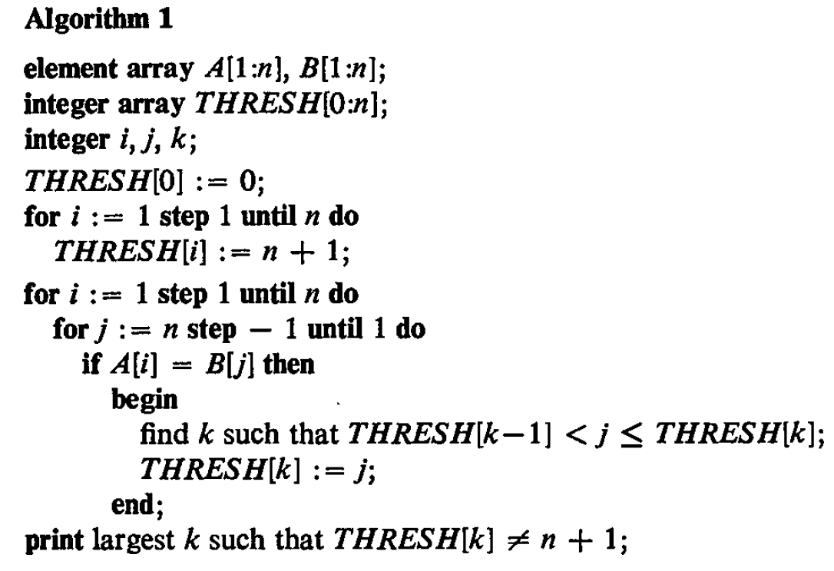
Approach 2(1/8)
A Fast Algorithm for Computing Longest Common Subsequences - Hunt and Szymanski
O(N²logn)

Slide 22
Approach 2(2/8)
A = “abcdbb” , B = “cbacbaaba”
if A[i] == b[j] => *
 | c | b | a | c | b | a | a | b | a
a |  |  | * |  |  | * | * |  | *
b |  | * |  |  | * |  |  | *
c | * |  |  | *
d
b |  | * |  |  | * |  |  | *
b |  | * |  |  | * |  |  | *

Slide 23
Approach 2(3/8)
A = “abcdbb” , B = “cbacbaaba”
n = max( |A|, |B|) = 9
Thresh[0:n]=
=
index | 0 | 1 | 2 | 3 | 4 | 5 | 6
value | 0 | n+1 | n+1 | n+1 | n+1 | n+1 | n+1
index | 0 | 1 | 2 | 3 | 4 | 5 | 6
value | 0 | 10 | 10 | 10 | 10 | 10 | 10

Slide 24
Approach 2(4/8)
index | 0 | 1 | 2 | 3 | 4 | 5 | 6
value | 0 | 10 | 10 | 10 | 10 | 10 | 10
Thresh[0:n]=
Thresh[k-1] ＜ j ≦ Thresh[k] => Thresh[k] = j

Slide 25
Approach 2(5/8)
index | 0 | 1 | 2 | 3 | 4 | 5 | 6
value | 0 | 10 | 10 | 10 | 10 | 10 | 10
index | 0 | 1 | 2 | 3 | 4 | 5 | 6
value | 0 | 9 | 10 | 10 | 10 | 10 | 10
 | c | b | a | c | b | a | a | b | a
a |  |  | * |  |  | * | * |  | 1
b |  | * |  |  | * |  |  | *
c | * |  |  | *
d
b |  | * |  |  | * |  |  | *
b |  | * |  |  | * |  |  | *
Point(i, j) = (1, 9)
Thresh[0] ＜9 ≦ Thresh[1] => Thresh[1] = 9
rank of point(1,9) = 1

Slide 26
Approach 2(6/8)
index | 0 | 1 | 2 | 3 | 4 | 5 | 6
value | 0 | 9 | 10 | 10 | 10 | 10 | 10
index | 0 | 1 | 2 | 3 | 4 | 5 | 6
value | 0 | 7 | 10 | 10 | 10 | 10 | 10
 | c | b | a | c | b | a | a | b | a
a |  |  | * |  |  | * | 1 |  | 1
b |  | * |  |  | * |  |  | *
c | * |  |  | *
d
b |  | * |  |  | * |  |  | *
b |  | * |  |  | * |  |  | *
Point(i, j) = (1, 7)
Thresh[0] ＜7 ≦ Thresh[1] => Thresh[1] = 7
rank of point(1,7) = 1

Slide 27
Approach 2(7/8)
index | 0 | 1 | 2 | 3 | 4 | 5 | 6
value | 0 | 3 | 10 | 10 | 10 | 10 | 10
index | 0 | 1 | 2 | 3 | 4 | 5 | 6
value | 0 | 3 | 8 | 10 | 10 | 10 | 10
 | c | b | a | c | b | a | a | b | a
a |  |  | 1 |  |  | 1 | 1 |  | 1
b |  | * |  |  | * |  |  | 2
c | * |  |  | *
d
b |  | * |  |  | * |  |  | *
b |  | * |  |  | * |  |  | *
Point(i, j) = (2, 8)
Thresh[1] ＜8 ≦ Thresh[2] => Thresh[2] = 8
rank of point(2,8) = 2

Slide 28
Approach 2(8/8)
index | 0 | 1 | 2 | 3 | 4 | 5 | 6
value | 0 | 1 | 2 | 5 | 8 | 10 | 10
 | c | b | a | c | b | a | a | b | a
a |  |  | 1 |  |  | 1 | 1 |  | 1
b |  | 1 |  |  | 2 |  |  | 2
c | 1 |  |  | 2
d
b |  | 2 |  |  | 3 |  |  | 3
b |  | 2 |  |  | 3 |  |  | 4
Length of LCS(A,B)=4

Slide 29
Improvement Approach 2
index | 0 | 1 | 2 | 3 | 4 | 5 | 6
value | 0 | 2 | 5 | 10 | 10 | 10 | 10
 | c | b | a | c | b | a | a | b | a
a |  |  | 1 |  |  | 1 | 1 |  | 1
b |  | 1 |  |  | 2 |  |  | 2
c | * |  |  | *
d
b |  | * |  |  | * |  |  | *
b |  | * |  |  | * |  |  | *
binary search => logn
j = 4

Slide 30
index | 0 | 1 | 2 | 3 | 4 | 5 | 6
value | 0 | 2 | 5 | 10 | 10 | 10 | 10
 | c | b | a | c | b | a | a | b | a
a |  |  | 1 |  |  | 1 | 1 |  | 1
b |  | 1 |  |  | 2 |  |  | 2
c | * |  |  | *
d
b |  | * |  |  | * |  |  | *
b |  | * |  |  | * |  |  | *
SetA{ j₁= 1 , j₂ = 4}
SetB{0 , 2 , 5 , 10, 10, 10, 10}
merging algorithms:
Hwang-Lin merge is recommended

Slide 31
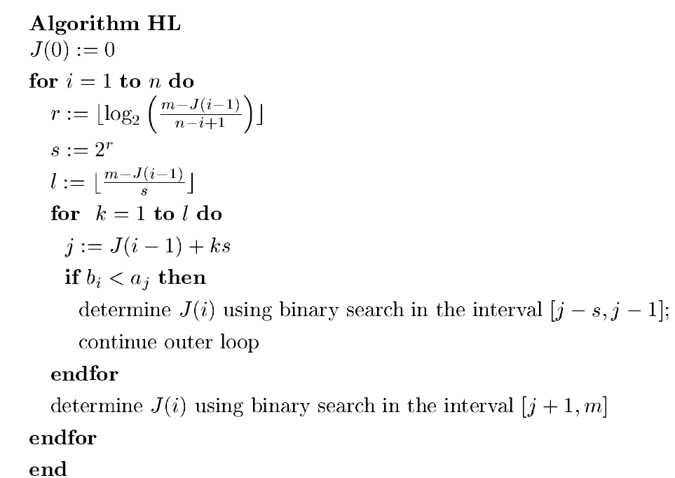
Hwang-Lin merge
Average case analysis of the merging algorithm of Hwang and Lin
W. Fernandez de la Vega* A.M.Frieze⁺ M. Santha*

Slide 32
A={1,3,4} B={0,2,5}
J(i) denotes the index of the rightmost term of the first sequence which is smaller than B_{i}
J[1:3]={0,1,3}
O(p log(n/p) + p)
for m rows, O(mp log(n/p) + mp)

Slide 33
Thank you for listening

