Slide 1
Protein Backbone Reconstruction with Tool Preference Classification and Feature Selection
Student: Hsin-Chuan Yuan (袁信全)
Advisor: Prof. Chang-Biau Yang (楊昌彪)
Date: March 24, 2014
1

Slide 2
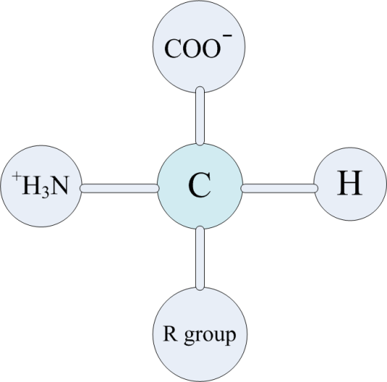
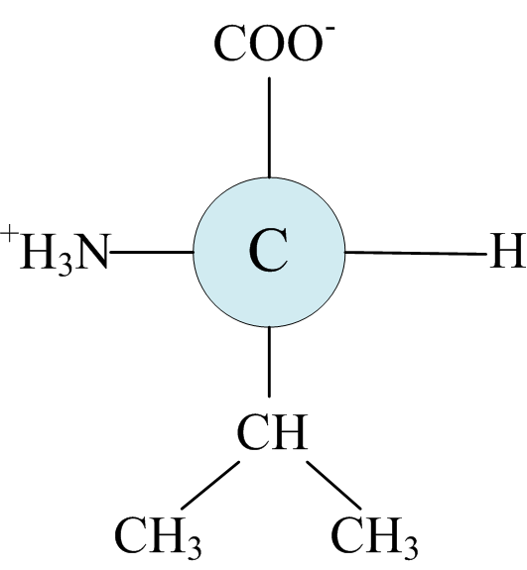
Introduction (1/3)
 | Amino Acid | One-letter Abbreviation | Three-letter Abbreviation
1 | Alanine | A | Ala
2 | Cysteine | C | Cys
3 | Aspartic Acid | D | Asp
4 | Glutamic Acid | E | Glu
5 | Phenylalanine | F | Phe
6 | Glycine | G | Gly
7 | Histidine | H | His
8 | Isoleucine | I | Ile
9 | Lysine | K | Lys
10 | Leucine | L | Leu
11 | Methionine | M | Met
12 | Asparagine | N | Asn
13 | Proline | P | Pro
14 | Glutamine | Q | Gln
15 | Arginine | R | Arg
16 | Serine | S | Ser
17 | Threonine | T | Thr
18 | Valine | V | Val
19 | Tryptophan | W | Trp
20 | Tyrosine | Y | Tyr
A protein is a consecutive
chain of amino acids.
The fundamental structure of Valine.

Slide 3
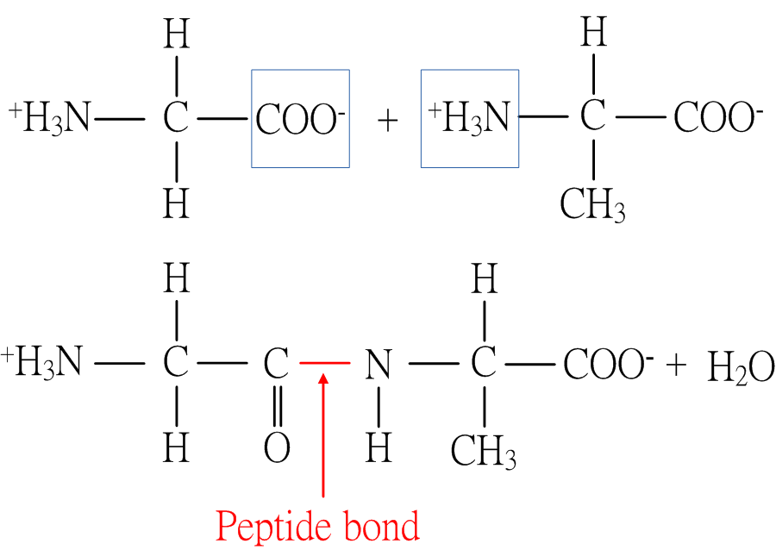
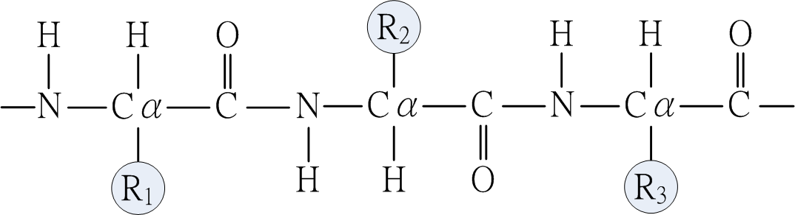
Introduction (2/3)
Peptide bond and backbone

Slide 4
Introduction (3/3)
Protein Backbone Reconstruction Problem (PBRP)
Input: A protein sequence and its all Cα coordinates.
Output: The coordinates of N, C and O atoms on the
backbone.

Slide 5
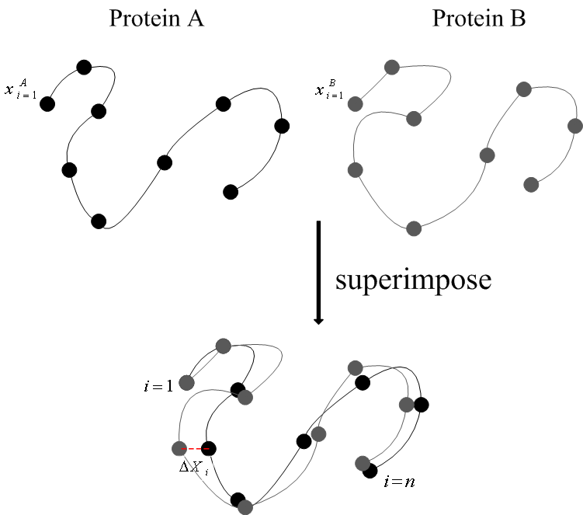
Root Mean Square Deviation (RMSD)
The RMSD is a measure of similarity between a predicted structure and a real one.
RMSD formula:

Slide 6
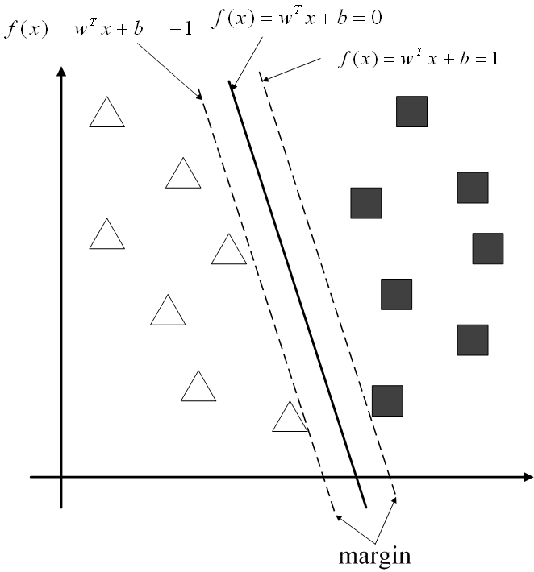
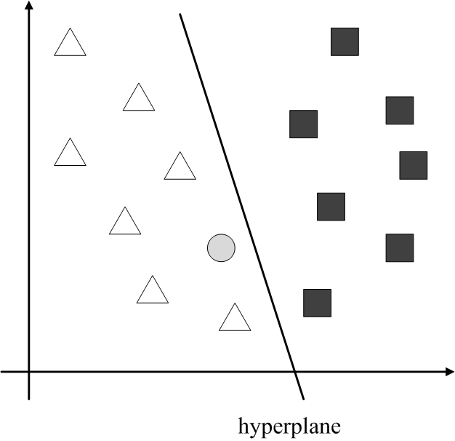
Support Vector Machine (SVM)
SVM is a supervised learning model which can be applied to classification or regression.

Slide 7
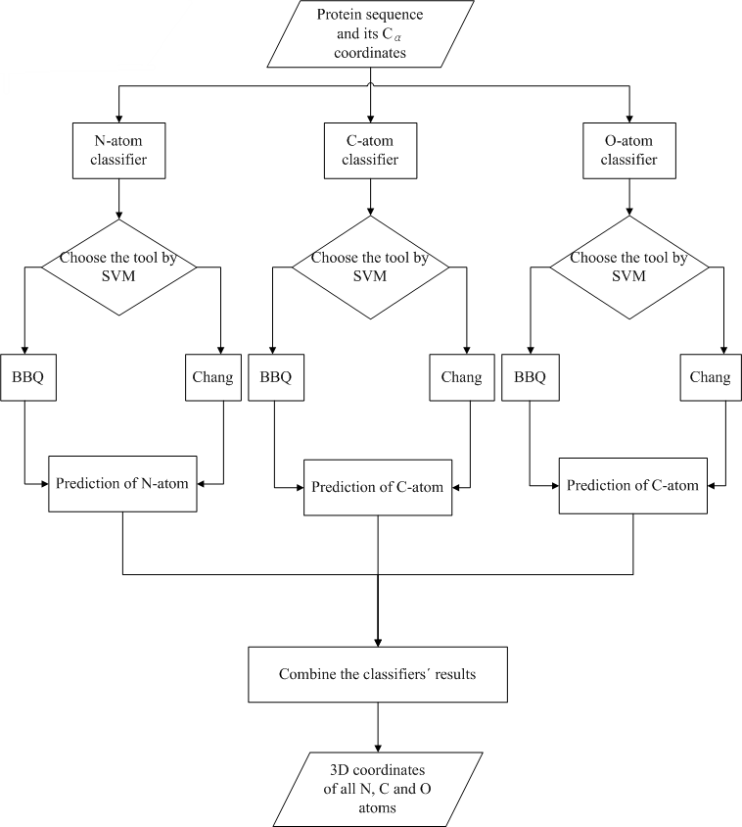
Previous Work (1/2)
Chen determines the tool to be used on N, C and O atoms of each protein.
The feature vectors were derived from a coding rule which applied on the properties of amino acids of each protein.

Slide 8
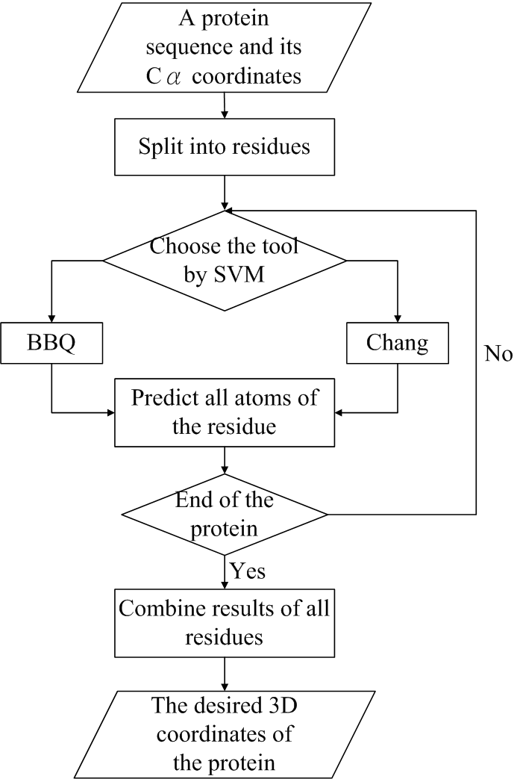
Previous Work (2/2)
Wu determines the tool to be used on all atoms of each residue of the proteins.
The feature vectors were derived from the properties of amino acids of each protein and the properties of the adjacent amino acids .

Slide 9
Our Method (1/3)
It is based on Chen’s method and Wu’s method which determines the tool to be used.
We further use 135 properties of amino acids as the training feature.
In order to balance the significance of each property of amino acids, we modified Wu’s method on the feature vectors by normalizing the properties.
We aim to select significant property from the 135 properties to obtain higher accuracy and increase the efficiency of the process.

Slide 10
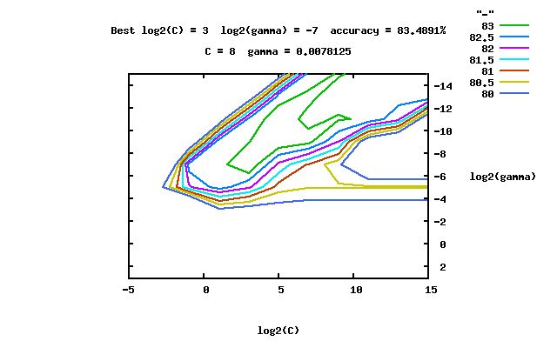
Our Method (2/3)
A grid-search technique was used to determine the best parameters, cost and gamma. The two parameters were limit in 2⁻¹⁰ to 2⁻⁵ and 2⁻³ to 2², respectively.

Slide 11
Our Method (3/3)
Fisher score and distance correlation are also applied on our method to determine a method on selecting crucial features.
However, the two method is not suitable for our case.

Slide 12
Experimental Results
Self-test
Training Set | Testing Set | BBQ | Chang’s Method | Chen’s Method | Wu’s Method | Our Method
CASP7 | CASP7 | 0.3624 | 0.4108 | 0.3505 | 0.3355 | 0.2659
CASP8 | CASP8 | 0.4584 | 0.4888 | 0.4106 | 0.4379 | 0.3443
CASP9 | CASP9 | 0.4280 | 0.4406 | 0.3693 | 0.4293

Slide 13
Experimental Results
Independent test
Training Set | Testing Set | BBQ | Chang’s Method | Chen’s Method | Wu’s Method | Our Method
CASP8 | CASP7 | 0.3624 | 0.4108 | 0.3589 | 0.3636 | 0.3661
CASP9 |  |  |  | 0.3609 | 0.3632 | 0.3632
Training Set | Testing Set | BBQ | Chang’s Method | Chen’s Method | Wu’s Method | Our Method
CASP7 | CASP8 | 0.4584 | 0.4888 | 0.4558 | 0.4589 | 0.4536
CASP9 |  |  |  | 0.4187 | 0.4590 | 0.4590
Training Set | Testing Set | BBQ | Chang’s Method | Chen’s Method | Wu’s Method | Our Method
CASP7 | CASP9 | 0.4280 | 0.4406 | 0.4127 | 0.4334 | 0.4363
CASP8 |  |  |  | 0.3757 | 0.4297 | 0.4372

Slide 14
Conclusion
We only get better result than Chen’s result in CASP7-CASP7.
We get better results than BBQ’s results in CASP7-CASP7 and CASP8-CASP8.
The other results are better than Chang’s results but worse than BBQ’s and Chen’s results.

Slide 15
Future Work
Find more useful features to improve our model.
Change the method of normalization.
Add probability feedback method to converge the result.
Determine the tool to be used on N, C and O atoms for each residue of the protein.

