Slide 1
A space-efficient algorithm for local similarities
Xiaoqiu Huang, Ross C.Hardison¹ and Webb Miller²
CABIOS Vol 6. no.4. 1990 Pages 373 – 381
Presenter : Ding-Yao Huang
Date:2014/07/15

Slide 2
Abstract
Existing dynamic-programming algorithms for identifying similar regions of two sequences require time and space proportional to the product of the sequence lengths.
Often this space requirement is more limiting than the time requirement. We describe a dynamic-programming local-similarity algorithm that needs only space proportional to the sum of the sequence lengths.
The method can also find repeats within a single long sequence. To illustrate the algorithm's potential, we discuss comparison of a 73360 nucleotide sequence containing the human β-like globin gene cluster and a corresponding 44594 nucleotide sequence for rabbit, a problem well beyond the capabilities of other dynamic-programming software.

Slide 3
Introduction(local alignment)
0
F(i, j) =max F(i – 1, j) – d
F(i, j – 1) – d
F(i – 1, j – 1) + s(x_{i}, y_{j})

Slide 4
Introduction(local alignment)
0
F(i, j) =max F(i – 1, j) – d
F(i, j – 1) – d
F(i – 1, j – 1) + s(x_{i}, y_{j})
y
 |  | T | A | C | T | A | A
 | 0 | 0 | 0 | 0 | 0 | 0 | 0
T | 0 | 1 | 0 | 0 | 1 | 0 | 0
A | 0 | 0 | 2 | 0 | 0 | 2 | 1
A | 0
T | 0
A | 0
x
x = TAATA
Y = TACTAA
d=2
s(x_{i}, y_{j})=1 if match
=-1 else

Slide 5
Introduction(local alignment)
0
F(i, j) =max F(i – 1, j) – d
F(i, j – 1) – d
F(i – 1, j – 1) + s(x_{i}, y_{j})
y
 |  | T | A | C | T | A | A
 | 0 | 0 | 0 | 0 | 0 | 0 | 0
T | 0 | 1 | 0 | 0 | 1 | 0 | 0
A | 0 | 0 | 2 | 0 | 0 | 2 | 1
A | 0 | 0 | 1 | 1 | 0 | 1 | 3
T | 0 | 0 | 0 | 0 | 2 | 0 | 1
A | 0 | 0 | 1 | 0 | 0 | 3 | 1
x
x = TAATA
Y = TACTAA
d=2
s(x_{i}, y_{j})=1 if match
=-1 else

Slide 6
Introduction(local alignment)
0
F(i, j) =max F(i – 1, j) – d
F(i, j – 1) – d
F(i – 1, j – 1) + s(x_{i}, y_{j})
y
 |  | T | A | C | T | A | A
 | 0 | 0 | 0 | 0 | 0 | 0 | 0
T | 0 | 1 | 0 | 0 | 1 | 0 | 0
A | 0 | 0 | 2 | 0 | 0 | 2 | 1
A | 0 | 0 | 1 | 1 | 0 | 1 | 3
T | 0 | 0 | 0 | 0 | 2 | 0 | 1
A | 0 | 0 | 1 | 0 | 0 | 3 | 1
x
x = TAATA
Y = TACTAA
d=2
s(x_{i}, y_{j})=1 if match
=-1 else

Slide 7
Introduction(local alignment)
0
F(i, j) =max F(i – 1, j) – d
F(i, j – 1) – d
F(i – 1, j – 1) + s(x_{i}, y_{j})
y
 |  | T | A | C | T | A | A
 | 0 | 0 | 0 | 0 | 0 | 0 | 0
T | 0 | 1 | 0 | 0 | 1 | 0 | 0
A | 0 | 0 | 2 | 0 | 0 | 2 | 1
A | 0 | 0 | 1 | 1 | 0 | 1 | 3
T | 0 | 0 | 0 | 0 | 2 | 0 | 1
A | 0 | 0 | 1 | 0 | 0 | 3 | 1
x
x = TAATA
Y = TACTAA
d=2
s(x_{i}, y_{j})=1 if match
=-1 else

Slide 8
Introduction
Our linear-space local similarity algorithm
the linear-space global alignment algorithm of Myers and Miller(1988)
techniques of Waterman and Eggert (1987).

Slide 9
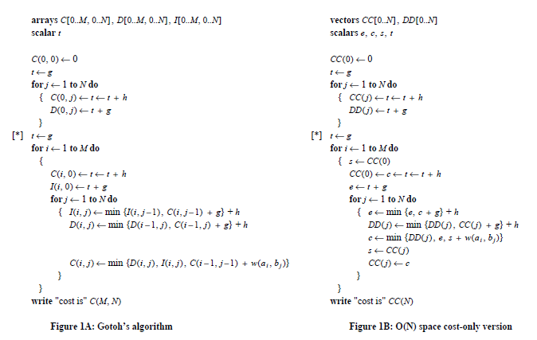
Myers and Miller(1988)

Slide 10
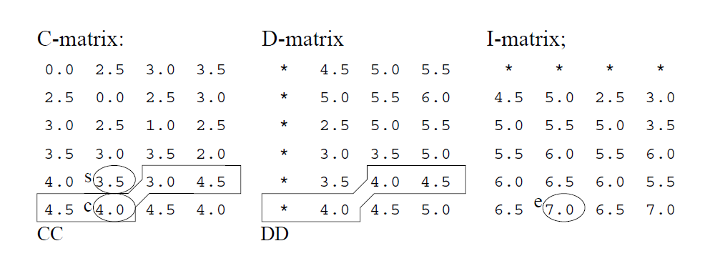
Myers and Miller(1988)
Linear space version for affine gap penalties.
A A G
A A G
A A G
AG
T
A
C
AG
T
A
C
AG
T
A
C

Slide 11
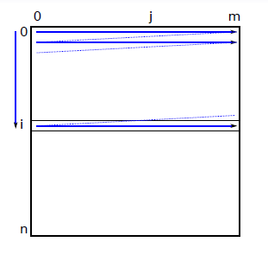
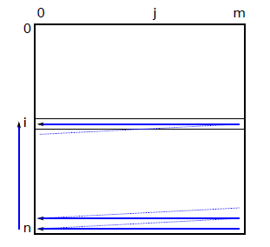
Hirschberg (1975)
Forward Computing
Backward Computing

Slide 12
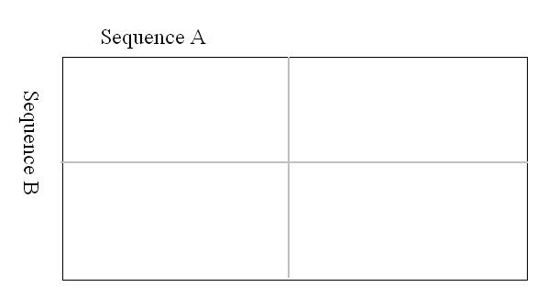



Midpoint
Hirschberg (1975): recursive divide-and-conquer
Forward Computing
Backward Computing

Slide 13

A general LCS algorithm
 |  | A | C | D | E
 | 0 | 0 | 0 | 0 | 0
A | 0 | 1 | 1 | 1 | 1
B | 0 | 1 | 1 | 1 | 1
C | 0 | 1 | 2 | 2 | 2
D | 0 | 1 | 2 | 3 | 3
LCS : ACD

Slide 14
Hirschberg’s algorithm
Sequence s: ABCD
Sequence t: ACDE
Algo (2, 4, “AB”, “ACDE”)
Algo(2, 4, “DC”, “EDCA”)
 |  | A | C | D | E
 | 0 | 0 | 0 | 0 | 0
A | 0 | 1 | 1 | 1 | 1
 |  | E | D | C | A
 | 0 | 0 | 0 | 0 | 0
D | 0 | 0 | 1 | 1 | 1
 |  | A | C | D | E
 | 0 | 1 | 1 | 1 | 1
B | 0 | 1 | 1 | 1 | 1
 |  | E | D | C | A
 | 0 | 0 | 1 | 1 | 1
C | 0 | 0 | 1 | 2 | 2
J = 0, 0 + 2 = 2
J = 1, 1 + 2 = 3
J = 2, 1 + 1 = 2
J = 3, 1 + 0 = 1
J = 4, 1 + 0 = 1

Slide 15
Hirschberg’s algorithm
Sequence s: ABCD
Sequence t: ACDE
Algo(1, 3, “C”, “CDE”)
Algo(1, 1,“A”, “A”)
 |  | A
 | 0 | 0
A | 0 | 1
 |  | C | D | E
 | 0 | 0 | 0 | 0
C | 0 | 1 | 1 | 1
Algo(1, 1, “B”, “A”)
Algo(1, 3, “D”, “EDC”)
 |  | A
 | 0 | 0
B | 0 | 0
 |  | E | D | C
 | 0 | 0 | 0 | 0
D | 0 | 0 | 1 | 1
J = 0, 0 + 1 = 1
J = 1, 1 + 1 = 2
J = 2, 1 + 0 = 0
J = 3, 1 + 0 = 1
J= 0, 0 + 0 = 0
J = 1, 1 + 0 = 1

Slide 16
Hirschberg’s algorithm
 |  | A
 | 0 | 0
A | 0 | 1
 |  | C | D | E
 | 0 | 0 | 0 | 0
C | 0 | 1 | 1 | 1
 |  | A
 | 0 | 0
B | 0 | 0
 |  | E | D | C
 | 0 | 0 | 0 | 0
D | 0 | 0 | 1 | 1
J= 0, 0 + 0 = 0
J = 1, 1 + 0 = 1
J = 0, 0 + 1 = 1
J = 1, 1 + 1 = 2
J = 2, 1 + 0 = 0
J = 3, 1 + 0 = 1
Hirschberg(1, 1, “A”, “A”) => A
Hirschberg(1, 0, “B”, null) = >null
Hirschberg(1, 1, “C”, “C”) => C
Hirschberg(1, 2, “D”, “DE”) => D
LCS : ACD

Slide 17
Waterman and Eggert (1987)
The algorithm of Smith & Waterman for identification of maximally similar subsequences is extended to allow identification of all non-intersecting similar subsequences with similarity score at or above some preset level

Slide 18
Waterman and Eggert (1987)
H_{i,j}= max(0, H_{i-1,j-1}+s(a_{i},b_{j}), H _{i - l , j} -v, H_{i,j-l}-v }
E_{i,j}= max(H _{i , j- l} –(v+u), E_{i,j-l}-v }
F_{i,j}= max(H _{i , j- l} –(v+u), F_{i,j-l}-v }
H*_{i,j}= max(0, H _{i - l , j} -v, H_{i,j-l}-v }
an affine function, gap(k) = u+ vk

Slide 19
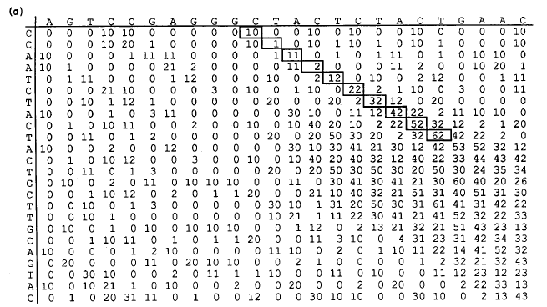

Slide 20
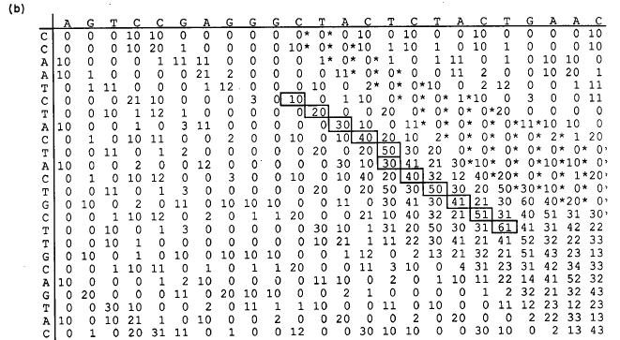

Slide 21
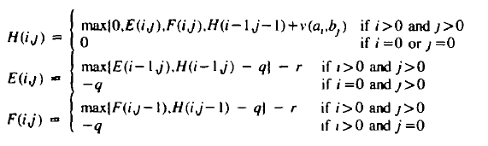

Finding a best local alignment
H(i,j):
第一序列前 i 個字母和第二序列前 j 個字母，最高的序列比對分數
E(i,j) : 在 H(i,j)中，第一序列第 i 個字母和第二序列gap比對
F(i,j) : 在 H(i,j)中，第一序列gap和第二序列第j 個字母比對

Slide 22
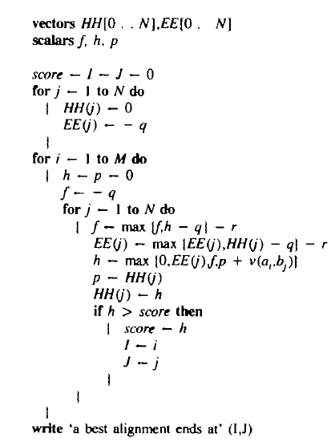
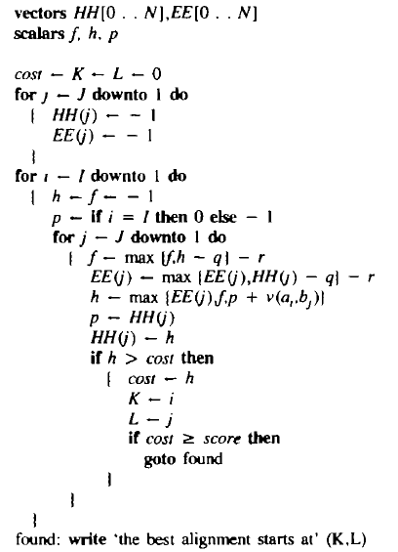

Slide 23



H-matrix
E-matrix
F-matrix
A A G
A A G
A A G
AG
T
A
C
AG
T
A
C
AG
T
A
C
f
HH
EE

Slide 24
Finding k best non-intersecting alignments

Slide 26
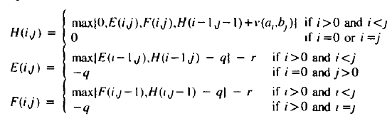
Finding repeated regions within a sequence
 |  | A | B | C | A | B | C
 | 0 | 0 | 0 | 0 | 0 | 0 | 0
A | 0 | 1 | 0 | 0 | 1 | 0 | 0
B | 0 | 0 | 2 | 0 | 0 | 2 | 0
C | 0 | 0 | 0 | 3 | 0 | 0 | 3
A | 0 | 1 | 0 | 0 | 4 | 0 | 0
B | 0 | 0 | 2 | 0 | 0 | 5 | 0
C | 0 | 0 | 0 | 3 | 0 | 0 | 6
 |  | A | B | C | A | B | C
 | 0 | 0 | 0 | 0 | 0 | 0 | 0
A |  | 1 | 0 | 0 | 1 | 0 | 0
B |  |  | 2 | 0 | 0 | 2 | 0
C |  |  |  | 3 | 0 | 0 | 3
A |  |  |  |  | 4 | 0 | 0
B |  |  |  |  |  | 5 | 0
C |  |  |  |  |  |  | 6

Slide 27
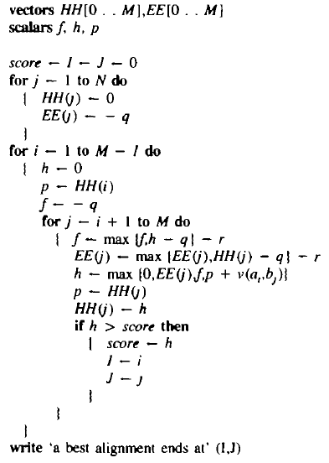
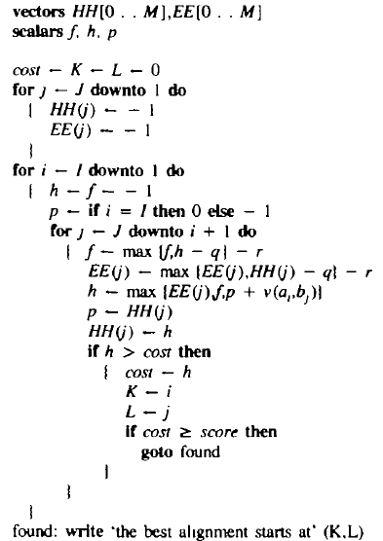

Slide 28
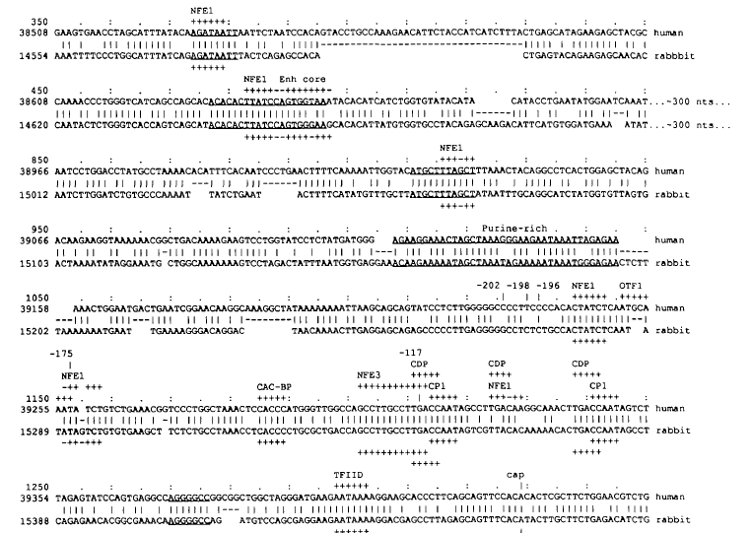
Implementation

Slide 29
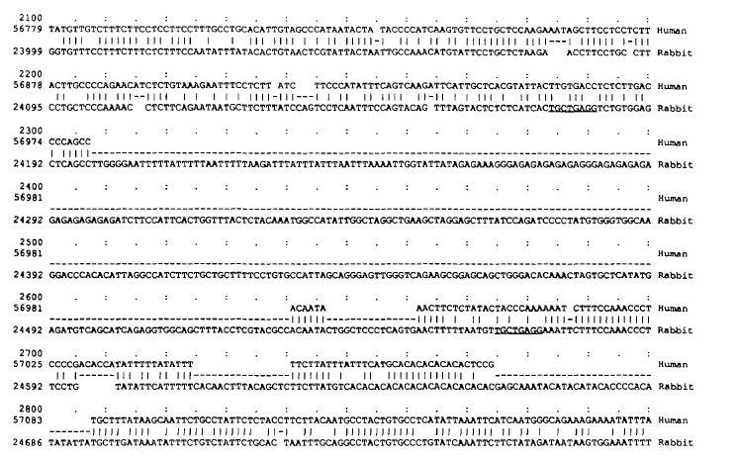
Implementation

Slide 30
Conclusion
Previous dynamic-programming algorithms for local similarity require space proportional to the product of the sequence lengths.
This paper presents an algorithm that uses only space proportional to the longer sequence's length.
Our current implementation of SIM computes later alignments very quickly, so k can be set very large without significantly decreasing the efficiency of the program

