Slide 1

Bit-Parallel LCS-length Computation Revisited
PR In Proc. 15th Australasian Workshop on Combinatorial Algorithms (AWOCA)
2004
Presenter:De-Sheng Jhan
2014/07/29

Slide 2
Abstract
The longest common subsequence (LCS) is a classic and well-studied measure of similarity between two strings A and B. This problem has two variants: determining the length of the LCS (LLCS), and recovering an LCS itself. In this paper we address the first of these two. Let m and n denote the lengths of the strings A and B, respectively, and w denote the computer word size. First we give a slightly improved formula for the bit-parallel O(⌈m/w⌉n) LLCS algorithm of Crochemore et al. [4]. Then we discuss the relative performance of the bit-parallel algorithms and compare our variant against one of the best conventional LLCS algorithms. Finally we propose and evaluate an O(⌈d/w⌉n) version of the algorithm, where d is the simple (indel) edit distance between A and B.

Slide 3
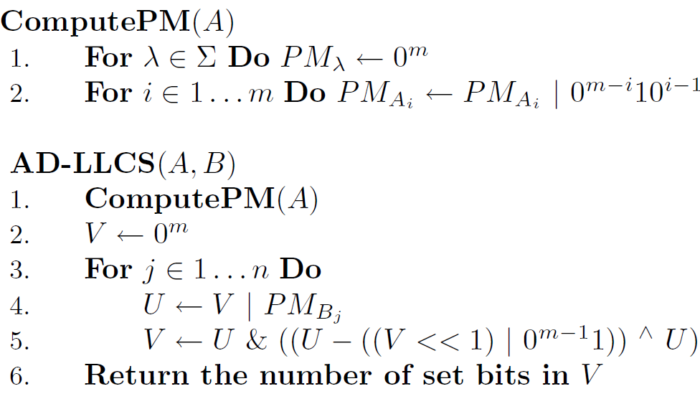
Allison-Dix(1/3)

Slide 4
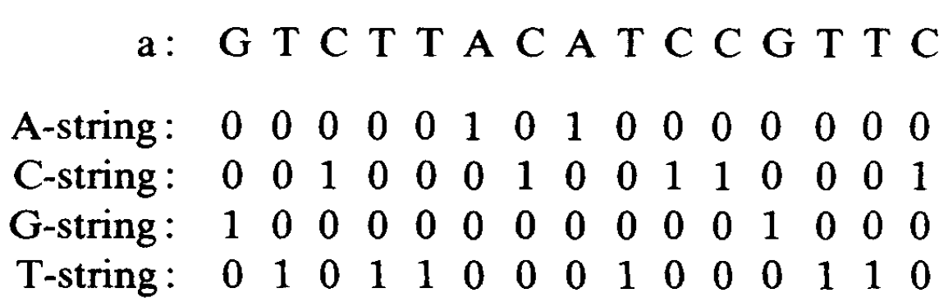
Allison-Dix(2/3)

Slide 5
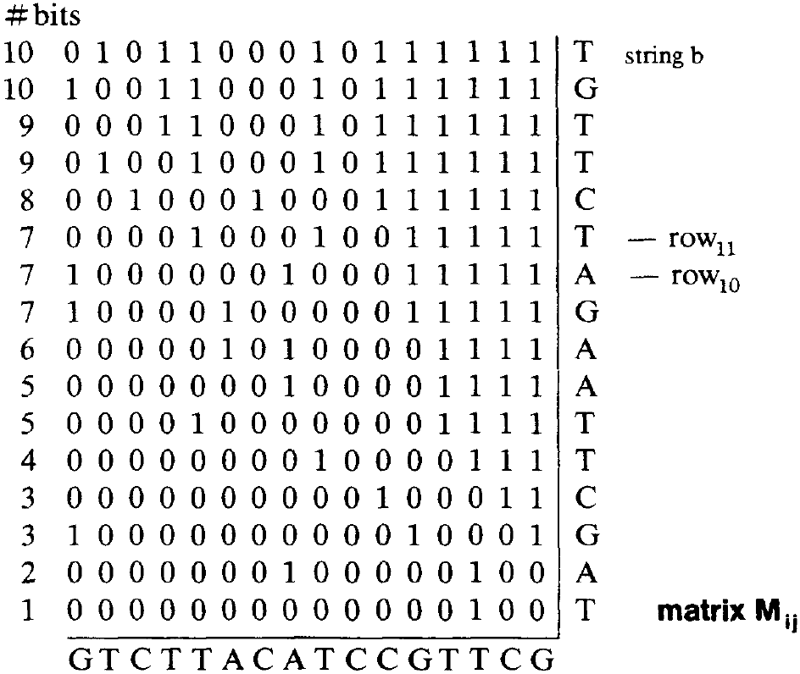
Allison-Dix(3/3)

Slide 6
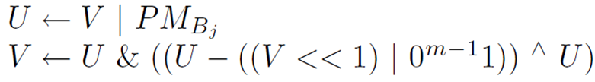
V_{row10} = 1000000100011111
PM_{T} = 0101100010001100
U = V | PM_{T} = 1101100110011111
(V_{row10}<<1) | 0^{m-1}1 = 0000001000111111
U - step2 = 1101011101100000
step3 ^ U = 0000100010011111
U Λ step4 = 0000100010011111
V_{row11} = 0000100010011111

Slide 7
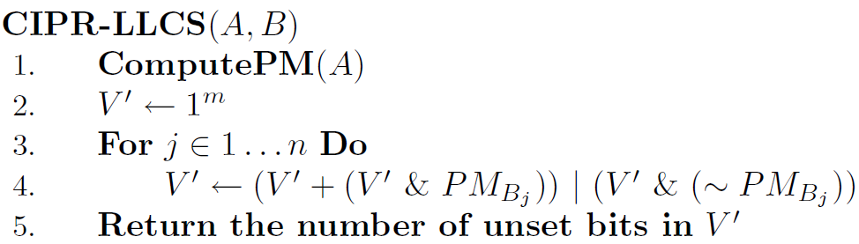
Crochemore et al.

Slide 8
V’ = ~V_{row10} = 0111111011100000
PM_{T} = 0101100010001100
V’&PM_{T} = 0101100010000000
V’ + step1 = 1101011101100000
V’ & (~ PM_{T}) = 0010011001100000
step2 | step3 = 1111011101100000
V_{row11} = (~step4) = 0000100010011111

Slide 9
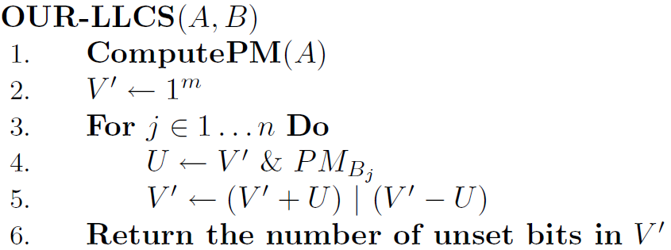
Our Improved Formula

Slide 10
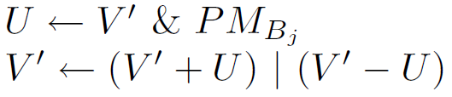
V’ = ~V_{row10} = 0111111011100000
PM_{T} = 0101100010001100
U = V’ & PM_{T} = 0101100010000000
V’ + U = 1101011101100000
V’ – U = 0010011001100000
step2 | step3 = 1111011101100000
V_{row11} = (~step4) = 0000100010011111

Slide 11
Performance(1/2)
O(⌈m/w⌉n)
AD was the slowest, CIPR was roughly 5% faster, and our variant was 15% faster than CIPR.

Slide 12
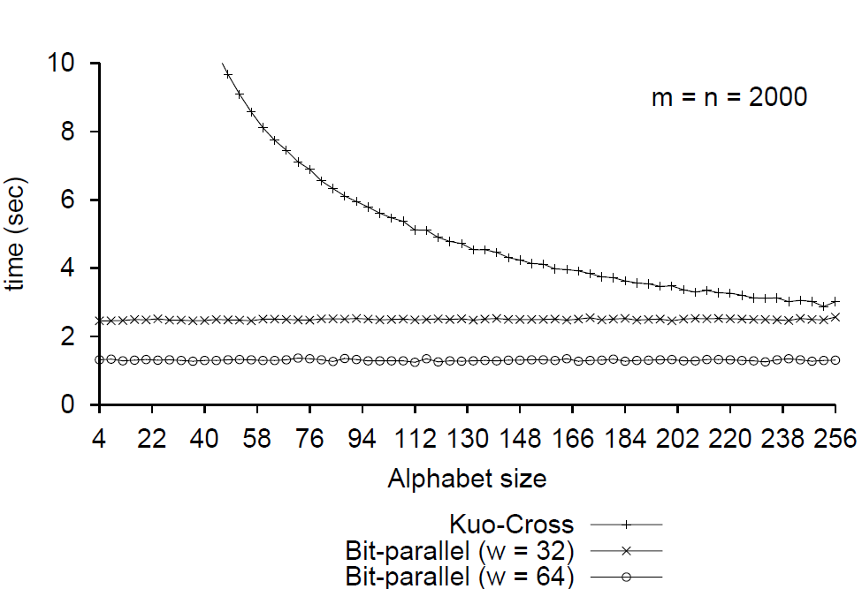
Performance(2/2)

Slide 13
An improved algorithm to find the length of the longest common subsequence of two strings
Shufen Kuo ,George R. Cross
Newsletter ACM SIGIR Forum Homepage archive Volume 23 Issue 3-4, Spring 1989 Pages 89-99

Slide 14
Abstract
Let A and B be strings of common length n. Define LLCS(A, B) to be the length of the longest common subsequence of A and B. Hunt and Szymanski presented an algorithm for finding LLCS(A, B) with time complexity O((r + n)logn), where r is the number of elements in the set {(i,j)lA[i ] = B[j]}. In the worst case the algorithm has running time of O(n²1ogn).
We present an improvement to this algorithm which changes the time complexity to O(r + n(LLCS(A, B) + logn)). Some experimental results show dramatic improvements for large n.

Slide 15
The Original Hunt-Szymanski Algorithm
A = abcbdda, B = badbabd
T_{i,k} = min{ j | A[1:i] and B[1:j] contain a CS of length k}
T_{5,1} = 1 LLCS(“abcbd”,”b”) = 1
T_{5,2} = 3 LLCS(“abcbd”,”bad”) = 2
T_{5,5} = undefined.
LLCS(A,B) = max{ k | T_{n,k} is defined }.

Slide 16
 | b | a | d | b | a | b | d
a |  | * |  |  | *
b | * |  |  | * |  | *
c
b | * |  |  | * |  | *
d |  |  | * |  |  |  | *
d |  |  | * |  |  |  | *
a |  | * |  |  | *
MatchList[1] = < 5, 2 >
MatchList[2] = < 6, 4, 1 >
MatchList[3] = < >
MatchList[4] = MatchList[2]
MatchList[5] = < 7, 3 >
MatchList[6] = MatchList[5]
MatchList[7] = MatchList[1]

Slide 17
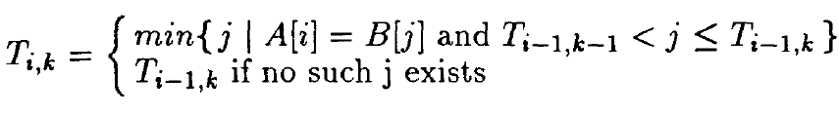
0 | 1 | 2 | 3 | 4 | 5 | 6 | 7
0 | 8 | 8 | 8 | 8 | 8 | 8 | 8
Thresh[0:7]:
T_{0,0} T_{0,1} T_{0,2} T_{0,3} T_{0,4} T_{0,5} T_{0,6} T_{0,7}
T_{1,K} , 1≦k≦7
T_{2,K} , 1≦k≦7
…
T_{7,K} , 1≦k≦7
|A| = |B| = 7
LLCS(A,B) = max{ k | T_{7,k} is defined }.

Slide 18
0 | 1 | 2 | 3 | 4 | 5 | 6 | 7
0 | 8->5 | 8 | 8 | 8 | 8 | 8 | 8
Thresh[0:7]:
binary search
MatchList[1] = < 5, 2 >
MatchList[2] = < 6, 4, 1 >
MatchList[3] = < >
MatchList[4] = MatchList[2]
MatchList[5] = < 7, 3 >
MatchList[6] = MatchList[5]
MatchList[7] = MatchList[1]
T_{0,0} < 5 ≦ T_{0,1}
T_{1,1} = 5

Slide 19
0 | 1 | 2 | 3 | 4 | 5 | 6 | 7
0 | 5->2 | 8 | 8 | 8 | 8 | 8 | 8
Thresh[0:7]:
binary search
MatchList[1] = < 5, 2 >
MatchList[2] = < 6, 4, 1 >
MatchList[3] = < >
MatchList[4] = MatchList[2]
MatchList[5] = < 7, 3 >
MatchList[6] = MatchList[5]
MatchList[7] = MatchList[1]
T_{0,0} < 2 ≦ T_{0,1}
T_{1,1} = 5

Slide 20
0 | 1 | 2 | 3 | 4 | 5 | 6 | 7
0 | 2 | 8 | 8 | 8 | 8 | 8 | 8
Thresh[0:7]:
T_{1,0} T_{1,1} T_{1,2} T_{1,3} T_{1,4} T_{1,5} T_{1,6} T_{1,7}
MatchList[1] = < 5, 2 >
MatchList[2] = < 6, 4, 1 >
MatchList[3] = < >
MatchList[4] = MatchList[2]
MatchList[5] = < 7, 3 >
MatchList[6] = MatchList[5]
MatchList[7] = MatchList[1]

Slide 21
0 | 1 | 2 | 3 | 4 | 5 | 6 | 7
0 | 1 | 3 | 6 | 7 | 8 | 8 | 8
Thresh[0:7]:
T_{7,0} T_{7,1} T_{7,2} T_{7,3} T_{7,4} T_{7,5} T_{7,6} T_{7,7}
LLCS(A,B) = max{ k | T_{7,k} is defined }.
MatchList[1] = < 5, 2 >
MatchList[2] = < 6, 4, 1 >
MatchList[3] = < >
MatchList[4] = MatchList[2]
MatchList[5] = < 7, 3 >
MatchList[6] = MatchList[5]
MatchList[7] = MatchList[1]
A = abcbdda, B = badbabd
LLCS(A, B) = 4

Slide 22
Time Analysis
MatchList needs O(nlogn) time
“find” operation needs O(rlogn) time
Time complexity is (r+n(logn))
n is length of strings

Slide 23
The Improved Hunt-Szymanski Algorithm(1/9)
before executing the ith iteration
0 | 1 | 2 | 3 | 4 | 5 | 6
0 | 2 | 4 | 30 | 32 | 41 | 78
MatchList[i] = < 52, 20,17,14,13,10,8,3,1 >

Slide 24
The Improved Hunt-Szymanski Algorithm(2/9)
before executing the ith iteration
0 | 1 | 2 | 3 | 4 | 5 | 6
0 | 2 | 4 | 30 | 32 | 41 | 78
1
3
20
17
14
13
10
8
52
MatchList[i] = <52,20,17,14,
13,10,8,3,1 >

Slide 25
The Improved Hunt-Szymanski Algorithm(3/9)
MatchList[i] =<52,20,17,14,13,10,8,3,1 >
MatchList[i] =<1,3,8,10,13,14,17,20,52 >

Slide 26
The Improved Hunt-Szymanski Algorithm(4/9)
before executing the ith iteration
0 | 1 | 2 | 3 | 4 | 5 | 6
0 | 2 | 4 | 30 | 32 | 41 | 78
1
temp = 0
1 > temp ok
finding
1≦Thresh[1]
temp=Thresh[1]
Thresh[1]= 1
MatchList[i] =<1,3,8,10,13,14,17,20,52 >

Slide 27
The Improved Hunt-Szymanski Algorithm(5/9)
before executing the ith iteration
0 | 1 | 2 | 3 | 4 | 5 | 6
0 | 2 | 4 | 30 | 32 | 41 | 78
1
3
temp = 2
3 > temp ok
finding
3≦Thresh[2]
temp=Thresh[2]
Thresh[2]= 3
MatchList[i] =<1,3,8,10,13,14,17,20,52 >

Slide 28
The Improved Hunt-Szymanski Algorithm(6/9)
before executing the ith iteration
0 | 1 | 2 | 3 | 4 | 5 | 6
0 | 2 | 4 | 30 | 32 | 41 | 78
1
3
8
temp = 4
8 > temp ok
finding
8≦Thresh[3]
temp=Thresh[3]
Thresh[3]= 8
MatchList[i] =<1,3,8,10,13,14,17,20,52 >

Slide 29
The Improved Hunt-Szymanski Algorithm(7/9)
before executing the ith iteration
0 | 1 | 2 | 3 | 4 | 5 | 6
0 | 2 | 4 | 30 | 32 | 41 | 78
1
3
8
temp = 30
10 < temp
MatchList[i] =<1,3,8,10,13,14,17,20,52 >

Slide 30
The Improved Hunt-Szymanski Algorithm(8/9)
before executing the ith iteration
0 | 1 | 2 | 3 | 4 | 5 | 6
0 | 2 | 4 | 30 | 32 | 41 | 78
1
3
8
52
temp = 30
52 > temp ok
finding
52≦Thresh[6]
temp=Thresh[6]
Thresh[6]= 52
MatchList[i] =<1,3,8,10,13,14,17,20,52 >

Slide 31
0 | 1 | 2 | 3 | 4 | 5 | 6
0 | 2 | 4 | 30 | 32 | 41 | 78
1
3
8
52
0 | 1 | 2 | 3 | 4 | 5 | 6
0 | 2 | 4 | 30 | 32 | 41 | 78
1
3
20
17
14
13
10
8
52

Slide 32
Time Analysis
MatchList needs O(nlogn) time
MatchList has been visited r times
O(nLLCS(A, B))
Improved alogrithm has time complexity:
O(r + n(LLCS(A, B) + logn))
|A| = |B| = n
r is the number of elements in the set
{(i, j)|A[i] = B[J]}

Slide 33
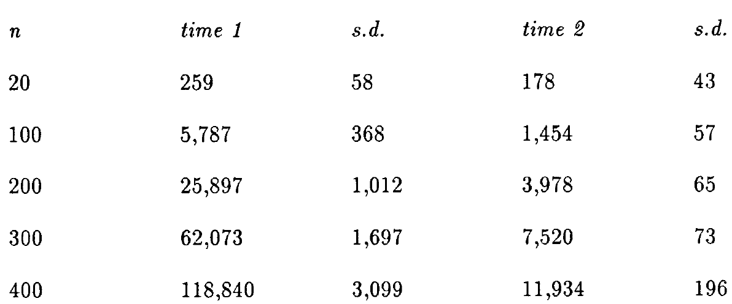
Experimental Results
Thousandth of a second
|A| = |B| = n

Slide 34
Thanks for listening

