Slide 1
Flexible Dynamic Time Warping for Time Series Classification
Presenter: Che-Jui Hsu (許哲睿)
Advisor: Dr. Chang-Biau Yang
Date: 2014/7/29

Slide 2
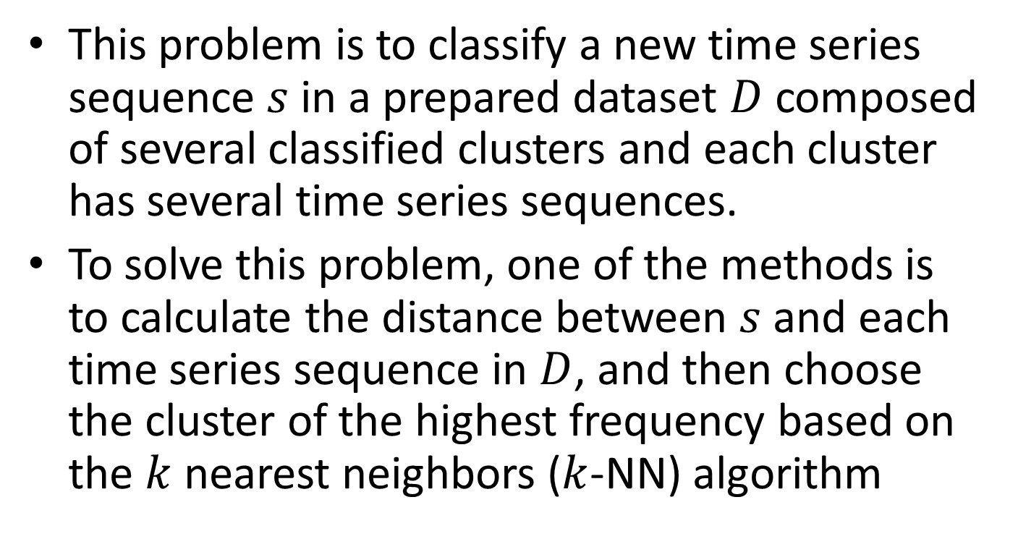
Time Series Classification Problem (1/2)
This problem is to classify a new time series sequence $s$ in a prepared dataset $D$ composed of several classified clusters and each cluster has several time series sequences.
To solve this problem, one of the methods is to calculate the distance between $s$ and each time series sequence in $D$, and then choose the cluster of the highest frequency based on the $k$ nearest neighbors ($k$-NN) algorithm

Slide 3



Time Series Classification Problem (2/2)
$$s$$
$$k=3$$
$$D$$

Slide 4




Dynamic Time Warping Algorithm (1/3)
$$DTW\left(i−1, j−1\right)$$
$$DTW\left(i−1, j\right)$$
$$DTW\left(i, j−1\right)$$
$$DTW\left(i, j\right)$$

Slide 5
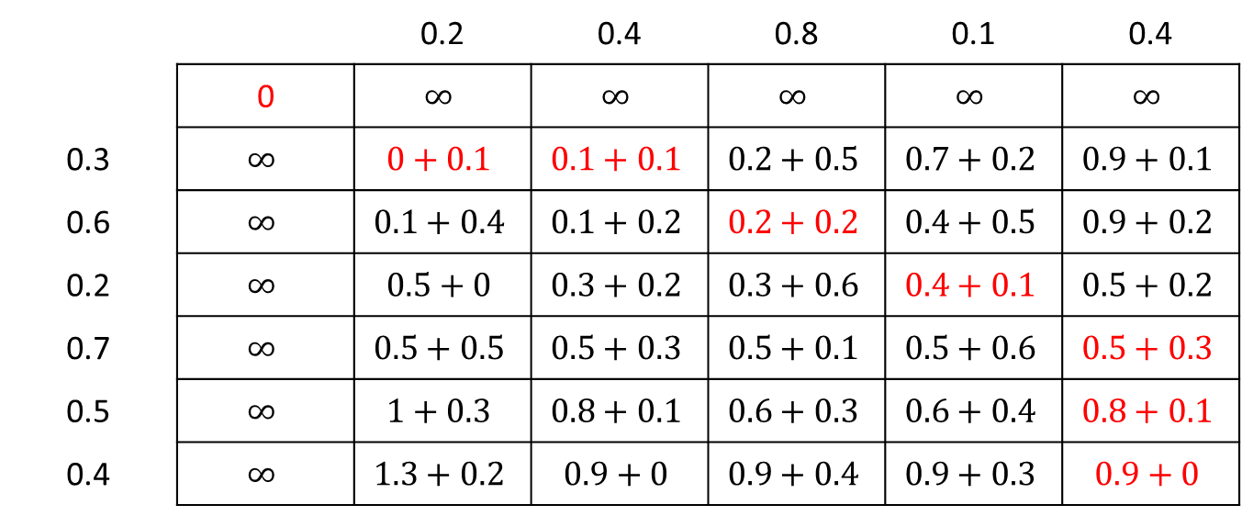

Dynamic Time Warping Algorithm (2/3)
$X = \{0.3, 0.6, 0.2, 0.7, 0.5, 0.4\}$, $Y = \{0.2, 0.4, 0.8, 0.1, 0.4\}$, $d\left(x_{i}, y_{j}\right)=\left|x_{i}−y_{j}\right|$
 |  | 0.2 | 0.4 | 0.8 | 0.1 | 0.4
 | 0 | $$∞$$ | $$∞$$ | $$∞$$ | $$∞$$ | $$∞$$
0.3 | $$∞$$ | $$0+0.1$$ | $$0.1+0.1$$ | $$0.2+0.5$$ | $$0.7+0.2$$ | $$0.9+0.1$$
0.6 | $$∞$$ | $$0.1+0.4$$ | $$0.1+0.2$$ | $$0.2+0.2$$ | $$0.4+0.5$$ | $$0.9+0.2$$
0.2 | $$∞$$ | $$0.5+0$$ | $$0.3+0.2$$ | $$0.3+0.6$$ | $$0.4+0.1$$ | $$0.5+0.2$$
0.7 | $$∞$$ | $$0.5+0.5$$ | $$0.5+0.3$$ | $$0.5+0.1$$ | $$0.5+0.6$$ | $$0.5+0.3$$
0.5 | $$∞$$ | $$1+0.3$$ | $$0.8+0.1$$ | $$0.6+0.3$$ | $$0.6+0.4$$ | $$0.8+0.1$$
0.4 | $$∞$$ | $$1.3+0.2$$ | $$0.9+0$$ | $$0.9+0.4$$ | $$0.9+0.3$$ | $$0.9+0$$

Slide 6
Dynamic Time Warping Algorithm (3/3)

Slide 7
Warping Windows

Slide 8
Our Algorithm (1/5)
Try to find a new method without applying the warping window but it can still have the property of the neighboring points in one sequence of time series may not align to the points that are too far away in another sequence.
We give the more score as the reward to the longer one-to-one segments. That is, we let the contiguous one-to-one segments as longer as possible.

Slide 9

Flexible Longest Common Subsequence (FLCS) (1/4)
$A=\text{ababccab}$, $B=\text{aabcbcb}$, $γ=2$
FLCS score: $1^{2}+3^{2}+1^{2}+1^{2}=12$
$s_{k}=σ_{k}+{v_{k}}^{γ}$

Slide 10
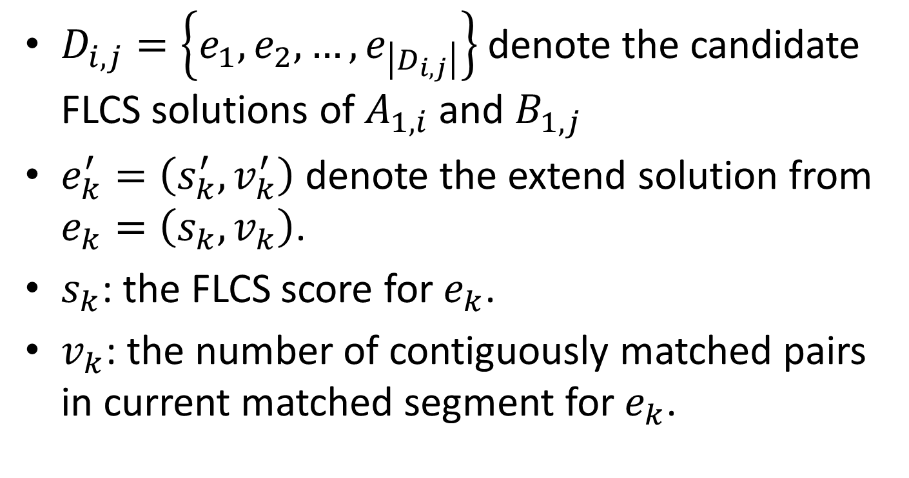
Flexible Longest Common Subsequence (FLCS) (2/4)
$D_{i, j}=\left\{e_{1},e_{2}, …,e_{\left|D_{i, j}\right|}\right\}$ denote the candidate FLCS solutions of $A_{1, i}$ and $B_{1, j}$
$e_{k}^{′}=\left(s_{k}^{′},v_{k}^{′}\right)$ denote the extend solution from $e_{k}=\left(s_{k},v_{k}\right)$.
$s_{k}$: the FLCS score for $e_{k}$.
$v_{k}$: the number of contiguously matched pairs in current matched segment for $e_{k}$.

Slide 11

Flexible Longest Common Subsequence (FLCS) (3/4)
$e_{k1}∈D_{i, j}$, $e_{k2}∈D_{i, j}$
If $s_{k1}≥s_{k2}$, $v_{k1}≥v_{k2}$ then $e_{k1}^{′}$ will be same or better than $e_{k2}^{′}$

Slide 12
Flexible Longest Common Subsequence (FLCS) (4/4)

Slide 13

Our Algorithm (2/5)
$X=\left\{0.3, 0.6, 0.2, 0.7, 0.5, 0.4\right\}$, $Y=\left\{0.2, 0.4, 0.8, 0.1, 0.4\right\}$, $t=0.2$, $γ=2$
Score(without gap): $2^{2}+1^{2}+1^{2}=6$
$s_{k}=σ_{k}+{v_{k}}^{γ}$

Slide 14
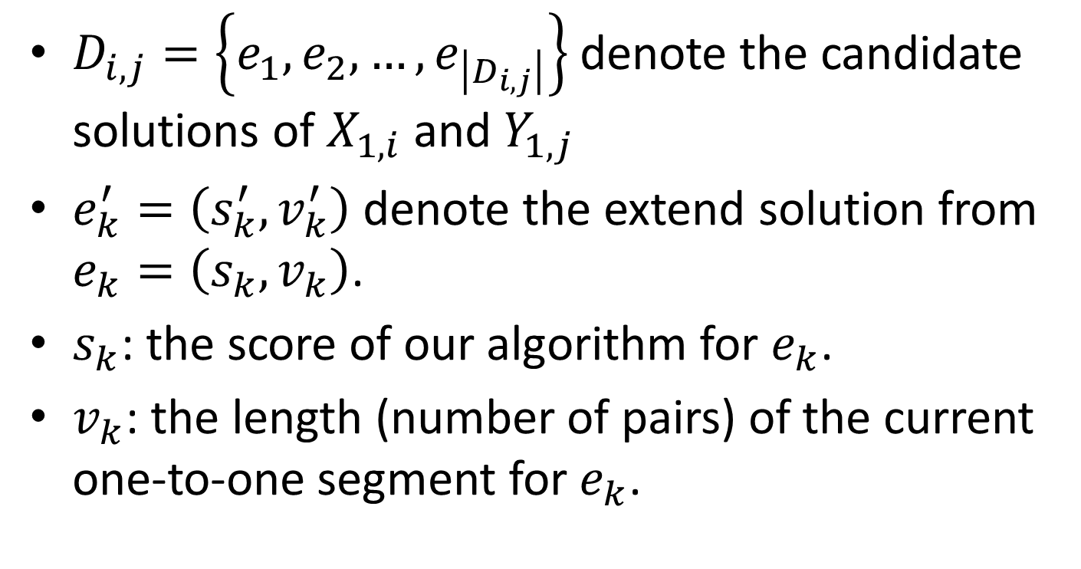
Our Algorithm (3/5)
$D_{i, j}=\left\{e_{1},e_{2}, …,e_{\left|D_{i, j}\right|}\right\}$ denote the candidate solutions of $X_{1, i}$ and $Y_{1, j}$
$e_{k}^{′}=\left(s_{k}^{′},v_{k}^{′}\right)$ denote the extend solution from $e_{k}=\left(s_{k},v_{k}\right)$.
$s_{k}$: the score of our algorithm for $e_{k}$.
$v_{k}$: the length (number of pairs) of the current one-to-one segment for $e_{k}$.

Slide 15
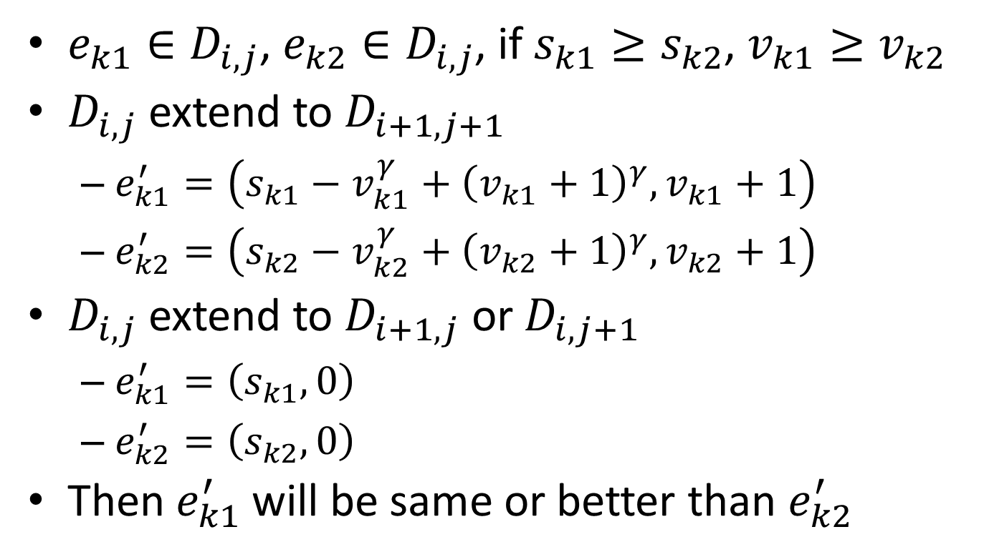
Our Algorithm (4/5)
$e_{k1}∈D_{i, j}$, $e_{k2}∈D_{i, j}$, if $s_{k1}≥s_{k2}$, $v_{k1}≥v_{k2}$
$D_{i, j}$ extend to $D_{i+1, j+1}$
$e_{k1}^{′}=\left(s_{k1}−v_{k1}^{γ}+{\left(v_{k1}+1\right)}^{γ},v_{k1}+1\right)$
$e_{k2}^{′}=\left(s_{k2}−v_{k2}^{γ}+{\left(v_{k2}+1\right)}^{γ},v_{k2}+1\right)$
$D_{i, j}$ extend to $D_{i+1, j}$ or $D_{i, j+1}$
$e_{k1}^{′}=\left(s_{k1},0\right)$
$e_{k2}^{′}=\left(s_{k2},0\right)$
Then $e_{k1}^{′}$ will be same or better than $e_{k2}^{′}$

Slide 16
Our Algorithm (5/5)

Slide 17
Experiments

Slide 18
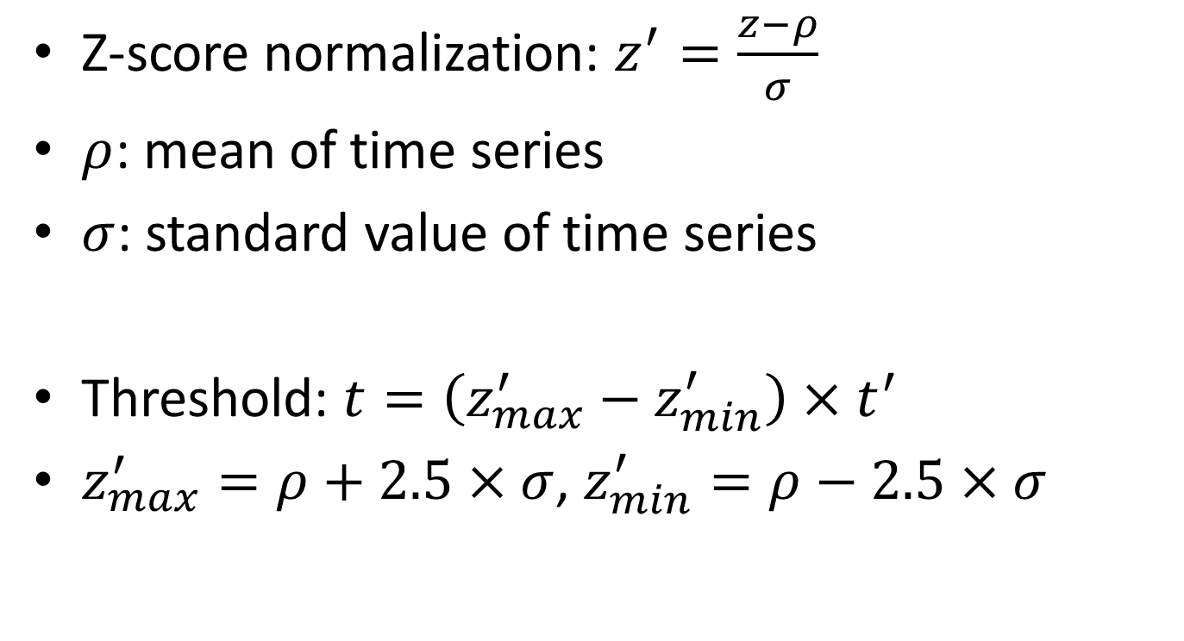
Comparison with Other Algorithms (1/3)
Z-score normalization: $z^{′}=\frac{z−ρ}{σ}$
$ρ$: mean of time series
$σ$: standard value of time series
Threshold: $t=\left(z_{max}^{′}−z_{min}^{′}\right)×t^{′}$
$z_{max}^{′}=ρ+2.5×σ$, $z_{min}^{′}=ρ−2.5×σ$

Slide 19
Comparison with Other Algorithms (2/3)

Slide 20
Comparison with Other Algorithms (3/3)

Slide 21
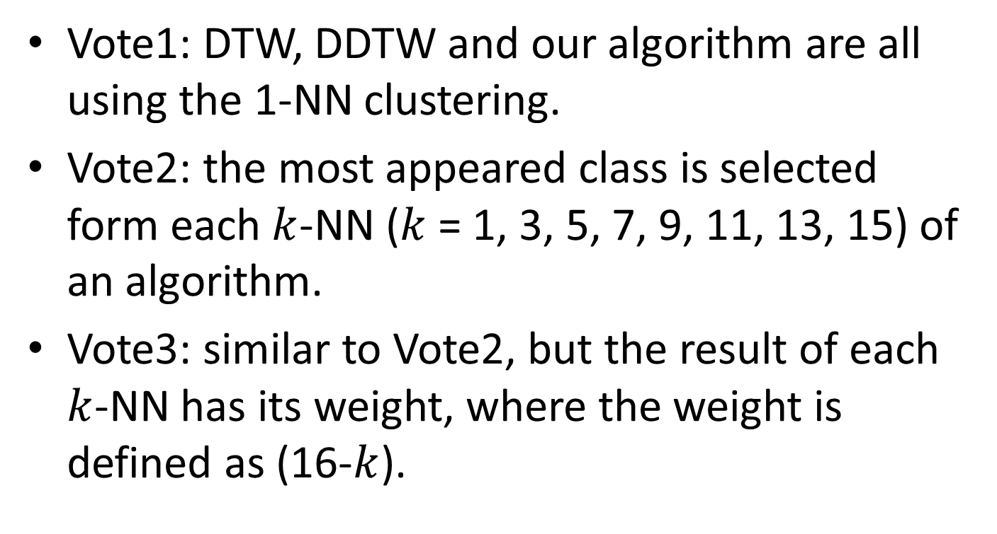
Applying Voting Strategies for Classification (1/2)
Vote1: DTW, DDTW and our algorithm are all using the 1-NN clustering.
Vote2: the most appeared class is selected form each $k$-NN ($k$ = 1, 3, 5, 7, 9, 11, 13, 15) of an algorithm.
Vote3: similar to Vote2, but the result of each $k$-NN has its weight, where the weight is defined as (16-$k$).

Slide 22
Applying Voting Strategies for Classification (2/2)

Slide 23
Using Behavior Knowledge Space for Classification (1/3)
Training step: build the BKS table which records the most appearance of the real class with the combination of the DTW, the DDTW and our algorithms.
Testing step: each time series uses three algorithms to classify and uses the BKS table to determine the class of each time series.
DTW | DDTW | Our Algorithm | A | B
A | A | B | 13 | 19
B | A | A | 20 | 15

Slide 24
Using Behavior Knowledge Space for Classification (2/3)
BKS1: the training step of the DTW, DDTW and our algorithms use 1-NN clustering and the testing step of the three algorithms use the voting strategy of Vote2.
BKS2: the training step of the three algorithms use all of 1-NN to 15-NN clustering and the testing step is the same to BKS1.

Slide 25
Using Behavior Knowledge Space for Classification (3/3)

Slide 26
Summarize Three Experiments

Slide 27
Conclusion
We propose an algorithm to measure the similarity of two time series sequences. With this algorithm, we may avoid the neighboring points in one sequence align to the points are separated far away in another sequence.
In the experiments, we observe the BKS2 method is better than the DTW and the DDTW algorithms individually.

