Slide 1
Correlated Mutations and Residue Contacts in Proteins
Göbel U, Sander C, Schneider R, Valencia A.
Proteins. 1994 Apr;18(4):309-17.
Presenter: Ding-Yao Huang
Date:2014/7/29

Slide 2
Abstract
The maintenance of protein function and structure constrains the evolution of amino acid sequences. This fact can be exploited to interpret correlated mutations observed in a sequence family as an indication of probable physical contact in three dimensions.
Here we present a simple and general method to analyze correlations in mutational behavior between different positions in a multiple sequence alignment. We then use these correlations to predict contact maps for each of 11 protein families and compare the result with the contacts determined by crystallography.

Slide 3
Abstract
For the most strongly correlated residue pairs predicted to be in contact, the prediction accuracy ranges from 37 to 68% and the improvement ratio relative to a random prediction from 1.4 to 5.1. Predicted contact maps can be used as input for the calculation of protein tertiary structure, either from sequence information alone or in combination with experimental information.
Notes:
蛋白質的很多特性與功能是和它實際的三維結構非常相關的

Slide 4
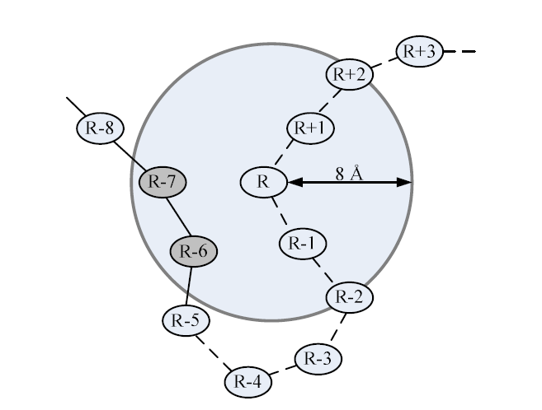
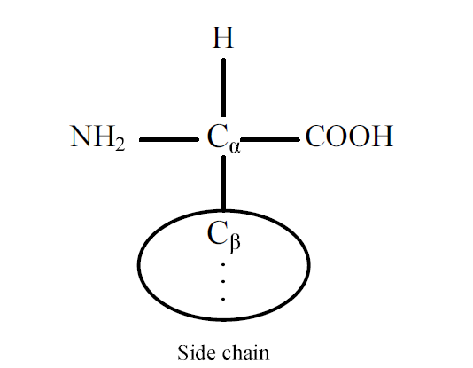
Definition of Contacts
In this article, we define two residues to be in contact if the distance between their C^{β} atoms (C^{α} for glycine residues) is <8 Å.

Slide 5
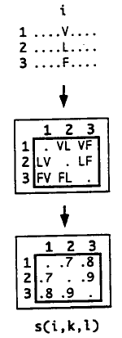
Method: Mutational Behavior at One Position
Seq. 5 10 Sequence position
# | |
1 AAAA SSSS TTTT
2 RRRR PPPP HHHH 66 1.00
3 TTTT GGGG EEED 63 0.95

Slide 6
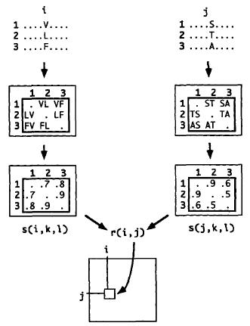
Method: Mutational Behavior at Two Positions

Slide 7



Correlation coefficient
Seq. 5 10 Sequence position
# | |
1 AAAA SSSS TTTT
2 RRRR PPPP HHHH
3 TTTT GGGG EEED
N is the number of aligned sequences.
W_{kl} is weight
σ_{i} = 2
Notes:
如果超過一個cut off

Slide 8
Accuracy
For a given target protein, we define the prediction
accuracy
A_{pred} = C_{correct}/C_{pred}
where C_{correct} is the number of the correctly predicted contacts and C_{pred} is the total number of predicted contacts.

Slide 9
For a given protein, the random prediction accuracy, A_{random}, is defined to be the fraction of the patterns generated that are contacts.
A_{random} = C_{obs}/C_{max}
where C_{obs} is the number of contacts observed in three-dimensional structure and C_{max} is the total number of possible contacts.
The improvement of a set of predictions is then given by
R_{Improve}= A_{pred}/A_{random}

Slide 10
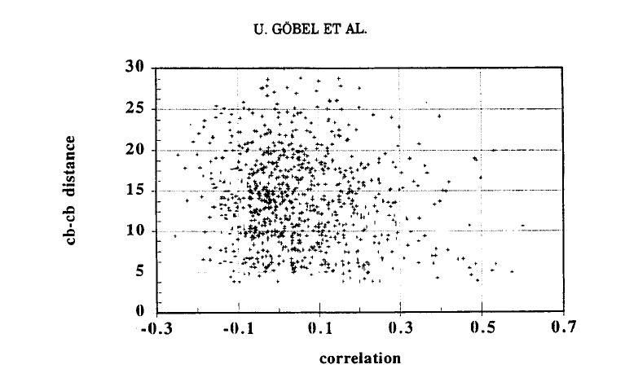
Results

Slide 11
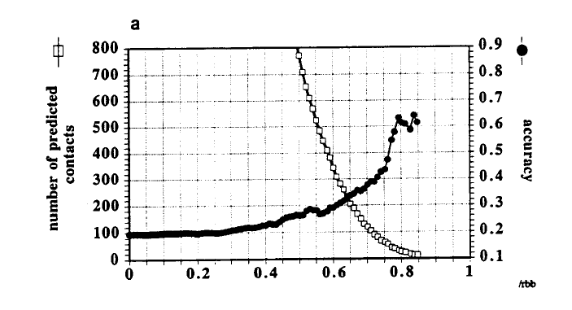
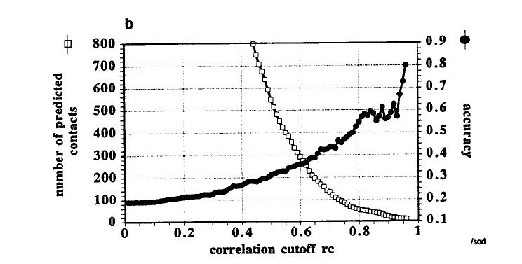

Slide 12
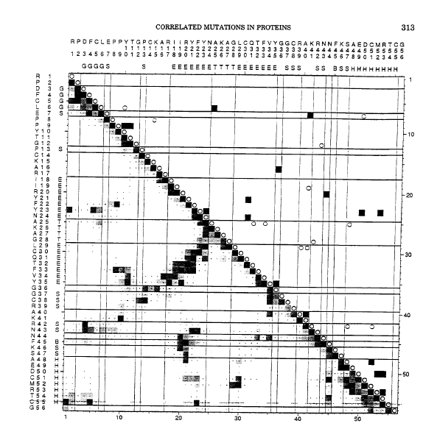

Slide 13
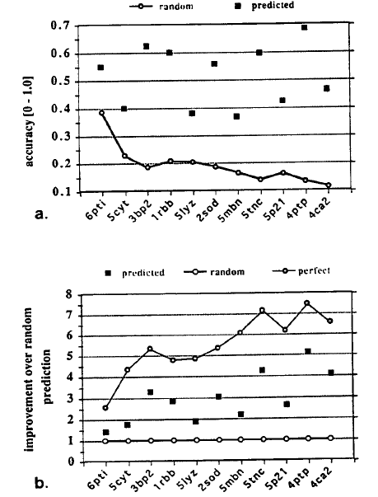

Slide 14
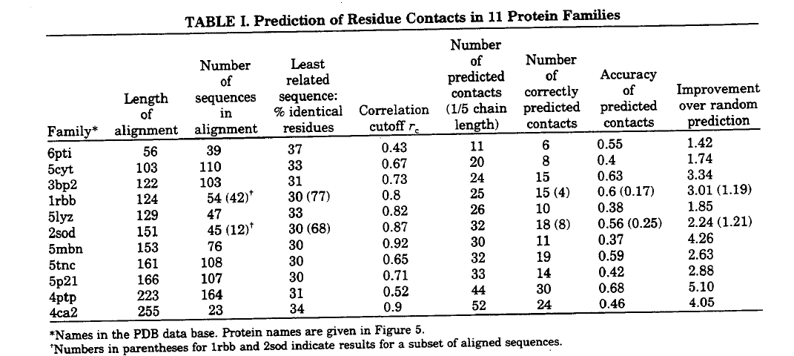

Slide 15
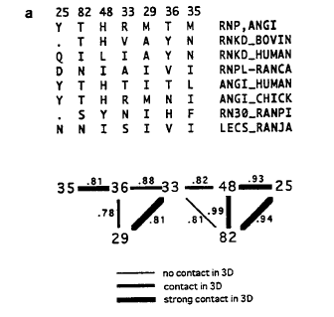
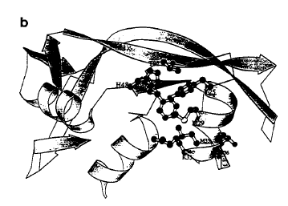

Slide 16
Conclusion
we present a method to analyze correlations in mutational behavior between different positions in a multiple sequence alignment
We then use these correlations to predict contact maps for each of 11 protein families and compare the result with the contacts determined by crystallography.

